Slide 2
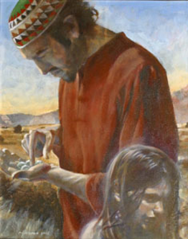
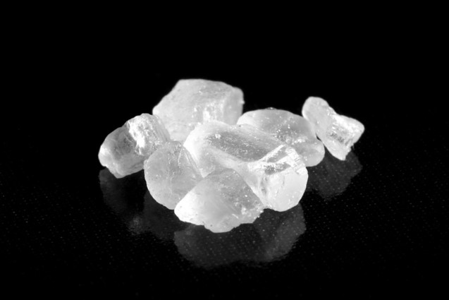
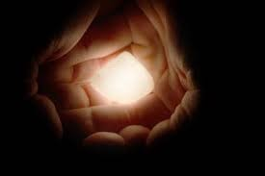
Mount Shelem
The brother of Jared went to great effort to prepare the stones.
“… and did molten out of a rock sixteen small stones; and they were white and clear, even as transparent glass; and he did carry them in his hands upon the top of the mount, and cried again unto the Lord, saying:”
Ether 3:1

Slide 3
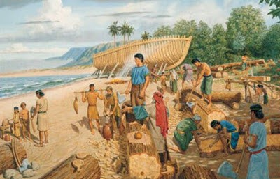
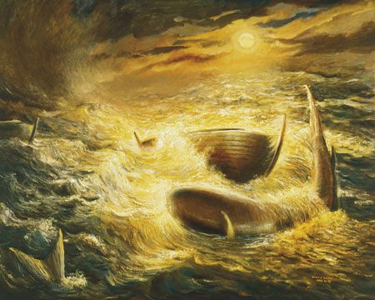
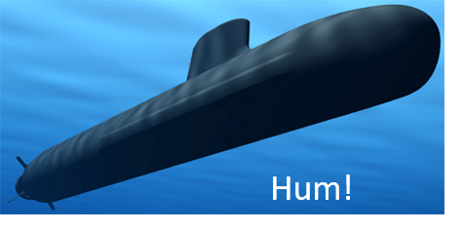
8 Vessels
“This first recorded ocean crossing was about forty centuries ago, of seaworthy, ocean-going vessels without known sails, engines, oars, or rudders—eight barges like and near contemporary with Noah’s ark, long as a tree, tight as a dish, peaked at the end like a gravy boat, corked at top ad bottom, illuminated by molten stones, perhaps with radium or some other substance not yet rediscovered by our scientists.
Light and like a fowl upon the water, this fleet of barges was driven by winds and ocean currents, landing at a common point in North America probably on the west shores.”
Spencer W. Kimball
Ether 3:1

Slide 4
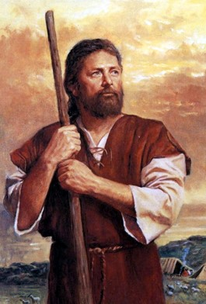
Understanding God
The brother of Jared understood the Doctrine of the Fall
He also understood the character and attributes of God:
All-powerful
“…because of the fall our natures have become evil continually; nevertheless, O Lord, thou hast given us a commandment that we must call upon thee, that from thee we may receive according to our desires.”
Ether 3:2-5

Slide 5
“It is a basic premise of Latter-day Saint theology that God ‘knoweth all things, and there is not anything save he knows it.’ [2 Nephi 9:20.]
The scriptures, both ancient and modern, are replete with this assertion of omniscience. Nevertheless, God has frequently asked questions of mortals, usually as a way to test their faith, measure their honesty, or develop their knowledge”
Elder Jeffrey R. Holland
As we humbly call upon the Lord, He will bless us according to our faith and His will

Slide 6
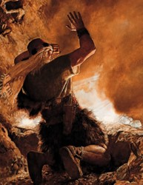
Conversation With The Lord
“It is true that the Savior appeared to the Prophets before the flood, but it is evident that he did not reveal himself in the fulness as he did to the Brother of Jared.”
“Talking ‘face to face,’ as stated in this revelation, does not mean that the Lord did not appear in a cloud; or, that his body was partially hidden from the view of the prophet.”
“…The Brother of Jared knew that the Lord was there, but evidently he did not understand that the Lord had a body apparently of flesh and bones. Through his great faith he was able to see the finger of the Lord when the Lord touched the stones.”
Ether 3:6-20 Joseph Fielding Smith

Slide 7
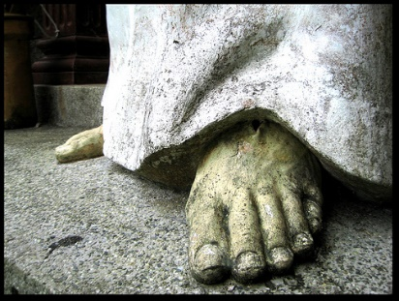
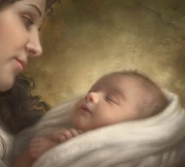
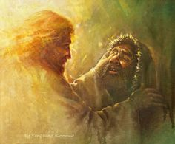
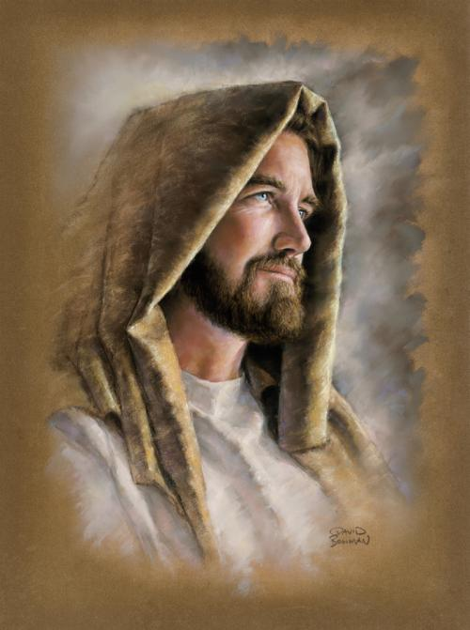
What Did The Brother of Jared Learn About Christ?
Ether 3:14
Jesus Christ was prepared from the foundation of the world to redeem us
Ether 3:15
God created us in His own image
Ether 3:16
Jesus Christ showed Himself in the spirit before He was born in the flesh
Ether 3:17
Jesus Christ’s physical body is in the likeness of His spirit body
Ether 3:18
Jesus Christ ministers to people to help them know that He is God
As we exercise faith in Jesus Christ, we will come to know Him better.

Slide 8
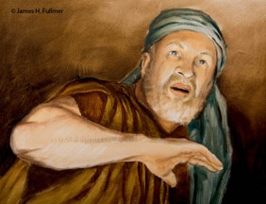
“Christ was saying to the brother of Jared, ‘Never have I showed myself unto man in this manner, without my volition, driven solely by the faith of the beholder.’ As a rule, prophets are invited into the presence of the Lord, are bidden to enter his presence by him and only with his sanction.
The brother of Jared, on the other hand, seems to have thrust himself through the veil, not as an unwelcome guest but perhaps technically as an uninvited one. …
Obviously the Lord himself was linking unprecedented faith with this unprecedented vision. If the vision itself was not unique, then it had to be the faith and how the vision was obtained that was so unparalleled. The only way that faith could be so remarkable was its ability to take the prophet, uninvited, where others had been able to go only with God’s bidding”
Jeffrey R. Holland
James H. Fullmer
Ether 3:15

Slide 9
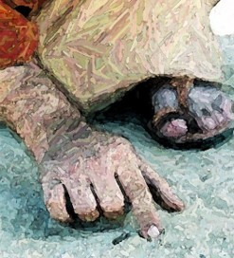
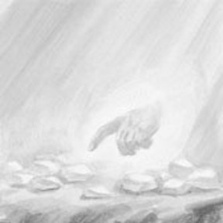
The Finger of the Lord
“Nowhere in the scriptures is a clearer account given of the nature of the spirit body of the Lord Jesus Christ and, indeed, of the characteristics of our own spirits.
The brother of Jared not only saw the finger of the antemortal Jesus Christ but indeed perceived His entire spirit body (see Ether 3:6, 13).
Understanding the premortal godhood of Jesus Christ together with our own spiritual identities prior to our births in the flesh is a great blessing and advantage. These insights breaching traditional boundaries were the direct result of the brother of Jared’s non-boundaried faith”
Elder Cecil O. Samuelson
Ether 3:16

Slide 10
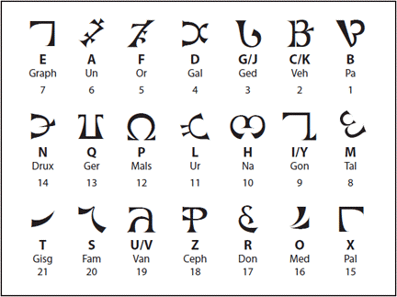
Write These Things
“In a language that cannot be read”
Possibly Adamic—the language of Adam or the language of God
Ether 3:22

Slide 11
“These Two Stones”
“Now, behold, I say unto you, that because you delivered up those writings which you had power given unto you to translate by the means of the Urim and Thummim, into the hands of a wicked man, you have lost them.”
D&C 10:1
“…you shall have a view of the plates, and also of the breastplate, the sword of Laban, the Urim and Thummim, which were given to the brother of Jared upon the mount, when he talked with the Lord face to face, and the miraculous directors which were given to Lehi while in the wilderness, on the borders of the Red Sea.”
D&C 17:1
The two stones that the Lord gave to the brother of Jared were part of what is called a Urim and Thummim.
The scriptures refer to more than one Urim and Thummim, but we are informed that Joseph Smith had the one used by the brother of Jared.
In Joseph Smith—History 1:35, the Prophet Joseph provides a partial description of this Urim and Thummim. He used it in translating the Book of Mormon and in obtaining other revelations.
Ether 3:23-24

Slide 12
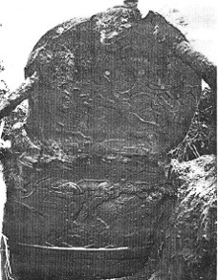
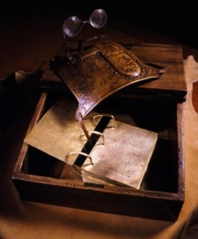
Interpreters
“King Mosiah possessed ‘two stones which were fastened into the two rims of a bow,’ called by the Nephites Interpreters, with which he translated the Jaredite record.
“And now Limhi was again filled with joy on learning from the mouth of Ammon that king Mosiah had a gift from God, whereby he could interpret such engravings; yea, and Ammon also did rejoice.” Mosiah 21:28
Mosiah had this gift before the people of Limhi discovered the record of Ether.
They may have been received when the ‘large stone’ was brought to Mosiah with engravings upon it.
“And it came to pass in the days of Mosiah, there was a large stone brought unto him with engravings on it; and he did interpret the engravings by the gift and power of God.”
Omni 1:20
Coriantumr was discovered by the people of Zarahemla
Joseph Fielding Smith

Slide 13
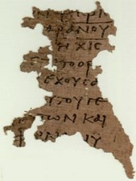
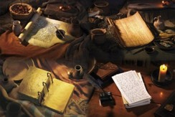
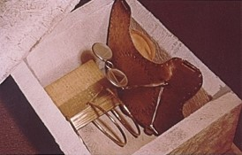
Urim and Thummin
“…or two stones, given to the Brother of Jared were those in the possession of Mosiah appears evident from Book of Mormon teachings.”
“The Brother of Jared was commanded to seal up his writing of the vision he had when Christ appeared to him, so that they could not be read by his people.”
“This vision was recorded in a language which was confounded, for it was not to go forth until after the resurrection of Christ.”
“The Urim and Thummim were also sealed up so that they could not be used for the purpose of interpreting those sacred writings of this vision, until such time as the Lord should grant to man to interpret them.”
Joseph Fielding Smith

Slide 14
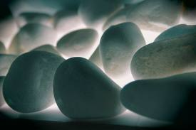
How Many Stones?
18
…and did molten out of a rock sixteen small stones… Ether 3:1
And behold, these two stones will I give unto thee, Ether 3 :23

Slide 15
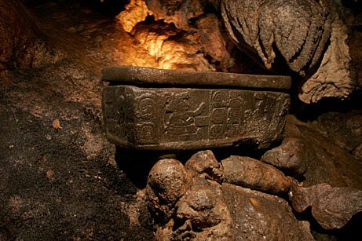
In The Lord’s Own Due Time
“And it came to pass that the Lord commanded him that he should seal up the two stones which he had received, and show them not, until the Lord should show them unto the children of men.”
Ether 3:27-28

Slide 16
Sources:
Spencer W. Kimball Conf. Report April 1963 pp. 63-64
Joseph Fielding Smith Questions and Answers 2:124-25 and (Interpreters)--Doctrines of Salvation 3:223-24
Elder Jeffrey R. Holland (Christ and the New Covenant: The Messianic Message of the Book of Mormon [1997], 19–20, 23 ).
Elder Cecil O. Samuelson (“The Brother of Jared,” in Heroes from the Book of Mormon [1995], 185).
Brother of Jared and Stones artwork by (Nathan Florence, 2002)
Presentation by ©http://fashionsbylynda.com/blog/

Slide 17
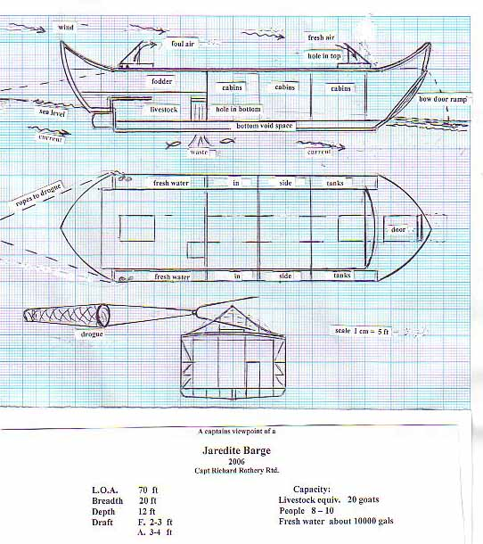
Where the Jaredites Traveled
Recently, someone sent me the following from an internet site regarding the Jaredites who: “were directed by the Lord to "go forth into the wilderness, yea into that quarter where there never had man been" (Ether 2:5). They built barges on which to cross "many waters." They continued until they came to "that great sea which divideth the lands." They remained on the seashore for four years during which time they constructed eight vessels for crossing the sea. How far they traveled we can only guess. That guess places the terminus of their land journey on the Pacific shores of the Asian continent. From there the prevailing winds "never cease to blow towards the promised land." First of all, a few comments on the above statement:
1. They did not build their barges during the four years they stayed on the seashore after reaching it. “And it came to pass at the end of four years that the Lord came again unto the brother of Jared, and stood in a cloud and talked with him (Ether 2:14) and “And the Lord said: Go to work and build, after the manner of barges which ye have hitherto built” (Ether 2:16). Obviously, they did not begin building the barges until after the four year period—which might have taken them another year to complete and ready all their supplies.
http://nephicode.blogspot.com/2010/12/where-jaredites-traveled.html

Slide 18
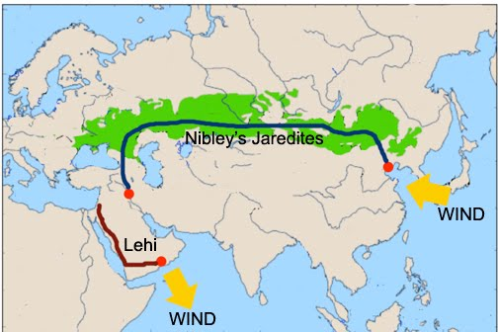
2. The “prevailing winds” do not blow out into the Pacific Ocean from the “Pacific shores of the Asian continent.” In fact, along the shore, those winds blow north into the Sea of Japan, or south into the Taiwan Straits. Out in the Pacific, they blow in toward land, moving all the way from the bulge of Peru westerly across the Pacific, then turn southward and blow toward Indonesia, then turn eastward in the Southern Ocean and blow toward South America in what is called the South Equatorial Current.
3. Winds that “never cease to blow towards the promised land” from the Pacific shores of the Asian continent would actually blow south in the South Equatorial Current gyre as mentioned in #2 above.
Nibley has the Jaredites crossing the Steppes (green) from Mesopotamia to the Pacific Ocean. Look how much more economically in time, effort, and travel it would have been to take them down the Persian Gulf shore, across the water hole trail, to where Lehi called Bountiful
4. The eastern Steppes of Asia, and down through China near present-day Beijing, which is the only way to get from the Mesopotamia to the Pacific Ocean, would not have been considered “that quarter where there never had man been” since those eastern lands along China’s eastern shore were occupied during the time of the Jaredites by Japheth's descendants. 5. By going across the Steppes, which the above would have to suggest, and the course Hugh Nibley suggested, would not have encountered “many waters” along the way. Nibley had to invent such waterways by saying that there were lakes along this route left over from the last ice age, but that is merely supposition, not provable by any modern knowledge.
http://nephicode.blogspot.com/2010/12/where-jaredites-traveled.html

Slide 19
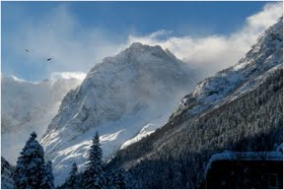
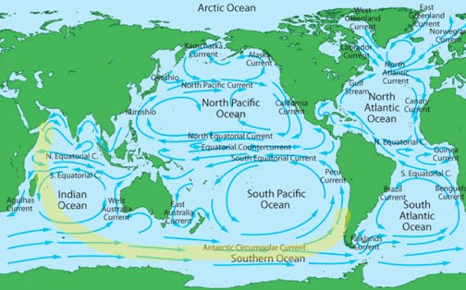
6. There simply is no “sea in the wilderness” in the mid- to eastern portion of the Steppes along the path this direction would have had to go. A sea in the wilderness suggests a very large body of water, and since the word “yam” meaning sea in the Hebrew language (yamha means lake) was used specifically for salt water bodies of water, almost always attached to the ocean directly or through some narrow passage (Persian Sea, Red Sea, Mediterranean Sea—the Sea of Galilee was actually called Lake Gennesaret, and the Sea of Death (Dead Sea) was a descriptive term originally, not a name).
7. Such a route would have taken the Jaredites over a series of mountains at the eastern end of the Steppes that separate the Steppes from the Gobi Desert and the eastern lands of China. Those mountain passes (only two existed anciently) are higher than the pass Hannibal used to cross the Alps where he lost half his experienced soldiers and most of his elephants despite having engineers to make roads for him. No Jaredite colony of men, women, and children, as well as animals, bees, and fish, could have possibly made such a crossing that even today is so dangerous that even with modern clothing, warmers, maps, etc., usually proves fatal to many in the trek. Thus, we can see that such flippant and arbitrary routes as some claim simply because they look at a map, are actually impossible routes, especially for the Jaredites to have taken with families and animal entourage.
Possible route
http://nephicode.blogspot.com/2010/12/where-jaredites-traveled.html

Slide 20
Do Rocks Glow in the Dark?
Many rocks and minerals can absorb incoming photons and release light. The emitted light is of longer wavelength/lower energy than the absorbed light, again due to conservation of energy (some energy of the absorbed photon is lost to heat; the rest is emitted as a lower energy photon). The absorbed light excites electrons in the fluorescent material to a higher energy level, which can then fall back down to the ground energy level and emit light in the process. The most familiar fluorescent objects are those that absorb ultraviolet light and emit visible light. Common fluorescent objects include highlighters, white clothes, and cat urine - they glow readily under a blacklight. Some common fluorescent minerals include many types of calcite, willemite, some agate, sodalite, rubies, and fluorite ("fluorescence" is named after fluorite). Fluorescence is often due to impurities in minerals (or lack thereof) and therefore varies - a sample of calcite from one locality might fluoresce yellow, that from another locality might glow pink, and that from a third locality might not fluoresce at all. There are a few exceptions - some minerals containing the uranyl ion (eg. autunite) are always fluorescent. Fluorescence involves light being absorbed and then emitted very quickly (for pure fluorescence, the emission lasts a few nanoseconds after the excitation light is turned off). However, some materials - notably glow-in the-dark toys - will keep glowing long after the excitation light is turned off. This is due to a related phenomenon called phosphorescence. Phosphorescent minerals do exist as well, but they are rarer than fluorescent ones. Much fluorescent calcite will exhibit short phosphorescence - not really what you'd call glow in the dark, but you can certainly see the glow fading out after turning off the blacklight. The most spectacular phosphorescence I've seen from a mineral is in sphalerite (zinc sulfide) from Franklin, New Jersey, which can keep glowing for a minute or two (interestingly, zinc sulfide containing traces of other metals is used in glow-in-the-dark toys). On a side note, some phosphors will glow when excited by radiation, as Rickster notes. Glowing watch dials in the past were made by mixing radium bromide with a zinc sulfide phosphor. Note that it is unlikely that you would get a strongly radioactive source next to a good phosphor in nature, so radioactive rocks don't glow. Finally fluorite has an unusual property - when exposed to radiation from nearby radioactive minerals, fluorite will develop numerous crystal defects, often turning dark purple or black. When heated, some irradiated fluorite will emit light ("thermoluminescence") and become colorless again.
Source:
http://en.wikipedia.org/wiki/Fluorescenc... http://en.wikipedia.org/wiki/Phosphoresc...

