Slide 2
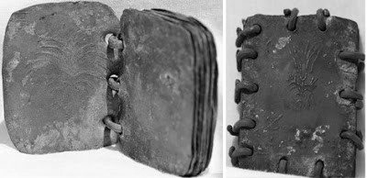
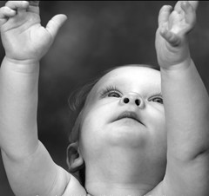
Putting Out of Reach
Sealing up the record of the Brother of Jared
Truths of the gospel are valuable to the Lord. He wants to share all of them with us, but He waits until we are ready to receive them.
“…and they were forbidden to come unto the children of men until after that he should be lifted up upon the cross; and for this cause did king Mosiah keep them, that they should not come unto the world until after Christ should show himself unto his people.”
Ether 4:1-5

Slide 3
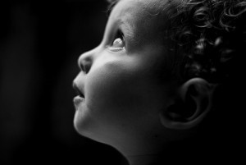
When Will We Receive the Records?
“But the words which are sealed he shall not deliver, neither shall he deliver the book. For the book shall be sealed by the power of God, and the revelation which was sealed shall be kept in the book until the own due time of the Lord, that they may come forth; for behold, they reveal all things from the foundation of the world unto the end thereof.”
2 Nephi 27:10

Slide 4
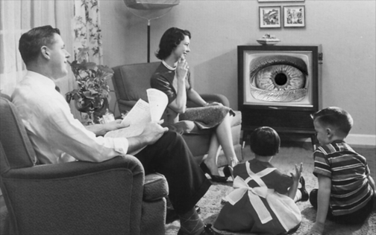
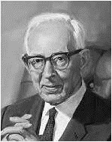
Probation
“Now the Lord has placed us on probation as members of the church. He has given us the Book of Mormon, which is the lesser part, to build up our faith through our obedience to the counsels which it contains…
Because we have not lived up to the requirements in this probationary state in the reading of the record which had been given to us and in following its counsels.”
How are we doing so far?
Why?
…and when we ourselves, members of the Church, are willing to keep the commandments as they have been given to us and show our faith as the Nephites did for a short period of time, then the Lord is ready to bring forth the other record and give it to us, but we are not ready now to receive it.”
Joseph Fielding Smith

Slide 5
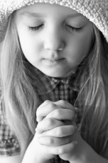
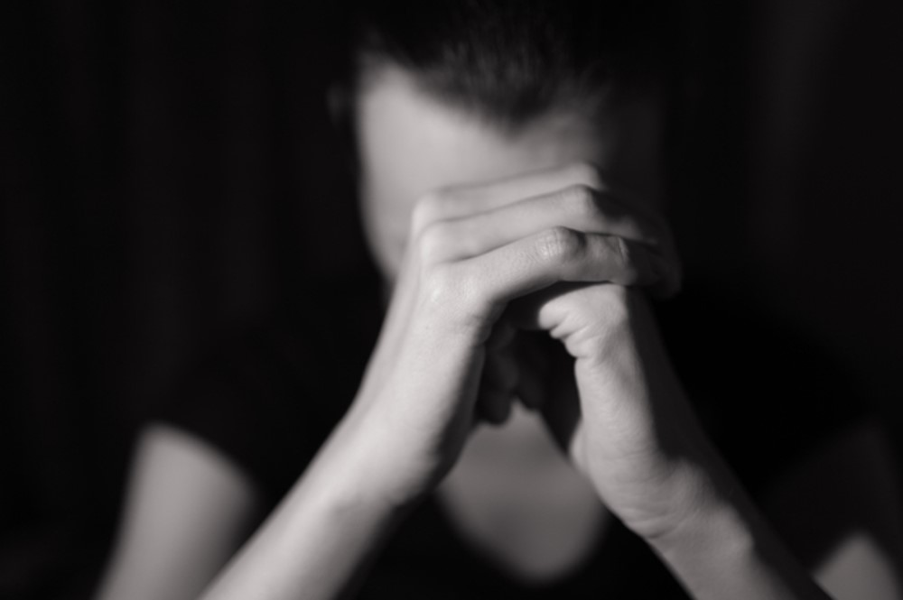
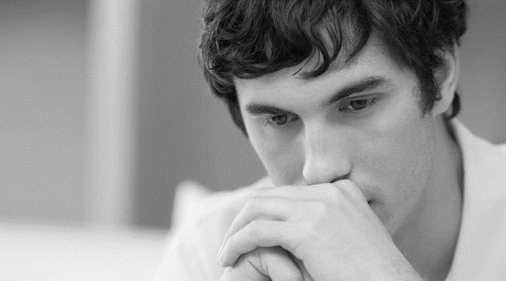
To Receive Revelation
We must:
Repent—come clean before the Lord..in all things
Exercise Faith
Be sanctified in Him
Sanctification is the act or process of acquiring sanctity, of being made or becoming holy. "Sanctity" is an ancient concept widespread among religions, a property of a thing or person sacred or set apart within the religion, from temple vessels to days of the week, to a human believer who achieves this state. To sanctify is literally "to set apart for special use or purpose", figuratively "to make holy or sacred", and etymologically from the Latin verb sanctificare which in turn is from sanctus "holy" and facere "to make".
Wikipedia
Ether 4:6-7

Slide 6
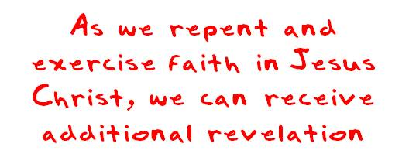
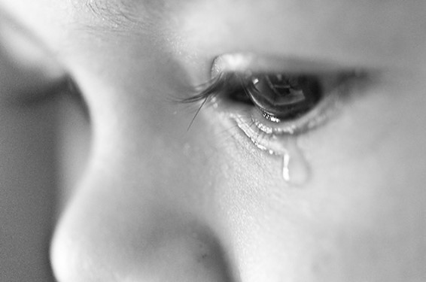
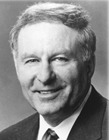
To Receive Revelation
Why do you think we need to repent and become clean in order to receive additional revelation?
To properly prepare to receive personal revelation, we must repent, ask through prayer, be obedient, search the scriptures, fast, think pure thoughts, and develop a spirit of reverence.”
Elder L. Lionel Kendrick

Slide 7
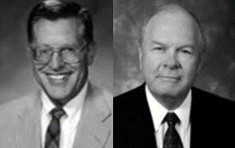
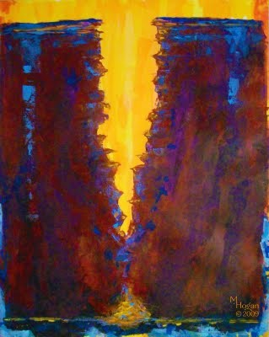
God Reveals Himself
“God reveals himself to the humble, to those who know their weakness and their limits, who gladly acknowledge them, and who earnestly open themselves to further light and knowledge from him who is eternal.”
JFM and RLM
Veil
What kind of veil did the Lord refer to?
A “veil of unbelief”
How is unbelief like a veil?
The word rend means to tear or divide.
What do you think it means to “rend [the] veil of unbelief”?
Ether 4:8-15

Slide 8
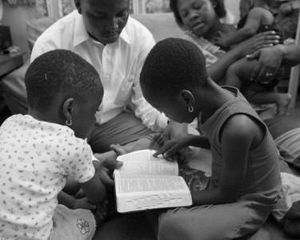
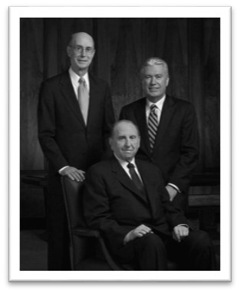
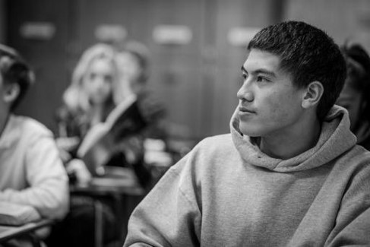
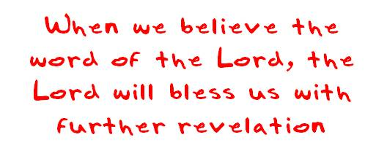
Exercising Faith By:
personal scripture study
following promptings from the Holy Ghost
following local Church leaders
studying the scriptures in church and seminary
following the words of latter-day prophets.
Ether 4:11

Slide 9
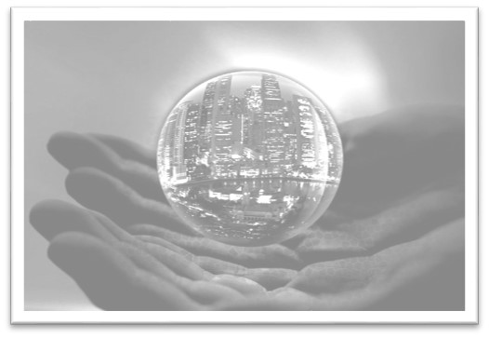
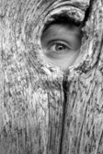
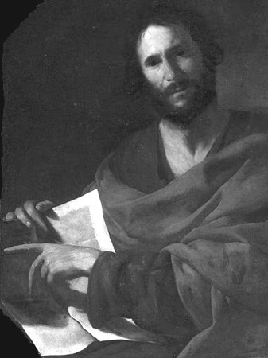
All To Be Revealed
“And then shall my revelations which I have caused to be written by my servant John be unfolded in the eyes of all the people. Remember, when ye see these things, ye shall know that the time is at hand that they shall be made manifest in very deed.”
“Adam, Enoch, Abraham, and John the Revelator all saw the panoramic vision. And that which Nephi say, but which was to be written by John [1 Nephi 14:18-28], shall be shown forth.”
JFM and RLM
“Nephi refers to the book of Revelation found in our present Bible. The sealed portion evidently describes the same general things and thus will help us more fully understand John’s revelation”
Student Manual
Ether 4:16

Slide 10
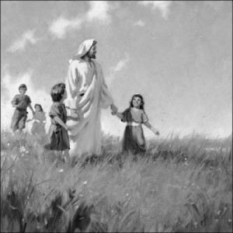
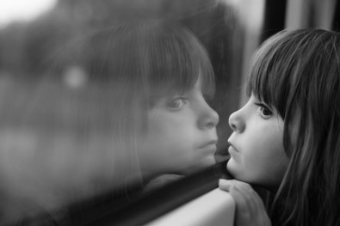
Kingdom Prepared For Him
“Those who kept the statues and commandments of God in their first estate, who were true and faithful to every trust in the premortal existence, were promised certain blessings, in life and everlasting continuation of the family…
When they come to earth, receive the gospel and its attendant covenants and ordinances, and live in such a manner as to merit the gifts and blessings of the Spirit, they qualify in time to receive unconditionally what they had been promised before they came here.
That is to say, their calling and election to eternal life—which had its origin in the first estate—is made sure.”
JFM and RLM
Calling and Election Sure:
Righteous followers of Christ can become numbered among the elect who gain the assurance of exaltation. This calling and election begins with repentance and baptism. It becomes complete when they “press forward, feasting upon the word of Christ, and endure to the end”
(2 Ne. 31:19–20). (2 Pet. 1:4–11; D&C 131:5–6).
Guide to the Scriptures
Ether 4:19

Slide 11
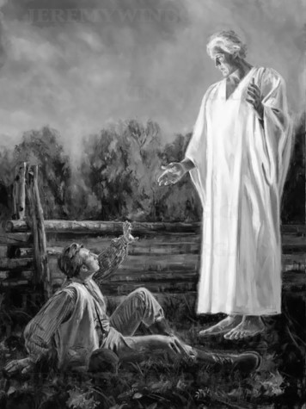
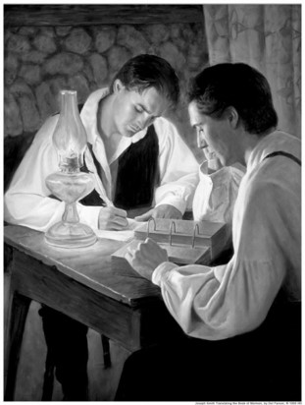
Touch Not
Moroni to Joseph Smith:
A specific charge to Joseph Smith that he is not to translate or touch the sealed portions of the record.
“Touch not the things which are sealed, for I will bring them forth in mine own due time; for I will show unto the children of men that I am able to do mine own work.”
2 Nephi 27:21
However:
He may show the plates to those who assist him in bringing forth the work
Ether 5

Slide 12
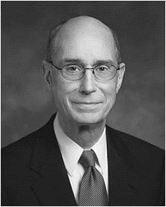
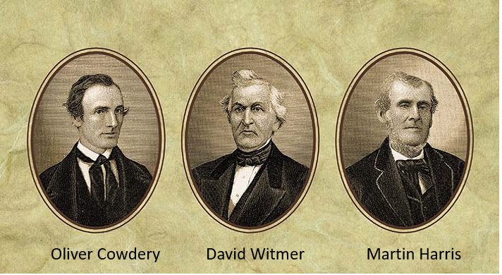
Three Witnesses
“The Three Witnesses never denied their testimony of the Book of Mormon. They could not because they knew it was true.
They made sacrifices and faced difficulties beyond what most people ever know. Oliver Cowdery gave the same testimony about the divine origin of the Book of Mormon as he lay dying.
… That they continued to affirm what they saw and heard in that marvelous experience, during long periods of estrangement from the Church and from Joseph, makes their testimony more powerful”
President Henry B. Eyring
Ether 5

Slide 13
Sources:
Suggested Hymn: 281 Help Me Teach with Inspiration
Joseph Fielding Smith Conference Report Oct. 1961, pp. 9-20
Elder L. Lionel Kendrick Personal Revelation Sept. 1999 Ensign
Joseph Fielding McConkie and Robert L. Millet Doctrinal Commentary on the Book of Mormon Vol. 4 pgs. 282-284
Student Manual Religion 121-122 of the Book of Mormon pg. 481
President Henry B. Eyring (“An Enduring Testimony of the Mission of the Prophet Joseph,” Ensign or Liahona, Nov. 2003, 90).

Slide 14
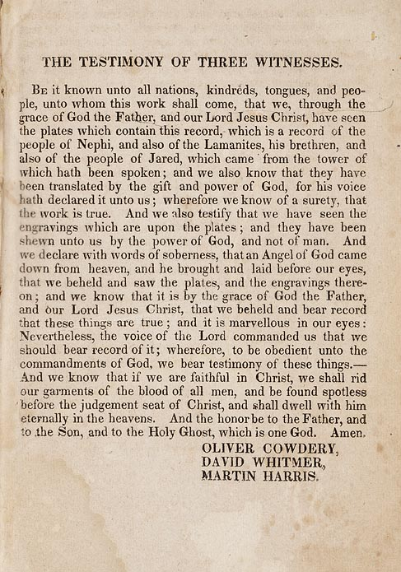
President James E. Faust of the First Presidency said:
“As a young Aaronic Priesthood boy, I received a firsthand confirmation of the remarkable testimony of the Three Witnesses concerning the truthfulness of the Book of Mormon. My stake president was President Henry D. Moyle, and his father was James H. Moyle. In the summertime Brother James H. Moyle would visit his family, and he would worship with us in our little ward in the southeast of the Salt Lake Valley.
“One Sunday, Brother James H. Moyle shared with us a singular experience. As a young man he went to the University of Michigan to study law. As he was finishing his studies, his father told him that David Whitmer, one of the witnesses of the Book of Mormon, was still alive. The father suggested to his son that he stop on his way back to Salt Lake City to visit with David Whitmer face-to-face. Brother Moyle’s purpose was to ask him about his testimony concerning the golden plates and the Book of Mormon.
“During that visit, Brother Moyle said to David Whitmer: ‘Sir, you are an old man, and I’m a young man. I have been studying about witnesses and testimonies. Please tell me the truth concerning your testimony as one of the witnesses of the Book of Mormon.’ David Whitmer then told this young man: ‘Yes, I held the golden plates in my hands, and they were shown to us by an angel. My testimony concerning the Book of Mormon is true.’ David Whitmer was out of the Church, but he never denied his testimony of the angel’s visitation, of handling the golden plates, or of the truthfulness of the Book of Mormon. Hearing with my own ears this remarkable experience directly from Brother Moyle’s lips had a powerful, confirming effect upon my growing testimony. Having heard it, I felt it was binding upon me” (“A Growing Testimony,” Ensign, Nov. 2000, 54).
The Witnesses:
In the late 1830s a spirit of faultfinding spread among the members of the Church. During this period, many Saints left the Church, including the Three Witnesses. Although David Whitmer never returned, Oliver Cowdery and Martin Harris later rejoined the Church. But even while the Three Witnesses were not members of the Church, none of them ever denied the experience they had had with the golden plates, and they continued to testify that the Book of Mormon is the word of God. (See Dallin H. Oaks “The Witness: Martin Harris,” Ensign, May 1999, 36–37.)

