Slide 2
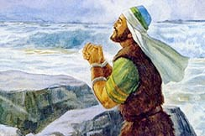
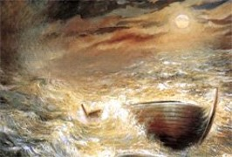
“Buried in the Depths of the Sea”
The Lord had responded to the brother of Jared’s request and drove them safely to the promised land.
344 Days
Driven by the wind
Light filled the barge--continually
Air filled the barge—tight like unto a dish—like unto Noah
They sang praises unto the Lord all day long
“Singing such praises buoy the spirit and brings strength to the weary souls and courage to the fearful hearts.”
JFM and RLM
Ether 6:1-12

Slide 3
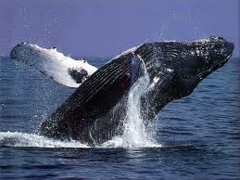
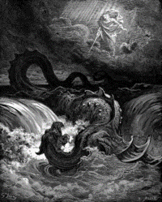
“Monster of the Sea—Whale”
“And God created great whales, and every living creature that moveth, which the waters brought forth abundantly, after their kind, and every winged fowl after his kind: and God saw that it was good.” Genesis 1:21
“Thou didst divide the sea by thy strength: thou brakest the heads of the dragons in the waters.”
Psalms 74:13
No monster of the sea—no whale to mar them
Read Job 21: Imagery of a Monster
The Lord points to His power in the leviathan—
Ether 6:10

Slide 4
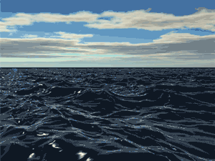
“Mountain Waves”
The Jaredites had to wait for their barges to surface before they could unplug a hole and receive air.
Ether 6:12

Slide 5
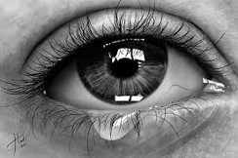
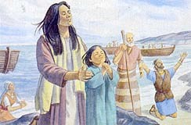
“Shedding of Tears”
“When the heart is softened by gratitude and humility and the mind is quickened by a recognition of God’s hand, the Spirit of the Lord fills the soul with joy even to tears.”
JFM and RLM
“Spiritual promptings move us on occasion to great joy, sometimes to tears…..The Holy Ghost causes our feelings to be more tender. We feel more charitable and compassionate. We are calmer. We have a greater capacity to love.” President Ezra Taft Benson
If we trust in the Lord, He will sustain us as we progress and prepare to receive eternal life
The Jaredites trusted in the Lord that He did indeed deliver them to the promised land
Ether 6:12

Slide 6
Populating the Land
After arriving on the land the brother of Jared, Jared, and their friends began to “multiply” and “spread upon the face of the land.”
”And they were taught to walk humbly before the Lord; and they were also taught from on high.”
The brother of Jared began to get old
The Gathering:
The brother of Jared –had 22 family members
Jared had 12 family members
The people desired to have a “king”
Ether 6:13-21

Slide 7
King or No King
“Suffer them that they may have a king. And therefore he said unto them: Choose ye out from among our sons a king, even whom ye will.”
“And now behold, this was grievous unto them. And the brother of Jared said unto them: Surely this thing leadeth into captivity.”
Kingship—a potential for abuse and wickedness—Pride
The brother of Jared realized that eventually under a monarchy they would turn from their ways of righteousness and led their people into unrighteous practices.
Ether 6:13-21

Slide 8
Pagag
He was the first born son of the brother of Jared
He was the first choice of the people in the new promised land to be king but he declined
The people chose all Pagag’s brothers to be their king but one by one they also declined
They all heeded the prophetic warning of his father against a monarchy
The sons, four of them, of Jared also declined to be the king except Orihah who ruled in righteousness
Ether 6:25-30

Slide 9
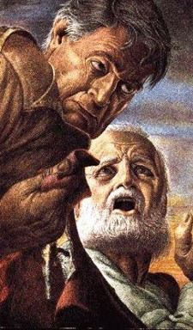
1 Samuel 8—History of Having a King
“When we come to the Book of 1 Samuel, we move from the period of the judges (Judges, Ruth, 1 Samuel 1-7) to the monarchy (1 Samuel 8.)
At Israel’s insistence, they will have a king, and Saul will be the first. The ride will be short, for Israel and for Saul (40 years really isn’t such a long time).
His sons will not reign after his death.
A new king, David, will reign in his place. The price for Saul is high. He loses his dynasty, his son Jonathan, and his own life. It is also high for Israel, as Samuel will clearly explain (1 Samuel 8:10-18).
If the Israelites thought that a king would give them security and uninterrupted peace, they were wrong. Under Saul’s leadership, there were many terrifying moments
(see 1 Samuel 13:7; 14:15).”
Guye Rowe
https://bible.org/seriespage/israel-gets-king-1-samuel-11-1623

Slide 10
What Mosiah Has to Say About Kings
“Now I say unto you, that because all men are not just it is not expedient that ye should have a king or kings to rule over you.
For behold, how much iniquity doth one wicked king cause to be committed, yea, and what great destruction!”
“And behold, now I say unto you, ye cannot dethrone an iniquitous king save it be through much contention, and the shedding of much blood.”
“For behold, he has his friends in iniquity, and he keepeth his guards about him; and he teareth up the laws of those who have reigned in righteousness before him; and he trampleth under his feet the commandments of God;
And he enacteth laws, and sendeth them forth among his people, yea, laws after the manner of his own wickedness; and whosoever doth not obey his laws he causeth to be destroyed; and whosoever doth rebel against him he will send his armies against them to war, and if he can he will destroy them; and thus an unrighteous king doth pervert the ways of all righteousness.”
Mosiah 29:16-23

Slide 11
Sources:
Joseph Fielding McConkie and Robert L. Millet Doctrinal Commentary on the Book of Mormon Vol. 4 pg. 287
President Ezra Taft Benson Come Unto Christ pg 20
Presentation by ©http://fashionsbylynda.com/blog/

Slide 12
Monsters of the Sea
”…"agon" (struggle) model, God does battle with the monsters of the sea at the beginning of the world in order to mark his sovereignty and power. Psalm 74 evokes the agon model: it opens with a lament over God's desertion of his people and their tribulations, then asks him to remember his past deeds: "You it was who smashed Sea with your might, who battered the heads of the monsters in the waters; You it was who crushed the heads of Leviathan, who left them for food for the denizens of the desert...“ In this world-view the seas are primordial forces of disorder, and the work of creation is preceded by a divine combat (or "theomachy").
Creation in the "agon" model takes the following storyline:
(1) God as the divine warrior battles the monsters of chaos, who include Sea, Death, Tannin and Leviathan;
(2) The world of nature joins in the battle and the chaos-monsters are defeated;
(3) God is enthroned on a divine mountain, surrounded by lesser deities;
(4) He speaks, and nature brings forth the created world, or for the Greeks, the cosmos. This myth was taken up in later Jewish and Christian apocalyptic literature and projected into the future, so that cosmic battle becomes the decisive act at the end of the world's history: thus the Book of Revelation (end of the 1st century CE) tells how, after the God's final victory over the sea-monsters, New Heavens and New Earth shall be inaugurated in a cosmos in which there will be "no more sea" (Revelation 21:1).
Wikipedia
Leviathan — Bible Dictionary
Any great sea or land monster, such as the crocodile, either as an actual creature (Job 41:1) or as symbolic of a nation (Ps. 74:14); a large serpent (Isa. 27:1).
Dragon—Bible Dictionary
Two Hebrew words are thus rendered though they are sometimes translated whale, serpent, jackal, or sea-monster. Probably a large snake or snakelike animal.
“Thou didst divide the sea by thy strength: thou brakest the heads of the dragons in the waters.” Psalms 74:13
Leviathan "twisted, coiled") is a sea monster referenced in the Tanakh, or the Old Testament.
The word has become synonymous with any large sea monster or creature. In literature (e.g., Herman Melville's Moby-Dick)
it refers to great whales, and in Modern Hebrew, it simply means "whale". It is described extensively in Job 41 and mentioned in Isaiah 27:1.
Wikipedia

