Slide 2
Boat Without An Anchor
Why is it important for a boat to have an anchor?
What dangers or difficulties might a boat encounter if it does not have an anchor?
What influence do waves have on a boat?

Slide 3
Life
“...even as chaff is driven before the wind, or as a vessel is tossed about upon the waves, without sail or anchor, or without anything wherewith to steer her; and even as she is, so are they.”
Mormon 5:18
social pressures, adversity, false teachings, or wickedness

Slide 4
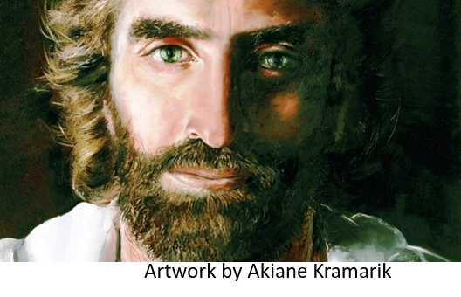
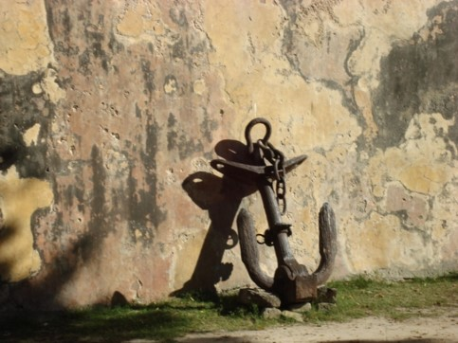
Spiritual Anchors
Just as ships need anchors to keep them from drifting away on the open seas, people need spiritual anchors in their lives if they are to remain steadfast and not drift into the sea of temptation and sin.
Faith in God and in his Son, the Lord Jesus Christ, is the main anchor we must have in our lives to hold us fast during times of social turbulence and wickedness that seem to be everywhere today.
This faith must be more than that of the generic dictionary variety. Our faith, for it to be meaningful and effective and to hold us fast, must be centered in Jesus Christ, in his life, in his atonement, and in the restoration of his gospel to the earth in the last days.”
Elder M. Russell Ballard

Slide 5
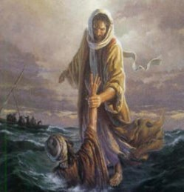
By Faith All Things Are Fulfilled
Ether Spoke of:
Hope for a better world—love our fellowmen with greater compassion
Hope for a place at the right hand of God
Faith making it an anchor to the souls of men
Faith which makes them steadfast
Faith which bring good works—to do good
Which leads to the glory of God
Hope that saves is born of faith in the Lord Jesus Christ.
Hope is not merely wishful thinking.
Hope comes from trusting in and following the Savior.
“True Repentance is based on and flows from faith in the Lord Jesus Christ, there is no other way.”
Ezra Taft Benson
Ether 12:3-4

Slide 6
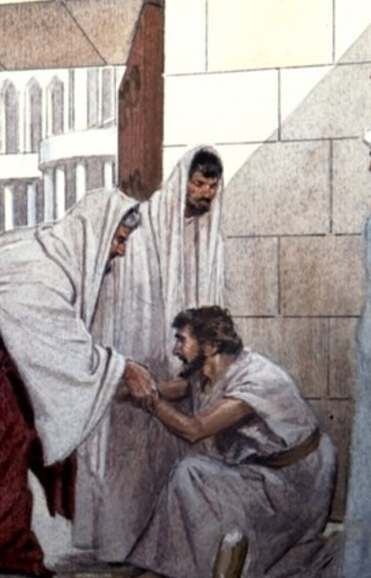
Degrees of Faith
Faith is a principle of action and power. Whenever we work toward a worthy goal, we exercise faith.
“Blessed art thou because of thy exceeding faith; I say unto thee, woman, there has not been such great faith among all the people of the Nephites.”
Alma 19:10
“Now ye see that this is the true faith of God;” Alma 44:4
“For if there be no faith among the children of men God can do no miracle among them” Ether 12:12
“…thus they did retain a hope through faith” Alma 25:16
“Do ye exercise faith in the redemption of him who created you?” Alma 5:15
What kind of Faith should we have?
Ether 12:3-4

Slide 7
Spiritually Blind Jaredites
“Moroni informs us that their disbelief was because “they saw them not.” This is an age-old rejection of the spiritual workings of God. The world states that ‘seeing is believing.’
Such logic…defies the workings of god and denies the words of prophets.
JFM and RLM
“Now faith is the substance of things hoped for, the evidence of things not seen.”
Hebrews 11:1
Those who need seeing proof say:
“How do ye know of their surety? Behold, ye cannot know of things which ye do not see; therefore ye cannot know that there shall be a Christ.”
Alma 30:15
Ether 12:5-6

Slide 8
People Can Receive a Spiritual Witness of Jesus Christ through:
Ether 12:5-6

Slide 9
Doctrinal Mastery
”And now, I, Moroni, would speak somewhat concerning these things; I would show unto the world that faith is things which are hoped for and not seen; wherefore, dispute not because ye see not, for ye receive no witness until after the trial of your faith.”
Ether 12:6

Slide 10
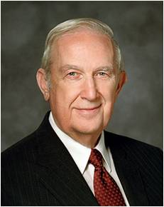
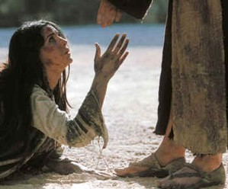
Trial of Your Faith
“You can learn to use faith more effectively by applying this principle taught by Moroni: ‘… ye receive no witness until after the trial of your faith’.
Thus, every time you try your faith, that is, act in worthiness on an impression, you will receive the confirming evidence of the Spirit.
Those feelings will fortify your faith. As you repeat that pattern, your faith will become stronger”
Richard G. Scott
Ether 12:6

Slide 11
Faith Precedes A Miracle
Moroni provides examples: match
2
1. The faith of Alma and Amulek
2. The faith of Nephi and Lehi
3. The faith of Ammon
4. The faith of the three disciples to not taste death
5. The faith of the brother of Jared
6. The faith of the fathers that the record be preserved for the Jews and the Gentiles
__a. Helaman 5:45; 3 Nephi 9:20
__b. 3 Nephi 28; Mormon 8:10- 11
__c. Ether 3:4-6, 25-26
__d. Alma 14:26-29
__e. Enos 1:12-13; 15-18
__f. Alma 17:29-39
4
5
1
6
3
Ether 12:7-22

Slide 12
Sources:
M. Russell Ballard Anchor Your Soul March 1993 Ensign
Ezra Taft Benson Teachings of pg. 71
Joseph Fielding McConkie and Robert L. Millet Doctrinal Commentary on the Book of Mormon Vol. 4 pg. 295
Richard G. Scott (“The Sustaining Power of Faith in Times of Uncertainty and Testing,” Ensign or Liahona, May 2003, 76).
Presentation by ©http://fashionsbylynda.com/blog/

