Slide 2
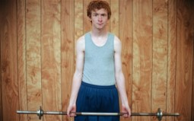
Changing Weaknesses to Strength
Weakness
Strength
Moroni…feared that the words he recorded in the Nephite record would be ridiculed and/or rejected by later readers because of his weakness in writing.
Moroni… prayed that the Lord would, through the great power of his Spirit, compensate for their weaknesses in writing.
…the Lord assured [Moroni] that the unbelieving, mocking Gentiles could not gain advantage over the meek and humble believers of the Nephite record.
Ether 12:23-26 JFM and RLM

Slide 3
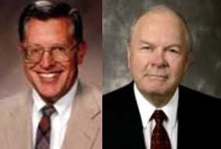
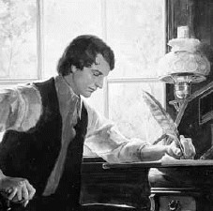
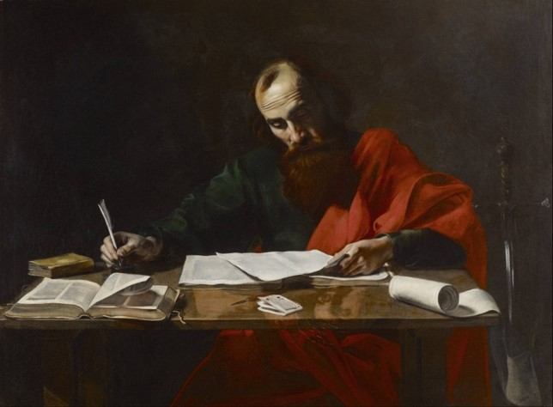
Mortal Men
“Even though the Book of Mormon was written and abridged by mortal men who had mortal frailties and weaknesses, the power and Spirit of God transforms this book that fools may perceive as “weak”—as a foolish fantasy—into an inspired volume of scripture that can and does convince Jew and Gentile that Jesus is indeed the Christ. “
The Gospel is Preached by the Weak and the Simple
Paul wrote: “But God hath chosen the foolish things of the world to confound the wise; and God hath chosen the weak things of the world to confound the things which are mighty;”
1 Corinthians 1:27
Ether 12:23-26 JFM and RLM

Slide 4
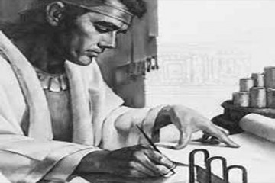
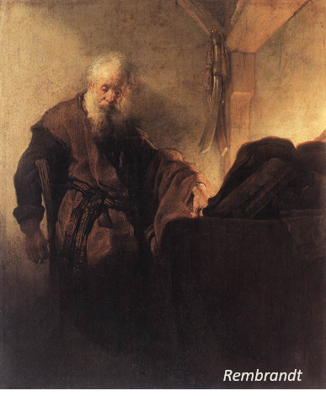
In My Weakness—Being Mortal
Prophets of God:
Nephi: “…O wretched man that I am! Yea, my heart sorroweth because of my flesh; my soul grieveth because of mine iniquities.
I am encompassed about, because of the temptations and the sins which do so easily beset me.”
2 Nephi 4:17-18
Paul:
“Now then it is no more I that do it, but sin that dwelleth in me.
For I know that in me (that is, in my flesh,) dwelleth no good thing: for to will is present with me; but how to perform that which is good I find not.
For the good that I would I do not: but the evil which I would not, that I do.”
Romans 7:17-19
Ether 12:23-27 JFM and RLM

Slide 5
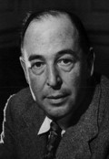
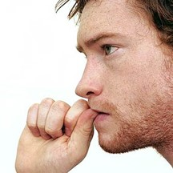
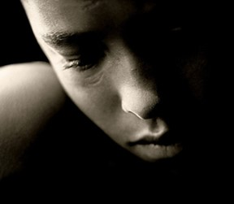
“When a man turns to Christ and seems to be getting on pretty well (in the sense that some of his bad habits are now corrected), he often feels that it would now be natural if things went fairly smoothly.
When troubles come along—illnesses, money troubles, new kinds of temptation—he is disappointed.
These things, he feels, might have been necessary to rouse him and make him repent in his bad old days; but why now?
Because God is forcing him on, or up, to a higher level: putting him into situations where he will have to be very much braver, or more patient, or more loving, that he ever dreamed of before. It sees to us all unnecessary, but that is because we have not yet had the slightest notion of the tremendous thing He means to make of us.”
C.S. Lewis

Slide 6
Doctrinal Mastery
“And if men come unto me I will show unto them their weakness. I give unto men weakness that they may be humble; and my grace is sufficient for all men that humble themselves before me; for if they humble themselves before me, and have faith in me, then will I make weak things become strong unto them.”
Ether 12:27

Slide 7
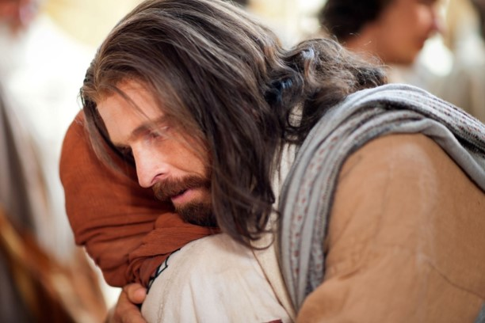
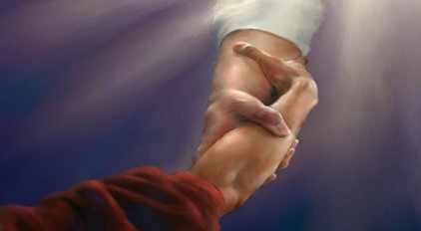
Saved in Our Weaknesses
“To have real faith is to trust in Christ’s love and in God’s plan. While God cannot save us in our sins; he has the will and power to save us in our weaknesses”
“And he said unto me, My grace is sufficient for thee: for my strength is made perfect in weakness. Most gladly therefore will I rather glory in my infirmities, that the power of Christ may rest upon me.
Therefore I take pleasure in infirmities, in reproaches, in necessities, in persecutions, in distresses for Christ’s sake: for when I am weak, then am I strong.”
2 Corinthians 12:9-10
Ether 12:27-28

Slide 8
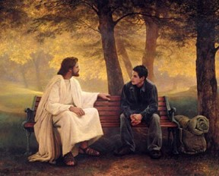
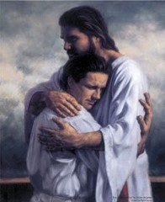
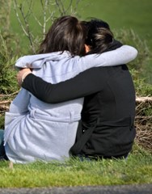
If we come unto Jesus Christ, then He will show us our weakness
If we humble ourselves and exercise faith in the Lord, then He will make weak things become strong unto us
If we are meek, we can receive the Lord’s grace to help us overlook the weaknesses of others
Ether 12:26-27

Slide 9
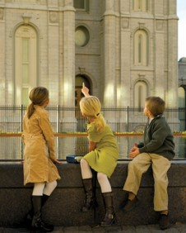
Come Unto Jesus Christ
What are some things we can do to “come unto Jesus Christ”?
Pray, fast, repent, study the scriptures, participate in temple worship, serve others, and seek to develop Christ like attributes.
What does the second principle imply will happen if we choose not to humble ourselves and exercise faith in Jesus Christ?
Our weaknesses will remain because we have refused the Lord’s grace to help us overcome them.
What do you think is meant by the phrase “my grace is sufficient for all … that humble themselves before me”?
Grace is a “divine means of help or strength, given through the bounteous mercy and love of Jesus Christ. This enabling power, or assistance, will never run out—no matter how many people draw upon it.
Ether 12:27

Slide 10
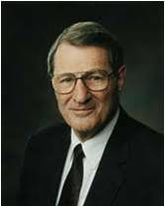
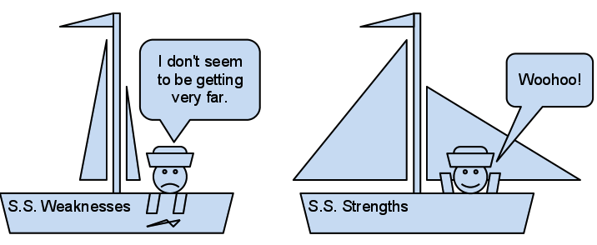
“When we read in the scriptures of man’s ‘weakness,’ this term includes the … weakness inherent in the general human condition in which the flesh has such an incessant [or constant] impact upon the spirit (see Ether 12:28–29).
Weakness likewise includes, however, our specific, individual weaknesses, which we are expected to overcome.
(see D&C 66:3; Jacob 4:7).
Life has a way of exposing these weaknesses” Neal A. Maxwell
Ether 12:28-29

Slide 11
Faith
“The Savior taught that a person with faith the size of a mustard seed can have power to move a mountain.”
Matthew 17:20
“Adversity can increase faith or instead can cause the troubling roots of bitterness to spring up…One’s life, therefore, cannot be both faith-filed and stress-free.
Therefore, how can you and I really expect to glide naively through life, as if to say, “Lord, give me experience, but not grief, not sorrow, not pain, not opposition, not betrayal, and certainly not to be forsaken. Keep from me, Lord, all those experiences which made Thee what Thou art! Then let me come and dwell with Thee and fully share Thy joy!”
Neal A. Maxwell
Ether 12:28-29

Slide 12
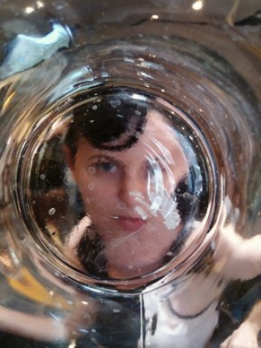
Hope
Paul said Hope is for things that are not seen that are true.
Romans 8:24
“(Hope is the) great realties of the resurrection, eternal life, a better world, and Christ’s triumphant second coming—things as they really will be.” Jacob 4:13
“Hope is not quite knowledge. Yet, being at the border of knowledge, we can see through “glass darkly” enough of the future to affect how we live today.”
“Christian’s hope draws on reliable witnesses from the past.”—Revelations from through the prophets.
Ether 12:32 Neal A. Maxwell

Slide 13
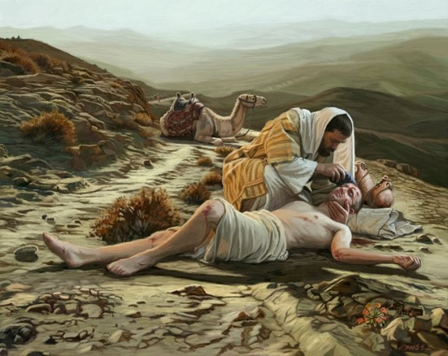
Charity
“Charity is the pure love of Christ. It is the love that Christ has for the children of men and that the children of men should have for one another. It is the highest, noblest, and strongest kind of love and the most joyous to the soul.”
1 Nephi 11:23
“Charity suffereth long, and is kind, and envieth not, and is not puffed up, seeketh not her own, is not easily provoked, thinketh no evil, and rejoiceth not in iniquity but rejoiceth in the truth, beareth all things, believeth all things, hopeth all things, endureth all things.” (Moroni 7:45; see also 1 Corinthians 13:4-7).
Ether 12:35

Slide 14
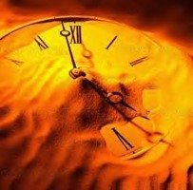
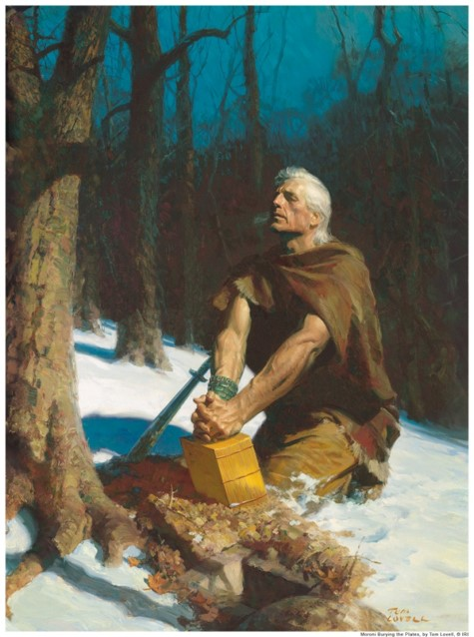
Time is Running Out— for me also
Moroni bids farewell to the Gentiles for whom he had prayed and for whom his record was intended.
He also bade farewell to the Nephites and the Lamanites.
Moroni’s final testimony:
“And then shall ye know that I have seen Jesus, and that he hath talked with me face to face, and that he told me in plain humility, even as a man telleth another in mine own language, concerning these things;
And only a few have I written, because of my weakness in writing.
And now, I would commend you to seek this Jesus of whom the prophets and apostles have written, that the grace of God the Father, and also the Lord Jesus Christ, and the Holy Ghost, which beareth record of them, may be and abide in you forever. Amen.”
Ether 12:38-41

Slide 15
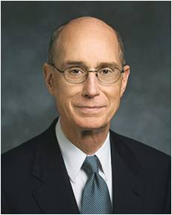
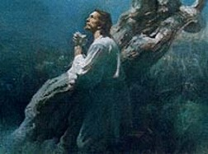
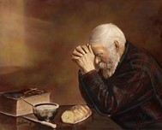
Go Forward In Faith
“Each of us who have made covenants with God face challenges unique to us. But each of us shares some common assurances. Our Heavenly Father knows us and our circumstances and even what faces us in the future.
His Beloved Son, Jesus Christ, our Savior, has suffered and paid for our sins and those of all the people we will ever meet.
He has perfect understanding of the feelings, the suffering, the trials, and the needs of every individual.
Because of that, a way will be prepared for us to keep our covenants, however difficult that may now appear, if we go forward in faith.
Henry B. Eyring
Ether 12:35

Slide 16
Sources:
Joseph Fielding McConkie and Robert L. Millet Doctrinal Commentary on the Book of Mormon Vol. 4 pg. 300
C.S. Lewis Mere Christianity p. 174
Neal A. Maxwell (Lord, Increase Our Faith [1994], 84).
“Lest Ye Be Wearied and Faint in Your Minds” May Ensign 1991
Notwithstanding My Weakness pg. 40-41
Henry B. Eyring Witnesses for God Nov. 1996 Ensign
The Will of God (3:03)
Presentation by ©http://fashionsbylynda.com/blog/

Slide 17
What else can we do to manage these vexing feeling of inadequacy?
We can distinguish more clearly between divine discontent and the devils dissonance, between dissatisfaction with self and disdain for self.
We can contemplate how far we have already come in the climb along the pathway to perfection; it is usually much further that we acknowledge, and such reflections restore resolve.
We can accept help as well as gladly give it. In the economy of heaven, God does not send thunder if a still, small voice is enough, or a prophet if a priest can do the job.
We can make allowance more than we sometimes do for the agency of others…Often our best effort is not fully effectual because of someone else’s worst effort.
We can write down and then act upon a few of those otherwise transient resolutions for self-improvement that are like a pebble in one’s shoe.
We can honestly acknowledge, in those moments of wonderment about our mattering, that if we were to die today, we would be genuinely and deeply missed.
We can put our hand to the plow, looking neither back nor around, comparatively.
We can make quiet but more honest inventories of our strengths….Self-contempt is of Satan. We should learn from our mistakes.
We can add to each other’s storehouse of self esteem. (—a compliment goes a long way).
We can also keep moving. Crosses are easier to carry when we keep moving….Feet are made to move forward.
We can know that when we have truly given what we have, it is like paying a full tithe, it is, in that respect, all that was asked.
We can allow for the reality that God is still more concerned with growth than with geography. (exploring your own possibilities).
We can learn that at the center of our agency is our freedom to form a healthy attitude toward whatever circumstances we are placed in. The strong Spirit can drive weak flesh beyond where the body first agrees to go!
Finally, we can accept this stunning, irrevocable truth: Our Lord can lift us from deep despair and cradle us midst any care. We cannot tell Him anything about either aloneness or nearness. (Neal A. Maxwell Not Withstanding My Weakness pgs. 9-11

