Slide 2
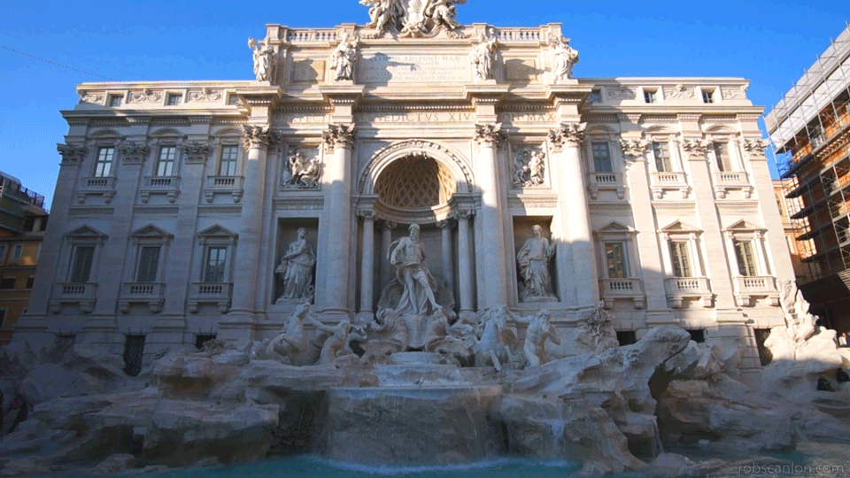
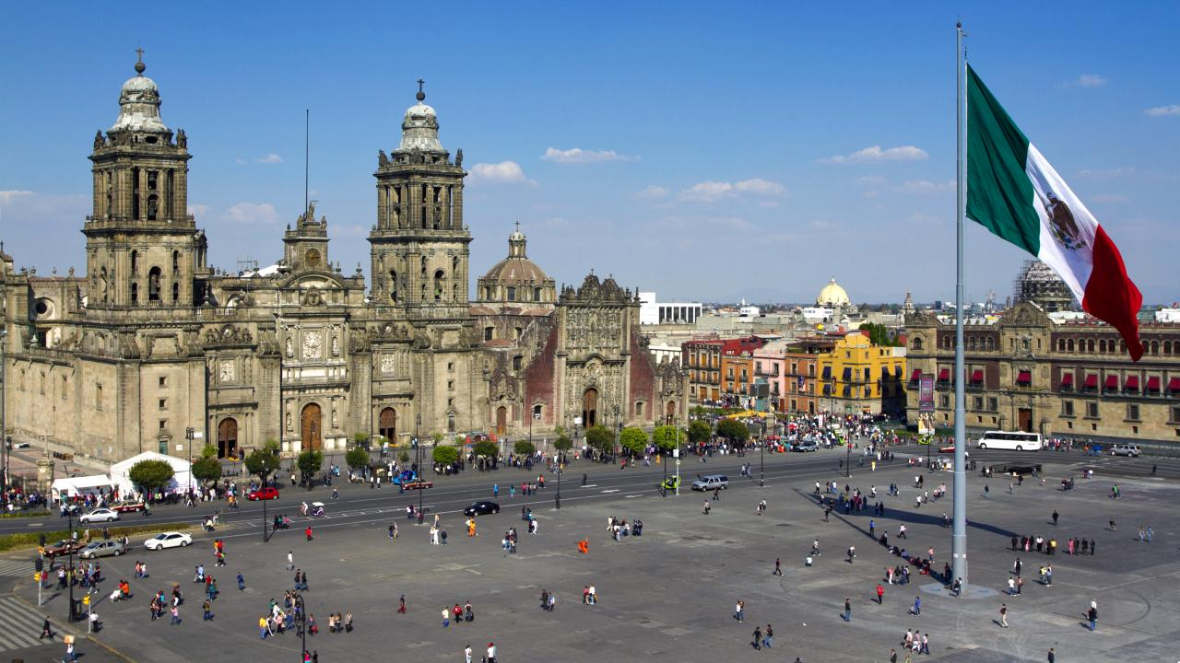
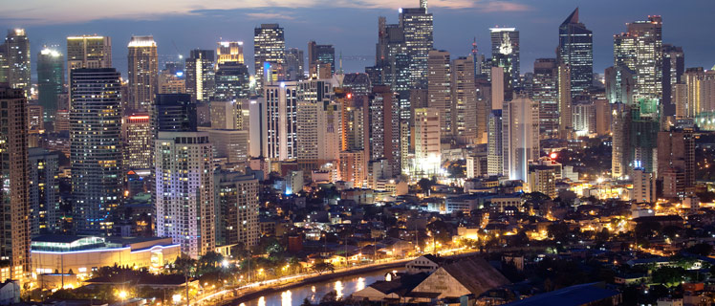
Name of A City
City of Light
The Eternal City
The City of Palaces
(Rome, Italy)
(Paris, France)
The Windy City
The Pearl of the Orient
Mexico City, Mexico
Manila, Philippines
Chicago, Illinois, United States

Slide 3
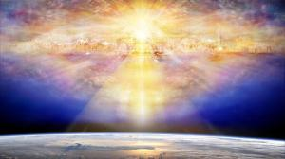
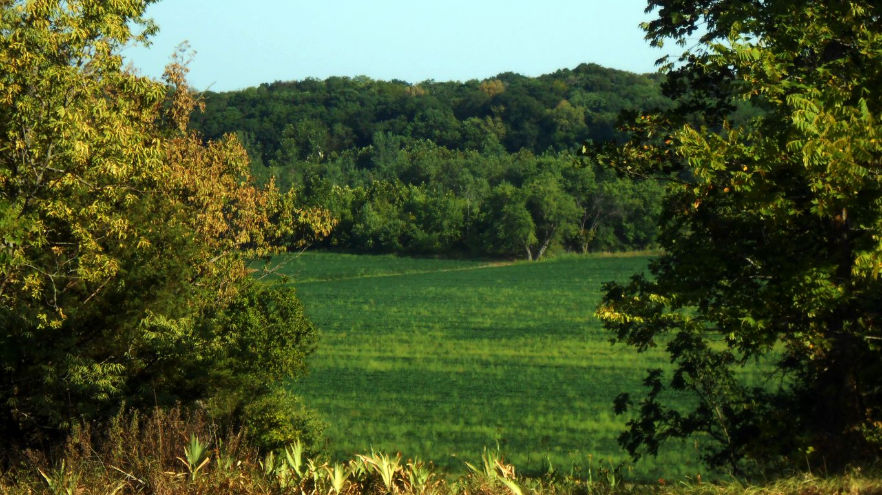
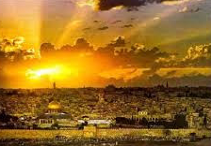
Ether’s Prophecies
The New Jerusalem
Ether 13:6, 8, 10
Jerusalem in the Holy Land
Ether 13:11
The City of Enoch
Ether 13:3; Moses 7:62-64

Slide 4
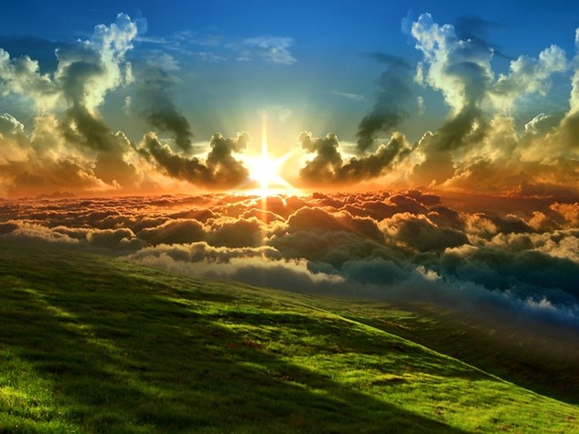
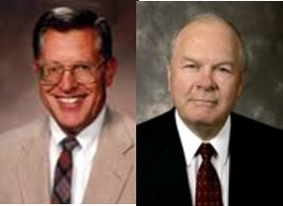
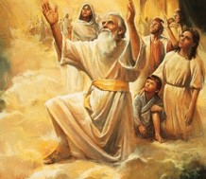
A Holy Sanctuary
“And that it was the place of the New Jerusalem, which should come down out of heaven, and the holy sanctuary of the Lord.”
Symbolic—the New Jerusalem will be built upon heavenly principles and under the influence of revelation to the Lord’s chosen officers.
Those who are cleansed and purified through the atonement of Jesus Christ will build up a new City of Holiness.
JFM and RLM
Literal—Enoch’s city—the City of Holiness that was taken up into heaven will come down from heaven and be united with the earthly New Jerusalem (see Moses 7:13-21)
Bruce R. McConkie
Ether 13:3

Slide 5
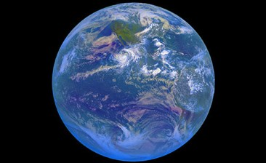
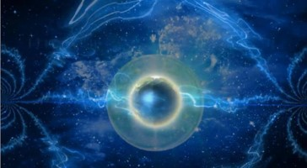
All Things Become New
“This earth was created in a new or paradisiacal state; then, incident to Adam’s transgression, it fell to its present telestial state….
…At the Second coming of our Lord, it will be renewed, regenerated, refreshed, transfigured, become again a new earth, a paradisiacal earth.
…its millennial status will be a return to its pristine state of beauty and glory, the state that existed before the fall…
(Isaiah 65:17-25; 66:22-24)
This same designation applies also to the celestial heaven and earth that will prevail in the day when the Father and the Son make this planet their habitation.”
(D&C 29:22-25; 77:1; 88:16-32; Revelation 21:10-27)
Ether 13:9 Bruce R. McConkie

Slide 6
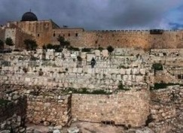
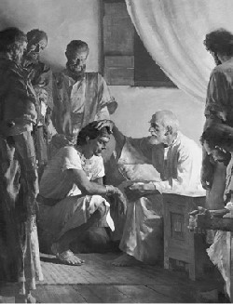
Built on American Soil
Ether’s prophecy:
New Jerusalem will be built on the American continent for the remnant of the house of Joseph and that also the Old Jerusalem will be built.
“And then cometh the New Jerusalem; and blessed are they who dwell therein, for it is they whose garments are white through the blood of the Lamb; and they are they who are numbered among the remnant of the seed of Joseph, who were of the house of Israel.”
Ether 13:10 JFM and RLM

Slide 7
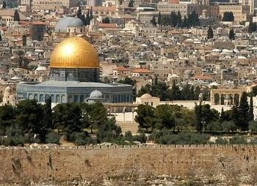
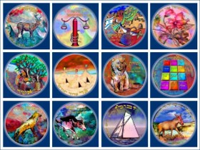
Built on Jerusalem Soil
Old Jerusalem will be ‘built up again, and become a holy city” And it will be a gathering place for Judah and others of the house of Israel.
“And then also cometh the Jerusalem of old; and the inhabitants thereof, blessed are they, for they have been washed in the blood of the Lamb; and they are they who were scattered and gathered in from the four quarters of the earth, and from the north countries, and are partakers of the fulfilling of the covenant which God made with their father, Abraham.”
Ether 13:11 JFM and RLM

Slide 8
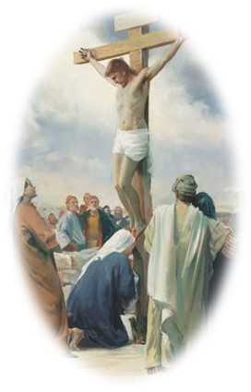
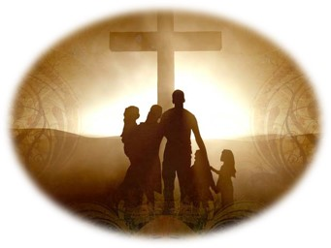
First and Last
“And when these things come, bringeth to pass the scripture which saith, there are they who were first, who shall be last; and there are they who were last, who shall be first.”
The people Israel rejected the covenant when it was first presented to them and thereby lost their position as the chosen people.
When the Gentiles have also had their opportunity, the gospel covenant will be taken back again to the Jews and the other tribes of Israel.
Ether 13:12

Slide 9
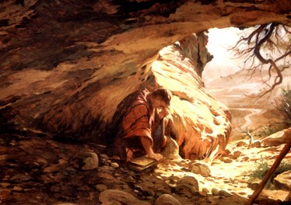
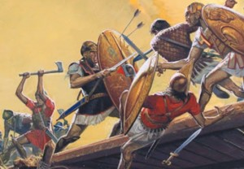
Rejection
The Jaredites rejected Ether and cast him out from among them. During the day, Ether hid himself in “the cavity of a rock,” where he finished his record of the Jaredites.
At night, he went out to see the things that were happening to his people, the Jaredites. He wrote about the things he saw.
There was a great war among the people
They sought to destroy Coriantumr with their secret plans
Many people were slain by those who belonged to secret organizations
He witnessed his people’s destruction
Ether 13:13-31; 14:1-31

Slide 10
Coriantumr
He was the last of the Jaredite Kings until around 500 BC
There was great wickedness during his reign
He studied in all arts of war and all the ‘cunning of the world’
He faced constant attacked from rival factions
He and his household rejected Ether’s words and attempted to slay Ether
Many, many Jaredites were slain and Coriantumr felt remorse and began to repent
His penitence was short-lived and the Jaredite nation was destroyed leaving Coriantumr the sole survivor, except for Ether, wandering until he was discovered
Ether prophesied that Coriantumr would come among the very people—the descendants of the Mulekites in Zarahemla—who after their eventual union with Mosiah I and his people from the land of Nephite sometime in the period of 279 BC to 130 BC
He dwelt with the Nephites for “9 moons”
Who’s Who

Slide 11
Shared
He was a military figure who contended with Coriantumr, the last of the Jaredite kings.
He defeated Coriantumr and placed him in captivity
Coriantumr’s sons rescued him and returned him to power
Shared and Coriantumr came up against one another in repeated battles until Shared was finally slain in the valley of Gilgal
Coriantumr suffered wounds in his thigh so he did not battle for 2 years
Shared’s actions proved to be the prelude to the final catastrophic events that brought about the fulfillment of Ether’s prophecy on the extinction of the Jaredite nation
Who’s Who

Slide 12
Shiz
He was the final contender with the Jaredite king
He was enraged over the death of his brother, Lib, at the hands of Coriantumr
He vowed to seek revenge
The land became strewn with the carcasses of the dead and the stench was polluting the air
He received 2 separate petitions (at different times) from Coriantumr to accept an offer of peace and that Coriantumr would relinquish his kingdom to save the lives of his people
He refused and the battles continued and Coriantumr was wounded again at the hill Ramah
During the battle, Shiz fainted because of loss of blood and Coriantumr beheaded him leaving Coriantumr and Ether the only ones remaining alive
Who’s Who

Slide 13
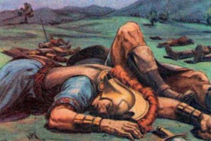
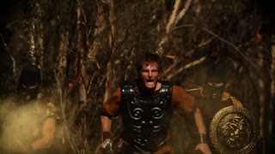
Recognition of prophecy
After Coriantumr suffered the wound in his thigh and was recovering he began to remember the words of Ether
“There is no salvation in merely recognizing the fulfillment of prophecy. Such recognition, however, may serve as a catalyst…, to the recognition of other workings of God and as a spiritual awakening of the soul that will lead one to call upon the Lord.
Perhaps Coriantumr had gone to the “point of no return.”
JFM and RLM
Ether 13:13-31; 14:1-31

Slide 14
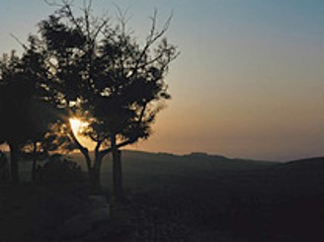
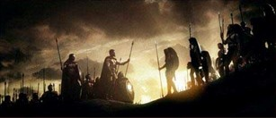
The Hill Ramah
Ether watched the battles for 4 years but did not participate
Years later the Nephites would battle in the same area called Cumorah
“Moroni notes that this hill, which was a sacred site to him, was the same Cumorah where his father, Mormon had deposited the sacred plates. We do not know whether this hill had any other significance to the Jaredite, but it may not be totally unreasonable to suggest that Ether, under the inspiration of the Lord, may have likewise secreted his plates away there in a similar manner as did Mormon.”
JFM and RLM
Ether 15:11-13

Slide 15
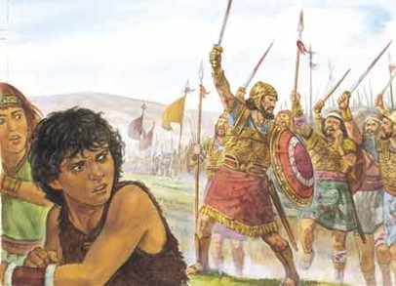
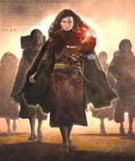
Women and children
Where were the women and children?
They were equipped with weapons and armor
All were fighting
They ended their days with ‘howlings and lamentations’
Ether 15:15-17

Slide 16
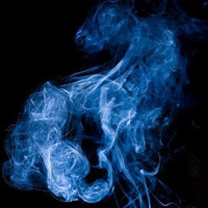
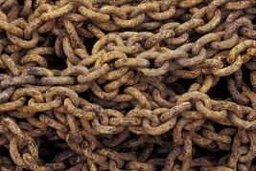
Spirit of the Lord Ceases
“But behold, the Spirit of the Lord had ceased striving with them, and Satan had full power over the hearts of the people; for they were given up unto the hardness of their hearts, and the blindness of their minds that they might be destroyed; wherefore they went again to battle.”
They were no longer being influenced by righteousness
Because of this desensitization they became bound by the chains of their own sinfulness and the day of grace had passed for them
Ether 15:18-19

Slide 17
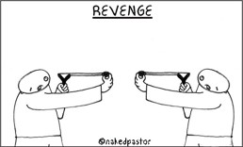
Irrational Thinking
Just as a person who is inebriated with alcohol suffers from dulled senses and slowed reactions, so also does a person whose intense anger produces an emotional intoxication and hence irrational thinking and actions.
Because anger and contention are of the devil, the clear thinking that comes from the guidance of the Spirit disappears where these prevail. Compassion and consideration for others is swallowed up by selfishness and self-indulgence.
Anger and vengeance can lead us to make choices that hurt ourselves and others.
Ether 15:22 JFM and RLM

Slide 18
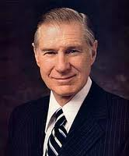
If we reject the Lord’s warnings to repent, His Spirit will withdraw and Satan will gain power over our hearts.
“We need not become paralyzed with fear of Satan’s power. He can have no power over us unless we permit it. He is really a coward, and if we stand firm, he will retreat. …
“We have heard comedians and others justify or explain their misdeeds by saying, ‘The devil made me do it.’ I do not really think the devil can make us do anything. Certainly he can tempt and he can deceive, but he has no authority over us which we do not give him.
“The power to resist Satan may be stronger than we realize. The Prophet Joseph Smith taught: ‘All beings who have bodies have power over those who have not. The devil has no power over us only as we permit him. The moment we revolt at anything which comes from God, the devil takes power.’
James E. Faust
While the devil has great power to tempt and deceive us, he cannot overpower our agency unless WE yield to his influence.

Slide 19
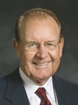
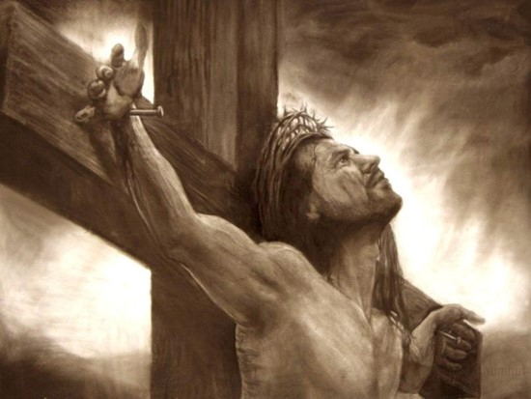
“When someone has hurt us or those we care about, that pain can almost be overwhelming. It can feel as if the pain or the injustice is the most important thing in the world and that we have no choice but to seek vengeance. But Christ, the Prince of Peace, teaches us a better way.”
It can be very difficult to forgive someone the harm they’ve done us, but when we do, we open ourselves up to a better future. No longer does someone else’s wrongdoing control our course.
When we forgive others, it frees us to choose how we will live our own lives. Forgiveness means that problems of the past no longer dictate our destinies, and we can focus on the future with God’s love in our hearts.”
Elder David E. Sorensen
Ether 15:22

Slide 20
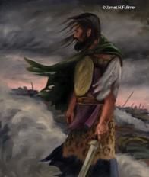
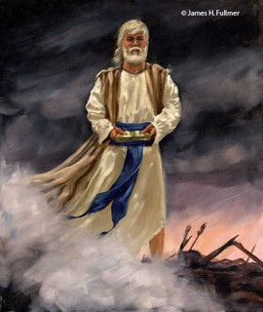
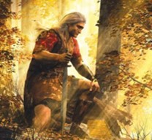
The Lone Survivors
Coriantumr did not die of his wounds but was left to see the full destruction of the Jaredite nation
James H. Fullmer
Ether was commanded by the Lord to complete the records and hide them so the records could be found in the future.
Ether’s fate is not known
James H. Fullmer
Moroni only recorded a hundredth part of Ether’s account
Ether 15:32-34

Slide 21
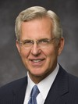
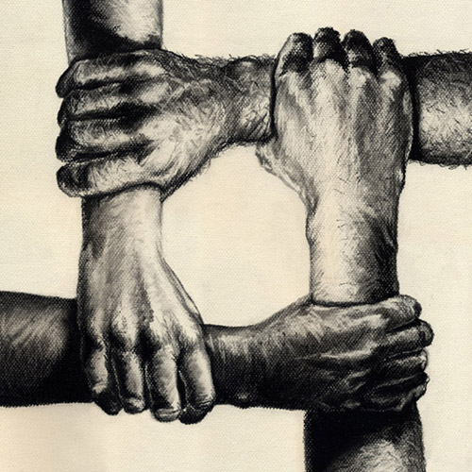
Zion is Zion
“Zion is Zion because of the character, attributes, and faithfulness of her citizens. Remember, ‘the Lord called his people Zion, because they were of one heart and one mind, and dwelt in righteousness; and there was no poor among them’
If we would establish Zion in our homes, branches, wards, and stakes, we must rise to this standard.
It will be necessary:
(1) to become unified in one heart and one mind;
(2) to become, individually and collectively, a holy people; and
(3) to care for the poor and needy with such effectiveness that we eliminate poverty among us.”
D. Todd Christofferson
Ether 15:32-34; Moses 7:18

Slide 22
Sources:
Joseph Fielding McConkie and Robert L. Millet Doctrinal Commentary on the Book of Mormon Vol. 4 pg. 307, 316-317
Bruce R. McConkie Millennial Messiah pg. 302-309
Doctrinal New Testament Commentary 3:580
The Book of Mormon Who’s Who by Ed J. Pinegar and Richard J. Allen pg. 42-43, 169, 173-74
(Teachings of the Prophet Joseph Smith, sel. Joseph Fielding Smith, Salt Lake City: Deseret Book Co., 1938, p. 181)” James E. Faust (“The Great Imitator,” Ensign, Nov. 1987, 35).
David E. Sorensen (“Forgiveness Will Change Bitterness to Love,” Ensign or Liahona, May 2003, 12).
D. Todd Christofferson, “Come to Zion,” Ensign or Liahona, Nov. 2008, 38).
Presentation by ©http://fashionsbylynda.com/blog/

Slide 23
President Joseph Fielding Smith has written the following about the New Jerusalem.
"The prevailing notion in the world is that this [the New Jerusalem] is the city of Jerusalem, the ancient city of the Jews which in the day of regeneration will be renewed, but this is not the case. We read in the Book of Ether that the Lord revealed to him many of the same things which were seen by John. Ether, as members of the Church will know, was the last of the prophets among the Jaredites, and the Lord had revealed to him much concerning the history of the Jews and their city of Jerusalem which stood in the days of the ministry of our Savior. In his vision in many respects similar to that given to John, ' Enoch saw the old city of Jerusalem and also the new city which has not yet been built, and he wrote of them as follows: [Ether 13:2-11 is then cited.]
"In the day of regeneration, when all things are made new, there will be three great cities that will be holy. One will be the Jerusalem of old which shall be rebuilt according to the prophecy of Ezekiel. One will be the city of Zion, or of Enoch, which was taken from the earth when Enoch was translated and which will be restored; and the city Zion, or New Jerusalem, which is to be built by the seed of Joseph on this the American continent. [He then cites Moses 7:62-64.]
" After the close of the millennia I reign we are informed that Satan, who was bound during the millennium, shall be loosed and go forth to deceive the nations. Then will come the end. The earth will die and be purified and receive its resurrection. During this cleansing period the City Zion, or New Jerusalem, will be taken from the earth; and when the earth is prepared for the celestial glory., the city will come down according to the prediction m the Book of Revelation." (Answers to Gospel Questions, 2:103-6.)
“To envision what is meant by [New Jerusalem], we must know these five facts:
“1. Ancient Jerusalem, the city of much of our Lord’s personal ministry among men, shall be rebuilt in the last days and become one of the two great world capitals, a millennial city from which the word of the Lord shall go forth.
“2. A New Jerusalem, a new Zion, a city of God shall be built on the American continent.
“3. Enoch’s city, the original Zion, ‘the City of Holiness, … was taken up into heaven.’ (Moses 7:13–21.)
“4. Enoch’s city, with its translated inhabitants now in their resurrected state, shall return, as a New Jerusalem, to join with the city of the same name which has been built upon the American continent.
“5. When this earth becomes a celestial sphere ‘that great city, the holy Jerusalem,’ shall again descend ‘out of heaven from God,’ as this earth becomes the abode of celestial beings forever. (Rev. 21:10–27.)” (Bruce R. McConkie, Doctrinal New Testament Commentary [1973], 3:580–81).
President Marion G. Romney, speaking of the tragic cycle of the Nephites and Jaredites, testified:
“We today are approaching the close of a similar cycle. We have been warned that we are ripening in iniquity and that we will be destroyed if we do not repent.
“Now my beloved brothers and sisters, I realize that these predictions are not pleasing, but nevertheless they speak the truth. They are the words of the true and living God, who said:
“…I tell you these things, even as I also told the people of the destruction of Jerusalem; and my word shall be verified at this time as it hath hitherto been verified.”
(D&C 5:20) (The Tragic Cycle,” pp.15-16)
Student Manual Religion 121-122 pg. 499-501
Where Zion is to Be Built:
“Let Israel gather to the stakes of Zion in all nations. Let every land be a Zion to those appointed to dwell there. Let the fulness of the gospel be for all the saints in all nations. Let no blessing be denied them. Let temples arise wherein the fulness of the ordinances of the Lord’s house may be administered. But still there is a center place, a place where the chief temple shall stand, a place to which the Lord shall come. … And that center place is what men now call Independence in Jackson County, Missouri, but which in a day to come will be the Zion of our God and the City of Holiness of his people” (Bruce R. McConkie, A New Witness for the Articles of Faith [1985], 595).

Slide 24
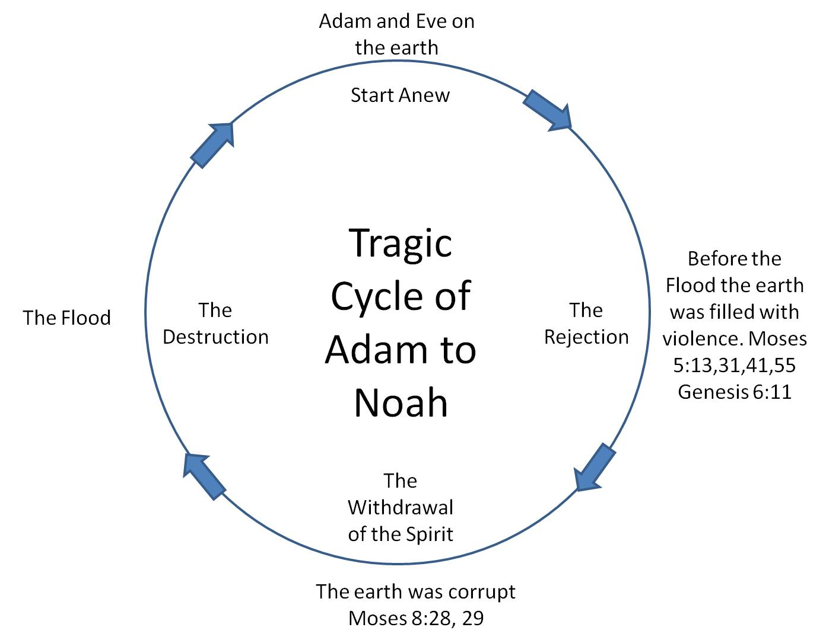
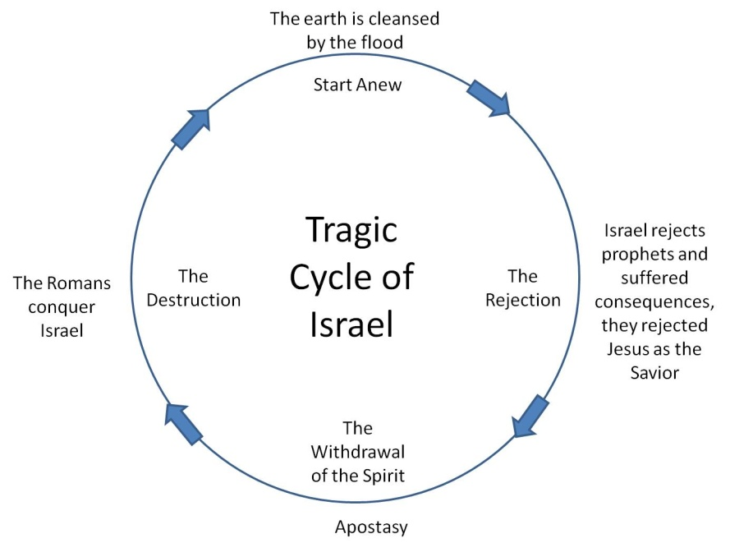
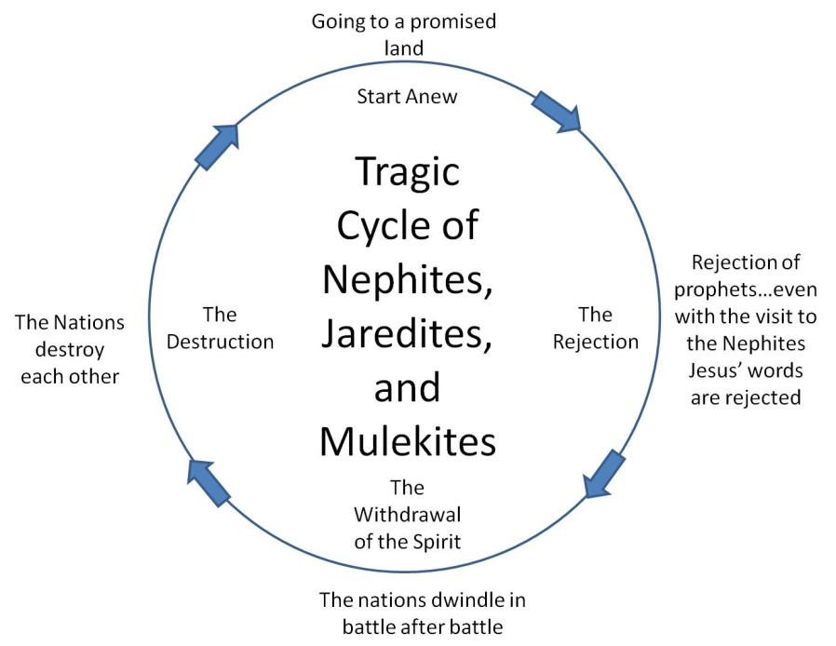
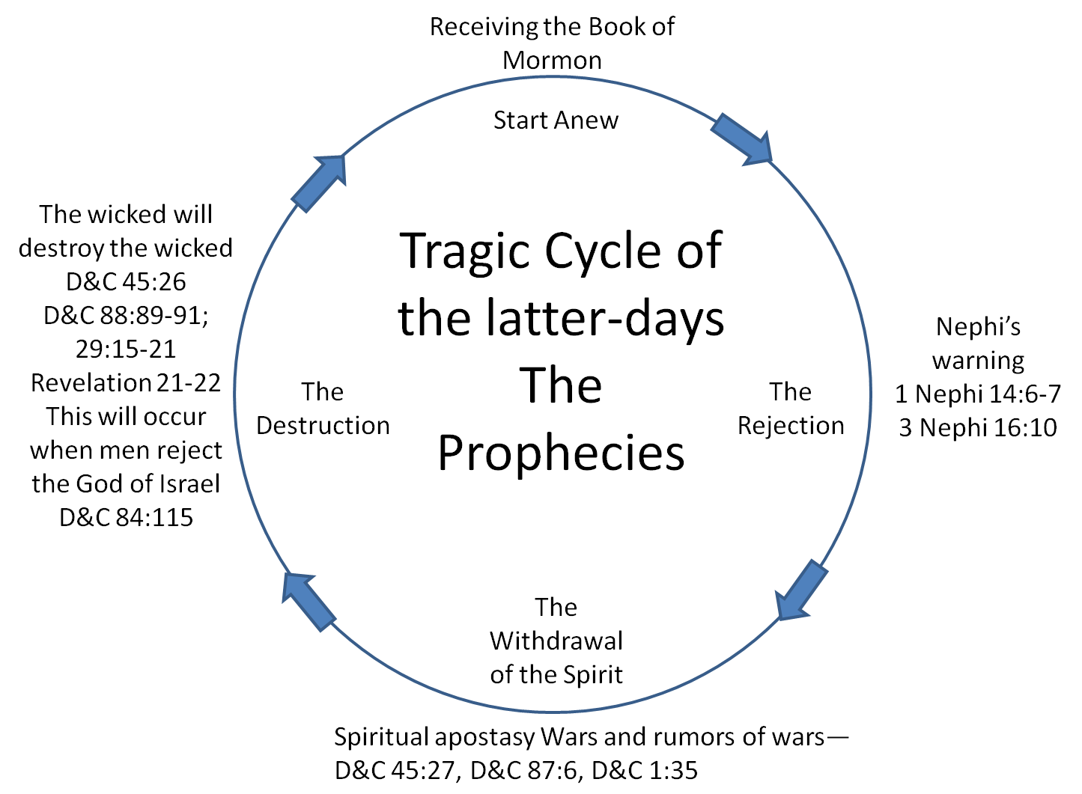
Tragic Cycles of our Earth

