Slide 2
The Book of Moroni
Moroni wrote:
Words of his own
The words of Jesus Christ to His twelve Nephite disciples
Words of his father, Mormon
The Book of Moroni
The Book was written about AD 401 to AD 421
Moroni did not say where he was when he wrote it—only that he wandered wherever he could for the safety of his life
(see Moroni 1:1–3).

Slide 3
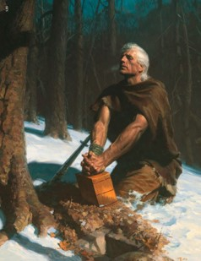
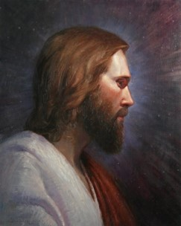
Moroni
Before the Nephites were destroyed, Moroni served among them as a military leader and a Church leader
Moroni was a witness of the Savior.
He testified, “I have seen Jesus, and … he hath talked with me face to face”
(Ether 12:39).
Moroni was faithful to his testimony, refusing to deny Christ during a time when the Lamanites were killing every Nephite who would not deny Him
(see Moroni 1:1–3).

Slide 4
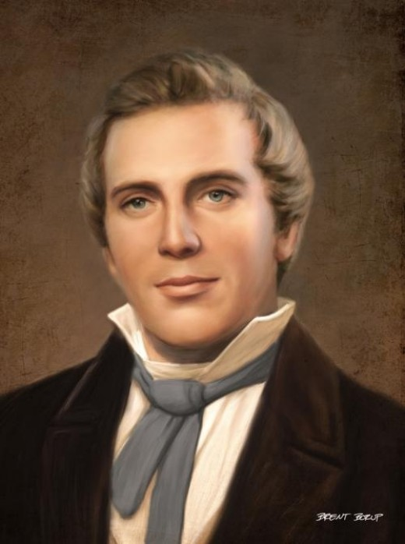
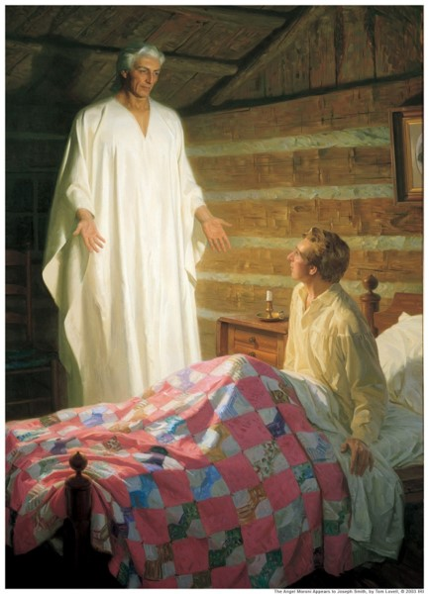
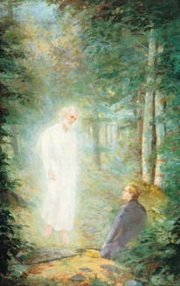
1,400 Years Later
In 1823, approximately 1,400 years after completing the record of the Book of Mormon, Moroni appeared to the Prophet Joseph Smith as a resurrected being and informed Joseph that the record was deposited in a hill near his home
(Joseph Smith—History 1:29–35).
At that time and periodically during the next four years, Moroni instructed Joseph Smith “respecting what the Lord was going to do, and how and in what manner his kingdom was to be conducted in the last days”
(Joseph Smith—History 1:54).

Slide 5
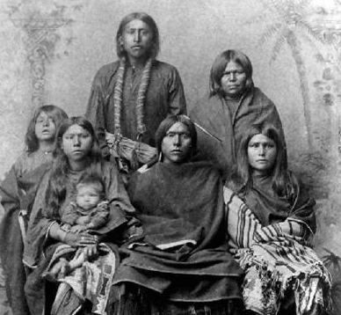
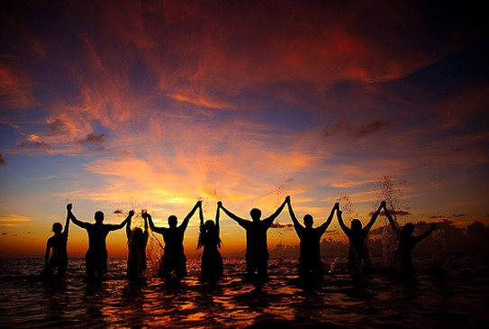
To Whom is the Book For?
Moroni stated, “I write a few more things, that perhaps they may be of worth unto my brethren, the Lamanites, in some future day.”
He also declared that he spoke “unto all the ends of the earth,” warning that at the judgment bar of God, all would be held accountable for the words he had written.
In preparation for this event, Moroni invited all to “Come unto Christ.”

Slide 6
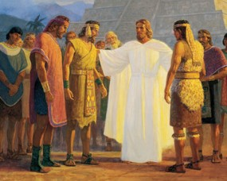
Moroni’s Teachings Include:
Details concerning Jesus Christ’s instructions to His twelve Nephite disciples as He gave them power to confer the gift of the Holy Ghost.
The only instructions in the Book of Mormon regarding the performance of priesthood ordinations and the prayers used in the ordinance of the sacrament.
Mormon’s teachings on discerning good from evil, the ministering of angels, charity as the pure love of Christ, and the salvation of little children.
Mormon’s description of the depravity of the Nephites and Lamanites before their final battle at Cumorah.
Moroni’s own teachings on gifts of the Spirit.

Slide 7
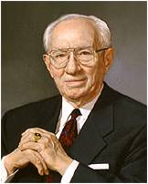
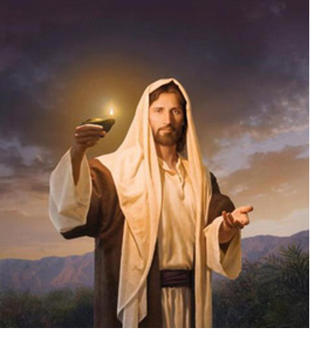
The Key Contribution
An invitation to “Come Unto Christ”
“The Book of Mormon is the only book that contains within its covers a promise that by divine power the reader may know with certainty of its truth”
President Gordon B. Hinckley

Slide 8
Standing Up, Standing Out
“My teacher was in the front of the class, talking about a snippet of a movie we were about to watch. … My teacher … nonchalantly explained that … the movie had a mature rating. I was stunned. … I never thought this would happen.
We can choose to stand as a witness of Jesus Christ, especially in difficult circumstances
“I sat in my chair, thinking about what I should do. A thought kept coming into my head: We have been asked not to watch offensive movies. I tried to rationalize that because I was in school, the part of the movie we were going to watch would be appropriate. But the thought of not watching offensive movies trumped my rationalizations.

Slide 9
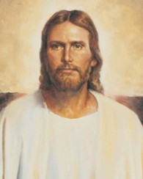
“I calmly raised my hand, and in front of my whole class, I asked to sit outside of class while the movie played. I felt everyone’s eyes on me as I pushed in my chair and grabbed my book. I saw the looks on their faces; they simply didn’t understand.
“While sitting in the hallway, I felt very happy. I knew I had done the right thing, no matter what my peers or teacher said. I felt stronger too. I knew I didn’t have to watch an inappropriate movie clip just because my teacher had presented it to us.
“… I believe that when we are faced with moments of adversity and we stand up to them, we are made stronger than if we had sat down and let them happen.
“This is an inner strength that is found through our Savior. If we look to Him in our times of difficulty, we will be made strong. Our faith in Him can help us face adversity”
Catherine Hall

Slide 10
Moroni Stands Alone
Wandering For Safety
Perhaps they (the records) will be of worth unto my brethren
After Moroni finished the history of the Jaredite people he added a few more words for the Lamanites in the last days
Revelation through Urim and Thummim:
“And for this very purpose are these plates preserved, which contain these records—that the promises of the Lord might be fulfilled, which he made to his people;
And that the Lamanites might come to the knowledge of their fathers, and that they might know the promises of the Lord, and that they may believe the gospel and rely upon the merits of Jesus Christ, and be glorified through faith in his name, and that through their repentance they might be saved. Amen.”
D&C 3:19-20
Moroni 1:1-4

Slide 11
Prophets Speak to the Future
About Joseph Smith:
“And his name shall be called after me; and it shall be after the name of his father. And he shall be like unto me; for the thing, which the Lord shall bring forth by his hand, by the power of the Lord shall bring my people unto salvation.”
2 Nephi 3:15
Alma to his son Helaman:
“And now behold, one purpose hath he fulfilled, even to the restoration of many thousands of the Lamanites to the knowledge of the truth; and he hath shown forth his power in them, and he will also still show forth his power in them unto future generations; therefore they shall be preserved.”
Alma 37:19
Mormon to the Lamanite future:
“And ye will also know that ye are a remnant of the seed of Jacob; therefore ye are numbered among the people of the first covenant; and if it so be that ye believe in Christ, and are baptized, first with water, then with fire and with the Holy Ghost, following the example of our Savior, according to that which he hath commanded us, it shall be well with you in the day of judgment. Amen.”
Mormon 7:10
Ether to the Jaredites:
“And it is by faith that my fathers have obtained the promise that these things should come unto their brethren through the Gentiles; therefore the Lord hath commanded me, yea, even Jesus Christ.”
Ether 12:22

Slide 12
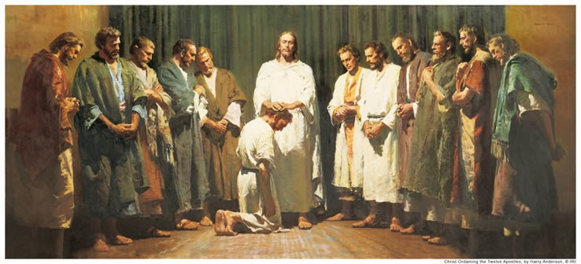
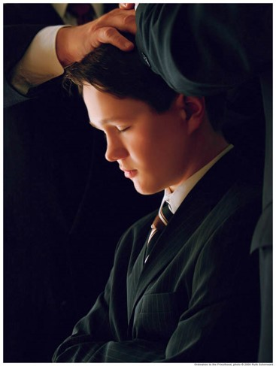
Preparing for an Ordinance
What might you do to prepare to perform this ordinance?
Jesus to his disciples:
“And when he had said this, he breathed on them, and saith unto them, Receive ye the Holy Ghost:”
John 20:22
“And the multitude heard not the words which he spake, therefore they did not bear record; but the disciples bare record that he gave them power to give the Holy Ghost. And I will show unto you hereafter that this record is true.”
3 Nephi 18:37
Moroni 2

Slide 13
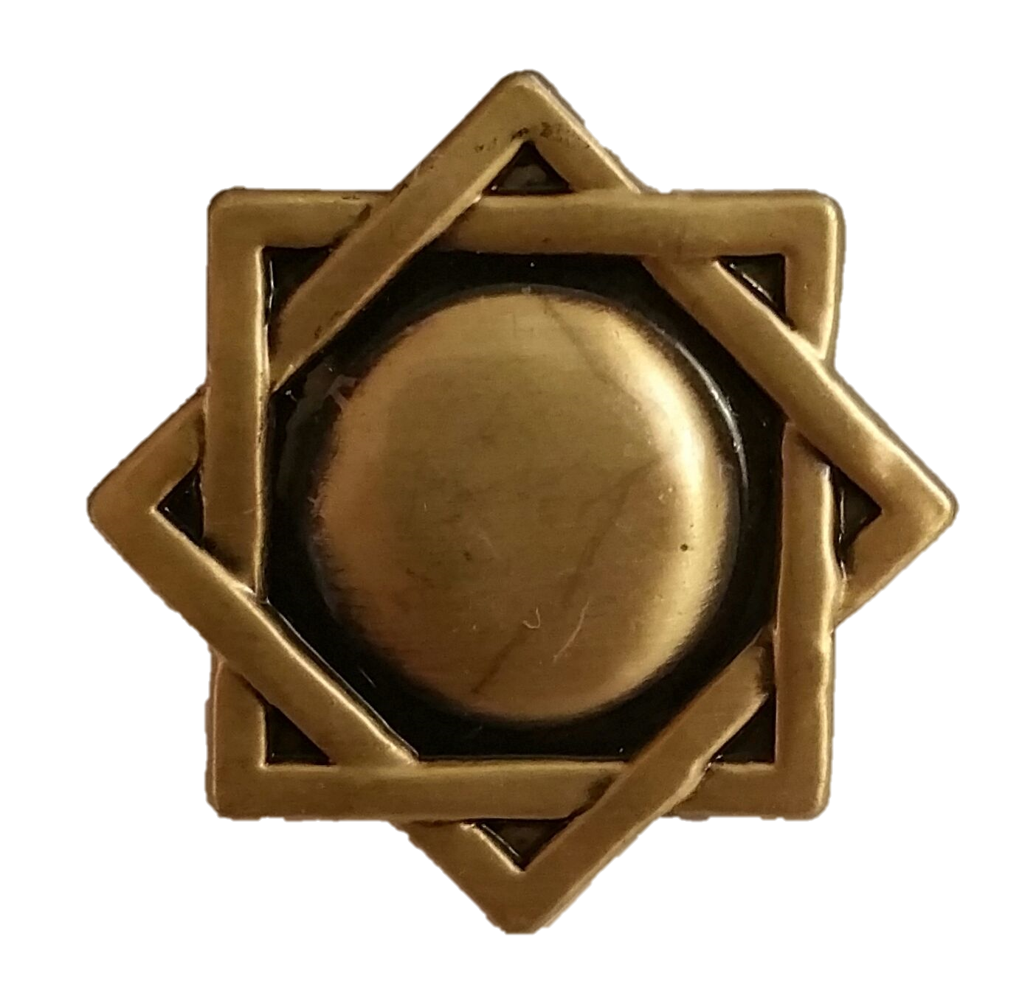
The Priesthood
What Priesthood do you need to hold to perform these ordinances?
Brethren who perform ordinances and blessings should prepare themselves by living worthily and striving to be guided by the Holy Spirit. They should perform each ordinance or blessing in a dignified manner, making sure it meets the following requirements:
1. It should be performed in the name of Jesus Christ.
2. It should be performed by the authority of the priesthood.
3. It should be performed with any necessary procedures, such as using specified words or using consecrated oil.
4. It should be authorized by the presiding authority who holds the proper keys (normally the bishop or stake president), if necessary according to the instructions in this chapter.
Handbook
The Melchizedek Priesthood
Moroni 2

Slide 14
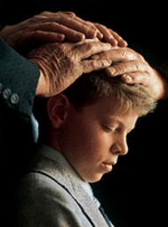
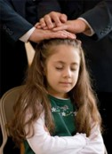
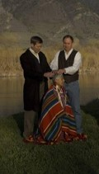
The Confirmation
Under the direction of the bishopric, one or more Melchizedek Priesthood holders may participate in a confirmation. They place their hands lightly on the person’s head. Then the person who performs the ordinance:
1. States the person’s full name.
2. States that the ordinance is performed by the authority of the Melchizedek Priesthood.
3. Confirms the person a member of The Church of Jesus Christ of Latter-day Saints.
4. Uses the words “Receive the Holy Ghost” (not “receive the gift of the Holy Ghost”).
5. Gives words of blessing as the Spirit directs.
6. Closes in the name of Jesus Christ.
Handbook
Moroni 2

Slide 15
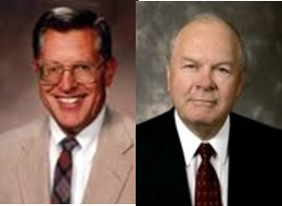
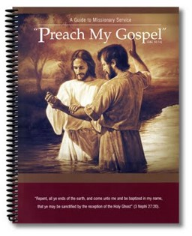
Priesthood Service
“The mission of the Church and the ministry of all priesthood representatives is to proclaim the gospel, to testify of the atoning sacrifice of Jesus Christ .”
“Yea, verily, verily, I say unto you, that the field is white already to harvest; wherefore, thrust in your sickles, and reap with all your might, mind, and strength.”
D&C:33:7
“Yea, open your mouths and spare not, and you shall be laden with sheaves upon your backs, for lo, I am with you.”
D&C 33:9
“All principles of the gospel and all priesthood ordinances are intended to lead men unto Christ. It is through him that all principles and ordinances of the gospel have any enduring efficacy.”
Moroni 3 JFM and RLM

Slide 16
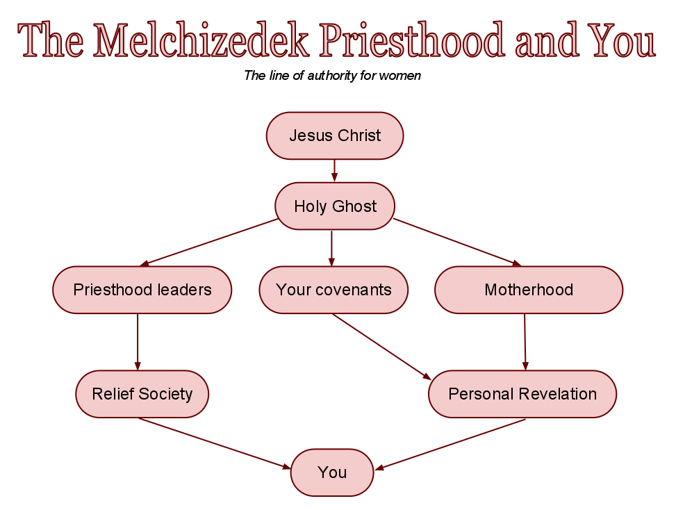
Divine Authority
“Acting with divine authority requires more than mere social contract. It cannot be generated by theological training or a commission from the congregation. No, in the authorized work of God there has to be power greater than that already possessed by the people in the pews or in the streets or in the seminaries—a fact that many honest religious seekers had known and openly acknowledged for generations leading up to the Restoration. …
“… We in the restored Church of Jesus Christ can trace the priesthood line of authority exercised by the newest deacon in the ward, the bishop who presides over him, and the prophet who presides over all of us. That line goes back in an unbroken chain to angelic ministers who came from the Son of God Himself, bearing this incomparable gift from heaven”
Elder Jeffrey R. Holland

Slide 17
Priesthood Duties
Read D&C 20:38-84
Duties of a Deacon
1. Pass the sacrament.
2. Watch over the Church.
3. Warn, expound, exhort, and teach, and invite all to come unto Christ.
4. Assist the bishop with temporal things.
5. Fellowship quorum members and other young men.
Duties of a Teacher:
Worthy brethren may be ordained teachers when they are at least 14 years old. A teacher has all the responsibilities
of a deacon. He also has additional responsibilities.
“The teacher’s duty is to watch over the church always, and be with and strengthen them;” D&C 53
Duties of a Priest
1. Teach the gospel.
2. Baptize.
3. Administer the sacrament.
4. Visit the members.
5. Ordain others to the Aaronic Priesthood.
6. Assist in missionary work.
Other Duties of All:
Set a Proper Example
Be a Good Home Teacher
Greet the Members at Church
Prepare the Sacrament
Help at Home
Be a Peacemaker
Lesson Manual--Priesthood

Slide 18
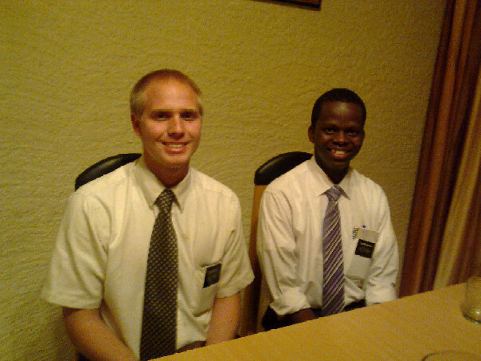
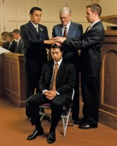
Priesthood Duties
Read D&C 20:38-84
Elder and High Priest:
When we are given the Melchizedek Priesthood, we are given the power to bless the spiritual lives of others.
The Melchizedek Priesthood “administereth the gospel and holdeth the key … of the knowledge of God. Therefore, in the ordinances thereof, the power of godliness is manifest” (see D&C 84:19–21).
Through the power of the Melchizedek Priesthood, we can consecrate oil, bless the sick, confer the priesthood and the gift of the Holy Ghost, ordain others to priesthood offices, dedicate graves, give blessings of comfort, bestow father’s blessings on our children, and participate in the higher temple ordinances.
Melchizedek Priesthood holders bestow the gift of the Holy Ghost on baptized Church members by the laying on of hands.
Lesson Manual--Priesthood

Slide 19
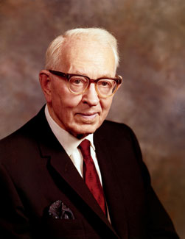
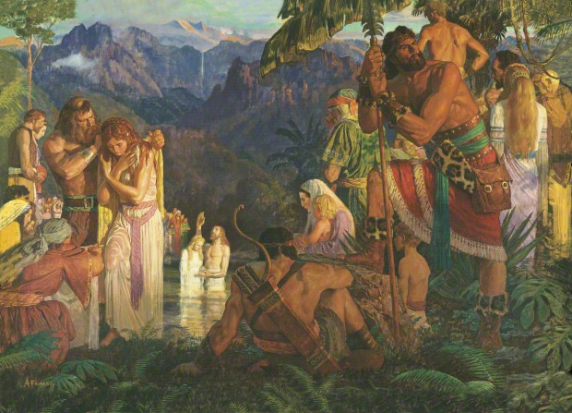
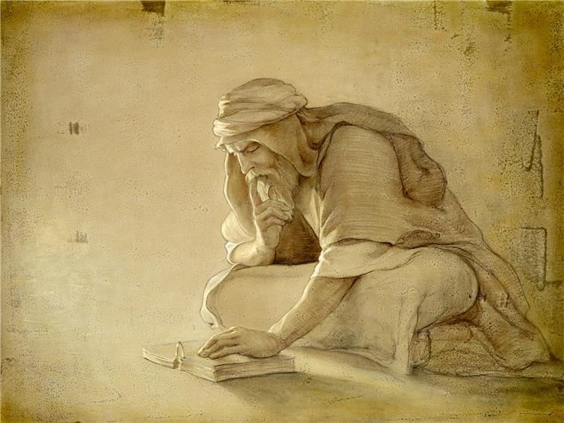
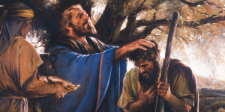
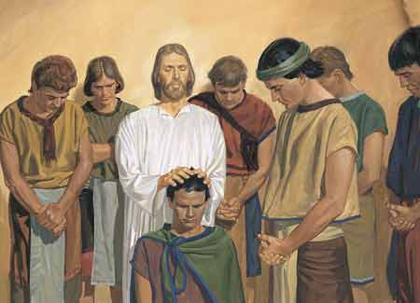
Priesthood Holders Among the Descendants of Levi
“The Nephites were descendants of Joseph. Lehi discovered this when reading the brass plates. … There were no Levites who accompanied Lehi to the Western Hemisphere.
Under these conditions the Nephites officiated by virtue of the Melchizedek Priesthood from the days of Lehi to the days of the appearance of our Savior among them. …
“When the Savior came to the Nephites, he established the Church in its fulness among them. …
Therefore we are justified in the belief that not only was the fulness of the Melchizedek Priesthood conferred, but also the Aaronic, just as we have it in the Church today; and this Aaronic Priesthood remained with them from this time until, through wickedness, all priesthood ceased.
We may be assured that in the days of Moroni the Nephites did ordain teachers and priests in the Aaronic Priesthood; but before the visit of the Savior they officiated in the Melchizedek Priesthood.”
President Joseph Fielding Smith

Slide 20
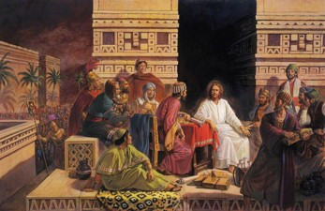
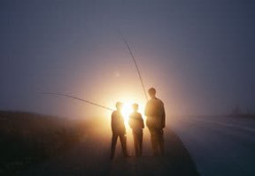
Did the 12 Nephite Disciples Serve as Apostles?
“This book [the Book of Mormon] also tells us that our Savior made His appearance upon this continent after His resurrection; … that they had Apostles, Prophets, Pastors, Teachers, and Evangelists; the same order, the same priesthood, the same ordinances, gifts, powers, and blessings, as were enjoyed on the eastern continent”
Prophet Joseph Smith
“While in every instance the Nephite Twelve are spoken of as disciples, the fact remains that they had been endowed with divine authority to be special witnesses for Christ among their own people. Therefore, they were virtually apostles to the Nephite race”
President Joseph Fielding Smith
Moroni 2:1

Slide 21
Sources:
Video: Blessings of the Priesthood
President Gordon B. Hinckley (“A Testimony Vibrant and True,” Ensign, Aug. 2005, 4).
(Catherine Hall, “Standing Up, Standing Out,” New Era, Feb. 2012, 11).
Handbook 2 Administering the Church 20.1, 20.3.10
Joseph Fielding McConkie and Robert L. Millet Doctrinal Commentary on the Book of Mormon Vol. 4 pg. 323
Elder Jeffrey R. Holland (“Our Most Distinguishing Feature,” Ensign or Liahona, May 2005, 44).
Duties and Blessings of the Priesthood: Basic Manual for Priesthood Holders, Part A Lessons 5,6,7, and 9
President Joseph Fielding Smith (Answers to Gospel Questions, comp. Joseph Fielding Smith Jr., 5 vols. [1957–66], 1:124, 126
Prophet Joseph Smith(History of the Church, 4:538).
President Joseph Fielding Smith (Doctrines of Salvation, comp. Bruce R. McConkie, 3 vols. [1954–56], 3:158).
Presentation by ©http://fashionsbylynda.com/blog/

