Slide 2
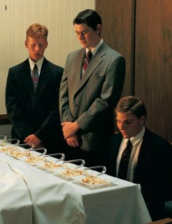
The Ordinance of the Sacrament
“O God, the Eternal Father,
we ask thee in the name of thy Son, Jesus Christ,
to bless and sanctify this bread to the souls of all those who partake of it;
that they may eat in remembrance of the body of thy Son, and witness unto thee, O God, the Eternal Father,
that they are willing to take upon them the name of thy Son, and always remember him,
and keep his commandments which he hath given them,
that they may always have his Spirit to be with them. Amen.
Moroni 4:3

Slide 3
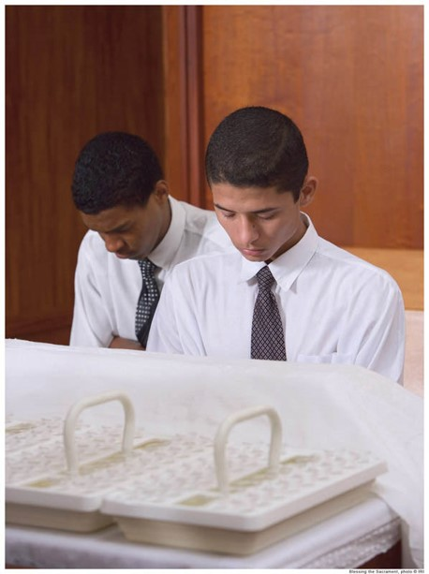
The Ordinance of the Sacrament
O God, the Eternal Father,
we ask thee, in the name of thy Son, Jesus Christ,
to bless and sanctify this wine to the souls of all those who drink of it,
that they may do it in remembrance of the blood of thy Son, which was shed for them;
that they may witness unto thee, O God, the Eternal Father,
that they do always remember him,
that they may have his Spirit to be with them. Amen.
Moroni 5:2

Slide 4
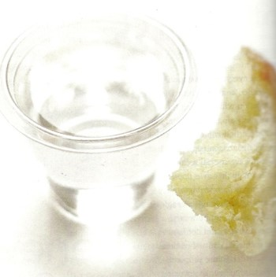
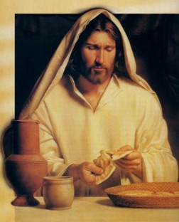
Eternal Atonement
“Emblems of the Sacrament are symbols of the sacrifice of the Savior’s flesh and body that were broken and his blood that was spilt in the course of the infinite and eternal Atonement.”
JFM and RLM
¶And as they did eat, Jesus took bread, and blessed, and brake it, and gave to them, and said, Take, eat: this is my body.
And he took the cup, and when he had given thanks, he gave it to them: and they all drank of it.
And he said unto them, This is my blood of the new testament, which is shed for many.
Mark 14:22-24
The emblems of the sacrament help us remember the Savior Jesus Christ and His atoning sacrifice
Moroni 4:3

Slide 5
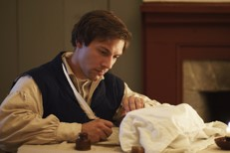
Changing Wine to Water
The Church uses water for wine in the blessing as given to Joseph Smith in revelation:
“For, behold, I say unto you, that it mattereth not what ye shall eat or what ye shall drink when ye partake of the sacrament, if it so be that ye do it with an eye single to my glory—remembering unto the Father my body which was laid down for you, and my blood which was shed for the remission of your sins.”
D&C 27:2

Slide 6
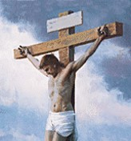
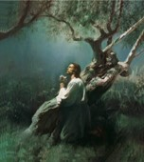
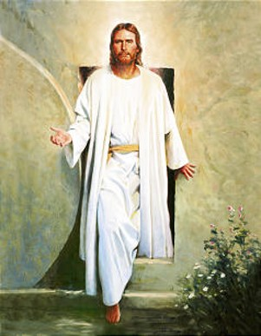
Explaining the Sacrament to Others
If a friend of another faith decided to attend sacrament meeting with you, how would you explain the meaning of the sacrament and its importance to you?
Bread--- Jesus Christ’s Body
Water (Wine)---Jesus Christ’s Blood
Symbolic of:
The Savior’s physical suffering and death on the cross
His Resurrection, when His body was reunited with His spirit
three days after He took death upon Himself.
His intense spiritual suffering and anguish when He took our
sins upon Himself, causing Him to bleed from every pore.
Because He took physical death upon Himself, all people will be
resurrected.
Because He suffered for our sins, we can be forgiven of our sins when we repent.

Slide 7
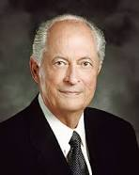
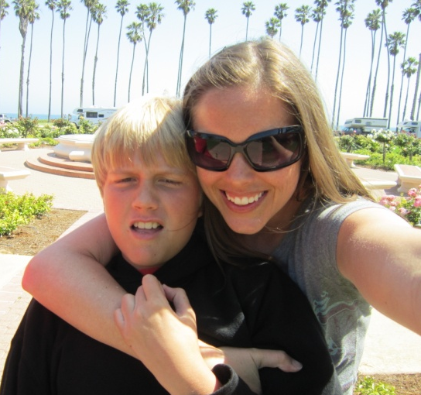
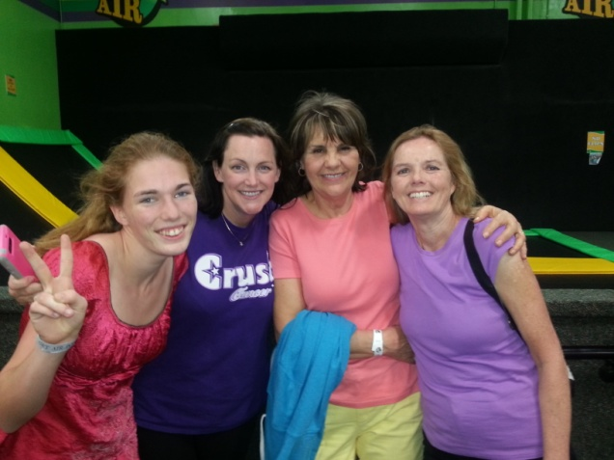
How We Conduct Our Lives
“How we treat our family members, our neighbors, business associates, (people at school), and all we meet will reveal if we have taken His name upon us and do always remember Him. How we conduct our lives, all we do and all we say, reflects on how we remember Him”
Robert D. Hales
Moroni 4:3

Slide 8
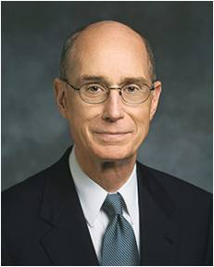
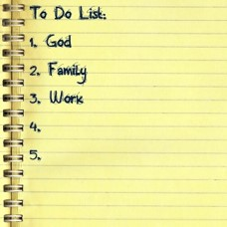
Covenants--Agreements and Promises
“We promise to take His name upon us.
That means we must see ourselves as His.
We will put Him first in our lives.
We will want what He wants rather than what we want or what the world teaches us to want”
Henry B. Eyring
As we partake of the sacrament, we promise to be willing to take upon ourselves the Lord’s name, always remember Him, and keep His commandments.

Slide 9
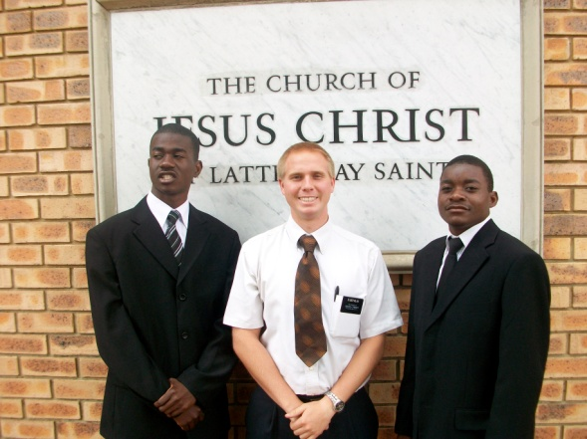
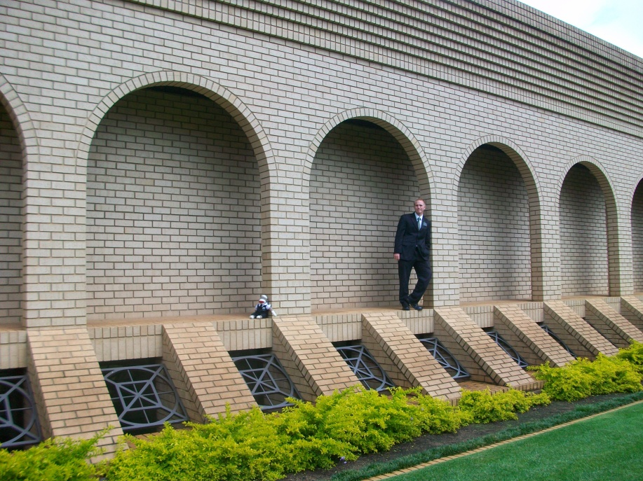
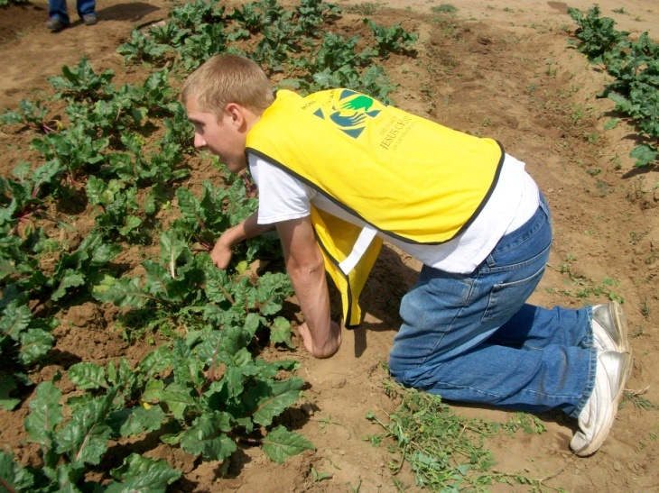
Witness---Promises
When we witness our willingness to take upon ourselves the name of Jesus Christ, we commit to live as His disciples.
We promise that we will not bring shame or reproach upon His name.
We commit to serve Him and our fellowman.
We also show that we are willing to be identified with Him and His Church.
As we faithfully keep the covenant we make during the sacrament, we can always have the Lord’s Spirit to be with us.

Slide 10
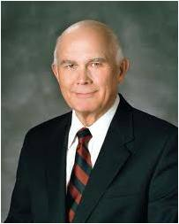
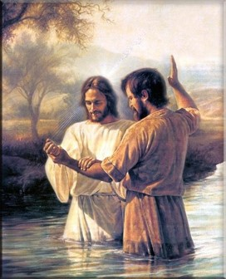
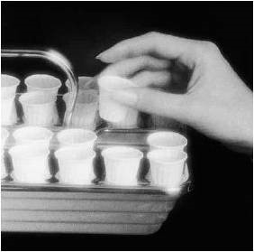
Renewing the Effects of Baptism
“The renewal of our covenants by partaking of the sacrament should also be preceded by repentance, so we come to that sacred ordinance with a broken heart and a contrite spirit…Then, as we renew our baptismal covenants and affirm that we will “always remember him’ the Lord will renew the promised remission of our sins, under the conditions and at the time he chooses…”
Dallin H. Oaks

Slide 11
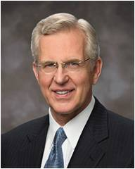
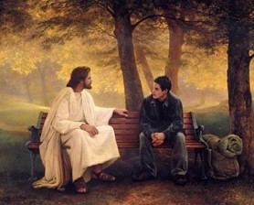
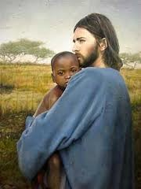
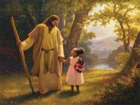
Always Remember Him—Not Just Sundays
“We should first put in place the things that make it possible to always remember Him—frequent prayer and scripture study, thoughtful study of apostolic teachings, weekly preparation to partake of the sacrament worthily, Sunday worship, and recording and remembering what the Spirit and experience teach us about discipleship.
“Other things may come to your mind particularly suited to you at this point in your life. …
“… I can attest that over time our desire and capacity to always remember and follow the Savior will grow. We should patiently work toward that end and pray always for the discernment and divine help we need”
Elder D. Todd Christofferson

Slide 12
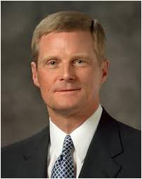
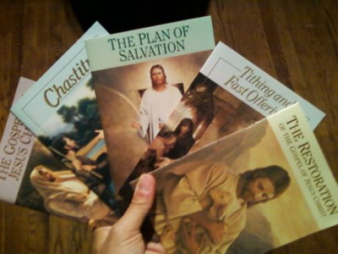
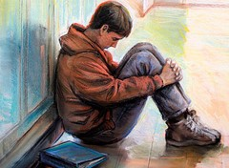
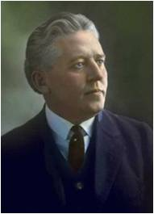
That They May Have His Spirit
To Be With Them
“The Spirit of the Lord can be our guide and will bless us with direction, instruction, and spiritual protection during our mortal journey”
Elder David A. Bednar
“If we have done wrong; if there is a feeling in our souls that we would like to be forgiven then the method to obtain forgiveness is not through rebaptism; it is not to make confession to man; but it is to repent of our sins, to go to those against whom we have sinned or transgressed and obtain their forgiveness, and then repair to the sacrament table where, if we have sincerely repented and put ourselves in proper condition, we shall be forgiven , and spiritual healing will come to our souls. It will really enter into our being.”
Elder Melvin J. Ballard

Slide 13
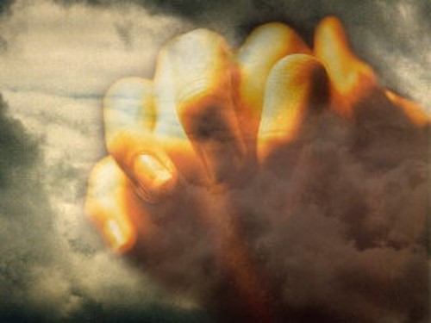
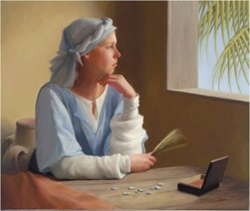
Spiritual Healing
”And ye are called to do this by prayer and thanksgiving, as the Spirit shall give utterance in all your doings in the house of the Lord, in the school of the prophets, that it may become a sanctuary, a tabernacle of the Holy Spirit to your edification.”
D&C 88:137
Nothing is so bitter as to lose the privilege of partaking of the sacrament.
However---through repentance:
Nothing is so sweet as the partaking of the sacrament and experiencing the Holy Spirit and the renewed promise of our Heavenly Father.
Alma 36:21

Slide 14
True To Our Covenants
The Spirit helps us to:
Speak with the power
Brings things to our remembrance
Gives us Peace and Joy
Opens up revelations to our minds
Shows us all things that we should do
Strengthens body, mind and spirit
Comforts us in times of sorrow
Unfolds to us the mysteries of the kingdom
Brings us many other spiritual blessing
D&C 88:137
John 14:26
Galatians 5:22
John 14:26; Moroni 10:5
Alma 5:46
2 Nephi 32:5
Romans 8:26
Acts 9:31
1 Nephi 10:19

Slide 15
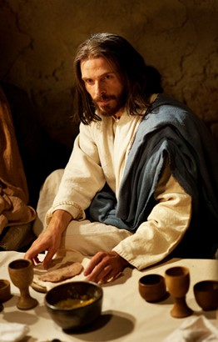
Checking Our Own Status with Our Covenants
When have you received guidance, direction, instruction, or protection because of the companionship of the Holy Ghost?
Each week during the sacrament, we have the opportunity to consider how well we are keeping the covenant described in the sacrament prayers. How can this help us in our efforts to always have the Spirit with us?
As you ponder what you have learned today about partaking of the sacrament, what part of the sacrament prayers is especially meaningful to you? Why?

Slide 16
Sources:
Video: Partake of the Sacrament (1:48)
Joseph Fielding Smith and Robert L. Millet Doctrinal Commentary on the Book of Mormon Vol. 4 pg. 125
Robert D. Hales Ensign May 1995
Henry B. Eyring (“That We May Be One,” Ensign, May 1998, 67).
Elder D. Todd Christofferson (“To Always Remember Him,” Ensign, Apr. 2011, 51).
Dallin H. Oaks Ensign Nov 1996
Elder David A. Bednar (“That We May Always Have His Spirit to Be with Us,” Ensign or Liahona, May 2006, 31).
Presentation by ©http://fashionsbylynda.com/blog/

Slide 17
WHAT I COVENANT TO DO | WHAT I THINK IT MEANS TO KEEP THIS PART OF MY COVENANT | WHAT I CAN DO TO KEEP THIS PART OF MY COVENANT
1. Be willing to take upon myself the Lord’s name
2. Always remember Him
3. Keep His commandments

Slide 18
“I have wondered how members of the Church can go to the sacrament service and partake of these emblems, and make these solemn covenants, and then immediately after the close of the meeting go out to some place of amusement, to attend a picture show, a baseball game, or some resort, …. When any of these things is done, the… person violates this sacred covenant so recently made or renewed….The fact remains, however, that when we indulge in habits of this kind we are covenant breakers…If a man fully realized what it means when he partakes of the sacrament, that he covenants to take upon him the name of Jesus Christ and to always remember him and keep his commandments, and this vow is renewed week by ...”
Joseph Fielding Smith Doctrines of Salvation 2:345-346
”One’s faithfulness to the covenants made in baptism and renewed with worthy partaking of the sacrament binds the renewed with worthy partaking of the sacrament binds the Lord to his part of the covenant agreement. He has promised that we may have the influence of the Holy Ghost as a constant companion.
The Holy Ghost is a sanctifier, as a result we are forgiven of our sins and cleansed by the Holy Spirit through worthy partaking of the sacrament.”
JFM and RLM Doctrinal Commentary on the Book of Mormon Vol 4 pg 237
“All of us face different family circumstances and home situations. All of us need strength in dealing with them. This strength come from faith in the Savior’s love and in the power of his atonement. If we trustingly put our hand in the Savior’s, we can claim the promise of the sacramental prayer to always have his Spirit with us. All problems are manageable with that strength, and all other problems are secondary in urgency to maintaining a strong spiritual life.”
Cheiko N. Okazaki Ensign Nov 1993

