Slide 2
Requirements For Baptism
A broken heart and a contrite spirit
A witness that they have truly repented
Taking upon His name and willing to serve Him to the end
Worthiness to be baptized:
They are to live in obedience to God’s commandments, showing that they are ready to make and keep the baptismal covenant
Through baptism, we covenant to take upon ourselves the name of Jesus Christ and serve Him to the end
Moroni 6:1-3

Slide 3
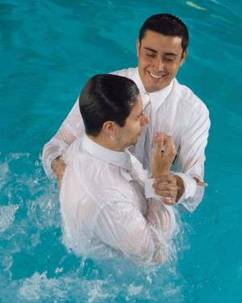
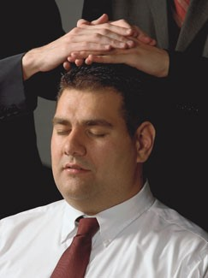
Waters of Baptism
“Sins are remitted not in the waters of baptism, as we say in speaking figuratively, but when we receive the Holy Ghost.
It is the Holy Spirit of God that erases carnality and brings us into a state of righteousness. We become clean when we actually receive the fellowship and companionship of the Holy Ghost.
It is then that sin and dross and evil are burned out of our souls as though by fire. The baptism of the Holy Ghost is the baptism of fire.”
Elder Bruce R. McConkie

Slide 4
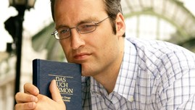
Responsibility
We have a responsibility to remember other members of the Church and to nourish them spiritually by the good word of God
We have a responsibility to help each other be continually watchful unto prayer
We have a responsibility to help each other rely on the Savior and His Atonement
Moroni 6:4

Slide 5
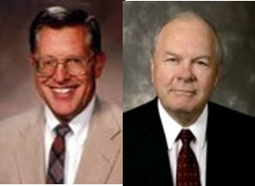
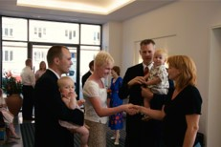
Care and Nourishment For Others
Spiritually Nourish
“…they were numbered among the people of the church of Christ; and their names were taken, that they might be remembered and nourished by the good word of God, to keep them in the right way, to keep them continually watchful unto prayer, relying alone upon the merits of Christ, who was the author and the finisher of their faith.”
Numbered—Might mean a record of the people baptized.
“Keeping a record of the members of the Church was not done for sake of reporting statistics or “boasting” in numbers but rather so that each member could be identified and remembered. ..Members are remembered in that priesthood leaders are kept aware of all those in their units in order that they can be spiritually Ministered to and encouraged to live the gospel…”
JFM and RLM
Moroni 6:4

Slide 6
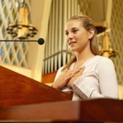
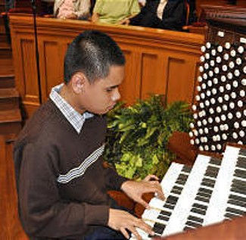
“It is not an easy thing to become a member of this Church. In most cases it involves setting aside old habits, leaving old friends and associations, and stepping into a new society which is different and somewhat demanding.
“With the ever-increasing number of converts, we must make an increasingly substantial effort to assist them as they find their way. Every one of them needs three things: a friend, a responsibility, and nurturing with ‘the good word of God’ (Moro. 6:4).

Slide 7
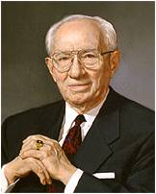
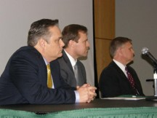
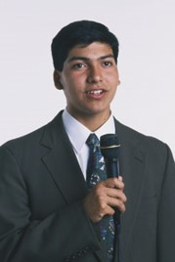
It is our duty and opportunity to provide these things. …
“This is a work for everyone. It is a work for home teachers and visiting teachers. It is a work for the bishopric, for the priesthood quorums, for the Relief Society, the young men and young women, even the Primary.
“I was in a fast and testimony meeting only last Sunday. A 15- or 16-year-old boy stood before the congregation and said that he had decided to be baptized.
“Then one by one boys of the teachers quorum stepped to the microphone to express their love for him, to tell him that he was doing the right thing, and to assure him that they would stand with him and help him. It was a wonderful experience to hear those young men speak words of appreciation and encouragement to their friend”
President Gordon B. Hinckley

Slide 8
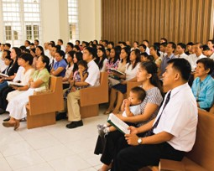
Our Responsibility
We have a responsibility to remember other members of the Church and to nourish them spiritually by the word of God. They may also say that we should help each other be continually watchful unto prayer and that we should help each other rely on the Savior and His Atonement.
“Most people don’t come to church looking merely for a few new gospel facts or to see old friends, though all of that is important. They come seeking a spiritual experience. They want peace. They want their faith fortified and their hope renewed. They want, in short, to be nourished by the good word of God, to be strengthened by the powers of heaven. Those of us who are called upon to speak or teach or lead have an obligation to help provide that, as best we possibly can”
Elder Jeffrey R. Holland
Moroni 6:4

Slide 9
The Purpose of Church Meetings
As Church members, we are to meet together often to fast and to pray
As Church member, we are to meet together often to strengthen each other spiritually
As Church members, we are to meet together often to partake of the sacrament in remembrance of Jesus Christ
Moroni 6:5-6

Slide 10
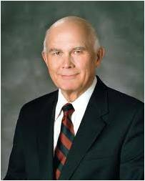
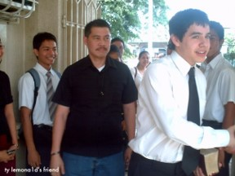
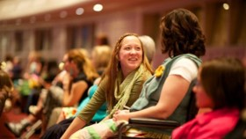
Joy in Attending Church
“Years ago, I changed my attitude about going to church. No longer do I go to church for my sake, but to think of others. I make a point of saying hello to people who sit alone, to welcome visitors, … to volunteer for an assignment. …
“In short, I go to church each week with the intent of being active, not passive, and making a positive difference in people’s lives. Consequently, my attendance at Church meetings is so much more enjoyable and fulfilling”
Elder Dallin H. Oaks

Slide 11
Do You or Could You?

Slide 12
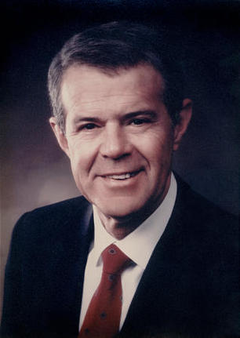
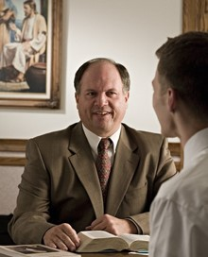
If Sin Occurs--Disobedience
“And they were strict to observe that there should be no iniquity among them; and whoso was found to commit iniquity, and three witnesses of the church did condemn them before the elders, and if they repented not, and confessed not, their names were blotted out, and they were not numbered among the people of Christ.”
“Church disciple…is not for the purpose of punishment only, but is intended to heal and renew.”
Richard E. Poelman
As often as we repent and seek forgiveness with real intent, we will be forgiven
Moroni 6:7

Slide 13
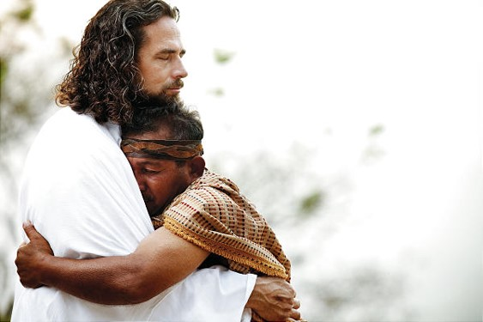
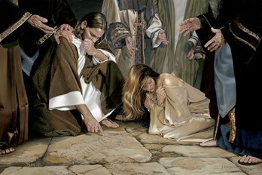
Forgiveness Can Be Obtained
“But as oft as they repented and sought forgiveness, with real intent, they were forgiven.”
“And him that repenteth not of his sins, and confesseth them not, ye shall bring before the church, and do with him as the scripture saith unto you, either by commandment or by revelation.
And this ye shall do that God may be glorified—not because ye forgive not, having not compassion, but that ye may be justified in the eyes of the law, that ye may not offend him who is your lawgiver—”
D&C 64:12-13
Moroni 6:8

Slide 14
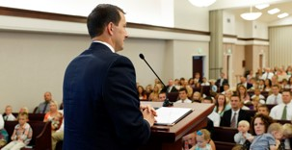
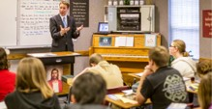
Meetings Led by the Spirit
“And their meetings were conducted by the church after the manner of the workings of the Spirit, and by the power of the Holy Ghost; for as the power of the Holy Ghost led them whether to preach, or to exhort, or to pray, or to supplicate, or to sing, even so it was done.”
“But notwithstanding those things which are written, it always has been given to the elders of my church from the beginning, and ever shall be, to conduct all meetings as they are directed and guided by the Holy Spirit.”
D&C 46:2
“Meetings should be conducted in a reverential manner that will be conducive to the spirit of true worship.
Speakers and teachers should like wise prayerfully seek inspiration that their part will be “led by the Spirit.” Congregation members, too, have a sacred obligation to spiritually prepare for meetings and attend them in the proper frame of mind so as to be touched by the power of the Holy Ghost.”
JFM and RLM
Moroni 6:9

Slide 15
Sources:
Video: Strengthen Thy Brethren (3:50)
Elder Bruce R. McConkie
(A New Witness for the Articles of Faith [1985], 290; see also page 239).
President Gordon B. Hinckley (“Converts and Young Men,” Ensign, May 1997, 47–48).
Joseph Fielding McConkie and Robert L. Millet Doctrinal Commentary on the Book of Mormon Vol. 4 pgs. 329, 332
Elder Jeffrey R. Holland (“A Teacher Come from God,” Ensign, May 1998, 26).
Elder Dallin H. Oaks (quoted in “Unselfish Service,” Ensign or Liahona, May 2009, 96).
Richard E. Poelman Ensign Nov 1993

Slide 16
Elder James E. Faust:
Church discipline is not limited to sexual sins but includes other acts such as murder, abortions, burglary, theft, fraud, and other dishonesty, deliberate disobedience to the rules and regulations of the Church, advocating or practicing polygamy, apostasy, or any other unchristianlike conduct, including defiance or ridicule of the Lord’s anointed, contrary to the law of the Lord and the order of the Church…
Among the activities considered apostate to the Church include when members “(1) repeatedly act in clear, open, and deliberate public opposition to the Church or its leaders; (2) persist in teaching as Church doctrine information that is not Church doctrine after being corrected by their bishops or higher authority; or (3) continue to follow the teachings of apostate cults (such as those that advocate plural marriage) after being corrected by their bishops or higher authority”
(General Handbook of Instructions, 1989, p. 10-3).
Nov. 1993 Ensign Keeping Covenants and Honoring the Priesthood
“Those who misunderstand the mission of the church and the indispensable role of discipline in fulfilling that mission may view excommunication, disfellowshipment, or other formal disciplinary measures as unfairly punitive and humiliating.
On the contrary, Elder Theodore m. Burton noted that “The most loving action the church can take at times is to disfellowship or excommunicate a person: (to Forgive is Divine., Ensign May 1983 pg. 70)
When deemed necessary through inspiration, these repentance remedies can help the sinner fully realize the seriousness of his transgression. If a serious offense is treated too lightly it is more likely to be repeated. Such Church actions can ensure that the necessary price for repentance is paid.
Through Church discipline a wrongdoer can demonstrate to the Lord, to the church, and to others a sincere desire to repent and be forgiven, whatever the cost. This period of discipline is an opportunity to be retained as a disciple of him who made our repentance possible. Joseph Fielding McConkie and Robert L. Millet Doctrinal Commentary Vol 4 pg. 331
Elder D. Todd Christofferson of the Quorum of the Twelve Apostles explained what it means to offer a broken heart and a contrite spirit unto the Lord:
“As you seek the blessing of conversion, you can offer the Lord the gift of your broken, or repentant, heart and your contrite, or obedient, spirit. In reality, it is the gift of yourself—what you are and what you are becoming” (“When Thou Art Converted,” Ensign or Liahona, May 2004, 12).

