Slide 2
Salvation of Little Children
Mormon writes an epistle to Mormon
Do little children need to be baptized?
Moroni 8:1-5

Slide 3
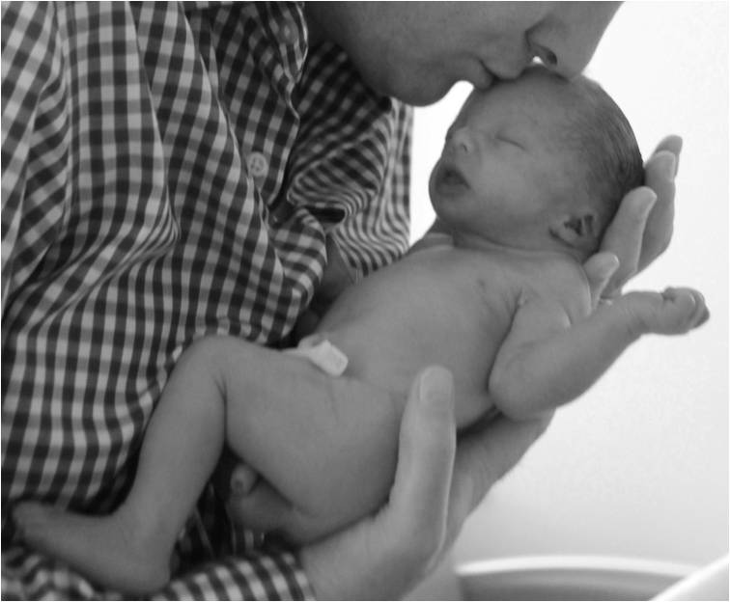
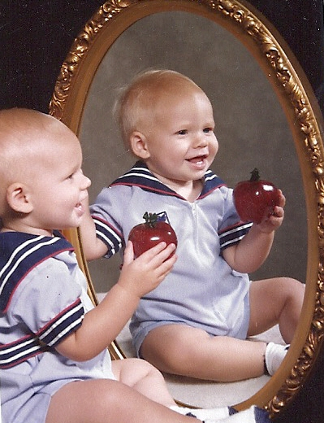
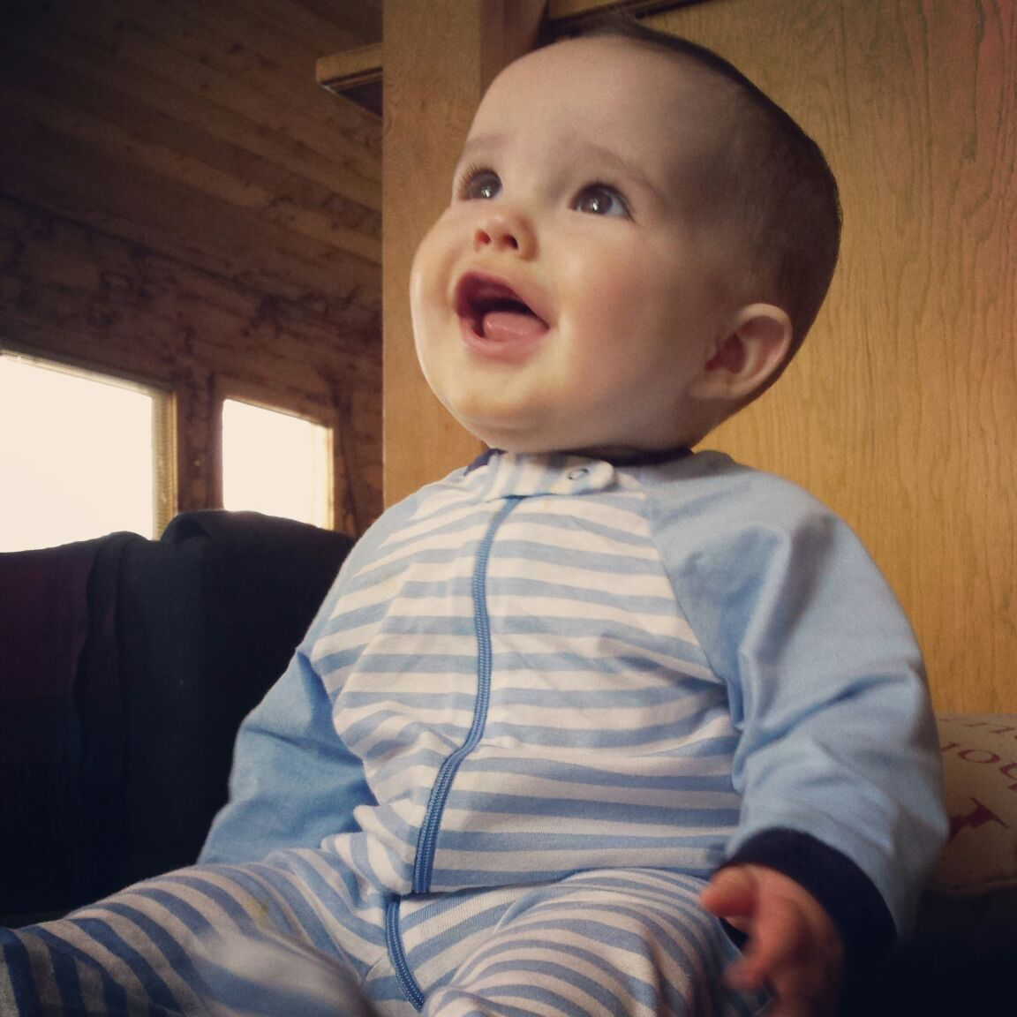
The ordinance of Baptism is “for remission of sins”
Little Children have no sins
“Repent and be baptized in the name of Jesus Christ, according to the holy commandment, for the remission of sins;” D&C 49:13
They are not capable of committing sin, nor does the devil have power to tempt them “until they begin to become accountable” before the Lord
“Wherefore, they cannot sin, for power is not given unto Satan to tempt little children, until they begin to become accountable before me;” D&C 29:47
Moroni 8:1-5

Slide 4
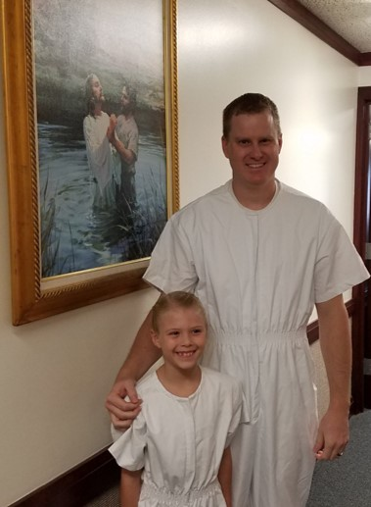
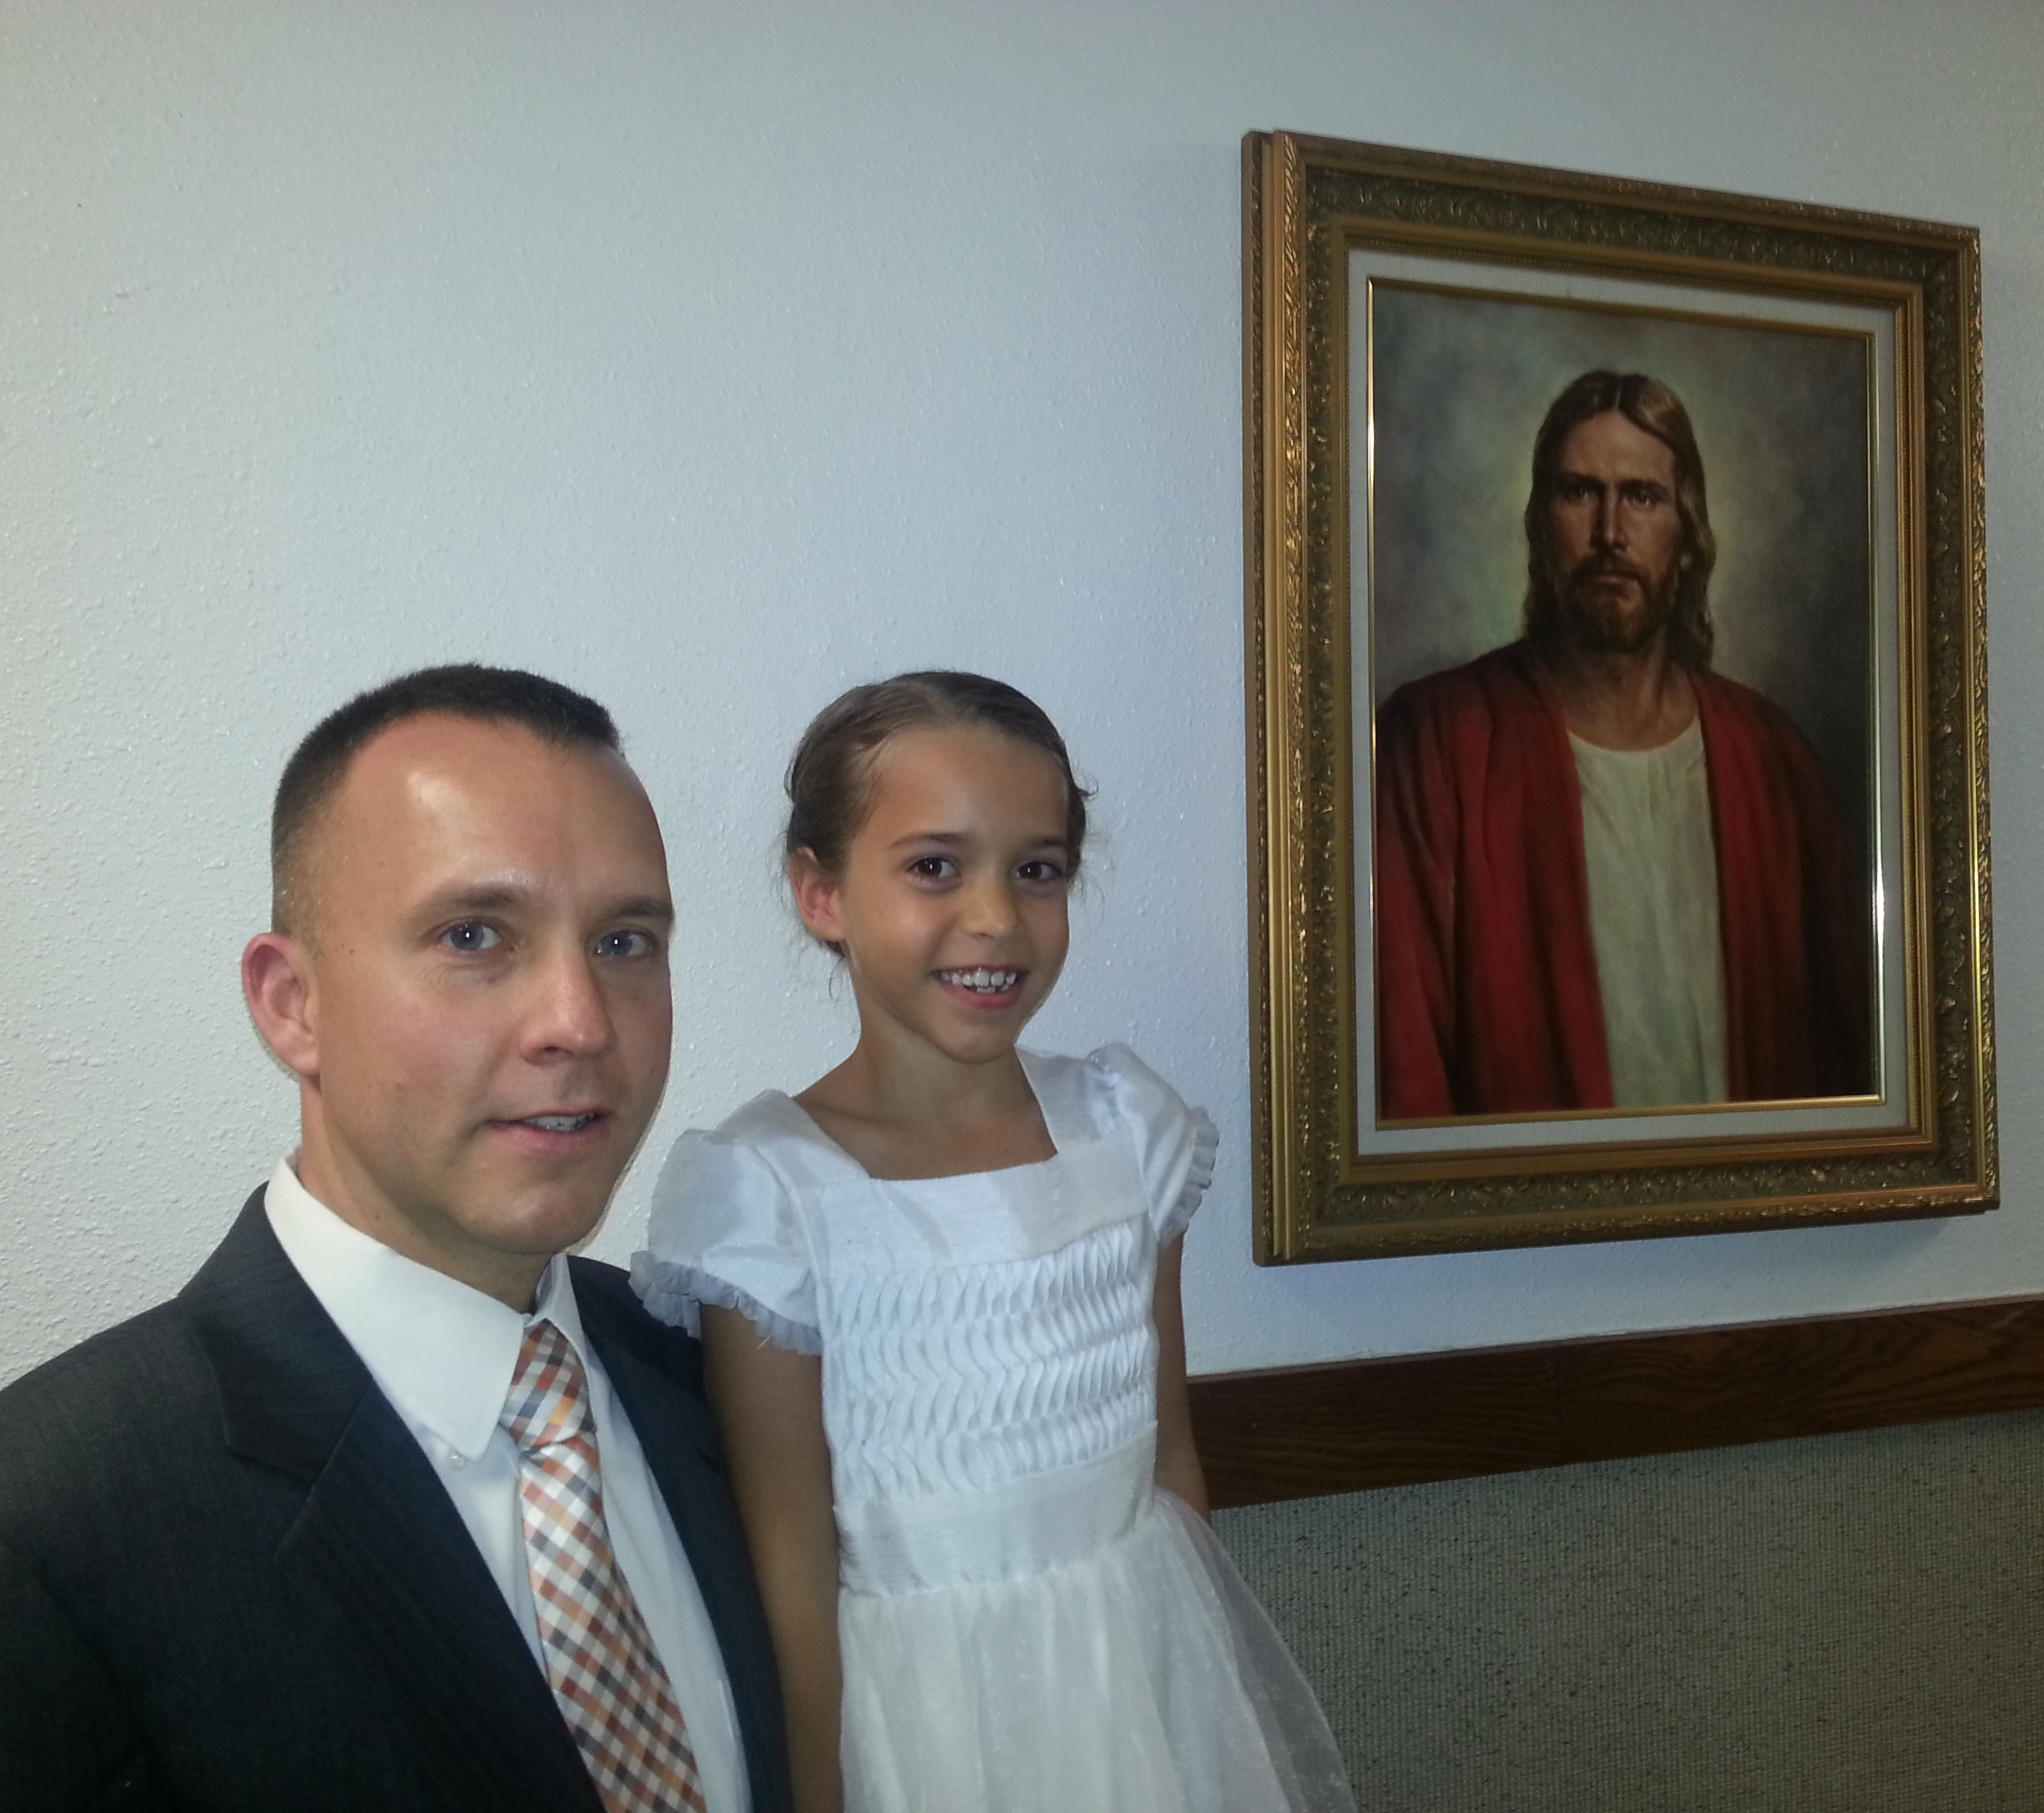
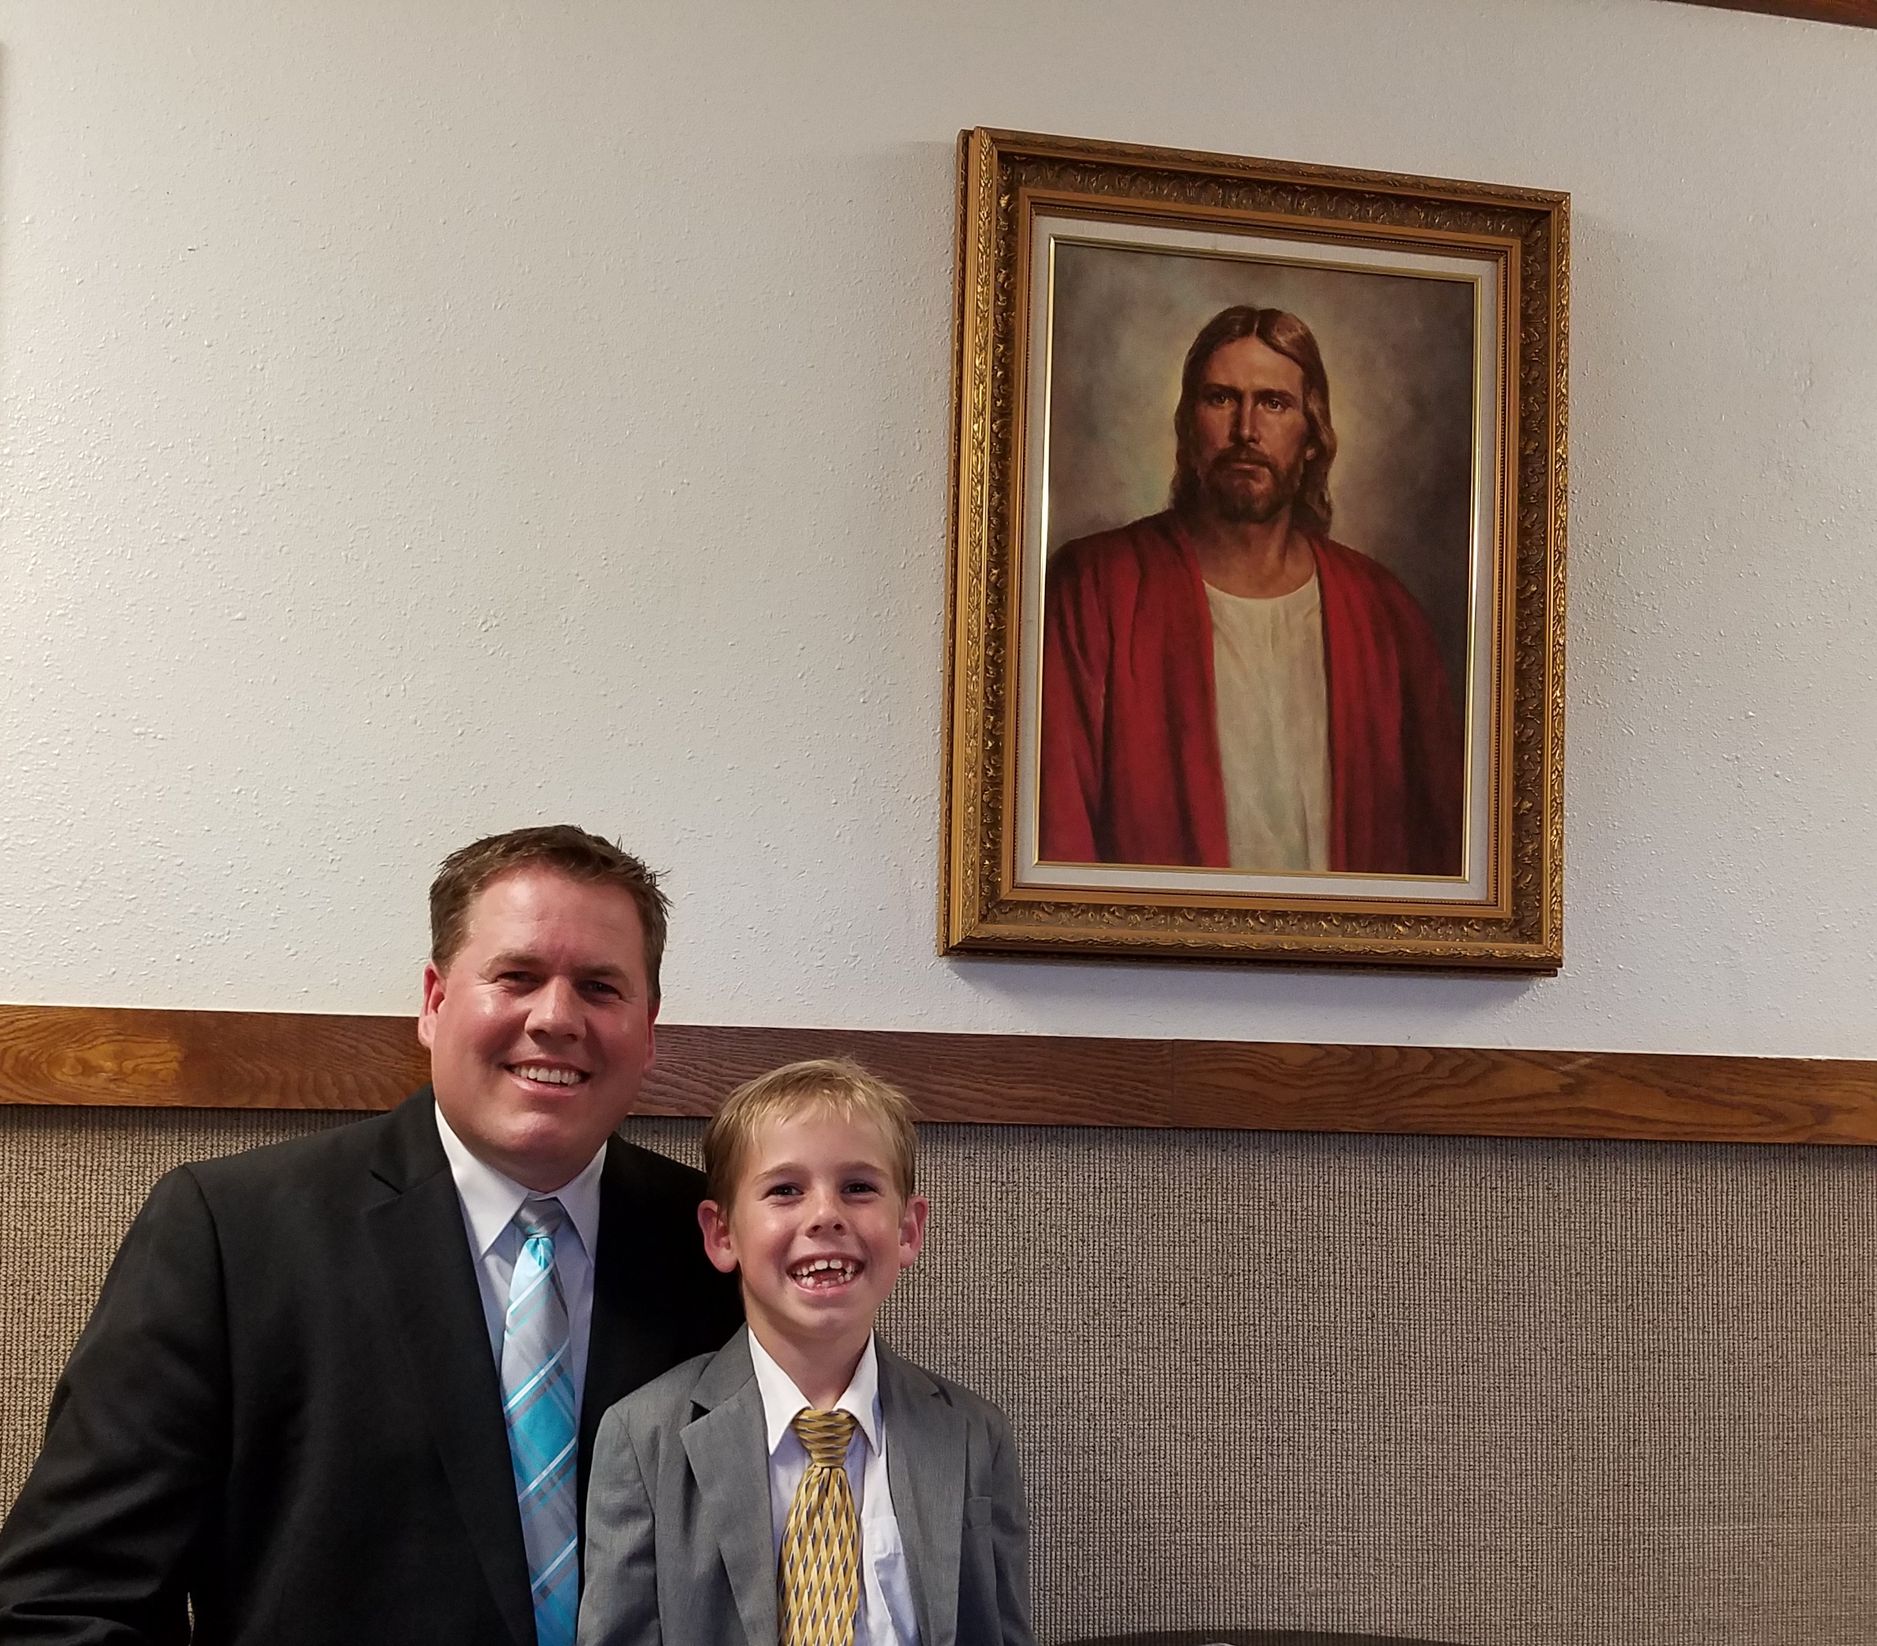
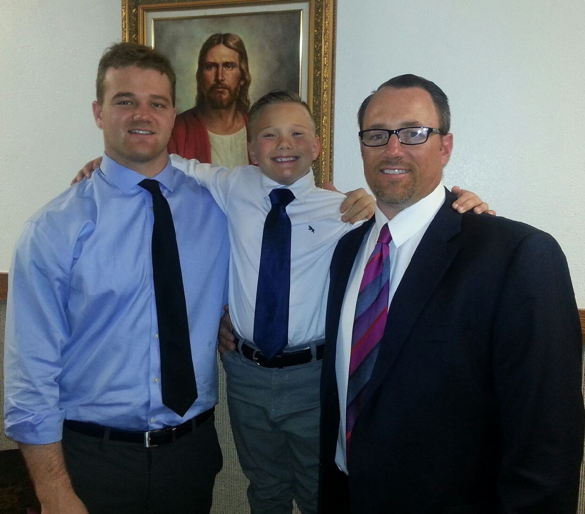
“Accountability does not burst full-bloom upon a child at any given moment in his life. Children become accountable gradually, over a number of years. Becoming accountable is a process, not a goal to be attained when a specified number of years, days, and hours have elapsed. In our revelation the Lord says, ‘They cannot sin, for power is not given unto Satan to tempt little children, until they begin to become accountable before me.’ (D&C 29:47.) There comes a time, however, when accountability is real and actual and sin is attributed in the lives of those who develop normally. It is eight years of age, the age of baptism. (D&C 68:27.)” Bruce R. McConkie

Slide 5
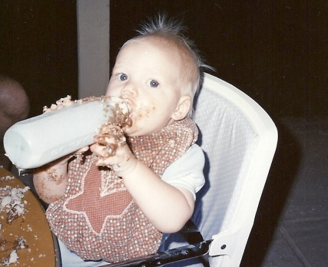
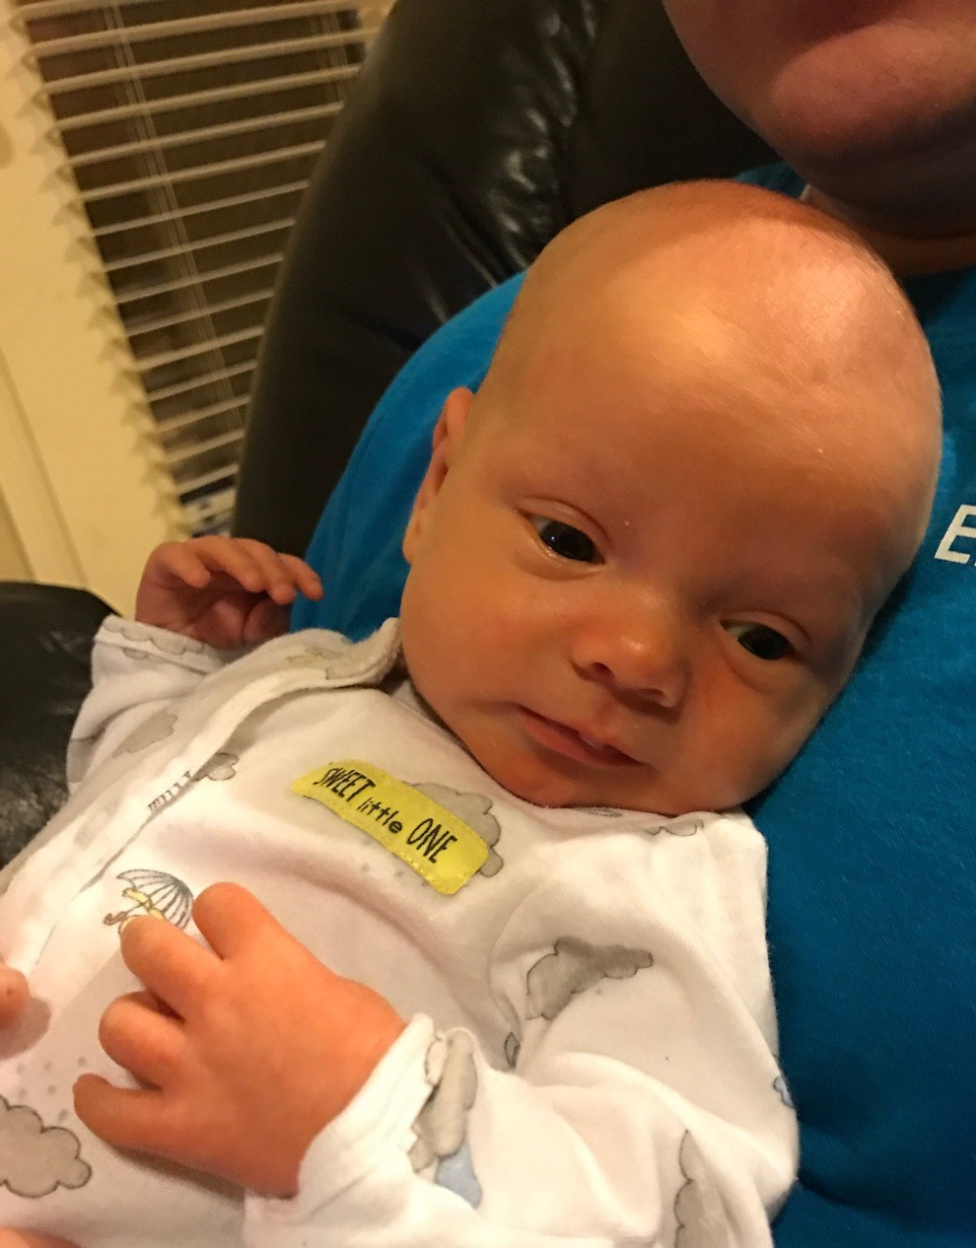
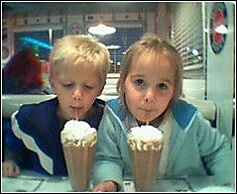
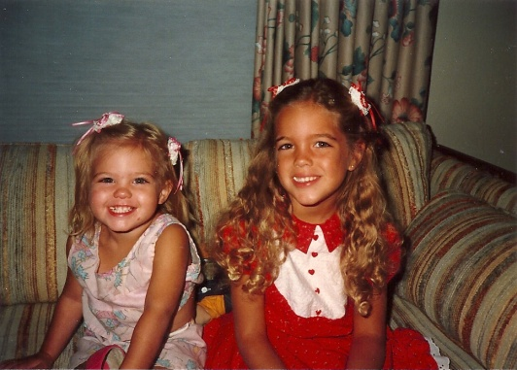
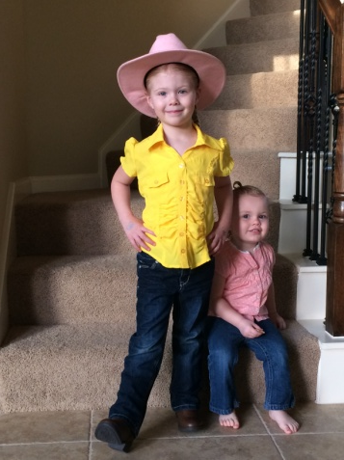
Little Children Are Whole
“…little children are whole, for they are not capable of committing sin; wherefore the curse of Adam is taken from them in me, that it hath no power over them; and the law of circumcision is done away in me.”
“They are “whole” and incapable of committing sin not because of any inherent perfection or goodness on their part but by reason of the Atonement. They are incapable of sinning because they are not accountable for their actions.”
JFM and RLM
Moroni 8:7

Slide 6
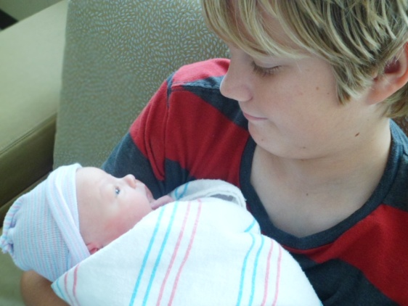
Are Children Pure?
“And the Lord spake unto Adam, saying: Inasmuch as thy children are conceived in sin, even so when they begin to grow up, sin conceiveth in their hearts, and they taste the bitter, that they may know to prize the good.”
Moses 6:55
“Little children are subject to the pull of and the effects of the Fall, just as everyone else is. They are not, however, held accountable for their acts….little children are saved without any preconditions—without faith, repentance, or baptism. Their innocence is decreed and declared by and through the tender mercies of an all-loving Lord—innocent through the Atonement”
Robert L. Millet
“…wherefore the curse of Adam is taken from them in me, that it hath no power over them; and the law of circumcision is done away in me.”
Moroni 8:8

Slide 7
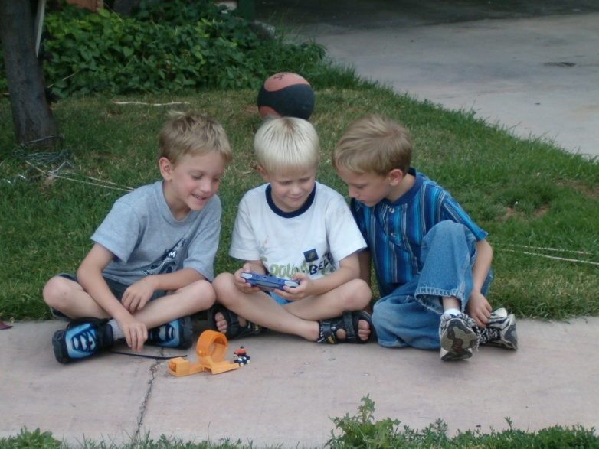
Pure and Innocent Behavior
“During these formative, innocent years, (Prior to age eight) a child may learn wrong behavior; but such is not the result of Satan’s temptations, but comes from the wrong teachings and the bad example of others.”
Elder Merlin R. Lybbert
Moroni 8:8-11

Slide 8
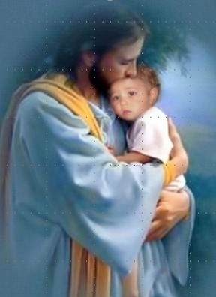
Little Children are Alive in Christ
“But little children are alive in Christ, even from the foundation of the world; if not so, God is a partial God, and also a changeable God, and a respecter to persons; for how many little children have died without baptism”
“The doctrine of baptizing children, or sprinkling them, or they must welter in hell, is a doctrine not true, not supported in Holy Writ, and is not consistent with the character of God. All children are redeemed by the blood of Jesus Christ, and the moment that children leave this world, they are taken to the bosom of Abraham.”
Joseph Smith
“Little children who die before the age of accountability are saved in the celestial kingdom…Serious thinking would tell us that if these children are saved, they are not subject to a later trial by the temptation and buffeting of Satan.”
Joseph Fielding Smith
Moroni 8:12-14

Slide 9
“It would be an injustice to little children who die in early life to deprive them of the opportunity to obtain all the blessings that are promised to adults who are faithful and true in this life.” Joseph Fielding Smith
Depriving Children of Blessings
The main purpose of mortal life…is to obtain tabernacles of flesh and bones, and then to be tried and proved through our deeds in the body. If an infant dies, it has obtained its body. The body does not grow in the grave, but the spirit returns to await the resurrection. Following the resurrection the infant will grow to the full stature of its spirit.”
Joseph Fielding Smith
“…our beloved friends who are now deprived of their little ones have great cause for joy and rejoicing..such children are in the bosom of the Father. They will inherit their glory and their exaltation, and they will not be deprived of the blessings that belong to them.”
Joseph F. Smith
Moroni 8:15-20

Slide 10
Repentance is baptism
Love endureth to the end by prayer
Baptism comes by faith
In Order to Dwell with God
The Comforter fills us with hope and love
Remission of sins brings meekness
Meekness brings the Holy Ghost
Moroni 8:25-26

Slide 11
Results of Pride
Has proven the destruction of the people
They have rejected the knowledge
The spirit has ceased to be with them
They have denied the Holy Ghost
The prophecies have been fulfilled
They must perish
Moroni 8:27-30

Slide 12
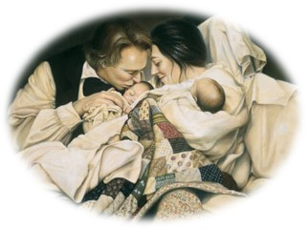
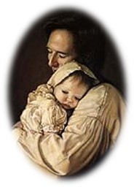
“You will have the joy, the pleasure, and satisfaction of nurturing this child, after its resurrection, until it reaches the full stature of its spirit.”
Joseph Smith

Slide 13
Presentation by ©http://fashionsbylynda.com/blog/
Sources:
Video: Children Are Alive in Christ (1:07)
Suggested song: A Child’s Prayer
Joseph Fielding McConkie and Robert L. Millet Doctrinal Commentary on the Book of Mormon Vol. 4 pg. 351
Robert L. Millet Life in Christ pg. 32-33
Bruce R. McConkie, “The Salvation of Little Children,” Ensign, Apr. 1977, 6
Elder Merlin R. Lybbert The Special Status of Children Ensign May 1994
Joseph Smith History of the Church 4:5
Joseph Fielding Smith Answers to Gospel Questions Vol. 1 pg.56-57, 59
Joseph F. Smith Gospel Doctrin pg. 452-456
Art of Joseph Smith-- Liz Lemon Swindle

Slide 14
Elder Merlin R. Lybbert The Special Status of Children Ensign May 1994
In a day when one of “the greatest problem[s] in our society is the abandonment of children through the abandonment of parental leadership” (Richard Lloyd Anderson, Understanding Paul, Salt Lake City: Deseret Book Co., 1983, p. 354), the First Presidency has asked that “we reemphasize the need for all adult members to focus on our children in an ongoing effort to help them learn to follow the teachings of the Savior.” Also they have asked each of us to “rededicate ourselves to nourish and bless them temporally and spiritually” (First Presidency Letter, 1 Aug. 1993; see Ensign, Jan. 1994, p. 80).
It may be helpful to review some of the doctrines as contained in the scriptures pertaining to the special status of children. These doctrines provide direction for those who are raising children and comfort to those of us who have lost a child in death at an early age.
Heavenly Father intended that each child should have the combined loving protection and guidance of caring parents. The pattern was established by Adam and Eve, our first parents. Joseph, the descendant of David, agreed to become the surrogate father of Jesus, the Son of God, when he accepted Mary as his wife, following a visitation of the angel Gabriel. In Nazareth, Joseph was regarded as the father of Jesus (see Matt. 13:55).
The Christ child grew and developed in a modest home, where Joseph earned a humble living as a carpenter, and where Jesus also learned this craft (see Mark 6:3). There were other members of the family. Mary and Joseph had four other sons and at least two daughters, all of whom were referred to in the community as the brothers and sisters of Jesus (see Matt. 13:55–56; Mark 6:3). The example of Joseph and Mary in providing a suitable home for their large family was such that Luke recorded that Jesus “grew, and waxed strong in spirit, filled with wisdom: and the grace of God was upon him” (Luke 2:40).
The Lord extends special protection to children and shares jurisdiction with earthly parents, even as we enjoy their presence. They cannot sin until they reach the age of accountability, which the Lord has declared to be eight years (see D&C 18:42; D&C 29:47). In fact, the power to even tempt them to commit sin has been taken from Satan. The prophet Mormon taught that “little children are whole, for they are not capable of committing sin. …
“Little children are alive in Christ, even from the foundation of the world; if not so, God is a partial God, and also a changeable God, and a respecter to persons; for how many little children have died without baptism!” (Moro. 8:8, 12.)
Because they cannot sin, they have no need of repentance, neither baptism. Adam’s original transgression has no claim as a result of the atonement of Jesus Christ. Mormon declared the practice of baptizing little children to be a “solemn mockery before God” (Moro. 8:9), for repentance and baptism apply to those who are “accountable and capable of committing sin” (Moro. 8:10).
Because all children who die before the age of accountability are pure, innocent, and wholly sin-free, they are saved in the celestial kingdom of heaven (see D&C 137:10; Mosiah 3:18). Understanding the special status of little children before God, because of their pure and innocent nature, brings understanding of the Lord’s commandment to “repent, and become as a little child, and be baptized in [His] name” (3 Ne. 11:37). The childlike qualities the Lord had reference to are developed by yielding to “the enticings of the Holy Spirit,” so as to become “submissive, meek, humble, patient, full of love, willing to submit to all things which the Lord seeth fit to inflict upon him, even as a child doth submit to his father.” Truly, such a person “becometh a saint” as spoken by Mosiah (Mosiah 3:19).

Slide 15
Parents in Zion have the special responsibility of teaching and training their children in righteousness. They are to be taught “to understand the doctrine of repentance, faith in Christ the Son of the living God, and of baptism and the gift of the Holy Ghost by the laying on of the hands, when eight years old.” Otherwise, the Lord declared, “the sin be upon the heads of the parents” (D&C 68:25). This teaching is to be done before a child reaches the age of accountability, and while innocent and sin-free. This is protected time for parents to teach the principles and ordinances of salvation to their children without interference from Satan. It is a time to dress them in armor in preparation for the battle against sin. When this preparation time is neglected, they are left vulnerable to the enemy. To permit a child to enter into that period of his life when he will be buffeted and tempted by the evil one, without faith in the Lord Jesus Christ and an understanding of the basic principles of the gospel, is to set him adrift in a world of wickedness. During these formative, innocent years, a child may learn wrong behavior; but such is not the result of Satan’s temptations, but comes from the wrong teachings and the bad example of others. In this context, the Savior’s harsh judgment of adults who offend children is better understood, wherein he said, “It were better for him that a millstone were hanged about his neck, and he cast into the sea, than that he should offend one of these little ones” (Luke 17:2).
We offend a child by any teaching or example which leads a little one to violate a moral law; causes him to stumble, or go astray; excites him to anger; creates resentment; or perhaps even leads him to become displeasing and disagreeable. Certainly, in the context of the Savior’s harsh indictment concerning anyone who “offends” a child, one guilty of such conduct is in serious jeopardy.
Every child is entitled to live in a home, as Jesus did, where there is an environment permitting growth in gospel understanding, where each can wax strong in spirit and his life be filled with wisdom, so that the grace of God will be upon him (see Luke 2:40). These precious little ones are as angels among us.
Fulfilling this opportunity of teaching is not dependent upon social status, wealth, or position. In fact, the most effective instruction may well be done at the humblest fireside. Some may rationalize their failure to follow this God-given instruction by assuming that children of tender years are not capable of understanding gospel principles. Parents who have followed the practice of teaching their children know otherwise. Family home evening presents a special opportunity to teach the gospel to the family. The parents of a five-year-old were concerned about how they should teach of Nephi’s encounter with the wicked Laban. Laban had repeatedly refused to make the precious brass plates containing a religious record available to Nephi and had sought to kill him and his brothers after confiscating their family wealth. When Nephi encountered the drunken Laban, the Spirit directed Nephi to slay him:
“Behold the Lord slayeth the wicked to bring forth his righteous purposes. It is better that one man should perish than that a nation should dwindle and perish in unbelief” (1 Ne. 4:13).
As this young boy, my grandson, knelt beside his bed that evening, his prayer demonstrated his understanding and personal application of the lesson. He said, “And help me, Heavenly Father, to be obedient like Nephi, even when it’s hard.”
Demonstration of these principles of truth as taught in the scriptures, and applied in the various settings of life, is a sure way of developing understanding and obedience in the lives of children. The Primary of the Church also teaches children the gospel of Jesus Christ. This is a valuable support the Church gives to parents and their children.
It is my witness that our kind and loving Heavenly Father has made special allowances for little children, consistent with their innocence and the eternal principle of agency. It is also my witness that he gave parents, and all adults, the responsibility of properly teaching and protecting them. Offenders of these little ones face a divine wrath. The Savior’s injunction to become as a little child is an invitation to purify our lives that we also may stand blameless before Him. In the name of Jesus Christ, amen.

Slide 16
“Every spirit of man was innocent in the begging; and God having redeemed man from the fall, men became again, in their infant state, innocent before God. D&C 93:38
“All those who believe that man, yes, even newly born infants, are tainted with ‘original sin,’ (in other words the transgression of Adam,) deny the mercies of the atoning blood of Jesus Christ. The Bible (as well as our modern scripture) teaches that Jesus Christ is in very deed, the Redeemer of mankind from the fall. He paid the debt that mankind became heir to through Adam’s transgression. The mortgage upon our souls was fully paid. It left no hangover penalty which required some act by, or in behalf of, any living creature, to free him from ‘original sin.’ The doctrine that infants come into this world under the curse of ‘original sin,’ is an abominable doctrine in the sight of God, and denies the greatness and mercy of the atonement. (See Moroni Chapter 8.)” (Joseph Fielding Smith, Church History and Modern Revelation: A Course of Study for the Melchizedek Priesthood Quorums [1949], 4:99).
“‘Do you believe in the baptism of infants?’ … No. … Because it is nowhere written in the Bible. … Baptism is for remission of sins. Children have no sins. … Children are all made alive in Christ, and those of riper years through faith and repentance” (Manuscript History of the Church, vol. E-1, p. 1666 josephsmithpapers.org, capitalization, punctuation, and spelling standardized).
The whole article, “Lead Me, Guide Me”: Dealing with Children with Behavior Disorders March 1994 Ensign
Advice for parents with misbehavior children:
“Some researchers think that certain behavior disorders may be linked to significant disruptions or “breaks” in the process by which infants and young children form strong bonds of trust and love with their primary caretakers. It seems that some children who undergo such breaks—often through abuse, neglect, or separation from a parent at a critical point in the attachment process—may later develop conduct disorders, an especially serious type of behavior disorder.”
Jan U. Pinborough
“We understand from our doctrine that before the age of accountability a child is ‘not capable of committing sin’ (Moro. 8:8). During that time, children can commit mistakes, even very serious and damaging ones that must be corrected, but their acts are not accounted as sins” (Dallin H. Oaks, “Sins and Mistakes,” Ensign, Oct. 1996, 65).

