Slide 2
The Condition of the Nephites
“Archeantus has fallen by the sword, and also Luram and Emron”—the great Nephite men who battled with the Lamanites
Mormon’s writes final letter to Moroni during a great battle with the Lamanites
Moroni 9:1-2

Slide 3
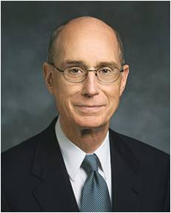
To Labor Among the People
We are to labor diligently in God’s service, even if those we serve do not respond positively.
“It is a covenant we make with God to keep all His commandments and give service as He would give it if He were personally present. Living up to that standard as best we can builds the strength we will need to endure to the end.
“Great priesthood trainers have shown me how to build that strength: it is to form a habit of pushing on through the fatigue and fear that might make you think of quitting. The Lord’s great mentors have shown me that spiritual staying power comes from working past the point when others would have taken a rest. …
“… I promise you if you do all that you can, God will magnify your strength and your wisdom”
President Henry B. Eyring
Moroni 9:4

Slide 4
The Lamanites
Moroni 9:2-5
Loss of many great men
Satan stirs up them continually
Mormon labors continually
They are angry with Mormon
Mormon fears the Spirit has left them
They have no fear of death
They have lost their love one for another
They thirst for blood and revenge
The Nephites
Moroni 9:7-10
Many men, women, and children are prisoners of the Lamanites
The husbands and fathers have been slain
They feed the women and children the flesh of the men
They give them very little water
The Nephites have taken the daughter of the Lamanites prisoners—they lost their chastity and virtue
They have murdered and tortured them and devoured their bodies
Both Lamanites and Nephites
Moroni 9:16-19
Many widows and daughters wander and are left to die
The army of the Nephites are weak
Many of the armies have fallen to an awful brutality
They are without order
They are without mercy
They delight in everything wicked
Mormon has no strength and cannot enforce his commands
They have become strong in wickedness

Slide 5
What do you think it means to be “without civilization”?
To act uncivilized—without refinement or restraint; to have no respect for other individuals; to disregard laws that govern society
What do you think it means to be “without principle”?
To live without standards and without honoring and keeping the commandments of God
What do you think it means to be “past feeling”?
To be hard-hearted against the Spirit of the Lord and the Light of Christ and to not distinguish between right and wrong
What evidence do you see in the world today that some people are without civilization, are without principle, and are past feeling?
Moroni 9:11, 20

Slide 6
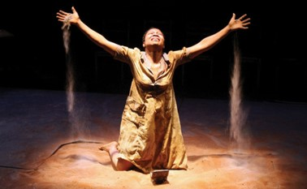
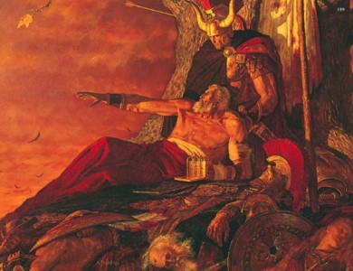
“Atay”
“Atay”—Greek
Introduced in playwrights to allow the audience to
see the consequences and forces as a result of the
choices made by the hero.
As the play progresses the hero approaches the
moment of Ate.
At any moment they could speak—as to repent, they could turn around, back out and undo their crisis.
If they chose right, there was hope. But if they chose wrong—usually of so many poor decisions in the past—the audience could do nothing but watch them destroy themselves.
“They “reached the point of no return”
So it is with the Nephites (and the Jaredites)…that they proved to be at the point of no return. They had known and been taught to repent of their sins but they chose to lose that power and so the Lord could not receive them back.
Mormon watches as the Nephites are destroyed—Student Manual

Slide 7
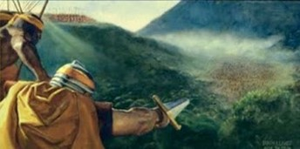
Past Feeling—without Principle
The Failure to respond to the promptings of the Holy Spirit:
“Our capacity to feel controls our behavior in many ways, and by inaction when our feelings prompt us to do good, we deaden that capacity to feel. It was Jesus’ striking sensitivity to the needs of those about him that made it possible for him to respond in action.
“At the other end of the spiritual spectrum are individuals such as Nephi’s erring brothers; Nephi noted their increasing insensitivity to things spiritual: ‘[God] hath spoken unto you in a still small voice, but ye were past feeling, that ye could not feel his words’.
Moroni 9:18-20

Slide 8
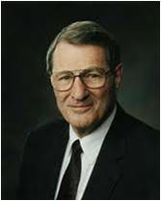
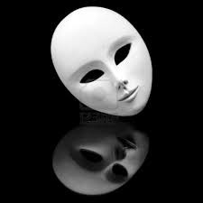
“When we become too encrusted with error, our spiritual antennae wilt and we slip beyond mortal reach. This can happen to entire civilizations. In his lamentation to his son Moroni, Mormon notes the deterioration of the Nephite society. The symptoms include a wickedness so profound that Mormon’s people were described by him as being ‘past feeling’.
The Apostle Paul lamented the destructive lasciviousness of Church members in Ephesus because they had developed such insensitivity in their satiation that they were ‘past feeling’.
A sex-saturated society cannot really feel the needs of its suffering members because, instead of developing the love that looks outward, it turns man selfishly inward. Imperviousness to the promptings of the still small voice of God will also mean that we have ears but cannot hear, not only the promptings of God, but also the pleas of men.”
Neal A. Maxwell
Moroni 9:18-20

Slide 9
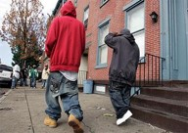
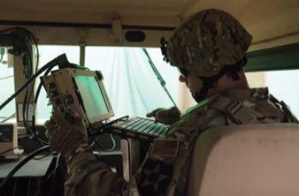
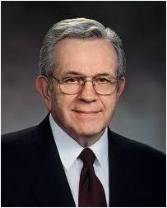
“The world grows increasingly noisy. Clothing and grooming and conduct are looser and sloppier and more disheveled. Raucous music, with obscene lyrics blasted through amplifiers while lights flash psychedelic colors, characterizes the drug culture. Variations of these things are gaining wide acceptance and influence over our youth. …
“This trend to more noise, more excitement, more contention, less restraint, less dignity, less formality is not coincidental nor innocent nor harmless.
“The first order issued by a commander mounting a military invasion is the jamming of the channels of communication of those he intends to conquer.
“Irreverence suits the purposes of the adversary by obstructing the delicate channels of revelation in both mind and spirit”
President Boyd K. Packer

Slide 10
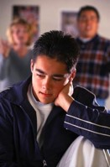
Trustful and Faithful
What causes you to be discouraged?
Trust that thou wilt be saved and God will spare thy life
Be faithful in Christ for He will lift thee up
If we are faithful in Jesus Christ, He will lift us up even when difficulties and wickedness surround us.
Moroni 9:21-22

Slide 11
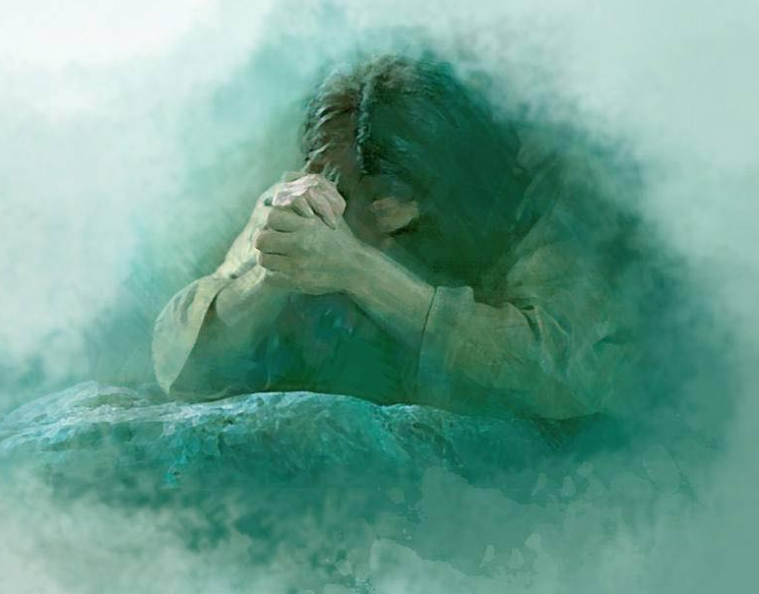
”…may his sufferings and death, and the showing his body unto our fathers, and his mercy and long-suffering, and the hope of his glory and of eternal life, rest in your mind forever.”
Yongsung Kim
Moroni 9:25-26

Slide 12
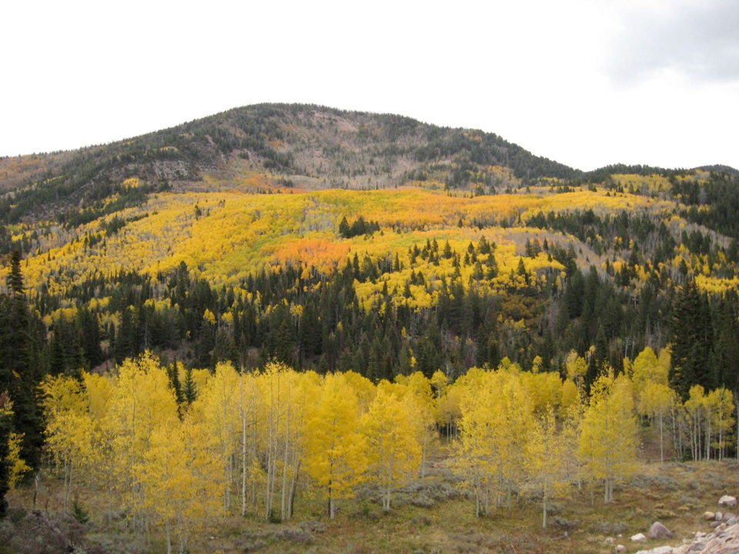
Mormon’s Final Words
“And may the grace of God the Father, whose throne is high in the heavens, and our Lord Jesus Christ, who sitteth on the right hand of his power, until all things shall become subject unto him, be, and abide with you forever. Amen.”
Moroni 9:26

Slide 13
Sources:
Video:
Strengthen Thy Brethren (10:06)
Reach Out With Love (8:32)
Scriptures Legacy (19:35)
President Henry B. Eyring (“Preparation in the Priesthood: ‘I Need Your Help,’” Ensign or Liahona, Nov. 2011, 58–59).
Neal A. Maxwell (A Time to Choose [1972], 59–60).
Atay—Student Manual Religion 121-122 Book of Mormon pg. 463
President Boyd K. Packer (“Reverence Invites Revelation,” Ensign, Nov. 1991, 22).
Presentation by ©http://fashionsbylynda.com/blog/

Slide 14
The Lamanites
Moroni 9:2-5
Loss of many great men
Satan stirs up them continually
Mormon labors continually
They are angry with Mormon
Mormon fears the Spirit has left them
They have no fear of death
They have lost their love one for another
They thirst for blood and revenge
The Nephites
Moroni 9:7-10
Many men, women, and children are prisoners of the Lamanites
The husbands and fathers have been slain
They feed the women and children the flesh of the men
They give them very little water
The Nephites have taken the daughter of the Lamanites prisoners—they lost their chastity and virtue
They have murdered and tortured them and devoured their bodies
Both Lamanites and Nephites
Moroni 9:16-19
Many widows and daughters wander and are left to die
The army of the Nephites are weak
Many of the armies have fallen to an awful brutality
They are without order
They are without mercy
They delight in everything wicked
Mormon has no strength and cannot enforce his commands
They have become strong in wickedness

