Slide 2
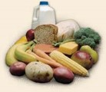
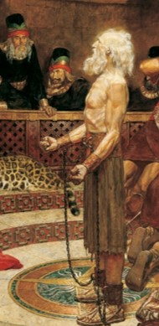
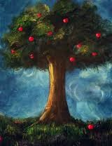
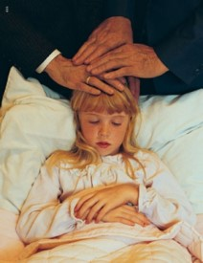
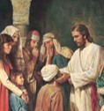
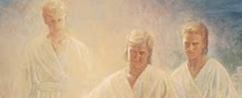
Given By the Spirit
To teach the word of wisdom
To teach the word in knowledge
To have great faith
To have the gift of healing
To work mighty miracles
To prophesy
To behold angels and ministering spirits
Speaking in tongues
Interpretation of languages and divers kinds of tongues
God grants gifts of the Spirit to profit His children
Moroni 10:9-17; D&C 46; 1 Corinthians 12-14

Slide 3
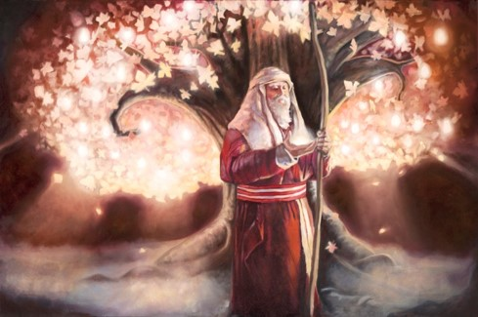
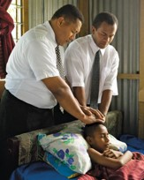
Gifts come in Different Ways
“…there are diversities of gifts, but the same Spirit. And there are differences of administration, but the same given to every man to profit withal…
All these [gifts] worketh that one and the selfsame Spirit, dividing to every man severally as he will.
For as the body is one, and hath many member, and all the member of that one body, being many, are one body; so also is Christ.”
Moroni 10:8-17; 1 Corinthians 12:4-7, 11-17

Slide 4
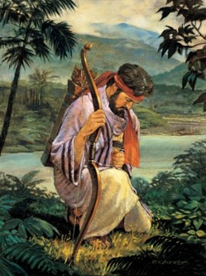
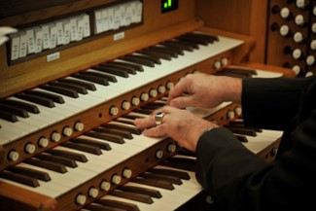
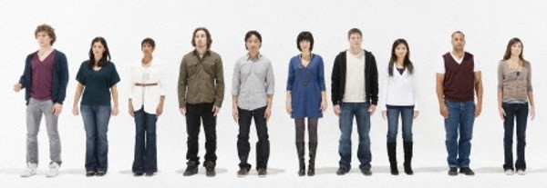
Being Deceived
Wherefore, beware lest ye are deceived; and that ye may not be deceived seek ye earnestly the best gifts, always remembering for what they are given;
For verily I say unto you, they are given for the benefit of those who love me and keep all my commandments, and him that seeketh so to do; that all may be benefited that seek or that ask of me, that ask and not for a sign that they may consume it upon their lusts.
And again, verily I say unto you, I would that ye should always remember, and always retain in your minds what those gifts are, that are given unto the church.
For all have not every gift given unto them; for there are many gifts, and to every man is given a gift by the Spirit of God.
To some is given one, and to some is given another, that all may be profited thereby.
D&C 46:8-12
Moroni 10:8-17

Slide 5
“The light of Christ is neither the Holy Ghost nor the gift of the Holy Ghost; but that member of the Godhead, because he alone with the Father and the Son is God, uses the light of Christ for his purposes. Thus spiritual gifts, the gifts of God…come from God by the power of the Holy Ghost. …meaning the Holy Ghost uses the light of Christ to transmit his gifts.”
Bruce R. McConkie
Moroni 10:18

Slide 6
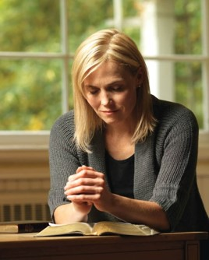
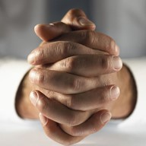
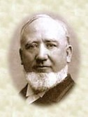
Gifts of God
Are you searching for the gifts that God has promised to bestow upon you?
Have you prayed (through Jesus Christ)for what these gifts might be or how to obtain them?
If I am an angry man…it is my duty to pray for charity
If I am an envious man…it is my duty to search for charity
If I am weak in my testimony…it is my duty to ask of God for strength, for wisdom, for knowledge of the truth
He gives us these gifts, and bestows them upon those who seek after them…because God has promised to give the gifts that are necessary for our perfection
Moroni 10:18—excerpts from President George Q. Cannon

Slide 7
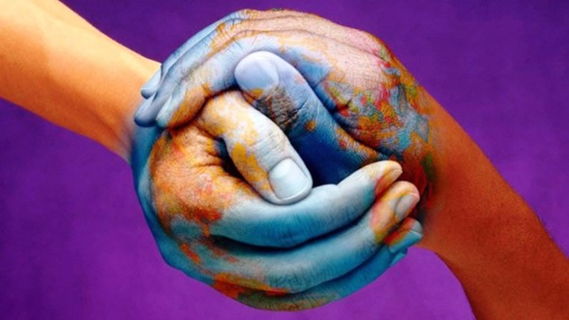
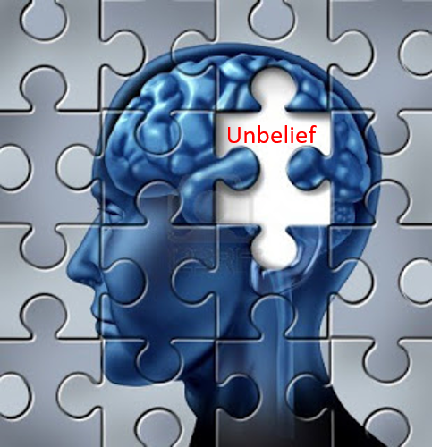
Yesterday, Today, and Forever
The gifts you have received or will acquire during your mortal probation on earth can never be taken away except if you choose to lose your faith in Christ
“And now I speak unto all the ends of the earth—that if the day cometh that the power and gifts of God shall be done away among you, it shall be because of unbelief.”
Moroni 10:19, 24

Slide 8
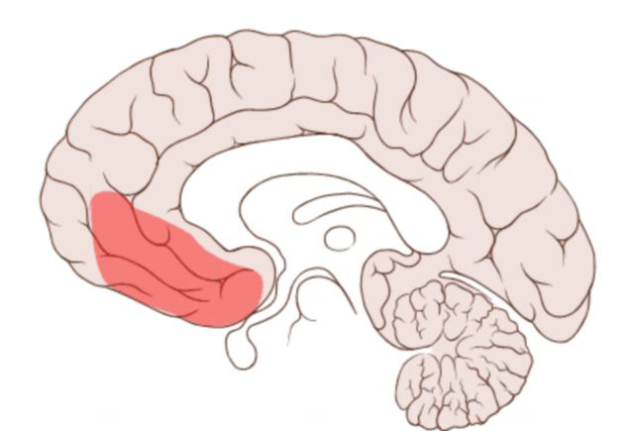
Lateral Frontal Pole—The Brain
What happens when we change our minds?
Scientists have found that when a decision goes wrong and things turn out differently than expected, the orbitofrontal cortex, located at the front of the brain behind the eyes, responds to the mistake and helps us alter our behavior.
Interestingly, researchers have found that cocaine addicts, who are often unable to weigh the rewards of drug use against its costs, show impairments of the orbitofrontal cortex.
Brain facts
Moroni 10:19, 24

Slide 9
Those who Deny Their Faith
“And if ye have no hope ye must needs be in despair; and despair cometh because of iniquity.”
Moroni 10:22-24

Slide 10
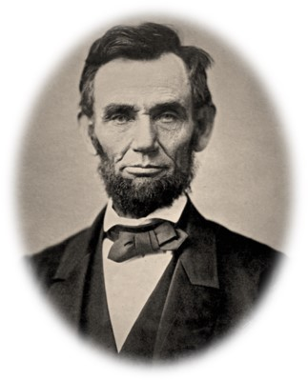
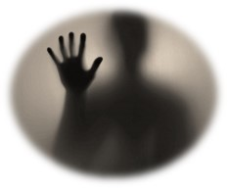
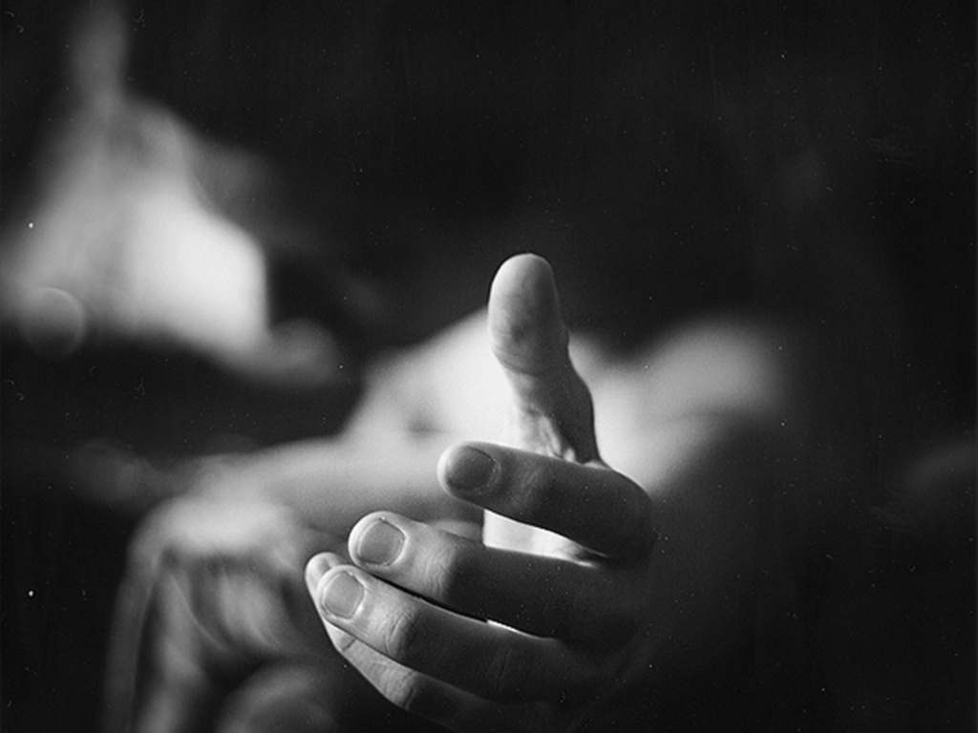
To Avoid Despair
“In the Book of Mormon we read that ‘despair cometh because of iniquity.’
(Moro. 10:22.) ‘When I do good I feel good,’ said Abraham Lincoln, ‘and when I do bad I feel bad.’
Sin pulls a man down into despondency and despair. While a man may take some temporary pleasure in sin, the end result is unhappiness. ‘Wickedness never was happiness.’ (Alma 41:10.)
Sin creates disharmony with God and is depressing to the spirit. Therefore, a man would do well to examine himself to see that he is in harmony with all of God’s laws.
Every law kept brings a particular blessing. Every law broken brings a particular blight. Those who are heavy-laden with despair should come unto the Lord, for his yoke is easy and his burden is light.”
President Ezra Taft Benson

Slide 11
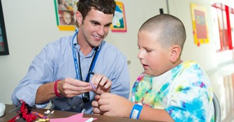
Those Who do Good
“Men and women do good, in the eyes of the Lord, only as they come unto him, as they receive the testimony of the servants of God, partake of the covenants and ordinances of his holy gospel, and become identified with the true Church of Jesus Christ by membership.”
JFM and RLM
“And there are none that doeth good except those who are ready to receive the fulness of my gospel, which I have sent forth unto this generation.”
D&C 35:12
Moroni 10:25

Slide 12
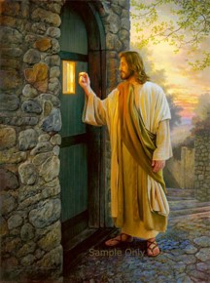
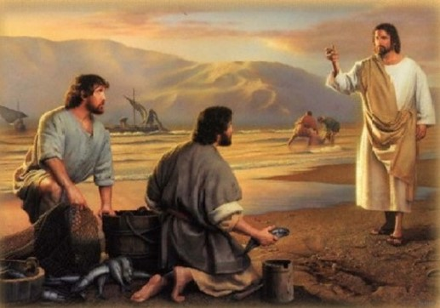
Come Unto Christ
“Yea, come unto Christ, and be perfected in him, and deny yourselves of all ungodliness; and if ye shall deny yourselves of all ungodliness, and love God with all your might, mind and strength, then is his grace sufficient for you, that by his grace ye may be perfect in Christ; and if by the grace of God ye are perfect in Christ, ye can in nowise deny the power of God.”
Moroni 10:32

Slide 13
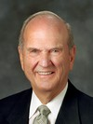
As we come unto Jesus Christ, we can be purified and perfected in Him
“We need not be dismayed if our earnest efforts toward perfection now seem so arduous [or difficult] and endless. Perfection is pending. It can come in full only after the Resurrection and only through the Lord. It awaits all who love him and keep his commandments.”
Russell M. Nelson
Moroni 10:30

Slide 14
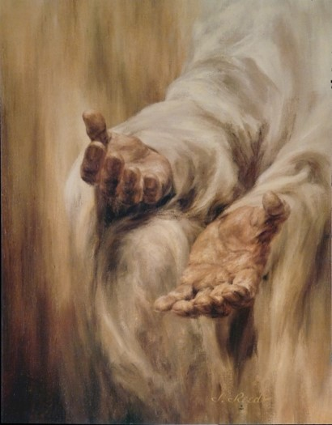
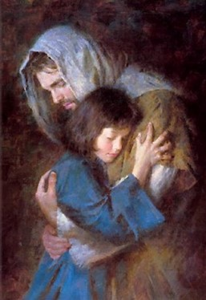
Deny Him Not
Once you have partaken of the Lord’s grace and mercy, have come to know his healing and lifting powers,
then your witness of Jesus Christ as a God of miracles and power is certain, you are a personal witness
“And again, if ye by the grace of God are perfect in Christ, and deny not his power, then are ye sanctified in Christ by the grace of God, through the shedding of the blood of Christ, which is in the covenant of the Father unto the remission of your sins, that ye become holy, without spot.”
Moroni 10:32-33 JFM and RLM

Slide 15
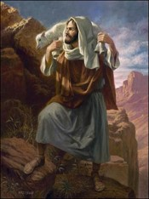
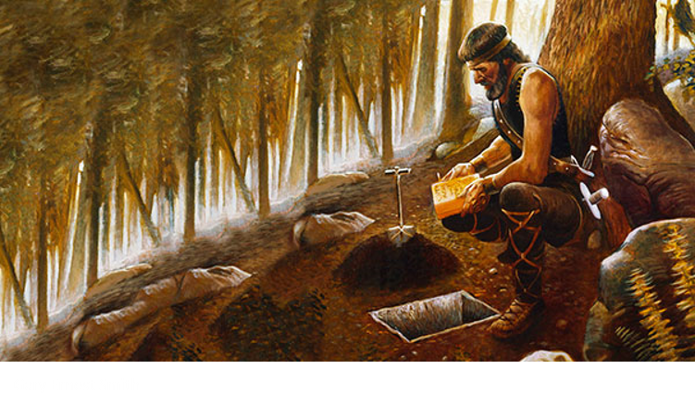
Moroni’s Farewell
“That final, last, lonely appeal of the keystone of our religion and the most correct book ever written is to touch not the unclean thing; it is to be holy and without spot; it is to be pure. And that purity can come only through the blood of that Lamb who bore our griefs and carried our sorrows, the Lamb who was wounded for our transgressions and bruised for our iniquities, the Lamb who was despised and afflicted, but whom we esteemed not …
“Purity—through the blood of the Lamb. That is what this book pleads for”
Jeffrey R. Holland
“And now I bid unto all, farewell. I soon go to rest in the paradise of God, until my spirit and body shall again reunite, and I am brought forth triumphant through the air, to meet you before the pleasing bar of the great Jehovah, the Eternal Judge of both quick and dead. Amen.”
Moroni 10:34

Slide 16
The Book of Mormon From Beginning to End
Your study of the Book of Mormon began and now ends with Moroni. You have studied about the witnesses of Jesus Christ and his teachings through His prophets.
You have studied about a society that if they were righteous they prospered and grew, and if they were unrighteous they were destroyed, by each other.
You have studied about the principles to the true gospel of Jesus Christ.
You have read what the current day prophets and leaders have testified of.
You have been given this unique opportunity to examine another testament of Jesus Christ
The
Book
of
Mormon
ANOTHER TESTAMENT
OF JESUS CHRIST

Slide 17
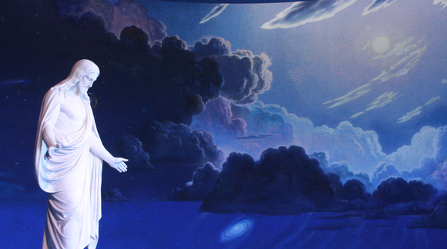
“Thus the Book of Mormon ends … on the promise of the Holy Resurrection.
That is most fitting, for this sacred testament—written by prophets, delivered by angels, protected by God—speaks as one ‘crying from the dead,’ exhorting all to come unto Christ and be perfected in him, a process culminating in the perfection of celestial glory.”
Jeffrey R. Holland
Revelation 14:6

Slide 18
My Testimony
During the last 10 months of studying the Book of Mormon my faith in Jesus Christ has grown tremendously. I have learned that Jesus is my Savior and through His mercy and grace I can be forgiven of the things I have done wrong. I have learned of the growing concern of the prophets, both ancient and present day, for the people of this earth.
I do not fully understand what the Book of Mormon people went through.
I have not been struck by an angel as Laman and Lemuel had.
I have not had visions like Lehi and Nephi. I have not seen the Lord like the brother of Jared, or others. I have not lost my husband, sons, or daughters to wars, prisons, or kidnappings. I have not witnessed war or contempt for my neighbors as the Lamanites and Nephites had. I have not seen Jesus and the signs of his crucifixion as the Nephites had.
But I do know I have a personal witness of my Savior of His atoning sacrifice. This feeling comes from within (I guess you could call it the Holy Ghost’s witness).
This Book is a true witness to me. Yes, there have been doubts at times, but how could anyone (Joseph Smith) make up such a master piece of the Lord’s work?
I, fondly, leave this testimony with you in the name of Jesus Christ. Amen

Slide 19
Sources:
Videos:
Hope Leads (1:31)
Come Unto Christ (2:52)
Bruce R. McConkie New Witness pg. 258
Excerpts from George C. Cannon Millennial Star April 1894 pg 260-261..Found also in Student Manual Religion 121-122 Book of Mormon pg. 529-530
President Ezra Taft Benson (“Do Not Despair,” Ensign, Oct. 1986, 2).
Joseph Fielding McConkie and Robert L. Millet Doctrinal Commentary on the Book of Mormon Vol. 4 pg. 370, 374
Jeffrey R. Holland (“A Standard unto My People” [address to CES religious educators, Aug. 9, 1994], 13–14, si.lds.org).
Jesus Art by Marco Aurelio Rodrigues
Russell M. Nelson, “Perfection Pending,” Ensign, Nov. 1995, 88).
Jeffrey R. Holland, Christ and the New Covenant: The Messianic Message of the Book of Mormon[1997], 339
http://www.brainfacts.org/sensing-thinking-behaving/awareness-and-attention/articles/2009/decision-making/
Testimony—Lynda
Presentation by ©http://fashionsbylynda.com/blog/

Slide 20
What I must do | What God promises

Slide 21
Gifts of the Spirit:
Moroni 10:8-19
Elder Bruce R. McConkie described the purposes and reasons for obtaining spiritual gifts:
“[The purpose of spiritual gifts] is to enlighten, encourage, and edify the faithful so that they will inherit peace in this life and be guided toward eternal life in the world to come. Their presence is proof of the divinity of the Lord’s work; where they are not found, there the Church and kingdom of God is not. The promise is that they shall never be done away as long as the earth continues in its present state, except for unbelief (Moro. 10:19), but when the perfect day comes and the saints obtain exaltation, there will be no more need for them. As Paul expressed it, ‘When that which is perfect is come, then that which is in part shall be done away.’ (1 Cor. 13.)
“Faithful persons are expected to seek the gifts of the Spirit with all their hearts. They are to ‘covet earnestly the best gifts’ (1 Cor. 12:31; D. & C. 46:8), to ‘desire spiritual gifts’ (1 Cor. 14:1), ‘to ask of God, who giveth liberally.’ (D. & C. 46:7; Matt. 7:7–8). To some will be given one gift; to others, another; and ‘unto some it may be given to have all those gifts, that there may be a head, in order that every member may be profited thereby.’ (D. & C. 46:29.)” (Mormon Doctrine, 2nd ed. [1966], 314).
“One of the great tragedies of life, it seems to me, is when a person classifies himself as someone who has no talents or gifts. …
“From Doctrine and Covenants 46:11–12, we have this truth: ‘For all have not every gift given unto them; for there are many gifts, and to every man is given a gift by the Spirit of God.
“‘To some is given one, and to some is given another, that all may be profited thereby.’
“God has given each of us one or more special talents. … It is up to each of us to search for and build upon the gifts which God has given. …
“Let us review some … less-conspicuous gifts: the gift of asking; the gift of listening; the gift of hearing and using a still, small voice; the gift of being able to weep; the gift of avoiding contention; the gift of being agreeable; the gift of avoiding vain repetition; the gift of seeking that which is righteous; the gift of not passing judgment; the gift of looking to God for guidance; the gift of being a disciple; the gift of caring for others; the gift of being able to ponder; the gift of offering prayer; the gift of bearing a mighty testimony; and the gift of receiving the Holy Ghost. …
“God does live. He does bless us with gifts. As we develop and share our God-given gifts and benefit from the gifts of those around us, the world can be a better place and God’s work will move forward at a more rapid pace” (Marvin J. Ashton, “There Are Many Gifts,” Ensign, Nov. 1987, 20, 23).
Elder Jeffrey R. Holland of the Quorum of the Twelve Apostles shared the following thoughts on Moroni’s concluding words in the Book of Mormon:
“Purity. Holiness. Character and conscience without blemish. All these through the grace of Christ, which cleanses our garments, sanctifies our souls, saves us from death, and restores us to our divine origins.
“With his last recorded breath Moroni bore witness of his own firm faith in such divine redemption. …
“Thus the Book of Mormon ends, flying as it were with Moroni, on the promise of the Holy Resurrection. [See Revelation 14:6.] That is most fitting, for this sacred testament—written by prophets, delivered by angels, protected by God—speaks as one ‘crying from the dead,’ exhorting all to come unto Christ and be perfected in him, a process culminating in the perfection of celestial glory” (Christ and the New Covenant: The Messianic Message of the Book of Mormon [1997], 339).

