Slide 2
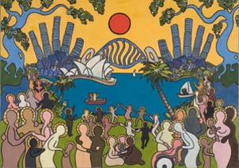
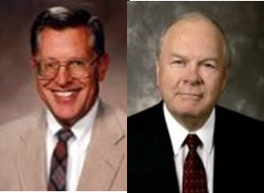
Peace for 2 Years
16th and 17th year of the reign of the judges
After the battles and burying the dead there was peace for 2 years
“Learn of me, and listen to my words; walk in the meekness of my Spirit, and you shall have peace in me.” D&C 19:23
“Whenever a people live the gospel, whenever they live in harmony with the statutes and ordinances God has given them, whenever they follow the light of their consciences and subscribe to the rules and standards established for those of the household of faith, they come to know the peace of the Spirit.”
JFM and RLM
Alma 30:1-5

Slide 3
Enticing on the Outside But
Empty on the Inside
False teachings are like this box…one can image what might be inside
But once opened it may be empty… the teachings of an anti-Christ

Slide 4
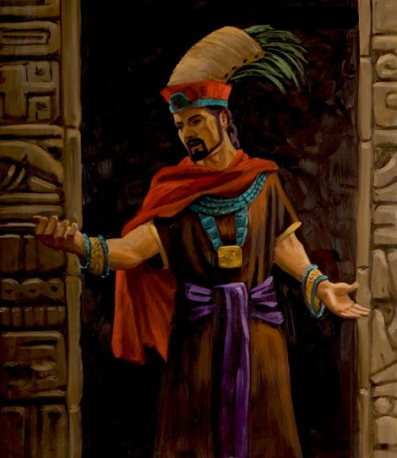
An Anti-Christ
Those who lived before the meridian of time:
One who defies and denies the prophecies concerning the coming of Christ.
Those who live now:
One who denies the divine birth of Jesus, his teachings, sufferings, death, and resurrection…
Many believe that He was just a good man.
James H. Fullmer
Alma 30:6

Slide 5
Korihor
He was a dissenter during the ministry of Alma the Younger
He is mentioned around 74 BC
He preached against the prophecies of the coming of the Messiah
He accused the priests of holding people in bondage for their own monetary gain
He was brought before Alma who was chief judge and governor over the land
He requested from Alma to give him a ‘sign’ of Christ
He led many people to sin
He was struck dumb by the Lord, and then convinced of the truth and asked Alma to restore his voice..which Alma denied
He later wrote a renouncement of his anti-Christian teachings
He was cast out and had to beg for food and was trampled to death by the Zoramites—the descendants of Zoram, Laban’s servant
Who’s Who

Slide 6
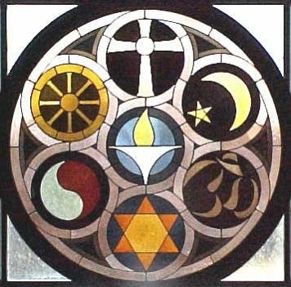
No Law Against a Man’s Beliefs
“…the Lord and his servants had forbidden discrimination according to belief.
The Lord desires that all his children in all ages accept the gospel and affiliate themselves with his true Church.
He will not bring this to pass, however, through pressure or unrighteous dominion of any kind.” JFM and RLM
For murder---punished by death
For robbery or adultery—punished
There was a law that men should be judged according to their crimes and punished for what he had done.
Alma 30:7-11

Slide 7
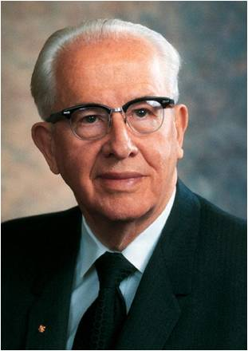
The Book of Mormon is for Us
“The Book of Mormon brings men to Christ through two basic means,
First, it tells in a plain manner of Christ and His gospel. It testifies of His divinity and of the necessity for a Redeemer and the need of our putting trust in Him. It bears witness of the fall and the Atonement and the first principles of the gospel…It proclaims we must endure to the end in righteousness and live the moral life of a Saint.
Second, the Book of Mormon exposes the enemies of Christ.
It confounds false doctrines and lays down contention.
It fortifies the humble followers of Christ against the evil
designs, strategies, and doctrines of the devil in our day….
that we might see the error and know how to combat
false educational, political, religious, and philosophical
concepts of our time.”
President Ezra Taft Benson

Slide 8
False Teachings of Korihor
1. Alma 30:13–14
2. Alma 30:15
3. Alma 30:16
4. Alma 30:17 (beginning with
“every man fared …”)
5. Alma 30:17 (beginning with “whatsoever a man did …”)
6. Alma 30:18
You cannot know something is true unless you see it. Therefore, you cannot know that there will be a Christ.
There is no such thing as sin. There is no universal standard of what is right or wrong.
People prosper by their own efforts alone. There is no such thing as an atonement.
It is impossible to know about things that will happen in the future, so you should not believe in Christ or follow the words of people who say they are prophets.
Forgiveness of sin is a crazy idea that comes from false traditions.
There is no life after death, so there is no need to worry about a judgment after this life.

Slide 9
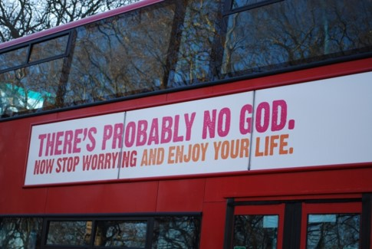
False Teachings of Today
There is no God
There are no new revelations
The Mormons are prejudice against anyone different from them
Anyone should be able to live the way they want
The Mormons belong to a cult
Anyone should do the what he/she wants to do
The Mormons practice polygamy
Joseph Smith was a fraud
Satan uses false doctrines to entice us to commit sin
Alma 30:12-18

Slide 10
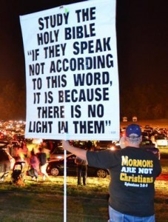
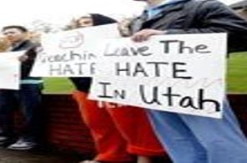
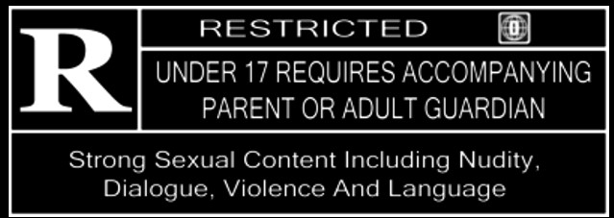
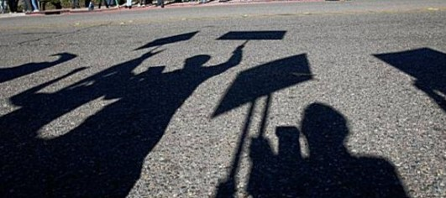
Criticizing Your Beliefs
“It was a very well done movie and not that violent.
It is up for an Academy award.”
Alma 30:7-11

Slide 11
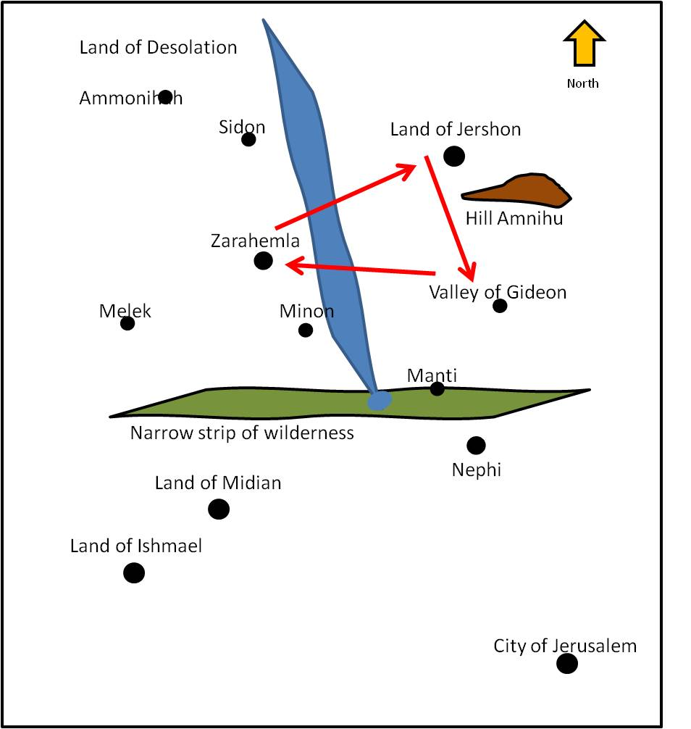
Korihor’s Preaching Tour
Korihor preaches in the Land of Jershon---They took him and bound him and carried him to Ammon, the high priest
Result—Ammon caused that Korihor be carried out of the land
Korihor preaches in the Land of Gideon---he had much success---however he was bound and carried before the chief judge over the land, Giddonah
Result—Giddonah, the high priest and the chief judge (no name) bound him and had officers take him to the land of Zarahemla before the chief judge and governor over all the land
Alma 30:19-29

Slide 12
Blasphemy
What is Blasphemy?
It consists in either or both of the following:
Speaking irreverently, evilly, abusively, or scurrilously against God or sacred things
Speaking profanely or falsely about Deity.
Forms of Blasphemy:
“Taking the name of the Lord in vain
Evil speaking of the Lord’s anointed
Belittling sacred temple ordinances or patriarchal blessings, or sacramental administrations
Claiming unwarranted divine authority
Promulgating with profane piety a false system of salvation.”
Bruce R. McConkie
Alma 30:30

Slide 13
See The Story of Alma and Korihor Readers Theater
Alma 30:30-60

Slide 14
The Form of an Angel
“Satan is one who ‘transformeth himself nigh unto an angel of light.’ (2 Nephi 9:9)
“Lucifer does not come personally to every false prophet, as he did to Korihor, any more than the Lord comes personally to every true prophet, as he did to Joseph Smith.
Such an appearance—either of God on the one hand or of Satan on the other—is, however, the end result of full devotion to the respective causes involved. In each instance an earthly representative, by obedience to the laws that are ordained, may see the face of the master he serves.”
Bruce R. McConkie

Slide 15
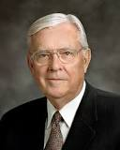
Beware of False Prophets
“When we think of false prophets and false teachers, we tend to think of those who espouse an obviously false doctrine or presume to have authority to teach the true gospel of Christ according to their own interpretation.
We often assume that such individuals are associated with small radical groups on the fringes of society.
However, I reiterate: there are false prophets and false teachers who have or at least claim to have membership in the Church.
There are those who, without authority, claim Church endorsement to their products and practices. Beware of such.”
M. Russell Ballard
Beware

Slide 16
Sources:
Video:
“All Things Denote There Is a God” (11:17)
Joseph Fielding McConkie and Robert L. Millet Doctrinal Commentary on the Book of Mormon Vol. 3 pg. 201-202
Book of Mormon Who’s Who Ed J. Pinegar and Richard J. Allen pg. 95
President Ezra Taft Benson A Witness and a Warning pg. 3
Bruce R. McConkie Mormon Doctrine pg. 90 Satan as angel—Millennial Messiah pg 72
M. Russell Ballard Beware of False Prophets and False Teachers Oct. 1999 Gen. Conf.
An actual picture of syrup on pancakes
Presentation by ©http://fashionsbylynda.com/blog/

Slide 17
Alma 30:1-6: Exposing Enemies:
President Ezra Taft Benson
“The Book of Mormon exposes the enemies of Christ. … It fortifies the humble followers of Christ against the evil designs, strategies, and doctrines of the devil in our day. The type of apostates in the Book of Mormon are similar to the type we have today. God, with his infinite foreknowledge, so molded the Book of Mormon that we might see the error and know how to combat false educational, political, religious, and philosophical concepts of our time” (“The Book of Mormon Is the Word of God,” Ensign, Jan. 1988, 3).
Signs: Alma 30:52:
Elder Robert D. Hales of the Quorum of the Twelve Apostles taught about the importance of recognizing the signs we have received concerning the truthfulness of the gospel:
“If we do not yield to the gentle influence of the Holy Ghost, we stand in jeopardy of becoming like Korihor, an anti-Christ in the Book of Mormon. Not only did Korihor disbelieve in God, but he also ridiculed the Savior, the Atonement, and the spirit of prophecy, falsely teaching that there is no God and no Christ.
“Korihor was not content merely to reject God and quietly go his own way. He mocked the believers and demanded that the prophet Alma convince him with a sign of God’s existence and power. Alma’s response is as meaningful today as it was then: ‘Thou hast had signs enough; will ye tempt your God? Will ye say, Show unto me a sign, when ye have the testimony of all these thy brethren, and also all the holy prophets? The scriptures are laid before thee, yea, and all things denote there is a God; yea, even the earth, and all things that are upon the face of it, yea, and its motion, yea, and also all the planets which move in their regular form do witness that there is a Supreme Creator.’ [Alma 30:44.]
“Eventually Korihor was given a sign. He was struck dumb. ‘And Korihor put forth his hand and wrote, saying: … I know that nothing save it were the power of God could bring this upon me; yea, and I always knew that there was a God.’ [Alma 30:52.]
“Brothers and sisters, you may already know, deep in your soul, that God lives. You may not know all about Him yet and do not understand all His ways, but the light of belief is within you, waiting to be awakened and intensified by the Spirit of God and the Light of Christ, which you are born with” (“Seeking to Know God, Our Heavenly Father, and His Son, Jesus Christ.” Ensign or Liahona, Nov. 2009, 31–32).
Bondage Alma 30:24:
“Korihor was arguing, as men and women have falsely argued from the beginning of time, that to take counsel from the servants of God is to surrender God-given rights of independence. But the argument is false because it misrepresents reality. When we reject the counsel which comes from God, we do not choose to be independent of outside influence. We choose another influence. We reject the protection of a perfectly loving, all-powerful, all-knowing Father in Heaven, whose whole purpose, as that of His Beloved Son, is to give us eternal life, to give us all that He has, and to bring us home again in families to the arms of His love. In rejecting His counsel, we choose the influence of another power, whose purpose is to make us miserable and whose motive is hatred. We have moral agency as a gift of God. Rather than the right to choose to be free of influence, it is the inalienable right to submit ourselves to whichever of those powers we choose” (Henry B. Eyring, “Finding Safety in Counsel,” Ensign, May 1997, 25).

