Slide 1
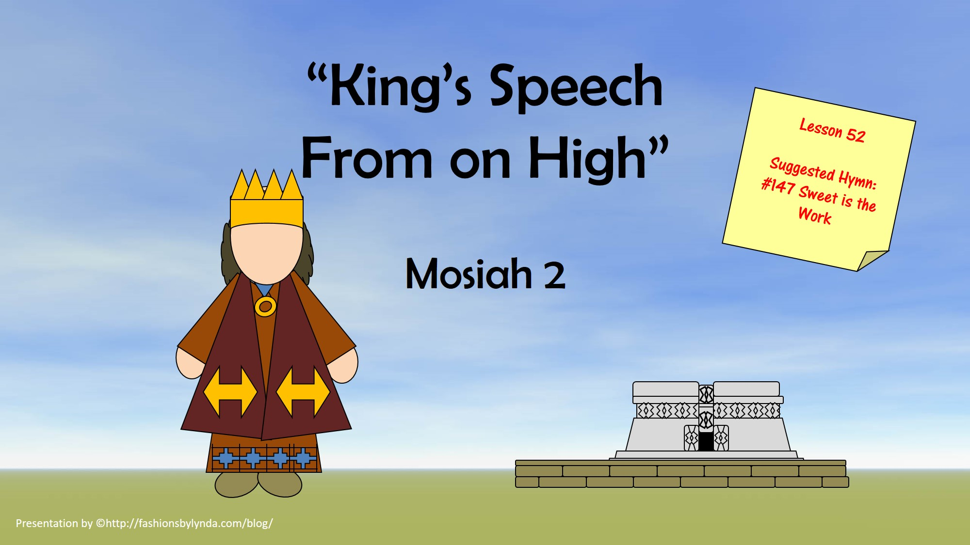

Slide 2

The Gathering
Who gathered?
Why did they gather?
Where did they gather?
What did they bring?
Mosiah 2:1-6

Slide 3
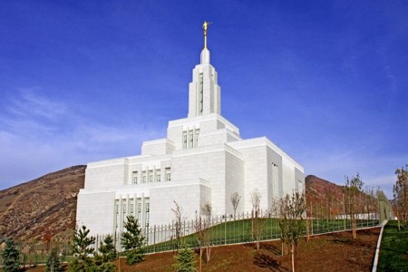
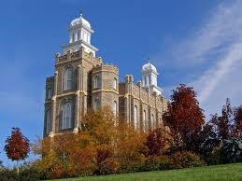
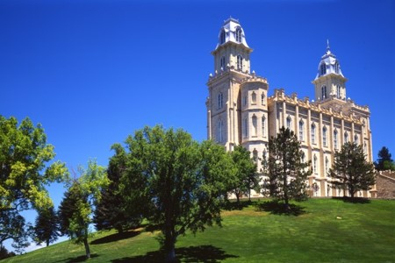
Mount of the Lord’s House
One always went “up” to the temple suggesting that the temples were built on a hill, or higher than where the people lived
Isaiah 2:2
“…that the mountain of the Lord’s house shall be established in the top of the mountains, and shall be exalted above the hills; and all nations shall flow unto it.”
Mosiah 2:1

Slide 4
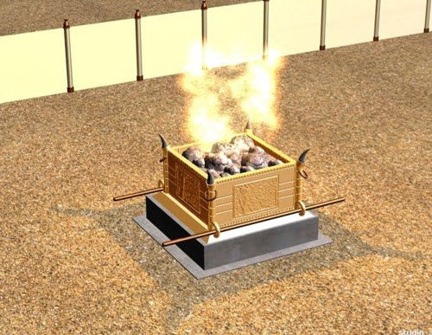
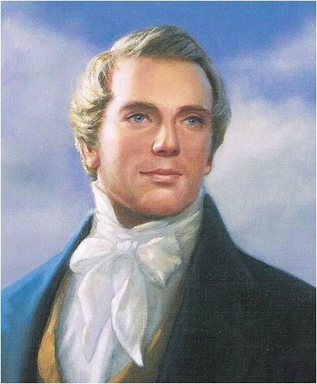
Burnt Offerings
An ordinance practiced in Adam’s time
Moses 5:7
This same offering will be offered again in our dispensation by the sons of Levi in fulfillment of the prophecies of Malachi and john the Baptist, and the promise of Joseph Smith
Malachi 3:3-4
D&C 13
Joseph Smith
Also
“That they might give thanks to the Lord their God, who had brought them out of the land of Jerusalem…”
Mosiah 2:-3-4

Slide 5
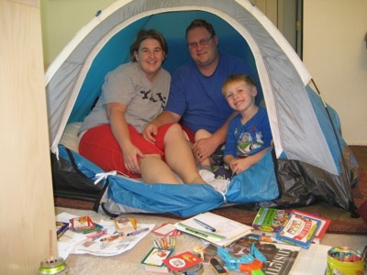
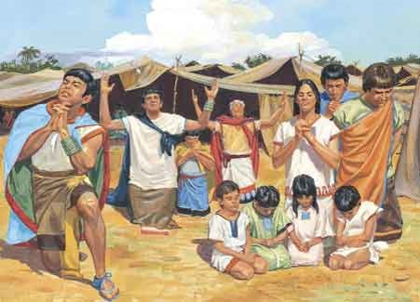
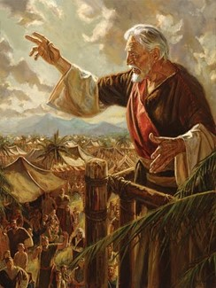
Patriarchal Organization
“According to his family:”
Including all members of their family
“…it is more important than ever to make our families the center of our lives and the top of our priorities. Families lie at the center of our Heavenly Father’s plan.”
L. Tom Perry
“And Adam and Eve blessed the name of God, and they made all things known unto their sons and their daughters.”
Moses 5:12
King Benjamin desired all the people, with their families, to hear the words of the Lord
Mosiah 2:5

Slide 6
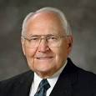
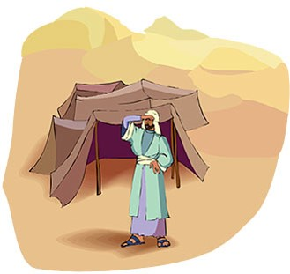
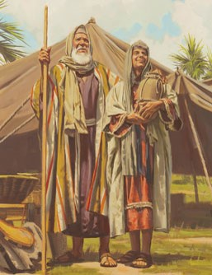
Pitch Their Tents
“They pitched their tents with their doors toward the temple so that they might hear the words of King Benjamin as he instructed them in the doctrine of eternal life.”
L. Tom Perry
Two Meanings:
Where your home is
Where your passions lie
Where your passions lie:
Genesis 13:12
“Abram dwelled in the land of Canaan, and Lot dwelled in the cities of the plain, and pitched his tent toward Sodom.”
Where your home is:
1 Nephi 2:15
And my father dwelt in a tent.
Mosiah 2:6

Slide 7


A Tower
King Benjamin could not teach within the walls of the temple because all could not hear him.
But because there so many people he had his words written and sent forth to those who could not hear.
Mosiah 2:6

Slide 8
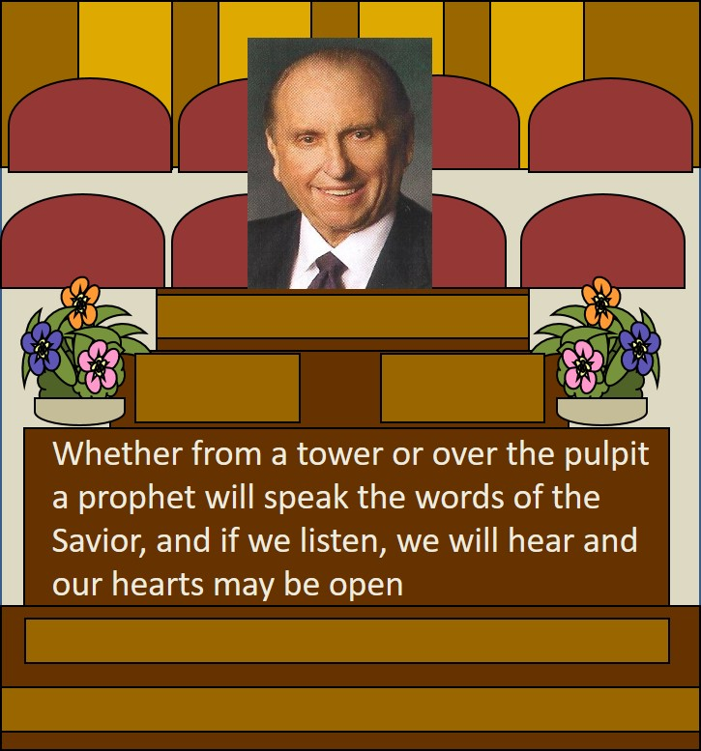
To Hear the Words
“Hearken unto me, and open your ears that ye may hear”
If we open our ears, hearts, and minds to the teachings of God’s servants, we can be blessed with understanding and personal revelation
Mosiah 2:9

Slide 9
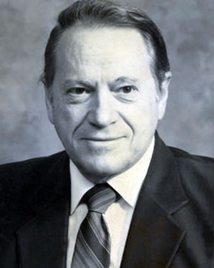
The Speech
You have chosen me to be ruler and king over this land
I will serve you with all my might; I have not asked for riches
Fear me not; I am a mortal man; I am like you
I have not made you slaves and ask you not to make slaves of one another
I have taught you to keep the commandments
I will not burden you with taxes
“Burdensome, unjust taxation is a form of theft. King Benjamin realized that a government has no more right to steal from its citizens than the citizens have to steal from one another.”
Rodney Turner
Mosiah 2:10-14

Slide 10
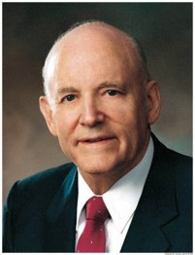
Labored With Mine Own Hands
“When we understand why we serve we will not worry about where we serve”
Mosiah 2:14

Slide 11
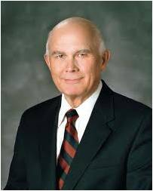
Reasons for Service
Some serve for hope of earthy reward
Some serve to obtain good companionship…these persons are more selective in choosing their friends than the Master was in choosing his servants
Some serve out of fear of punishment
Some serve out of a sense of duty or out of loyalty to family, friends, or traditions— ‘the good soldier’
The higher reason for service is the hope of an eternal reward…this hope is one of our most powerful motivations…
Each of the above is self-centered…
Those who follow the Savior’s example must lose themselves in their service to others…if our service is to be most efficacious, it must be unconcerned with self and heedless of personal advantage. In order to stand blameless before God at the last day, we must also serve him with all our heart and mind.”
Dallan H. Oaks
Mosiah 2:14-19

Slide 12
Doctrinal Mastery
“And behold, I tell you these things that ye may learn wisdom; that ye may learn that when ye are in the service of your fellow beings ye are only in the service of your God.”
Mosiah 2:17
When we serve others, we serve God.

Slide 13
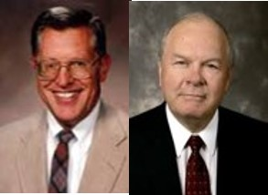
Unprofitable Servants
People make a profit when they receive more than they give. We are unprofitable servants to our Heavenly Father because the value of the blessings He gives us will always greatly exceed the value of the service He receives from us.
We can repay them by obedience and service (helping)
What is the greater debt we owe to God?
We can repay God through obedience and faithful service
How does one repay his parent for raising them in righteousness?
“In our relationship with God we are at best unprofitable servants”
JFM and RLM
Mosiah 2:21-24

Slide 14
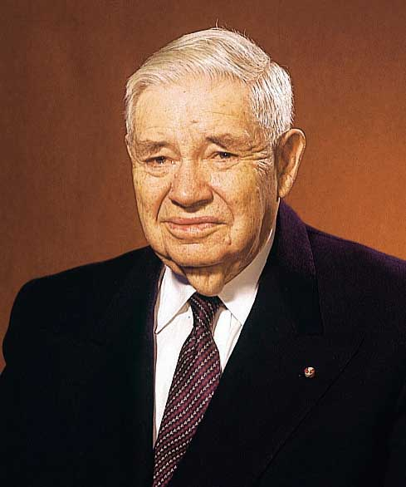
Dust of the Earth
Mosiah 2:25-26
We did not create nor do we own the elements of the earth
King Benjamin talks about the indebtedness to God by noting that even our bodies are made of borrowed materials
JFM and RLM
All mankind, according to our restored text, are born into mortality “by water, and blood, and the spirit.: and so become “of dust” living souls
Moses 6:59
We were born of the dust of the earth in the same manner that our first earthly father was born of dust.
Our bodies, like his, were formed from the elements of this earth and at death will return to those elements from which they were taken, until the glorious day of resurrection
“All who have inhabited the earth since Adam have take bodies and become souls in like manner”
James R. Clark
Adam, the first of all men, was formed from the ground
Genesis 2:7

Slide 15
Responsibility of Teaching
Should the King Benjamin, the messenger, fail to deliver the message, he then assumes a responsibility for the sins of those who went unwarned because he shrugged his duty.
What message do we have to give?
Who are we responsible for?
“Behold, I sent you out to testify and warn the people, and it becometh every man who hath been warned to warn his neighbor.
Therefore, they are left without excuse, and their sins are upon their own heads.”
D&C 88:81-82
Mosiah 2:27-28

Slide 16
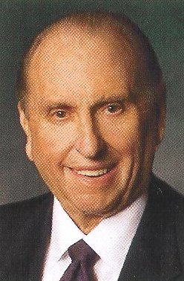
Responsibility of the People:
To accept Mosiah as their king and ruler
Keep the commandments
Keep from falling into the enemies hands
Keep the commandments that Mosiah will teach
Keep peace among yourselves
“We have an opportunity to sustain—support, help, pray for—each of these people in their callings. We indicate our willingness to do so by raising our right hands when their names are read to us in general conference, stake conference, ward or branch conference, or sacrament meeting. Raising our hands is a sign to us, to them, and to the Lord that we will sustain them.”
Thomas S. Monson
Mosiah 2:27-28

Slide 17
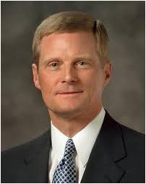
“We should … endeavor to discern when we ‘withdraw [ourselves] from the Spirit of the Lord, that it may have no place in [us] to guide [us] in wisdom’s paths that [we] may be blessed, prospered, and preserved’ …
“… If something we think, see, hear, or do distances us from the Holy Ghost, then we should stop thinking, seeing, hearing, or doing that thing.
If that which is intended to entertain, for example, alienates us from the Holy Spirit, then certainly that type of entertainment is not for us.
Because the Spirit cannot abide that which is vulgar, crude, or immodest, then clearly such things are not for us.
Because we estrange the Spirit of the Lord when we engage in activities we know we should shun, then such things definitely are not for us.”
David A. Bednar
WISDOM’S PATH
EXIT NOW
Mosiah 2:36-38

Slide 18
A State of Never-ending Happiness
If we keep the commandments, we will receive temporal and spiritual blessings in this life and eventually live with Heavenly Father in a state of never-ending happiness.
All, except the little children, had been taught since Lehi had left Jerusalem
Those who desire to keep the commandments will be blessed and happy
Those who die in their sins
Those who rebel
Will have no place with the Lord
Everlasting punishment
Mosiah 2:33-41

Slide 19
Doctrinal Mastery
And moreover, I would desire that ye should consider on the blessed and happy state of those that keep the commandments of God. For behold, they are blessed in all things, both temporal and spiritual; and if they hold out faithful to the end they are received into heaven, that thereby they may dwell with God in a state of never-ending happiness. O remember, remember that these things are true; for the Lord God hath spoken it.
Mosiah 2:41

Slide 20
Sources:
Videos:
The Natural Man (3:23)
Unprofitable Servant (3:04)
Service That Counts (1:51)
Joseph Smith Teaching of Joseph Smith p 172-173
L. Tom Perry The Importance of Family April 2003 Gen. Conf.
Tents--Thou Shalt Give Heed unto All His Words April 2000
Rodney Turner (Studies in Scriptures, ed. By K. Jackson 7:211)
Dallin H. Oak Pure in Heart p 38-49
Joseph Fielding McConkie and Robert L. Millet Doctrinal Commentary on the Book of Mormon Vol. 2 p 139-140
James R. Clark Messages of the First Presidency 4:205
Thomas S. Monson We Sustain Our Leaders March 2012 Ensign
David A. Bednar, “That We May Always Have His Spirit to Be with Us,” Ensign or Liahona, May 2006, 30
Presentation by ©http://fashionsbylynda.com/blog/

