Slide 1
Retaining a Remission of Sins
Mosiah 4
Lesson 54
Suggested Hymn: #185 Reverently and Meekly Now
Presentation by ©http://fashionsbylynda.com/blog/

Slide 2
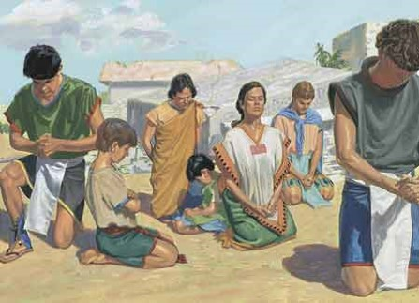
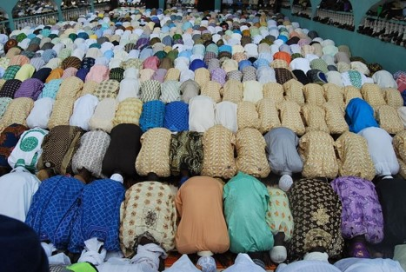
Fallen To The Earth
“…for fear of the Lord had come upon them.”
Fear—Hebrew (Yirah)
Reference or respect…the righteous long to attain the divine presence.
In many cultures of the ancient world, prostration was a manifestation of reverence, respect, or overwhelming awe.
Mosiah 4:1 JFM and RLM

Slide 3
A Carnal State
Opposite of Spiritual
In Eden—Adam and Eve were in a state of: incorruptible, immortal, and free from all taint of sin
With the Fall came the consuming lusts of the flesh…the birth of carnal man
A Carnal Man is one who yields to the flesh
It refers to our physical appetites rather than our spiritual desire to draw nearer to the Lord.
See Alma 41:11
However:
There is one plan of redemption—one system of remission of sins
Mosiah 4:2 JFM and RLM

Slide 4
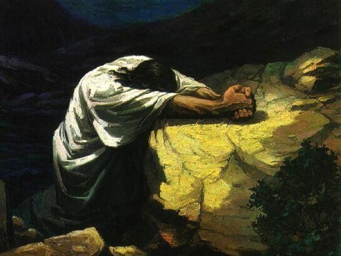
Believe in Christ
Any and all efforts toward Godly sorrow and ultimate forgiveness must center in that redemption that is found only in Christ and his atoning blood.
The blood of Christ is central to the remission of sins.
No matter what the degree of remorse
“A religion that does not require the sacrifice of all things never has power sufficient to produce the faith necessary unto life and salvation.”
Lectures on Faith 6:7
Mosiah 4:2 JFM and RLM

Slide 5
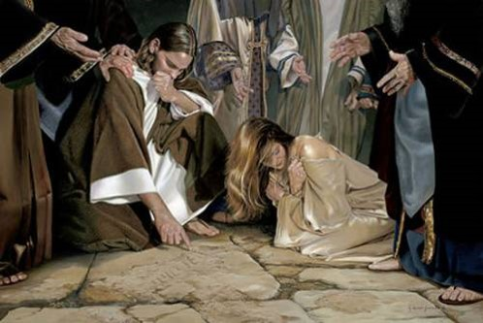
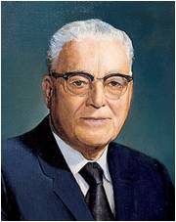
Remission of Sins
King Benjamin’s people received a remission of their sins
How can we know that we have been forgiven of our sins?
“…becometh a saint through the atonement of Christ the Lord, and becometh as a child, submissive, meek, humble, patient, full of love, willing to submit to all things which the Lord seeth fit to inflict upon him, even as a child doth submit to his father.” Mosiah 3:19
“If the time comes when you have done all that you can to repent of your sins, whoever you are, wherever you are, and have made amends and restitution to the best of your ability; if it be something that will affect your standing in the Church and you have gone to the proper authorities, then you will want that confirming answer as to whether or not the Lord has accepted of you. In your soul-searching, if you seek for and you find that peace of conscience, by that token you may know that the Lord has accepted of your repentance”
Harold B. Lee
Mosiah 4:3

Slide 6
How do you know when you have been forgiven?
Where is the grove that I might pray?
Have I walked around it?
I can not find it
Where is my grove where I need to find peace?
How long is my walk?
How long do I anguish?
Can’t the adversary just release me?
Doesn't he know that I don’t desire his words?
Doesn’t he know he can’t have me?
He knows me well, but my God knows me better.
So where is my grove that I might pray
That I might have the peace and love with me
That I might feel of His love
That I might be released from this bondage in my mind
I have found that grove that I might pray
I have walked around it and through it and found it
I have found that grove and I have found peace
My walk is still but a short way off
I anguish only a little now
The adversary is not easily part of me
He still knows me well but he can’t have me
My Savior knows me better and He has reached out for me
I know Him now and what He has done for me
I have found that grove and wish to stay and feel of presence and His love
My mind will be forever free from sorrow
—anonymous

Slide 7
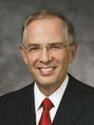
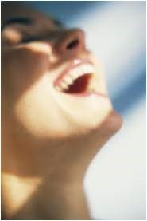
Filled With Joy
“As we honestly confess our sins, restore what we can to the offended, and forsake our sins by keeping the commandments, we are in the process of receiving forgiveness. With time, we will feel the anguish of our sorrow subside, taking ‘away the guilt from our hearts’ (Alma 24:10) and bringing ‘peace of conscience’ (Mosiah 4:3).
“For those who are truly repentant but seem unable to feel relief: continue keeping the commandments. I promise you, relief will come in the timetable of the Lord. Healing also requires time.”
Neil L. Anderson
Feelings of Remission:
Peace and Joy
Enjoying being with others of the same faith
Knowing that favors and blessings are restored
Wanting to serve
Wanting to study and gain a knowledge of light and truth
As we exercise faith in Jesus Christ and sincerely repent, we can be filled with joy, receive a remission of our sins, and have peace of conscience.
Mosiah 4:3

Slide 8
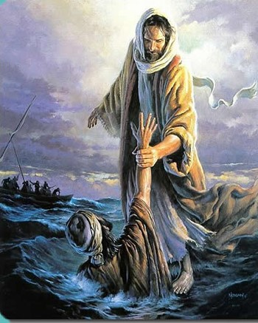
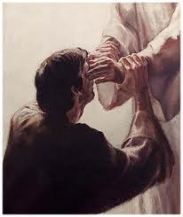
How can we be saved?
Know the goodness of God by:
His Power
His Wisdom
His Patience
His long-suffering
His Atonement
Then :
Trust in Him
Be diligent in keeping His commandments
Continue in Faith to the end
Mosiah 4:4-8

Slide 9
Doctrinal Mastery
Believe in God; believe that he is, and that he created all things, both in heaven and in earth; believe that he has all wisdom, and all power, both in heaven and in earth; believe that man doth not comprehend all the things which the Lord can comprehend.
Mosiah 4:9
Mosiah 4:4-8

Slide 10
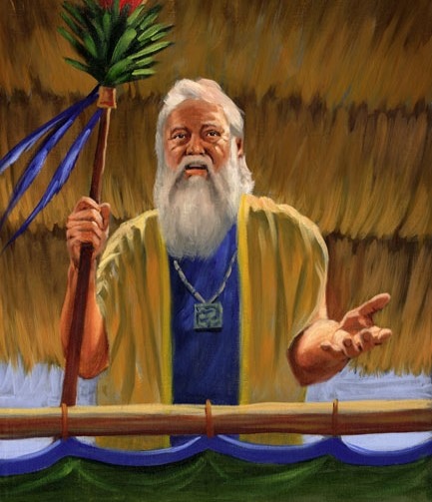
Retain a Remission of Sins
King Benjamin told his people they must “Believe in God”
That they needed to remember the greatness of God
That He created all things
That they were to humble themselves
That they were to pray daily
That they were to stand steadfastly in the faith.
James H. Fullmer
Nevertheless :
“…he that repents and does the commandments of the Lord shall be forgiven;”
D&C 1:32
God created all things and has all power and wisdom
Mosiah 4:9-12

Slide 11
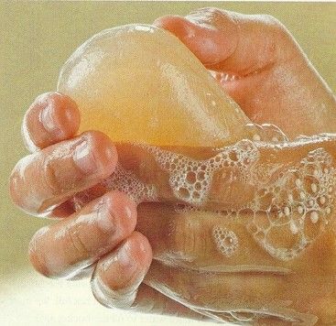
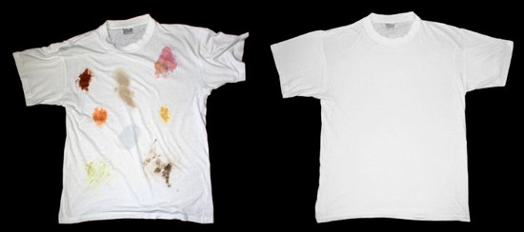
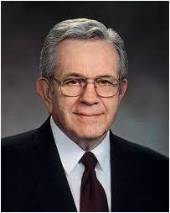
Knowing Your Forgiven
“It is one thing to be adorned in clean clothing It is quite another to keep it clean.
“…It is one thing to be baptized for the remission of sins and quite another to retain that state of purity.”
Humility and reliance upon the Lord are as the soap and water with which the Saints cleanse their garments.
“For those who truly desire it, there is a way back. Repentance is like unto a detergent. Even ground-in stains of sin will come out.”
Boyd K. Packer
Mosiah 4:11-12

Slide 12
God’s Greatness
If we remember God’s greatness, humble ourselves, pray daily, and stand steadfastly in the faith, then we will be filled with God’s love, retain a remission of our sins, and grow in knowledge.
How might humbling ourselves help us grow in knowledge?
How has praying daily helped you retain a remission of your sins?
How can worthily partaking of the sacrament help us to humble ourselves and retain a remission of our sins?
When has doing one of the things listed in the left column of the chart helped you to feel God’s love for you?
Mosiah 4:11-12

Slide 13
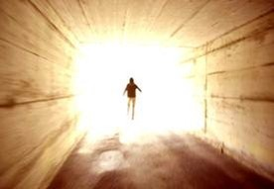
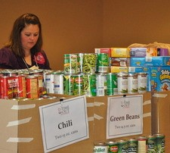
To Have the Lord’s Spirit
Paul Taught:
“But the fruit of the Spirit is love, joy peace, longsuffering, gentleness, goodness, faith,
Meekness, temperance: against such there is no law.”
Galatians 5:22-23
Those who live in the Spirit walk in the Spirit
One who is filled with the Spirit of God:
They will seek to live peaceably with one another.
They will fulfill their sacred family responsibilities
They will help the needy. (succor=give aid, help, or relief)
Book of Mormon Student Manual
Mosiah 4:13-16

Slide 14
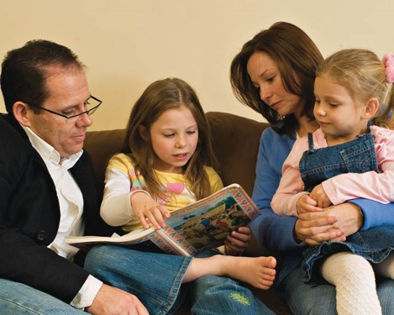
A Great Responsibility
To the parents
“But if any provide not for his own, and specially for those of his own house, he hath denied the faith, and is worse than an infidel.”
1 Timothy 5:8
“And again, verily I say unto you, that every man who is obliged to provide for his own family, let him provide, and he shall in nowise lose his crown; and let him labor in the church.”
D&C 75:28
“But I have commanded you to bring up your children in light and truth.” D&C 93:40
We have no more right to neglect the spiritual welfare of our families than to refuse them food and clothing.
Mosiah 4:14-15

Slide 15
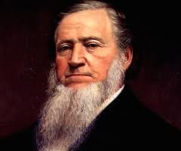
Sharing
For those who stand in need:
“Suppose that in this community there are ten beggars who beg from door to door for something to eat, and that nine of them are imposters who beg to escape work… (What is your choice?) To give food to the ten,…or to repulse the ten because you do not know which is the worthy one?
You will all say, administer charitable gifts to the ten, rather than turn away the only truly worthy…person among them.
If you do this, it will make no difference in your blessings, whether you administer to worthy or unworthy persons, inasmuch as you give alms with a single eye to assist the truly needy.”
Brigham Young
Mosiah 4:16-18

Slide 16
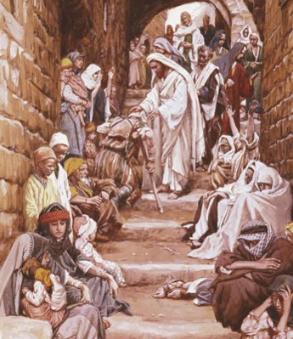
To the Rich and the Poor
King Benjamin speaks to both the rich and the poor
To the rich: That they should give to the poor
To the poor: That they should not covet
“…I give not because I have not, but if I had I would give…”
Coveting = not just wanting something that doesn’t belong to you but it is an attitude.
It is setting one’s heart on the things of the world more than on the things of God
Mosiah 4:17-25

Slide 17
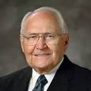
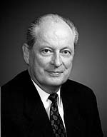
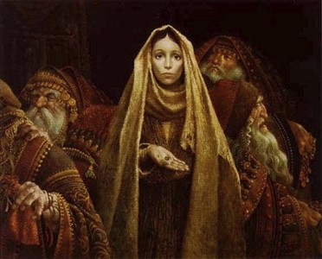
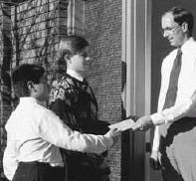
Fast Offerings
“An important reason for fasting is to contribute the amount saved from the meals not eaten to care for the poor and the needy.”
L. Tom Perry
“Showing compassion to those in need and giving of our abundance to help others is an ancient principle. The Lord commanded Moses, “Thou shalt not harden thine heart, nor shut thine hand from thy poor brother: But thou shalt open thine hand wide unto him, and shalt surely lend him sufficient for his need.” (Deut. 15:7–8).
Neil K. Newell
In the Church today:
How can you participate in fast offerings?
We can fast
We can contribute fast offerings
Aaronic Priesthood holders can gather
fast offerings from ward or branch
members
Mosiah 4:26

Slide 18
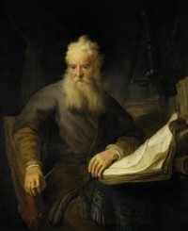
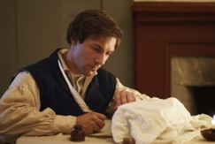
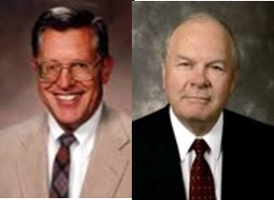
Wisdom and Order
“Behold, mine house is a house of order, saith the Lord God, and not a house of confusion.”
D&C 132:8
Paul
Let all things be done decently and in order.
I Corinthians 14:40
“The Lord’s people are always commanded to search out and care for the poor. They are, however, to do so in wisdom and order—to see to it that such efforts do not neglect the needs of their families. Nor can our obligation to extend temporal aid overshadow eternal covenants…”
JFM and RLM
Joseph Smith
“Do not run faster or labor more than you have strength and means provided to enable you to translate; but be diligent unto the end.”
D&C 10:4
Mosiah 4:26

Slide 19
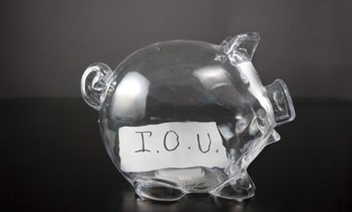
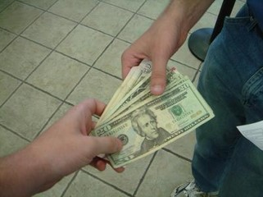
Borrowing
“And I would that ye should remember, that whosoever among you borroweth of his neighbor should return the thing that he borroweth, according as he doth agree, or else thou shalt commit sin; and perhaps thou shalt cause thy neighbor to commit sin also.”
Law of Moses
“And if a man borrow ought of his neighbour, and it be hurt, or die, the owner thereof being not with it, he shall surely make it good.”
Exodus 22:14
Borrowing Money:
If there is any one here intending to go into debt for speculation, … I would advise him to hesitate, pray over it, and carefully consider it before he obligates himself by borrowing money and going into debt. In other words, keep out of debt if you can. Pay your debts as soon as you can.
Money is something that a man ought to be able to take care of and use wisely
if he has it; if he does not know how to take care of it, it will escape from his pockets, it will take the wings of the morning and flee away.
I again admonish the Latter-day Saints to aim and diligently endeavor to free themselves from debt. Get out of debt and keep out of debt, and then you will be financially as well as spiritually free.
Mosiah 4:28

Slide 20
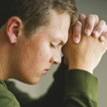
Watch and Pray
“Verily, verily, I say unto you, ye must watch and pray always, lest ye be tempted by the devil, and ye be led away captive by him.”
3 Nephi 18:15
“For our words will condemn us, yea, all our works will condemn us; we shall not be found spotless; and our thoughts will also condemn us; and in this awful state we shall not dare to look up to our God; and we would fain be glad if we could command the rocks and the mountains to fall upon us to hide us from his presence.”
Alma 12:14
However:
“But that ye would humble yourselves before the Lord, and call on his holy name, and watch and pray continually, that ye may not be tempted above that which ye can bear, and thus be led by the Holy Spirit, becoming humble, meek, submissive, patient, full of love and all long-suffering;”
Alma 13:28
If we are not careful about our thoughts, words, and deeds and do not keep the commandments or continue in the faith of Jesus Christ throughout our lives, we will perish.
Mosiah 4:30

Slide 21
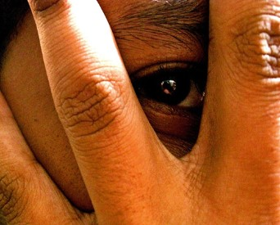
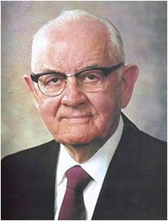
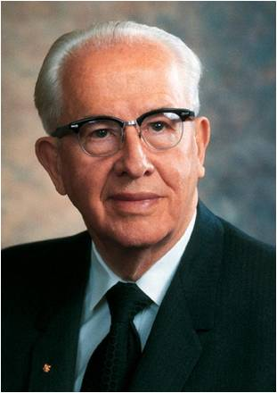
Secret Thoughts
“If men’s secret acts shall be reveled it is likely that their secret thoughts will also be reveled…
The one who harbors evil thoughts sometimes feels safe in the conviction that these thoughts are unknown to others…
Accordingly, men’s deeds and thoughts must be recorded in heaven, and recording angels will not fail to make complete recordings of our thoughts and actions.”
Spencer W. Kimball
“Think clean thoughts. Those who think clean thoughts do not do dirty deeds. You are not only responsible before God for your acts but also for controlling your thoughts. So live that you would not blush with shame if your thoughts and acts could be flashed on a screen in your church.
The old adage is still true that you sow thoughts and
you reap acts, you sow acts and you reap habits, you
sow habits and you reap a character, and your
character determines your eternal destiny.
‘As a man thinketh, so is he.’” Ezra T Benson
Mosiah 4:30

Slide 22
Filling Our Lives With Light
Light and darkness cannot occupy the same space at the same time.
Light Dispels Darkness
For example:
Appropriate music
Uplifting visual images
Wholesome activities
Clean thoughts and words
All of these will invite the Spirit into our lives and push unworthy thoughts out of our minds.
What can you do to keep your thoughts, words, and deeds clean?

Slide 23
Sources:
Video:
Watch Your Thoughts (1:17)
Joseph Fielding McConkie and Robert L. Millet Doctrinal Commentary on the Book of Mormon Vol. 2 p. 156
Harold B. Lee (“Stand Ye in Holy Places,” Ensign, July 1973, 122).
Neil L. Anderson (“Repent … That I May Heal You,” Ensign or Liahona, Nov. 2009, 42).
See also Luke 15:8-10 “Rejoice with Me” Parable of the Lost Coin
Boyd K. Packer Cleansing the Inner Vessel Oct 2010 Gen. Conf.
Brigham Young Discourses of Brigham Young p. 274
Book of Mormon Student Manual Religion 121-122 p. 165
L. Tom Perry Conference Report, Apr. 1986, 39; or Ensign, May 1986, 31.
Neil K. Newell Fast Offerings: Blessings We Give, Blessings We Receive Oct. 1998 Conf. Report
Barrowing: In Conference Report, Oct. 1911, 128–29.
Deseret News: Semi-Weekly, 8 Aug. 1884, 1.
In Conference Report, Oct. 1903, 5.
Spencer W. Kimball Miracle of Forgiveness pg. 108
Ezra T Benson (in Conference Report, Oct. 1964, 60; quoting Proverbs 23:7).
Other Good Reads: Gordon B. Hinckley “Thou Shalt Not Covet” Ensign March 1990
Presentation by ©http://fashionsbylynda.com/blog/

Slide 24
Caring for the Poor and Needy Mosiah 4:11,-26:
“Don’t we all cry out for help and hope and answers to prayers? Don’t we all beg for forgiveness for mistakes we have made and troubles we have caused? Don’t we all implore that grace will compensate for our weaknesses, that mercy will triumph over justice at least in our case? Little wonder that King Benjamin says we obtain a remission of our sins by pleading to God, who compassionately responds, but we retain a remission of our sins by compassionately responding to the poor who plead to us [see Mosiah 4:11–12, 20, 26]” (Jeffrey R. Holland, “Are We Not All Beggars?” Ensign or Liahona, Nov. 2014, 41).
Thoughts and Words Mosiah 4:30:
“Some bad thoughts come by themselves. Others come because we invite them by what we look at and listen to. Talking about or looking at immodest pictures … can stimulate powerful emotions. It will tempt you to watch improper [videos] or movies. These things surround you, but you must not participate in them. Work at keeping your thoughts clean by thinking of something good. The mind can think of only one thing at a time. Use that fact to crowd out ugly thoughts. Above all, don’t feed thoughts by reading or watching things that are wrong. If you don’t control your thoughts, Satan will keep tempting you until you eventually act them out” (Richard G. Scott, “Making the Right Choices,” Ensign, Nov. 1994, 37).
Watch Your Thoughts and Words Mosiah 4:30:
“As you learn to control your thoughts, you can overcome habits, even degrading personal habits. You can gain courage, conquer fear, and have a happy life. I had been told … as I grew up that thoughts must be controlled, but no one told me how. I’ve thought about this over the years and have decided that the mind is like a stage. During every waking moment the curtain is up. There is always some act being performed on that stage. It may be a comedy, a tragedy, interesting or dull, good or bad; but always there is some act playing on the stage of your mind.
“Have you noticed that shady little thoughts may creep in from the wings and attract your attention in the middle of almost any performance and without any real intent on your part? … If you permit them to go on, all thoughts of any virtue will leave the stage. … What do you do at a time like that, when the stage of your mind is commandeered by the imps of unclean thinking … ? If you can fill your mind with clean and constructive thoughts, then there will be no room for these persistent imps, and they will leave” (Boyd K. Packer, “Worthy Music, Worthy Thoughts,” New Era, Apr. 2008, 7–8).
Removing Bad Thoughts Mosiah 4:30:
“Choose a favorite hymn or song, … one with words that are uplifting and music that is reverent, one that makes you feel something akin to inspiration. There are many beautiful songs to choose from. Seek the guidance of the Spirit in making your selection. Go over the song in your mind carefully. Memorize it. Even though you have had no musical training, you can think through a simple song. Now use this as the course for your thoughts to follow. Make it your emergency channel. …
“Because the music is uplifting and clean, the baser thoughts will slip shamefully away. For while virtue, by choice, will not associate with filth, evil cannot tolerate the presence of light. In due time you will find yourself humming the music inwardly, almost automatically, to drive out unworthy thoughts” (Boyd K. Packer, “Worthy Music, Worthy Thoughts,” 11).

