Slide 2
Difficult To Do Right
A young woman is trying to do what is right. She prays and reads her scriptures often. She attends her Church meetings. She wants to be good, but at school and in other places she hears inappropriate language and sees a lot of inappropriate behavior. Sometimes she gives in to temptation and does things she knows are not right.
Why can it be difficult for us to always desire to do what is right?

Slide 3
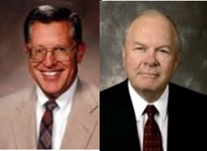
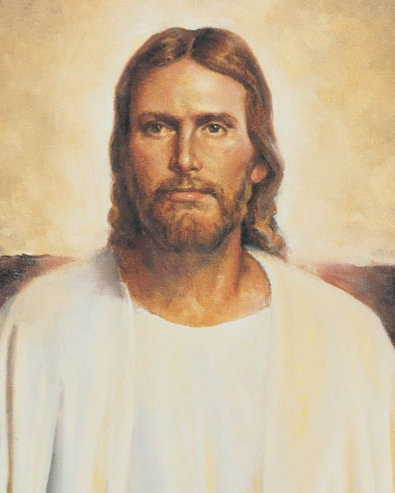
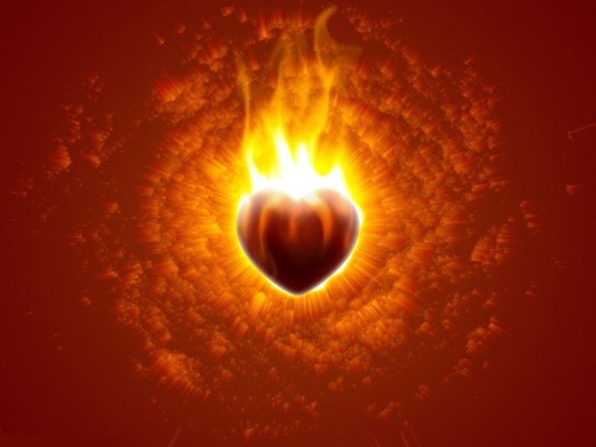
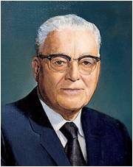
We Believe
“One of the true sign of conversion is an intelligent acceptance of the words of the Lord’s anointed.”
JFM and RLM
“Man or woman is not truly converted unless he sees the power of God resting upon the leaders of this Church and it goes down into his heart like fire.”
Harold B. Lee
Mosiah 5:2

Slide 4
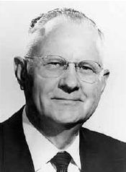
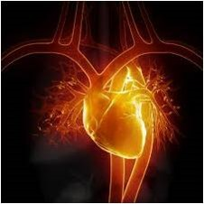
The Heart
Dictionary definition:
Heart is the enter of total personality with reference to intuition, feeling, or emotion: the center of emotion, in contrast to head as the center of the intellect.
The core of life and strength
Including:
The mind, spirit, and soul, and one’s entire emotional nature and understanding.
The central source of one’s mental faculties or capacities
“for as he (man) thinketh in his heart, so is he.”
Proverbs 23:7
The seat of one’s affection, moral life, and character
The heart is defined as having spirit, courage, and enthusiasm
Mosiah 5:2 Delbert L. Stapley

Slide 5
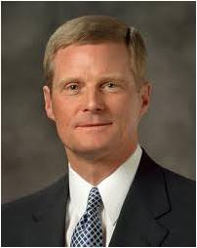
Inward Change
Have you ever felt that you needed to change spiritually?
What did you do about it?
If you have experienced a change, have you maintained that change to this day?
“The essence of the gospel of Jesus Christ entails a fundamental and permanent change in our very nature made possible through our reliance upon ‘the merits, and mercy, and grace of the Holy Messiah’ (2 Nephi 2:8). As we choose to follow the Master, we choose to be changed—to be spiritually reborn”
David A. Bednar
As our hearts are changed through the Spirit of the Lord, we lose the desire to do evil and gain the desire to do good continually
Mosiah 5:1-4

Slide 6
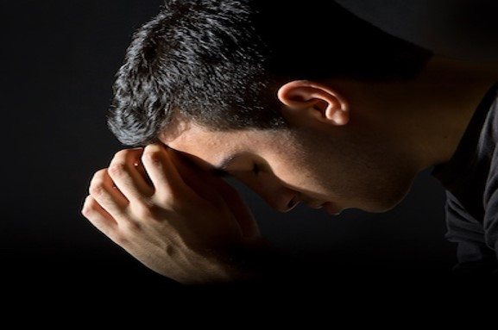
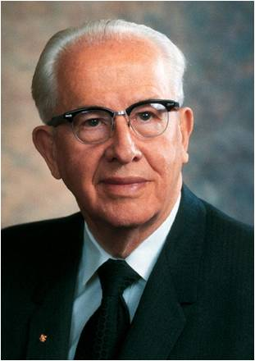
As our hearts are changed through the Spirit of the Lord, we lose the desire to do evil and gain the desire to do good continually
“Becoming Christlike is a lifetime pursuit and very often involves growth and change that is slow, almost imperceptible. …
“… True repentance involves a change of heart and not just a change of behavior. … Most repentance does not involve sensational or dramatic changes, but rather is a step-by-step, steady, and consistent movement toward godliness.” Ezra Taft Benson
Mosiah 5:1-4

Slide 7
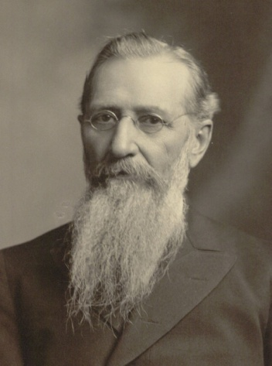
The Power of the Holy Spirit Within
“What a glorious condition was this! A condition in which the Lord God Omnipotent, by the power of His Spirit, had wrought a mighty change in the hearts of that people, that they no longer had any desire to do evil, but were filled only with a fervent desire to do that which was good.”
…the influence and power of the Holy Spirit…the feeling that came upon me was that of pure peace, of love and of light…
…I felt as though I wanted to do good everywhere to everybody and to everything.
…I felt a newness of life, a newness of desire to do that which was right.
There was not one particle of desire for evil left in my soul.”
Joseph F. Smith--Speaking of his baptism
Mosiah 5:2

Slide 8
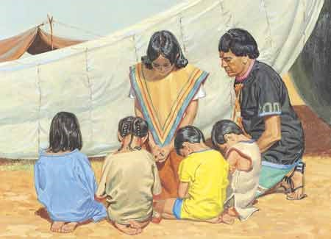
Disposition
An individual’s nature—his or her desires and temperament.
King Benjamin’s people did not have the desire to do evil anymore
Nephi’s Cry:
“O Lord, wilt thou redeem my soul? Wilt thou deliver me out of the hands of mine enemies? Wilt thou make me that I may shake at the appearance of sin?”
2 Nephi 4:31
Mosiah 5:2

Slide 9
What Brings About a Change of Heart?
A change of heart is more than just a change of behavior.
When we experience a change of heart, we become new people, changed through the power of the Savior’s Atonement.
“The gospel of Jesus Christ encompasses much more than avoiding, overcoming, and being cleansed from sin and the bad influences in our lives; it also essentially entails doing good, being good, and becoming better. … This mighty change is not simply the result of working harder or developing greater individual discipline. Rather, it is the consequence of a fundamental change in our desires, our motives, and our natures made possible through the Atonement of Christ the Lord. Our spiritual purpose is to overcome both sin and the desire to sin, both the taint and the tyranny of sin”
David A. Bednar
Why do you think we need the Atonement of Jesus Christ in order to truly change?
Mosiah 5:2

Slide 10
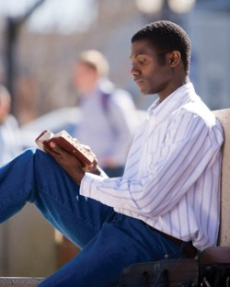
Spirit of Prophecy For The Faithful Servants
“The spirit of revelation is the spirit of prophecy.
That same spirit by which one gains a remission of sins, by which he loses all desire for future sin—
that same spirit grants to faithful men and women “great views of that which is to come,” allowing them when appropriate, to “prophesy of all things.”
Faith brings knowledge, a knowledge which everlastingly enriches the soul.
The command of the Lord is always to seek learning, even by study and by faith
D&C 88:118
Mosiah 5:3 JFM and RLM

Slide 11
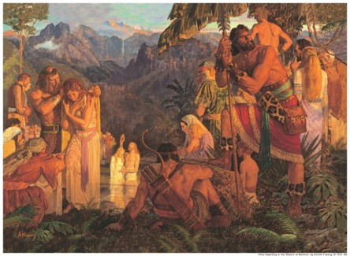
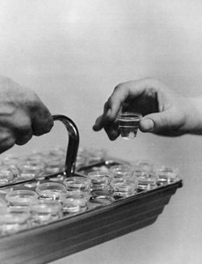
A Renewal of Covenants
King Benjamin’s people were already baptized.
“They had been baptized at their initial conversion or as they arrived at the years of accountability, they had previously taken upon themselves the name of Christ; and they now renewed those commitment to keep the commandments of God the remainder of their days”
True saints:
“live by every word that proceedeth forth from the mouth of God”
D&C 84:44
Salvation is not found in partial truths or in partial acceptance of the truth— “it is in all things and all the remainder of our days”
Mosiah 5:5 JFM and RLM

Slide 12
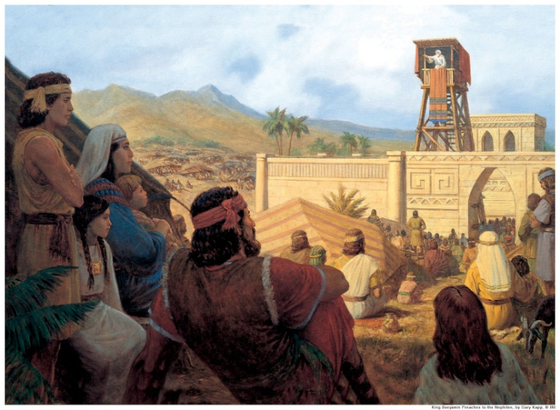
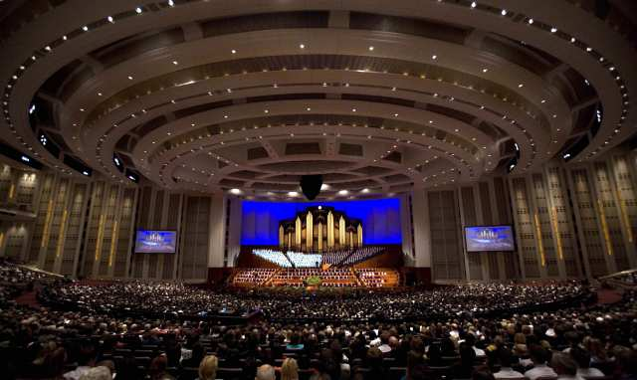
The Power of the Spoken Words
“And now, these are the words which king Benjamin desired of them; and therefore he said unto them: Ye have spoken the words that I desired; and the covenant which ye have made is a righteous covenant.”
“The gospel teacher (King Benjamin) labors with all his soul to present a message which would please God and would edify and motivate his listeners to righteousness. No greater reward could be presented him than a congregation who feels the spiritual power of his words, and believes and acts upon them.”
JFM and RLM
As we make and keep sacred covenants, we take upon ourselves the name of Jesus Christ
Mosiah 5:6

Slide 13
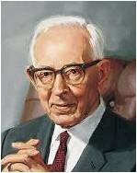
A New Name
What name did King Benjamin give his people?
The name of Christ
When do we take upon ourselves the name of Jesus Christ?
We take upon ourselves the name of Jesus Christ when we make and keep sacred covenants
“Jesus Christ also “becomes our Father” because He “offers us life, eternal life, through the atonement which he made for us.
…We become the children, sons and daughters of Jesus Christ, through our covenants of obedience to him”
Joseph Fielding Smith
Mosiah 5:8

Slide 14
Elohim—Our Heavenly Father
We were born of an eternal Heavenly Father.
We acquired spiritual qualities and characteristics from God
All of us are now spirit sons or daughters of God and have part of his divine nature in us
Can you see the reasonable basis for the belief that you can become a god like his is by progressing here and hereafter?
Our Earthly Father
Each of us had an earthly father who gave us mortal life and thus became our physical father
We have acquired earthly qualities and characteristics from him
We bear his name and have part of his nature in us
Consider the reasonable truth that you possess many of his characteristics and can become like him
Jesus Christ—Our Savior and Spiritual Father
Jesus Christ is he who gives us immortality beyond the grave through the Resurrection. Since that is true for all men, he is the Father of all the family of God
We can be spiritually reborn through the sanctifying influence of the Atonement; hence, for all who will repent, be baptized, and endure faithfully to the end by following the spirit, Christ becomes their father
Through rebirth we acquire distinct Chrislike qualities, partake of his divine nature, and become his son or daughter
We now take upon ourselves a new name, even the name of Jesus Christ. Do you understand that you have the qualities and power to become like him through this “mighty change” called spiritual rebirth?
How are we Children of God, the Father, and Jesus Christ?
Mosiah 5:7-12 Book of Mormon Student Manual 2013

Slide 15
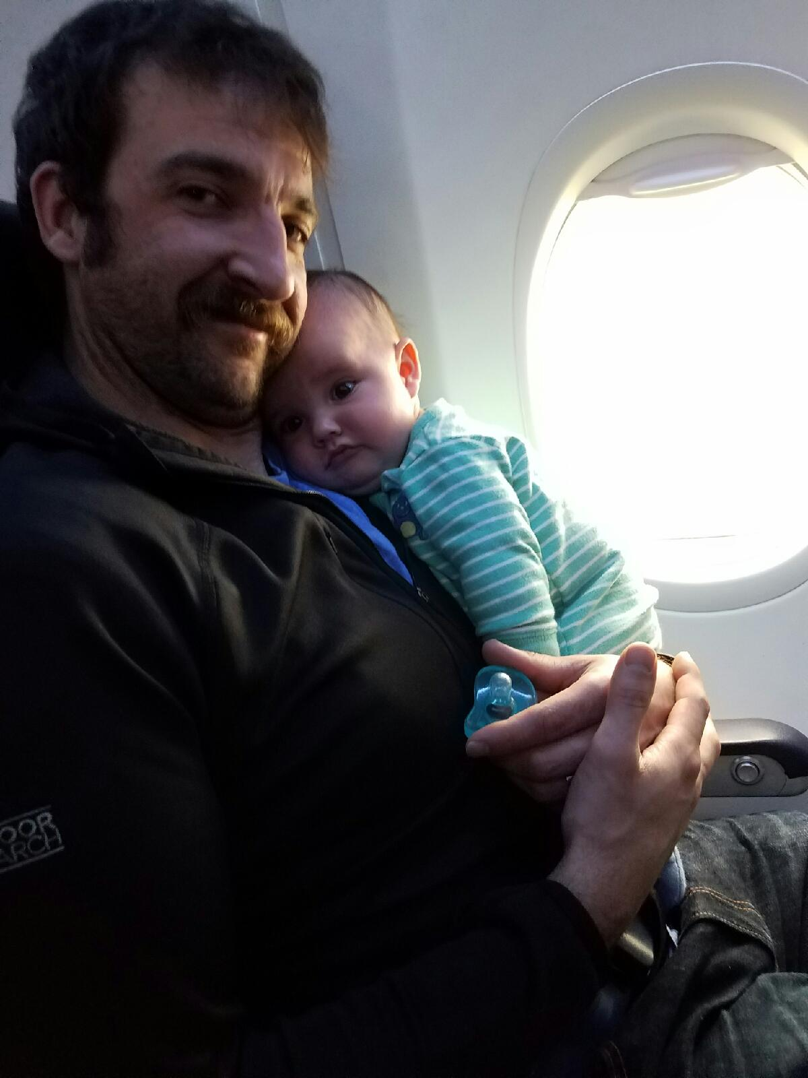
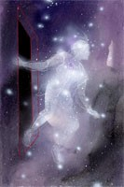
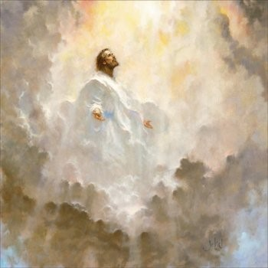
Process of Becoming like God
Requires three fathers
Our Heavenly Father, who gave us our spirit body
Our earthly father, who gave us a physical, mortal body
Our Savior-Father, who gives us a resurrected, eternal body, which will be a celestial body if we accept him and faithfully live by his every word. Also he gives us a remission of our sins and enables us to develop a celestial spirit
Mosiah 5:7-12 Book of Mormon Student Manual

Slide 16
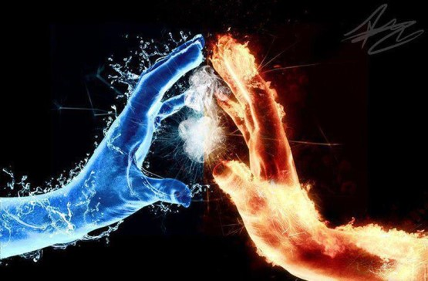
The Right Hand of God
Sinister—left side
Something unfavorable
Sheep—Matthew 25:33
The Lord has frequently utilized this distinction to contrast the blessed state of those who are loyal to him and keep the commandments
Dexter—right side
Something favorable
Goats—Matthew 25:33
“Fear thou not; for I am with thee: be not dismayed; for I am thy God: I will strengthen thee; yea, I will help thee; yea, I will uphold thee with the right hand of my righteousness.”
Isaiah 41:10
Those found on the right hand of Christ “know the name by which (they are) called;…the name of Christ
Mosiah 5:9-10

Slide 17
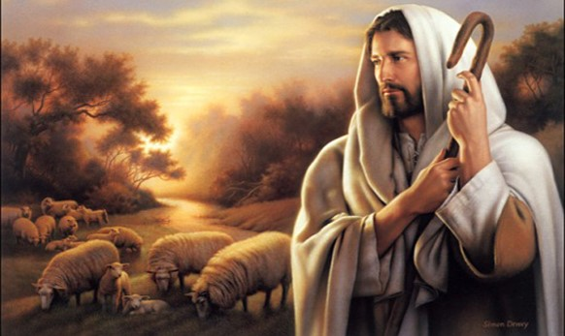
Some Other Name
Spiritual orphans:
Those who are not adopted into the family of the Lord Jesus Christ
Those who choose not to align themselves with him and his case
Simon Dewey
“Behold, I say unto you, that the good shepherd doth call you; yea, and in his own name he doth call you, which is the name of Christ; and if ye will not hearken unto the voice of the good shepherd, to the name by which ye are called, behold, ye are not the sheep of the good shepherd.
And now if ye are not the sheep of the good shepherd, of what fold are ye? Behold, I say unto you, that the devil is your shepherd, and ye are of his fold; and now, who can deny this? Behold, I say unto you, whosoever denieth this is a liar and a child of the devil.”
Alma 5:38-39
Mosiah 5:10

Slide 18
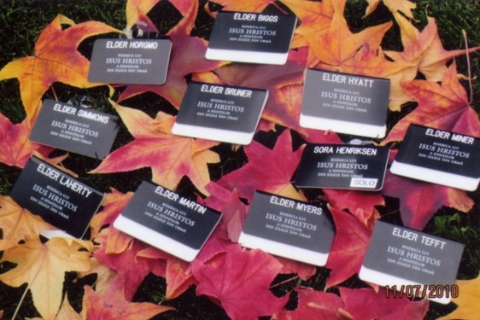
Take Upon Ourselves
What do you think it means to have the name of Christ written in your heart?
What blessings come to those who have the name of Christ written in their hearts?
How do those who honor the name of Christ show reverence and love for the name of Christ?
How well have we taken upon ourselves the name of Christ?
Mosiah 5:11-15

Slide 19
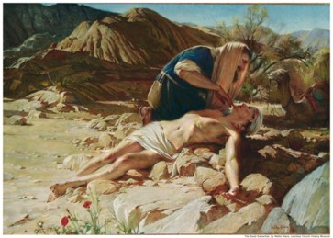
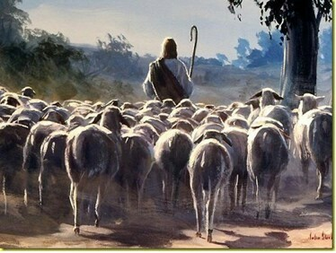
Never Blotted Out And Know the Lord
“Birthrights can be lost. One can be disinherited, can lose the privileges and blessings of membership in the royal family. Neither men nor demons can rob one of the rightful family ties; on the other hand, impurity and disloyalty can sever one from the honors of heirship.”
JFM and RLM
King Benjamin pleads with his people to be spiritually alert and avoid transgression
Jesus taught that his sheep knew his voice—To know the Lord is to recognize the voice of Christ in this life
King Benjamin reminds us that we come to know the Lord through serving others (Mosiah 2:17).
Mosiah 5:11-15

Slide 20
“The word ‘steadfast’ is used to suggest fixed in position, solid and firm, unshaken and resolute (Oxford English Dictionary Online,2nd ed. [1989], “Steadfast”). The word ‘immovable’ is used to indicate that a person or thing is unalterable, firmly secured, and not subject to change.
It also signifies the quality of being unyielding and incapable of being diverted from one’s purpose (Oxford English Dictionary Online, “Immovable”). Thus, a person who is steadfast and immovable is solid, firm, resolute, firmly secured, and incapable of being diverted from a primary purpose or mission”
David A. Bednar
Mosiah 5:15

Slide 21
Mosiah I and Mosiah II
King Benjamin named his son Mosiah after his own father.
It was Mosiah I who was commanded of the Lord to depart into the wilderness because of the wickedness of the Nephites (Omni 1:12)
The book of Mosiah is name after Mosiah II, for he is the one who kept the record
Mosiah 6:4-7

Slide 22
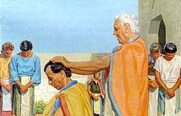
Last Words of King Benjamin
It was important for King Benjamin to keep a record of the names of those who entered into a covenant with the Lord
Everyone except little children entered into the covenant and had taken upon them the name of Christ
King Benjamin consecrated his son Mosiah to be a ruler and a king over his people
He also appointed priest to teach the people and to remind them of their covenants
He dismissed each family to return to their own houses
Mosiah 6:1-3

Slide 23
Mosiah’s Reign
Mosiah was 30 years old when he began to reign
It was 466 years from the time that Lehi left Jerusalem
King Benjamin lived 3 more years then died
King Mosiah did “walk in the ways of the Lord, and did observe his judgments and his statutes, and did keep his commandment in all things”
King Mosiah had his people till the earth and produce things for themselves like his father had done
Mosiah started the “Judges program” having elected Alma as chief judge
He died about 92 BC at the age of 63 and reigned 33 years

Slide 24
Sources:
Delbert L. Stapley Conf. Report Oct. 1968 pg. 27-28 or quoted in Book of Mormon Student Manual Religion 121-122 p 166
Joseph Fielding McConkie and Robert L. Millet Doctrinal Commentary on the Book of Mormon Vol. 2 p. 175-176
Harold B. Lee Be Loyal to the Royal Within You p 90
David A. Bednar (“Clean Hands and a Pure Heart,” Ensign or Liahona, Nov. 2007, 81–82).
(“Ye Must Be Born Again,” Ensign or Liahona, May 2007, 20).
(“Steadfast and Immovable, Always Abounding in Good Works,” New Era, Jan. 2008, 2)
Ezra Taft Benson, “A Mighty Change of Heart,” Ensign, Oct. 1989, 5
Joseph Fielding Smith (Doctrines of Salvation, comp. Bruce R. McConkie, 3 vols. [1954–56], 1:29).
Book of Mormon Student Manual Religion 121-122 p 168
Joseph F. Smith Speaking of his baptism—Conf. Report April 1898 p 65-66
Presentation by ©http://fashionsbylynda.com/blog/

Slide 25
Elohim—Our Heavenly Father
We were born of an eternal Heavenly Father.
We acquired spiritual qualities and characteristics from God
All of us are now spirit sons or daughters of God and have part of his divine nature in us
Can you see the reasonable basis for the belief that you can become a god like his is by progressing here and hereafter?
Our Earthly Father
Each of us had an earthly father who gave us mortal life and thus became our physical father
We have acquired earthly qualities and characteristics from him
We bear his name and have part of his nature in us
Consider the reasonable truth that you possess many of his characteristics and can become like him
Jesus Christ—Our Savior and Spiritual Father
Jesus Christ is he who gives us immortality beyond the grave through the Resurrection. Since that is true for all men, he is the Father of all the family of God
We can be spiritually reborn through the sanctifying influence of the Atonement; hence, for all who will repent, be baptized, and endure faithfully to the end by following the spirit, Christ becomes their father
Through rebirth we acquire distant Chrislike qualities, partake of his dive nature, and become his son or daughter
We now take upon ourselves a new name, even the name of Jesus Christ. Do you understand that you have the qualities and power to become like him through this “mighty change” called spiritual rebirth?
Mosiah 7-12 Book of Mormon Student Manual Religion 121-122 pg. 168

