Slide 2
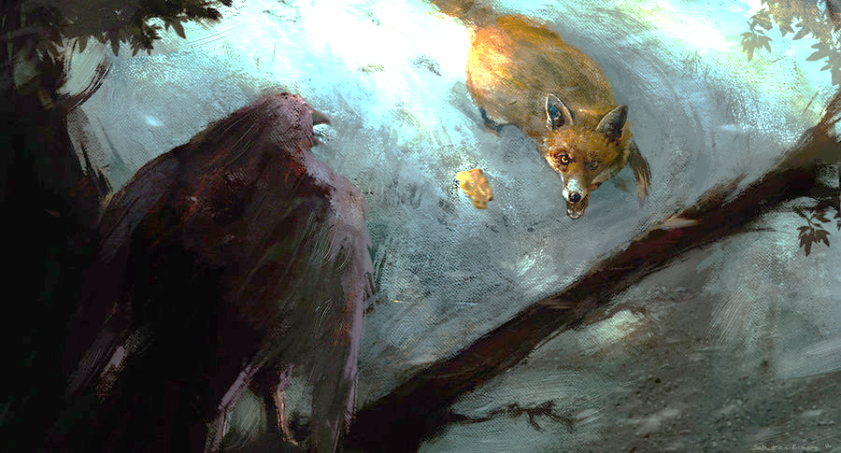
The Crow and The Fox
A crow sat in a tree with a piece of cheese in her beak. A fox came along and began telling the crow how noble and beautiful she was.
What was the fox able to do through flattery?
Sabastien Ecosse
When the fox asked if her voice was as beautiful as her feathers, the crow opened her beak to sing for the fox. As the crow let out a noisy “Caw!” the cheese dropped to the ground and the fox took it and ran.

Slide 3
Noah
He was the son of Zeniff
He was the second of the Nephite kings in the colony established by Zeniff and reigned around 160 BC
Because of his wicked ways, he led the Nephite people into bondage
The Lord sent a prophet (around 150 BC) to call Noah and his priests to repent
After Abinidi’s death Noah fled into the wilderness out of fear
His son, Limhi, did not flee and stayed to protect the people while Gideon, a strong soldier, rebelled against King Noah and attempted to kill him
Gideon searched for Noah and the others and found that Noah had suffered death by fire—which was a prophecy of Abinadi’s

Slide 4
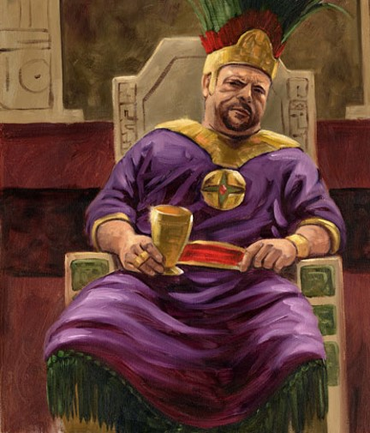
A Corrupt Kingdom
Noah did not “walk in the ways” of his father by:
Not keeping the commandments of God
Went after his own desires
Had many wives and concubines—a wicked practice of a man living with more than one woman in or out of marriage without God’s approval
Caused that his people commit sins
Changed the affairs of the kingdom
James H. Fullmer
No longer did the people walk in the lighted path of goodness but chose instead to follow a dark and crooked road
Mosiah 11:1-4

Slide 5
Bad Influences
Friends who don’t respect your standards
Advertisement that sells inappropriate morals
Inappropriate lyrics in music
Inappropriate online viewing or socializing
Friends who tempt you to do something wrong
Friends or dates with immoral values
Inappropriate movies or television
Parties with alcohol or drugs

Slide 6
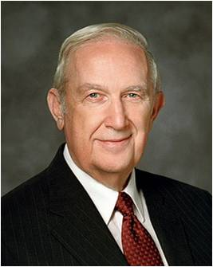
If we allow ourselves to be influenced by the vain and flattering words of others, we can be deceived into committing sin
“You can’t please God without upsetting Satan, so you will get pressure from those he tempts to do wrong.
Individuals who do wrong want you to join them because they feel more comfortable in what they are doing when others do it also…
One of the hardest things for you to recognize is how truly strong you already are and how others silently respect you.
You don’t need to compromise your standards to be accepted by good friends.
No one intends to make serious mistakes. They come when you compromise your standards to be more accepted by others. You be the strong one. You be the leader. Choose good friends and resist peer pressure together.”
Richard G. Scott
Mosiah 11:1-2

Slide 7
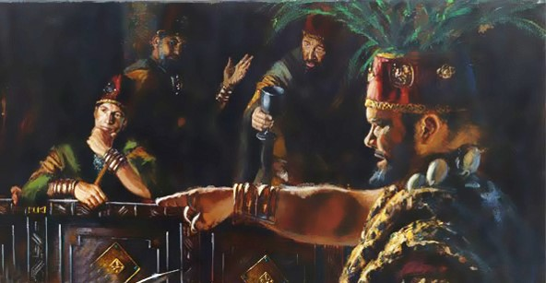
Noah’s Priests
The Priests, consecrated by Zeniff had been replaced by Noah’s own men and caused them to do as he did, by having wives and concubines and do all manner of wickedness.
The priests were corrupt and their priesthood defiled.
A righteous government is essential to the preservation of society, and leadership is a sacred trust. All who have led others in the paths of wickedness will be rewarded according to their works.
Mosiah 11:5-7 Manual

Slide 8
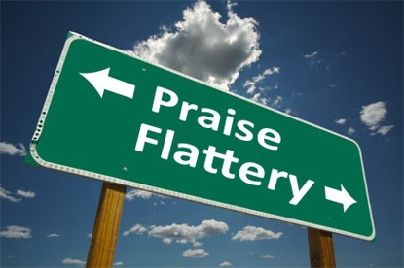
Why do you think the people were willing to support Noah in his wickedness?
Why can “vain and flattering words” lead people to be deceived?
Flattery is false praise, usually given
to manipulate the person being
praised.
When we believe the vain and flattering words of others, we open ourselves to be misled
What can we do when people all around us are living unrighteously?
Mosiah 11:5-7

Slide 9
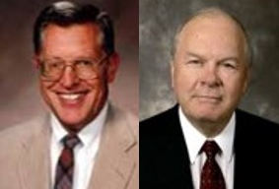
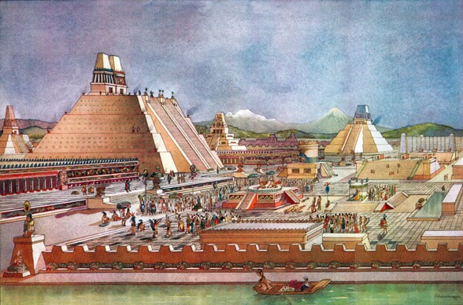
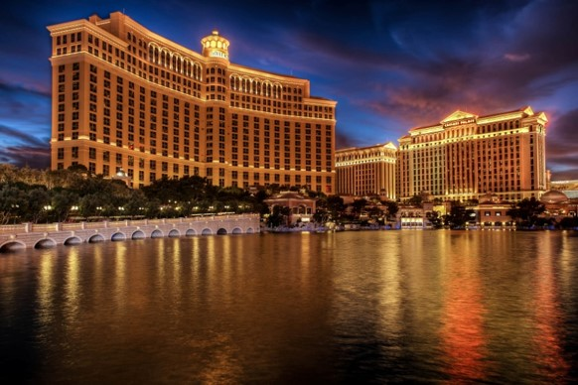
Noah’s Empire
An earmark of false religion is its attempt to hide its emptiness in such things as pomp and ceremony, grandeur and elegance. JFM and RLM
The purpose of great and spacious buildings, ornate in décor, is to create a sense of reverence and awe that otherwise would be lacking.
However…
These are the kingdoms of the world
Mosiah 11:8-15

Slide 10
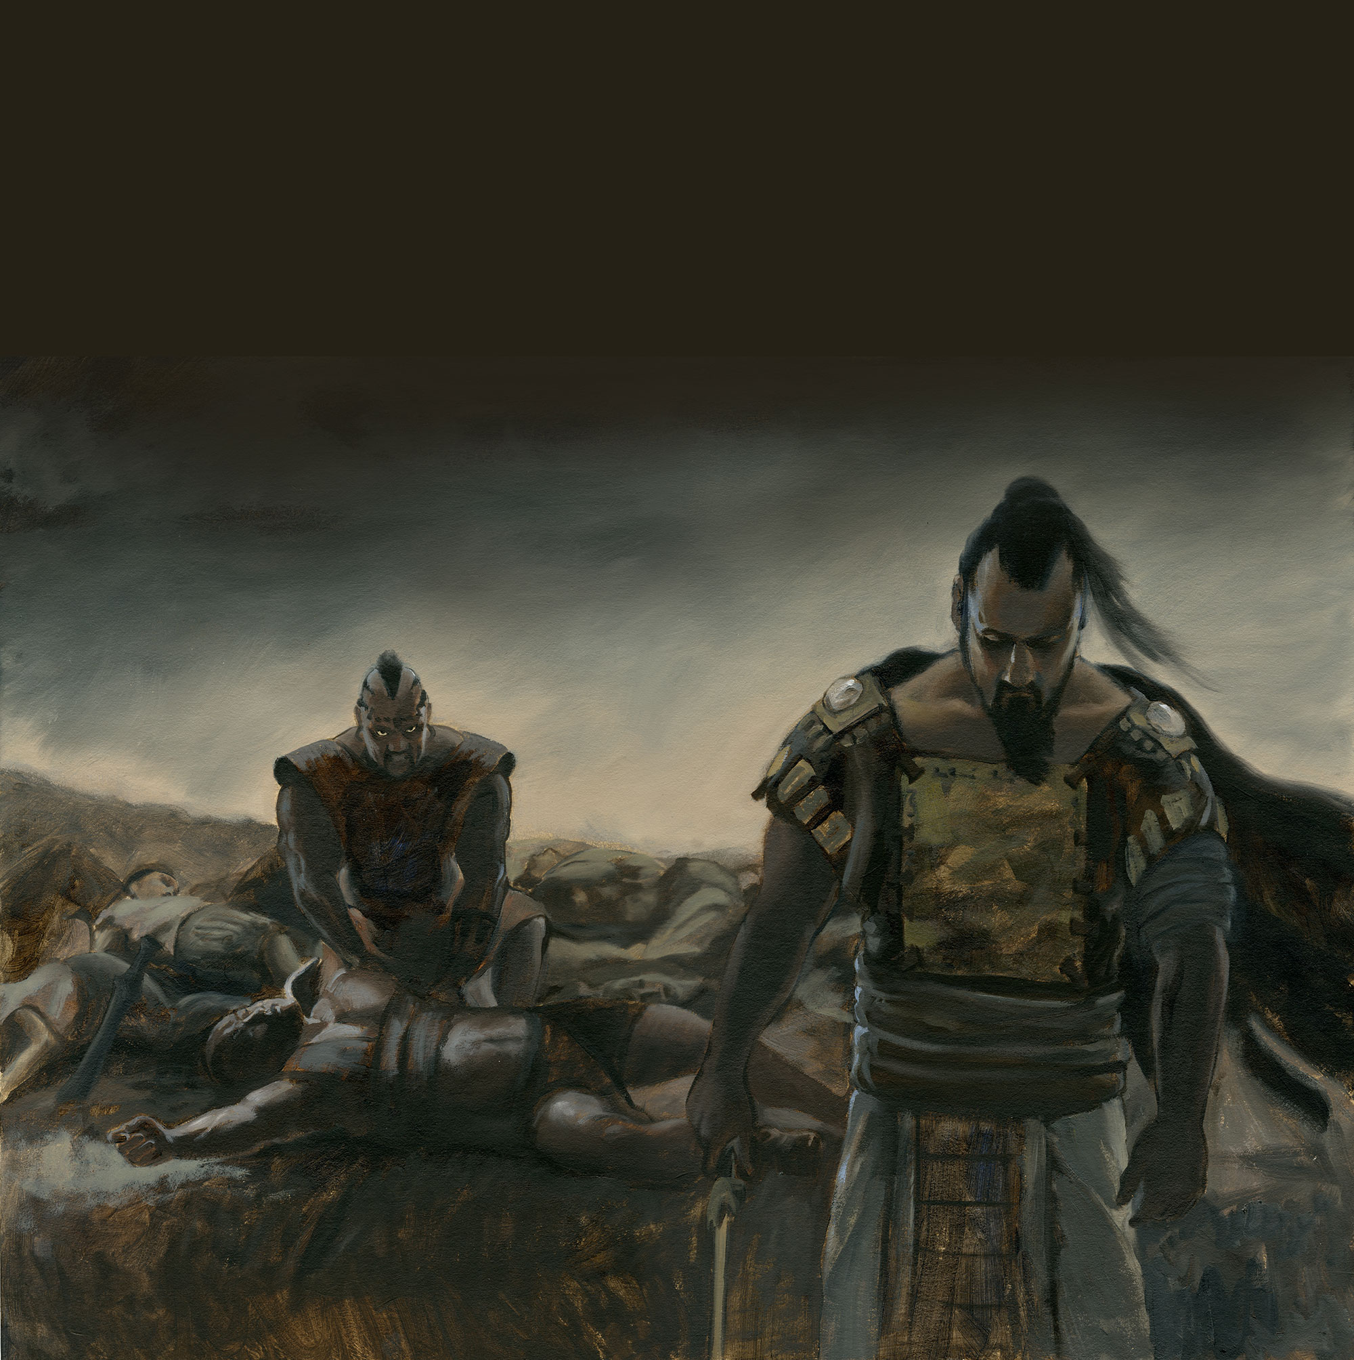
Boasting in Their Own Strength
The Lord told Nephi that if the day ever came that the Nephites rebelled against the commandments, the Lamanites would be given power to scourge them “to stir them up in the ways of remembrance.”
1 Nephi 2:21-24
The Lamanites, little by little began attacking the flocks and fields of the Nephites
Some of the Nephites were killed and Noah’s army fought back and drove them back temporarily---
“…and thus they did boast, and did delight in blood, and the shedding of the blood of their brethren, and this because of the wickedness of their king and priests.”
Mosiah 11:16-19

Slide 11
Abinadi
He was a Nephite
The Lord sent him to the Nephites in the land of Lehi-Nephi during the reign of King Noah to warn the people of their destruction if they don’t repent or their unrighteous living
Around 150 BC
His words were rejected and he was forced to flee
After 2 years he returned in disguise to teach about the Lord
He was found and bound before Noah’s court
His mission was to teach about the Savior
He was surrounded by the Spirit and taught from Isaiah
He prophesied of king Noah’s death
They rejected him again, except one man, and he was burned at the stake

Slide 12
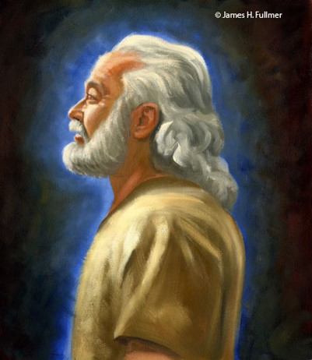
Abinadi’s First Warning
The Lord does not discipline a people unless he first warns them of that which is to come and with great patience invites them to repent.
We know of no instance in which the nation of Israel or any of its remnants have been placed in bondage to their enemies that was not the result of their own wickedness and in which they were not forewarned by prophets sent specifically for that purpose.
As disobedience brings bondage and sorrow to nations, so it does to individuals.
James H. Fullmer
Jealous God—Man cannot serve two masters—a manifestation of his desire to save all his children
Matthew 6:24
Mosiah 11:20-23 JFM and RLM

Slide 13
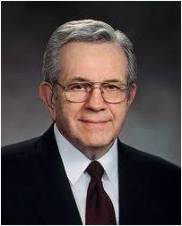
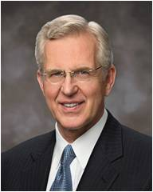
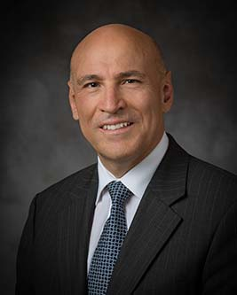
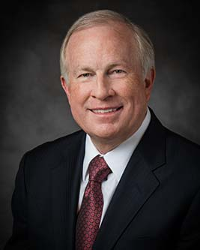
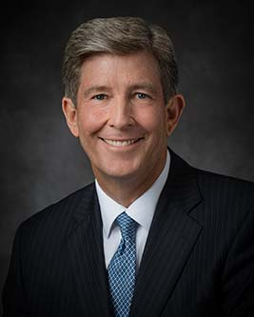
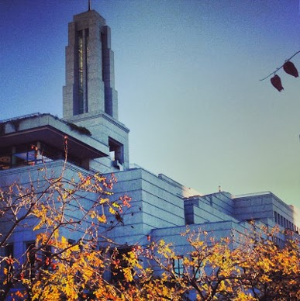
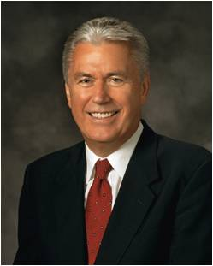
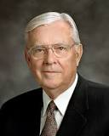
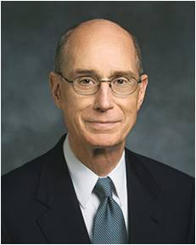
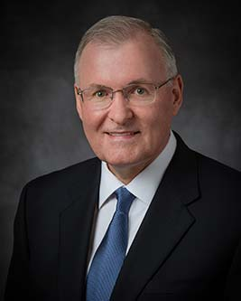
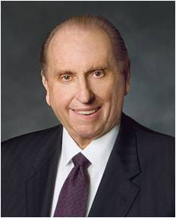
Prophet’s Warnings of Today
Peace will come to those who read the scriptures—Elder Boyd K. Packer
Follow the Holy Spirit—Elder D. Todd K. Christofferson
Share the Gospel--Elder S. Gifford Nielsen, M. Russell Ballard, and Randy D. Funk
God calls prophets to call people to repentance and warn of the consequences of sin
Let us reach out to others with faith and with love-- Elder Arnulfo Valenzuela
As we repent and become converted to the Lord, we become whole, and our guilt is swept away– Elder Timothy J. Dyches
Repent and be faithful-- President Dieter F. Uchtdorf
Give priesthood service-- President Henry B. Eyring
Home teaching…Become stronger to survive trials… May we show increased kindness toward one another, and may we ever be found doing the work of the Lord—
President Thomas S. Monson

Slide 14
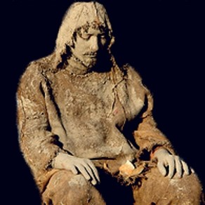
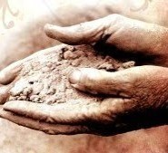
Except They Repent
“They were slow to hearken unto the voice of the Lord their God; therefore, the Lord their God is slow to hearken unto their prayers, to answer them in the day of their trouble.
In the day of their peace they esteemed lightly my counsel; but, in the day of their trouble, of necessity they feel after me.”
D&C 101:7-8
Repent in sackcloth ---an appropriate symbol for the godly sorrow and contrition of soul that is part of true repentance
Ashes—The strewing of ashes upon oneself was also a symbolic gesture representing the depth of humility and the fullness of penitence
1 Kings 20:31-32
They will be put in bondage
The Lord will not hear their prayers
The Lord will not deliver them out of their afflictions
They will be smitten by their enemies
Mosiah 11:21-25

Slide 15
Sin can blind us from recognizing the truth of prophets’ words
“The message of repentance is often not welcomed. …
“… When prophets come crying repentance, it ‘throws cold water on the party.’ But in reality the prophetic call should be received with joy. Without repentance, there is no real progress or improvement in life.
Pretending there is no sin does not lessen its burden and pain.
Suffering for sin does not by itself change anything for the better.
Only repentance leads to the sunlit uplands of a better life.
And, of course, only through repentance do we gain access to the atoning grace of Jesus Christ and salvation.”
D. Todd Christofferson
Mosiah 11:21-25

Slide 16
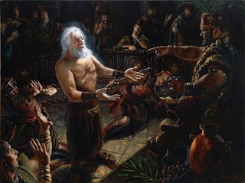
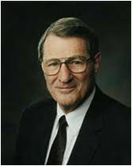
Noah Seeks Abinadi’s Life
The Prophet’s message of truth brought anger in their hearts—Abinadi flees
Anger within
Who is Abinadi?
Who is the Lord?
Who is it that they should judge me and my people?
“The last days will be rampant with the cardinal sins, just “as in the days of Noah.” Society in the days of Noah, scriptures advise, was “corrupt before God” and “filled with violence…
Corruption and violence—sound familiar? Both of these awful conditions crest because of surging individual selfishness. When thus engulfed, no wonder men’s hearts in our day will fail them because of fear.”
Neal A. Maxwell
Mosiah 11:26-29

Slide 17
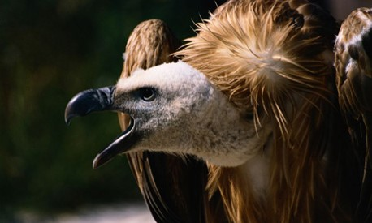
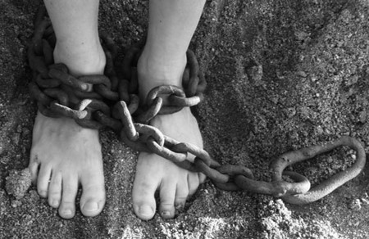
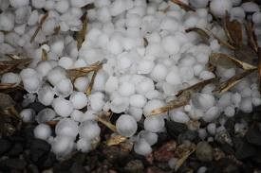
Second Warning and Prophecy
Brought into bondage
They shall be smitten on the cheek-- to be smitten on the cheek is a reproach itself, and is a suffering not very patiently endured.
They shall be driven by man
They shall be slain
Animals will devour them
They will have sore afflictions—famine, pestilence, They shall howl—mourn, weep
They shall have burdens lashed on their backs—slavery
There will be hail from the east wind and insects shall pester and devour their crops
Except they repent—they will be destroyed off the face of the earth
After two years Abinadi returns in disguise and prophesies of God’s wrath
Mosiah 12:1-7

Slide 18
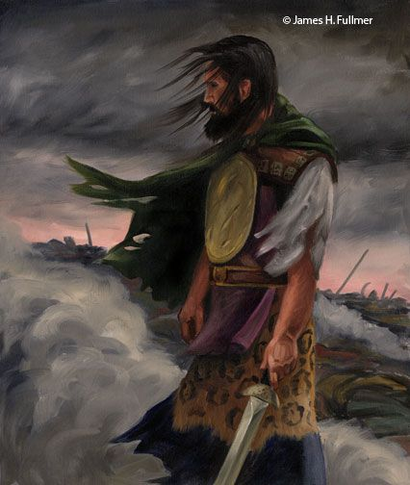
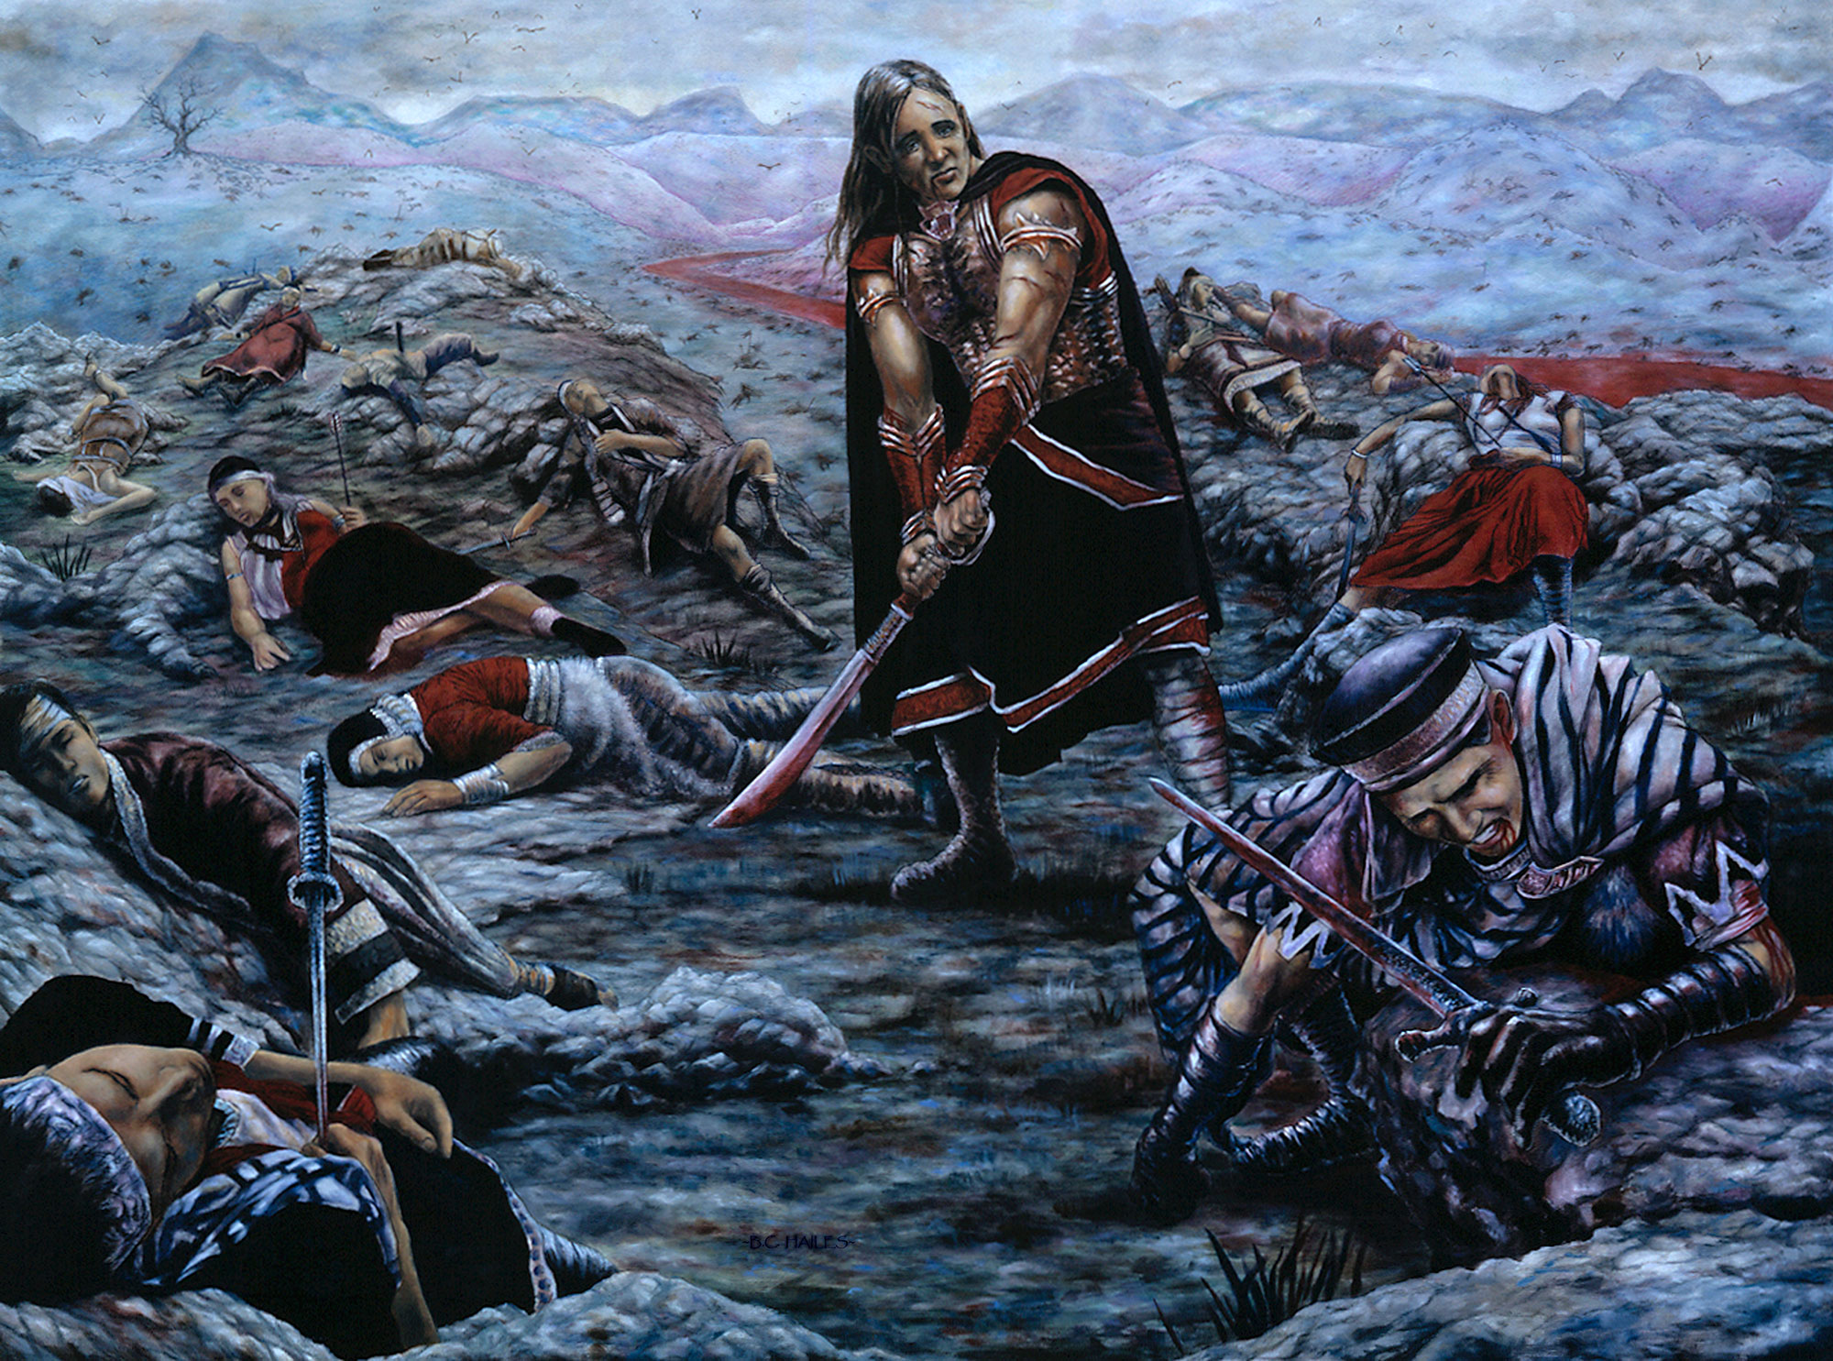
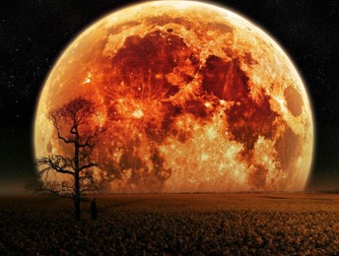
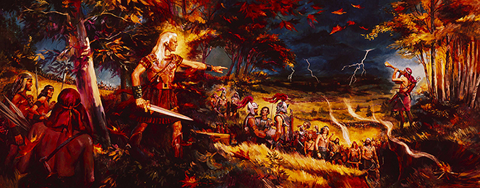
History of Destruction
The testimony of history is most eloquent in warnings against wickedness. Within the Book of Mormon we have the testimony of three civilizations:
The Jaredites
The Mulekites
The Nephites
All of which God will indeed destroy the wicked from off the face of the earth.
A prelude to destruction that will precede the great millennial day
JFM and RLM
Mosiah 12:8

Slide 19
Sources:
Richard G. Scott Making the Right Choices Oct. 1994 General Conf.
Joseph Fielding McConkie and Robert L. Millet Doctrinal Commentary on the Book of Mormon Vol 2. p. 201,203, 206
Manual---Book of Mormon Student Manual Religion 121-122
D. Todd Christofferson, “The Divine Gift of Repentance,” Ensign or Liahona, Nov. 2011, 38).
Neal A. Maxwell Put off the Natural Man and Come Off Conqueror Oct. 1990 Gen. Conf.
Presentation by ©http://fashionsbylynda.com/blog/

