Slide 2
Survey
I KNOW what it means to live the gospel of Jesus Christ.
I LIVE the gospel of Jesus Christ.
How well do these statements describe yourself?
Using a scale of 1 to 10 (with 10 representing that the statement describes you very well)
Mosiah 12:18-24

Slide 3
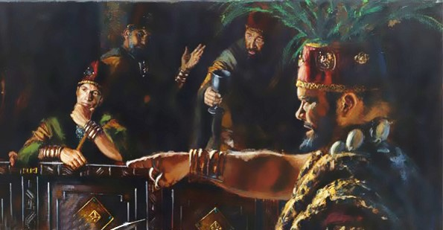
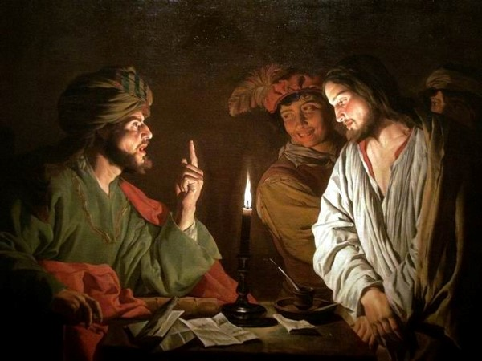
Cross Examination
After Abinadi was in prison he was later brought before King Noah and his priests. The priests questioned him, trying to confuse him into saying something they could use against him. Then one of them asked him to explain a scripture passage.
They used the same tactics that the Sanhedrin used on the Savior. They attempted to “cross him” in his words
See Mark 14:55-64
Mosiah 12:18-19

Slide 4
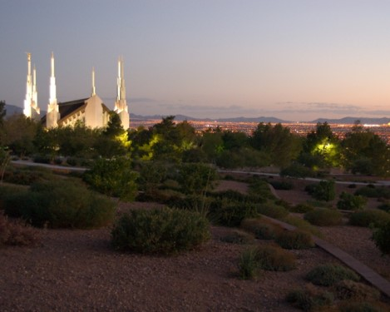
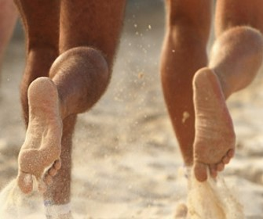
How Beautiful on the Mountains
“How beautiful upon the mountains are the feet of him that bringeth good tidings; that publisheth peace; that bringeth good tidings of good; that publisheth salvation; that saith unto Zion, Thy God reigneth;”
Mountains—temples—a place of worship
Feet--In the ancient world, before electronic communications were available, important messages were often brought by runners traveling on foot. Isaiah uses the messengers’ feet to symbolize the messengers themselves
Old Testament Manual
Published--it is a message of good tidings, a message of peace and salvation. The messengers described by Isaiah include the prophets and also the Lord himself
Mosiah 12:20 and Isaiah 52:7

Slide 5
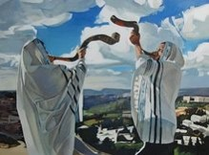
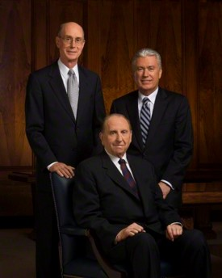
The Watchmen
“Thy watchmen shall lift up the voice; with the voice together shall they sing; for they shall see eye to eye when the Lord shall bring again Zion;”
Eye to eye—same faith—same God
And set watchmen round about them, and build a tower, that one may overlook the land round about, to be a watchman upon the tower, that mine olive trees may not be broken down when the enemy shall come to spoil and take upon themselves the fruit of my vineyard.
D&C 101:45
As watchmen on the tower of Zion, it is our obligation and right as leaders to speak out against current evils—evils that strike at the very foundation of all we hold dear as the true church of Christ and as members of Christian nations.
Ezra Taft Benson
Mosiah 12:21 and Isaiah 52:8

Slide 6
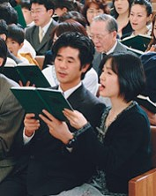
Break Forth Into Joy
“Break forth into joy; sing together ye waste places of Jerusalem; for the Lord hath comforted his people, he hath redeemed Jerusalem;”
The song to be sung in Zion will be a new song, sung when all will know Christ (i.e., during the Millennium).
The words of the song, which will include parts of verse 8, are recorded in Doctrine and Covenants 84:99–102.”
(“Great Are the Words of Isaiah,”p. 199.)
Mosiah 12:23 and Isaiah 52:9

Slide 7
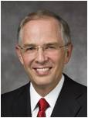
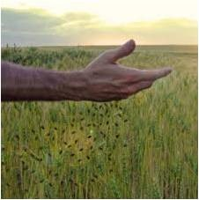
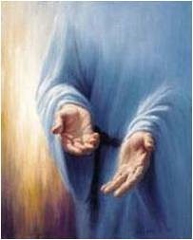
His Holy Arm
“The Lord hath made bare his holy arm in the eyes of all the nations, and all the ends of the earth shall see the salvation of our God?”
“The scriptures speak of His arms being open, extended, stretched out, and encircling. They are described as mighty and holy, arms of mercy, arms of safety, arms of love, “lengthened out all the day long.”
We have each felt to some extent these spiritual arms around us. We have felt His forgiveness, His love and comfort. The Lord has said, “I am he [who] comforteth you.”
The Lord’s desire that we come unto Him and be wrapped in His arms is often an invitation to repent. “Behold, he sendeth an invitation unto all men, for the arms of mercy are extended towards them, and he saith: Repent, and I will receive you.”
^{Neil L. Andersen}
Mosiah 12:24 and Isaiah 52:10

Slide 8
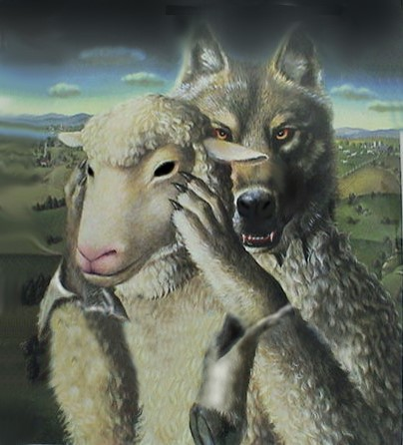
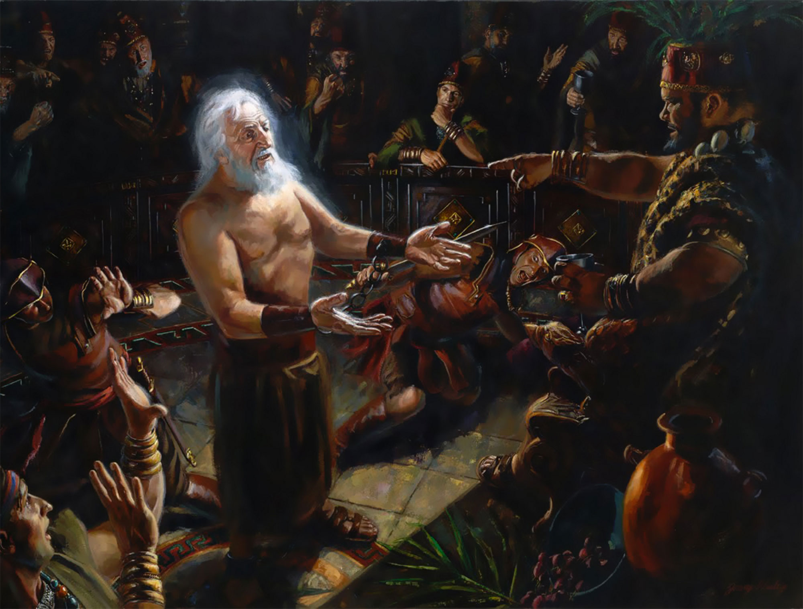
Profess to be the Watchmen
Not only did the Priests fail to keep a watch over their people, but they became instigators of the very evils from which they were to protect their people.
They became the wolves in sheep’s clothing
They had the knowledge of God and professed to act in his name, but they had take the Lord in vain. D&C 63:62
They added to their own darkness by their own works and evil example.
Abinadi says, “Wo be unto you for perverting the ways of the Lord.”
Jeremy Winborg
Mosiah 12:25-26 JFM and RLM

Slide 9
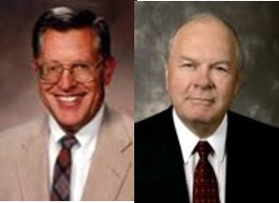
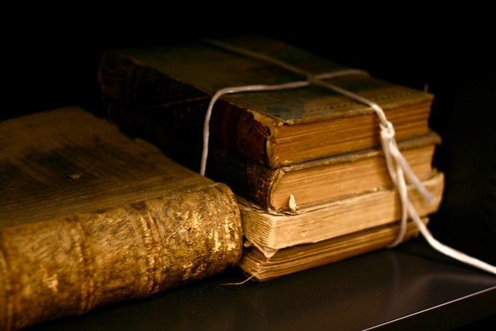
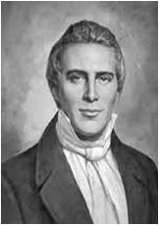
Apply Your Hearts to Understanding
The Priest’s of Noah were men of learning and intellect, yet they had no wisdom and understanding of the heart.
In our day:
“It was of professors of religion that the Lords said, “They draw near to me with their lips, but their hearts are far from me, they teach for doctrines the commandments of men, having a form of godliness, but they deny the power thereof:”
Joseph Smith
Mosiah 12:25-26 JFM and RLM

Slide 10
Abinadi VS The Priests
What do you teach?
The Law of Moses
If you teach the Law of Moses why don’t you keep the commandments?
Why do you set your hearts on riches?
Why do you commit whoredoms and spend your strength with harlots and cause the people to commit sin?
You know that I speak the truth
Mosiah 12:28-30

Slide 11
Does Salvation come by the Law of Moses?
Yes
I know if ye keep the commandments of God ye shall be save
The Lord said to me: “I am the Lord thy God who delivered you our of the land of Egypt, out of bondage…Thou shalt have no other God before me. Thou shalt not make unto thee any graven image.”
Have ye done all this?
Have you taught the people the commandments
No, you haven’t
Mosiah 12:31-37

Slide 12
They Do Not Understand
Abinadi charges Noah and his priests with their idolatry. They profess salvation through observance of ritual, the meaning of which they do not understand.
They have not fulfilled their obligations as priests to teach these things to the people.
Abinadi now comes to them as Moses did to Israel
Mosiah 12:37

Slide 13
Away With This Fellow
King Noah and his priests cannot rest until they have put Abinadi to rest
Touch me not God shall smite you if ye lay your hands upon me
He is Mad
The Lord’s purpose had not been fulfilled yet so they could not take him away. Abinadi was sent there to fulfill the commandment of God by preaching to them of their wickedness—
The Spirit of the Lord was with Abinadi
Mosiah 13:1-5

Slide 14
A Type and A Shadow of Things To Come
They had not the power to slay him until he was finished with his message
“Therefore, hold on thy way, and the priesthood shall remain with thee; for their bounds are set, they cannot pass. Thy days are known, and thy years shall not be numbered less; therefore, fear not what man can do, for God shall be with you forever and ever”
D&C 122:9
By slaying Abinadi, Noah and his priests condemned themselves to death. In killing him with fire they chose the manner of their own or their descendants’ deaths.
If they had chosen to repent an accept his message, then their eternal reward would have been the same as Abinadi’s.
JFM and RLM
Mosiah 13:7-10

Slide 15
Abinadi Has 10 Commandments
Some may wonder how Abinadi received the Ten Commandments which God had given to Moses.
The Brass plates obtained by Nephi contained the five books of Moses (1 Nephi 5:11)
These records would have been passed down by Nephite prophets and record keepers
The records were common knowledge to Noah and his priests
Institute manual
לא יהיה לך אלוקים אחר על פני
Mosiah 13:12-24

Slide 16
The Ten Commandments
“[The] Ten Commandments [were] written by the finger of Jehovah on tablets of stone for the salvation and safety, for the security and happiness of the children of Israel, and for all of the generations which were to come after them.”
Gordon B. Hinckley
Thou shalt have no other gods before me
Thou shalt not make unto thee any graven image
Thou shalt not take the name of the Lord God in vain
Remember the sabbath day, to keep it holy
Honour thy father and thy mother
Thou shalt not kill
Thou shalt not commit adutery
Thou shalt not steal
Thou shalt not bear false witness
Thou shalt not covet
Mosiah 13:11-24 Exodus 20:3-17

Slide 17
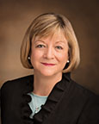
If the commandments of God are not written in our hearts, we will not seek to obey them with real intent
“We need to get the gospel from our heads into our hearts! It is possible for us to merely go through the motions of living the gospel because it is expected or because it is the culture in which we have grown up or because it is a habit. …
“We all need to seek to have our hearts and very natures changed so that we no longer have a desire to follow the ways of the world but to please God.”
Bonnie L. Oscarson
Mosiah 13:11

Slide 18
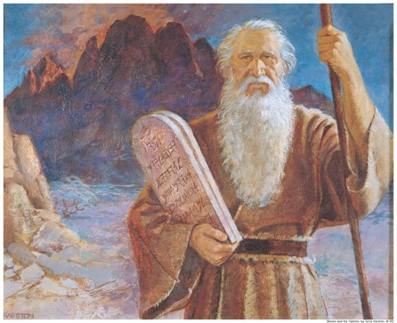
“The modern reader should not see the Mosaic code—anciently or in modern times—as simply a tedious set of religious rituals slavishly (and sometimes militantly) followed by a stiffnecked people who did not accept the Christ and his gospel.
This historic covenant, given by the hand of God himself and second only to the fulness of the gospel as an avenue to righteousness, should be seen rather as the unparalleled collection of types, shadows, symbols, and prefigurations of Christ that it is. For that reason it was once (and still is, in its essence and purity) a guide to spirituality, a gateway to Christ, a path of strict commandment-keeping that would, through the laws of duty and decency, lead to higher laws of holiness on the way to immortality and eternal life. …
“… It is crucial to understand that the law of Moses was overlaid upon, and thereby included, many basic parts of the gospel of Jesus Christ, which had existed before it. It was never intended to be something apart or separated from, and certainly not something antagonistic to, the gospel of Jesus Christ. … Its purpose was never to have been different from the higher law. Both were to bring people to Christ”
Jeffrey R. Holland

Slide 19
Teaching Salvation
Salvation is in Christ, not in law
Salvation does not come by law alone
“After all our obedience and good works, we cannot be saved from death or the effects of our individual sins without the grace extended by the atonement of Jesus Christ.
The Book of Mormon makes this clear. It teaches that ‘salvation doth not come by the law alone’ (Mosiah 13:28).
In other words, salvation does not come simply by keeping the commandments. …
Even those who try to obey and serve God with all their heart, might, mind, and strength are ‘unprofitable servants’ (Mosiah 2:21). Man cannot earn his own salvation”
Dallin H. Oaks
Mosiah 13:27-28

Slide 20
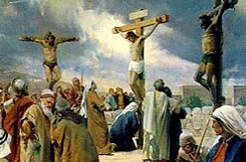
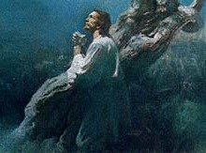
Understanding the Role of Jesus Christ
No one can be saved except through the Atonement of Jesus Christ
Jesus Christ has carried my sorrows, such as …
Jesus Christ was wounded and bruised for my transgressions, such as …
Mosiah 13:27-28

Slide 21
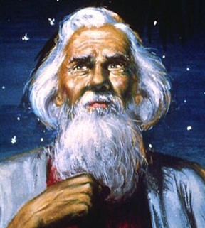
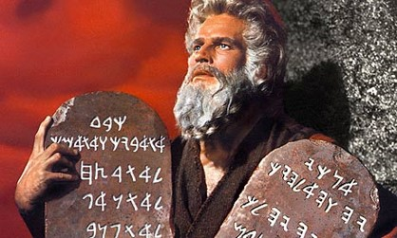
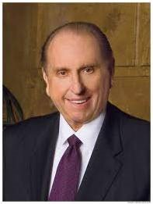
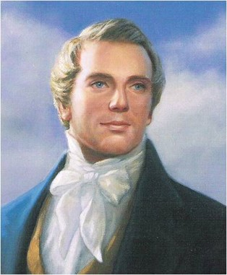
All Prophets Testify of Christ
A prophet is a man called by God to be His representative on earth. When a prophet speaks for God, it is as if God were speaking (see D&C 1:38).
A prophet is also a special witness for Christ, testifying of His divinity and teaching His gospel. A prophet teaches truth and interprets the word of God.
He calls the unrighteous to repentance. He receives revelations and directions from the Lord for our benefit. He may see into the future and foretell coming events so that the world may be warned.
Gospel Principles
Mosiah 14:1-12 Isaiah 53

Slide 22
Sources:
Gordon B. Hinckley (“Our Solemn Responsibilities,” Ensign, Nov. 1991, 51).
Old Testament: Gospel Doctrine Teacher’s Manual, (2001), 187–89
Ezra Taft Benson “Watchman, Warn the Wicked” Ensign July 1973
Neil L. Andersen “Repent … That I May Heal You” October 2009 General Con.
Joseph Fielding McConkie and Robert L. Millet Doctrinal Commentary on the Book of Mormon Vol. 2 pg. 209, 214
Joseph Smith--History 1:9
Dallin H. Oaks (“Another Testament of Jesus Christ,” Ensign, Mar. 1994, 67).
Bonnie L. Oscarson, “Do I Believe?” Ensign or Liahona, May 2016, 88).
Jeffrey R. Holland (Christ and the New Covenant: The Messianic Message of the Book of Mormon [1997], 136–37, 147; see also2 Nephi 11:4; Mosiah 16:14–15).
Student Manual Institute of Religion 121-122 Book of Mormon pg 192
Gospel Principles Chapter 9 Prophets of God (2011); 39-43
Presentation by ©http://fashionsbylynda.com/blog/

Slide 23
How well do I Keep the Commandments? | Almost Never | Some of the time | Much of the time | Almost always
1. I love God and put Him first in my life (before friends, hobbies, my own desires, and so on).
2. I avoid worshipping graven images or idols (including entertainers, sports stars, material possessions, and so on).
3. I speak the Lord’s name with reverence.
4. I keep the Sabbath day holy by recognizing it as the Lord’s day, not mine.
5. I honor my parents by being obedient and respectful.
6. I control my anger and do not act violently toward others.
7. I remain sexually pure. I avoid inappropriate images, language, and actions.
8. I refrain from stealing and cheating.
9. I tell the truth.
10. I avoid coveting (which means to intensely desire something that belongs to someone else).

Slide 24
Song of the Suffering Servant
Mosiah 14 and Isaiah 53
Presentation by ©http://fashionsbylynda.com/blog/

Slide 25
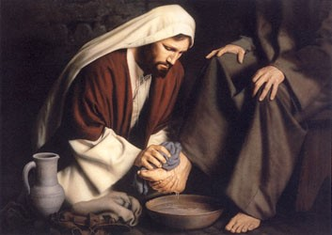
Abinadi’s 2nd Message
The Great Suffering Servant Song
Isaiah had a clear understanding of the mission and suffering of the Savior more than 700 years before His birth
The Servant Songs (also called the Servant poems or the Songs of the Suffering Servant) are songs in the Book of Isaiah.
“These verses are known among biblical scholars as a ‘servant’s song.’ This is a major poetic passage wherein a servant of the Lord is described, although not specifically identified. There are differences of opinion among commentaries regarding the identity of this Servant. ..”
Hoyt W. Brewster, Jr.
Isaiah 53 is often called the “Song of the Suffering Servant,” who is Jesus Christ.

Slide 26
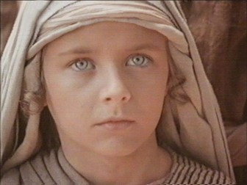
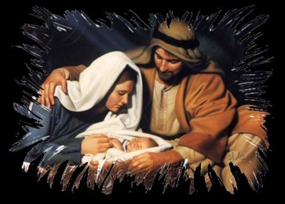
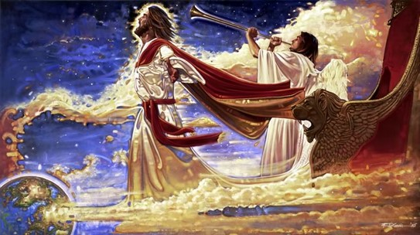
The Messiah
Who hath believed our report?—Many did not believe the report about the works and mission of Christ (John 12:37-41)
For he--Christ
Shall grow up before him--God
As a tender plant—Child, humble innocent. God would watch over the young Jesus as a careful gardener watches a tender plant
As a root out of dry ground—You wouldn’t expect a root to grow out of dry ground. Spiritual barrenness of the Jewish Apostasy, grew up in Nazareth, a nowhere town
When this Messiah comes he will come tenderly, quietly, obscurely from an unexpected source.
What kind of Messiah were they expecting?
What kind of Messiah will come for the Millennium?
Mosiah 14:1-2 Isaiah 53:1-2

Slide 27
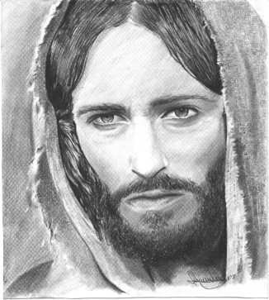
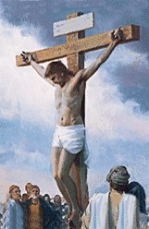
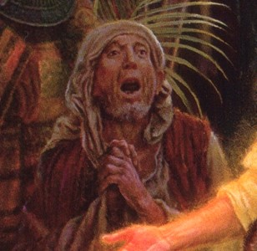
Despised/Rejected
He hath no form or comeliness/no beauty that we should desire him—He will look like an ordinary man. People will have to recognize him by who hi is and what he teaches and not by his physical countenance
Despised/Rejected—They knew the mortal Messiah would be largely rejected. He was excommunicated by the people of Nazareth
We hid…our faces from him—an expression used concerning a person’s reaction to a leper—shunning in disgust and fear.
Despised/esteemed him not—most viewed him as one of no worth
Mosiah 14:3 Isaiah 53:3

Slide 28
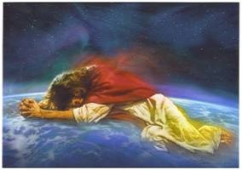
Smitten of God
Borne our grief/sorrows—In Gethsemane he took upon himself our grief and sorrow, as well as our sins
Stricken—in Hebrew/ OT—suffering the emotional pain of having leprosy and the isolation that come with it.
Beginning in Gethsemane and fully felt on the cross, for the first time in Jesus’ moral ministry, God withdrew His presence. Christ had to feel all that we would suffer which included complete isolation
Smitten of God/afflicted—Anciently it was believed if a person suffered it was because they were being punished by God. They believed Jesus was being punished for sin.
Ironically, they are correct
But whose sin caused him to suffer?
All of ours
Mosiah 14:4 Isaiah 53:4

Slide 29
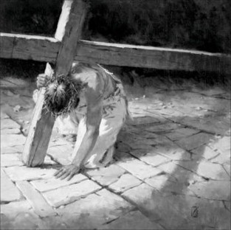
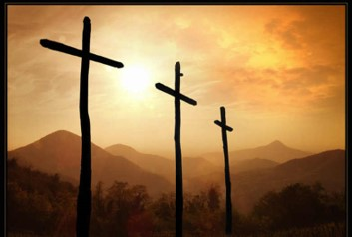
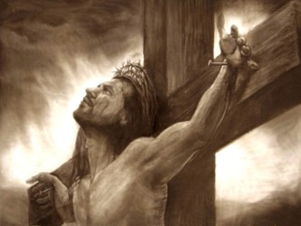
“The utter loneliness and excruciating pain of the Atonement begun in Gethsemane reached its zenith when, after unspeakable abuse at the hands of Roman soldiers and others, Christ cried from the cross, “Eli, Eli, lama sabachthani? That is to say, My God, my God, why hast thou forsaken me?”
In the depths of that anguish, even nature itself convulsed. “There was a darkness over all the earth. … And the sun was darkened.”
“And, behold, the veil of the temple was rent in twain from the top to the bottom; and the earth did quake, and the rocks rent ”causing many to exclaim, “The God of nature suffers.” Finally, even the seemingly unbearable had been borne, and Jesus said, “It is finished.”
“Father, into thy hands I commend my spirit.” Someday, somewhere, every human tongue will be called upon to confess as did a Roman centurion who witnessed all of this, “Truly this was the Son of God.”
Jeffrey R. Holland
Mosiah 14:4 Isaiah 53:4

Slide 30
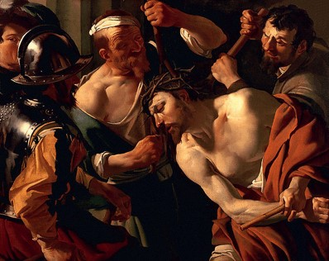
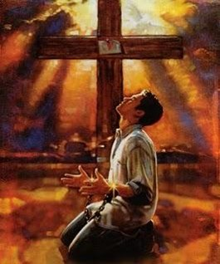
Wounded
Wounded for our transgressions—Hebrew word—Pierced fatally
Bruised for our iniquities—Hebrew word—Crushed (olive press)
Chastisement of our peace was upon him—He suffered the chastisement that brings us peace
With his stripes we are healed—paradox—Through the wounding of one person (Christ's whipping), another’s wounds are healed
Are we automatically healed?
No. We must return to Christ, repent, be converted and
then he heals us.
Mosiah 14:5 Isaiah 53:5

Slide 31
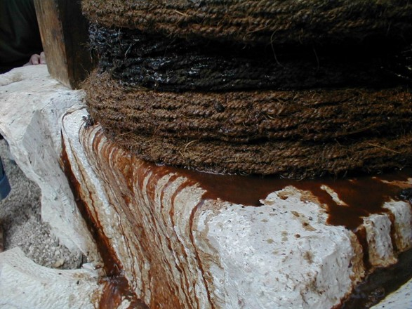
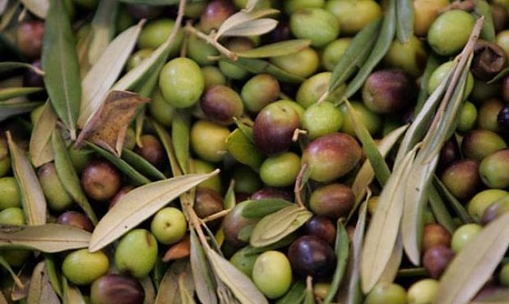
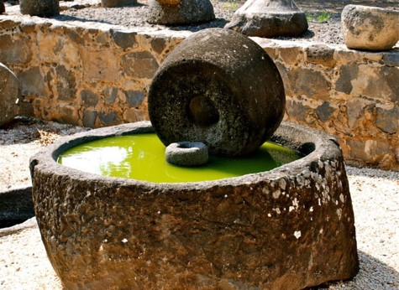
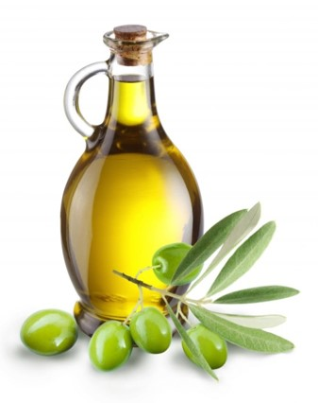
The Olive Press
When Olives are crushed for the first time it comes out red
With each pressing the color gets lighter and lighter, the less pressed, the more pure
Mosiah 14:5 Isaiah 53:5

Slide 32
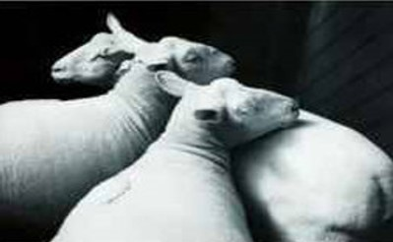
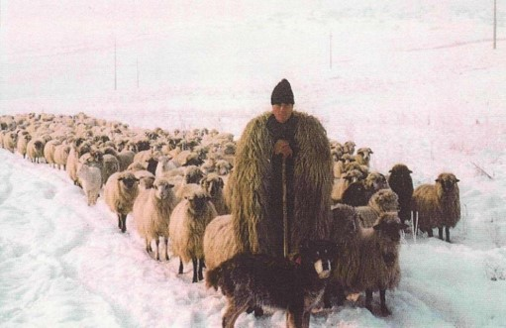
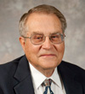
All We Like Sheep
Have gone astray way—All of us
Sheep:
They wander with no direction
Are helpless
Are fragile and defenseless
They need living water
They need to be touched (daily)
They need to be anointed (sunburns)
Once a sheep is sheered it is vulnerable (the repentance process)
Sheepherder VS Shepherd
A sheepherder moves from behind pushing them along
Whereas:
The sheep follow their Master, the Shepherd
“Seeing ourselves as sheep helps us appreciate our dependence on the Lord. Just as sheep require a shepherd to watch over them and provide for their needs, so we need the Lord’s tender care.” See Isaiah 40:11 Victor L. Ludlow
Mosiah 14:6 Isaiah 53:6

Slide 33
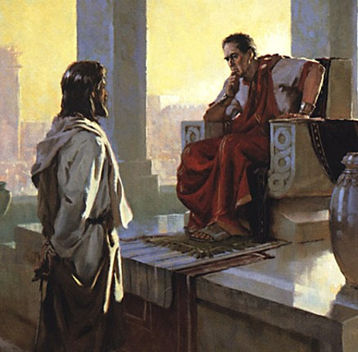
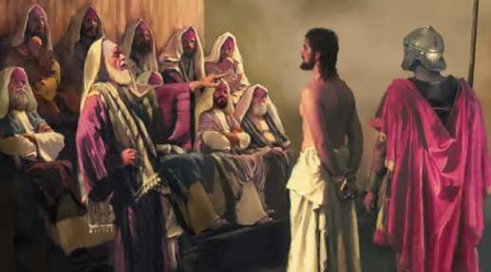
Silent Suffering—Submitting His Will
Oppressed/afflicted—refers mainly to the abuse of the arrest and false trial
Brought as a lamb/opened not his mouth—Standing before Herod and much of his interview with Pilate, Jesus did not speak instead he submitted himself.
Jesus submitted His will the that of His Father
“Not my will, but thine, be done”
Luke 22:42
“…even more than man can suffer”
Mosiah 3:7
Did Jesus suffer for the 3rd part of heaven who went with Satan?
Mosiah 14:7 Isaiah 53:7

Slide 34
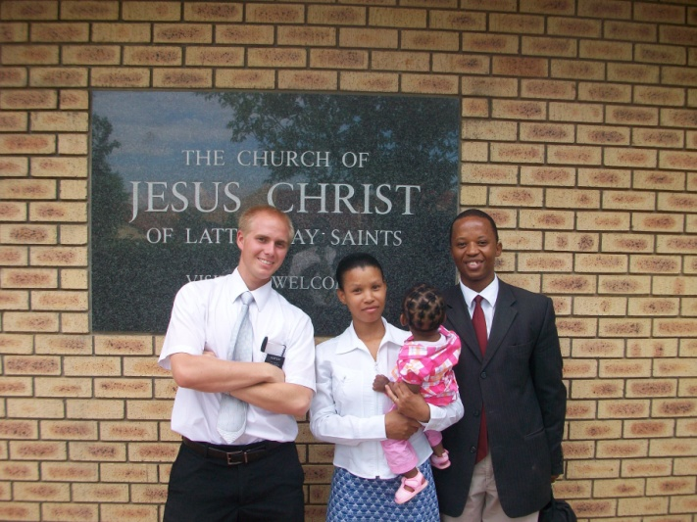
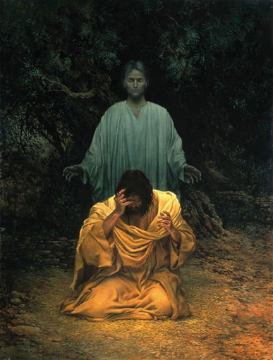
Unfair Trial
Taken from prison/Judgment—taken forcibly and denied a fair trial
Who shall declare his generation?—who are His descendants?—Who shall testify of His life’s mission?
Implying that because He was “cut off” He had none….But Christ became our Spiritual Father
Mosiah 15:10-11
Gethsemane—how did an angel strengthen Christ?
He saw us in a vision. In some small way we each helped Christ endure and complete the Atonement
Mosiah 14:8 Isaiah 53:8

Slide 35
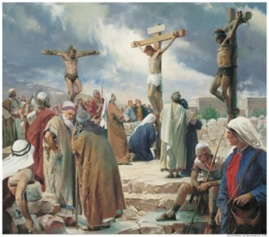
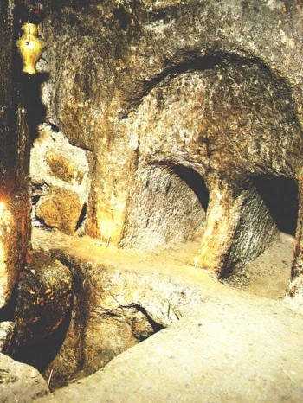
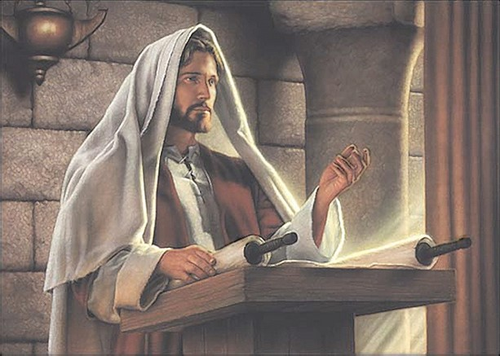
The Savior’s Death and Burial
Grave with the wicked--Jesus was crucified between two thieves
With the rich—Joseph of Arimathea, believed to be a member of the Sanhedrin and a wealthy follower of Christ, buried Jesus in his own tomb
Any deceit in his mouth—The mouth often represents how God’s word is delivered…the Savior’s mouth symbolizes the importance of the words that he preached during His ministry—God of Truth
Victor L. Ludlow
Mosiah 14:9 Isaiah 53:9

Slide 36
The Acceptance—The Obedience
Pleased the Lord to bruise him---Did it please God to see his Son suffer?
The Father was pleased that His Son would obediently offer such a sacrifice according to His will. The Father was pleased because of the magnificent love his Son showed to us.
Have you ever been “pleased” when someone has made the right choice to become clean (repent of a sin) and to see them suffer at the same time?
“Satan will have his victories; he will “bruise the heel” of God’s son; yet the ultimate victory will be with Christ, who will bruise the head of the adversary”
JFM and RLM
“God made it possible for His spirit children to return to Him as purified, resurrected beings.”
Victor L. Ludlow
Mosiah 14:10 Isaiah 53:10

Slide 37
The Righteous Servant
Travail of his soul—a childbirth image—Literally Christ suffers as a woman suffers in laboring to deliver her child.
As he dies he “gives birth’ to us as his spiritual offspring.
His knowledge shall justify many—His knowledge was gained through the experience of the Atonement.
To justify means to be judged and found innocent
We will not be judged and found righteous through our own merits but because of Christ's suffering, and through that experience he now knows how to reach each one of us and rebuild our lives so we may become innocent again.
Mosiah 14:11 Isaiah 53:11

Slide 38
The Rewards
Divide him a portion/the spoil—All victors win the right to take the spoils which in this case means to inherit all the Father has.
Christ divides this with tall those who are his spiritually begotten.
D&C 88
Because he poured out his soul—Pouring out our souls in prayer—expressing our deepest, most heartfelt desires to the lord—holding nothing back.
Christ poured out his soul to the Father and fully yielded to His will, even to death.
Intercession for the transgressors—Christ stand between us and the Father and speaks as our defense and requests mercy for those of us who are repentant.
Mosiah 14:12 Isaiah 53:12

Slide 39
The Believer
When the prophet Abinadi quoted this Isaianic prophecy to wicked King Noah’s court, at least one young priest believed Abinadi’s teaching. Alma not only believed, but he also declared Christ message and mission to many others who came into the shepherd's fold.
Mosiah 17:2

Slide 40
Sources:
Hoyt W. Brewster, Jr. Isaiah Plain and Simple p. 209
Notes from Poway Institute by Lesley Meacham and Becky Davies
Jeffrey R. Holland The Atonement of Christ
http://jesuschrist.lds.org/SonOfGod/eng/his-life-and-teachings/articles/the-atonement-of-jesus-christ
Victor L. Ludlow Unlocking Isaiah in the Book of Mormon p. 223
Joseph Fielding McConkie and Robert L. Millet Doctrinal Commentary on the Book of Mormon Vol. 2 p. 224
Presentation by ©http://fashionsbylynda.com/blog/

Slide 41
Olive oil is a fat obtained from the olive (the fruit of Olea europaea; family Oleaceae), a traditional tree crop of the Mediterranean Basin. The oil is produced by pressing whole olives.
It is commonly used in cooking, cosmetics, pharmaceuticals, and soaps and as a fuel for traditional oil lamps. Olive oil is used throughout the world, but especially in the Mediterranean countries and, in particular, in Greece, which has the highest consumption per person.
http://en.wikipedia.org/wiki/Olive_oil

Slide 42
The Ultimate Inheritance—An Allegory— Cree L. Kofford Conference Report 1991 Oct
“I desire to teach you concerning matters of eternal significance. In doing so I shall speak allegorically, which simply means that I will teach by using a story which has symbolic meanings.
In an allegorical sense, I am here today as a member of the trial team assembled by your chief advocate. We have now received the legal action in which each of you has been named as a party defendant. I and others of the trial team have reviewed the pleadings carefully and have confirmed that the real purpose of opposing counsel is to prove that you are not eligible to receive your ultimate inheritance. Our adversary’s trial team is even now working tirelessly to assemble the facts necessary to bring about your defeat.
By virtue of motions made, heard, and previously decided, we have been compelled to produce, on behalf of each of you, all records relating to your business and personal transactions. These include a schedule of your neighbors, friends, and business acquaintances. Additionally, full disclosure concerning your spouse, your children, your parents, and members of your extended family has been made.
You should know that our adversary is prepared to spend such time, effort, and money as is necessary to deprive you of your inheritance. They have already expended untold millions of dollars in preparing their case against each of you. They have hired gifted, talented, and experienced people to work for them. They intend to win!
Fortunately, you are represented by the most skilled, capable, and diligent counsel I have ever seen. It’s amazing to watch him as he argues on your behalf before the Supreme Judge.
For example, our adversary brought a motion seeking an order that some of you have already forfeited your rights to your ultimate inheritance and therefore a summary judgment should be entered against you. I must admit he was brilliant in his presentation. For a time it seemed to me that he would prevail. Many of the court personnel were nodding their heads in seeming agreement with him. His argument was powerful.
Citing several of you by name, he said, “If these defendants have lived this long and have not yet taken serious steps to qualify for their ultimate inheritance, why should we waste further time of the court? Let us simply enter judgment against them now and be done with it.” So powerful was his presentation that many in the public gallery applauded when he concluded.
You could have heard a pin drop when your chief advocate arose. The suspense in the courtroom was electrifying. What arguments could he possibly make that would overcome those just presented? I wish you could have been there.
In contrast to the bombastic and cynical arguments of opposing counsel, your advocate began your defense as a trickle and built to the force of a mighty river. Humbly, softly, meaningfully, and compellingly, he pled your case. I knew the impact he was having when I saw tears streaming down the cheeks of many in the courtroom. I don’t remember all of his arguments and logic, but I do remember him saying that man is a little lower than the angels (see Ps. 8:5) and that the worth of souls is great (see D&C 18:10). In one of the most majestic moments, his eyes filled with compassion and his voice quivering with indignation, he admonished, “He that is without sin among you, let him first cast a stone.” (John 8:7.)
He went on to argue that “this life is the time for men to prepare to meet God” (see Alma 34:32) and closed with a breathtaking summary in which he said no one has the right to judge the sum total of a man’s life until that life has been lived.
There was silence in the room when he finished, silence broken only by the voice of the Supreme Judge announcing his decision: “Motion of counsel for the plaintiffs is denied. The issues sought to be summarily decided here are better left until trial of this matter on the merits,” he said.
Now, in preparation for your appearance on the witness stand, you should be advised that, in the law, we have what are known as threshold questions. These are simply questions that are the point of beginning, or the starting place. The threshold question in your trial is, Do you love the Lord God with all your heart and with all your soul and with all your mind? (See Matt. 22:37.) If the answer is no, there will be a motion for judgment against you. That motion will be granted.

Slide 43
Continued:
On the other hand, if you answer yes, opposing counsel will immediately test the validity of your answer with the question, Do you keep his commandments? (See John 14:15.) A negative response will reveal your fraud, and you will stand judged by your own testimony. If your answer is in the affirmative, there will then follow hours, perhaps days, of questions, each designed to prove that you do not, in fact, keep his commandments. Among those questions will be the following:
1. Do you love your neighbor as yourself? (See Matt. 22:39.)
2. Do you place worldly pursuits or personal pleasures above your service to God? (See Ex. 20:3.)
3. Do you take the name of the Lord God in vain? (See Ex. 20:7.)
4. Do you keep the Sabbath day holy? (See Ex. 20:8.)
5. Do you honor your father and mother? (See Ex. 20:12.)
6. Do you commit adultery or fornication? (See Ex. 20:14.)
7. Do you steal? (See Ex. 20:15.)
8. Do you bear false witness? (See Ex. 20:16.)
9. Do you covet? (See Ex. 20:17.)
Remember, opposing counsel and his trial team will be fully conversant with your conduct and behavior. Witnesses will have been subpoenaed by them to testify against you. Your neighbors will present their testimony concerning your conduct with them. Those who have observed your Sabbath day activity will be called to the stand. On each point where you are vulnerable, witnesses will be produced to contradict your sworn testimony.
As your counsel we will, of course, be equally well prepared. Your chief counsel will produce every witness favorable to you and elicit from them every fact which may be used on your behalf.
However, one thing is clear—the ultimate outcome of your case is dependent upon the facts which you provide. There’s an old adage among trial lawyers that says, “We don’t make the facts, we only present them.” The facts which represent your life are the facts that will ultimately determine your victory or your defeat.
That is one of the reasons I have come today. I have been asked to see that you are clearly informed concerning this matter and to urge you, where necessary, to create facts which will allow the Supreme Judge to find on your behalf. Fortunately for you, your life’s facts can still be created. No matter how long you have lived, no matter how many mistakes you have made, your life’s story can still be changed. It can still be written. It is not too late. Please, I plead with you, help him to help you win your ultimate inheritance.
Now before closing, I should like to express my deep love to all, who is my sweetheart and my heartbeat. I honor her and the womanhood which she so elegantly represents. I love our five children, who are my best friends, and our twelve grandchildren, who regularly teach me the joy of unconditional love.
In the name of the Lord Jesus Christ, amen.

