Slide 2
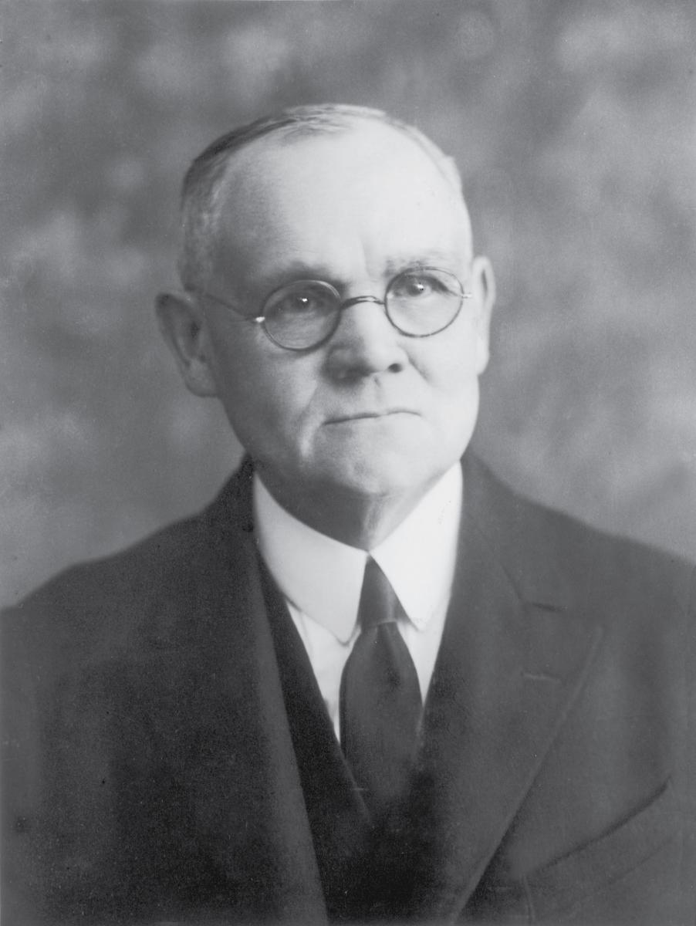
The Ministry--Elohim
Elohim as the Father of spirits
Is the Father of the spirits of all men, including Jesus Christ
(Hebrews 12:9; Numbers 16:22)
He is the ultimate object of our worship
Elohim is our Father because He gave us life—spiritual birth
Mosiah 15:1-4 James E. Talmage

Slide 3
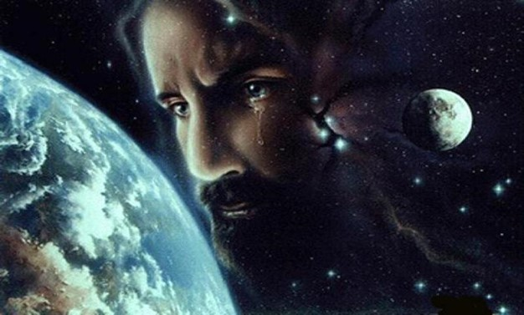
The Ministry--Christ
Christ as the Father
The Father of Creation
Jesus is known as Father by virtue of his role as Creator. Long before he became mortal he was directly involved in creation
“While yet in the premortal existence Jehovah advanced and progressed until he became like unto God. Under the direction of the Father he became the creator of worlds without number, and thus was himself the Lord Omnipotent”
Bruce R. McConkie
Mosiah 15:1-4 James E. Talmage see also: Moses 1:31-33; Moses 7:30

Slide 4
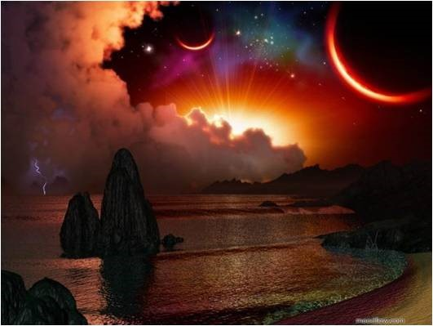
The Father of Heaven and Earth
Jehovah in Book of Mormon
The Nephite and Jaredite prophets came to know full well that the Messiah the only Begotten Son of the Father in the flesh, was the same being who had created all things
Mosiah 15:1-4 James E. Talmage see also 2 Nephi 25:12 Alma 11:38-39 3 Nephi 9:15

Slide 5
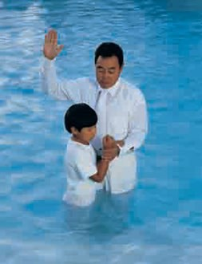
Spiritual Rebirth
Those who are “born again”
Those who are changed from their carnal and fallen state to a state of righteousness, are received into a new family relationship—they become the sons and daughters of Jesus Christ by adoption.
Spiritual rebirth is an absolute necessity for one who aspires to the celestial kingdom.
Jesus Christ becomes the Covenant Father
D&C 66:2; 133:57
Mosiah 15:1-4 James E. Talmage see also Moses 6:59

Slide 6
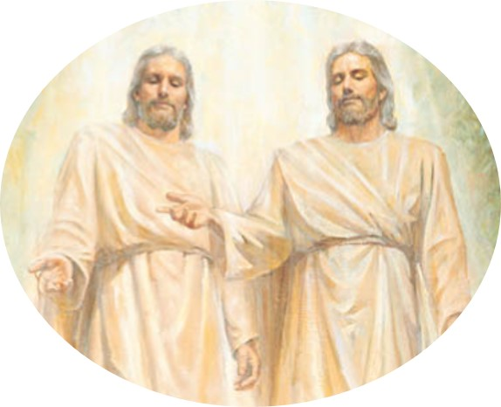
Divine Investiture of Authority
“I am come in my Father’s name”
John 5:43
Christ acted and spoke on behalf of his Father
“My doctrine is not mine, but his that sent me”
John 7:16
“The Father, Elohim, has placed his name upon the Son, has given him his own power and authority, had has authorized him to speak in the first person as though he were the original or primal Father.”
Bruce R. McConkie
Mosiah 15:1-4 James E. Talmage

Slide 7
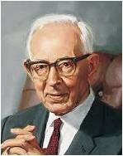
“All revelation since the fall has come through Jesus Christ, who is the Jehovah of the Old Testament. In all scriptures, where God is mentioned and where he has appeared, it was Jehovah…The Father has never dealt with man directly and personally since the fall, and he has never appeared except to introduce and bear record of the son.”
Joseph Fielding Smith
Mosiah 15:1-4

Slide 8
Authority
Abinadi taught that our Father in Heaven not only places his name upon his Son but also invests his Son with his powers and attributes.
“How is our Lord the Father?”
“It is because of the atonement, because he received power form his Father to do that which is infinite and eternal. This is a matter of his Eternal Parent investing him with power from on high so that he becomes the Father because he exercises the power of that Eternal Being.
Bruce R. McConkie
Mosiah 15:1-4 James E. Talmage

Slide 9
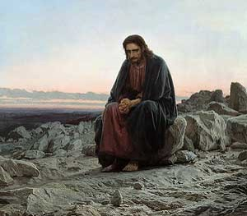
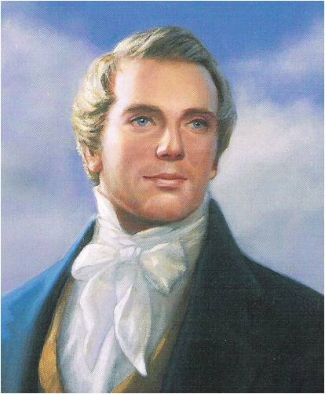
Flesh Being Subject to the Spirit
Flesh, Son, and man —The Mortal Messiah will subject himself to the will of the Spirit, man can put off the natural man and become a saint
The Savior was tempted like we are, yet without sin
Hebrew 4:15
“…is called the Son because of the flesh, and descended in suffering below that which man can suffer; or , in other words, suffered greater suffering, and was exposed to more powerful contradictions than any man can be. But, notwithstanding all this, he kept the law of God, and remained without sin, showing thereby that it is in the power of man to keep the law and remain also without sin…”
Joseph Smith
Mosiah 15:5

Slide 10
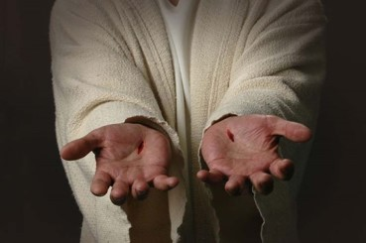
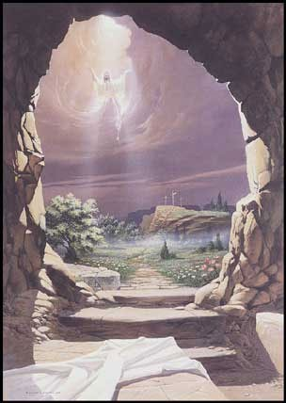
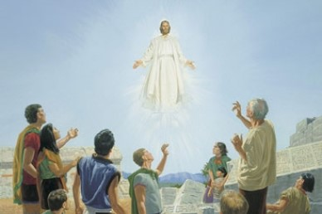
Breaketh the Bands of Death
He who knew the shame of the cross arose with healing in his wings, that he might raise up all men in like manner---Resurrection
“…All shall rise from the dead and stand before God, and be judged according to their works.”
Alma 11:40-41
Victory
The effects of the atonement will pass upon all who are the descendants of Adam and Eve…all of us
Mosiah 15:8

Slide 11
Importance in a Word
Redeem---Redeemeth---Redeemed---Redemption
Fine and punishment—
a large sum of money
A family member pays the fine
How would you feel about that person?
Offender
To Redeem is to release from debt or paying a ransom
Mosiah 15:9

Slide 12
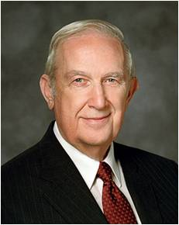
Justice
Fine and punishment—
JUSTICE
Offender
US
“Justice … requires that every broken law be satisfied. When you obey the laws of God, you are blessed, but there is no additional credit earned that can be saved to satisfy the laws that you break. If not resolved, broken laws can cause your life to be miserable and would keep you from returning to God”
Richard G. Scott
Mosiah 15:9

Slide 13
Fines and Punishment
Misery and Shut Out From Presences of God
intersession
A person coming between two people or groups of people to help them become reconciled—in other words, to come to harmony with one another.
Mosiah 15:9

Slide 14
Demands of Justice
Justice demands that we be punished for our sins. The Savior does not erase the demands of justice; He stands between us and justice to satisfy justice’s demands by taking the punishment for us. He has paid the price to redeem us—to release us from punishment.
Mosiah 15:8-9

Slide 15
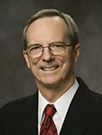
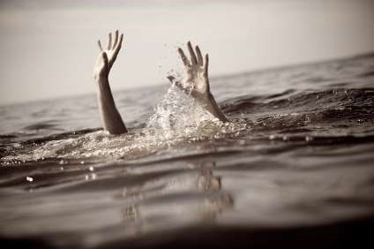
Bowels of Mercy
Jesus’ compassion for His children (the offenders)---Father of Grace
“The seat of pity or kindness; hence, tenderness compassion”
Webster’s 1828 Dictionary
Mercy and Grace—Companion Doctrines
Mercy mentioned 396 times in Standard Works and Grace 252 times
Lifeguard and Swimmer Analogy
Mercy—when a lifeguard stretches a pole out for a drowning victim, the victim must reach out and hold on if he desires to be rescued.
Grace--Both the lifeguard and the victim must fully participate if the swimmer’s life is to be saved.
Mosiah 15:9 Tad R. Calllister

Slide 16
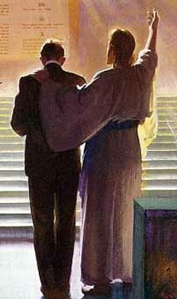
Betwixt---the Mediator
“…for there is one God, and one mediator between God and men, the man Christ Jesus.”
1 Timothey 2:5
“…to appear in the presence of God for us”
Hebrews 9:24
He is our “..advocate with the Father”
1 John 2:1
D&C 38:4 “…pleaded before the Father for them”
D&C 110:4 “…I am your advocate with the Father”
Hebrews 7:25 “…seeing he ever liveth to make intercession for them.”
Mosiah 15:9

Slide 17
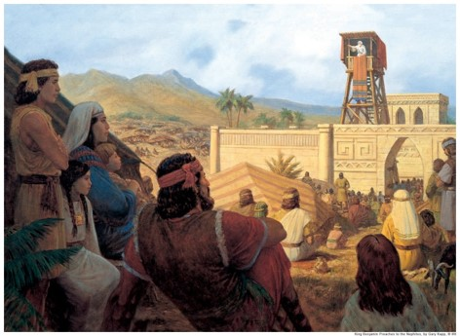
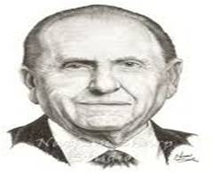
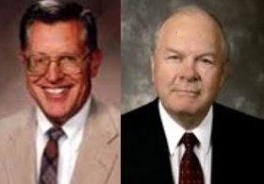
His Seed
Those who hear the words of the prophets and prophesied of the coming of the Lord
Those who have listened to the prophets’ words
Those that believe that the Lord will redeem them
Those that look forward to the day of remission of their sins
Those who have published peace
A Prophet is one who has the testimony of Jesus, one who knows by the spirit of prophecy and revelation that Jesus is Lord and that salvation is in Him.
JFM and RLM
Mosiah 15:10-14

Slide 18
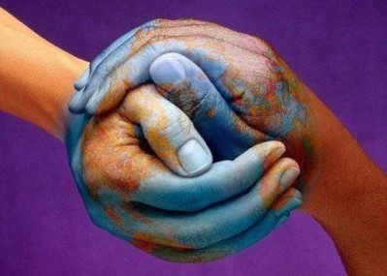
Mountains of Peace
Those who publish peace
“But learn that he who doeth the works of righteousness shall receive his reward, even peace in this world, and eternal life in the world to come.”
D&C 59:23
Many people think of peace as the absence of war. But we can feel peace even in times of war, and we can lack peace even when no war is raging. The mere absence of conflict is not enough to bring peace to our hearts. Peace comes through the gospel—through the Atonement of Jesus Christ, the ministration of the Holy Ghost, and our own righteousness, sincere repentance, and diligent service.
lds.org---Peace
Mosiah 15:15-19

Slide 19
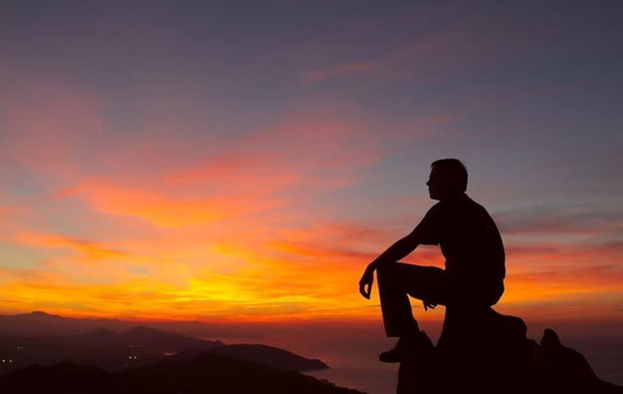
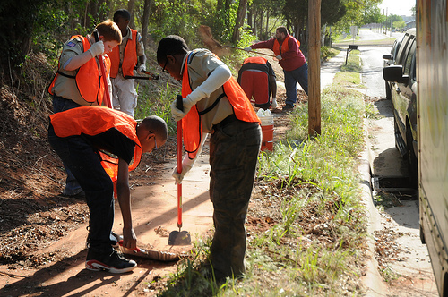
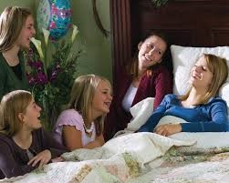
Inner Peace
Even when the world is in turmoil all around us, we can receive the blessing of inner peace. This blessing will continue with us as we stay true to our testimony of the gospel and as we remember that Heavenly Father and Jesus Christ love us and watch over us.
In addition to feeling peace ourselves, we can be an influence for peace in our families, our community, and the world. We work for peace when we keep the commandments, give service, care for family members and neighbors, and share the gospel. We work for peace whenever we help relieve the suffering of another.
Mosiah 15:15-19

Slide 20
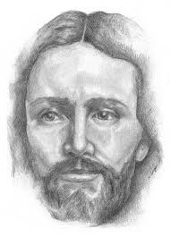
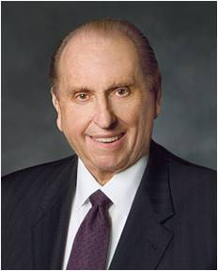
Prince of Peace
Search inward--Peace cannot be imposed. It must come from the lives and hearts of men.
Reach outward--service, to be acceptable to the Savior, must come from willing minds, ready hands, and pledged hearts.
Look heavenward--through prayer, that path to spiritual power—even a passport to peace.
“We are reminded of His Beloved Son, the Prince of Peace, that pioneer who literally showed the way for others to follow. His divine plan can save us from the Babylons of sin, complacency, and error. His example points the way. When faced with temptation, He shunned it. When offered the world, He declined it. When asked for His life, He gave it.”
Thomas S. Monson
Mosiah 15:15-19

Slide 21
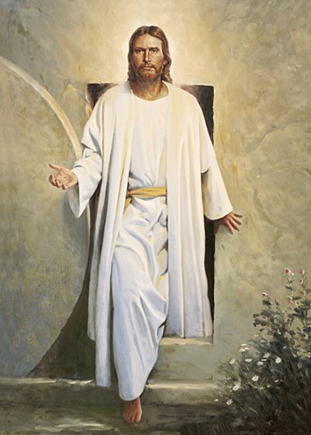
First Resurrection
Bands of Death Broken—resurrection
The Son Reignth—”Alleluia: for the Lord God omnipotent reigneth” Revelation 1:6
Power over death—The effects of Christ’s resurrection will pass upon all
The Resurrection of the Just—The Resurrection of the Celestial
Abinadi was referring to the resurrection of all celestial persons from the days of Adam to the time that Christ was to rise from the tomb.
“…those who have been, and who are, and who shall be, even until the resurrection of Christ” vs 21
Mosiah 15:20-25

Slide 22
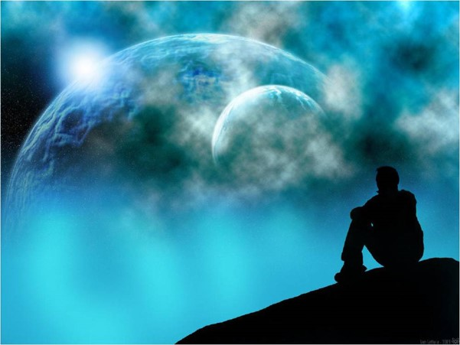
All Part of the First Resurrection
Joseph Smith—a specific event reserved for the just ---faithful saints from the time of the Savior to the second coming
Millennial---those living in the Millennium as spoken of as coming forth as the first resurrection
Mosiah 15:20-25; D&C 88:96-98; D&C 132:19

Slide 23
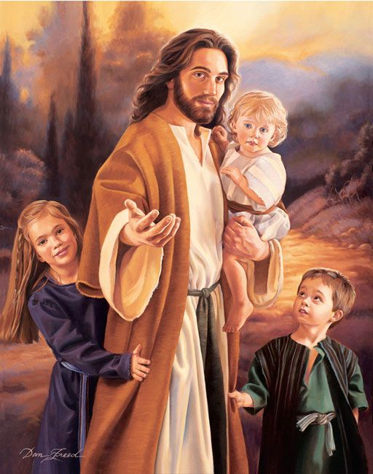
Resurrection for Others
Those who died without a knowledge of the gospel
Those who do not have the opportunity to hear the gospel in this life will have the opportunity in the world to come
Those who “died without law”
They will come for in the resurrection but in the terrestrial glory
Little children also have eternal life
“…little children shall be saved. They are alive in Christ an shall have eternal life. For them the family unit will continues, and the fulness of exaltation is theirs. No blessing shall be withheld. They shall rise in immortal glory, grow to full maturity, and live forever in the highest heaven of the celestial kingdom.”
Bruce R. McConkie
Dan Freed
Mosiah 15:20-25; D&C 76:71-72

Slide 24
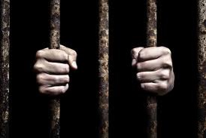
Rebel Against God
Fear—humble reverence
Those who “rebel against God and die in their sins” will not and cannot be redeemed unto salvation
Those who reject the higher counsel from God and his prophets are natural enemies to God.
Those who are liars, sorcerers, adulterers, whoremongers will suffer the “wrath of God”
These are they “who shall not be redeemed from the devil until the last resurrection, until the Lord, even Christ eh lamb, shall have finished his work.”
Mosiah 15:26; Mosiah 2:37: D&C 76:81-85

Slide 25
Refuse to Repent
For behold, I, God, have suffered these things for all, that they might not suffer if they would repent;
But if they would not repent they must suffer even as I;
D&C 19:16-17
Resurrection is universal
Redemption—the atonement brings a general redemption, only those who repent and live fully the gospel will be redeemed and return to the presence of the Father
Mosiah 15:26 and Mosiah 16:2-5

Slide 26
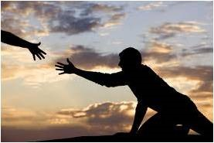
Glory and Exaltation
“Salvation consists in the glory, authority, majesty, power and dominion which Jehovah possesses and in nothing else; and no being can possess it but himself or one like him.”
Joseph Smith
Salvation is eternal life—highest in the heavens
Exaltation—the glories of celestial kingdom—eternal life—salvation
To be saved is to be exalted—qualifies to be part of the Church of the Firstborn, the Church of the Exalted
Life Beyond
Mosiah 15:27

Slide 27
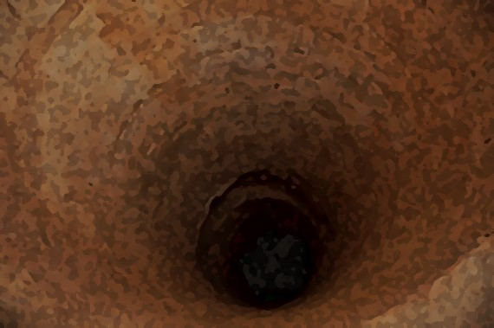
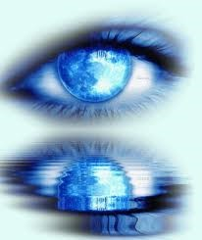
Abinadi Quotes Isaiah
Isaiah 52:8-10
Abinadi rejoices in the coming glory of the Millennium, that era of consummate peace when Christ will have won the victory and when that old serpent, even Satan, will have been bound and consigned to the bottomless pit for a thousand years
See eye to eye—To be united
Being of one mind
In the Millennial day those of every nation, kindred, and tongue will feel compelled to acknowledge the power of Israel’s God.
Mosiah 15:28-31 and Mosaih 16:1; Mosiah 27:31: D&C 88:104

Slide 28
Savior to Redeem Us
From death
Because of the Atonement of Jesus Christ, all people will be resurrected.
The Righteous will be in the State of Happiness
Mosiah 16: 6-11

Slide 29
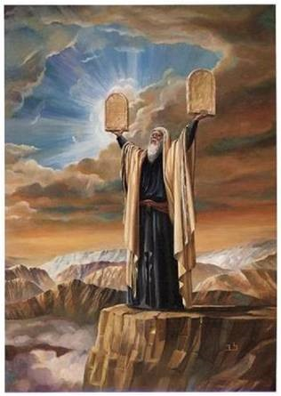
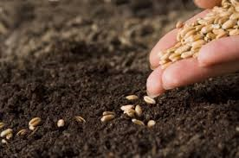
Abinadi’s Testimony
Teach—
The law of Moses
That it is a shadow to come
That redemption comes through Christ the Lord who is the Eternal Father
“It matters not how well the farmer cultivates, nourishes, and tends his field, if he has forgotten to plant his seed.”
Mosiah 16:14-15; Mosiah 12:27-28 JFM and RLM

Slide 30
Sources:
James E. Talmage The Articles of Faith p. 465-73
Bruce R. McConkie The Mystery of Godliness p 52
Promised Messiah p. 63,371
The Salvation of Little Children p. 3,7 also the Life Beyond, chapter 8, 134
Joseph Fielding Smith Doctrines of Salvation 1:27
Joseph Smith Lectures on Faith 5:2, 7:9
Joseph Fielding McConkie and Robert L. Millet Doctrinal Commentary on the Book of Mormon Vol. 2 p. 225-243
Tad R. Callister Infinite Atonement p.310
Richard G. Scott “The Atonement Can Secure Your Peace and Happiness,” Ensign or Liahona, Nov. 2006, 42).
Thomas S. Monson Finding Peace March Liahona 2004
Presentation by ©http://fashionsbylynda.com/blog/

