Slide 2
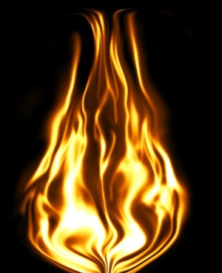
Fire of Testimony and Death
Abinadi ‘s words kindle a fire of testimony
Spiritual--Conversion is always a miraculous matter, particularly in the midst of wickedness and among a people who are smitten with hardheartedness, as a result of their iniquities
JFM and RLM
Physical--Deliberately causing death through the effects of combustion has a long history as a form of capital punishment. Many societies have employed it as an execution method for such crimes as treason, heresy, and witchcraft. The form of this type of execution in which the condemned is bound to a large wooden stake is usually called burning at the stake
Wikipedia
Abinadi is sentenced to death by fire
Mosiah 17:1

Slide 3
Alma
He was a descendant of Nephi—One of the son’s of colonizer Zeniff
He was a young man and a priest at King Noah’s court—about 25 years old
He repented of his sins and had a mighty change of heart because of Abinadi’s words
He pled for Abinadi’s release and King Noah ordered Alma’s execution
Alma fled for his life and gathered secretly to teach the words of Abinadi baptizing many at the Waters of Mormon
He and many people made their way to Zarahemla—around 120 BC and joined Mosiah and his people
He baptized Limhi, son of Noah
He established the Church throughout Zarahemla—Mosiah 25:21-22
He had a son, Alma the younger, and consecrated him High Priest
He died at age 82 years of age around 91 BC
Who’s Who

Slide 4
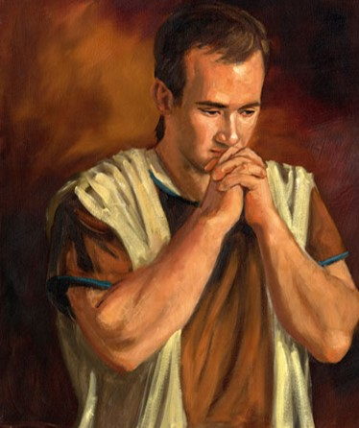
Alma Believes
Alma knew of the things which Abinadi had testified of and plead that King Noah would not be angry with Abinadi
“…the guilty taketh the truth to be hard…”
1 Nephi 16:2
In King Noah’s eyes Alma added insult to injury, not only had Abinadi delivered a message which tore away at his kingdom, but Abinadi had converted a soul in the process
Mosiah 17:2-4
James H. Fullmer

Slide 5
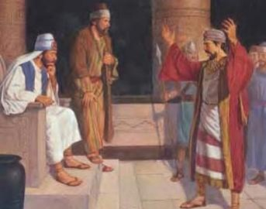
Standing for Truth
Have you ever seen someone stand up for what is right when it was difficult for them to do so?
What happened?
“Be strong—in standing for the right. We live in an age of compromise. … In situations with which we are daily confronted, we know what is right. … We must cultivate the strength to follow our convictions”
Gordon B. Hinckley
Consquences of Alma’s Actions:
The king was more angry and sought to cast him out
Alma fled and hid himself and began to write all the words which Abinadi had spoken—sometimes you need to remove yourself from the situation
Mosiah 17:2-4

Slide 6
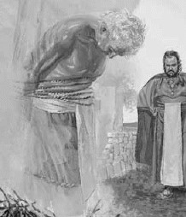
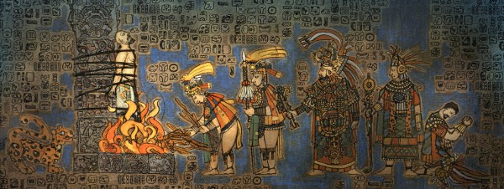
A Martyr’s Death
King Noah judges Abinadi with treason
Abinadi bound and cast into prison for 3 days
Abinadi refuses to recall all that he has said to King Noah and the priests…He has come to do what he was sent to do
Abinadi’s last words “Oh God, receive my soul.”
Mosiah 17:5-20

Slide 7
Shedding Innocent Blood
To murder—to take the life of one who is innocent
“sin unto death”
1 John 5:16-17
A crime against humanity, a heinous offense to heaven for which there is no forgiveness
2 Nephi 9:35
Other Martyrdoms:
Joseph and Hyrum Smith D&C 135:1
Women and Children when Alma and Amulek were taken prisoners Alma 14:10
John the Baptist Mark 6:16
James Acts 12:1
Stephen Acts 7:59-60
Paul—see sources
Zenock Alma 33:17
Abel The first Martyr
D&C 138:40 and Genesis 4:8
“…and the blood of the innocent shall stand as a witness against them, yea, and cry mightily against them at the last day.
Alma 14:11
Mosiah 17:10

Slide 8
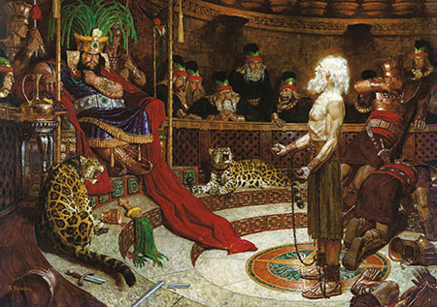
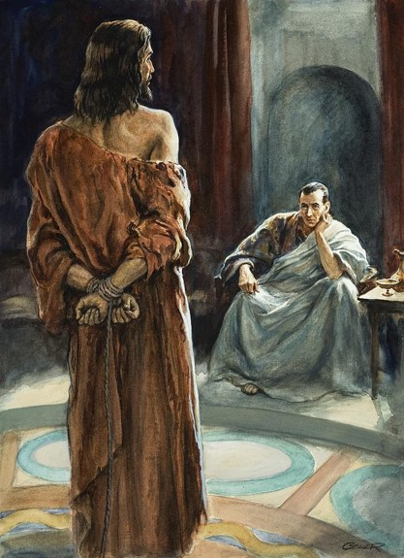
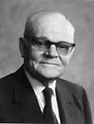
Those Who Know
King Noah knew that Abinadi was innocent and feared him and the priests
Pontius Pilate knew that Jesus was innocent and feared him and the people
“…on the basis that he does not know they are true, because everything the Lord does or says has within itself the evidence of its own authenticity, and every person is divinely endowed with the means to discover that evidence and know for himself that it is true.”
Marion G. Romney
If we remain true to God in all circumstances, we can help others recognize the truth
Mosiah 17:11

Slide 9
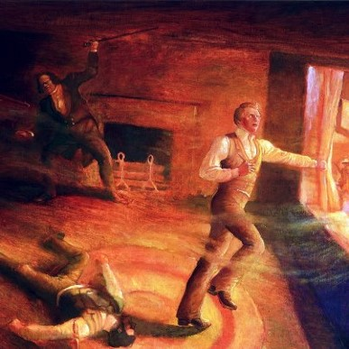
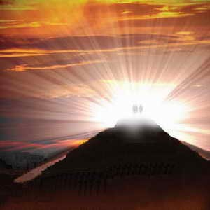
Testament Lives On
“It is not easy to die, even to die for one’s testimony, but the taste of death is so much sweeter to those whose lives and words bear fervent witness of him whose servants they are. Frequently the Lord requires certain of his representative to shed their own blood in a martyr’s death that their testament might be in full force.”
D&C 135:5
Hebrews 9:16-17
JFM and RLM
“And I will give power unto my two witnesses and they shall prophesy a thousand two hundred and threescore days, clothed in sackcloth...
and when they shall have finished their testimony, the beast that ascendeth out of the bottomless pit shall make war against them, and shall overcome them, and kill them…
After 3 days… “And they ascended up to heaven in a cloud; and their enemies beheld them.”
Mosiah 17:13-20 and Revelation 11:3,7,12

Slide 10
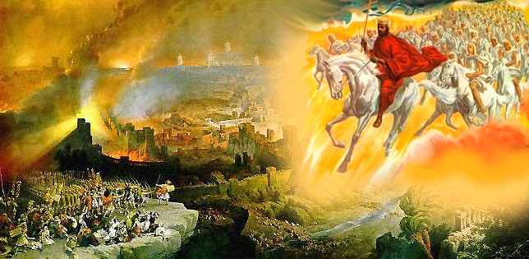
Shall Rise First
“For the Lord himself shall descend from heaven with a shout, with the voice of the archangel, and with the trump of God: and the dead in Christ shall rise first:”
1 Thessalonians 4:16

Slide 11
Sources:
Video:
Stand as a Witness
Joseph Fielding McConkie and Robert L. Millet Doctrinal Commentary on the Book of Mormon Vol. 2 pg 248
http://en.wikipedia.org/wiki/Death_by_burning
Gordon B. Hinckley (“Building Your Tabernacle,” Ensign, Nov. 1992, 52).
Marion G. Romney Conference Report April 1976
Book of Mormon Who’s Who Ed J. Pinegar and Richard J. Allen p. 11-12
Presentation by ©http://fashionsbylynda.com/blog/

Slide 12
PAUL
See also Pauline Epistles
An Apostle in the New Testament. Paul’s Hebrew name was Saul, and he went by this name until the beginning of his mission to the Gentiles. He had previously persecuted the Church but was converted to its truth after seeing a vision of Jesus Christ. Paul went on three major missionary journeys and wrote many letters to the Saints. Fourteen of these letters form a part of the New Testament today. He was finally taken as a prisoner to Rome and was killed, probably in the spring of A.D. 65.
LDS Guide to the Scriptures
Neither the Bible nor other sources say how or when Paul died, but Ignatius, probably around 110, writes that Paul was martyred. Christian tradition holds that Paul was beheaded in Rome during the reign of Nero around the mid-60s at Tre Fontane Abbey (English: Three Fountains Abbey).By comparison, tradition states that Peter, who was not a Roman citizen, was given the more painful death of being crucified upside-down.
In June 2009, Pope Benedict announced excavation results concerning the tomb of Paul at the Basilica of Saint Paul Outside the Walls. The sarcophagus was not opened but was examined by means of a probe, which revealed pieces of incense, purple and blue linen, and small bone fragments. The bone was radiocarbon dated to the 1st or 2nd century. According to the Vatican, these findings are consistent with the tradition that the tomb is Paul's.[The sarcophagus was inscribed in Latin saying, "Paul apostle martyr".
http://en.wikipedia.org/wiki/Paul_the_Apostle

Slide 13
The Mediator--- Boyd K. Packer------Let me tell you a story—a parable.
There once was a man who wanted something very much. It seemed more important than anything else in his life. In order for him to have his desire, he incurred a great debt.
He had been warned about going into that much debt, and particularly about his creditor. But it seemed so important for him to do what he wanted to do and to have what he wanted right now. He was sure he could pay for it later.
So he signed a contract. He would pay it off some time along the way. He didn’t worry too much about it, for the due date seemed such a long time away. He had what he wanted now, and that was what seemed important.
The creditor was always somewhere in the back of his mind, and he made token payments now and again, thinking somehow that the day of reckoning really would never come.
But as it always does, the day came, and the contract fell due. The debt had not been fully paid. His creditor appeared and demanded payment in full.
Only then did he realize that his creditor not only had the power to repossess all that he owned, but the power to cast him into prison as well.
“I cannot pay you, for I have not the power to do so,” he confessed.
“Then,” said the creditor, “we will exercise the contract, take your possessions, and you shall go to prison. You agreed to that. It was your choice. You signed the contract, and now it must be enforced.”
“Can you not extend the time or forgive the debt?” the debtor begged. “Arrange some way for me to keep what I have and not go to prison. Surely you believe in mercy? Will you not show mercy?”
The creditor replied, “Mercy is always so one-sided. It would serve only you. If I show mercy to you, it will leave me unpaid. It is justice I demand. Do you believe in justice?”
“I believed in justice when I signed the contract,” the debtor said. “It was on my side then, for I thought it would protect me. I did not need mercy then, nor think I should need it ever. Justice, I thought, would serve both of us equally as well.”
“It is justice that demands that you pay the contract or suffer the penalty,” the creditor replied. “That is the law. You have agreed to it and that is the way it must be. Mercy cannot rob justice.”
There they were: One meting out justice, the other pleading for mercy. Neither could prevail except at the expense of the other.
“If you do not forgive the debt there will be no mercy,” the debtor pleaded.
“If I do, there will be no justice,” was the reply.
Both laws, it seemed, could not be served. They are two eternal ideals that appear to contradict one another. Is there no way for justice to be fully served, and mercy also?
There is a way! The law of justice can be fully satisfied and mercy can be fully extended—but it takes someone else. And so it happened this time.
The debtor had a friend. He came to help. He knew the debtor well. He knew him to be shortsighted. He thought him foolish to have gotten himself into such a predicament. Nevertheless, he wanted to help because he loved him. He stepped between them, faced the creditor, and made this offer.
The Mediator Continued:
“I will pay the debt if you will free the debtor from his contract so that he may keep his possessions and not go to prison.”
As the creditor was pondering the offer, the mediator added, “You demanded justice. Though he cannot pay you, I will do so. You will have been justly dealt with and can ask no more. It would not be just.”
And so the creditor agreed.
The mediator turned then to the debtor. “If I pay your debt, will you accept me as your creditor?”
“Oh yes, yes,” cried the debtor. “You save me from prison and show mercy to me.”
“Then,” said the benefactor, “you will pay the debt to me and I will set the terms. It will not be easy, but it will be possible. I will provide a way. You need not go to prison.”
And so it was that the creditor was paid in full. He had been justly dealt with. No contract had been broken. The debtor, in turn, had been extended mercy. Both laws stood fulfilled. Because there was a mediator, justice had claimed its full share, and mercy was fully satisfied.
Each of us lives on a kind of spiritual credit. One day the account will be closed, a settlement demanded. However casually we may view it now, when that day comes and the foreclosure is imminent, we will look around in restless agony for someone, anyone, to help us.
And, by eternal law, mercy cannot be extended save there be one who is both willing and able to assume our debt and pay the price and arrange the terms for our redemption.
Unless there is a mediator, unless we have a friend, the full weight of justice untempered, unsympathetic, must, positively must fall on us. The full recompense for every transgression, however minor or however deep, will be exacted from us to the uttermost farthing.
But know this: Truth, glorious truth, proclaims there is such a Mediator.
Elder Boyd K. Packer
For Full Talk
May Ensign 1977

