Slide 2
As Many As Would Hear
Alma repents of his sins
Alma teaches of repentance and redemption
As many would hear Alma teaches in secret hiding himself in the daytime from the searches of the king
As many did believe they went to a place called “Mormon”
Alma teaches the words of Abinadi of the power of Christ, his suffering, resurrection, and ascension to heaven
Mosiah 18:1-7

Slide 3
Those That Are Willing To:
To bear one another’s burdens
Mourn with those that mourn
Comfort those that stand in need of comfort
Stand as witnesses of God at all times and in all things, and in all places
Be redeemed of God and be numbered with those of the first resurrection and have eternal life
Be baptized and enter into a covenant with the Lord
Willing to serve Him and keep His commandments
Mosiah 18:8-10

Slide 4
Baptism is a Two-Way Promise
God promises:
That I will be redeemed of God
That I will be part of the first resurrection
That I will receive eternal life
He will pour out His Spirit upon me
Baptism is the “first fruits of repentance” Moroni 8:25
A covenant is an agreement between God and man but that God and man “do not act as equals in the agreement. God gives the conditions for the covenant, and men agree to do what he asks them to do. God then promises men certain blessings for their obedience”
[Guide to the Scriptures, “Covenant”]
Mosiah 18:8-10

Slide 5
I AM WILLING TO … | GOD PROMISES …
Help bear others’ burdens, that they may be light (see Mosiah 18:8). | That I will be redeemed of God (see Mosiah 18:9).
Mourn with those who mourn (see Mosiah 18:9). | That I will be part of the First Resurrection (see Mosiah 18:9).
Comfort those who stand in need of comfort (see Mosiah 18:9). | That I will receive eternal life (see Mosiah 18:9).
Stand as a witness of God at all times, in all things, and in all places (see Mosiah 18:9). | He will pour out His Spirit upon me (see Mosiah 18:10).
Serve God and keep His commandments (see Mosiah 18:10).
…that he may pour out his Spirit more abundantly upon you?

Slide 6
Doctrinal Mastery
8. And it came to pass that he said unto them: Behold, here are the waters of Mormon (for thus were they called) and now, as ye are desirous to come into the fold of God, and to be called his people, and are willing to bear one another’s burdens, that they may be light;
9. Yea, and are willing to mourn with those that mourn; yea, and comfort those that stand in need of comfort, and to stand as witnesses of God at all times and in all things, and in all places that ye may be in, even until death, that ye may be redeemed of God, and be numbered with those of the first resurrection, that ye may have eternal life—
10. Now I say unto you, if this be the desire of your hearts, what have you against being baptized in the name of the Lord, as a witness before him that ye have entered into a covenant with him, that ye will serve him and keep his commandments, that he may pour out his Spirit more abundantly upon you?
Mosiah 18:8-10

Slide 7
Baptizing Helam
Alma was filled with the Holy Spirit
“O Lord, pour out thy Spirit upon thy servant, that he may do this work with holiness of heart.”
They were both buried in the water
Alma held the priesthood—one who was ordained after the holy order of God. Thus he would have been baptized previously…
“…therefore, when Alma baptized himself with Helam that was not a case of Alma baptizing himself, but merely as a token to the Lord of his humility and full repentance.”
Joseph Fielding Smith
Alma and Helam were filled with the Holy Spirit
Mosiah 18:12-14

Slide 8
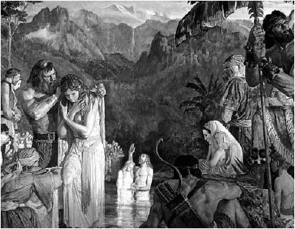
Baptizing Every One
Alma baptizes about 204 souls
And they were filled with the grace of God—filled with his blessings and his love, more specifically his Spirit.
Mosiah 18:15-16

Slide 9
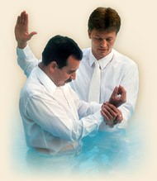
Establishing The Church of God
They were called the Church of God or the Church of Christ from that time forward
Those who were baptized from that time forward was added to His church
Alma ordained priests—50 and taught them things concerning the kingdom of God
Mosiah 18:17-18

Slide 10
Teaching VS Preaching
Alma commands the priests to teach the things spoken of by the holy prophets and to preach repentance and faith in God
“The words preaching and teaching are sometimes used interchangeably. Like peanut butter and jelly, chips and salsa… you can have one without the other, but they often go together.
…good preaching always involves some teaching. On the other hand, good teaching does not always involve preaching.”
Pastor Mark Driscoll
Preaching—to the audience of believers and non believers
Teaching—to the students or audience with the same focus
Mosiah 18:19-20

Slide 11
Unity of Faith
No contention among them
Looking forward with one eye—to be single minded, focused, and riveted on the cause of Christ.
“It is to be more concerned about building up the kingdom of God and establishing his righteousness in the earth than with personal achievement or self-aggrandizement.” See 3 Nephi 13:22 and D&C 88:67-68
JFM and RLM
Having one faith and one baptism, having their hearts knit together in unity and in love one towards another
See D&C 82:19
Mosiah 18:21

Slide 12
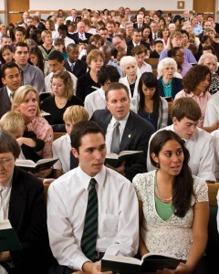
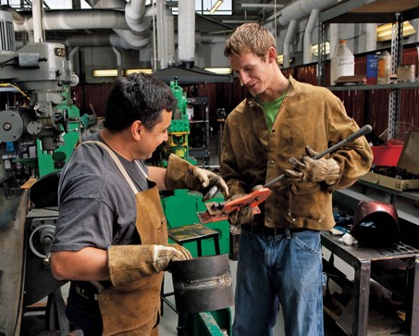
Alma Commanded
The People:
To observe the Sabbath Day and Keep it Holy
To give thanks to the Lord
The priests:
They are to labor with their own hands for support
One day a week to set apart to gather together to teach the people and worship God
They were not to depend on the people for their support
That they were to teach with the power and authority from God
Mosiah 18:23-26

Slide 13
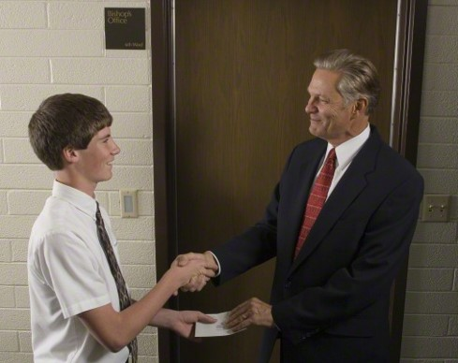
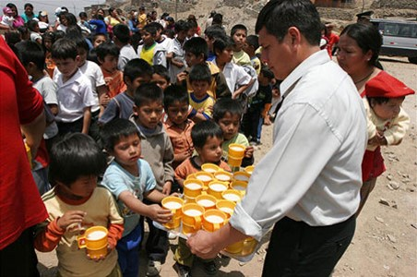
According To Their Wants
To the People:
Of their substance—people should have what they need—the Law of Consecration—Law of Zion (D&C 105:3-5)
Impart of their own free will
“A religion that cannot save a people temporally has not the power to save them spiritually.
The society of Zion is made up of a people who have put their trust in the Spirit which leads to do good, to do justly, to walk humbly to judge righteously
D&C 11:12
The people of such a holy commonwealth seek the interest of their neighbors.”
JFM and RLM
Mosiah 18:23-29 also Mosiah 4:26 and D&C 82:17

Slide 14
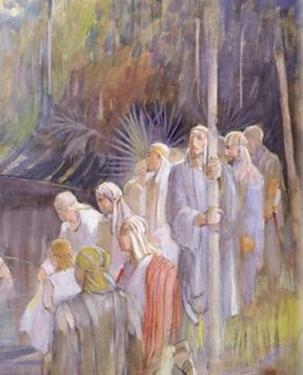
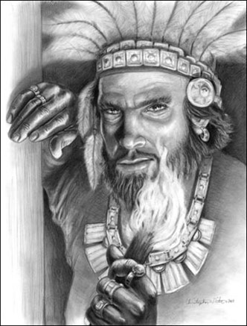
A Long Time in the Forrest and 450 Souls
The People:
How beautiful are they to the eyes--There is peaceful excitement and joy associated with true conversion.
What Alma taught was new to them only because under King Noah the people were in a state of apostasy
Noah:
A rebellious soul is never content to wallow in their own wickedness…they frequently try to thwart with zeal the righteous from succeeding.
The Lord can warn us when we are in danger
Mosiah 18:30-35

Slide 15
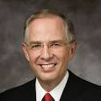
“Working as a special agent for the FBI, my friend investigated organized crime groups transporting illegal drugs into the United States.
“On one occasion, he and another agent approached an apartment where they believed a known drug dealer was distributing cocaine. My friend describes what happened:
“‘We knocked on the door of the drug dealer. The suspect opened the door, and upon seeing us, tried to block our view. But it was too late; we could see the cocaine on his table.
“‘A man and a woman who were at the table immediately began removing the cocaine. We had to prevent them from destroying the evidence, so I quickly pushed the drug suspect who was blocking the door to the side. As I pushed him, my eyes met his. Strangely, he did not appear angry or afraid. He was smiling at me.
“‘His eyes and disarming smile gave me the impression that he was harmless, so I quickly left him and started to move toward the table. The suspect was now behind me. At that instant, I had the distinct, powerful impression come into my mind: “Beware of the evil behind the smiling eyes.”
“‘I immediately turned back toward the suspect. His hand was in his large front pocket. Instinctively I grabbed his hand and pulled it from his pocket. Only then did I see, clutched in his hand, the semiautomatic pistol ready to fire. A flurry of activity followed, and I disarmed the man.’ …
“… The Holy Ghost warned my friend of physical danger; the Holy Ghost will
also warn you of spiritual danger”
Elder Neil L. Andersen

Slide 16
The Lord can warn the righteous when they are in danger.
The people took their tents and departed into the wilderness
Mosiah 18:34-35

Slide 17
Sources:
Video:
Abinadi Converted One Soul (1:23)
Stand Tall (4:08)
Beware of the Evil Behind Smiling Eyes
Joseph Fielding Smith Answers to Gospel Questions 3:203-204
Pastor Mark Driscoll --http://theresurgence.com/2013/04/23/what-s-the-difference-between-preaching-and-teaching
Joseph Fielding McConkie and Robert L. Millet Doctrinal Commentary on the Book of Mormon vol. 2 p. 261, 263-264
Elder Neil L. Andersen (“Beware of the Evil Behind the Smiling Eyes,” Ensign or Liahona, May 2005, 46–47).
Presentation by ©http://fashionsbylynda.com/blog/

Slide 18
Differences Between the People of Limhi and the People of Alma adapted from: Book of Mormon Student Manual, Religion 121-122 pg 159-60
Time Period | People of Limhi | People of Alma
1. Abinadi’s 2nds Visit | Noah’s people rejected and killed Abinadi (Mosiah 17) Continue in Wickedness | Alma believed Abinadi, forced to flee (Mosiah 17:2-4)
2. Aftermath of Abinadi’s 2nd visit | Noah/Limhi’s people continued in wickedness (19:2-20) They were divided, they were contentious, they were attacked by the Lamanites King Noah killed and the people were brought into Lamanite bondage and they must pay 50% tribute | A small group believed Alma (18:3-21 They travel to hear Alma preach They were taught to repent and have faith They covenanted with God They escaped the efforts of King Noah that wanted to destroy them
3. 2 years from Abinadi’s death (19:29) | They endured bondage The Lamanites attacked (20:7) They fought back and they accepted bondage | Alma’s people prospered (23:2-5) The Lord strengthened them They built a city
4. A period of time following the first two years (19:29) | Conditions of bondage intensified (21:3-6) Smitten on cheeks and heavy burden and murmuring Three wars end in defeat, and many killed, much sorrow (21:7-12) | Alma’s people continued in peace and prosperity (23:19-20) They lived righteously and they prospered exceedingly
5. Continued after the first two years | Limhi’s people repented (21:7-14, 25-26) Compelled to be humble Accepted bondage and abuse Cried mightily to the Lord Sent for help to Zarahemla | Alma’s people continued in peace and prosperity
6. Continued after the first two years | Eventually delivered (21:16-31) Lord was slow to hear Prospered by degrees Covenanted with God Delivered. (22:11) | Alma’s people continued in peace and prosperity
7. 121-120 BC Mosiah 22:24-25 footnotes | Arrived in Zarahemla (22:13-16) Lamanite army pursued Limhi’s people | Alma’s people experienced bondage and delivery from the Lord (Mosiah 23-24) The Lamanite army sent after Limhi’s people discovered Alma’s people in the land of Helam (24:8-10)

