Slide 2
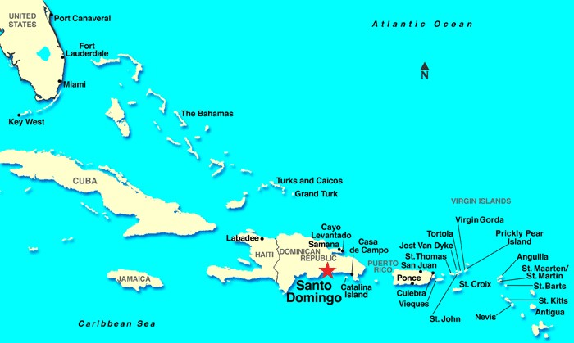
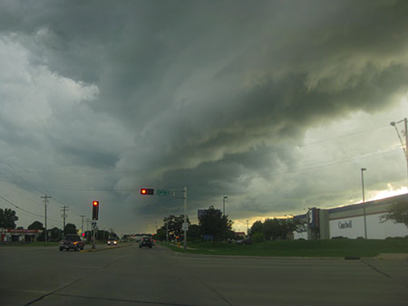
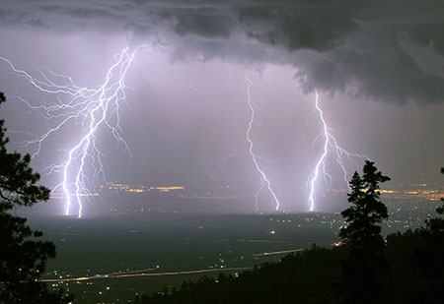
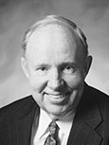
“One Sunday morning … we awoke to a beautiful day in Santo Domingo in the Dominican Republic. The Caribbean sun was shining, and the sky was clear. A gentle breeze was blowing, barely ruffling the leaves on the trees; it was warm and peaceful and still. But far out to sea, beyond the reach of our physical senses that day, the deadly destroyer was coming our way, implacable and irresistible.
The Hurricane Center, with responsibility to track and predict the path of Hurricane Georges, was constantly updating the information available on the Internet. In the peaceful, placid quiet of that morning, by virtue of those seeing eyes in the sky, I saw the predicted path of the storm, aimed like an arrow at the heart of Santo Domingo.
“Within 48 hours the storm struck the island with intense … fury, leaving in its path destruction, desolation, and death.”
David R. Stone

Slide 3
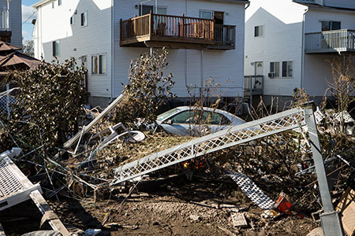
What were the conditions preceding the storm?
How did Elder Stone know the storm was coming?
“Great as the damage and destruction and death from these awesome phenomena of physical force can be, there is even more desolation caused in people’s lives by spiritual hurricanes. These furious forces often cause far more devastating damage than physical cyclones, because they destroy our souls and rob us of our eternal perspective and promise.”
David R. Stone

Slide 4
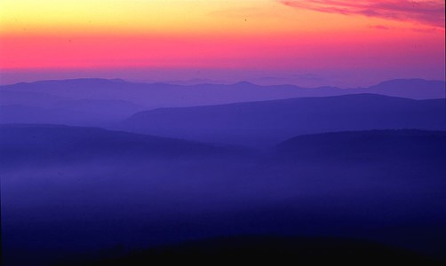
The Purpose of Warnings
Have you ever had a time that someone tried to warn you about a danger that you could not foresee?
Did you listen to this warning?
If you had listened, how were you blessed?
What is the purpose of a warning?
Who warns you about things you should avoid or things that might be harmful to you?

Slide 5
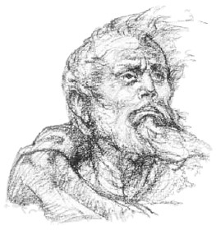
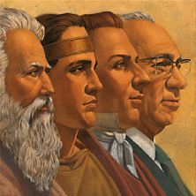
Spiritual Warnings
To whom does God reveal spiritual warnings for His Church?
The Lord sent Abinadi to warn the Nephites of the consequences of their sins.
The Lord sends Prophets to warn us against the evils of the day

Slide 6
Division Among the Remainder of the People
Those that were with Alma:
Were enjoying their peaceful life with their conversion
Choosing to follow unrighteous individuals can lead us to make poor decisions we will later regret
Those that stayed with King Noah:
Some began to breathe out threats against King Noah
There began to be contention among them
Mosiah 18:30 and Mosiah 19:1-3

Slide 7
Gideon
A strong military leader in the army of King Noah
He rose to take action against evil
Around 145 BC he lead a revolt against the abuses of King Noah and attempted to slay him but was interrupted by the invasion of the Lamanites
King Noah’s son, Limhi, later heeded Gideon’s advice to disable their Lamanite guards with drunkenness and gained freedom for the people to return to Zarahemla
He became a teacher of the people in the Church of God
Around 91 BC he challenged arrogant zealot Nehor “with the words of God” (Alma 1:9)
Nehor slew Gideon with the sword
He gave his life in defending the truth
Who’s Who

Slide 8
The Story
Gideon draws sword to slay King Noah—
King Noah fled
Gideon pursues him to the tower by the temple
King Noah sees the Lamanite army were on the borders of the land
Gideon spared the king’s life
Mosiah 19:4-8

Slide 9
King Noah commanded that the people flee
He also fled before them
The Lamanites captured them and began to slay them
King Noah commanded that the women and children flee but many woman remained
Mosiah 19:9-12

Slide 10
Those who stayed had their fair daughters stand forth and plead with the Lamanites to not slay them
The Lamanites had compassion on them
They took them back to the Land of Nephi under the condition that they deliver up King Noah and their property—1/2 of what they had to pay tribute to the king of the Lamanites
Mosiah 19:13-15

Slide 11
Limhi
Son of King Noah
Grandson of Zeniff
He was appointed king by the voice of the people around 145 BC, but ascension to power began around 150 BC
He was the last of the Nephite kings in the colony established by Zeniff among the Lamanites in the land of Nephi
He did not seek after the wicked ways of his father, Noah
He served as a spiritual guide for his people
He sought to escape the bondage his people were in with the Lamanites and ruled in an atmosphere of constant fear of Lamanite attack or retribution
Who’s Who
Who’s Who

Slide 12
Limhi, the son of Noah, was also taken captive
He was desirous to not have his father destroyed
But he knew of his father’s wickedness
Gideon sent men into the wilderness secretly to find the people and King Noah
They met the people in the wilderness but King Noah and the priests were not there
Mosiah 19:16-18

Slide 13
The people had sworn that if they return to the Land of Nephi and if their wives and their children were slain that they would seek revenge and also perish with them
Earlier King Noah had commanded that they should not return and they were angry with him, so they caused that he should suffer by fire
Prophecy Fulfilled- Mosiah 12:3
But the priests fled into the wilderness
Mosiah 19:19-21

Slide 14
The people told Gideon that they had slain the king and the priests had fled further into the wilderness
The men had told them what had happened to the people in the land of Nephi
And they rejoiced to hear that their loved ones were not slain
Mosiah 19:22-24

Slide 15
The King of the Lamanites made an oath to not slay them
The people made Limhi to be their king and he made an oath to the king of the Lamanites to pay tribute to him ½ of all they possessed
Limhi began to establish peace among his people
The king of the Lamanites set guards around the people so they would not escape
For 2 years they had peace
Mosiah 19:25-29

Slide 16
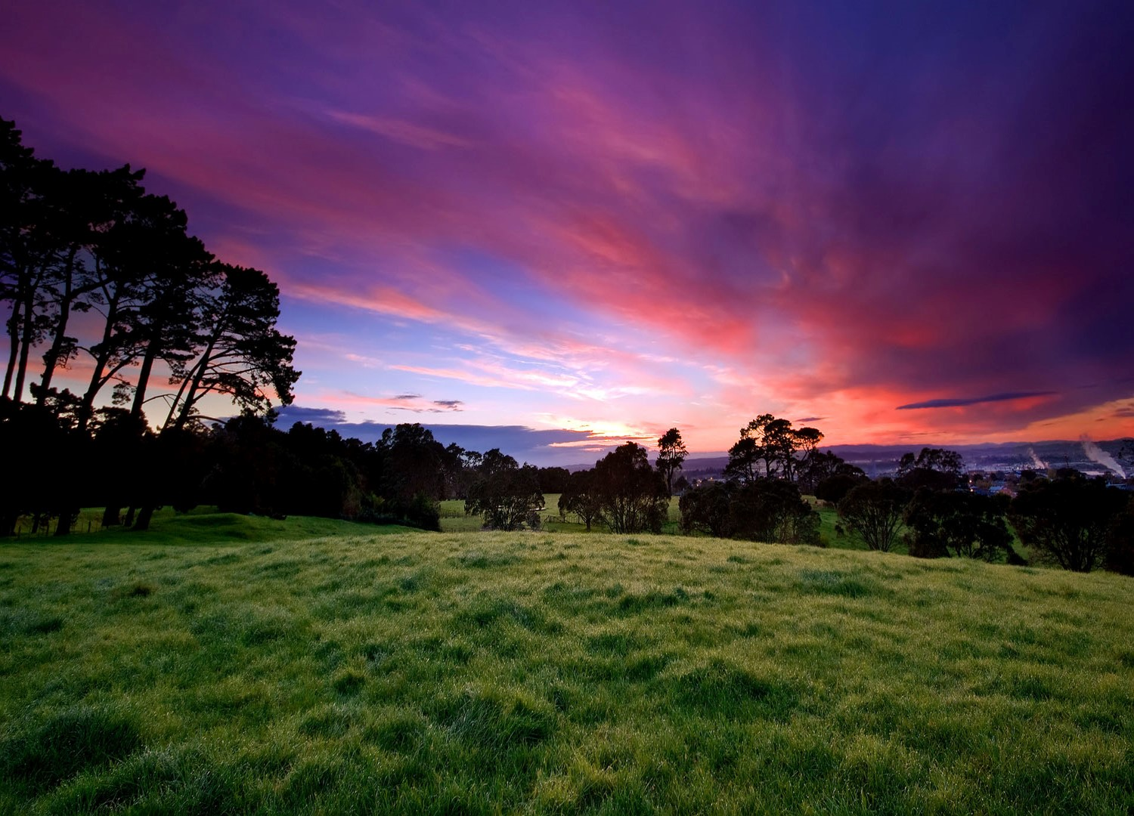
In a place called Shemion the daughters of the Lamanites danced and sang
The priests of King Noah who had fled further into the wilderness came upon the daughters
They took the daughters and went into the wilderness, there were 24 of them
Mosiah 20:1-5

Slide 17
When the Lamanites found out about their daughters they were angry with Limhi…they thought it was his people who had carried the daughters away
The king and his people went into the land of Nephi to destroy the people of Limhi
Mosiah 20:6-7

Slide 18
Limhi discovered them while in the tower
He also discovered that they were preparing for war.
He gathered his people…
Mosiah 20:8

Slide 19
And departed to the fields and forest and laid wait
Mosiah 20:9

Slide 20
The Lamanites came upon them, began to slay them for they fought like lions
The Lamanites thought their king was dead and they fled
The battle was “sore” and the people of Limhi fought for the wives and children—like dragons and drove them back
The people brought the king of the Lamanites to Limhi and bound him
Mosiah 20:9-13

Slide 21
Gideon, the king’s captain, persuaded Limhi to not search for the priest’s of Noah
He reminded Limhi of Abinadi’s prophecy
Gideon said it was better for them to be in bondage than to be slain
The king told Limhi he had broken the oath he had made because of the missing daughters
Limhi knew nothing of this and wanted to search for the priests
Mosiah 20:15-24

Slide 22
Limhi and his people went back to the Lamanites without weapons
The Lamanites had compassion on them and returned to their own land
Mosiah 20:25-26

Slide 23
Gideon Reminds Us of Abinadi’s Words
Ignoring or rejecting the words of the Lord’s servants brings suffering and sorrow

Slide 24
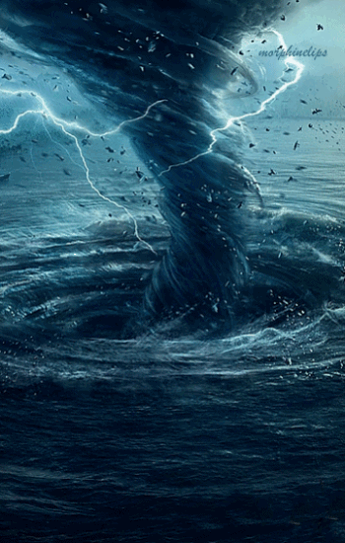
“We … have our spiritual hurricane guardians, those whose calling it is to watch and warn, helping us avoid spiritual damage, destruction, and even death. Our watchmen on the tower are known to us as apostles and prophets. They are our spiritual eyes in the sky, and they know, through inspiration and insight and pure intelligence, the course these storms may take.
They continue to raise their voices in warning to tell us of the tragic consequences of willful and wanton violations of the Lord’s commandments. To intentionally ignore their warnings is to court misery, sorrow, and ruin. To follow them is to follow the chosen servants of the Lord into spiritual pastures of peace and plenty.”
David R. Stone

Slide 25
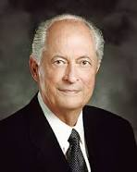
What are some things prophets and apostles teach in our day that will help us avoid suffering and sorrow?
What do they teach that will help bring us peace and happiness and help us return to God’s presence?
“Our spiritual safety lies in turning to the clear voice of our living prophet. If we listen to his voice and obey his counsel, we will be able to live as Christ would have us live and endure to the end so that one day we, along with our families, will return back into the
presence of our Heavenly Father
and our Savior Jesus Christ”
Robert D. Hales

Slide 26
Sources:
Video:
Safety Lies in Obeying the Prophets (0:52)
David R. Stone, “Spiritual Hurricanes,” Ensign, Nov. 1999, 31
Ed. J. Pinegar and Richard J. Allen Book of Mormon Who’s Who p. 58-59, 113
Robert D. Hales (“Hear the Prophet’s Voice and Obey,” Ensign, May 1995, 17).
Presentation by ©http://fashionsbylynda.com/blog/

Slide 27
List in order Mosiah 19-20
______ Gideon seeks to kill King Noah.
______ The Nephite women and children plead with the Lamanites not to slay them.
______ King Noah suffers death by fire.
______ A Lamanite army comes into the borders of Shemlon.
______ The priests of Noah kidnap 24 Lamanite daughters.
______ The Lamanite king pleads with his army to spare the people of Limhi.
______ Noah and some of his men flee from the Lamanites, leaving their wives and children behind.
______ Limhi orders his people not to slay the Lamanite king.
______ There is peace between the Nephites and Lamanites for two years.
______ Limhi promises that his people will pay one half of their possessions to the Lamanites.
______ The Nephites repel a Lamanite attack and capture the Lamanite king.
Answers: 1, 4, 5, 2, 8, 11, 3, 10, 7, 6, 9.

