Slide 2
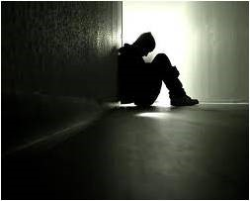
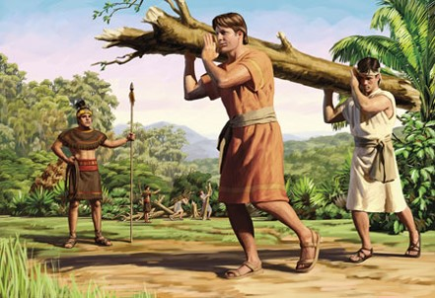
A Prophecy Fulfilled--Bondage
Physical Captivity—Bondage
Surrounded--Guarded by Lamanites
Smite --to strike or hit hard, with or as if with the hand, a stick, or other weapon or to affect mentally, morally, or emotionally
Exercise Authority--the power or right to control, judge, or prohibit the actions of others
Afflictions—A condition of pain, suffering, or distress.
Spiritual Captivity
Guilt-- an emotion that occurs when a person believes that they have violated a moral standard that they themselves believe in.
Contentions—murmur against--complain
Pity themselves–sympathy and sorrow aroused by the misfortune or suffering
Impatience—Restless and unable to endure irritation or opposition; intolerant
Mosiah 21:1-12

Slide 3
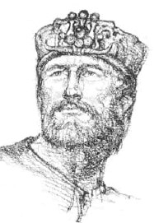
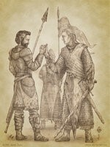
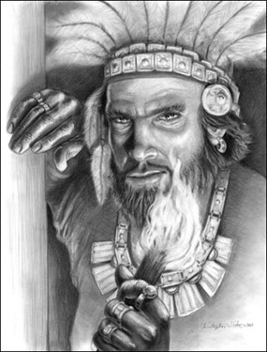
Breech—Breaking the Oath
The People of Limhi broke the oath the King of the Lamanites and Limhi had made
Mosiah 19:25-26
“And they did afflict the king sorely with their complaints; therefore he granted unto them that they should do according to their desires.”—The pressure of the people
What are the consequences of breaking a promise?
To Others?
To Yourself?
Mosiah 21:6

Slide 4
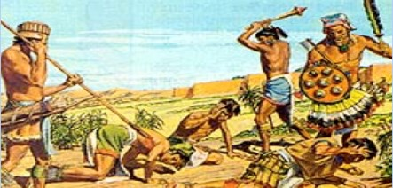
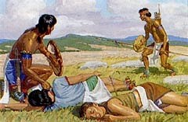
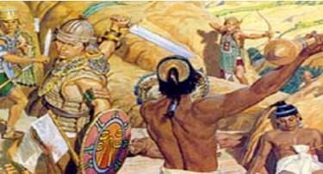
The Wars—against the Lamanites
1st
Gathered together
Put on armor
Went forth against the Lamanites
Were beaten, driven back, and lost many
They mourned and lamented
They feared the Lamanites
2nd
Because of their cries, they stirred up more to go into battle
Driven back
Suffered much loss
3rd
Went into battle again
Driven back
Suffered much loss
Those who were not killed returned to the city of Nephi
Mosiah 21:7-9

Slide 5
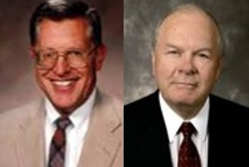
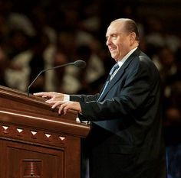
Rebuke and Chasten
Why did they get beaten so many times?
Why wasn’t the Lord with them?
Their afflictions had come because they had rejected the Lord’s invitation to repent
“The Lord who is patient and long-suffering even with evil may be equally slow to redeem the transgressor. …time and suffering are a part of the healing process.”
JFM and RLM
“As many as I love, I rebuke and chasten”
Revelations 3:19
They were slow to hearken unto the voice of the Lord their God; therefore, the Lord their God is slow to hearken unto their prayers, to answer them in the day of their trouble.
In the day of their peace they esteemed lightly my counsel; but, in the day of their trouble, of necessity they feel after me.
D&C 101:7-8
Mosiah 21:13-15

Slide 6
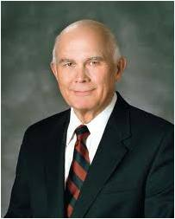
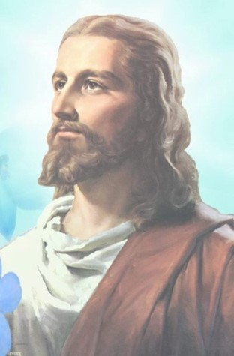
The Lord Hears Their Cries
Now that they were humbled, would the Lord help them defeat the Lamanites?
“The scriptures declare and illustrate that God’s thoughts are not man’s thoughts and God’s way are not man’s way.”
Dallin H. Oaks
“For my thoughts are not your thoughts, neither are your ways my ways, saith the Lord.
For as the heavens are higher than the earth, so are my ways higher than your ways, and my thoughts than
your thoughts.”
Isaiah 55:8-9
“Therefore, sanctify yourselves that your minds become single to God, and the days will come that you shall see him; for he will unveil his face unto you, and it shall be in his own time, and in his own way, and according to his own will.”
D&C 88:68

Slide 7
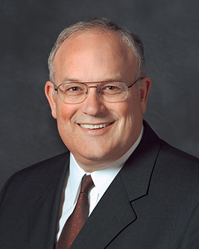
The Lord’s Way--Deliverance
The Lord softened the Lamanites hearts so:
Their burdens were lighter
The Lord did not see fit to deliver them out of bondage---yet
When we humble ourselves, call upon God, and repent of our sins, He will hear our prayers and ease the burden of our sins in His own time
“… these trials [burdens] are not just to test us. They are vitally important to the process of putting on the divine nature. If we handle these afflictions properly, they will be consecrated for our gain.”
^{Paul V. Johnson}
Mosiah 21:13-15

Slide 8
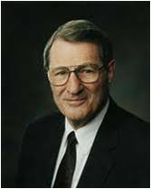
The Test of Our Faith
“Enduring it well”
Part of the normal pattern of life on earth
…enduring well…is an essential part of mortality’s planned refining process. Refining requires heat (trials). Refining also requires time. …refining also requires…a genuine and continuing confidence in the Refiner (Jesus Christ)”
“Mortality is a proving ground, a test of faith and obedience. By refining the submissive person, it makes him or her fit to return home to God.”
“We need perspective as to the length of our trials: perspective as regards their comparative intensity; assurance that, if we are faithful, our enemies will not finally prevail, either; and assurance that life's timetable for us is likewise know to God, “according as [our] works shall be.”
Mosiah 21:13-15 Neal A. Maxwell

Slide 9
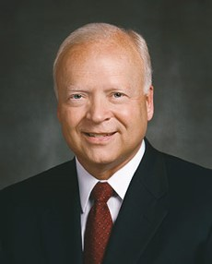
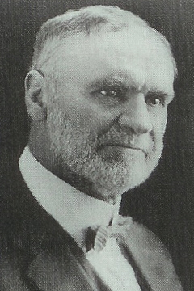
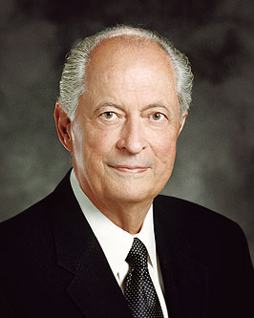
Spiritual Healing and Growth
“When we sin and refuse to repent, like the people of King Limhi, we bring upon ourselves additional pain—sometimes physical and always spiritual.
“Pain is a gauge of the healing process. It often teaches us patience.
Kent F. Richards
‘No pain that we suffer, no trial that we experience is wasted. It ministers to our education, to the development of such qualities as patience, faith, fortitude, and humility. … It is through sorrow and suffering, toil and tribulation, that we gain the education that we come here to acquire.’
Orson F. Whitney
“‘Pain brings you to a humility that allows you to ponder. It is an experience I am grateful to have endured. …
“‘I learned that the physical pain and the healing of the body … are remarkably similar to the spiritual pain and the healing of the soul in the process of repentance’”
Robert D. Hales
If we turn to the Lord, repent of our sins, and put forth the effort the Lord requires of us, then He will deliver us from our sins

Slide 10
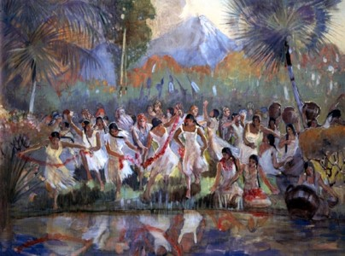
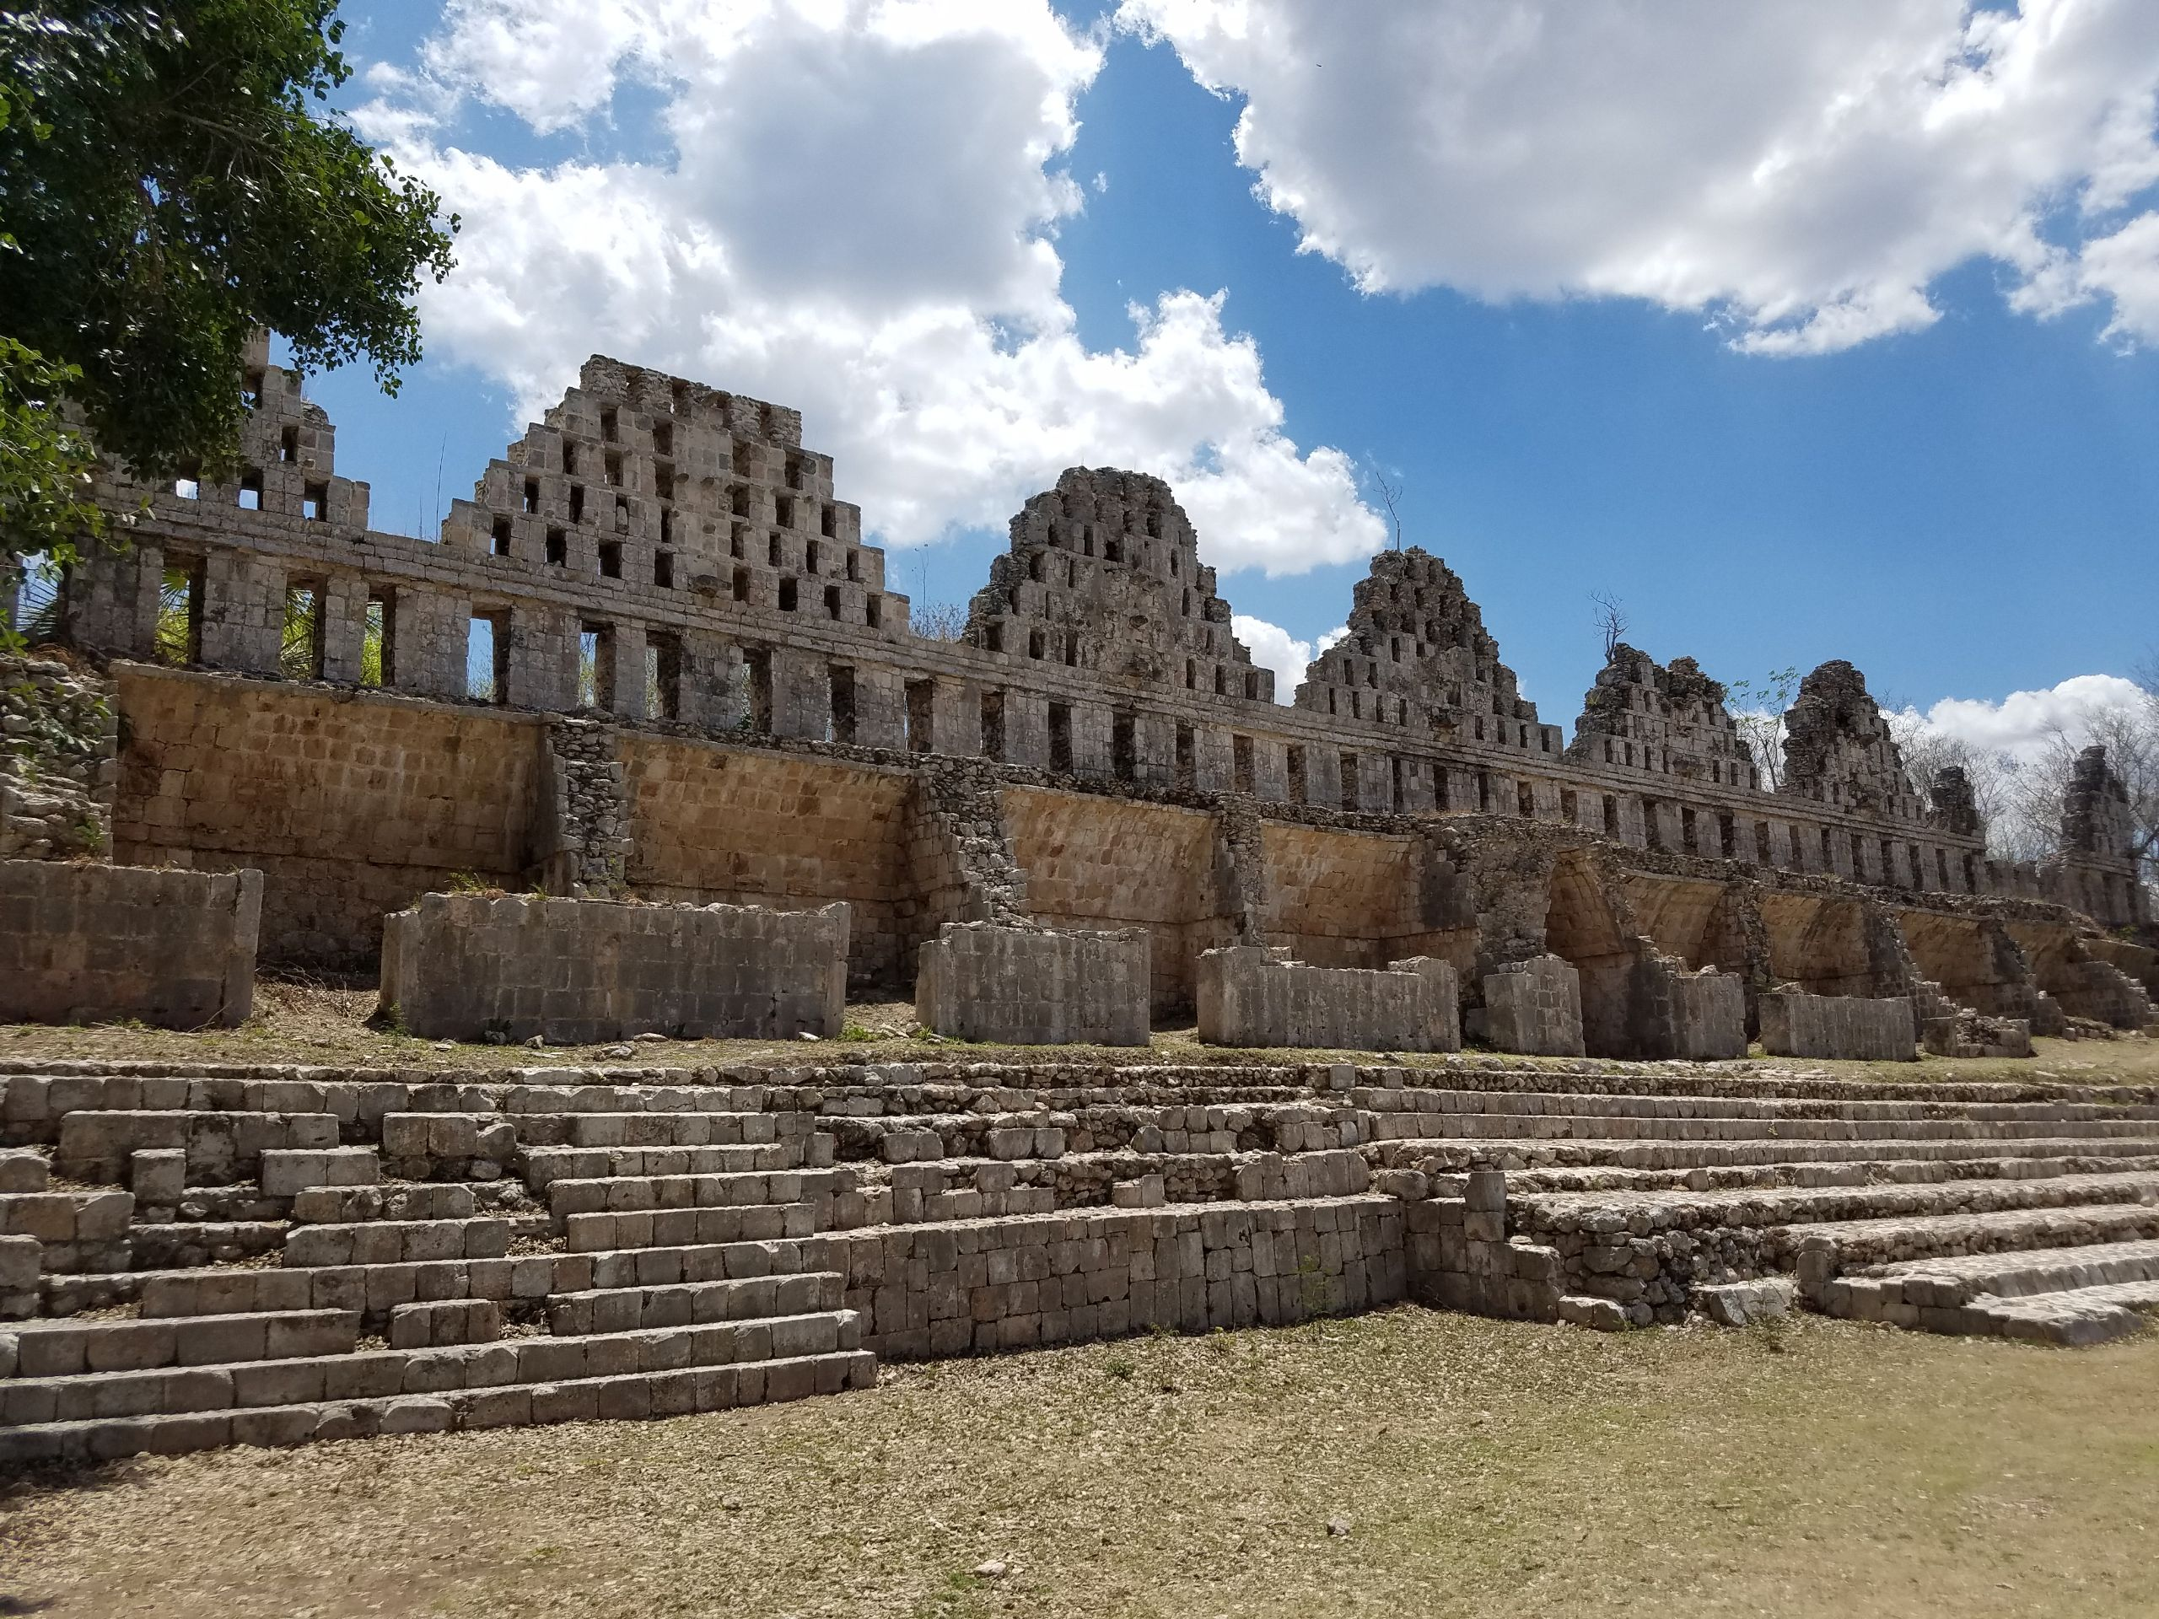
Prosper in the Land
By degrees—line upon line
The Priests who had taken the daughters of the Lamanites:
They had come into the land and taken grain and many precious things from the people of Limhi
The People:
Did not suffer from hunger
Secured their substances—grain and flocks
Kept watch over their people and their land
Desirous to find the priest and punish them
There was no more disturbance between the Lamanites and the people of Limhi until the time that Ammon and his brethren came into the land.
Mosiah 21:16-22

Slide 11
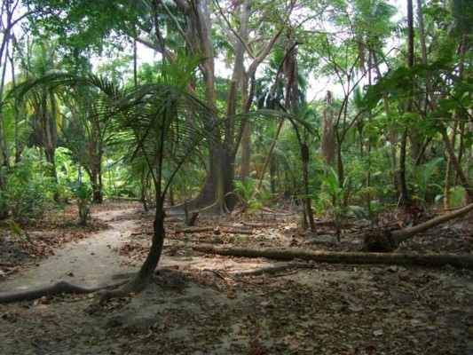
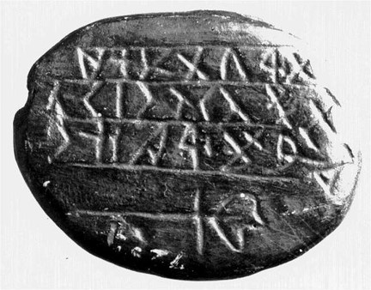
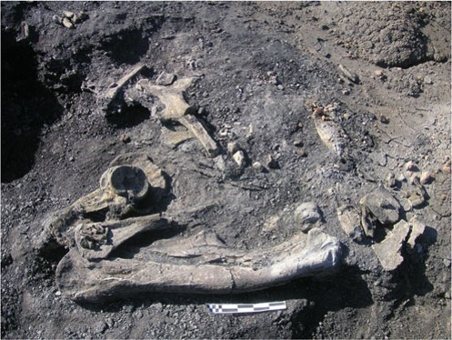
Land of Desolation
Limhi sent a small number of men [43…Mosiah 8:7] to search for the Land of Zarahemla
The men were lost in the wilderness.
They found a land that had been covered with dry bones once peopled then destroyed
They found a record which Limhi could not read
Mosiah 21:25-28

Slide 12
People From the Land of Zarahemla
King Limhi discovers Ammon and others outside their walls
Thinking they are the priests…they are bound and cast into prison
Limhi discovers they are from the Land of Zarahemla and filled with “exceeding great joy”
Ammon tells Limhi that King Mosiah could interpret the engravings
Mosiah 21:23-24

Slide 13
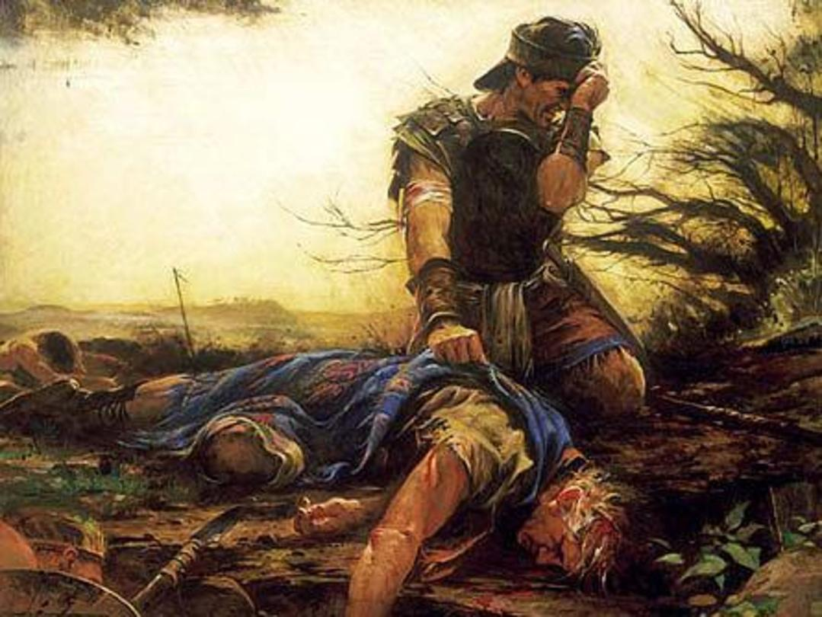
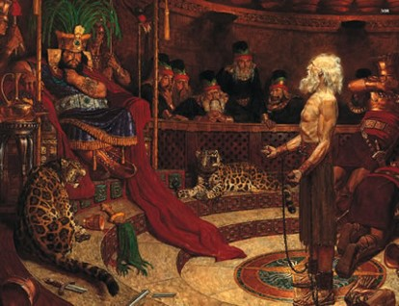
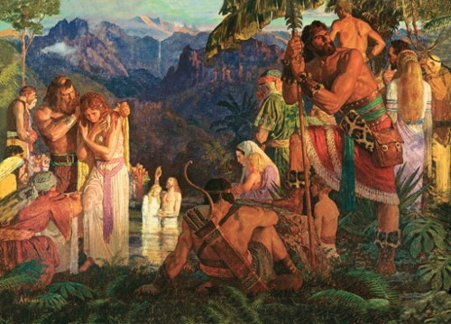
Sorrow For Their Brethren
Ammon is filled with sorrow because:
So many had been slain by the Lamanites
That King Noah and the priest had led the people astray
That Abinadi had been martyred
That Alma and the people had left with some people and the people didn’t know what happened to them
Mosiah 21:29-31

Slide 14
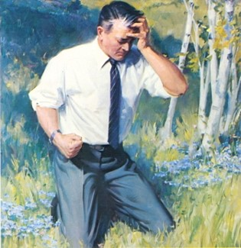
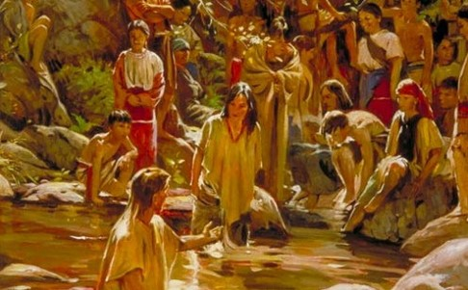
Faith Brings Freedom
“[Repentance] is essential to your happiness in this life and throughout eternity. Repentance is much more than just acknowledging wrongdoings. It is a change of mind and heart. … It includes turning away from sin and turning to God for forgiveness. It is motivated by love for God and the sincere desire to obey His commandments”
True to the Faith
King Limhi entered into a covenant with God and many of his people to serve and keep His commandments
No Authority:
The people wanted to be baptized but Ammon “declined doing this thing”—feeling of unworthiness
They were desirous to escape as Alma had done and willing to serve God, but they must wait for their deliverance
Mosiah 21:32-36

Slide 15
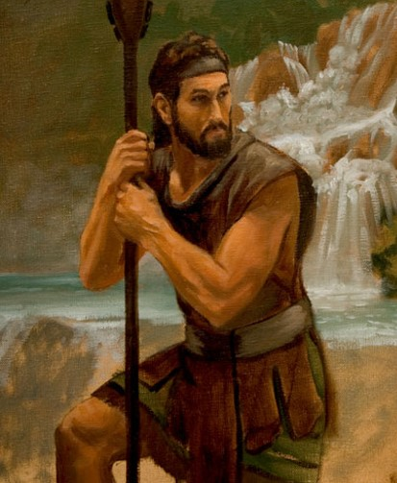
Deliverance
The voice of the people—gathering together to discuss how to escape from the Lamanites
The fear:
Impossible for them to go into battle because the Lamanites were so numerous
Gideon’s idea:
Through the back pass, the back wall is where the Lamanites guard the people and are drunk at night
Gather the people and their flocks and herds and drive them into the wilderness
He will pay the last tribute to the Lamanites with wine and the Lamanites will be drunken and asleep
And they will travel around the land of Shilom
Mosiah 22:1-10
James H. Fullmer

Slide 16
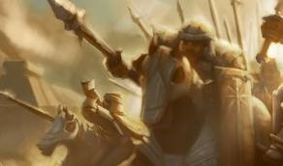
The Lord Will Fight Our Battles
Such deliverance comes only when they have turned their hearts in trust toward Him who has promised to preserve them and fight their battles.
Peace first---War only if the Lord commands it
D&C 98:32-38
32 Behold, this is the law I gave unto my servant Nephi, and thy fathers, Joseph, and Jacob, and Isaac, and Abraham, and all mine ancient prophets and apostles.
33 And again, this is the law that I gave unto mine ancients, that they should not go out unto battle against any nation, kindred, tongue, or people, save I, the Lord, commanded them.
34 And if any nation, tongue, or people should proclaim war against them, they should first lift a standard of peace unto that people, nation, or tongue;
35 And if that people did not accept the offering of peace, neither the second nor the third time, they should bring these testimonies before the Lord; Then I, the Lord, would give unto them a commandment, and justify them in going out to battle against that nation, tongue, or people.
37 And I, the Lord, would fight their battles, and their children’s battles, and their children’s children, until they had avenged themselves on all their enemies, to the third and fourth generation.
38 Behold, this is an ensample unto all people, saith the Lord your God, for justification before me.

Slide 17
Returning to the Land of Zarahemla
Mosiah receives them with joy
Being Subject to:
Being in a position or in circumstances that place one under the power or authority of another or others--
Obeying the laws of the land
Lamanites sends army out to look for Limhi and his people
After 2 days they were lost in the wilderness
Mosiah 22:13-16

Slide 18
Sources:
Joseph Fielding McConkie and Robert L. Millet Doctrinal Commentary on the Book of Mormon Vol 2 pg 273
Paul V. Johnson More Than Conquerors through Him That Loved Us April 2011 General Conf.
Neal A. Maxwell if Thou Endure It Well pg 2-3, 8-10
Kent F. Richards, Orson F Whitney, Robert D. Hales “The Atonement Covers All Pain,” Ensign or Liahona, May 2011, 15).
(True to the Faith: A Gospel Reference [2004], 132).
Presentation by ©http://fashionsbylynda.com/blog/

Slide 19
Comparison of the Bondage and Deliverance of Limhi and Almav
Limhi’s Bondage and Deliverance | Alma’s Bondage and Deliverance
Limhi’s group was placed under bondage with much bloodshed (21:5-12) | Alma’s group was placed under bondage with no bloodshed (23:35-38)
The Lord was slow to hear their cries because they had been slow to hear Him (21:15) | The Lord was not slow to hear their cries (24:10-13)
The Lord softened the Lamanites’ hearts so they eased the burdens of Limhi’s group (21:15) | The Lord physically eaed the burdens of Alma’s group (24:14-15)
They prospered by degrees as their faith increased (21:16) | The Lord visitied them in their afflictions (24:14)
Gideon devised a plan of escape (22:9) | The Lord said, “I will deliver you” (24:16)
They got the guards drunk (22:7, 10) | The Lord put the gurds to sleep (24:19)
They needed to have Ammon lead them to Zarahemla (22:11) | The Lord led them to Zarahemla (24:23-25)
William, “Deliverance from Bondage?“ 271

Slide 20
Mosiah 21:14-16:
“Repentance means striving to change. It would mock the Savior’s suffering in the Garden of Gethsemane and on the cross for us to expect that He should transform us into angelic beings with no real effort on our part. Rather, we seek His grace to complement and reward our most diligent efforts (see 2 Nephi 25:23). … Real repentance, real change may require repeated attempts, but there is something refining and holy in such striving. Divine forgiveness and healing flow quite naturally to such a soul” (D. Todd Christofferson, “The Divine Gift of Repentance” Ensign or Liahona, Nov. 2011, 39).
Afflictions Mosiah 21:13-16:
“The Lord will give relief with divine power when you seek deliverance in humility and faith in Jesus Christ.
“Don’t say, ‘No one understands me; I can’t sort it out, or get the help I need.’ Those comments are self-defeating. No one can help you without faith and effort on your part [see Harold B. Lee, Stand Ye in Holy Places (1974), 241–42]. Your personal growth requires that. Don’t look for a life virtually free from discomfort, pain, pressure, challenge, or grief, for those are the tools a loving Father uses to stimulate our personal growth and understanding. As the scriptures repeatedly affirm, you will be helped as you exercise faith in Jesus Christ [see Enos 1:15–18]. … Faith in Christ means we trust Him; we trust His teachings. That leads to hope, and hope brings charity, the pure love of Christ—that peaceful feeling that comes when we sense His concern, His love, and His capacity to cure us or to ease our burdens with His healing power” (Richard G. Scott, “To Be Healed,” Ensign, May 1994, 8).

