Slide 2
Meanwhile…
Alma was warned of King Noah’s army approaching
“The Lord did strengthen them that the people of King Noah could not overtake them to destroy them”
They traveled 8 days in the wilderness and came to a beautiful place…a land of pure water
They pitched their tents, tilled the ground, built buildings and ‘labored exceedingly’
Mosiah 23:1-5

Slide 3
Loved by the people
The people wanted Alma to be their king
“Behold, it is not expedient that we should have a king; for thus saith the Lord: Ye shall not esteem one flesh above another, or one man shall not think himself above another; therefore I say unto you it is not expedient that ye should have a king.”
Freedom
He reminds them of King Noah and his wickedness and that they had been oppressed by that king and was put into bondage.
Alma desired that they ‘stand fast in liberty’
Mosiah 23:6-13

Slide 4
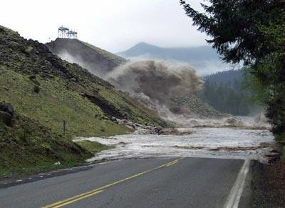
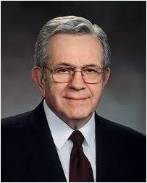
Responding to the Warnings
When the Teton dam (built not far from Rexburg, Idaho,) collapsed and unleashed seventeen miles of backed-up water and accumulated debris upon the towns and farms beneath it, only 11 of nearly 35 thousand people in the path of the flood died. Why?
Because they were warned; and more importantly, because they heeded the warning instantly…”
Mosiah 23:1-5

Slide 5
the Warnings
“We, too, have been warned. It seems almost against our natures to accept warning or guidance from others.
There are, however, times when, regardless of how much we know, our very existence depends upon paying attention to those who guide us.”
Boyd K. Packer
Italy
coronavirus
Mosiah 23:1-5

Slide 6
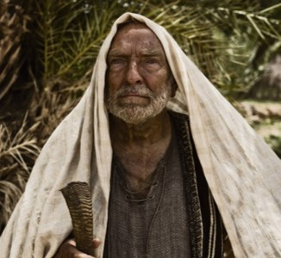
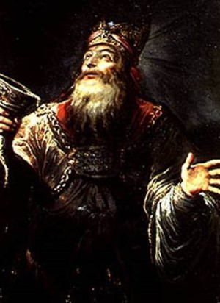
Kings
“Kings set the moral tone for their nation.
Those who taught in righteousness:
Melchizedek, king of Salem—caught up with the city of Enoch (JST- Genesis 14:34
King Benjamin (Mosiah 5:5-7)
“Even though a Righteous King is chosen, there is no way to assure that those who succeed him will be of like spirit”
Example:
The Lord commanded Samuel to warn Israel not to establish a monarchical government, but they would not listen to their God or to his prophet. (1 Samuel 8:11-18)
Mosiah 23:6-13 JFM and RLM

Slide 7
How to Remain Free
Leaders and teachers should be men or women of God with:
Morals
Values
Humility
Honesty
Righteousness
Righteous Judgment
Those who keep the commandments
and honor their covenants
Who can we trust in for our eternal well being?
Love your neighbor
Keep the commandments
Listen to the prophets
Keep your covenants
Mosiah 23:14-15

Slide 8
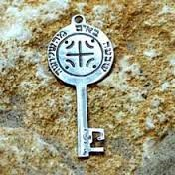
Alma, A High Priest
He was the founder of their church—
He laid the foundation for the Church among the people…the church had not originated with him…but he must have known about the brass plates, Lehi, Nephi, and the teachings of his ancestors
He must have held the keys of the priesthood because he had the authority to consecrate all their priests and teachers
“Again I say unto you, that it shall not be given to any one to go forth to preach my gospel, or to build up my church, except he be ordained by some one who has authority, and it is known to the church that he has authority and has been regularly ordained by the heads of the church.”
D&C 42:11
Mosiah 23:16-18

Slide 9
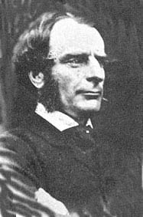
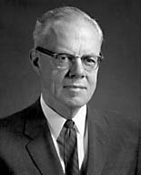
Choosing to Repent and Live Righteously
“There are two freedoms, the false where one is free to do what he likes, and the true where he is free to do what he ought” Charles Kingsley
“We are inclined to think of law as something merely restrictive…we sometimes think law is the opposite of …[God] made man free—and then gave him the commandments to keep him free.”
Richard L. Evans
Mosiah 23:19-20

Slide 10
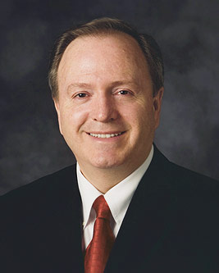
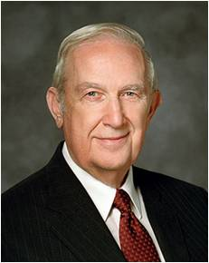
Patience
The Lord chasten them--with their patience
“The word chasten comes from the Latin castus, meaning ‘chaste or pure,’ and chasten means ‘to purify’ Lynn G. Robbins
“Testing … is needed even when you are living a worthy, righteous life and are obedient to [God’s] commandments. Just when all seems to be going right, challenges often come in multiple doses applied simultaneously”
Richard G. Scott
The Lord will try our patience and faith to help us increase our trust in Him
Mosiah 23:21-22

Slide 11
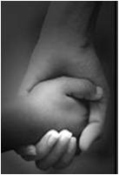
Trust in the Lord
“It is great challenges that produce great people, and great difficulties that produce great faith”
JFM and RLM
“Though he were a Son, yet learned he obedience by the things which he suffered;
And being made perfect, he became the author of eternal salvation unto all them that obey him;”
Hebrews 5:8-9
How can you ever know light if you had never known darkness?
How could you ever know what sweetness is if you have never tasted bitter?
How could you ever know patience if you have never had challenges?
How could you ever trust in the Lord if He isn’t part of your life?
Mosiah 23:23-29

Slide 12
Softening the Hearts
The Lamanites appear in the land of Helam
Alma’s people begin to pour out their hearts to the Lord
The Lord softens the hearts of the Lamanites
Alma delivered them into the hands of the Lamanites and they take possession of the land
Mosiah 23:25-29

Slide 13
What happened to the priests of Noah?
The Lamanites finally found them in the land of Amulon
They began to possess the land and till the ground
Their leader was Amulon
They did not destroy them because of the daughters of the Lamanites
Mosiah 23:31-34

Slide 14
Amulon
He was the leader of the priests of King Noah from about 150 BC to 121 BC
Following the death of Noah, he and other priests joined with the Lamanites forces after having been in the wilderness
When they found the settlement of Alma they promised Alma that they would spare their life's
He was placed as the ruler of the land of Helam
He threatened anyone to be put to death if they were caught praying
The Lord caused a sleep to come upon Amulon and his guards and the people of Alma escaped to Zarahemla
Amulon and his people were appointed by the king of the Lamanites to teach the Nephite language to the Lamanites
Who’s Who

Slide 15
Lamanites and Amulonites
Amulon and the other priest join the Lamanites
They find the land of Helam while looking for the land of Nephi
After Alma shows them the way to the land of Nephi but Amulon breaks his promise and sets guards around them
Some of them went to the land of Nephi and the others remained in the land of Helam and brought their wives and children
Mosiah 23:35-38

Slide 16
King and Ruler
Amulon is granted by the king of the Lamanites that he should be ruler over the people of Alma
Amulon was to obey the king of the Lamanites and not do anything contrary to his will—full subjection
The King of the Lamanites appointed Amulon to be a teacher over the people in the land of Shemlon, and Amulon
The king was called Laman after his father Laman and appointed Amulon to teach the people the language of the Nephites
Mosiah 23:19-Mosiah 24: 1-4

Slide 17
Laman’s People
Even though the people were friendly they knew not God
They did not know the law of Moses or the words of Abinadi
They were taught that they should keep a record
The Lamanites began to prosper and trade one with another—which leads to Pride
Mosiah 24:5-7

Slide 18
Come Unto Christ Liberty
Depths of Humility
Seek help from God
Blessings
Prosperity
Humility Cycle
Misery/Endless Wo
We come to ourselves
Selfishness
Self-Indulgence
Become “Lifted Up”
Inequality
Class divisions
Hatred
War
Pride Cycle
Persecution of Others
Seek Control over others
Use others
Insensitivity
Past Feeling
Personal Apostasy
Sin and Bondage

Slide 19
Amulon exercises Authority
Amulon knew of Abinadi’s words, yet he put tasks upon them and put task masters over the people of Alma
Amulon commanded them that they should stop their cries and stop praying ‘Calling upon God”
Alma’s people pour out their hearts to God
Mosiah 24:8-12

Slide 20
Lift up your heads
How can prayer help us when we have difficult burdens?
When we experience trials, why might it be comforting to know that God knows the “thoughts of [our] hearts”?
“Lift up your heads and be of good comfort, for I know of the covenant which ye have made unto me; and I will covenant with my people and deliver them out of bondage.
And I will also ease the burdens which are put upon your shoulders, that even you cannot feel them upon your backs, even while you are in bondage; and this will I do that ye may stand as witnesses for me hereafter, and that ye may know of a surety that I, the Lord God, do visit my people in their afflictions.”
Mosiah 24:14

Slide 21
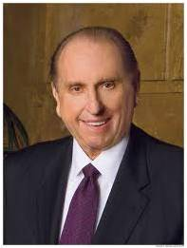
“Remember that this work is not yours and mine alone. It is the Lord’s work, and when we are on the Lord’s errand, we are entitled to the Lord’s help. Remember that the Lord will shape the back to bear the burden placed upon it.”
Thomas S. Monson
“The Lord is intent on your personal growth and development. That progress is accelerated when you willingly allow Him to lead you through every growth experience you encounter, whether initially it be to your individual liking or not. When you trust in the Lord, when you are willing to let your heart and your mind be centered in His will, when you ask to be led by the Spirit to do His will, you are assured of the greatest happiness along the way and the most fulfilling attainment from this mortal experience. If you question everything you are asked to do, or dig in your heels at every unpleasant challenge, you make it harder for the Lord to bless you”
Richard G. Scott

Slide 22
Deliverance
The people’s burdens became light
The Lord strengthened them
They were cheerful and patient to the will of the Lord
Their faith was great
“Thou shalt go before this people, and I will go with thee and deliver this people out of bondage.”
They gathered their flocks and grain
The Lord caused a “deep sleep” to come upon the Lamanites at night
They departed and traveled all day to a valley they called Valley of Alma
They gave thanks
Mosiah 24:18-22

Slide 23
Make Haste
Alma is warned that the Lamanites have awakened
The Lord will “stop the Lamanites in this valley that they come no further in pursuit of this people.”
It took them 12 day to arrive in the land of Zarahemla
King Mosiah received them with joy
Mosiah 24:23-25

Slide 24
Sources:
Video:
Lifting Burdens (3:35)
Joseph Fielding McConkie and Robert L. Millet Doctrinal Commentary on the Book of Mormon Vol. 2 p. 278
Charles Kingsley in Wallis, Treasure Chest p 47
Richard L. Evans Conf. Report Oct 1959
Richard G. Scott (“Trust in the Lord,” Ensign, Nov. 1995, 16).
Merriam-Webster’s Collegiate Dictionary, 11th ed. (2003), “chasten”]” (Lynn G. Robbins, “The Righteous Judge,” Ensign or Liahona, Nov. 2016, 97).
The Book of Mormon Who’s Who by Ed J. Pinegar and Richard J. Allen pg. 24
Thomas S. Monson Ensign, May 1992 p 48
Richard G. Scott (“Finding Joy in Life,” Ensign, May 1996, 25).
Pride Cycle—Poway Institute Notes from Lesley Meachum and Becky Davies
Boyd K. Packer “That All May Be Edified, 203”
Presentation by ©http://fashionsbylynda.com/blog/

Slide 25
Comparison of the Bondage and Deliverance of Limhi and Almav
Limhi’s Bondage and Deliverance | Alma’s Bondage and Deliverance
Limhi’s group was placed under bondage with much bloodshed (21:5-12) | Alma’s group was placed under bondage with no bloodshed (23:35-38)
The Lord was slow to hear their cries because they had been slow to hear Him (21:15) | The Lord was not slow to hear their cries (24:10-13)
The Lord softened the Lamanites’ hearts so they eased the burdens of Limhi’s group (21:15) | The Lord physically eaed the burdens of Alma’s group (24:14-15)
They prospered by degrees as their faith increased (21:16) | The Lord visitied them in their afflictions (24:14)
Gideon devised a plan of escape (22:9) | The Lord said, “I will deliver you” (24:16)
They got the guards drunk (22:7, 10) | The Lord put the gurds to sleep (24:19)
They needed to have Ammon lead them to Zarahemla (22:11) | The Lord led them to Zarahemla (24:23-25)
William, “Deliverance from Bondage?“ 271

Slide 26
Land of Nephi
Land of Zarahemla
Waters of Mormon
Land of Helam
Jaradite ruins

Slide 27
The Wandering Nephites
200 B.C. to 121 B.C.
Destroyed Jaredite Nation
Land of Zarahemla
Mulek 589 BC
Mosiah l
King Benjamin
Mosiah ll
Jaredite plates discovered and returned to Limhi…5
Alma & his people escape back to Zarahemla…8
2
Ammon and Limhi escape to Zarahemla…7
Mosiah I…1
Zeniff…3
Ammon…6
Jerusalem
Lehi & Nephi 600 BC
Mosiah 1 and righteous Nephites
Zeniff
King Noah
King Limhi
Land of Lehi-Nephi
City of Helam
About 200 BC
Alma escapes…4
Waters of Mormon
1. Mosiah I leads the few remaining righteous Nephites from the original land settled by Lehi to the Land of Zarahemla (Omni 1:3)
2. (About 200 BC ill fated expedition to return to Lehi-Nephi. Contention and infighting. All slain in the wilderness except 50 who return to Zarahemla (Omni 1:28) (Mosiah 9:1-3)
3. Zeniff leads a second expedition (abt. 200 BC) to Lehi-Nephi and settles there with the permission of King Laman (Mosiah 9: 3-10)
4. (about 148 BC) Alma flees King Noah to the Waters of Mormon (Mosiah 17 and 18)
5. (about 121 BC) King Limhi sends expedition of 43 men to find Zarahemla in hopes of escaping Lamanite bondage. They find remnants of Jaredites and 24 gold plates and return to Land of Lehi-Nephi (Mosiah 6: 7-8)
6. (About 121 BC) Ammon’s expedition (16 “Strong Men”) to find Zeniff’s colony (Mosiah 7)
7. (About 121-120 BC) King Limhi’s people get the Lamanites drunk and escape back to Zarahemla (Mosiah 22)
8. (Between 145 and 121 BC) Alma and his people escape Lamanites and return to Zarahemla (Mosiah 24)

Slide 28
The Rights and Freedoms of Americans
(From: Hartley, William H., Vincent, William S.. American Civics. N.Y., 1974, pp. 34ff)
In drafting the Constitution, most of the Founding Fathers believed that the safeguards written into it would protect the rights of Americans. But when the Constitution was sent to the states in 1787 for ratification, a great roar of disapproval went up. In Virginia, Patrick Henry protested vigorously against the lack of a specific statement of rights. Other Americans from different states demanded that a Bill of Rights be added to the Constitution. A number of states ratified the Constitution only conditionally. That is, they would approve the Constitution only if it were changed to include these rights. Two years after the new American government went into effect, the Bill of Rights was added as the first ten amendments to the Constitution. Congress discussed nearly 200 proposals for amendments before it presented these ten to the states for approval. The states ratified these amendments, and they became part of the Constitution in 1791.
THE BILL OF RIGHTS
The first ten amendments to the Constitution, or the Bill of Rights, set forth the priceless rights or freedoms that all Americans may enjoy. A brief summary of these great freedoms is given here.
FREEDOM OF RELIGION
The first right, or freedom, guaranteed in the Bill of Rights is freedom of religion. This right is guaranteed in the First Amendment. Freedom of religion guarantees to all Americans the right to practice any religion they choose, or to practice no religion at all. Congress is forbidden to establish any religion as our nation's official religion. Congress cannot favor any one religion over others or tax citizens in order to support any one religion.
FREEDOM OF SPEECH
The right to express your ideas and opinions when you speak is called freedom of speech. Freedom of speech also means the right to listen to the thoughts and opinions of others. This freedom guarantees that Americans are free to express their thoughts and ideas about anything. They may talk freely to their friends and neighbors or speak in public to a group of people. Of course, no one may use his freedom of speech to injure others. If a person knowingly says things that are false about another, he may be sued in court by the person or persons who believe they have been harmed by what he said. Americans are free to express opinions about their government or anything else. They are free to criticize the actions of the government and of government officials. In a dictatorship, where the nation's government has all the powers, the people have no right to speak like this. They do not dare to criticize the actions of the government. If they do, they may be imprisoned. But all Americans enjoy the freedom of speech, which is guaranteed in the First Amendment.
FREEDOM OF THE PRESS
The freedom to express your ideas and opinions in writing is known as freedom of the press. This freedom is closely related to freedom of speech and is also guaranteed by the First Amendment. Freedom of the press gives all Americans the right to express their ideas and thoughts freely in writing. This writing may be in newspapers, books, magazines, or any other printed or written form. Americans are also free to read what others write. They may read any newspaper, book or magazine they want. Because they are free to read a variety of facts and opinions, Americans can become better-informed citizens.
FREEDOM OF ASSEMBLY
Another priceless freedom guaranteed by the First Amendment is freedom of assembly, or freedom to hold meetings. Americans are free to meet together to discuss problems and to plan their actions. Of course, such meetings must be carried on in a peaceful way
FREEDOM OF PETITION
The freedom of petition is the right to ask your government to do something or to refrain from doing something. The First Amendment contains this guarantee, also. The freedom of petition gives you the right to write to your Congressman and request him to work for the passage of laws you favor. You are free to ask him to change laws that you do not like. The right of petition also helps government officials to know what Americans think and what actions they want the government to take.
.

Slide 29
FREEDOM OF PETITION
The freedom of petition is the right to ask your government to do something or to refrain from doing something. The First Amendment contains this guarantee, also. The freedom of petition gives you the right to write to your Congressman and request him to work for the passage of laws you favor. You are free to ask him to change laws that you do not like. The right of petition also helps government officials to know what Americans think and what actions they want the government to take.
THE RIGHT TO BEAR ARMS
The Second Amendment to the Constitution guarantees Americans the right to bear arms. In the early years of our nation, Americans needed weapons in order to serve in the militia, or volunteer armies, that were established to defend our states. The militia provided protection during emergencies, too. Many Americans also believed that without weapons they would be powerless if the government tried to overstep its powers and rule by force.
"NO-QUARTERING" RIGHT
The Third Amendment states, "No soldier shall, in times of peace, be quartered in any house. . . ." Under British rule, the colonists sometimes had to feed and house British soldiers against their will. As a result, Americans wanted this practice forbidden under the Bill of Rights.
THE RIGHT TO EQUAL JUSTICE
The Bill of Rights contains many rights that are guaranteed to persons accused of a crime. Amendments Five, Six, Seven, and Eight are all concerned with these rights. Our nation places great importance on these rights in order to guarantee equal justice for all Americans.
A person must be indicted, or formally accused of a crime, by a group of citizens called a "grand jury" before he can be brought into court for trial.
A person accused of a crime is guaranteed the right to know what law he is accused of breaking.
A person accused of a crime has a right to a prompt public trial by a jury of his fellow citizens.
An accused person cannot be put into prison and kept there for weeks or months while awaiting a trial. He has the right to leave jail, in most cases, if he can raise a certain sum of money, or bail, as a pledge that he will appear at his trial.
An accused person has a right to a lawyer to represent him in court.
All the testimony and evidence against an accused person must be presented publicly in court.
The accused person has the right to call any witnesses to appear if their testimony will help him.
The accused person cannot be forced to testify or give evidence against himself.
If the accused person is found guilty, he cannot be given cruel or unusual punishment. If the accused person is found not guilty of a serious crime, he cannot be tried a second time for this same crime.
THE RIGHT TO OWN PRIVATE PROPERTY
The Fifth Amendment guarantees Americans the right to own private property. No person may take away anything that we own. Nor can the government seize our land, money, or other forms of property without cause, or without paying for it. The right to own private property is one of America's basic freedoms. Our free economic system is based upon this right.
THE RIGHT TO ENJOY MANY OTHER FREEDOMS
To make doubly sure that Americans should enjoy every right and freedom possible, Amendment Nine was added to the Constitution. This amendment states that the list of rights contained in the Bill of Rights is not complete. There are many other rights that all Americans have and will continue to have even though they are not mentioned in the Bill of Rights. Among them are the following.
Freedom to live or travel anywhere in our nation
Freedom to work at any job for which we can qualify
Freedom to marry and raise a family
Freedom to receive a free education in good public schools
Freedom to join a political party, a union, and other legal groups
As a final guarantee of our rights, the Tenth Amendment set aside many powers of government for the states. This Amendment says that all powers not given to the federal government by the Constitution, nor forbidden to the states, are set aside for the states, or for the people. This provision leaves with the states the power to act in many ways to guarantee the rights of their citizens.
SUMMARY
Government is the authority or power that people establish to help them run their affairs. Governments serve many important purposes, but the most important one is that government makes it possible for people to live and work together. Government provides us with rules of conduct we can follow. Government makes it possible for people to live by known laws, and helps provide many services that citizens acting alone could not perform themselves. Our nation's government is based on the American Constitution. This Constitution, together with its Bill of Rights and other amendments, provides us with a workable plan of government. The Constitution also guarantees to all Americans many priceless rights and freedoms. Our nation's government is based upon the approval, or consent, of the people who are governed. It is a federal system in which certain powers are given to the national government and other powers are left to the states and to the people. Certain powers are shared by both federal and state governments. In both federal and state governments, powers are separated and balanced among three branches of government.

Slide 30
Come Unto Christ Liberty
Depths of Humility
Seek help from God
Blessings
Prosperity
Humility Cycle
Misery/Endless Wo
We come to ourselves
Selfishness
Self-Indulgence
Become “Lifted Up”
Inequality
Class divisions
Hatred
War
Pride Cycle
Persecution of Others
Seek Control over others
Use others
Insensitivity
Past Feeling
Personal Apostasy
Sin and Bondage

