Slide 2
Test Your Testimony
Never Sometimes Always
When someone asks a question about the Church do you bear your testimony?
How often do you do something nice for someone?
How often do you take the advice from your parents?
How often do you take council from the prophets?
How often do you pray?
How often do you read and study the scriptures?
How often do you bear your testimony?
How often do you feel of the Holy Spirit?
How would you describe your testimony today?

Slide 3
The Rising Generation
The Children during King Benjamin’s time grew up and:
Did not believe in traditions of their fathers
Did not believe in the resurrection
Did not believe in the coming of Christ
Not understanding the word of God
Hardened Hearts
Not be baptized or join the Church
Separated themselves—did not associate with the things of God
Mosiah 26:1-4

Slide 4
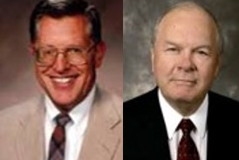
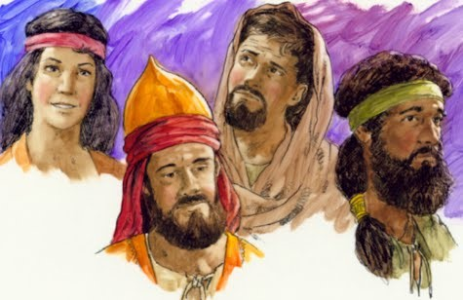
A Foundation Laid
“When a generation of young people grows to maturity without a proper doctrinal foundation—whether because of parental negligence or through rebellion on the part of the youth—then a foundation has indeed been laid, a foundation, unfortunately, for faithlessness and immorality…”
JFM and RLM
The rising generation grew into adulthood without the same beliefs the parents had during King Benjamin’s time.
Mosiah 26:5-6

Slide 5
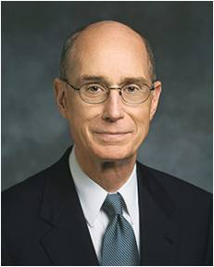
Develop and Maintain
“Testimony requires the nurturing by the prayer of faith, the hungering for the word of God in the scriptures, and the obedience to the truth we have received. There is danger in neglecting prayer. There is danger to our testimony in only casual study and reading of the scriptures. They are necessary nutrients for our testimony. …
“Feasting on the word of God, heartfelt prayer, and obedience to the Lord’s commandments must be applied evenly and continually for your testimony to grow and prosper.”
Henry B. Eyring
To develop and maintain a testimony, we need to feast on the word of God, pray in faith, and obey the Lord’s commandments

Slide 6
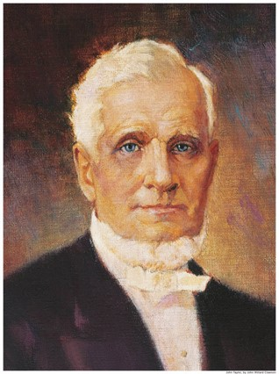
Sins That Go Unchecked
“It became expedient that those who committed sin, that were in the church, should be admonished by the church”.
It was necessary for Church members who had sinned to be judged and held accountable.
When sins go unchecked the spirit ceases to thrive.
Some live in their sins and hide their iniquities
“…if any man who tampers with iniquity, he will have to bear that iniquity, and if any of you want to partake of the sins of men, and uphold them you will have to bear them…”
Pres. John Taylor
Mosiah 26:5-6

Slide 7
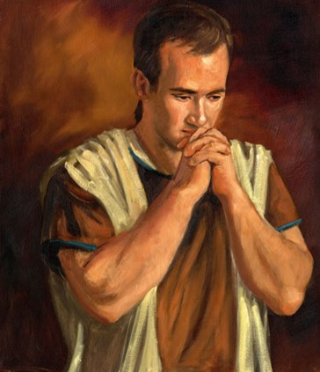
Brought Before Alma
Alma was High Priest at that time and Mosiah had given him authority over the church
The offenders seem to be guilty of crimes of the law and the church
Alma was troubled and told to judge them
Alma goes to the Lord seeking advise
Today
Disciplinary Council:
Bishops and branch presidents and stake, mission, and district presidents have a responsibility to help members overcome transgression through repentance. The most serious transgressions, such as serious violations of civil law, spouse abuse, child abuse, adultery, fornication, rape, and incest, often require formal Church discipline. Formal Church discipline may include restriction of Church membership privileges or loss of Church membership.
Church Handbook
They also seek the guidance of the Lord
James H. Fullmer
Mosiah 26:7-13

Slide 8
The Lord’s Advice to Alma
The Lord blesses Alma because of his faith
“For behold, this is my church; whosoever is baptized shall be baptized unto repentance. And whomsoever ye receive shall believe in my name; and him will I freely forgive.”
“Therefore I say unto you, Go; and whosoever transgresseth against me, him shall ye judge according to the sins which he has committed; and if he confess his sins before thee and me, and repenteth in the sincerity of his heart, him shall ye forgive, and I will forgive him also.”
Those who will repent—He will forgive
Those who do not repent—will not be numbered with His people
Mosiah 26:22-32

Slide 9
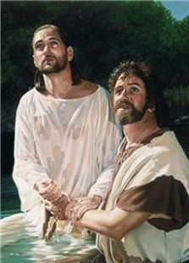
Membership in the Church
“Membership in the Church is more than a badge of belonging, more than conformity to socially acceptable standard. It is sign of one’s commitment to the Lord and his gospel, an evidence of his willingness to take and put on the name of Christ in very deed.
Only persons willing to abide by the terms of the baptismal covenant—those willing to “come forth with broken hearts and contrite spirits, and witness before the church that they have truly repented of all their sins.” those who have a “determination to serve” the Lord “to the end,” those willing to bear the burden of discipleship—should be received into the Church of Jesus Christ”
D&C 20:37
Mosiah 26:22-32 JFM and RLM

Slide 10
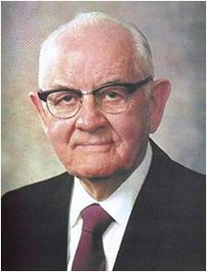
Confession of sins leads to forgiveness
“The confession of Sin is a necessary element in repentance and therefore in obtaining forgiveness. It is one of the tests of true repentance.”
“Perhaps confession is one of the hardest of all the obstacles for the repenting sinner to negotiate. His shame often restrains him from making known his guilt and acknowledging his error.
Sometime his assumed lack of confidence in mortals to who he should confess his sin justifies in his mind his keeping the secret locked in his own heart.”
Mosiah 26:35-36 Spencer W. Kimball

Slide 11
The Lord will forgive those who repent in the sincerity of their hearts.
“When the apples in a barrel rot, it is not enough to throw away half of the spoiled apples from the barrel and replace them with fresh apples on top. This would result in all the apples rotting. Instead it would be necessary to empty the barrel and completely clean…the entire inside.”
“The Lord knows whether or not one is making but a show of repentance. Feigning repentance or bluffing is futile, for both the transgressor and the Lord know the degree of sincerity.”
“..with all his heart”
Repentance must involve an all-out, total surrender to the program of the Lord.”
Mosiah 26:29 Spencer W. Kimball

Slide 12
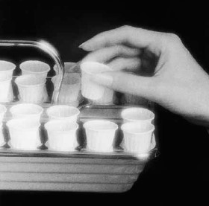
Matthew 6: 12,14-15
“And forgive us our debts, as we forgive our debtors.”
“For if ye forgive men their trespasses, your heavenly Father will also forgive you:”
“But if ye forgive not men their trespasses, neither will your Father forgive your trespasses.”
We must forgive others to receive the Lord’s forgiveness.
“I can forgive but I cannot forget is another way of saying I cannot forgive.”
Henry Ward Beecher
“I may add that unless a person forgives his brother his trespasses with all his heart he is unfit to partake of the sacrament?”
Spencer W. Kimball
For he that eateth and drinketh unworthily, eateth and drinketh damnation to himself, not discerning the Lord’s body.”
1 Corinthians 11:29
“I, the Lord, will forgive whom I will forgive, but of you it is required to forgive all men.”
D&C 64:10
Mosiah 26:31

Slide 13
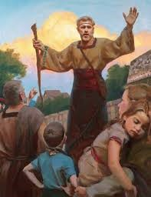
Alma Judges
Alma writes down the things he heard from the Lord
Alma judges:
Those that repented he did number them among the people of the Church
Those that did not repent their names were blotted out—cut off from the Church—no promises given
Alma regulated the affairs of the church
Many were baptized
They began to have peace and prosper in the affairs of the church
Mosiah 26:33-39

Slide 14
Prosperity and Peace
When there is wickedness among a people, what happens to their economic and social status?
When there is righteousness among a people what is their economic and social status?
Mosiah 26:39

Slide 15
Sources:
Video:
Atonement, Not a One-Time Thing (3:01)
Henry B. Eyring (“A Living Testimony,” Ensign or Liahona, May 2011, 127).
John Taylor April Conf. 1880
Joseph Fielding McConkie and Robert L. Millet Doctrinal Commentary on the Book of Mormon Vol. 2 p. 298
Spencer W. Kimball Miracle of Forgiveness p. 177, 203-204, 263
Presentation by ©http://fashionsbylynda.com/blog/

Slide 16
Test Your Testimony
Never Sometimes Always
When someone asks a question about the Church do you bear your testimony?
How often do you do something nice for someone?
How often do you take the advice from your parents?
How often do you take council from the prophets?
How often do you pray?
How often do you read and study the scriptures?
How often do you bear your testimony?
How often do you feel of the Holy Spirit?
How would you describe your testimony today?

Slide 17
“Jesus Christ has prescribed a very clear method for us to repent and find healing in our lives. The cure for most mistakes can be found by seeking forgiveness through personal prayer. However, there are certain spiritual illnesses, particularly those dealing with violations of the moral law, which absolutely require the assistance and treatment of a qualified spiritual physician. …
“If you ‘awake to a sense of your awful situation’ [Ether 8:24] and wish to return to full spiritual health, see your bishop. He holds the keys and can help you along the pathway of repentance” (Boyd K. Packer, “The Key to Spiritual Protection,” Ensign or Liahona, Nov. 2013, 28).
“Spencer W. Kimball [gave] a superb guide to forgiveness through repentance. It has helped many find their way back. He [identified] five essential elements of repentance.
“Sorrow for sin. Study and ponder to determine how serious the Lord defines your transgression to be. That will bring healing sorrow and remorse. It will also bring a sincere desire for change and a willingness to submit to every requirement for forgiveness. …
“Abandonment of sin. This is an unyielding, permanent resolve to not repeat the transgression. By keeping this commitment, the bitter aftertaste of that sin need not be experienced again. …
“Confession of sin. You always need to confess your sins to the Lord. If they are serious transgressions, such as immorality, they need to be confessed to a bishop or stake president. Please understand that confession is not repentance. It is an essential step, but is not of itself adequate. Partial confession by mentioning lesser mistakes will not help you resolve a more serious, undisclosed transgression. Essential to forgiveness is a willingness to fully disclose to the Lord and, where necessary, His priesthood judge all that you have done. …
“Restitution for sin. You must restore as far as possible all that which is stolen, damaged, or defiled. Willing restitution is concrete evidence to the Lord that you are committed to do all you can to repent.
“Obedience to all the commandments. Full obedience brings the complete power of the gospel into your life with strength to focus on the abandonment of specific sins. It includes things you might not initially consider part of repentance, such as attending meetings, paying tithing, giving service, and forgiving others. …
“I would add a sixth step: Recognition of the Savior. Of all the necessary steps to repentance, I testify that the most critically important is for you to have a conviction that forgiveness comes because of the Redeemer. It is essential to know that only on His terms can you be forgiven” (Richard G. Scott, “Finding Forgiveness,” Ensign, May 1995, 76).
“Church discipline is an inspired process that takes place over a period of time. Through this process and through the Atonement of Jesus Christ, a member can receive forgiveness of sins, regain peace of mind, and gain strength to avoid transgression in the future. Church disciplinary action is not intended to be the end of the process. It is designed to help Heavenly Father’s children continue in their efforts to return to full fellowship and the full blessings of the Church. The desired result is that the person make whatever changes are necessary to repent completely” (“Church Disciplinary Councils,” True to the Faith: A Gospel Reference [2004], 38).

Slide 18
Youth Articles: Questions about Bearing Your Testimony The Church of Jesus Christ of Latter-day Saints
ELYSE ALEXANDRIA HOLMES
If you’ve ever asked yourself these questions, here are some answers.
Do I have to share a story or experience when I bear my testimony?
People often share stories or personal experiences when they bear their testimonies, and these can be a great way of describing how a testimony grew. But a story is not a testimony. A short, relevant story can help you illustrate a point, but make sure to include how that story enlarged your testimony and what gospel truths you learned from that experience. A testimony is what you know about the gospel, not about where you’ve been or what you’ve done.
Elder David A. Bednar of the Quorum of the Twelve Apostles taught: “A testimony is what we know to be true in our minds and in our hearts by the witness of the Holy Ghost (see D&C 8:2). As we profess truth rather than admonish, exhort, or simply share interesting experiences, we invite the Holy Ghost to confirm the verity of our words.”
Also, be careful about the experiences you share. Some are deeply personal to yourself or others, including stories about sin, repentance, and sacred spiritual experiences. Stories like these should not be shared in a public setting unless you feel prompted to. When you do feel prompted, keep them general, focusing on what you learned from the experience rather than the specific details of what happened.
Do I have to express thanks or love in my testimony?
While it is not inappropriate to express love or appreciation when you bear your testimony, these expressions are not considered a testimony. Testimonies focus on what you have learned spiritually about the gospel. Expressions of love or gratitude should not replace a testimony.
Elder M. Russell Ballard of the Quorum of the Twelve Apostles said, “[I] worry that too many of our members’ testimonies linger on ‘I am thankful’ and ‘I love,’ and too few are able to say with humble but sincere clarity, ‘I know.’”
Do I have to cry or show emotion to have a real testimony?
Many people cry or show emotion when they bear testimony or feel the Spirit strongly, but not everyone has the same emotional reaction when he or she feels the Spirit. You do not have to express emotion the same way as others when you bear testimony.
President Howard W. Hunter (1907–95) said: “I get concerned when it appears that strong emotion or free-flowing tears are equated with the presence of the Spirit. Certainly the Spirit of the Lord can bring strong emotional feelings, including tears, but that outward manifestation ought not to be confused with the presence of the Spirit itself.”
If I’m not sure I have a testimony, do I still try to share it?
It’s easy to feel like your testimony isn’t strong enough or worth sharing, but as you share your testimony, you will find how much of a testimony you really have! Do not be afraid to bear your testimony. You will find that the more you share your testimony, the more it grows.
President Boyd K. Packer, President of the Quorum of the Twelve Apostles, said:
“It is not unusual to have a missionary say, ‘How can I bear testimony until I get one? How can I testify that God lives, that Jesus is the Christ, and that the gospel is true? If I do not have such a testimony, would that not be dishonest?’
“Oh, if I could teach you this one principle: a testimony is to be found in the bearing of it!
“Somewhere in your quest for spiritual knowledge, there is that ‘leap of faith,’ as the philosophers call it. It is the moment when you have gone to the edge of the light and stepped into the darkness to discover that the way is lighted ahead for just a footstep or two.”

