Slide 2
Unbelievers Persecute
Complaints from the members to Alma
Alma goes to Mosiah
Mosiah consults the priests
Decisions about issues are not made by one person. It takes a quorum to make decisions through prayer and fasting
Mosiah 27:1

Slide 3
Proclamation Sent by Mosiah
Any unbelievers should not persecute any of those who belong to the church of God
“We claim the privileged of worshipping the Almighty God according to the dictates of our own conscience, and allow all men the same privilege, let them worship how, where, or what they may”
Article of Faith 1:11
“The spirit of one is peace, the spirit of the other is contention. Persecution is often born of the fear of detection, while patience and long-suffering are born of the confidence of the Spirit”
JFM and RLM
Mosiah 27:2-3

Slide 4
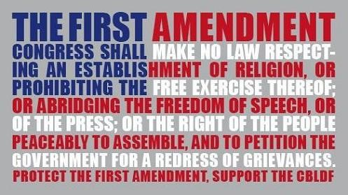
Part of the 1st Amendment
Freedom of religion or Freedom of belief is a principle that supports the freedom of an individual or community, in public or private, to manifest religion or belief in teaching, practice, worship, and observance; the concept is generally recognized also to include the freedom to change religion or not to follow any religion. The freedom to leave or discontinue membership in a religion or religious group —in religious terms called "apostasy" — is also a fundamental part of religious freedom, covered by Article 18 of the Universal Declaration of Human Rights.
Freedom of religion is considered by many people and nations to be a fundamental human right. In a country with a state religion, freedom of religion is generally considered to
mean that the government permits
religious practices of other sects
besides the state religion, and does
not persecute believers in other
faiths.

Slide 5
Equality
There should be no pride or haughtiness disturb their peace--having or showing the insulting attitude of people who think that they are better, smarter, or more important than other people
They should esteem his neighbor as himself—all souls of men are of equal worth. It is contrary to the spirit of heaven to hold one in greater esteem than another.
Priests and teachers should labor with their own hands for their support—the servants of the Lord in all ages have been called and provide for themselves and their families
Members are organized into local congregations called wards or branches. These congregations are organized geographically, and members attend a ward or branch near their home. Congregations meet together on Sundays to worship. The leader of a congregation is a bishop or a branch president. He is not paid for his service, but he donates his time to serve the congregation.
Mormon.org
Mosiah 27:4-5

Slide 6
Alma, the Younger
He was the son of Alma the Elder
He was ‘numbered among the unbelievers’ (Mosiah 27:8)
He was visited by a heavenly messenger about 100-92 BC
He had a spiritual transformation and redirected his life to the service of God
He was appointed chief judge of the land around 91 BC
He defeated a conspirator Amlici
He was consecrated high priest of the Church by his father (Alma 4:4; 5:3)
He later delegated his office to another to serve on a mission
He reformed the church in Zarahemla
He was rejected by the city of Ammonihah around 82 BC but stayed with Amulek and eventually converted Zeezrom
He made a safe haven for the Anti-Levi-Nephites
He went to the land of Melek, but was never heard of again…presumable being translated like Moses (Alma 45:18-19)
Who’s Who

Slide 7
Ammon
He was the son of King Mosiah
He was ‘numbered among the unbelievers’ (Mosiah 27:8)
He was visited by a heavenly messenger and called to repent
He had a desire to serve a mission to declare the gospel to “every creature”
He went with the others to the Lamanites for 14 years from around 92-77 BC
(Alma 17:4)
He went to the land of Ishmael and gained the respect of King Lamoni and defended the royal flocks and herds
King Lamoni was converted
He was sent to free his brethren who were in the land of Middoni
He set the stage for King Lamoni’s father (king over all the Lamanites) to be converted
He assisted in the conversion of the Anti-Lehi-Nephites—becoming the people of Ammon
Who’s Who

Slide 8
Aaron
He was the son of Mosiah
He was ‘numbered among the unbelievers’ (Mosiah 27:8)
He was visited by a heavenly messenger which brought about a transformation
Rather than accept the voice of the people as first choice to succeed his father as king, he embarked on a missionary journey that lasted 14 years (Mosiah 29:2-3)
He and his other brothers went to the Lamanites to preach the gospel
After persecuted and imprisoned he eventually was led by the spirit to present the gospel plan to the great king over all the Lamanites
As a missionary, he and his brothers brought thousands of Lamanites into the gospel of Christ and they “became a righteous people”
(Alma 23:7)
He served faithfully throughout his life
Who’s Who

Slide 9
Omner
He was the son of King Mosiah
He was ‘numbered among the unbelievers’ (Mosiah 27:8)
He was visited by a heavenly messenger about 100-92 BC
He had a spiritual transformation and redirected his life to the service of God
He accompanied his three brothers on a 14 year mission to the Lamanites
He assisted to secure an area south of Bountiful where those Lamanites (called Anti-Lehi-Nephites) from the assaults of their former countrymen
Who’s Who

Slide 10
Himni
He was the son of King Mosiah
He was ‘numbered among the unbelievers’ (Mosiah 27:8)
He was visited by a heavenly messenger and was transformed along with his brothers
He also traveled with his brothers to the Lamanites for 14 years
He assisted in the safety of the Anti-Lehi-Nephites in securing the Land Bountiful as their new home near the Nephites
Who’s Who

Slide 11
The Privilege
Called to Repentance by an angel:
If all rebellious souls were accorded a personal visit from an angel assuring the reality of the world to come with its rewards and punishments, there would be little need for faith on anyone's part.
2. Such appearances of angels would create the temptation to obtain a testimony by negative behavior rather than through righteousness. Given that few among the faithful are privileged to enjoy the ministering of angels, it would seem a strange system of theology that freely granted such a privilege to the wicked.
3. Some appreciable number of people have had such an experience and have rejected the divine counsel and chosen not to repent, and thus we have no record of the experience. Example: Laman and Lemuel had an experience from an angel and there is no evidence of their conversion
The Savior explained that those who reject the testimony of scripture and living prophets would also reject the testimony of angel were they to appear to them
(Luke 16:31)
Mosiah 27:10-17 JFM and RLM

Slide 12
The Privilege
5. Testimony of scripture “some have entertained angels unawares” (Hebrews 13:2) We might suppose that many instances angels have sought to entice transgressors from their course in unobserved or less dramatic ways than this appearance to Alma and the sons of Mosiah
The prayers of the righteous cannot go unheard. Alma the Elder and Mosiah were both men of great faith who no doubt implored the heavens night and day with a plea of help to save their wayward sons. Nor did they pray alone, for their pleading were joined by those of all the faithful of the Church in and around Zarahemla
It needs to be remembered that the Lord, who can manifest his power in a great variety of ways, is hardly limited to angelic ministration or open visions. Many have had conversion experiences of spiritual impact and consequence equal to Alma’s experiences …those who have had divinely received a life-changing experience involving such things as a confrontation with death, an inspired sermon, a caring parent or relative, or a sensitive priesthood leader.
Mosiah 27:10-17 JFM and RLM

Slide 13
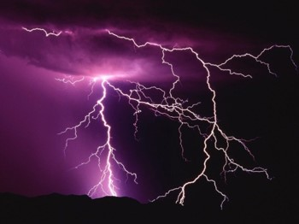
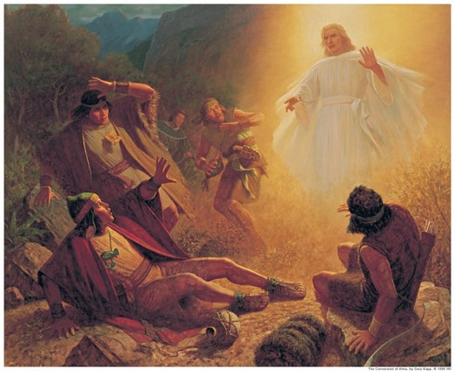
The Thunder of the Earth
Alma knew it was the Lord—for he probably heard his father’s sermons growing up
Alma became dumb—could not open his mouth—and he became weak
Most people become weak (physically) when they have experienced such a powerful message.
Saul:
“And he was three days without sight, and neither did eat nor drink…And when he had received meat, he was strengthened.:
Acts 9:9,19
Joseph Smith:
“… When I came to myself again, I found myself lying on my back, looking up into heaven. When the light had departed, I had no strength; …”
Mosiah 27:10-17

Slide 14
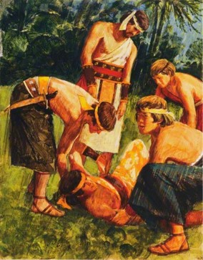
A Witness of the Lord’s Hand
Because Alma was weak he was carried and laid before his father
Alma, the elder, caused that his people should assemble together for them to see what the Lord had done
The priests and teachers were also to assemble to fast and to pray that Alma might be able to speak and that his “limbs might receive their strength”
2 days and 2 nights they fasted and prayed
Alma, then received his strength and began to speak— “bidding them to be of good comfort”
Thought:
Do you think that there could have been countless others that received a vision, or a visit from an angel but refused to repent?
We, of course, would not have a record of it.
King Lamoni—
Lay as if dead for 2 days and 2 nights
Alma 18:43
Saul—
3 days without sight
Acts 9:9
Mosiah 27:18-21

Slide 15
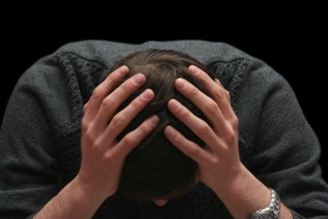
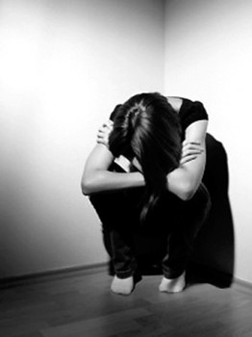
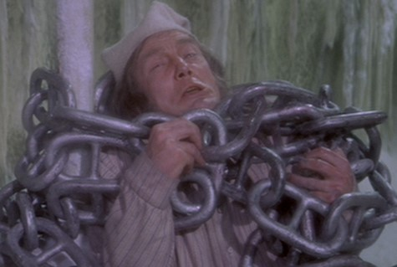
Anguish and Inner Pain
Alma had experienced:
“racked with eternal torment”—a remnant of something destroyed
“suffered pains of hell”—experience something bad or intolerable
“inexpressible horror”-- An intense, painful feeling
“gall of bitterness”-- expressive of severe grief, anguish
“encircled about by the everlasting chains of death”-- Captivity or oppression; spiritual bondage
Alma 36:12-19

Slide 16
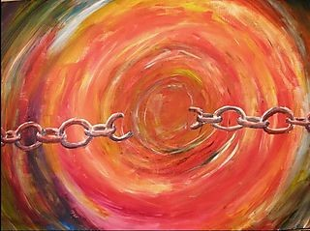
Born of the Spirit
“For, said he, I have repented of my sins, and have been redeemed of the Lord; behold I am born of the Spirit.”
“Because of Christ’s atonement, Alma could, through his own repentance…be redeemed of the Lord. That is, he could be freed from the dominion and power of Satan to enjoy the peace and love of heaven”
“As the man of sin is to die and be buried in the watery grave of baptism, thus allowing his spirit to come forth into a newness of life, so Alma came forth, as it were from his own grave with a new spirit. Alma, whose life had been consumed with wickedness, was as a prisoner released from prison seeking to right the wrongs of his life.”
Mosiah 27:24 JFM and RLM

Slide 17
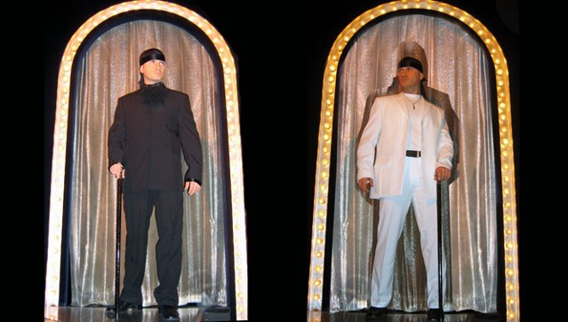
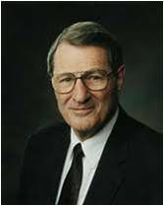
“The very process of being born again spiritually is not a one-time occurrence. Hence, Paul said that he died ‘daily’ (1 Cor. 15:31). Such is the process of putting off the old self as one becomes a woman or a man of God.
Quick change artists are rare.
I have not seen many put off the old and put on the new very rapidly.”
Neal A. Maxwell
We must be born again in order to inherit the kingdom of God.
Mosiah 27:24

Slide 18
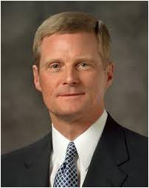
“We begin the process of being born again through exercising faith in Christ, repenting of our sins, and being baptized by immersion for the remission of sins by one having priesthood authority.
“… After we come out of the waters of baptism, our souls need to be continuously immersed in and saturated with the truth and the light of the Savior’s gospel. Sporadic and shallow dipping in the doctrine of Christ and partial participation in His restored Church cannot produce the spiritual transformation that enables us to walk in a newness of life. Rather, fidelity to covenants, constancy of commitment, and offering our whole soul unto God are required if we are to receive the blessings of eternity. …
“Total immersion in and saturation with the Savior’s gospel are essential steps in the process of being born again”
David A. Bednar

Slide 19
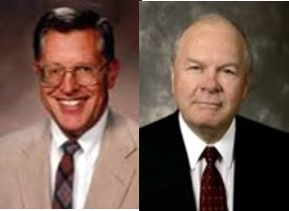
Born Again
Basic Doctrinal concepts:
Both the baptism of the water and the baptism of the spirit symbolize birth
One must be born again to “see” and “enter” the kingdom of God—”Born again comes by the Spirit of God through ordinances” Joseph Smith
The new birth (baptism and receiving the Holy Ghost) brings a change of attitude and character “Water baptism is only a preparatory cleansing…whereas, the baptism of fire and the Holy Ghost cleanses more thoroughly…” Orson Pratt
The new birth brings new knowledge, new insights, and new direction to life
Those who are born again are received into a new family; they become the sons and daughters of Jesus Christ
Birth is just a beginning—the journey of faith lies ahead
Though the new birth is a result of a definite time of decision—a desire for the things of righteousness—it is usually a quiet but powerful process
JFM and RLM

Slide 20
“We are born again as we die as pertaining to unrighteousness and when we live as pertaining to the things of the Spirit. But that doesn’t happen in an instant, suddenly. That … is a process. Being born again is a gradual thing, except in a few isolated instances that are so miraculous that they get written up in the scriptures. As far as the generality of the members of the Church are concerned, we are born again by degrees, and we are born again to added light and added knowledge and added desires for righteousness as we keep the commandments. …
“As members of the Church, if we chart a course leading to eternal life; if we begin the processes of spiritual rebirth, and are going in the right direction; if we chart a course of sanctifying our souls, and degree by degree are going in that direction; if we chart a course of becoming perfect, and, step by step and phase by phase, are perfecting our souls by overcoming the world, then it is absolutely guaranteed—there is no question whatever about it—we shall gain eternal life. Even though we have spiritual rebirth ahead of us, perfection ahead of us, the full degree of sanctification ahead of us, if we chart a course and follow it to the best of our ability in this life, then when we go out of this life we’ll continue in exactly that same course”
Bruce R. McConkie

Slide 21
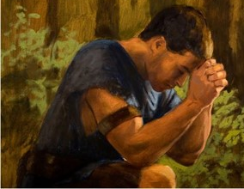
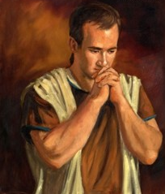
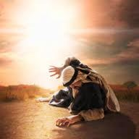
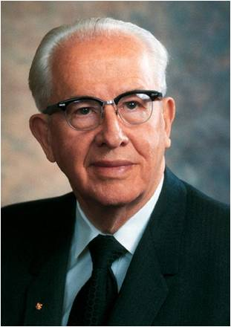
“We must be careful, as we seek to become more and more godlike, that we do not become discouraged and lose hope. Becoming Christlike is a lifetime pursuit and very often involves growth and change that is slow, almost imperceptible. The scriptures record remarkable accounts of men whose lives changed dramatically, in an instant, as it were:
Alma the Younger, Paul on the road to Damascus, Enos praying far into the night, King Lamoni. Such astonishing examples of the power to change even those steeped in sin give confidence that the Atonement can reach even those deepest in despair.
James H. Fullmer
James H. Fullmer
“But we must be cautious as we discuss these remarkable examples. Though they are real and powerful, they are the exception more than the rule. For every Paul, for every Enos, and for every King Lamoni, there are hundreds and thousands of people who find the process of repentance much more subtle, much more imperceptible. Day by day they move closer to the Lord, little realizing they are building a godlike life. They live quiet lives of goodness, service, and commitment”
Ezra T. Benson
Mosiah 27:24

Slide 22
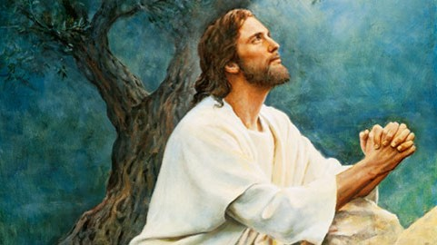
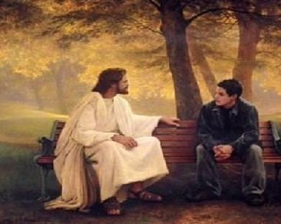
Changing Through the Atonement
How have you been changed through the Atonement as you have repented and done your best to follow the Savior?
What is one thing you can do to more fully come to the Lord so that you can be changed through the Atonement?
Mosiah 27:24

Slide 23
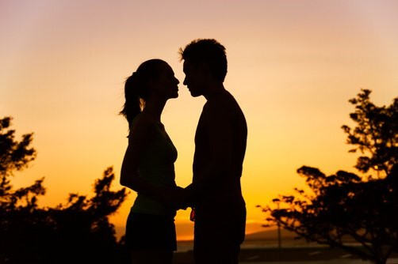
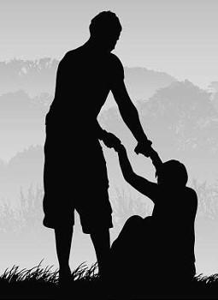
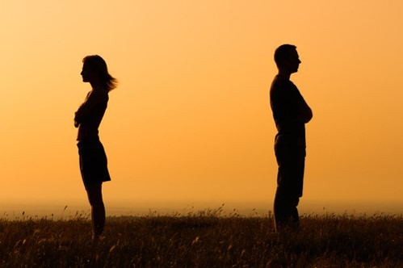
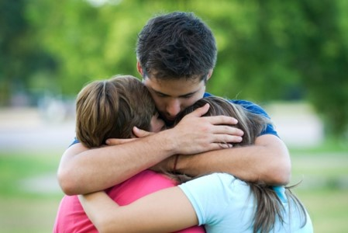
Restitution
restitution = to the act of repairing damage that has been done and correcting our unwise choices
Right the Wrong--Restitution
“The true spirit of repentance demands that he who injures [another] shall do everything in his power to right the wrong.”
Spencer W. Kimball
Even those who rebel against the Lord and His teachings can be forgiven.
To truly repent, a person must do everything possible to repair the damage he or she has done.
Through the Atonement of Jesus Christ, we can be changed to a state of righteousness.
Mosiah 27:32-37

Slide 24
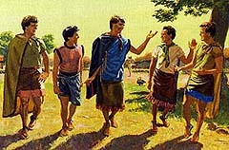
To Truly Repent
To truly repent, a person must do everything possible to repair the damage he or she has done
Alma the Younger and the sons of Mosiah travel throughout the land, striving to repair the injuries they had done and then try to strengthen the Church
Mosiah 27:35

Slide 25
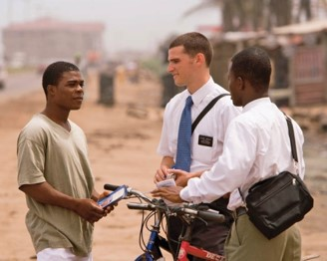
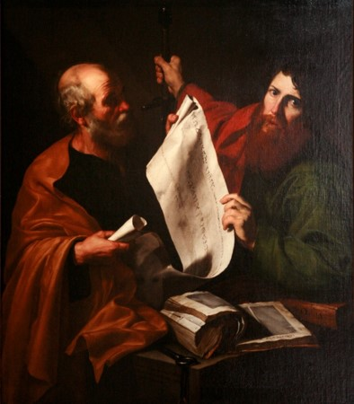
Labored Without Ceasing
Strengthening the Church—Alma and the 4 brothers devoted their labors in preaching to the Lamanites throughout the land
Example:
Apostle Paul—after he was converted he dwelt in Arabia for 3 years, then returned with full force to the teachings of the Savior and the Gospel
“But by the grace of God I am what I am: and his grace which was bestowed upon me was not in vain; but I laboured more abundantly than they all: yet not I, but the grace of God which was with me.”
1 Corinthians 15:10
To the Brethren of the church:
“Let him know, that he which converteth the sinner from the error of his way shall save a soul from death, and shall hide a multitude of sins.”
James 5:20
The Hidden sins—the one who is doing the labors of conversion
Mosiah 27:32-37

Slide 26
Sources:
Video: We Must Be Born Again (1:55)
http://en.wikipedia.org/wiki/Freedom_of_religion
http://mormon.org/faq/no-paid-clergy
Joseph Fielding McConkie and Robert L. Millet Doctrinal Commentary on the Book of Mormon Vol. 2 p. 302, born again: 169-274
Who’s Who In the Book of Mormon Ed J. Pinegar and Richard J. Allen pp. 2-3, 12-13, 20, 150,
Joseph Smith History 1:20 Joseph Smith Teachings p. 162
Neal A. Maxwell BYU Fireside 12/2/84 Orson Pratt The Holy Spirit pp. 56-57
David A. Bednar (“Ye Must Be Born Again,” Ensign or Liahona, May 2007, 21).
Bruce R. McConkie (“Jesus Christ and Him Crucified,” Brigham Young University 1976 Speeches, Sept. 5, 1976, 5–6, speeches.byu.edu).
Ezra T. Benson (“A Mighty Change of Heart,” Ensign, Oct. 1989, 5).
Spencer W. Kimball Miracle of Forgiveness p. 195

