Slide 2
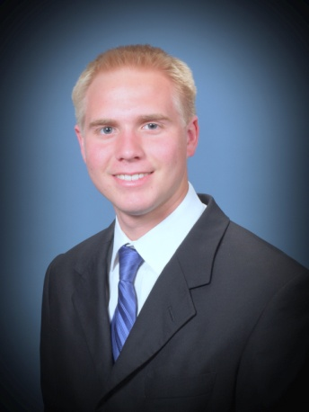
Can I Really Serve a Mission?
Questions of an upcoming Missionary:
When should I go?
Why should I go?
How can I afford to go?
What will happen to my friends/girlfriend/boyfriend if I leave for 2 years or 18 months?
What will I miss?
Will I be able to withstand the change in my daily routine? The food? The culture?
Will I be able to wake up early?
Will I be able to handle the rejections?
What if I don’t get along with my companion?
Will I be able to be spiritual all the time?
The question really is:
How can I serve the Lord?

Slide 3
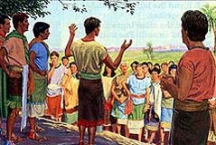
A Sincere Desire
Alma and the sons of Mosiah desire:
To go to the Lamanites in the Land Of Nephi and preach the gospel
That they might “cure them” of their hatred towards the Nephites
That there might be peace between them
That salvation be declared to “every creature” for they could not bare that “any human soul should perish”
Why did these men desire to serve a mission?
They were filled with love for all mankind
Mosiah 28:1-4

Slide 4
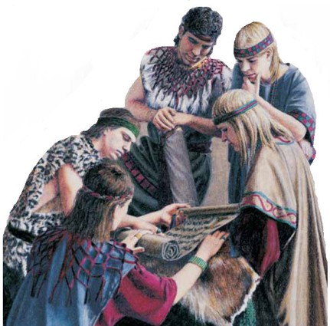
Bearing the Hardships
What difficulties might Alma and the sons of Mosiah face in Lamanite territory?
Imprisonment
Torture
Bondage
Killed
“Having become true Christians, the sons of Mosiah considered the gospel to be the solution to political, social, and economic problems as well as to religious problems.
Risking their very lives they went down into the southland among a savage and barbaric people to cure the enmity between the two nations by teaching them the gospel.
They did not go to disrupt them or to change their government or to preach politics or to do anything else offensive or subversive.
They went to serve and save. No war or insurrection comes out of the missionary work of true saints in foreign lands.”
Book of Mormon Student Manual
Mosiah 28:1-4

Slide 5
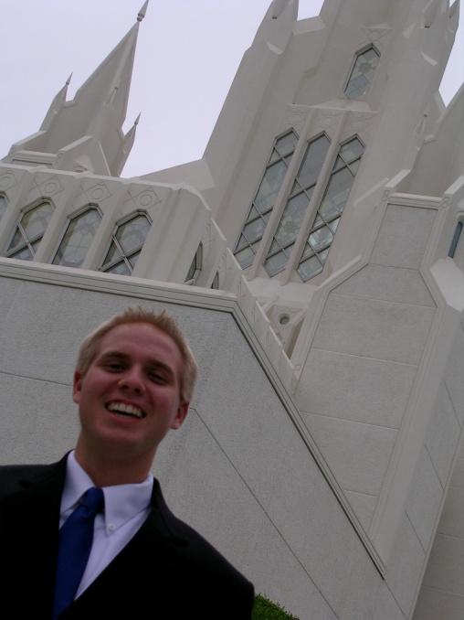
Inquiring of the Lord
Alma and the sons of Mosiah plead to go on this mission
How are missionaries called?
Every missionary who is called and assigned or reassigned to a particular mission is called by revelation through the Lord's servants, the prophets. A member of the Quorum of the Twelve assigns prospective missionaries to one of more than three hundred missions of the Church.
Frequently Asked Questions
“And the Lord said unto Mosiah: Let them go up, for many shall believe on their words, and they shall have eternal life; and I will deliver thy sons out of the hands of the Lamanites.”
Update 2020 (July):
407 missions
Mosiah 28:5-7

Slide 6
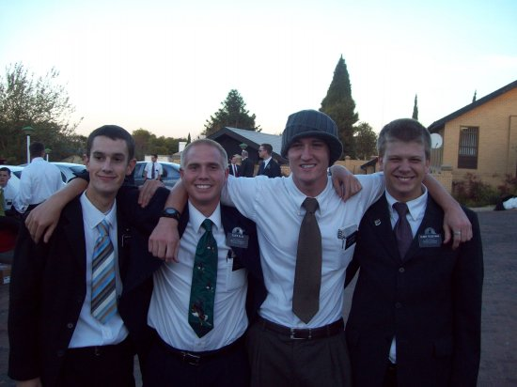
Bringing Salvation to Their Own Souls
Therefore, O ye that embark in the service of God, see that ye serve him with all your heart, might, mind and strength, that ye may stand blameless before God at the last day.
Therefore, if ye have desires to serve God ye are called to the work;…
As our conversion deepens, our desire to share the gospel increases
…For behold the field is white already to harvest; and lo, he that thrusteth in his sickle with his might, the same layeth up in store that he perisheth not, but bringeth salvation to his soul;”
D&C 4:2-4

Slide 7
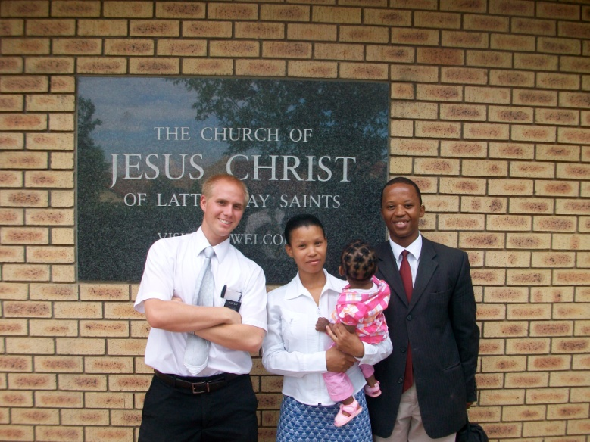
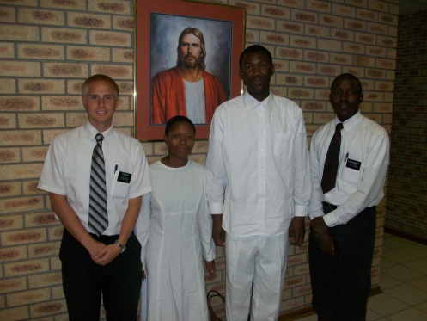
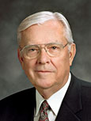
“The key to successful member missionary work is the exercise of faith.
One way to show your faith in the Lord and His promises is to prayerfully set a date to have someone prepared to meet with the missionaries.
I have received hundreds of letters from members who have exercised their faith in this simple way. Even though families had no one in mind with whom they could share the gospel, they set a date, prayed, and then talked to many more people.
The Lord is the Good Shepherd, and He knows His sheep who have been prepared to hear His voice. He will guide us as we seek His divine help in sharing His gospel.”
M. Russell Ballard

Slide 8
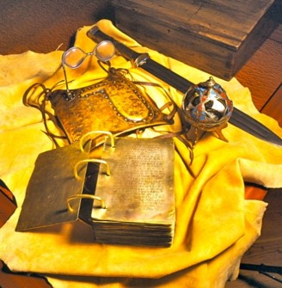
The Caretaker of the Records
The Brass Plates of Laban
Records:
The Plates of Brass
The Plates of Nephi
The Plates of Gold found by the people of Limhi
Conferred them on Alma, the younger
The Large Plates of Nephi
The Plates of Gold—translated by King Mosiah using two stones fastened into the two rims of a bow—gave an account of the Jaredites.
Sacred revelation kept secret:
Until after the resurrection of Christ (Alma 63:12)
The vision of the brother of Jared was revealed during the appearance of the Savior to the Nephites
Mosiah 28:10-20

Slide 9
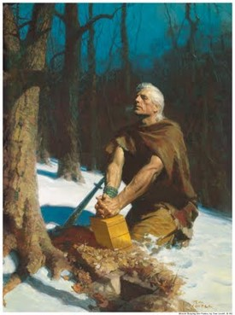
Sealed Portions of the Records
“After the appearing of the Savior to the Nephites, the vision of the brother of Jared was revealed to the Nephites.
When Moroni made his abridgment of the record of Ether, he copied on his record the vision of the brother of Jared. At the command of the lord, however, Moroni also sealed up the greater things in this vision and the “interpreter’—which were the same ‘two stones’ had by the brother of Jared, so hat this vision should not be made known even in our day among the Gentiles, in the day of their wickedness (2 Nephi 27:80)’
…until the day that they shall repent of their iniquity, and become clean before the lord.” (Ether 4:6).
So we today do not have the fulness of the account written and
sealed up by the brother of Jared and again sealed by Moroni.
This part of the record the Prophet Joseph Smith was forbidden
to translate. We have, then, received but the ‘lesser part.’
(3 Nephi 26:8-11)
Student Manual

Slide 10
The Voice of the People
The People desired Aaron to be their king
“Now I declare unto you that he to whom the kingdom doth rightly belong has declined, and will not take upon him the kingdom.”
“Therefore I will be your king the remainder of my days; nevertheless, let us appoint judges, to judge this people according to our law; and we will newly arrange the affairs of this people, for we will appoint wise men to be judges, that will judge this people according to the commandments of God.
Now it is better that a man should be judged of God than of man, for the judgments of God are always just, but the judgments of man are not always just.”
Mosiah 29:1-47

Slide 11
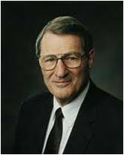
Citizenship Shares Responsibility
“For what happens in cultural decline both leaders and followers are really accountable. … It is easy to criticize bad leaders, but we should not give followers a free pass”
Neal A. Maxwell
Why is it important for both leaders and followers to be accountable for their actions?
What can you do to support righteous laws and leaders? (Articles of Faith 1:12.)
Not every country in the world has the
opportunity to choose their own leaders,
the Lord will always help those who trust in Him, no matter where they live.

Slide 12
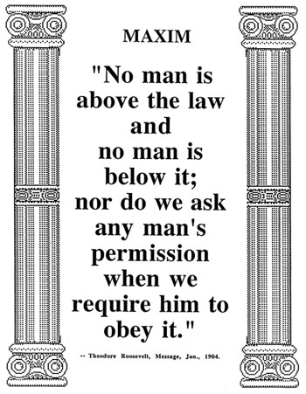
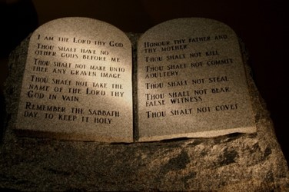
Upholding the Law
Unrighteous leadership can bring contention and sin.
It is not common for the voice of the people to choose something that is not right.
If the people choose iniquity, the judgments of God will come upon them.
Each person has a duty to uphold righteous
laws and leaders.

Slide 13
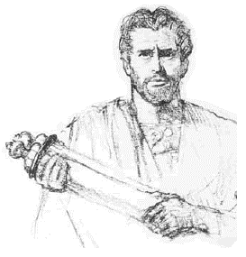
A System of Judges
“And now I desire that this inequality should be no more in this land, especially among this my people; but I desire that this land be a land of liberty, and every man may enjoy his rights and privileges alike, so long as the Lord sees fit that we may live and inherit the land, yea, even as long as any of our posterity remains upon the face of the land.”
Though the judges were to be selected ‘by the voice of the people,’ the Nephites were to be governed according to the laws which have been given to them by their fathers.
King Mosiah knew the personal experience the loneliness and the bitter burdens of a monarch “all the trials and troubles of a righteous king, yea, all the travails of soul for their people, and also all the murmurings of the people to their king; and he explained it all unto them.” (vs 33)
Mosiah 29:1-47 JFM and RLM

Slide 14
Righteous Judgments
According to the law Mosiah had given them, and that the lower judges and higher judges were to judge one another as needed to ensure that righteous judgments would be made.
Now it came to pass that in the first year of the reign of the judges over the people of Nephi, from this time forward, king Mosiah having gone the way of all the earth, having warred a good warfare, walking uprightly before God, leaving none to reign in his stead; nevertheless he had established laws, and they were acknowledged by the people; therefore they were obliged to abide by the laws which he had made.
Mosiah 29:1-47; Alma 1:1

Slide 15
Benefits and Consequences
Mosiah 29:26–27
Mosiah 29:30–34
Mosiah 29:37–39
The voice of the people generally does not desire things that are “contrary to that which is right,
There is a need for all citizens to share in the burden of their government and to answer for their own sins.
Because of their unrighteous choices their consequences would be the judgments of God would come upon them and they would be destroyed
If the voice of the people chooses iniquity, then the judgments of God will come upon them.

Slide 16
Alma—First Judge
Alma was appointed the first chief judge and governor over the and was at the same time the high priest over the Church, having been called to serve as successor to his father in the latter capacity.
Their judges, for the most part, men not only with political acumen but also with priestly and prophetic stature.
Each person has a duty to uphold righteous principles, laws, and leaders
The chief judge received his office “with an oath and sacred ordinance to judge righteously, and to keep the peace and the freedom of the people, and to grant unto them their sacred privileges to worship the Lord their God, yea, to support and maintain the cause of God all his days, and to bring the wicked to justice according to their crime.”
Mosiah 29:1-47; Alam 2:16; 60:1; Alma 50:39 JFM and RLM

Slide 17
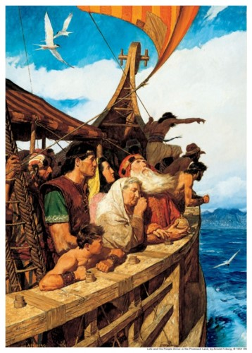
The Reign of the Judges
The change in the government instituted through King Mosiah was so significant that from then until the birth of Christ (see 3 Nephi 2:8) the Nephites recorded their time in relation to the beginning of the reign of the judges. Previously the Nephites kept track of time from the year Lehi left Jerusalem.
“After Lehi left Jerusalem, time was reckoned according to the date of his departure. With establishment of the system of the judges we encounter a new reckoning of time among the Nephites—the “first year of the reign of the judges,” and so on.
This system would be in effect until the sign of the birth of Christ would be given, when they would begin reckoning their time from that point (see 3 Nephi 3:8)
Mosiah 29:44

Slide 18
Death of Alma, King Mosiah and Alma
“And now it came to pass that his [Alma’s] father died, being eighty and two years old, having lived to fulfil the commandments of God.
And it came to pass that Mosiah died also, in the thirty and third year of his reign, being sixty and three years old; making in the whole, five hundred and nine years from the time Lehi left Jerusalem.
And thus ended the reign of the kings over the people of Nephi; and thus ended the days of Alma, who was the founder of their church.”
Mosiah 29:44-47

Slide 19
Sources:
Video:
Priesthood Duty (4:59)
M. Russell Ballard, “Creating a Gospel-Sharing Home,” Ensign or Liahona, May 2006, 86).
Book of Mormon Student Manual Religion 121-122 pg 203
Frequently Asked Questions The Divine Call of a Missionary,” Elder Ronald A. Rasband's April 2010 general conference address.
Neal A. Maxwell (“Repent of [Our] Selfishness,” Ensign, May 1999, 24).
Presentation by ©http://fashionsbylynda.com/blog/

Slide 20
Preparing to Serve
Frequently asked questions from prospective missionaries and their parents
See:
https://www.lds.org/callings/missionary/faqs
Who should serve a mission?
President Thomas S. Monson said: “We affirm that missionary work is a priesthood duty—and we encourage all young men who are worthy and who are physically able and mentally capable to respond to the call to serve. Many young women also serve, but they are not under the same mandate to serve as are the young men. We assure the young sisters of the Church, however, that they make a valuable contribution as missionaries, and we welcome their service.” (Thomas S. Monson, "Welcome to Conference," Liahona, November 2012, 4).
Learn more by watching President Monsons Saturday morning address from the October 2012 general conference.
President Monson also said: “To the mature brothers and sisters of the Church, I remind you that the Lord needs many, many more of you to serve as full-time missionaries. If you are not yet at the season of life to serve a couples mission, I urge you to prepare now for the day when, as your circumstances allow, you and your spouse might do so. There are few times in your lives when you will enjoy the sweet spirit and satisfaction that come from giving full-time service together in the work of the Master.”

