Slide 2
Change
Why can it sometimes be difficult to make the changes that the Lord would like us to make in our lives?

Slide 3
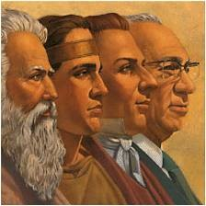
Remember When?
Alma delivers a message to his people to:
Remember he had been consecrated as their High Priest
“God’s chief representative on earth, the one who holds the highest spiritual position in his kingdom in any age, is called the high priest. This special designation of the chief spiritual officer of the Church has reference to the administrative position which he holds rather than to the office to which his is ordained in the priesthood.”
Bruce R. McConkie
Out of the bondage of King Noah:
Alma, the elder, and his followers---baptized in the waters of Mormon
Ammon, King Limhi, and his people
Alma 5:1-6

Slide 4
Change of Heart
heart often refers to the “real, inward person”
Receiving the Lord’s image in your countenance
Waking out of a deep sleep
Being filled with light
A change of heart is like …
Being born of God
When we believe in the word of God and exercise faith in Jesus Christ, we can experience a mighty change of heart
Being freed from chains
Singing about redeeming love
Having your soul expand
Alma 5:7-9, 14

Slide 5
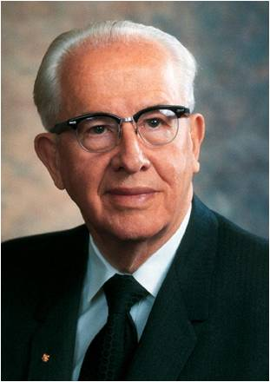
“Becoming Christlike is a lifetime pursuit and very often involves growth and change that is slow, almost imperceptible. The scriptures record remarkable accounts of men whose lives changed dramatically, in an instant, as it were: Alma the Younger, Paul on the road to Damascus, Enos praying far into the night, King Lamoni.
Such astonishing examples of the power to change even those steeped in sin give confidence that the Atonement can reach even those deepest in despair.
But we must be cautious as we discuss these remarkable examples. Though they are real and powerful, they are the exception more than the rule.
For every Paul, for every Enos, and for every King Lamoni, there are hundreds and thousands of people who find the process of repentance much more subtle, much more imperceptible.
Day by day they move closer to the Lord, little realizing they are building a godlike life. They live quiet lives of goodness, service, and commitment.
They are like the Lamanites, who the Lord said ‘were baptized with fire and with the Holy Ghost, and they knew it not’ ” Ezra Taft Benson
3 Nephi 9:20

Slide 6
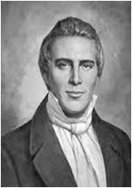
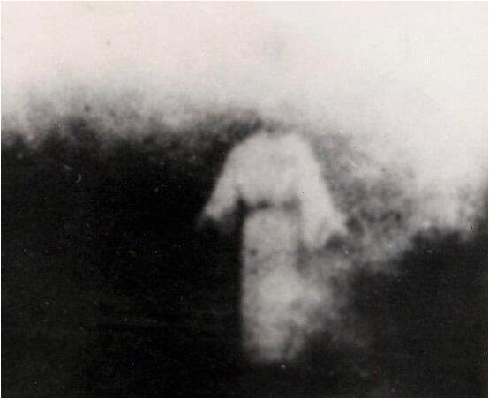
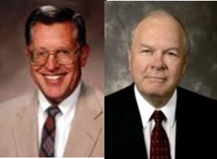
Complete Salvation
“Salvation is for a man to be saved from all his enemies; for until a man can triumph over death, he is not saved. A knowledge of the priesthood alone will do this.”
Joseph Smith
“One can obtain the promise of salvation in this life, but one must pass through death and resurrection to receive completer salvation. Salvation, or exaltation come to the faithful in the life beyond.”
JFM and RLM
Alma 5:9

Slide 7
Conditions of Salvation
People must believe the word verse 11
People must experience the mighty change, the new birth verse 12
One must humble themselves and put their trust in God verse 13
One must remain steadfast and faithful to the end of their mortal lives verse 13
When we believe in the word of God and exercise faith in Jesus Christ, we can experience a mighty change of heart.
Alma 5:11-13

Slide 8
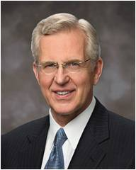
Born Again
Being “born of God” or “born again” refers to the change that a person experiences when they accept Jesus Christ and begin a new life as His disciple.
“You may ask, Why doesn’t this mighty change happen more quickly with me? … For most of us, the changes are more gradual and occur over time. Being born again … is more a process than an event. And engaging in that process is the central purpose of mortality”
Elder D. Todd Christofferson
Alma 5:9

Slide 9
Countenance
“the general appearance of a person’s face, which often reflects spiritual attitude and state of mind.”
Alma 5:14

Slide 10
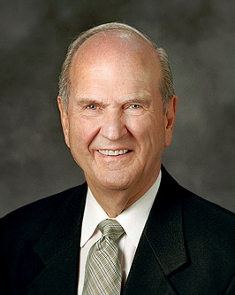
Bright recollection and perfect remembrance
“As all will be resurrected, your physical body will then be restore to its proper and perfect frame. The day of your resurrection will be a day of judgment that will determine the kind of life you shall have hereafter.
“That judgment will consider not only your actions, but also your innermost intent and heartfelt desires. Your everyday thoughts have not been lost.
“Scriptures speak of the ‘bright recollection’ and ‘perfect remembrance’ that your mind will provide in times of divine judgment”
Russell M. Nelson
Alma 5:18; Alma 11:43; Alma 40:23

Slide 11
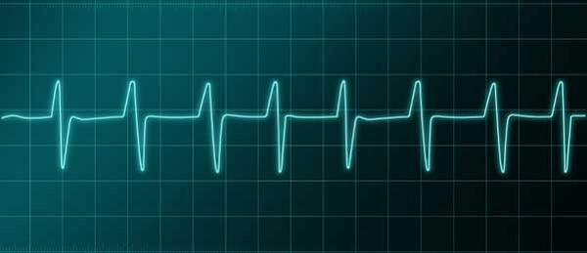
Questions
Have ye spiritually been born of God?
Have ye received his image in your countenances?
Have ye experienced this mighty change in your hearts?
Do ye exercise faith in the redemption of him who created you?
Do you look forward with an eye of faith, and view this mortal body raised in immortality, and this corruption raised in incorruption, to stand before God to be judged according to the deeds which have been done in the mortal body?
Can you imagine to yourselves that ye hear the voice of the Lord, saying unto you, in that day: Come unto me ye blessed, for behold, your works have been the works of righteousness upon the face of the earth?
Or do ye imagine to yourselves that ye can lie unto the Lord in that day, and say—Lord, our works have been righteous works upon the face of the earth—and that he will save you?
Can ye look up to God at that day with a pure heart and clean hands?
Can you look up, having the image of God engraven upon your countenances?
Can ye think of being saved when you have yielded yourselves to become subjects to the devil?
By experiencing a change of heart, we prepare ourselves to stand before God to be judged
Alma 5:14-20

Slide 12
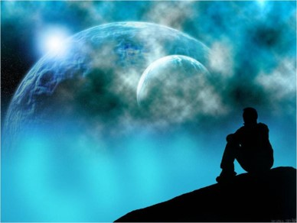
Know of That Day
Garments stained with blood—a soul spoiled by the effects of sin
Ye are murderers—not to take a life by killing, but a destruction of the soul…the killing of spiritual sensitivities (Alma 36:14)
Sit down at the kingdom of with the Prophets—Salvation has little or nothing to do with offices or callings…it is not dependent upon prominence in the earthly kingdom—Salvation is the result of living in a manner that we are clean and spotless before God
Creator can not be a liar—
Those who are unclean may not enter into His presence without repentance, using the atonement of the Savior
Blameless— “…and let virtue garnish thy thoughts unceasingly; then shall thy confidence wax strong in the presence of God; and the doctrine of the priesthood shall distil upon thy soul as the dews from heaven.” D&C 121:45
Alma 5:14-27

Slide 13
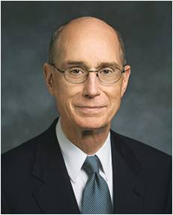
Are You Prepared for kingdom of heaven?
“You will have put yourself so often in the Master’s service, bringing the cleansing companionship of the Holy Ghost, that you will be on the front row, early, whenever and wherever the Master calls.”
Henry B. Eyring
Alma 5:14-27

Slide 14
Alma Speaks of:
Redeeming his people from their sins—Christ did not come to redeem them in their sins…he came to redeem them of their sins
Pride—”God resisteth the proud, but giveth grace unto the humble” James 4:6; 1 Peter 5:5
The Kingdom of heaven is soon at hand--to the Nephites Christ will soon visit them…it also means that we soon will face that time of death that we must reckon ourselves in regard to the commandments of God
Stripped of envy—Charity is the antidote—they should be filled with love for their fellow men and seek to build the kingdom of God together
Mock of his brother—They (we) should not make fun of, gossip, or speak ill of others
Alma 5:28-31

Slide 15
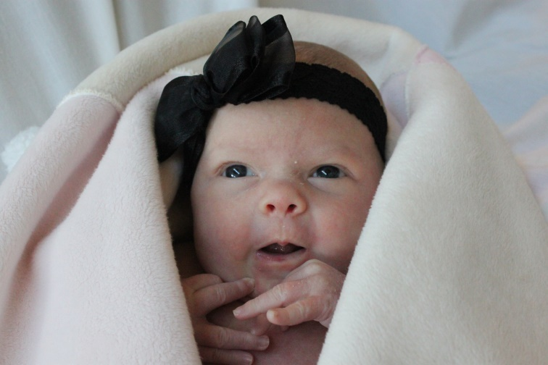
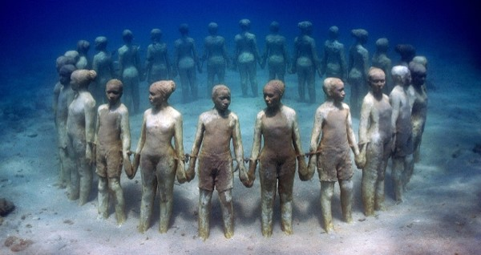
All are called
A Just and Living God
Those who are born on the earth since Adam will have the opportunity to hear the gospel.
Those who die before they hear the word will have the opportunity to be taught the gospel in the spirit world.
It will be up to them to reject or accept the Savior as the redeemer.
D&C 137
An Invitation:
“and he inviteth them all to come unto him and partake of his goodness; and he denieth none that come unto him, black and white, bond and free, male and female; and he remembereth the heathen; and all are alike unto God, both Jew and Gentile.”
2 Nephi 26:33
Alma 5:33

Slide 16
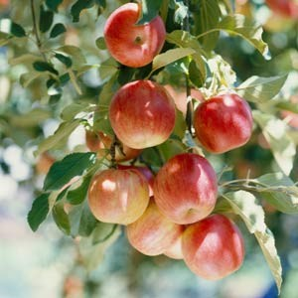
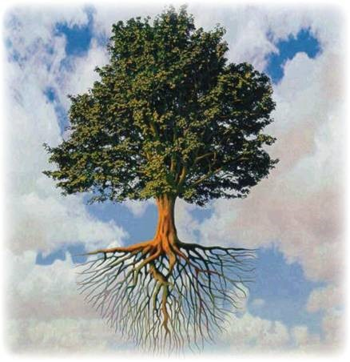
The Fruit of the Tree
Christ is the tree of life
To partake of that fruit is to partake of the cleansing powers of Christ and to receive the blessing of His spirit
Alma 5:34-36

Slide 17
Sources:
Videos:
Can You Imagine? (8:24)
A Mighty Change of Heart (4:39)
Bruce R. McConkie Mormon Doctrine pg 355-356
Joseph Smith Teachings p 305, 297, 301
Joseph Fielding McConkie and Robert L. Millet Doctrinal Commentary on the Book of Mormon Vol. 3 pg 27
Elder D. Todd Christofferson (“Born Again,” Ensign or Liahona, May 2008, 78).
Ezra Taft Benson (“A Mighty Change of Heart,” Ensign, Oct. 1989, 5).
Elder Russell M. Nelson “Choices” General Conference April 7, 2015
Henry B. Eyring “To Draw Closer to God” A Collection of Discourses P. 58
Presentation by ©http://fashionsbylynda.com/blog/

Slide 18
Spiritual Cardiogram | Always | Almost Always | Usually | Sometimes | Seldom if ever
Alma 5:15
Alma 5:16
Alma 5:19
Alma 5:27
Alma 5:28
Spiritual Cardiogram | Always | Almost Always | Usually | Sometimes | Seldom if ever
Alma 5:15
Alma 5:16
Alma 5:19
Alma 5:27
Alma 5:28
Spiritual Cardiogram handouts
Spiritual Cardiogram | Always | Almost Always | Usually | Sometimes | Seldom if ever
Alma 5:15
Alma 5:16
Alma 5:19
Alma 5:27
Alma 5:28
Spiritual Cardiogram | Always | Almost Always | Usually | Sometimes | Seldom if ever
Alma 5:15
Alma 5:16
Alma 5:19
Alma 5:27
Alma 5:28

Slide 19
Stripping Ourselves of Envy: Alma 5:29
It has been said that envy is the one sin to which no one readily confesses, but just how widespread that tendency can be is suggested in the old Danish proverb, “If envy were a fever, all the world would be ill.” The parson in Chaucer’s Canterbury Tales laments it because it is so far-reaching﻿—it can resent anything, including any virtue and talent, and it can be offended by everything, including every goodness and joy.⁵ As others seem to grow larger in our sight, we think we must therefore be smaller. So, unfortunately, we occasionally act that way.
How does this happen, especially when we wish so much that it would not? I think one of the reasons is that every day we see allurements of one kind or another that tell us what we have is not enough. Someone or something is forever telling us we need to be more handsome or more wealthy, more applauded or more admired than we see ourselves as being. We are told we haven’t collected enough possessions or gone to enough fun places. We are bombarded with the message that on the world’s scale of things we have been weighed in the balance and found wanting.⁶ Some days it is as if we have been locked in a cubicle of a great and spacious building where the only thing on the TV is a never-ending soap opera entitled Vain Imaginations.
How can we overcome such a tendency so common in almost everyone? For one thing, we can do as these two sons did and start making our way back to the Father. We should do so with as much haste and humility as we can summon. Along the way we can count our many blessings and we can applaud the accomplishments of others. Best of all, we can serve others, the finest exercise for the heart ever prescribed. But finally these will not be enough. When we are lost, we can “come to ourselves,” but we may not always be able to “find ourselves,” and, worlds without end, we cannot “save ourselves.” Only the Father and His Only Begotten Son can do that. Salvation is in Them only. So we pray that They will help us, that They will “come out” to meet and embrace us and bring us into the feast They have prepared.
They will do this! The scriptures are replete with the promise that God’s grace is sufficient.⁹ This is one arena where no one has to claw or compete. Nephi declares that the Lord “loveth the [whole] world” and has given salvation freely.
sisters, I testify that no one of us is less treasured or cherished of God than another. I testify that He loves each of us﻿—insecurities, anxieties, self-image, and all. He doesn’t measure our talents or our looks; He doesn’t measure our professions or our possessions. He cheers on every runner, calling out that the race is against sin, not against each other. I know that if we will be faithful, there is a perfectly tailored robe of righteousness ready and waiting for everyone, “robes … made … white in the blood of the Lamb.”
Jeffrey R. Holland April 2002 Sat. Morning General Conference

