Slide 2
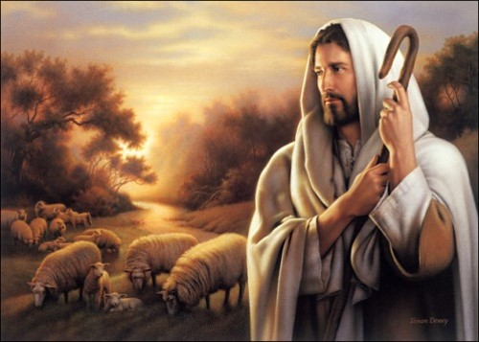
A Shepherd Has Called
“O ye workers of iniquity; ye that are puffed up in the vain things of the world, ye that have professed to have known the ways of righteousness nevertheless have gone astray, as sheep having no shepherd, notwithstanding a shepherd hath called after you and is still calling after you, but ye will not hearken unto his voice!”
“Behold, I say unto you, that the good shepherd doth call you; yea, and in his own name he doth call you, which is the name of Christ; and if ye will not hearken unto the voice of the good shepherd, to the name by which ye are called, behold, ye are not the sheep of the good shepherd.”
Alma 5:37-38

Slide 3
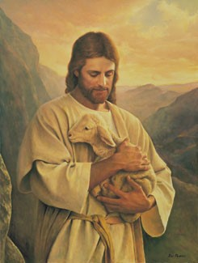
What Fold Are Ye?
“The Lord is my shepherd; I shall not want.
He maketh me to lie down in green pastures: he leadeth me beside the still waters.
He restoreth my soul: he leadeth me in the paths of righteousness for his name’s sake.
Yea, though I walk through the valley of the shadow of death, I will fear no evil: for thou art with me; thy rod and thy staff they comfort me.
Thou preparest a table before me in the presence of mine enemies: thou anointest my head with oil; my cup runneth over.
Surely goodness and mercy shall follow me all the days of my life: and I will dwell in the house of the Lord for ever.”
Psalm 37
Alma 5:37-38

Slide 4
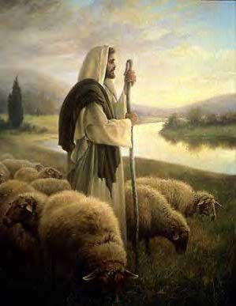
The Ancient Prophets
“He shall feed his flock like a shepherd: he shall gather the lambs with his arm, and carry them in his bosom, and shall gently lead those that are with young.”
Isaiah 40:11
“Son of man, prophesy against the shepherds of Israel, prophesy, and say unto them, Thus saith the Lord God unto the shepherds; Woe be to the shepherds of Israel that do feed themselves! should not the shepherds feed the flocks?”
Ezekiel 34:2
“I am the good shepherd, and know my sheep, and am known of mine.”
John 10:14

Slide 5
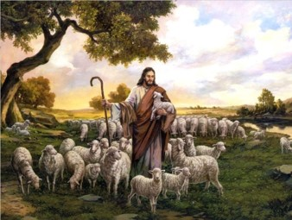
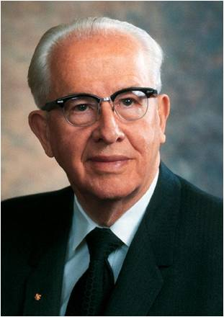
The Good Shepherd
In Jesus’ time, the Palestinian shepherd was noted for his protection of his sheep. Unlike modern sheepherders, the shepherd always walked ahead of his flock.
He led them.
The shepherd knew each of the sheep and usually had a name for each.
The sheep knew his voice and trusted him and would not follow a stranger.
Thus, when called, the sheep would come to him. (See John 10:14, 16.) …
“Jesus used this common illustration of his day to declare that He was the Good Shepherd, the True Shepherd. Because of His love for His brothers and sisters, He would willingly and voluntarily lay down His life for them” President Ezra Taft Benson

Slide 6
Do We Need a Shepherd?
How are people like sheep in need of a shepherd?
How does the Good Shepherd show His love and concern for the sheep?
(He continues to call after them in His own name.)
How can we tell if we are hearkening to the voice of the Good Shepherd?
What are some works that might indicate that a person is following the Good Shepherd?
To follow the voice of the Good Shepherd, we must separate ourselves from wickedness
Alma 5:37-38

Slide 7
Those who are committed to following Jesus Christ:
“When you choose to follow Christ, you choose to be changed. …
“Men [and women] changed for Christ will be captained by Christ. …
“Their will is swallowed up in His will. (See John 5:30.)
“They do always those things that please the Lord. (See John 8:29.)
“Not only would they die for the Lord, but more important they want to live for Him.
“Enter their homes, and the pictures on their walls, the books on their shelves, the music in the air, their words and acts reveal them as Christians.
“They stand as witnesses of God at all times, and in all things, and in all places. (See Mosiah 18:9.)
“They have Christ on their minds, as they look unto Him in every thought. (See D&C 6:36.)
“They have Christ in their hearts as their affections are placed on Him forever. (See Alma 37:36.)
“Almost every week they partake of the sacrament and witness anew to their Eternal Father that they are willing to take upon them the name of His Son, always remember Him, and keep His commandments. (See Moro. 4:3.)”
President Ezra Taft Benson
If we bring forth good works, we show that we are hearkening to the voice of Jesus Christ and are following Him

Slide 8
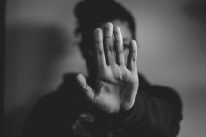
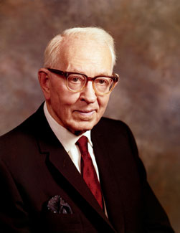
Those not included in “the fold”
“All who refuse to receive the fulness of the truth, or bide by the principles and ordinances of the everlasting gospel.
They may have received a testimony; they may be able to testify that they know that Jesus is the Christ, but in their lives they have refused to accept ordinances which are essential to entrance into the celestial kingdom
They have refused to live the gospel, when they knew it to be true; or have been blinded by tradition; or for other cause have not been willing to walk in the light.
Joseph Fielding Smith

Slide 9
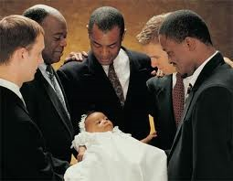
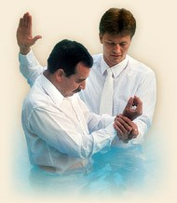
In His Name
Entrance to the kingdom of God requires us to take upon ourselves the name of Christ
Salvation is found in no other name
“Having been commissioned of Jesus Christ, I baptize you in the name of the Father, and of the Son, and of the Holy Ghost. Amen.”
D&C 20:73
“Every member of the church of Christ having children is to bring them unto the elders before the church, who are to lay their hands upon them in the name of Jesus Christ, and bless them in his name.”
D&C 20:70
“O God, the Eternal Father, we ask thee in the name of thy Son, Jesus Christ, to bless and sanctify this bread…this water…”
D&C 20:77,79
Alma 5:38

Slide 10
The Other Name
No Man Can Serve Two Masters:
Matthew 6:24 (scripture mastery)
Cain takes upon himself the name of Perdition—
Moses 5:24
The Other Name is Satan
A child of the devil
Like many others Cain received the fullness of the gospel then chose to deny it… making a bargain with Satan
“Thus saith the Lord concerning all those who know my power, and have been made partakers thereof, and suffered themselves through the power of the devil to be overcome, and to deny the truth and defy my power—
They are they who are the sons of perdition, of whom I say that it had been better for them never to have been born;”
D&C 76:31-32
Alma 5:39

Slide 11
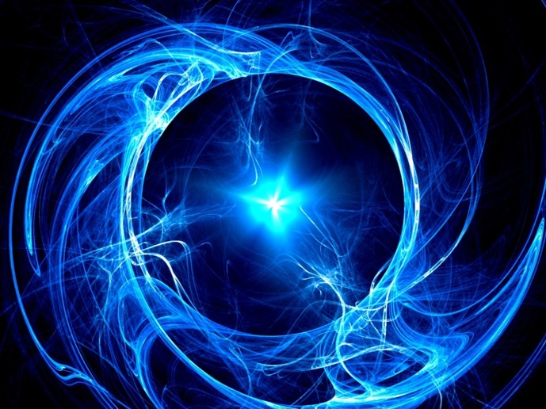
By the Spirit of Prophecy
Alma speaks in the ‘energy of my soul’
Alma speaks plainly (2 Nephi 25:28)
Alma speaks according to the Holy Order of God
Alma is commanded to be a witness and bear
testimony of the ‘things which are to come’
Alma testifies of fasting and prayer
Alma Speaks through the spirit of prophecy
Alma testifies of Jesus the Christ—coming to take away the sins of the world
Alma preaches of repentance
Alma 5:43-51

Slide 12
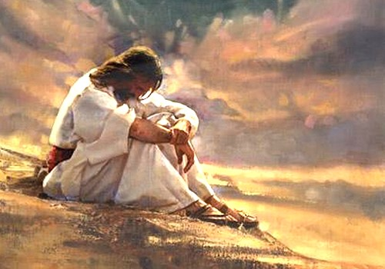
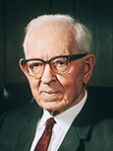
Fasting and Prayer
Through fasting and prayer, we can invite the Holy Spirit to reveal truth to us.
“When a man has the manifestation from the Holy Ghost, it leaves an indelible impression on his soul, one that is not easily erased. It is Spirit speaking to spirit, and it comes with convincing force. A manifestation of an angel, or even of the Son of God himself, would impress the eye and mind, and eventually become dimmed, but the impressions of the Holy Ghost sink deeper into the soul and are more difficult to erase” Joseph Fielding Smith
Alma 5:43-51

Slide 13
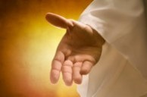
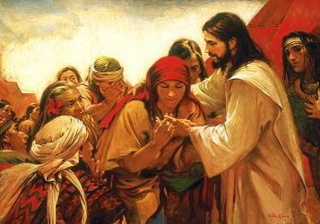
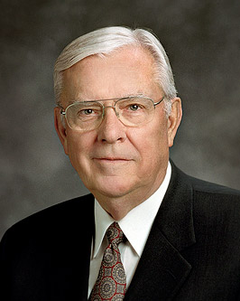
Alma’s Testimony
“…and I say unto you, that I know that Jesus Christ shall come, yea, the Son, the Only Begotten of the Father, full of grace, and mercy, and truth. And behold, it is he that cometh to take away the sins of the world, yea, the sins of every man who steadfastly believeth on his name.”
“Individual, personal testimony of gospel truth, particularly the divine life and mission of the Lord Jesus Christ, is essential to our eternal life. … In other words, life eternal is predicated upon our own individual, personal knowledge of our Father in Heaven and His Holy Son. Simply knowing about them is not enough.
We must have personal, spiritual experiences to anchor us.
These come through seeking them in the same intense, single-minded way that a hungry person seeks food”
Elder M. Russell Ballard
Alma 5:48

Slide 14
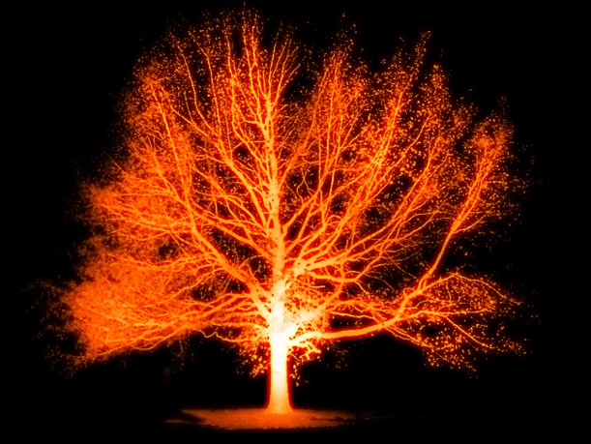
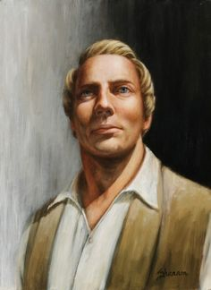
Unquenchable Fire
“Only sons of Perdition are damned forever in darkness.”
“Nevertheless, it is not written that there shall be no end to this torment, but it is written endless torment.
Again, it is written eternal damnation; wherefore it is more express than other scriptures, that it might work upon the hearts of the children of men, altogether for my name’s glory.”
D&C 19:6-7
“Those who will eventually inherit the telestial kingdom suffer and repent in hell after death”
“A man is his own tormentor and his own condemner….The torment in disappointment in the mind of man is as exquisite as a lake with fire and brimstone…”
Joseph Smith
Alma 5:52 JFM and RLM

Slide 15
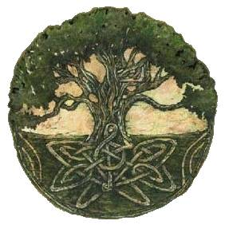
Tree-Metaphor
“If the root be holy, so are the branches, but if the root system becomes corrupted by absorbing poisonous elements from its environment, then ‘the ax is laid at the root of the tree’ and it will have to be cut down and cast into the fire.”
Ogden and Skinner
People
Works and Righteousness
Source and supplier
Alma 5:52 JFM and RLM

Slide 16
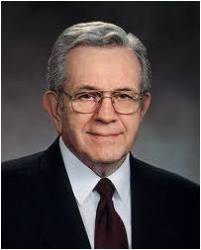
Touch Not
Touch not unclean things—we cannot partake of forbidden fruit unless we first touch them
“Many a bitter tear is shed by those who thought it cute to flirt with sin or nibble at that which is forbidden”
JFM and RLM
“…leave it alone. Turn it off, walk away from it, burn it, erase it, destroy it…
H. Burke Peterson
Throughout your life there may be times when you have gone places you never should have gone and done things you never should have done. If you will turn away from sin, you will be able one day to know the peace that comes from following the pathway of complete repentance.
Pres. Boyd K. Packer
Alma 5:57-62

Slide 17
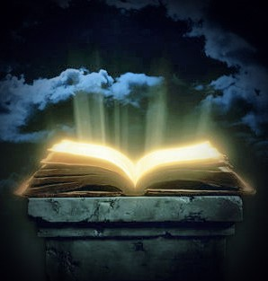
The Book of Life
Lamb’s book of Life—a record kept in heaven which contains the names of the faithful and an account of their righteous covenants, and deeds
Revelations 20:12 John the Revelator
“And I saw the dead, small and great, stand before God; and the books were opened; and another book was opened, which is the book of life; and the dead were judged out of those things which were written in the books, according to their works.”
D&C 128:6
You will discover in this quotation that the books were opened; and another book was opened, which was the book of life; but the dead were judged out of those things which were written in the books, according to their works; consequently, the books spoken of must be the books which contained the record of their works, and refer to the records which are kept on the earth. And the book which was the book of life is the record which is kept in heaven; the principle agreeing precisely with the doctrine which is commanded you in the revelation contained in the letter which I wrote to you previous to my leaving my place—that in all your recordings it may be recorded in heaven.
D&C 128:7
Alma 5:58

Slide 18
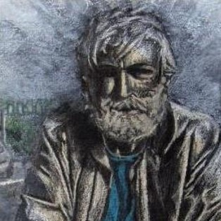
Bring Unto His Fold
Suffer no ravenous wolf to enter among you—The honest and sincere truth-seekers are always welcome in the congregation of the Saints.
“…and ye shall not forbid any man from coming unto you when ye shall meet together, but suffer them that they may come unto you and forbid them not;
But ye shall pray for them, and shall not cast them out; and if it so be that they come unto you oft ye shall pray for them unto the Father, in my name.”
3 Nephi 18:22-23
Partakers of the tree of life
Christ is the tree of life. To be a partaker
of the fruit of the tree of life is to feast upon the principle of salvation is taught and reveled by Him
Alma 5:59-62

Slide 19
Sources:
President Ezra Taft Benson (“A Call to the Priesthood: ‘Feed My Sheep,’” Ensign, May 1983, 43; see also John R. Lasater, “Shepherds of Israel,” Ensign, May 1988, 74–75).
President Ezra Taft Benson (“Born of God,” Ensign, Nov. 1985, 5, 6–7).
Joseph Fielding Smith, Answers to Gospel Questions, comp. Joseph Fielding Smith Jr. [1958], 2:151
Elder M. Russell Ballard (“Feasting at the Lord’s Table,” Ensign, May 1996, 80).
Joseph Smith Teachings pg. 357
Joseph Fielding McConkie and Robert L. Millet Doctrinal Commentary on the Book of Mormon Vol. 3 pg. 44-45
H. Burke Peterson “Touch Not the Evil Gift, nor the Unclean Thing” General Conf. Oct 1993
President Boyd K. Packer The Atonement Gen. Conf. October 2012
Joseph Fielding Smith Doctrines of Salvation, 2:28-29
D. Kelly Ogden and Andrew Skinner Book of Mormon 1:395
Presentation by ©http://fashionsbylynda.com/blog/

Slide 20
Those who are committed to following Jesus Christ:
“When you choose to follow Christ, you choose to be changed. …
“Men [and women] changed for Christ will be captained by Christ. …
“Their will is swallowed up in His will. (See John 5:30.)
“They do always those things that please the Lord. (See John 8:29.)
“Not only would they die for the Lord, but more important they want to live for Him.
“Enter their homes, and the pictures on their walls, the books on their shelves, the music in the air, their words and acts reveal them as Christians.
“They stand as witnesses of God at all times, and in all things, and in all places. (See Mosiah 18:9.)
“They have Christ on their minds, as they look unto Him in every thought. (See D&C 6:36.)
“They have Christ in their hearts as their affections are placed on Him forever. (See Alma 37:36.)
“Almost every week they partake of the sacrament and witness anew to their Eternal Father that they are willing to take upon them the name of His Son, always remember Him, and keep His commandments. (See Moro. 4:3.)”
President Ezra Taft Benson (“Born of God,” Ensign, Nov. 1985, 5, 6–7).

Slide 21
How can the world’s uncleanness lad Church members away from their covenants? Alma 5:57-60
“Drifting away from the course of life marked out by the Lord has occurred as individuals begin to make compromises with the Lord’s standards. This is particularly true when the transgression is willful and no repentance occurs. …
It begins as individual members of the Church knowingly begin to make compromises with the Lord’s standard.
They seek justification for their diversions in the knowledge that others are compromising as well.
Those who willfully sin soon seek to establish a standard of their own with which they can feel more comfortable and which justifies their misconduct.
They also seek the association of those who are willing to drift with them along this path of self-delusion”
Dean L. Larsen “Likening the Scriptures unto Us” 8

