Slide 1
Lesson 74
Suggested Hymn #270 I’ll Go Where You Want Me to Go

Slide 2
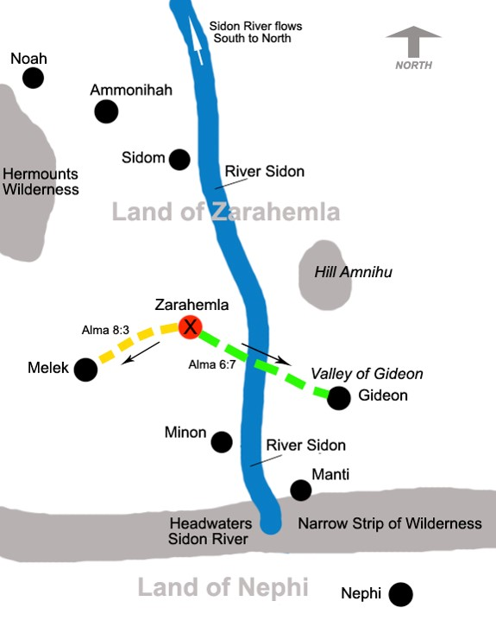
The 10th Year of the Reign of the Judges
Alma preaches in Zarahemla, Gideon, Melek
Alma baptizes many
Alma 8:1-5

Slide 3
Ammonihah
Alma goes to Ammonihah
Ammonihah was a cosmopolitan city with both Nephite and non-Nephite citizens— the religion was possibly after the order of Nehor—see article
Alma 8:1-5

Slide 4
Ammonihahites
They were those who dwelled in the city of Ammonihah
The inhabitants of the city rejected the gospel delivered by Alma and Amulek
The wicked population was destroyed in 81 BC by invading Lamanites (Alma 16:9)
Ammonihah was a cosmopolitan city with both Nephite and non-Nephite citizens. (see article)
Who’s Who

Slide 5
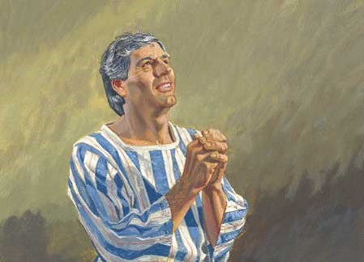
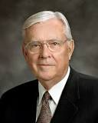
Ammonihah
Alma goes to Ammonihah and is rejected
A Great Hold upon the hearts of the people
Alma labored much in the spirit…wrestling with God in mighty prayer
For their repentance
Mighty Prayer
“I recognize that, on occasion, some of our most fervent prayers may seem to go unanswered. We wonder, ‘Why?’ I know that feeling! I know the fears and tears of such moments. But I also know that our prayers are never ignored. Our faith is never unappreciated. I know that an all-wise Heavenly Father’s perspective is much broader than is ours. While we know of our mortal problems and pain, He knows of our immortal progress and potential.”
Elder Russell M. Nelson
Alma 8:7-18

Slide 6
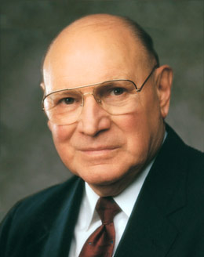
Effectiveness of Prayers
How close do you feel to your Heavenly Father?
Do you feel that your prayers are answered?
Do you feel that the time you spend in prayer enriches and uplifts your soul?
Is there room for improvement?

Slide 7
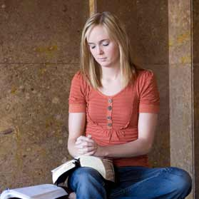
Vain Repetitions
“There are many reasons our prayers lack power. Sometimes they become routine. Our prayers become hollow when we say similar words in similar ways over and over so often that the words become more of a recitation than a communication. This is what the Savior described as ‘vain repetitions’ (Matthew 6:7). Such prayers, He said, will not be heard. …
“Do your prayers at times sound and feel the same? Have you ever said a prayer mechanically, the words pouring forth as though cut from a machine? Do you sometimes bore yourself as you pray?
“Prayers that do not demand much of your thought will hardly merit much attention from our Heavenly Father. When you find yourself getting into a routine with your prayers, step back and think. Meditate for a while on the things for which you really are grateful.”
Joseph B. Wirthlin

Slide 8
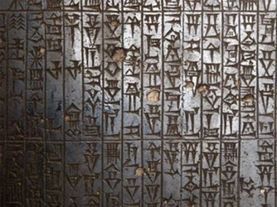
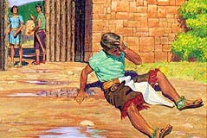
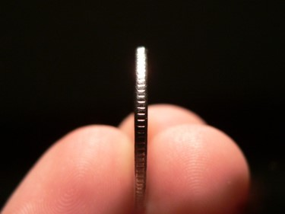
Revile, Spit Upon and Cast Out
Where righteousness reigned in a Nephite society the people were allowed to worship or believe as they chose, as long as their behavior stayed within legal bounds
The Law:
“Nevertheless, they durst not lie, if it were known, for fear of the law, for liars were punished; therefore they pretended to preach according to their belief; and now the law could have no power on any man for his belief.”
Alma 1:17
Weighed Down With Sorrow
Alma has been on “two sides of the coin”. He has known of sin and the repentance process and the remittance of sin. His sorrow is for the wicked and knows of the unspeakable joy of restoration to righteousness which he desires the people to have.
Alma 8:14-16

Slide 9
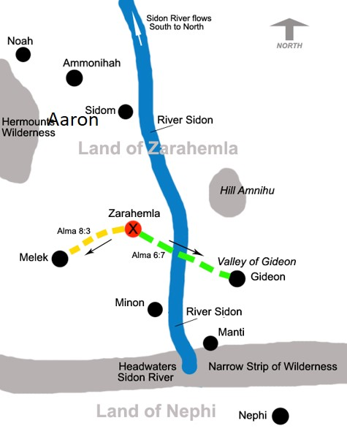
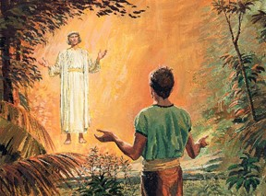
Alma’s Return
Alma is cast out and heads to the city called Aaron
An Angel appears to Alma
“Blessed art thou, Alma; therefore, lift up thy head and rejoice, for thou hast great cause to rejoice; for thou hast been faithful in keeping the commandments of God from the time which thou receivedst thy first message from him. Behold, I am he that delivered it unto you.”
“And behold, I am sent to command thee that thou return to the city of Ammonihah, and preach again unto the people of the city; yea, preach unto them. Yea, say unto them, except they repent the Lord God will destroy them.”
Alma returns Speedily and enters by another way into the city of Ammonihah
Alma 8:14-16

Slide 10
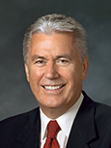
When individuals choose to turn away from the Lord, we can ask God in mighty prayer that He will pour out His Spirit upon them.
“Faith is powerful, and often it does result in miracles. But no matter how much faith we have, … it cannot violate another person’s agency.
“One woman prayed for years that her wayward daughter would return to the fold of Christ and felt discouraged that her prayers had seemingly gone unanswered. This was especially painful when she heard stories of other prodigal children who had repented of their ways.
“The problem was not a lack of prayers or a shortage of faith. She needed only to understand that, as painful as it might be for our Father in Heaven, He will not force anyone to choose the path of righteousness. …
“God will invite, persuade. God will reach out tirelessly with love and inspiration and encouragement. But God will never compel—that would undermine His great plan for our eternal growth” Dieter F. Uchtdorf
Alma 8:11-13

Slide 11
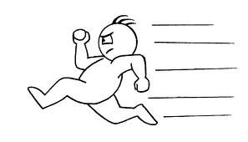
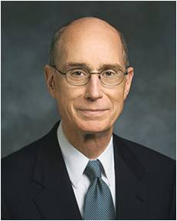
“However much faith to obey God we now have, we will need to strengthen it continually and keep it refreshed constantly. We can do that by deciding now to be more quick to obey and more determined to endure. Learning to start early and to be steady are the keys to spiritual preparation. …
“… A loving Heavenly Father and His Beloved Son have given us all the help They can to pass the test of life set before us. But we must decide to obey and then do it.
We build the faith to pass the tests of obedience over time and through our daily choices. We can decide now to do quickly whatever God asks of us. And we can decide to be steady in the small tests of obedience which build the faith to carry us through the great tests, which will surely come”
President Henry B. Eyring

Slide 12
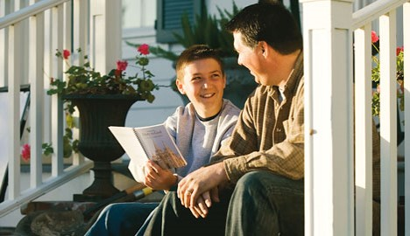
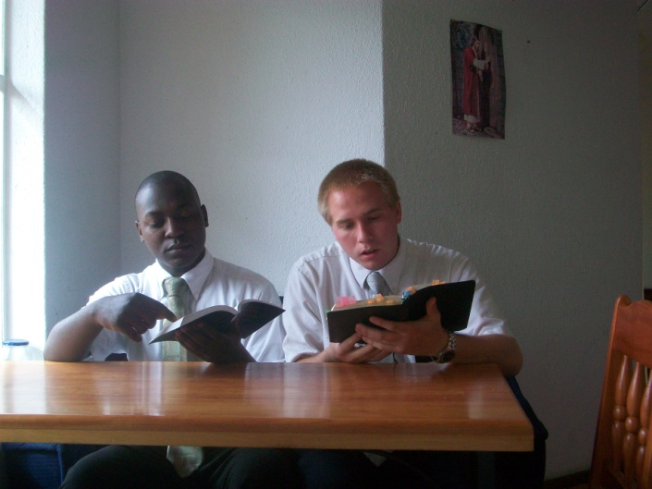
How Quick Are We to Obey?
1. As a young woman is leaving for school, her mother asks her to wear a more modest shirt.
2. In an interview with his bishop, a new priest is challenged to earn the Duty to God Award.
If we choose to obey the Lord’s direction promptly, then we can bring blessings into the lives of others
3. Two missionaries feel impressed during their daily planning session to visit a less-active family in which the mother is not a member of the Church.

Slide 13
Amulek
He was the son of Giddonah, who was the son of Ishmael, a descendant of Aminadi…who interpreted the writing which was upon the wall of the temple…and Aminadi was a descendant of Nephi. (Alma 10:2-3)
He was a Nephite in the city of Ammonihah
He was a prominent citizen and wealthy
He received a visit from an angel about Alma around 82 BC
He offered Alma food and shelter
Amulek and Alma preached repentance to the people in the city of Ammonihah
Amulek assisted Alma in confounding the lawyer Zeezrom through inspiration.
Amulek and Alma were cast into prison
They were delivered out of their enemies hands by the Lord
The Lord commanded them to leave the city of Ammonihah
Amulek and Alma were companions preaching among the Nephites
Who’s Who

Slide 14
Repent Ye, For Thus Saith the Lord
Alma and Amulek Preach Repentance
“And Alma went forth, and also Amulek, among the people, to declare the words of God unto them; and they were filled with the Holy Ghost.
And they had power given unto them, insomuch that they could not be confined in dungeons; neither was it possible that any man could slay them; nevertheless they did not exercise their power until they were bound in bands and cast into prison. Now, this was done that the Lord might show forth his power in them.
And it came to pass that they went forth and began to preach and to prophesy unto the people, according to the spirit and power which the Lord had given them.”
Alma 8:30-32

Slide 15
Sources:
Video:
“Teachings of Thomas S. Monson: Following the Promptings of the Spirit”
Ammonihah—see article
Who’s Who Book of Mormon by Ed J. Pinegar and Richard J. Allen pg. 21 and 23-24
Elder Russell M. Nelson (“Jesus Christ—the Master Healer,” Ensign or Liahona, Nov. 2005, 86).
Dieter F. Uchtdorf, “Fourth Floor, Last Door,” Ensign or Liahona, Nov. 2016, 16–17
Joseph B. Wirthlin, “Improving Our Prayers” [Brigham Young University devotional, Jan. 21, 2003], 2, speeches.byu.edu
President Henry B. Eyring(“Spiritual Preparedness: Start Early and Be Steady,” Ensign, Nov. 2005, 38, 40).
Presentation by ©http://fashionsbylynda.com/blog/

Slide 16
The name Ammonihah is a Book of Mormon toponym referenced 26 times in the text. 1 of those references is in the book of Helaman. The other 25 citations are all in the book of Alma. Ammonihah first appears by name in Mormon's compendium in the 10th year of the reign of the judges (ca. 82 BC). The city was obliterated in a brutal Lamanite invasion in the 11th year of the reign of the judges (ca. 81 BC) and it lay unoccupied and in ruins for several years as required by the law of apostate cities in Deuteronomy 13:12-16. (See John W. Welch, "The Destruction of Ammonihah and the Law of Apostate Cities" in Reexploring The Book of Mormon, Salt Lake City: Deseret Book & FARMS, 1992, chapter 50. By the 19th year of the reign of the judges (ca. 72 BC) the city had been partially rebuilt. It figures in the war with the Lamanites under Amalickiah and is never mentioned again except as an historical referent. Another name for Ammonihah is "Desolation of Nehors"Alma 16:11. Nehor and his successor, Amlici, are both important in the discussion. The locus of their power base centered in Ammonihah Alma 15:15. The recent realization (by Royal Skousen) that all 19 occurrences of the word "Amalekites" in the 1981 LDS text should read "Amlicites" (see the blog article entitled "Peripatetic Amlici") opens up a number of interesting implications for Ammonihah that have yet to be fully explored. The city of Ammonihah was in the land of Ammonihah Alma 8:18.
Ammonihah was a cosmopolitan city with both Nephite and non-Nephite citizens. This implies a trade route location 6 with non-Nephite enclaves or proximity to a major non-Nephite region. Alma 8:20. Amulek's comment also reflects the Amlicite partition Alma 2:11 five years earlier and its aftermath Alma 3:11 with religious connotations.
The economy was flourishing in Ammonihah. This is evidenced by Amulek's comment that he had neglected spiritual matters because he was so busy making money. Alma 10:4, 5. It is further evidenced by the extreme hubris of the natives Alma 16:9 and the strength of the local legal profession Alma 10:31, 32.
Nehor was executed for the murder of Gideon in the first year of the reign of the judges (ca. 91 BC) Alma 1:15, but his apostate belief system survived him Alma 1:16. At the time of his death, Nehor had recently founded a church Alma 1:6. Where was Nehor's church located? It was in the city of Ammonihah Alma 14:16, 18; Alma 15:15; Alma 16:11. Therefore, when Nehor was travelling to preach to his believers & supporters Alma 1:7, he was headed to Ammonihah. We previously established that Nehor slew Gideon in the valley of Gideon (see the article entitled "Gideon" in this blog) because Gideon was a church leader Alma 1:7 in his eponymous valley defending his fellow church members from heresy and apostasy. We know that Gideon was one of the seven churches founded by Alma₁ ca. 120 B.C. (see the blog article "The Church in Zarahemla"). From this we deduce that the valley of Gideon was en route from the local land of Zarahemla to Ammonihah. 7 This means Ammonihah was east of river Sidon 8. See the article "The Usumacinta/Sidon Correlation" in this blog for a great deal more information about Ammonihah east of Sidon and the implications of that important discovery first noted by V. Garth Norman.
http://bookofmormonresources.blogspot.com/2011/12/ammonihah.html

