Slide 2
Zeezrom
He was a lawyer in the city of Ammonihah
He was introduced in the Book of Mormon around 82 BC
He was in business to ‘stir up the people to riotings…’ against Alma and Amulek
He questioned Alma and Amulek, to catch Alma and Amulek in contradictory statements
After much debate he grew more fearful that he had been wrong in his position
He recognized the truth of the gospel and repented along with many others
While Zeezrom lay with a burning fever, Alma and Amulek gave him a blessing
He was baptized by Alma and later went with Alma and Amulek to preach to the Zoramites in the land of Antionum, then to Zarahemla
Who’s Who

Slide 3
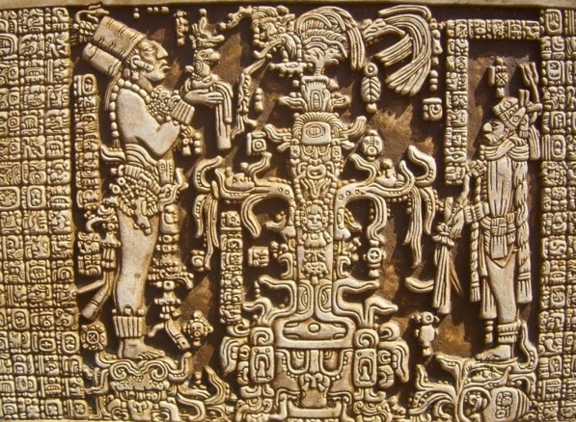
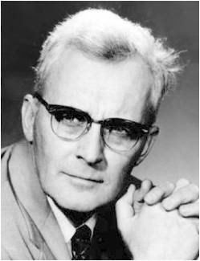
Judges and Laws
Lesson 76
The Man Was Compelled to Pay That Which He Owed, or Be Stripped, or Be Cast out from among the People:
The Judge Received for His Wages . . . a Senine of Gold . . . according to the Law:
Lesson 76
“It seems that in the ancient court the judge had to be paid before you were let out of prison. It says here that the judges' pay was one senine a day. Later on it tells us in 3 Nephi 12:26 that you won't come out of prison until you have paid the last senine. They won't let you out until you have paid the judges. The judge is paid if nothing else. That's exactly the system we have in the Book of Mormon.”
Hugh W. Nibley
Alma 11:2-3

Slide 4
A Measure of Money
Lesson 76
The Nephites had adopted their own money system according to their weights and not by the customary Jewish monetary system around the time of King Mosiah and the Reign of the Judges
Lesson 76
Alma 11:4-19 see handouts

Slide 5
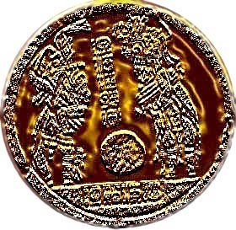
Expert in the Devil
Lesson 76
Zeezrom’s offer to Alma and Amulek:
Lesson 76
An onti was a piece of silver with the greatest value One onti was equal to approximately one week’s wages for a judge, which means that six onties was equal to about six weeks of wages for a judge.
A Lawyer would get more money based on the number of cases he participated in; as such lawyers would purposely cause disturbances among the people to initiate more court cases
Alma 11:21

Slide 6
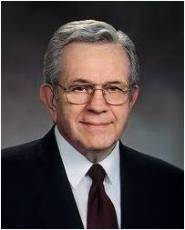
Lesson 76
When we rely on the Holy Ghost, we can overcome temptation.
Lesson 76
“It is not expected that you go through life without making mistakes, but you will not make a major mistake without first being warned by the promptings of the Spirit. This promise applies to all members of the Church. …
“If you are slipping into things that you should not slip into or if you are associating with people who are pulling you away in the wrong direction, that is the time to assert your independence, your agency. Listen to the voice of the Spirit, and you will not be led astray.
“… As a servant of the Lord, I promise that you will be protected and shielded from the attacks of the adversary if you will heed the promptings that come from the Holy Spirit.”
President Boyd K. Packer
Alma 11:22

Slide 7
The Dialogue
Lesson 76
Will you answer me a few questions?
According to the Spirit of God which is in me.
I will pay you 6 onties of silver to deny the existence of a Supreme Being
You can not tempt the righteous. I know you know that there is a God. 6 onties is a lot of money but I can not deny a true and living God.
Is there a true and living God?
Yes!
Is there more than one God?
No!
How do you know?
An angel has told me.
Lesson 76
Alma 11:21-31

Slide 8
Lesson 76
Who will come? Is it the Son of God?
Yes.
Can he save his people in their sins?
He can not.
See, he says there is one God, but the Son of God shall come and not save his people—as though he had authority to command God.
You have contradicted me…you said I have authority to command God…I said He will not save His people in their sins.
He can not save them in their sins…for I can not deny His word.
No unclean thing can enter into the Kingdom of Heaven
Is the Son of God the very Eternal God?
Yes…He is the very Eternal God of heaven and earth, and all things, He is the beginning and the end, the first and the last.
Lesson 76
Alma 11:32-39

Slide 9
Lesson 76
Exaltation
Eternal Life
One who qualifies to dwell with and be part of the Church of the Firstborn
Lesson 76
Salvation—to be saved
Salvation
Eternal Life
Life in the highest heaven with the Gods and angels
One’s saved condition—through the atoning sacrifice of Jesus Christ
Alma 11:40

Slide 10
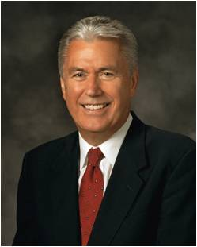
Lesson 76
When we believe in Jesus Christ, we can be redeemed from our sins.
Lesson 76
“We need a strong faith in Christ to be able to repent. Our faith has to include a ‘correct idea of [God’s] character, perfections, and attributes.’
If we believe that God knows all things, is loving, and is merciful, we will be able to put our trust in Him for our salvation without wavering. Faith in Christ will change our thoughts, beliefs, and behaviors that are not in harmony with God’s will.”
President Dieter F. Uchtdorf
Alma 11:40

Slide 11
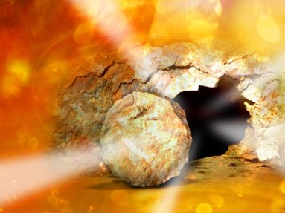
Resurrection and Judgment
Lesson 76
All people who live on the earth will eventually be resurrected.
“They can die no more; their spirits uniting with their bodies, never to be divided.”
Lesson 76
All people will be resurrected and will stand before God to be judged according to their works.
Alma 11:41-45

Slide 12
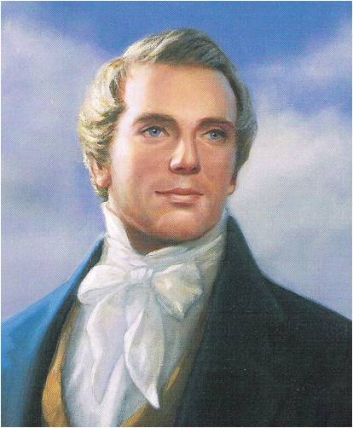
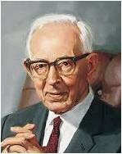
Lesson 76
“As concerning the resurrection, I will merely say that all men will come from the grave as they lie down, whether old or young; there will not be ‘added unto their stature one cubit.’ neither taken from it ; all will be raised by the power of God, having spirit in their bodies, and not blood.”
Joseph Smith
Lesson 76
The body will come forth as it is laid to rest, for there is no growth or development in the grave. As it is laid down, so will it arise, and changes to perfection will come by the law of restitution. But the spirit will continue to expand and develop, and the body, after the resurrection will develop to the full stature of man.”
Joseph Fielding Smith
“These changes will come naturally, of course but almost instantly.”
Alma 11:43

Slide 13
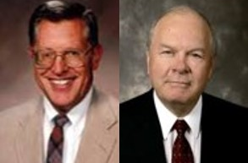
Lesson 76
“The resurrected body is physical, tangible, substantial. And yet it is spiritual, meaning immortal, not subject to death.”
JFM and RLM V3 pg 80
Lesson 76
“So also is the resurrection of the dead. It is sown in corruption; it is raised in incorruption:
It is sown in dishonour; it is raised in glory: it is sown in weakness; it is raised in power:
It is sown a natural body; it is raised a spiritual body. There is a natural body, and there is a spiritual body.”
1 Corinthian 15:42-44
Alma 11:45

Slide 14
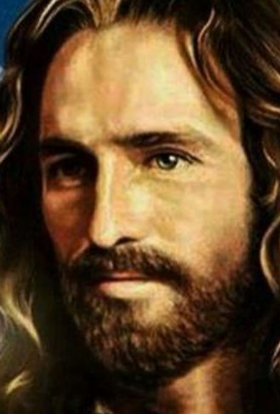
Lesson 76
“[Jesus Christ] acts as the Father in that he is the Creator of heaven and earth. …
“… The Savior himself made this triumphant announcement as he appeared to the Nephites in the New World:
“‘Behold, I am Jesus Christ the Son of God. I created the heavens and the earth, and all things that in them are. I was with the Father from the beginning. I am in the Father, and the Father in me; and in me hath the Father glorified his name’.
“Clearly, Christ—under the direction of his Father—is the Father of creation, the Creator of heaven and earth and all things that in them are.” Jeffrey R. Holland
Lesson 76
3 Nephi 9:15

Slide 15
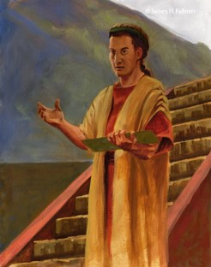
The Silence
Lesson 76
Lesson 76
“Now, when Amulek had finished these words the people began to be astonished, and also Zeezrom began to tremble. And thus ended the words of Amulek, or this is all that I have written?”
James H. Fullmer
Alma 11:46

Slide 16
Sources:
Video: Resurrected Perfect Form (1:51)
Who’s Who in the Book of Mormon Ed J. Pinegar and Richard J. Allen pg. 191-192
Hugh W. Nibley, Teachings of the Book of Mormon, Semester 2, p. 316] Notes on John Welch, a teacher at BYU Law School
President Boyd K. Packer (“Counsel to Youth,” Ensign or Liahona, Nov. 2011, 18).
President Dieter F. Uchtdorf: (“Point of Safe Return,” Ensign or Liahona, May 2007, 100). Lectures on Faith [1985], 38
Joseph Smith Teachings pg. 199-200
Joseph Fielding Smith Improvement Era June 1904 and Doctrines of Salvation 2:293-94
Jeffrey R. Holland, Christ and the New Covenant: The Messianic Message of the Book of Mormon [1997], 184, 186.
Presentation by ©http://fashionsbylynda.com/blog/

Slide 17
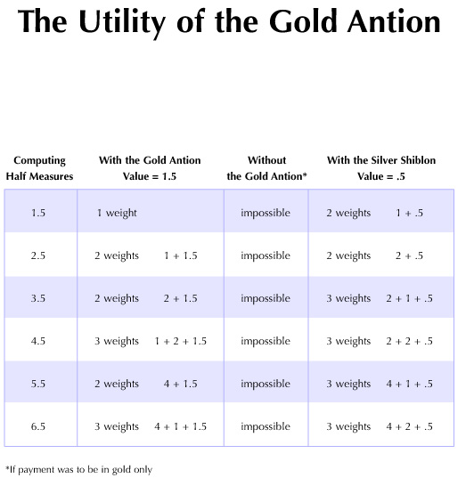
http://byustudies.byu.edu/book_of_mormon_charts/charts/111.aspx
http://byustudies.byu.edu/book_of_mormon_charts/charts/111.aspx

Slide 18
IS THERE MORE THAN ONE GOD? Alma 11:28
The Latter-day Saint doctrine of the Godhead (that the Father, the Son, and the Holy Ghost are three separate Personages who are perfectly unified in purpose and doctrine) has come under attack in the modern Christian world. Christians who trace their conception of God to fourth- and fifth-century creeds that declare the doctrine of the Trinity (that the Father, the Son, and the Holy Ghost are not separate beings) often question members of the Church about our unique conception of God. The question raised with its given answer in Alma 11:28–33 has also left many questioning the doctrine of the Godhead as outlined in the restored Church. Roy W. Doxey (1908–1992), assistant in the office of the Council of the Twelve and dean emeritus of Religious Instruction, Brigham Young University, explained a possible reason for Amulek’s answer that there is but one God:
“Is there more than one God? The question is often raised in response to Alma chapter 11, where Zeezrom, a critic, is contending with the missionary Amulek. …
“In order to understand Amulek’s statement [that there is but one true and living God], we must look at the full context. Throughout most of their history, many Israelites (forefathers of the Nephites) were eager to accept the numerous pagan gods of the Egyptians and Canaanites. Although the Book of Mormon is silent about the specific apostate notions held by the people in Zeezrom’s city of Ammonihah, it is clear that some apostate Nephites of Alma’s time were idolatrous—as some of their Israelite fathers had been. When Alma, Amulek’s missionary companion, was chief judge as well as high priest over the Church, he helped to establish a strong and faithful body of church members. Nevertheless, ‘those who did not belong to their church did indulge themselves in sorceries, and in idolatry.’ (Alma 1:32.) Apostasy was such a problem that Alma later gave up the judgment seat, ‘that he himself might go forth among his people, or among the people of Nephi, that he might preach the word of God unto them.’ (Alma 4:19.)
“As a missionary, Alma found that many of the people were steeped in idolatry. He discovered, for example, that the people in the city of Zoram ‘were perverting the ways of the Lord, and that Zoram, who was their leader, was leading the hearts of the people to bow down to dumb idols.’ (Alma 31:1.)
“This is the context, then, of the discussion Alma and Amulek had with Zeezrom. Seen in this light, Amulek’s answer is completely understandable and, of course, correct: There is only one ‘true and living God’—who shares none of his godhood with the hosts of false gods invented by man” (Roy W. Doxey, “I Have a Question” Ensign, Aug. 1985, 11).
Traditional Christian Trinity:
“Our first and foremost article of faith in The Church of Jesus Christ of Latter-day Saints is ‘We believe in God, the Eternal Father, and in His Son, Jesus Christ, and in the Holy Ghost’ [Articles of Faith 1:1]. We believe these three divine persons constituting a single Godhead are united in purpose, in manner, in testimony, in mission. We believe Them to be filled with the same godly sense of mercy and love, justice and grace, patience, forgiveness, and redemption. I think it is accurate to say we believe They are one in every significant and eternal aspect imaginable except believing Them to be three persons combined in one substance, a Trinitarian notion never set forth in the scriptures because it is not true. …
“In the year a.d. 325 the Roman emperor Constantine convened the Council of Nicaea to address—among other things—the growing issue of God’s alleged ‘trinity in unity.’ What emerged from the heated contentions of churchmen, philosophers, and ecclesiastical dignitaries came to be known (after another 125 years and three more major councils) [Constantinople, a.d. 381; Ephesus, a.d. 431; Chalcedon, a.d. 451] as the Nicene Creed, with later reformulations such as the Athanasian Creed. These various evolutions and iterations of creeds—and others to come over the centuries—declared the Father, Son, and Holy Ghost to be abstract, absolute, transcendent, immanent, consubstantial, coeternal, and unknowable, without body, parts, or passions and dwelling outside space and time. In such creeds all three members are separate persons, but they are a single being, the oft-noted ‘mystery of the trinity.’ They are three distinct persons, yet not three Gods but one. All three persons are incomprehensible, yet it is one God who is incomprehensible.
“We agree with our critics on at least that point—that such a formulation for divinity is truly incomprehensible. …
“We declare it is self-evident from the scriptures that the Father, the Son, and the Holy Ghost are separate persons, three divine beings, noting such unequivocal illustrations as the Savior’s great Intercessory Prayer … , His baptism at the hands of John, the experience on the Mount of Transfiguration, and the martyrdom of Stephen—to name just four [see John 17; Matthew 3:13–17; 17:1–6; and Acts 7:54–60]” (Jeffrey R. Holland, “The Only True God and Jesus Christ Whom He Hath Sent,” Ensign or Liahona, Nov. 2007, 40–41).
Elder Jeffrey R. Holland

Slide 19
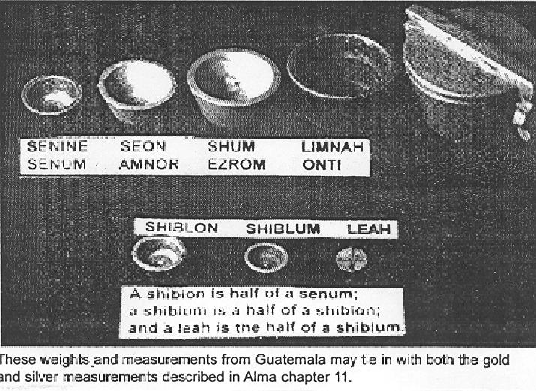

Slide 20
Alma 11:5 A Limnah:
According to Diane Wirth, the term Limnah (Alma 11:5), a gold standard, has not an Egyptian, but a Hebrew meaning of "to count or weigh." (Brown, Driver, and Briggs, "A Hebrew and English Lexicon of the Old Testament"). These terms appear to be quite fitting since we know that the Nephites used a combination of Egyptian and Hebrew in the language they referred to as "reformed Egyptian." [Diane E. Wirth, A Challenge to the Critics, pp. 47-48]
Alma 11:6 A Senum:
According to Diane Wirth, if we take the word senum, referred to in Alma 11:3, we come up with an Egyptian word with a Nephite ending. Nephite endings to words were no doubt a grammatical device to change Egyptian words to their language. Sen in Egyptian means "one-half" or "doubling." Jesclard noted "This would also tend to fit into the Nephite method, because a senum is doubled each time to make the next highest amount." [Diane E. Wirth, A Challenge to the Critics, p. 47]
http://stepbystep.alancminer.com/alma_11

Slide 21
Alma 11:13 An Onti Was As Great As Them All:
According to Diane Wirth, Alma 11:13 refers to "an onti," which is an Egyptian word meaning "small amount" or "short of an amount." [Diane E. Wirth, A Challenge to the Critics, p. 47]
Although Alma 11:13 states that "an onti was as great as them all," the idea that might be grasped is that the word "onti" was associated with value.
Alma 11:15 Therefore, a Shiblon for Half a Measure of Barley:
The reader should note that in Alma 11:15 that things were measured in terms of "barley." According to Hugh Nibley, this is very interesting because the first Babylonian and the first Egyptian money were always the amount of silver necessary to buy a measure of barley. It was always barley. It wasn't emer wheat or the other grains they had. And it's very interesting that barley doesn't grow wild in Egypt as emer wheat and other things do. But barley was it. It was the word for money and it was what they used. . . . This reference to barley is very striking because nobody knew about this custom in Joseph Smith's day. It wasn't discovered until the 1850s. [Hugh W. Nibley, Teachings of the Book of Mormon, Semester 2, p. 317]

Slide 22
Alma 11:16 A Shiblum [Shilum]:
According to Diane Wirth, an interesting observation has been made by John Welch. In Alma 11:16 we come across a unit of measurement called shiblum. Checking an original fragment and the Printer's Manuscript of the Book of Mormon, it was found that the word was actually shilum, not shiblum. Shilumjust happens to be a Hebrew word meaning "payment, reward, or retribution." [Diane E. Wirth, A Challenge to the Critics, p. 48]
Alma 11:22 All These (Six Onties of Silver) Will I Give Thee If Thou Wilt Deny the Existence of a Supreme Being:
One might ask, Why did Mormon take up space on his abridgment to show the Nephite money scale? Do we find the answer in Alma 11:22? In other words, did Mormon only show the money scale in order to help the reader appreciate the enormity of Zeezrom's bribe? ("All these will I give thee if thou wilt deny the existence of a supreme being") Or is the answer tied to a number of things. One possible insight is that in the scriptures, certain numbers are symbolic. The bribe of six onties was equal to 42 Senums, or 42 days pay for a judge. The number 42 is a product of 6 X 7. The number "6" is symbolic of Satan. The number "7" is symbolic the perfection, or the combination of "4" man + "3" God. However, Satan can imitate the ways of God: "And I stood upon the sand of the sea, and saw a beast rise up out of the sea, having seven heads and ten horns, and upon his horns ten crowns, and upon his heads the name of blasphemy" (see Revelation 13:1). Thus we might ask, Is the amount of Zeezrom's bribe an allusion to Satan?

Slide 23
Zeezrom's big issue was the need for this "Son of God" to "save the people in their sins" (Alma 11:34). Apparently, according to Zeezrom's philosophy, salvation was a given (Nehor doctrine--see Alma 1:4). Beyond that, the object of life "was to get gain; and they got gain according to their employ" (Alma 10:31). Mormon notes that "the foundation of the destruction of this people is beginning to be laid by the unrighteousness of your lawyers and your judges" (Alma 10:27). Amulek's response was a discourse on the role of the Son of God (The Eternal Judge)--"all shall rise from the dead and stand before God, and be judged according to their works" (Alma 11:41).
Thus, if the issue has to do with judgment, why does Amulek speak on resurrection? Unlike an unjust society where men get gain according to their unrighteous works, the resurrection will be perfectly just--"everything shall be restored to its perfect frame, as it is now, or in the body, and shall be brought and be arraigned before the bar of Christ the Son, and God the Father, and the Holy Spirit, which is one Eternal God, to be judged according to their works, whether they be good or whether they be evil" (Alma 11:44). [Alan C. Miner, Personal Notes]
Alma 11:24 Lucre:
While the meaning of the word "lucre" is riches or money, there is a connotation of worldliness. Titus 1:10-11 says the following: "For there are many unruly and vain talkers and deceivers, specially they of the circumcision; Whose mouths must be stopped, who subvert whole houses, teaching things which they ought not, for filthy lucre's sake."

