Slide 2
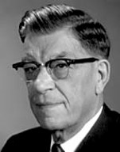
Zeezrom’s Intentions
Whose plan was Zeezrom following?
What did Alma say were the devil’s intentions?
What enabled Alma to see through this plan?
“When the great council was held in heaven, in which all of us were involved, the Father presented his plan for peopling the earth, and for the salvation of man. Lucifer wanted to amend the plan. He proposed to destroy the agency of man and to save all mankind, that not one soul would be lost. This he would accomplish through outright force and coercion, denying all persons the right of choice.
Satan’s proposal of compulsion was rejected by
the Father, and Lucifer “was angry, and kept not
his first estate; and, … many followed after him.”
(Abr. 3:28.)
Elray L. Christiansen
Alma 12:1-7

Slide 3
The Snares of Satan
How does Satan operate? What are his tactics? Using his superior knowledge, his unique powers of persuasion, half-truths, and complete lies, the evil one uses the spirit children who followed him (which were many), plus mortal beings who have yielded to his evil ways, to wage war against Jehovah and his followers; and they will, if they can, influence us to become critical and to rebel against God and his work. Thus he destroys the souls of men.
The scriptures tell us: “Satan stirreth them up, that he may lead their souls to destruction.” (D&C 10:22.)
“Yea, he saith unto them: Deceive and lie in wait to catch, that ye may destroy; behold, this is no harm. …
“And thus he flattereth them, and leadeth them along until he draggeth their souls down to hell; and thus he causeth them to catch themselves in their own snare.
“And thus he goeth up and down, to and fro in the earth, seeking to destroy the souls of men.” (D&C 10:25–27.) Elray L. Christiansen

Slide 4
Overcoming Deceptions
The Holy Ghost can help us recognize the deceptions of the adversary
To overcome a temptation or deception, we must first recognize it and the harm it can cause us. Then we must do all we can to avoid it.
When has the Holy Ghost helped you recognize and avoid temptation?

Slide 5
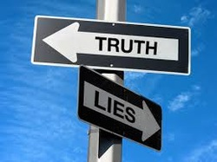
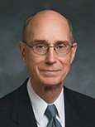
“Just as the Holy Ghost strengthens us against evil, He also gives us the power to discern truth from falsehood. …
Our human reason and the use of our physical senses will not be enough. We live in a time when even the wisest will be hard-pressed to distinguish truth from clever deception. …
“… Since falsehoods and lies may be presented to us at any time, we need a constant influence of the Spirit of Truth to spare us moments of doubt.”
Henry B. Eyring

Slide 6
He knows all our thoughts—
“Yea, I tell thee, that thou mayest know that there is none else save God that knowest thy thoughts and the intents of thy heart.”
D&C 6:16
Where does Satan get his power?
From Us
“The Devil has no power over us only as we permit him.”
Joseph Smith
Alma 12:1-7

Slide 7
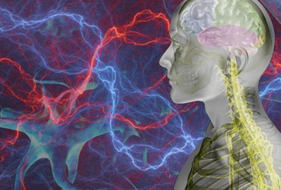
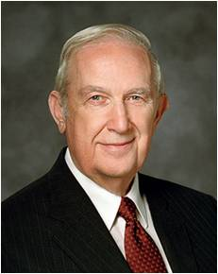
Harden Hearts Softened
A marvelous transformation of character took place with Zeezrom because of the power of the word—the Holy Spirit
“When faith is properly understood and used, it has dramatically far-reaching effects. Such faith can transform an individual’s life from maudlin, common everyday activities to a symphony of joy and happiness. …Faith (has) the capacity to discover hidden characteristics and traits that can transform life. Truly, faith in the Savior is a principle of action and power.”
Richard G. Scott
“God uses your faith to mold your character.
• Character is the manifestation of what you are becoming.
• Strong character results from consistent correct choices.
• The bedrock of character is integrity.
• The more your character is fortified, the more enabled you are to exercise the power of faith.”
“Humility is that quality that permits us to be taught from on high through the Spirit or to be taught from sources whose origin was inspiration from the Lord…”
Alma 12:7-8

Slide 8
Spiritual Tuition
In order to gain knowledge and skills required to become successful in a career:
Estimate how much you might pay in tuition at a college, university, or trade school
“Spiritual understanding … simply cannot be given to [us]. The tuition of diligence and of learning by study and also by faith must be paid to obtain and personally ‘own’ such knowledge. Only in this way can what is known in the mind also be felt in the heart”
David A. Bednar
God reveals spiritual truths to us according to the heed and diligence we give unto Him
Zeezrom asked Alma about resurrection
Alma taught him about gaining a spiritual knowledge.
“The mysteries of God are spiritual truths known only by revelation … to those who are obedient to the gospel”
Alma 12:9

Slide 9
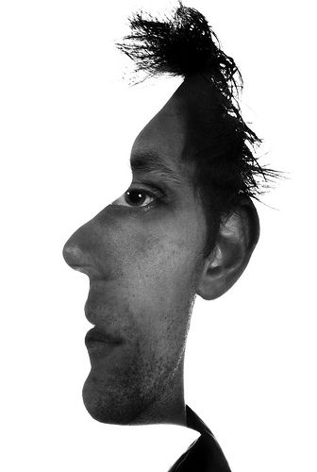
Greater and Lesser Portions
“It is a remarkable thing how two people can be seated beside one another, hear exactly the same message preached, and come away with two different conclusions…
“To one listener the presentation is as the gibberish of alien tongues; to another, as manna from heaven.”
“What is mystery to one man may not be a mystery to another”
For those who are prepared and ready for the Spirit to guide and direct them are capable of understanding the word of God
Alma 12:10 JRM and RLM

Slide 10
Held Accountable
“There is another record that will be used to judge us. The Apostle Paul taught that we ourselves are a record of our life (see Romans 2:15).
Stored in our body and mind is a complete history of everything we have done.
President John Taylor taught this truth: “[The individual] tells the story himself, and bears witness against himself. … That record that is written by the man himself in the tablets of his own mind, that record that cannot lie will in that day be unfolded before God and angels, and those who shall sit as judges”
Gospel Principles
We will be held accountable before God for our thoughts, words, and actions
Alma 12:14

Slide 11
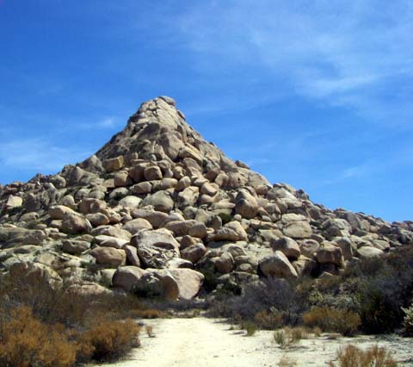
Covered By Rocks
Why do you think those who do not repent would rather be covered by rocks and mountains than stand before God?
Satan uses media to deceive you by making what is wrong and evil look normal, humorous, or exciting.
You live in a day of marvelous technologies that give you easy access to a wide variety of media
The information and entertainment provided through these media can increase your ability to learn, communicate, and become a force for good in the world. However, some information and entertainment can lead you away from righteous living.
Alma 12:14 For the Strength of Youth

Slide 12
Antionah
He was a chief ruler among the people of Ammonihah around 82 BC
He challenged Alma concerning the doctrine of immortality through the Resurrection
He rejected the word Alma taught along with the remaining leadership of the city—with the exception of Zeezrom
Who’s Who

Slide 13
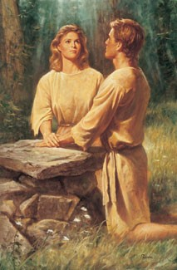
Mortal to Immortality
“God prevented Adam and Eve in Eden from partaking of the fruit of the tree of life (and thereby prevented them from living in mortality forever)…
Alma explained that God did not desire our first parents to live forever in their fallen condition, but rather made know a plan whereby they could be made ready, after a life of mortality, to enter through Christ into resurrection immortality.”
If we repent and do not harden our hearts, then we can receive a remission of our sins and enter into God’s rest
Alma 12:20-21 Seminary Manual 2013

Slide 14
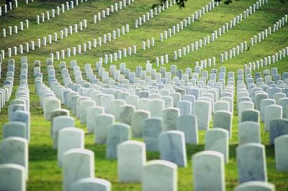
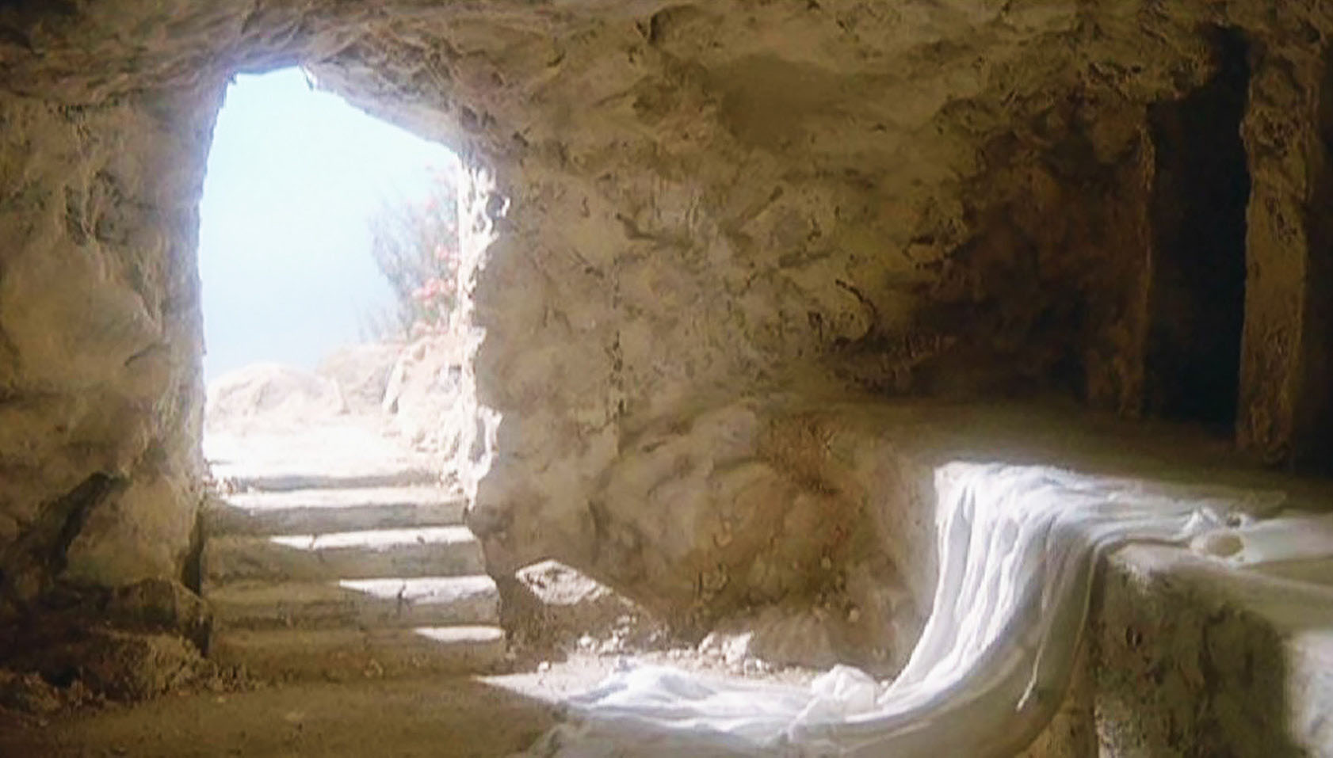
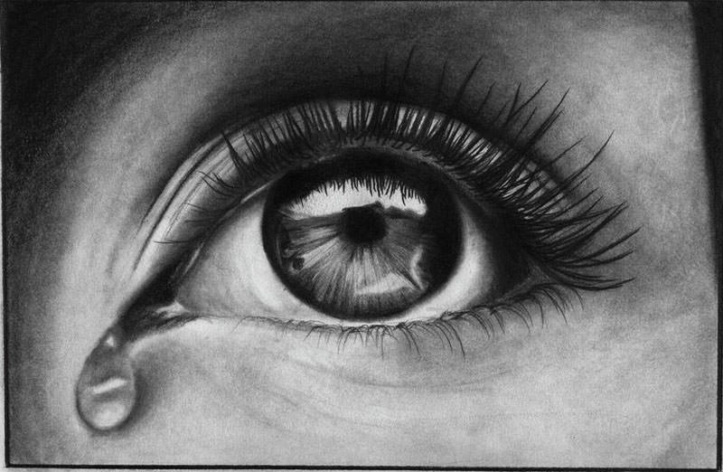
To Answer Antionah’s Questions
Effects of the Fall
Alma 12:22, 24
What God Has Done to Bring About Our Redemption
Alma 12:24-25, 28-33
What we Must Do to Be Redeemed
Alma 12:24, 30, 34, 37
Repent, and harden not your hearts having faith in the Lord and keeping all the commandments
All mankind became subject to death
The plan of salvation—the resurrection of the dead
How does the Atonement of Jesus Christ allow us to overcome the effects of the Fall?
Because of the Atonement of Jesus Christ, we will all overcome physical death through resurrection. And through the Savior’s Atonement and our repentance, we can return to God from our “lost and fallen” state.

Slide 15
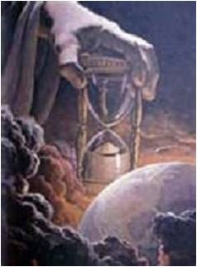
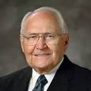
The Purpose of This Life
A probationary state--A space (time) granted in which man can repent
A time to prepare to meet God
A time to prepare for that endless state which is after resurrection of the dead
“The main purpose of earth life is to allow our spirits, which existed before the world was, to be united with our bodies for a time of great opportunity in mortality. The association of the two together has given us the privilege of growing, developing, and maturing as only we can with spirit and body united.
With our bodies, we pass through a certain amount of trial in what is termed a probationary state of our existence. This is a time of learning and testing to prove ourselves worthy of eternal opportunities. It is all part of a divine plan our Father has for His children”
Elder L. Tom Perry
Alma 12:24

Slide 16
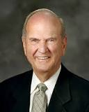
Decisions for Eternity
“The aging process is . . . a gift from God, as is death. The eventual death of your mortal body is essential to God’s great plan of happiness. Why?
Because death will allow your spirit to return home to Him. From an eternal perspective,
death is only premature for those who are not prepared to meet God.”
Elder Russell M. Nelson

Slide 17
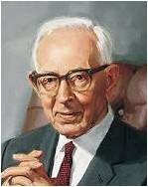
Entering Into My Rest
“A person enters into the rest of God when he enters into the personal presence of the Lord or encounters the fulness of the Glory of God. The rest of God is also that which one enters when one has lived a faithful life and is received into paradise in the postmortal spirit world.
“In the ultimate sense, to enter the rest of the Lord is to enter into what some scriptures call the Church of the Firstborn, the Church of the exalted, that organization beyond the veil whose membership is composed of those who have received the promise of eternal life.”
Joseph Fielding Smith
Alma 12:34

Slide 18
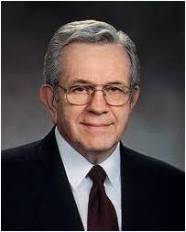
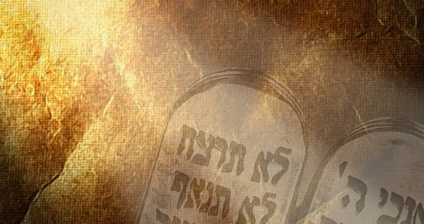
Why Keep the Commandments?
Speaking to teachers of youth:
“Young people wonder ‘why?’—Why are we commanded
to do some things, and why we are commanded not to do
other things? A knowledge of the plan of happiness, even
in outline form, can give young minds a ‘why.’ …
“Most of the difficult questions we face in the Church right now, and we could list them—abortion and all the rest of them, all of the challenges of who holds the priesthood and who does not—cannot be answered without some knowledge of the plan as a background.
“Alma said this, and this is, I think of late, my favorite scripture, although I change now and again: ‘God gave unto them commandments, after having made known unto them the plan of redemption’ (Alma 12:32; emphasis added). …
“… If you are trying to give [students] a ‘why,’ follow that pattern: ‘God gave unto them commandments, after having made known unto them the plan of redemption”
President Boyd K. Packer

Slide 19
Sources:
Elray L. Christiansen Power Over Satan Oct. 1974 General Conf.
Henry B. Eyring, “The Holy Ghost as Your Companion,” Ensign or Liahona, Nov. 2015, 104, 105
Joseph Smith Teachings pg. 181
Richard G. Scott The Transforming Power of Faith and Character Oct. 2010 Gen. Conf.
David A. Bednar (“Watching with All Perseverance,” Ensign or Liahona, May 2010, 43).
Joseph Fielding McConkie and Robert L. Millet Doctrinal Commentary on the Book of Mormon Vol. 3 pg. 83
Elder Russell M. Nelson Decisions for Eternity Oct Gen. Conf 2013
Gospel Principles Manual Chapter 46 The Final Judgment (Deseret News, Mar. 8, 1865, 179).
Who’s Who in the Book of Mormon Ed J. Pinegar and Richard J. Allen pg. 28
Elder L. Tom Perry (“Proclaim My Gospel from Land to Land,” Ensign, May 1989, 14).
President Boyd K. Packer (“The Great Plan of Happiness” [address to CES religious educators, Aug. 10, 1993], si.lds.org).
Joseph Fielding Smith Gospel Doctrine pg. 58, 126
Presentation by ©http://fashionsbylynda.com/blog/

