Slide 2
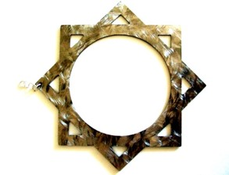
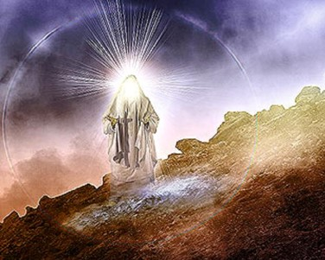
Calling High Priests
Two priesthoods:
Melchizedek and Aaronic—includes Levitical
Melchisedec—Melchizedek
The Higher Priesthood
Anciently Called:
“The Holy Order of the Son of God”
To avoid being too frequent in repetition of his name, they, the church, in ancient days, called that after Melchizedek.”
D&C 107: 1-3
JFM and RLM
Alma 13:1

Slide 3
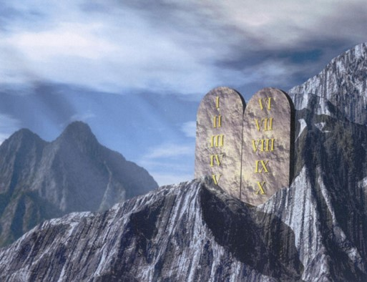
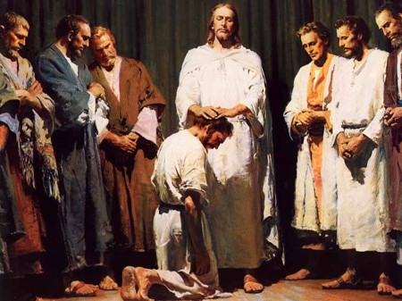
Christ—the Great High Priest
They were commissioned to teach the gospel from the time of Adam to the time of Moses
All who were ordained to the priestly office in ancient days were thought of as types or prophecies of him.
“All priesthood is Melchizedek, but there are different portions or degree of it”
Joseph Smith
Alma 13:1-2

Slide 4
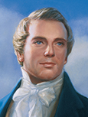
Foreordained
Priesthood holders were called and prepared before the foundation of the world because of their faith and good works
“Every man who has a calling to minister to the inhabitants of the world was ordained to that very purpose in the Grand Council of heaven before this world was. I suppose that I was ordained to this very office in that Grand Council.”
Joseph Smith
Alma 13:3

Slide 5
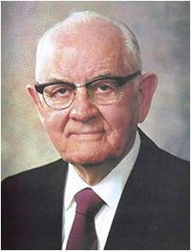
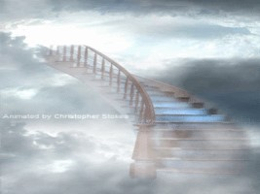
“In the world before we came here, faithful women were given certain assignments while faithful men were foreordained to certain priesthood tasks. While we do not now remember the particulars, this does not alter the glorious reality of what we once agreed to.”
Priesthood leaders teach the Lord’s commandments to the children of men so they might enter into His rest
Rest
Enjoyment of peace and freedom from worry and turmoil. The Lord has promised such rest to His faithful followers during this life. He has also prepared a place of rest for them in the next life.”
Guide to the Scriptures
Alma 13:6

Slide 6
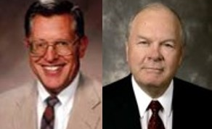
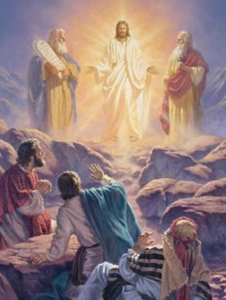
Foreordination
Called and Prepared
“As the Grand council in Heaven Christ was called and ordained to his early ministry, so were all who minister in his name first called in heavenly councils, where they too were ordained to the labors that would be theirs in mortality.”
JFM and RLM
“All prophets had the Melchizedek Priesthood and were ordained by God himself.”
Joseph Smith
No one is called to a position who is not properly prepared
Alma 13:3-9

Slide 7
Melchizedek Priesthood
When were Melchizedek Priesthood holders ﬁrst called and prepared?
(See Alma 13:3–5.)
What duty do all Melchizedek Priesthood holders have?
(See Alma 13:6.)
What phrases in Alma 13:7 describe the Melchizedek Priesthood?
What are some qualiﬁcations for being ordained to the Melchizedek Priesthood?
(See Alma 13:10.)
Alma 13:3-9

Slide 8
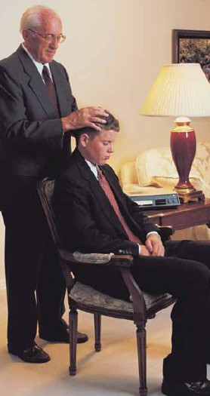
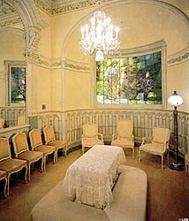
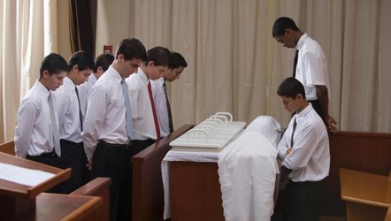
Blessings
Through the Melchizedek Priesthood:
The gift of the Holy Ghost
Patriarchal blessings and other priesthood blessings
The leadership of General Authorities and leadership of local leaders such as bishops or branch presidents.
The blessings you have received through the covenants your parents have made in the temple
Baptism
Partaking of the sacrament, which are performed by the authority of the Aaronic Priesthood but under the direction of Melchizedek Priesthood leaders.
Alma 13:3

Slide 9
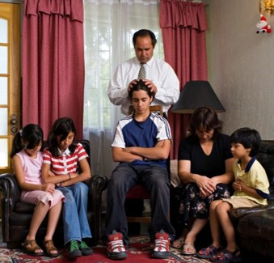
Magnify Your Callings
The High Priests chose to repent and work righteousness
“For whoso is faithful unto the obtaining these two priesthoods of which I have spoken, and the magnifying their calling, are sanctified by the Spirit unto the renewing of their bodies.”
D&C 84:33
“Men are entrusted with the priesthood so that they may serve and bless others. Through faithfulness… they sanctity their own souls…”
“Therefore, O ye that embark in the service of God, see that ye serve him with all your heart, might, mind and strength, that ye may stand blameless before God at the last day.
Therefore, if ye have desires to serve God ye are called to the work;
For behold the field is white already to harvest; and lo, he that thrusteth in his sickle with his might, the same layeth up in store that he perisheth not, but bringeth salvation to his soul;
D&C 4:2-4
Alma 13:10-11

Slide 10
Priestcraft VS Priesthood
People of Ammonihah--
Professors of Nehor:
False order of priesthood called priestcraft
Alma 14:18 and Alma 1:12-15
Blessings through Melchizedek Priesthood:
Having the spirit of prophecy
Having the spirit of revelation
The gift of speaking with tongues
The gift of preaching
The gift of the Holy Ghost
The gift of translation
Priesthood leaders help us look to Jesus Christ, repent, and live in peace
Alma 13:10-12

Slide 11
Melchizedek—A Type of Christ
He was introduced in the Book of Mormon by Alma in around 82 BC—”none were greater”
He was a King over the land of Salem
He exercised mighty faith and received the office of the high priesthood
He preached repentance to the people
The people repented and they established peace in their land
He was called the Prince of Peace
He received tithes from Abraham—He was keeper of the storehouse (JST Genesis 14:37-39)
He ordained Abraham (D&C 84:14)
He was called the king of heaven…the King of Peace
(JST Genesis 14:26-40)
Alma 13:14-19

Slide 12
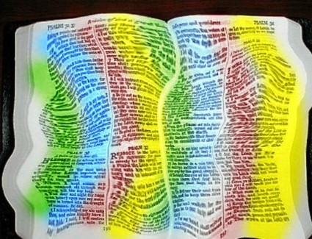
Wrest Them--Scriptures
“Some profess to accept the voice of heaven, but only after having distorted its purpose to suit their own.”
“As also in all his epistles, speaking in them of these things; in which are some things hard to be understood, which they that are unlearned and unstable wrest, as they do also the other scriptures, unto their own destruction.”
2 Peter 3:16
Those who wrest in the scriptures:
Taking what is truth and embellishing on it as fantasy
Stretching a text beyond what is meant
Not giving the text an appropriate application—meaning
Taking the plain meaning and twisting to mean something else
Picking and choosing which scripture suits yourself
"Webster states that to wrest is to 'turn or twist; to ascribe a wrong meaning or intent to; to deliberately misinterpret or distort.' The Lord warned against wresting the scriptures (D&C 10:63).
Alma 13:20

Slide 13
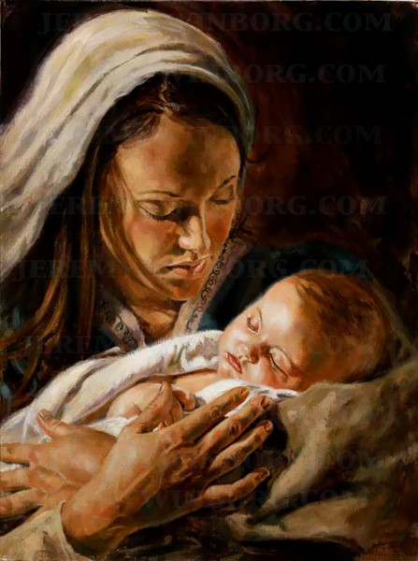
Alma Announces Christ's Birth
The Day of Salvation
Glad tidings of Great Joy
Preparation of hearts to receive the word
Joyful News
Made known to Holy Men
Prophecies being fulfilled
Jeremy Winborg
Alma 13:21-26

Slide 14
Humble
If we humble ourselves and watch and pray continually, we will not be tempted above what we are able to bear
“There is nothing wrong with feeling pleased with the results of our hard work. But it is also important to recognize God’s hand in the things we are able to accomplish…
“There is no place for arrogance in our lives,” President Hinckley stated. “There is no place for conceit. There is no place for egotism.”
Arrogance, conceit, and egotism will stifle our ability to receive personal revelation, and may also damage our relationships with others…”
Being humble not only helps us in relationships, but it also gives us the opportunity to receive direction and guidance from our Heavenly Father.
Caroline H. Benzley
Alma 13:28

Slide 15
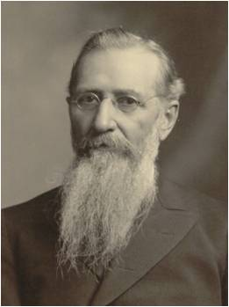
Enter Into His Rest
“The ancient prophets speak of ‘entering into God’s rest’; what does it mean?
To my mind, it means entering into the knowledge and love of God, having faith in his purpose and in his plan, to such an extent that we know we are right, and that we are not hunting for something else.”
Joseph F. Smith
As we respond humbly to the invitation to repent, the Spirit will lead us into the rest of the Lord.
“True saints enter into the rest of the Lord while in this life, and by abiding in the truth, they continue in that blessed state until they rest with the Lord in heaven. … The rest of the Lord, in eternity, is to inherit eternal life, to gain the fulness of the Lord’s glory.”
Bruce R. McConkie
Alma 13:29; Alma 12:34; D&C 84:23-24

Slide 16
Sources:
Videos:
Foreordained to Bear the Priesthood (0:33)
Ordinary Men and Women Can Be Made Pure (0:51)
Foreordination (0:41)
Joseph Fielding McConkie and Robert L. Millet Doctrinal commentary on the Book of Mormon Vol. 3 pg. 93
Joseph Smith Teachings pg. 180-181; (Teachings of Presidents of the Church: Joseph Smith [2007], 511).
President Spencer W. Kimball (Teachings of Presidents of the Church: Spencer W. Kimball[2006], 215–16).
Joseph F. Smith, Teachings of Presidents of the Church: Joseph F. Smith [1998], 56).
Caroline H. Benzley Be Humble 2002 September New Era
Bruce R. McConkie, Mormon Doctrine, 2nd ed. [1966], 633).

Slide 17
Other Quotes for Alma 13:3-5
True to the Faith includes the following explanation of foreordination:
“In the premortal spirit world, God appointed certain spirits to fulfill specific missions during their mortal lives. This is called foreordination.
“Foreordination does not guarantee that individuals will receive certain callings or responsibilities. Such opportunities come in this life as a result of the righteous exercise of agency, just as foreordination came as a result of righteousness in the premortal existence. …
“The doctrine of foreordination applies to all members of the Church, not just to the Savior and His prophets. Before the creation of the earth, faithful women were given certain responsibilities and faithful men were foreordained to certain priesthood duties. Although you do not remember that time, you surely agreed to fulfill significant tasks in the service of your Father. As you prove yourself worthy, you will be given opportunities to fulfill the assignments you then received” (True to the Faith: A Gospel Reference [2004], 69–70).
President Joseph Fielding Smith:
“God gave his children their free agency even in the [premortal] spirit world, by which the individual spirits had the privilege, just as men have here, of choosing the good and rejecting the evil, or partaking of the evil to suffer the consequences of their sins. Because of this, some even there were more faithful than others in keeping the commandments of the Lord. …
“The spirits of men had their free agency. … The spirits of men were not equal. They may have had an equal start, and we know they were all innocent in the beginning; but the right of free agency which was given to them enabled some to outstrip others, and thus, through the eons of immortal existence, to become more intelligent, more faithful, for they were free to act for themselves, to think for themselves, to receive the truth or rebel against it” (Doctrines of Salvation, comp. Bruce R. McConkie, 3 vols. [1954–56], 1:58–59).
Elder Neal A. Maxwell of the Quorum of the Twelve Apostles taught:
“Premortality is not a relaxing doctrine. For each of us, there are choices to be made, incessant and difficult chores to be done, ironies and adversities to be experienced, time to be well spent, talents and gifts to be well employed. Just because we were chosen ‘there and then,’ surely does not mean we can be indifferent ‘here and now.’ Whether foreordination for men, or foredesignation for women, those called and prepared must also prove ‘chosen, and faithful.’ (See Rev. 17:14; D&C 121:34–36)” (“Premortality, a Glorious Reality,” Ensign, Nov. 1985, 17).
President Boyd K. Packer of the Quorum of the Twelve Apostles taught:
“No more profound truth has been conveyed to us in the restoration than the knowledge of our premortal existence. No other church knows or teaches this truth. The doctrine is given only in outline form, but salient facts are repeated often enough in the revelations to assure us of certain fundamental truths.
“… The few crucial facts we know about our status in premortal life are these: ‘Man was also in the beginning with God.’ (D&C 93:29.) We lived in the presence of God, our Eternal Father; we are His offspring. Intelligence, or spirit, was organized as spirit bodies before the world was. (See Abraham 3:22.) Each of us was endowed with agency. Authority was conferred and leaders were chosen. (Alma 13:1–4.)” (Our Father’s Plan [1984], 14–15).
Wrest Alma 13:20:
"President Joseph Fielding Smith gave the following counsel regarding wresting or misinterpreting the scriptures: 'It is wrong to take one passage of scripture and isolate it from all other teachings dealing with the same subject. We should bring together all that has been said by authority on the question. If we were to make a photograph, it would be necessary for all of your rays of light to be focused properly on the subject. If this were not done then a blurred picture would be the result. This is the case when we try to obtain a mental picture, when we have only a portion of the facts dealing with the subject we are considering.' (DS 2:95.)
"The Prophet Joseph gave the key whereby scriptures are to be interpreted: 'What is the rule of interpretation?' he asked. 'Just no interpretation at all. Understand it precisely as it reads. I have a key by which I understand the scriptures. I enquire, what was the question which drew out the answer, or caused Jesus to utter the parable?' (TPJS, p. 276-7)." (Hoyt W. Brewster, Jr., Doctrine and Covenants Encyclopedia, p. 651)

