Slide 2
Recap
Zeezrom
A lawyer from the city of Ammonihah who tried to trick Alma and Amulek in the gospel words, but later became converted
Ammonihah
A city outside of Zarahemla of Nephites who were after the order of Nehor, who taught priestcraft and started his own church
Amulek
A citizen of Ammonihah who received a visitation from an angel about Alma, that he is a servant of God
Fire
Alma and Amulek watched as the faithful people of Ammonihah were burned because they believed in Alma’s words
Onties
Money offered by Zeezrom to Amulek to renounce the words of the Lord
Alma
Son of Alma and missionary to the city of Ammonihah and surrounding areas
Alma 11-14

Slide 3
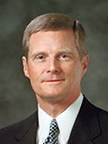
Guilt
Guilt
“Guilt is to our spirit what pain is to our body—a warning of danger and a protection from additional damage.”
David A. Bednar
What purpose does guilt serve?

Slide 4
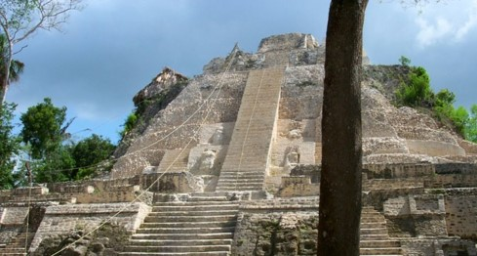
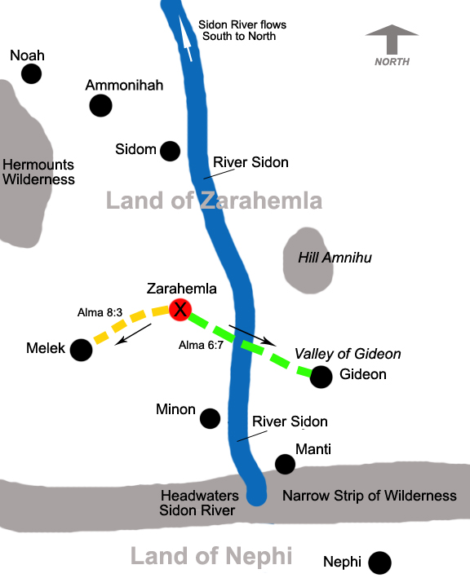
Spiritual and Physical Suffering
Zeezrom’s physical illness was the result of the guilt and torment he felt because he had committed so many serious sins.
Zeezrom and the other believers who were cast out went to Sidon
Zeezrom thought Alma and Amulek had died
Balm of Gilead:
“It is painful to be the victim. But have you not yet learned how much more painful it is to be the offender?
How precious is that spiritual balm of Gilead, for there is a spirit in man.
There are spiritual disorders and spiritual diseases that can cause intense suffering.”
Elder Boyd K. Packer
Alma 15:3-4

Slide 5
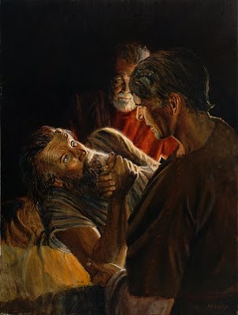
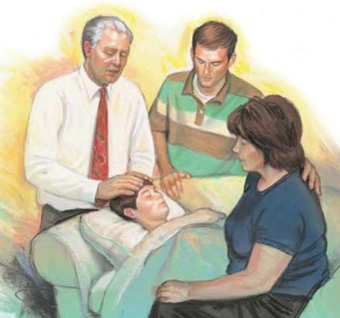
Seeking Help—Pleading Mercy
After Zeezrom finds out that Alma and Amulek are alive he desires them to come to him
Alma exercised the priesthood he held
“And then Alma cried unto the Lord, saying: O Lord our God, have mercy on this man, and heal him according to his faith which is in Christ.”
“If one has the faith to be healed physically, he has he faith by which that cleansing and healing power can work a spiritual miracle and purify him from the stains of sin.
Bruce R. McConkie
”And the prayer of faith shall save the sick, and the Lord shall raise him up; and if he have committed sins, they shall be forgiven him.”
James 5:15
Alma 15:4-10

Slide 6
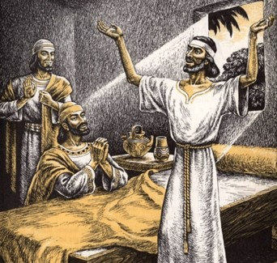
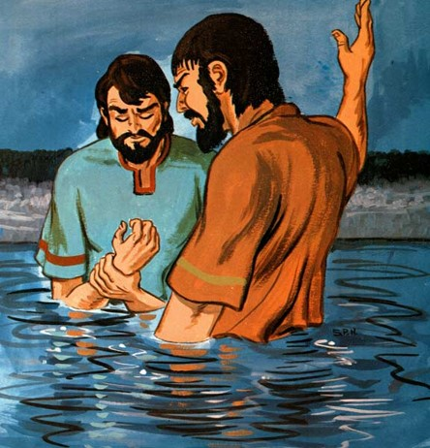
Leaped and Baptized
“Zeezrom leaped upon his feet, and began to walk; and this was done to the great astonishment of all the people; and the knowledge of this went forth throughout all the land of Sidom.”
Through our faith in Jesus Christ we can be healed
“And Alma baptized Zeezrom unto the Lord; and he began from that time forth to preach unto the people.”
Alma 15:11-12

Slide 7
“When we have faith in the Lord Jesus Christ, we must have trust in him. We must trust him enough that we are content to accept his will, knowing that he knows what is best for us. …
“… Faith, no matter how strong it is, cannot produce a result contrary to the will of him whose power it is. … We cannot have true faith in the Lord without also having complete trust in the Lord’s will and in the Lord’s timing.”
Dallin H. Oaks
If a person is not immediately healed physically, it does not necessarily mean that he or she lacks faith in Jesus Christ or is not worthy. During times such as these, individuals should continue to exercise faith in Jesus Christ, seek to do His will, and seek to learn from the experience.

Slide 8
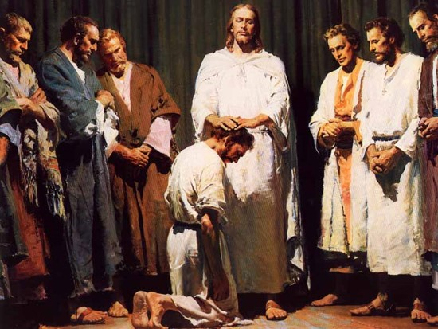
Blessings in Sidon
Alma established a church
Alma consecrated priests and teachers
Alma baptized those who were desirous
Many came from all the region and were baptized
“In our day we would say, “ordained priests and teachers.” Literally, in consecrate is to “set apart,” or to “make holy.” We note that both priests and teachers were given the authority to baptize.”
JFM and RLM
Because there were no Levites among the Nephites the priesthood was of the Melchizedek Order.
Alma 15:13-14

Slide 9
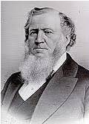
A Price to Be Paid--Sacrifice
What About Amulek?
What happened to Amulek’s wealth?
It was left in Ammonihah
What happened to his friends and family?
They rejected him
What happened to anyone he knew that believed him?
They were burned
What happened to the rest of his people?
They were destroyed by the Lamanites
“The Saints sacrifice everything; but, strictly speaking, there is no sacrifice about it. If you give a penny for a million of gold! A handful of earth for a planet! A temporary worn out tenement for one glorified, that will exist, abide, and continue to increase throughout a never ending eternity, what a sacrifice to be sure!”
Brigham Young
Alma 15:16-18

Slide 10
Administer and Strengthen
Alma makes sure Sidon is secure in their testimony and prays for them continually
“…Alma having seen all these things, therefore he took Amulek and came over to the land of Zarahemla, and took him to his own house, and did administer unto him in his tribulations, and strengthened him in the Lord.
“And thus ended the tenth year of the reign of the judges over the people of Nephi.”
Alma 15:17-19

Slide 11
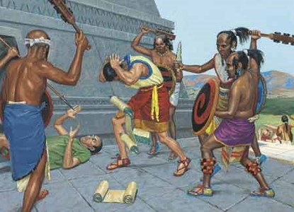
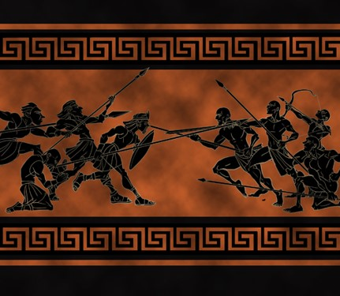
Stiffnecked People
The People of Ammonihah were hard hearted and didn’t believe in repentance
The 11th year the 2nd month and 5th day of the Reign of the Judges
The Lamanites suddenly attacked the city of Ammonihah and destroyed its inhabitants before the Nephites could raise up an army to go against them
Some Nephites were taken captive
Alma 15:15 and Alma 16:1-4

Slide 12
Zorum—the Nephite Captain
He is introduced in the Book of Mormon about 81 BC
He was the chief captain over the Nephite armies
He had two sons, Aha and Lehi
He inspired Alma to take up forces to capture the Nephites taken by the Lamanites in the land of Ammonihah
Alma, from the Lord’s command, instructed him where they could find the Lamanites
He and his two sons marched forth to engage the Lamanites
He was able to scatter the Lamanites and drove them back into the wilderness
He helped in aiding the Nephite prisoners to return to their homes
Who’s Who

Slide 13
Their Cause is Just
Alma Prays
The Lord tells Alma:
The Lamanites will cross the river Sidon in the south wilderness, away up beyond the borders of the land of Manti.
They will meet them and the Lord will deliver the captives into their hands.
The Lamanites were angry because some of the Lamanites had converted over to the Nephites
Alma 24: 17-30
Noah
Ammonihah
North
Sidon
Hill Amnihu
Zarahemla
Valley of Gideon
The words of the Lord spoken through His prophets will always be fulfilled
Melek
Minon
Headwaters Sidon River
Manti
Narrow strip of wilderness
Nephi
God allows men to fight when there is a ‘just cause’
Alma 16:6

Slide 14
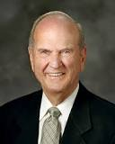
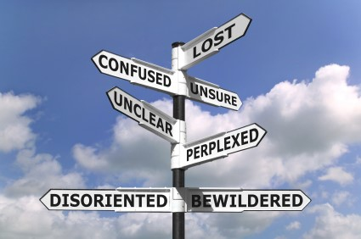
Help Line
“What if you are lost and have no map? Suppose you are alone. You do not know where you are. What can you do? You call for help! You call home! Call the Church! Pray! When connected with your help line, you learn that you need to make a climb here or a turn there to get back on course. Or you may have to go back to the beginning in order to be certain that you can get where you want to go.”
Russell M. Nelson
“Ask, and it shall be given you; seek, and ye shall find; knock, and it shall be opened unto you: for every one that asketh receiveth; and he that seeketh findeth; and to him that knocketh it shall be opened” (Matthew 7:7-8).
In order to find and receive, we must seek and ask.
As we seek and follow guidance from the Lord’s prophets, the Lord strengthens and protects us.

Slide 15
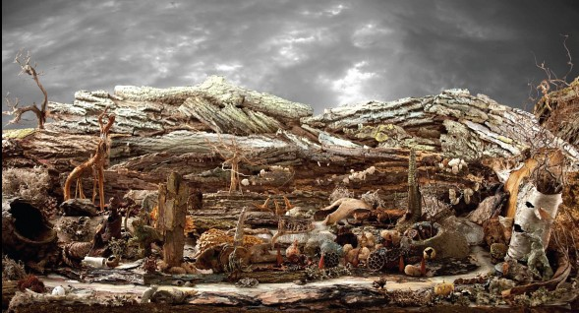
Desolation of Nephors
Lamanites driven out of the land
Every living soul of Ammonihah was destroyed (Prophecy)
The City was destroyed—even though it was a ‘great city’
“carcasses were mangled by dogs and wild beasts”
Dead bodies heaped up and covered in shallow graves
There was a stench that kept people away
The people of Nehor remained desolate
Desolation of Abomination
Alma 16:9-11

Slide 16
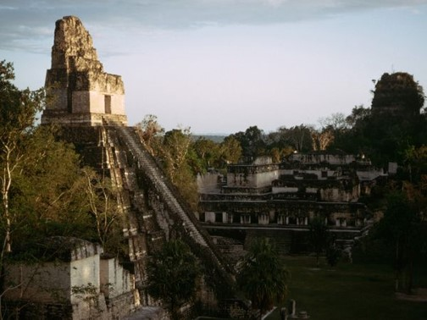
Building After the Manner of the Jews
Alma and Amulek built up their sanctuaries
A normal place for a large gathering or meeting was usually at a temple
“Wherefore I, Jacob, gave unto them these words as I taught them in the temple, having first obtained mine errand from the Lord.’
Jacob 1:17
“…I come up into the temple this day that I might declare unto you the word of God.”
Jacob 2:2
“…thereby they might gather themselves together, to go up to the temple to hear the words which his father should speak unto them.”
Mosiah 1:18
Alma 16:13

Slide 17
No Inequality—All Will Receive
The Lord poured out all his spirit on all the face of the land to prepare the minds of the children of men…to prepare their hearts to receive the word.
“As there was a spirit that went forth to prepare the way before the appearance of Christ to the Nephites, so there is a spirit that must go forth to prepare the way before his final return.”
JFM and RLM
“28 And it shall come to pass afterward, that I will pour out my spirit upon all flesh; and your sons and your daughters shall prophesy, your old men shall dream dreams, your young men shall see visions:
29 And also upon the servants and upon the handmaids in those days will I pour out my spirit.
30 And I will shew wonders in the heavens and in the earth, blood, and fire, and pillars of smoke.
31 The sun shall be turned into darkness, and the moon into blood, before the great and the terrible day of the Lord come.”
Joel 2:28-31
Alma 16:13-20

Slide 18
Sources:
Video: Zeezrom Lay Sick
David A. Bednar, “We Believe in Being Chaste,” Ensign or Liahona, May 2013, 44
Elder Boyd K. Packer Balm of Gilead October 1987 Gen. Conf
Bruce R. McConkie Doctrinal New Testament Commentary 3:275
Dallin H. Oaks, “Faith in the Lord Jesus Christ,” Ensign, May 1994, 99, 100).
Brigham Young Journal of Discourses 1:114
Who’s Who in the Book of Mormon by Ed J. Pinegar and Richard J. Allen p. 198-199
Russell M. Nelson Living by Scriptural Guidance Oct. 2000 Gen. Conf.
Joseph Fielding McConkie and Robert L. Millet Doctrinal Commentary on the Book of Mormon Vol. 3 p. 116-117, 121

Slide 19
Spiritual and Physical Disorders:
“I [once] asked a doctor of family medicine how much of his time was devoted purely to correcting physical disorders. He has a large practice, and after thoughtfully considering, he answered, ‘Not more than 20 percent. The rest of the time I seem to be working on problems that very much affect the physical well-being of my patients but do not originate in the body.
“‘These physical disorders,’ the doctor concluded, ‘are merely symptoms of some other kind of trouble.’
“In recent generations one after another of the major diseases has yielded to control or cure. Some very major ones still remain, but we now seem able to do something about most of them.
“There is another part of us, not so tangible, but quite as real as our physical body. This intangible part of us is described as mind, emotion, intellect, temperament, and many other things. Very seldom is it described as spiritual.
“But there is a spirit in man; to ignore it is to ignore reality. There are spiritual disorders, too, and spiritual diseases that can cause intense suffering.
“The body and the spirit of man are bound together” (Boyd K. Packer, “The Balm of Gilead,” Ensign, Nov. 1977, 59).

