Slide 2
The Meeting—14 years later
While Alma was on his way to Manti from the land of Gideon he met up with the sons of Mosiah
Ammonihah
North
Sidon
Hill Amnihu
Zarahemla
Melek
Minon
Valley of Gideon
Manti
Narrow strip of wilderness
Nephi
Ammon, Aaron, Himni, Omner,
“…sons of Mosiah were with Alma at the time the angel first appeared unto him…”
Alma 17:1-2

Slide 3
Wax Strong in the Knowledge of Truth
They were men of sound understanding by searching the scriptures
“But this is not all; they had given themselves to much prayer, and fasting; therefore they had the spirit of prophecy, and the spirit of revelation, and when they taught, they taught with power and authority of God.”
If we search the scriptures diligently, we will wax strong in the knowledge of the truth and know the word of God
Alma 17:2-3

Slide 4
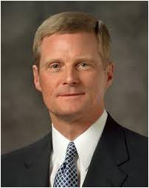
To Prepare for a Mission
How can I prepare for a Mission?
“You can increase in your desire to serve God (see D&C 4:3), and you can begin to think as missionaries think, to read what missionaries read, to pray as missionaries pray, and to feel what missionaries feel.
You can avoid the worldly influences that cause the Holy Ghost to withdraw, and you can grow in confidence in recognizing and responding to spiritual promptings.
Line upon line and precept upon precept, here a little and there a little, you can gradually become the missionary you hope to be and the missionary the Savior expects. …
“The preparation I am describing is not oriented only toward your missionary service as a (18) 19- or 20- or 21-year-old. … You are preparing for a lifetime of missionary work. … We are missionaries always”
Elder David A. Bednar

Slide 5
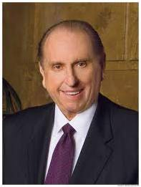
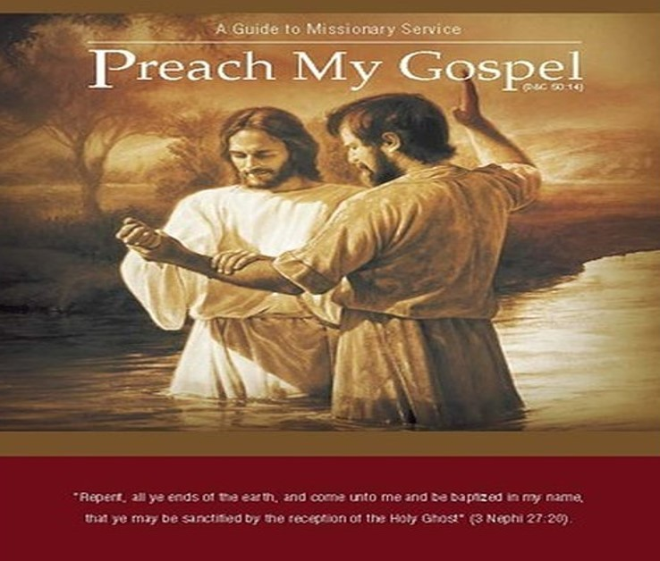
As we pray and fast, we can receive the spirit of prophecy and revelation and teach with power.
“To young men of the Aaronic Priesthood and to you young men who are becoming elders: I repeat what prophets have long taught—that every worthy, able young man should prepare to serve a mission. Missionary service is a priesthood duty—an obligation the Lord expects of us who have been given so very much.
Young men, I admonish you to prepare for service as a missionary. Keep yourselves clean and pure and worthy to represent the Lord.
Maintain your health and strength. Study the scriptures. Where such is available, participate in seminary or institute. Familiarize yourself with the missionary handbook Preach My Gospel.
“A word to you young sisters: while you do not have the same priesthood responsibility as do the young men to serve as full-time missionaries, you also make a valuable contribution as missionaries, and we welcome your service.”
President Thomas S. Monson

Slide 6
Instrument in the Hands of God
Setting a Good Example
The Sons of Mosiah:
Men of sound understanding
They had given themselves to much prayer and fasting
They had the spirit of prophecy and revelation
They taught with power and authority
Many were brought before the altar of God—including the Anti-Lehi-Nephites
Labored in the spirit—suffered much
“The soul that has borne no burden knows no strength”
JFM and RLM
When we are patient in our afflictions, we can serve as good examples to those around us and become instruments in the Lord’s hands
Alma 17:2-5, 11

Slide 7
Their Story—1st year of the Reign of Judges
They left their father for a mission to the land of Nephi
A place where the people hated the Nephites
“Often our sincere love for people and our good example can do more to interest them in the gospel than what we might say.”
Student Manual
They knew they would face afflictions and persecution.
The Lord visited them and comforted them
Alma 17:9-12

Slide 8
The Lamanites
From the time Nephi and his people separated themselves and their families from Laman and Lemuel, the Lamanites fell deeper and deeper into darkness
Nephi reports:
“an idle people, full of mischief and subtlety” (2 Nephi 5:24)
Enos reports:
“they became wild, and ferocious, and a bloodthirsty people, full of idolatry and filthiness”
(Enos 1:20)
“loved murder and would drink the blood of beasts”
(Jarom 6)
Mormon’s Statement about the Sons of Mosiah:
“… for they had undertaken to preach the word of God to a wild and a hardened and ferocious people.” (Alma 17:14)
Alma 17: 13-16 and Student Manual

Slide 9
Separated themselves
North
Zarahemla
Nephi
Ammon went to the Land of Ishmael
Land of Ishmael
Customs of the Lamanites:
To bind strangers
To carry before the king
If the king so wished he would have them killed or taken into captivity and put in prison
Alma 17:19-20

Slide 10
King Lamoni
He was a descent of Ishmael—the one who journeyed with Lehi and his family
He was the King of the Land of Ishmael
He is introduced in the Book of Mormon around 91 BC
Ammon having been bound and taken captive was brought before Lamoni and he was pleased with Ammon and released him from the bands
Ammon became his servant and watched over his flocks
Ammon teaches him about the plan of salvation and he is overcome by the spirit and fell into a stupor for 2 days and 2 nights
After he arose he testified to his wife of the coming Messiah (Alma 19:13)
The royal household and others were converted along with him, and the church was established in that part of the land
Who’s Who

Slide 11
Brought Before the King
Ammon was bound and carried before King Lamoni
Ammon said he wanted to dwell with them for awhile or all his days
The King wanted Ammon to marry one of his daughters
Ammon wanted to be the King’s servant
Custom: Ammon went with the other servants to watch over the King’s flocks
Alma 17:21-25

Slide 12
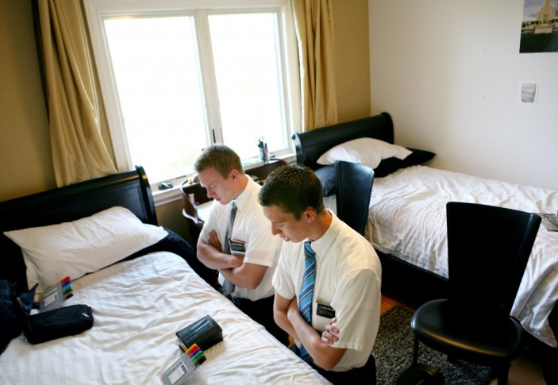
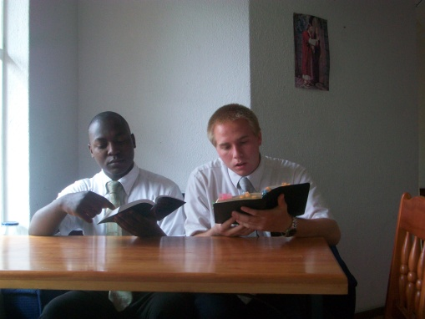
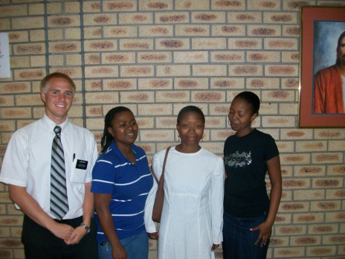
Service Before Preaching
“It appears that Ammon wanted to win the King’s confidence through first serving him.
What do you suppose might have happened if Ammon had immediately called the king to repentance?
Ammon had faith that an opportunity would arise for him to demonstrate the power of God that was within him.”
Student Manual
Preparation
Preparing Spiritually to testify of Christ
Gaining a love for those whom you teach
Being patient with your approach of the gospel and all it has to offer—some people can jump right in and grasp the gospel, others need a slower approach—step by step

Slide 13
Watching the Flocks
Ammon and other servants drove the flocks to the water—Waters of Sebus
Some Lamanites would come and scatter the flocks
Alma 17:26-27

Slide 14
Fearful Servants
The servants were afraid that the king would slay them for losing the flocks
They went and searched for the flocks, then gathered them back to the water
Alma 17:28-32

Slide 15
Rescue
They gathered them back to the water
Ammon told the servants to encircle the flocks and he would take care of the Lamanites who came to scatter the flocks
Alma 17:33-34

Slide 16
Stone Throwing
The Lamanites did not fear Ammon
They also had stones but could not hit Ammon
Ammon threw stones at them
Alma 17:35

Slide 17
Taking Arms
They lifted their clubs to smite Ammon
But Ammon smote off their arms
After Ammon had taken many arms they fled
Alma 17:35-38

Slide 18
Returning to the King
Ammon returned to the watering hole
The servants returned to the king to testify of all that happened
Alma 17:39

Slide 19
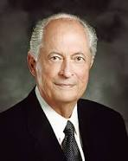
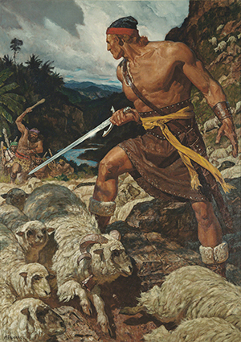
“Now, we may read this as a story about some shepherds trying to round up some missing sheep, but the message is much more powerful and significant than that.
Ammon was a missionary with noble intentions to bring the king and his kingdom back to the fold of righteousness, to the well of living water. The challenge looked daunting to those who could see only, in everyday terms, sheep strung out on hillsides and not enough manpower to round them up. They were discouraged and fearful that the king would discover their loss.
Ammon not only led the force to recapture the sheep, he drove away the evil men who caused the problems; and his heroic efforts persuaded the king to follow him and to follow the Savior.
Ammon teaches us that no matter our circumstances, we can be an example to others, we can lift them, we can inspire them to seek righteousness, and we can bear testimony to all of the power of Jesus Christ.”
Elder Robert D. Hales
Through service, we can help others prepare to accept the gospel.

Slide 20
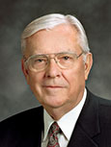
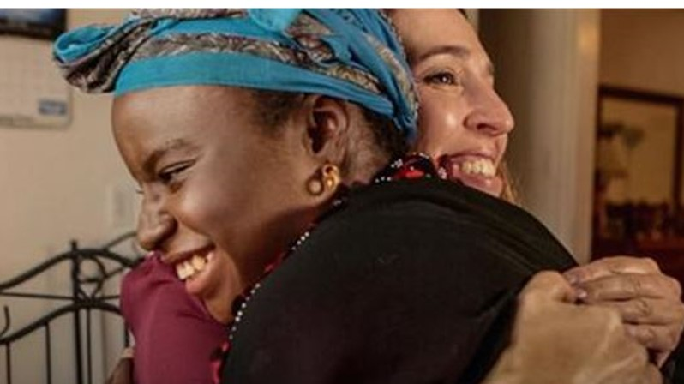
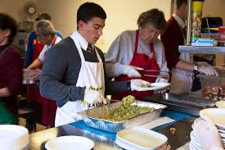
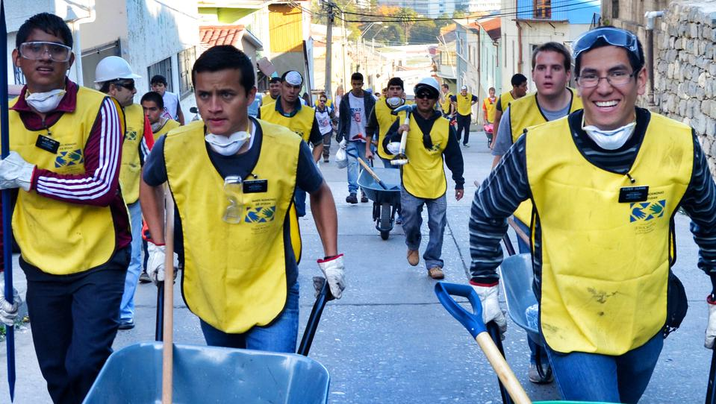
Through service, we can help others prepare to accept the gospel.
“As a pure expression of our love and concern, we can reach out to those who have need of our help. … There are countless ways to serve.
“Through our heartfelt kindness and service, we can make friends with those whom we serve. From these friendships come better understanding of our devotion to the gospel and a desire to learn more about us. …
“When we do this, brothers and sisters, the honest in heart will feel our sincerity and our love. Many will want to know more about us. …
“In all of our service, we need to be sensitive to the promptings of the Holy Ghost. The still, small voice will let us know who needs our help and what we can do to help them.”
M. Russell Ballard

Slide 21
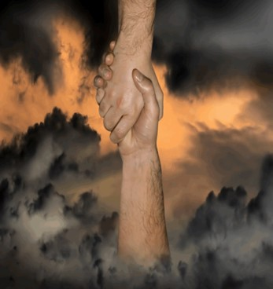
A Rescue
What are some dangers we have around us that we would need rescuing from?
Illegal drugs, alcohol, cigarettes, etc.
Pornography
Immorality
Immodest dress
Inappropriate language
Who Are Our Ammon’s of Today?
Our Parents
Bishops and Leaders
Teachers and Neighbors
Prophets
What can we do to be rescued?
Obedience to our parents
Studying scriptures and applying them in our daily lives
Listening to the Prophets and their council
Also By Using the Atonement

Slide 22
Sources:
Video:
Search the Scriptures
Elder David A. Bednar (“Becoming a Missionary,” 46).
Joseph Fielding McConkie and Robert L. Millet Doctrinal Commentary on the Book of Mormon Vol. 3 pg. 125
Student Manual Book of Mormon Religion 121-122 pg. 245-246
President Thomas S. Monson (“As We Meet Together Again,” Ensign or Liahona, Nov. 2010, 5–6).
Who’s Who in the Book of Mormon Ed J. Pinegar and Richard J. Allen pg 104-105
Elder Robert D. Hales “When Thou Art Converted, Strengthen Thy Brethren May 1997 Ensign
M. Russell Ballard, “Finding Joy through Loving Service,” Ensign or Liahona, May 2011, 48
Presentation by ©http://fashionsbylynda.com/blog/

Slide 23
7 tips for sister missionaries
The time between when a young woman decides to go on a mission for The Church of Jesus Christ of Latter-day Saints to the day she enters the Missionary Training Center is filled with much to do. It can be difficult to determine what is necessary versus what can slide. Here are some things prospective sister missionaries should consider doing (as many wish they’d done) before entering the MTC.
1. It’s time to go shopping. If you’re leaving for a mission in the summer or spring, you might have a difficult time finding proper clothing for the full 18 months. A salesperson laughed at one sister when she asked the clerk where the long skirts were in June. You need to purchase a basic year-round wardrobe since you might not have access to clothing stores once out on the mission.
Pay attention to materials sent from the LDS Church's Missionary Department or mission president and his wife (or contact your mission president’s wife, if possible) about what to wear, as some standards can change from mission to mission. For instance, in one mission the sisters wore skirts just below the knee, but in another most of the sisters were on bikes and ankle-length skirts were easier to wrap around a bike bar.
Weather can also factor into what you need. Those nice business jackets and fitted skirts don’t come out often if you’re in the jungles of South America, but will be necessary if you’re at a visitor's center. For wherever you go, make sure you get a decent pair of comfortable dress walking shoes.
2. Buy church-approved music you like. Those two Especially for Youth CDs you got for your 14th birthday are going to grind on you after 18 months of nothing but. Do pay attention to music that has been approved for missionaries in your mission.
3. Research your mission. Talk to those who have gone there, read the information sent to you about your mission, contact your mission president (if possible) and learn about the local customs. A mission experience varies drastically from one mission to another and even from mission president to president.
4. Start an exercise routine. A Mormon mission is physically taxing and the more fit you are now, the easier the transition will be. Many sisters (and elders) spend the first few months of their mission in pain because they’re sore from going from Internet surfer to constant biker or walker.
5. Step up studying of your scriptures and other doctrine. A mission can be very spiritually fulfilling, but there needs to a very strong foundation for it. Every day people are going to be challenging your beliefs. You need to be strengthening your testimony because in the mission field it’s going to get torn down. Many skip this important step because they think that in a few months they will be studying nonstop so it doesn’t matter. But your testimony will come under fire, and if you’re not prepared it will be much like not exercising, you will be spiritually sore for a while.
6. Develop an after-your-mission plan so you don’t wallow when you come home. If you’re in school, talk to your professors and administrators to determine what you’ll need to do to get re-enrolled. (While on their missions, some sisters received special permission to go online and register for the semester after they came home.) Talk to your employer about your work options. Will you have a job when you get home?
If you’re going to be seeking employment or enrollment in different place, get the necessary recommendations and references in order before you leave, since a year and a half can make it more difficult for people to remember you.
7. Before you leave, do some of the things you love that you won’t be able to for the next 18 months. Maybe you love to travel, so take a weekend getaway before your mission. Or maybe you'd rather spend an evening reading your favorite book one last time before you leave. I went white-water rafting the weekend before I went into the MTC. My only warning is to keep it within reason, so it's not too difficult to walk away from and not something that will bring about unnecessary injuries.
Melissa Dymock is the author of "Sisters: A Modern Girl’s Guide to Serving a Mission" published by Covenant Communications.
April 12, 2012 Desert News

Slide 24
How did Ammon Prepare for a Mission?
Alma 17:25 | Ammon Meets the king and asks to be his servant
Alma 17:29 | Ammon wants to win the hearts of his fellow-servants
Alma 18:3 | Ammon’s actions show he is a friend to the king
Alma 18:9 | Ammon feeds the King’s horses
Alma 18:9 | Ammon Prepares the chariots
Alma 18:14 | Ammon asks the king what he would have him do, and what he desires to know
Alma 18:24 | Ammon is now prepared to teach
“Don’t Miss This in the Book of Mormon” by Emily Belle Freeman and David Butler

Slide 25
“They Taught and Did Minister One to Another”
James M. Paramore
April 1986 Gen. Conf
Ammon Prepared for a Mission
The desire of his heart was to bring people to God.
He was always a servant, a minister. He was out among the people.
He prepared himself by fasting, studying the scriptures, and prayer.
He went forth believing he could make a difference with the help of God.
He anxiously looked for every possible opportunity to serve.
He kept all of the commandments.
As a result of doing all of these things, he taught with power and authority and established the Church of God.

