Slide 2
Recap—True or False
1. Because King Lamoni was pleased with Ammon, he offered one of his daughters to be Ammon’s wife.
(See Alma 17:24.)
2. Ammon said that he wanted to be the king’s servant. (See Alma 17:25.)
3. Ammon feared for his life when a group of Lamanites scattered the flocks of the king.
(See Alma 17:28–30.)
4. With great power, Ammon fought off the Lamanites and cut off the arms of those who raised their clubs against him.
( See Alma 17:37–38.)
5. Ammon returned to King Lamoni with the arms of the Lamanites (See Alma 17:39, Alma 18:8)
True False
True False
True False
True False
True False

Slide 3
Use Reader’s Theater for Alma 18:1-35
Alma 18
1-35
King Lamoni is Converted

Slide 4
Questions
Why do you think Lamoni was silent before Ammon?
Lamoni had become fearful because of the murders he had committed and that he was worried that Ammon was the Great Spirit and had come to punish him
What ideas did the king and his servants have about Ammon’s identity?
That he was a great man with strength, or a Great Spirit that was taught to them by their fathers
What did Lamoni think Ammon’s purpose was in coming?
To punish the people because of their murders and to prevent Lamoni from slaying more of his servants
What impressed Lamoni besides the power Ammon demonstrated in defending the flocks?
His faithfulness

Slide 5
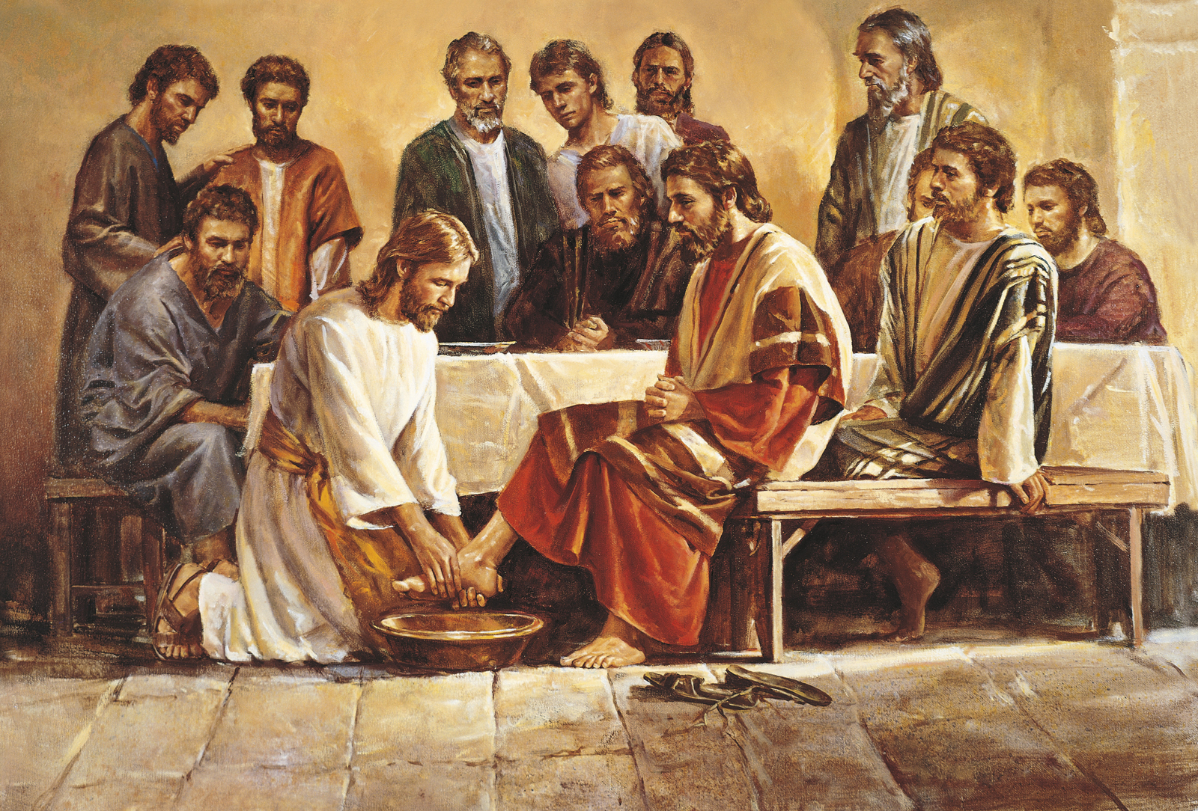
As we serve others faithfully, we can help them prepare to receive the truths of the gospel
As we serve Heavenly Father and Jesus Christ faithfully, our ability to do Their work increases

Slide 6
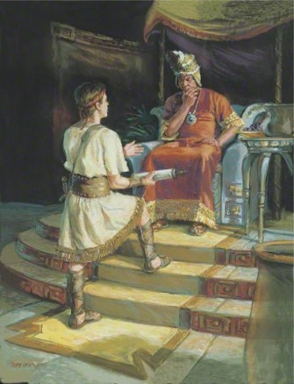
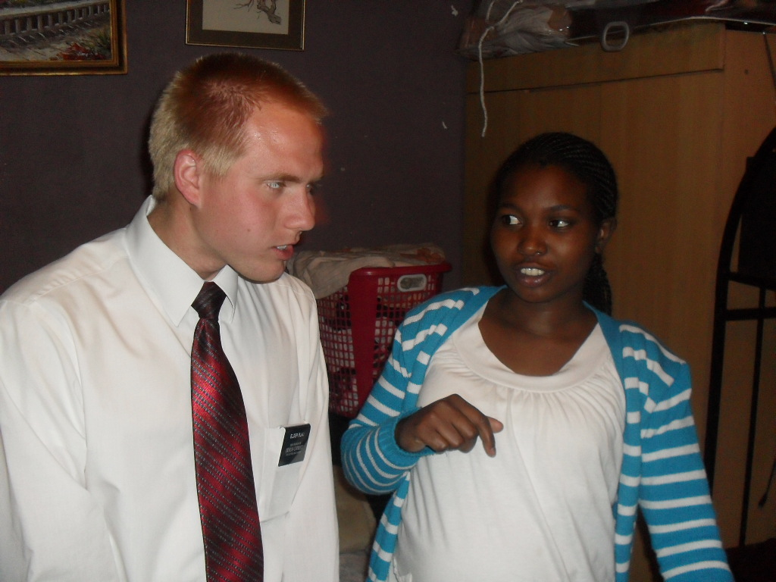
Starting At the Beginning
Alma begins by teaching Lamoni from the very beginning usually as all missionaries do when teaching a new investigator

Slide 7
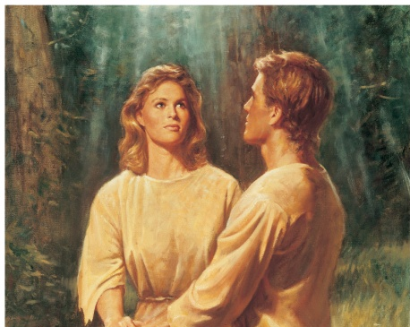
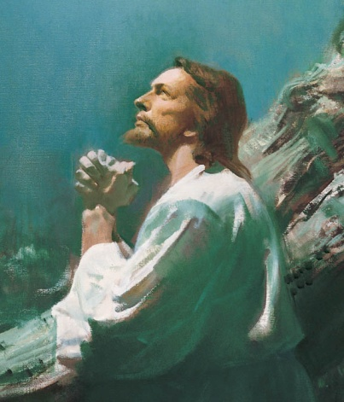
Ammon Teaches Lamoni
Creation of the Earth
“Before we can comprehend the Atonement of Christ, … we must first understand the Fall of Adam. And before we can understand the Fall of Adam, we must first understand the Creation.”
The Plan of Salvation
The Fall of Adam and Eve
“The Creation required the Fall. The Fall required the Atonement. The Atonement enabled the purpose of the Creation to be accomplished. Eternal life, made possible by the Atonement, is the supreme purpose of the Creation.”
The Atonement of Christ
Alma 18:36-39
Russell M. Nelson

Slide 8
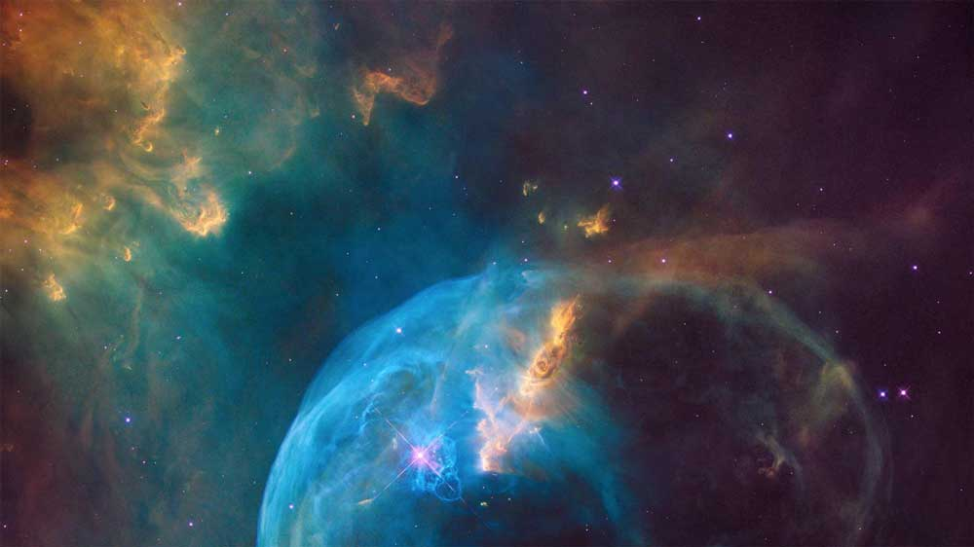
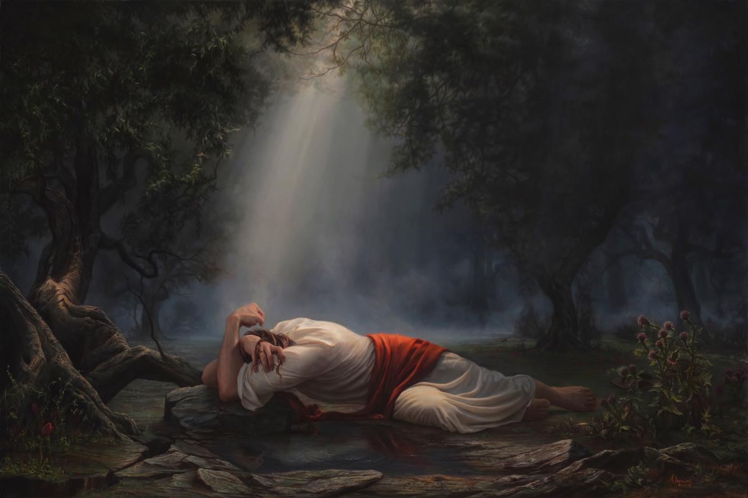
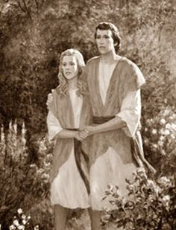
“…Foundational doctrines—the Creation, the Fall, and the Atonement—the “three pillars of eternity” and the “greatest events that have ever occurred in all eternity.”
“If we can gain an understanding of them, then the whole eternal scheme of things will fall into place, and we will be in a position to work out our salvation. …
“… These three are the foundations upon which all things rest. Without any one of them all things would lose their purpose and meaning, and the plans and designs of Deity would come to naught”
Elder Bruce R. McConkie

Slide 9
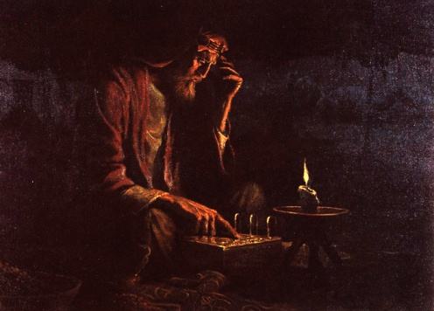
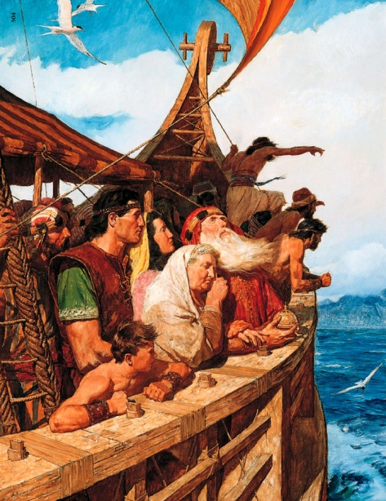
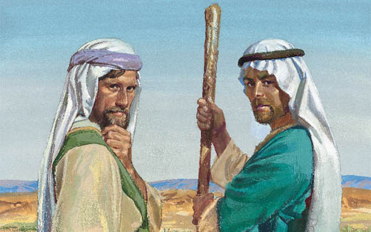
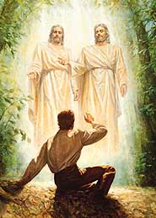
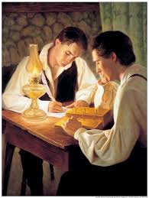
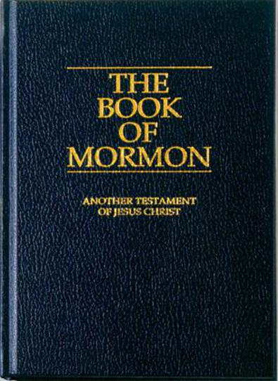
Ammon Teaches the Past
With records of:
Lehi leaving Jerusalem and journeying in the wilderness
The rebellion of Laman and Lemuel and the sons of Ishmael
Where do we start to teach about the gospel?
From our records:
Witness of Joseph Smith
The restoration of the Church
Alma 18:36-39

Slide 10
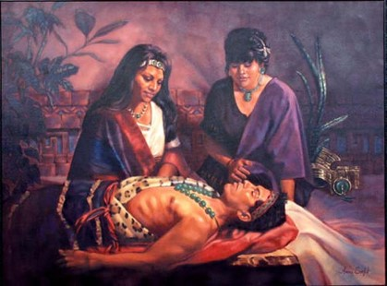
Lamoni’s Cry
O Lord, have mercy; according to thy abundant mercy which thou hast had upon the people of Nephi, have upon me, and my people.
As we understand our need for the Savior, we will desire to repent
Lamoni fell to the earth, as if dead
His servants carried him in unto his wife and he lay as if dead for 2 days and 2 nights—great mourning
Alma 18:40-42

Slide 11
Sources:
Videos:
Ammon Teaches King Lamoni (1:32)
Sharing the Gospel (1:30)
Sharing the Gospel: Immokalee (2:45)
Elder Russell M. Nelson (“The Atonement,” Ensign, Nov. 1996, 33, 35). (“The Creation,” Ensign, May 2000, 84).
Elder Bruce R. McConkie (“The Three Pillars of Eternity” [Brigham Young University devotional address, Feb. 17, 1981], 1, speeches.byu.edu).
Horses: BYU Education
https://byustudies.byu.edu/content/hard-evidence-ancient-american-horses
Presentation by ©http://fashionsbylynda.com/blog/

Slide 12
Alma 18:36-39:
“The plan required the Creation, and that in turn required both the Fall and the Atonement. These are the three fundamental components of the plan. The creation of a paradisiacal planet came from God. Mortality and death came into the world through the Fall of Adam [see 2 Nephi 2:25; Moses 6:48; Joseph Smith Translation, Genesis 6:49]. Immortality and the possibility of eternal life were provided by the Atonement of Jesus Christ [see 2 Nephi 2:21–28]. The Creation, the Fall, and the Atonement were planned long before the actual work of the Creation began” (Russell M. Nelson, “The Creation,” Ensign, May 2000, 84). Russell M. Nelson
Alma 18:40-42:
Repentance exists as an option only because of the Atonement of Jesus Christ. It is His infinite sacrifice that “bringeth about means unto men that they may have faith unto repentance” (Alma 34:15). Repentance is the necessary condition, and the grace of Christ is the power by which “mercy can satisfy the demands of justice” (Alma 34:16). Our witness is this:
“We know that justification [or forgiveness of sins] through the grace of our Lord and Savior Jesus Christ is just and true;
“And we know also, that sanctification [or purification from the effects of sin] through the grace of our Lord and Savior Jesus Christ is just and true, to all those who love and serve God with all their mights, minds, and strength” (D&C 20:30–31).
…the invitation to repent is an expression of love. When the Savior “began to preach, and to say, Repent: for the kingdom of heaven is at hand” (Matthew 4:17), it was a message of love, inviting all who would to qualify to join Him “and enjoy the words of eternal life in this world, and eternal life [itself] in the world to come” (Moses 6:59). If we do not invite others to change or if we do not demand repentance of ourselves, we fail in a fundamental duty we owe to one another and to ourselves…
…repentance means striving to change. It would mock the Savior’s suffering in the Garden of Gethsemane and on the cross for us to expect that He should transform us into angelic beings with no real effort on our part..
Real repentance, real change may require repeated attempts, but there is something refining and holy in such striving…
Repentance means not only abandoning sin but also committing to obedience…
Repentance requires a seriousness of purpose and a willingness to persevere, even through pain…
…resolve to abandon and forsake the sin and to repair, as fully as one possibly can, the damage he or she has caused now forms in that new heart. This resolve soon matures into a covenant of obedience to God. With that covenant in place, the Holy Ghost, the messenger of divine grace, will bring relief and forgiveness…
Whatever the cost of repentance, it is swallowed up in the joy of forgiveness.
October 2011 Gen. Conf. The Divine Gift of Repentance
D. Todd Christofferson

Slide 13
Something of Interest in the next 6 slides
Alma 18:9 Horses and Chariots:
Alma 18:9 states that "the king had commanded his servants . . . that they should prepare his horses and chariots, and conduct him forth to the land of Nephi." Two major questions have been raised by anti-LDS critics of the Book of Mormon concerning the statement that there were "horses and chariots" on the American continents before the time of Christ (see Alma 18:9). These critics have maintained that:
(1) no horses existed on the American continents before the time of Columbus; and
(2) the people who lived on the American continents did not know the principle of the wheel before the coming of Columbus.
However, since the publication of the Book of Mormon, considerable archaeological evidence has come forth to reinforce its claims that there were horses on the American continents before the time of Columbus and that these early peoples did know the principles of the wheel. [Daniel H. Ludlow, A Companion to Your Study of the Book of Mormon, p. 206] [See the commentary on Enos 1:21; 3 Nephi 3:22; Ether 9:19]

Slide 14
Alma 18:9 Horses:
In Alma 18:9, mention is made of "horses." According to Diane Wirth, the extinction of the horse in Mesoamerica before the coming of the Spanish Conquistadors can be likened to the near-extinction of the bison in the early west. An additional example of extinction can be found in the Bible. There are many references to lions in the Bible, yet the last Palestinian lion of record was killed in a hunt around A.D. 1100. Today there are no so-called archaeological remains of lions in the land of Israel. Apparently not a bone has been left. Therefore, a lack of skeletal remains of an animal in a particular area does not necessarily mean that the animal was never there.
Several curious artifacts and bas-reliefs in Mesoamerican art portray four-legged animals. At Chichen Itza, on the Yucatan Peninsula, for example, there is a bas-relief of a bearded man, who stands alongside what appears to be a horse. Although there are those who claim this is a dog, when has anyone seen a Mexican dog almost tall enough to reach a man's shoulder--even a short man? It appears more reasonable that this "dog" is a small breed of horse. Robert Marx claims to have found frescoes of horses at a site near Chichen Itza of "horses grazing, frolicking and running, some mounted with riders." [Diane E. Wirth, A Challenge to the Critics, pp. 53, 56] See the commentary on Enos 1:21; 3 Nephi 3:22; Ether 9:19]

Slide 15
According to Hunter and Ferguson, the claim made by the Book of Mormon that horses were on this continent and used in ancient America for purposes similar to the uses we make of them today finds strong support in the numerous fossil remains of horses that have been obtained from the asphalt deposits of Rancho La Brea in southern California. Of course, it is claimed that those fossil remains pre-date Book of Mormon times. However, there is no logical reason for believing, since horses were here prior to the arrival of the Jaredites and the Nephites, that horses could not have still been in America during the period in which those ancient civilizations flourished. . . . We could do no better at this point in dealing with this subject than to quote from an official publication of the Los Angeles County Museum on the subject of the existence of horses in early times in America:
The presence of herds of horses in the vicinity of the asphalt deposits during the period of accumulation is clearly testified to by the numerous remains of these mammals found at Rancho La Brea. While many individuals are recorded in the collections, all of them belong to a single species, the extinct western horse (Equus occidentalis Leidy). In stage of evolution and in general body structure this type resembles the modern horse, although differing from it in a number of specific details. Standing on the average about 14 1/2 hands (4 feet, 10 inches) at the withers, this animal was of the height of a modern Arab horse. It was, however, of considerably heavier build . . .
Horses were among the more common types of hoofed mammals on the North American continent during Pleistocene time and several distinct species have been described from fossil remains. The abundance and widespread distribution of horses in North America make the apparent disappearance of the group in this region prior to the advent of the white man an added and an unusual feature of their long and eventful career.
[Milton R. Hunter and Thomas Stuart Ferguson, Ancient America and The Book of Mormon, pp. 312-313] See the commentary on Enos 1:21; 3 Nephi 3:22; Ether 9:19]

Slide 16
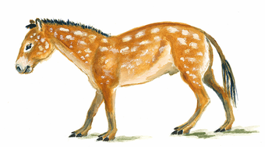
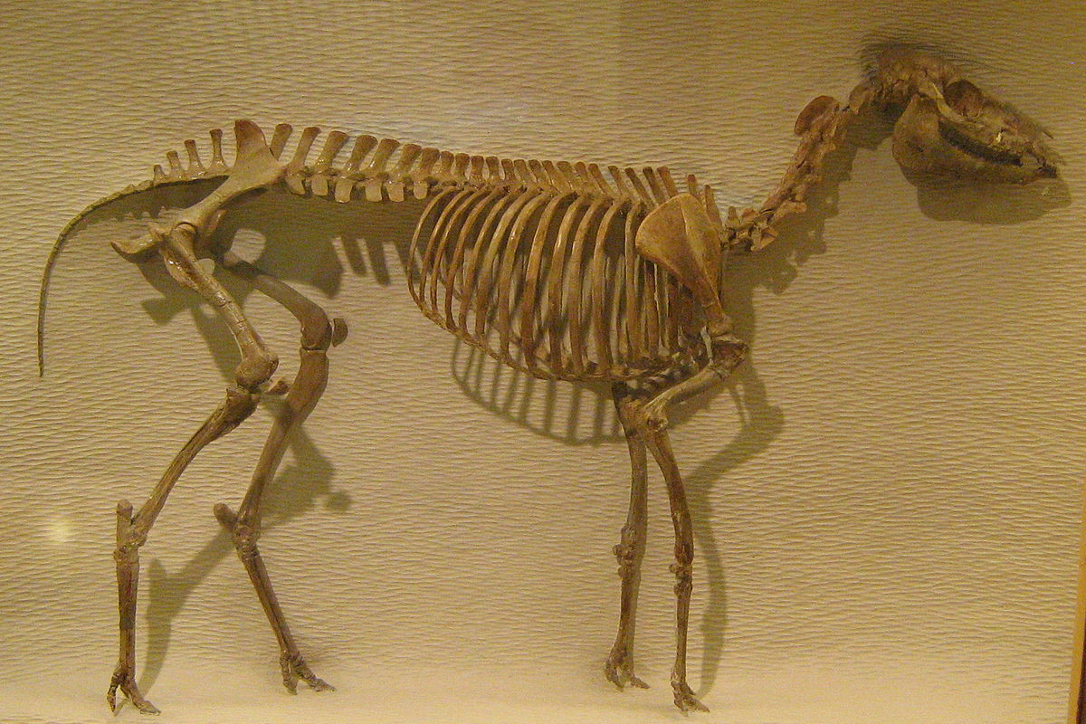
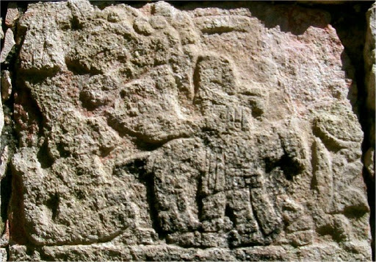
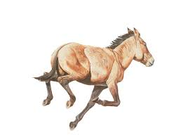
Mesohippus: American 3-toed horse
Eohippus: American 4-toed horse.
Carving of horse from the south wall of the Temple of the Tablets, Chichen Itza, Mexico.
American modern horse from La Brea tar pit
Most historians claim that all Indian ponies descended from European horses brought to America by the Spanish--but note the great difference in size as indicated by the level of the rider's feet. Not even evolutionists claim such a great change in a mere 350 years. [Glenn A. Scott, Voices from the Dust, p. 88]

Slide 17
According to Verneil Simmons, we have no idea what these "chariots" looked like. They could have been two-wheeled carts or even flatbed bodies on four wheels which would have been practical for moving their goods. The toys come in two-wheeled and four-wheeled models and indicate that both types were possible. Since we assume they would have been constructed of wood, it is unlikely that no evidence would survive until today. [Verneil W. Simmons, Peoples, Places And Prophecies, pp. 134-135]
Verneil Simmons also writes about an interesting phenomenon of archaeological "scholarship." He comments that until very recently, almost the first thing one read in a textbook or was told in the classroom was the supposed fact that the principle of the wheel was unknown to the ancient inhabitants of this continent. . . . However, as excavations increased more wheeled toys were found in the state of Veracruz and in other areas of Mexico. Eventually the cumulative evidence reached the point that the books had to be rewritten and public confession made that the wheeled toys had been hidden in museum storage rooms for decades (because it was a well known fact that the principle of the wheel was unknown in ancient America!). [Verneil W. Simmons, Peoples, Places and Prophecies, p. 134]

Slide 18
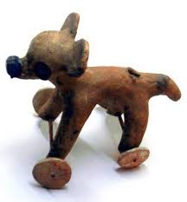
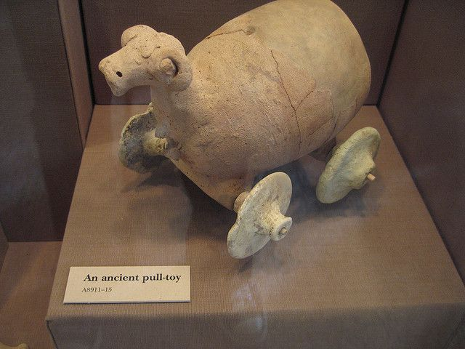
Ancient Mesopotamia
Not only did the wheel represent the sun, but the commonly portrayed dog, often carried on wheels, was also a symbol of the sun. With regard to this symbolism, the eminent archaeologist, J. Eric Thompson, stated: "Both the dog and the jaguar are intimately associated with the underworld, the former because he led the sun and the dead to the underworld." . . . It was believed by peoples in both Old and New Worlds that the sun made its transit at night through the underworld. Thus we have the Mesoamerican dog, like the Egyptian dog Anubis, taking a role as a guide for the dead--giving the deceased a means of transportation through the underworld to the dawn of resurrection when the sun once more rises to the heavens. Thus a complete sacred cycle of death (the underworld) and rebirth (the rising sun) is portrayed in the combined symbol of dog and wheel. This phenomenon alone would be reason enough to explain why the wheel was not used by the common people of Mesoamerica before the Conquest. [Diane E. Wirth, A Challenge to the Critics, pp. 62-63]

