Slide 2
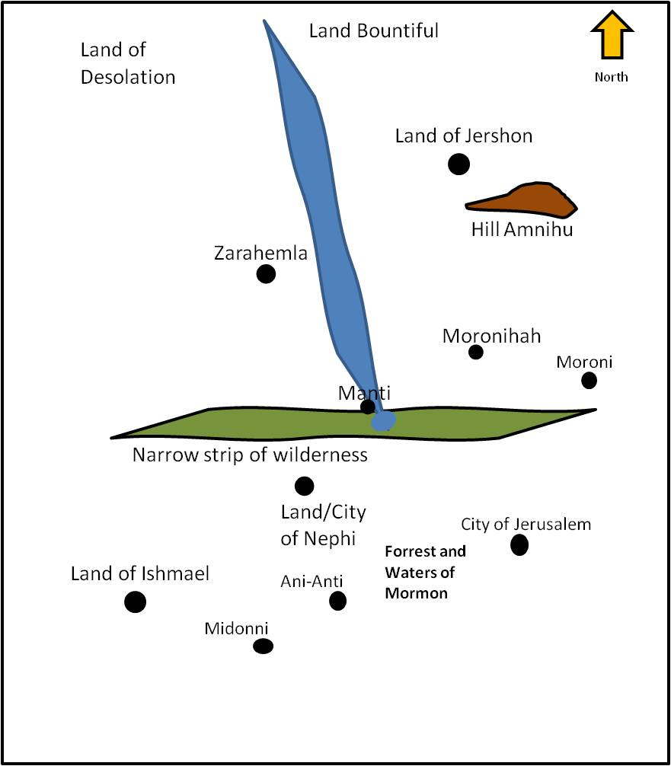
The Mission of the Sons of Mosiah
About 90 BC
After Ammon and the sons of Mosiah separated Aaron and his brothers, Omner and Himni go to preach in Jerusalem
The City of Jerusalem
A great city built by the Lamanites, the Amalekites, and the Amulonites
Alma 21:1-2

Slide 3
Aaron
He was the son of Mosiah
He was ‘numbered among the unbelievers’ (Mosiah 27:8)
He was visited by a heavenly messenger which brought about a transformation
Rather than accept the voice of the people as first choice to succeed his father as king, he embarked on a missionary journey that lasted 14 years (Mosiah 29:2-3)
He and his other brothers went to the Lamanites to preach the gospel
After persecuted and imprisoned he eventually was led by the spirit to present the gospel plan to the great king over all the Lamanites
As a missionary, he and his brothers brought thousands of Lamanites into the gospel of Christ and they “became a righteous people”
(Alma 23:7)
He served faithfully throughout his life
Who’s Who

Slide 4
Muloki and Ammah
They were companions with Aaron on his mission to the Lamanites in about 90 BC
The first reference to them was spoken of by the Lord to Ammon that they and Aaron were in prison in the land of Middoni
When Aaron was rejected in the City of Jerusalem he went to the village of Ani-Anti where Aaron met Muloki and Ammah preaching repentance and redemption to the people
They joined with Aaron after the community of Ani-Anti rejected them to go to the land of Middoni
They , along with Aaron, were put in prison and suffered many afflictions
Alma and King Lamoni rescued them and they continued to preach in every synagogue of the Amalekites or any where they were admitted.
Who’s Who

Slide 5
Amalekites and Amulonites
They were a group of apostates in the city of Jerusalem who practiced after the order of Nehor
The Amalekites were appointed captains of the Lamanite armies because of their murderous dispositions
Generally they instigated the Lamanites to go to war against the Nephites
The Amulonites were descendants of the priests of King Noah
Eventually the Amulonites turned against their Lamanite allies and were hunted down and slain
AMULON
Nehor

Slide 6
Preaching in the Synagogues
Aaron first preached to the Amalekites
The basis of the order of Nehor:
One could do as he pleases and still be saved
The Amulonite and the Amalekites built their synagogues after the order of Nehor
The Amulonites and Amalekites hearts were more hardened than the Lamanites
Nehor
Alma 21:3-10

Slide 7
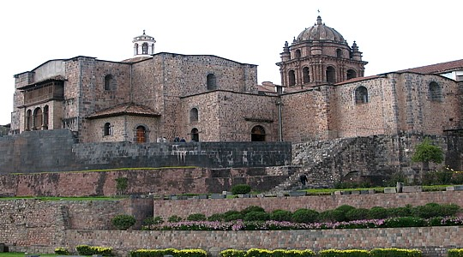
Theology of Satan
God will save all men…this is the doctrine of Lucifer in the Grand Council of Heaven and popularized by Nehor among the descendants of Lehi
Why would they want to assemble together and worship when salvation (according to the order of Nehor) was already given to them?
Why did the Amulonites and Amalekites build a synagogue?

Slide 8
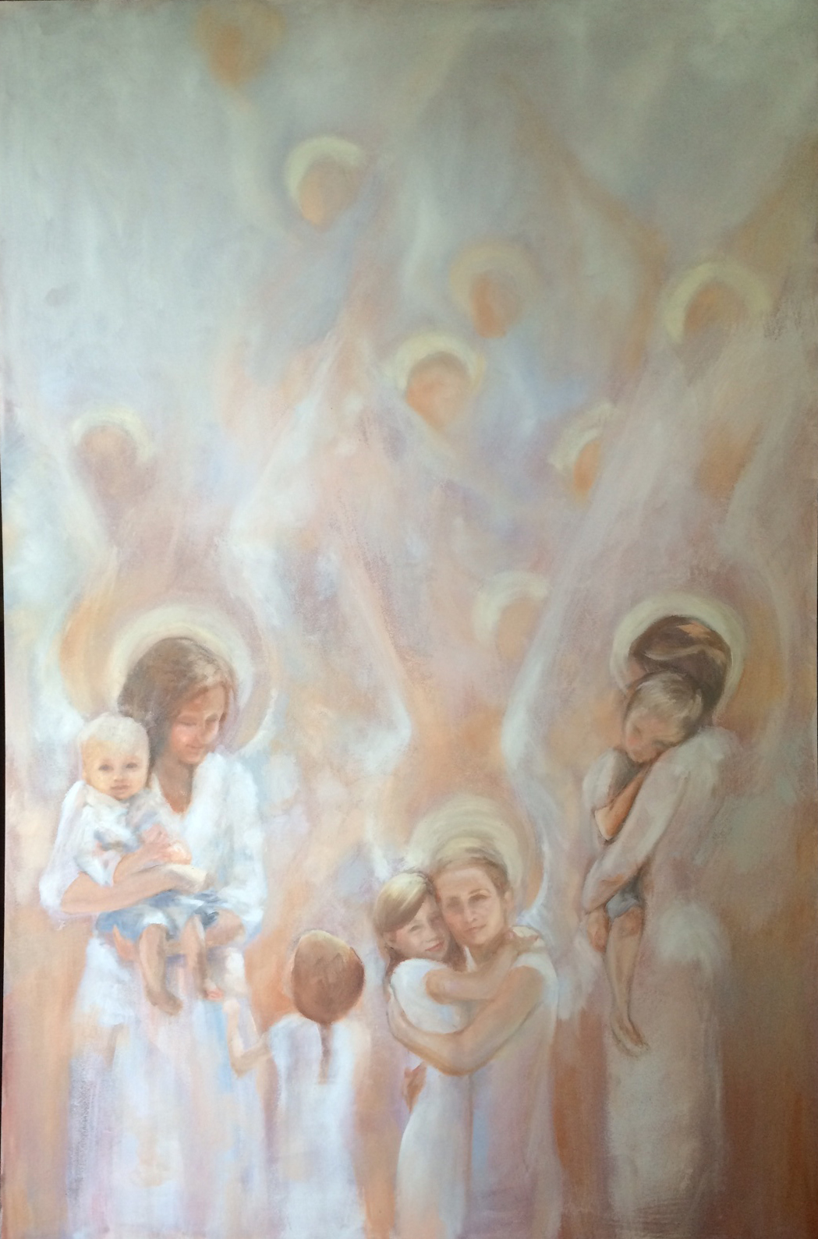
Angels Appear Not
“In harmony with the order of heaven, angels appear unto “just and holy men”.
Abraham saith unto him, They have Moses and the prophets; let them hear them.
And he said, Nay, father Abraham: but if one went unto them from the dead, they will repent.
And he said unto him, If they hear not Moses and the prophets, neither will they be persuaded, though one rose from the dead.
Luke 16:29-31
Clearly, those who will not hear the word of God as preached by one such as Aaron will not hear it if preached by one who has come back form the dead.
Lovetta Reyes
The issue is the message, not the messenger.
McConkie and Millet

Slide 9
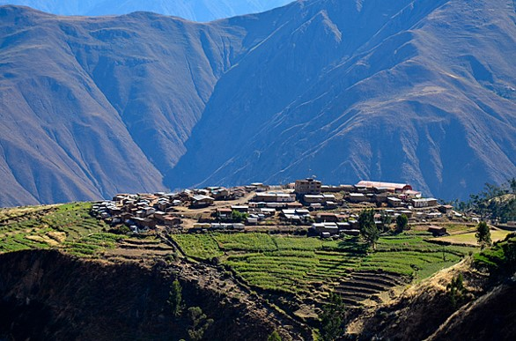
Ani-Anti
Aaron’s words are rejected and he leaves the synagogue and came to the village of Ani-Anti
He met Muloki and Ammah preaching repentance and redemption
They were also rejected and went to the land of Middoni
Alma 21:11-12

Slide 10
Thrown in Prison
In the land of Middoni, Aaron, Muloki, and Ammah were cast into prison while the other companions fled out of the regions round about.
There they suffered many things
Alma 21:13

Slide 11
Hardships While Preaching
Alma 21:5–8
Alma 21:9–11
Alma 21:12–13
Alma 20:29–30
Contention among them…
Aaron was preaching in vain
The Amalekites were mocking and angry
They were cast into prison
Cast out, bound with cords, and smitten
If we patiently persist through trials, the Lord will bless us with His Spirit and help us do His work
However:

Slide 12
Rescued by Ammon and Lamoni
Through the King of all the land Ammon and King Lamoni were able to rescue them and fed and clothed them.
They began to preach again where the Lord would take them…preaching the word of God in every Amalekite synagogue or wherever they could preach.
Alma 21:13-16

Slide 13
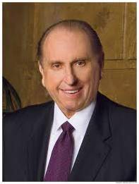
“To reach, to teach, to touch the precious souls whom our Father has prepared for His message is a monumental task.
Success is rarely simple.
Generally it is preceded by tears, trials, trust, and testimony”
President Thomas S. Monson
Alma 21:16-17

Slide 14
Returning to the Land of Ishmael
Ammon and King Lamoni return to the land of Ishmael
King Lamoni released Ammon as his servant
King Lamoni had synagogues built and they did come together to hear the word of God and that they were a ‘free people’
“And he also declared unto them that they might have the liberty of worshiping the Lord their God according to their desires, in whatsoever place they were in, if it were in the land which was under the reign of King Lamoni.”
Alma 21:18-23 Article of Faith 11

Slide 15
Aaron Returns to the Land of Nephi
Aaron and his brethren are led by the spirit to return to the Land of Nephi
They went to the Father of Lamoni
Instead of being servants Lamoni wants them to administer (to teach or instruct) unto him—every missionary's dream—the golden ones
Alma 22:1-4

Slide 16
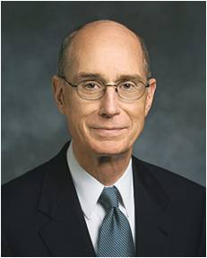
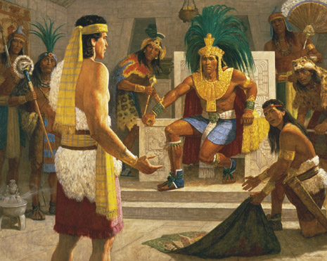
King Lamoni’s Father is Prepared
“God will put prepared people in the way of His prepared servants who want to share the gospel. ..
The Lord has said He will reveal truth to our mind and our heart by the Holy Ghost.”
President Henry B. Eyring
How can you prepare to instantly share the gospel of Christ?
Using the Scriptures
Aaron rehearsed all that Ammon rehearsed to Lamoni’s father.
Aaron was prepared to teach and Lamoni’s father was prepared to listen.
Alma 22:5-14; D&C 8:2

Slide 17
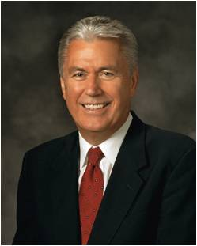
Asking Questions
?
It’s natural to have questions—the acorn of honest inquiry has often sprouted and matured into a great oak of understanding. . . . Please, first doubt your doubts before you doubt your faith. We must never allow doubt to hold us
prisoner and keep us from the divine love, peace, and gifts that come through faith in
the Lord Jesus Christ.”
President Dieter F. Uchtdorf
Lamoni’s father asked the same types of questions that his son asked of Ammon
“Eternal life, or exaltation, is to inherit a place in the highest degree of the celestial kingdom, where we will live in God’s presence and continue as families…
… This gift is made possible through the Atonement of Jesus Christ”
(True to the Faith: A Gospel Reference [2004], 52).
D&C 131:1–4

Slide 18
Eternal Life Questions
Why do you want to receive eternal life?
What would you be willing to give up in order to receive eternal life?
The Savior’s answer:
Keep the Commandments
What if you already keep the commandments?
The Savior’s answer:
Matthew 19:16-22
The King’s response: “…I will give up all that I possess, yea, I will forsake my kingdom, that I may receive this great joy”
Aaron’s answer: pray and repent. Have faith and hope
Alma 22:15-16

Slide 19
A Sacrifice for Eternal Salvation
“Let us here observe, that a religion that does not require the sacrifice of all things never has power sufficient to produce the faith necessary unto life and salvation; for, from the first existence of man, the faith necessary unto the enjoyment of life and salvation never could be obtained without the sacrifice of all earthly things.
It was through this sacrifice, and this only, that God has ordained that men should enjoy eternal life; and it is through the medium of the sacrifice of all earthly things that men do actually know that they are doing the things that are well pleasing in the sight of God.
When a man has offered in sacrifice all that he has for the truth’s sake, not even withholding his life, and believing before God that he has been called to make this sacrifice because he seeks to do his will, he does know, most assuredly, that God does and will accept his sacrifice and offering, and that he has not, nor will not seek his face in vain.
Under these circumstances, then, he can obtain the faith necessary for him to lay hold on eternal life.”
(Lectures on Faith [1985], 69).

Slide 20
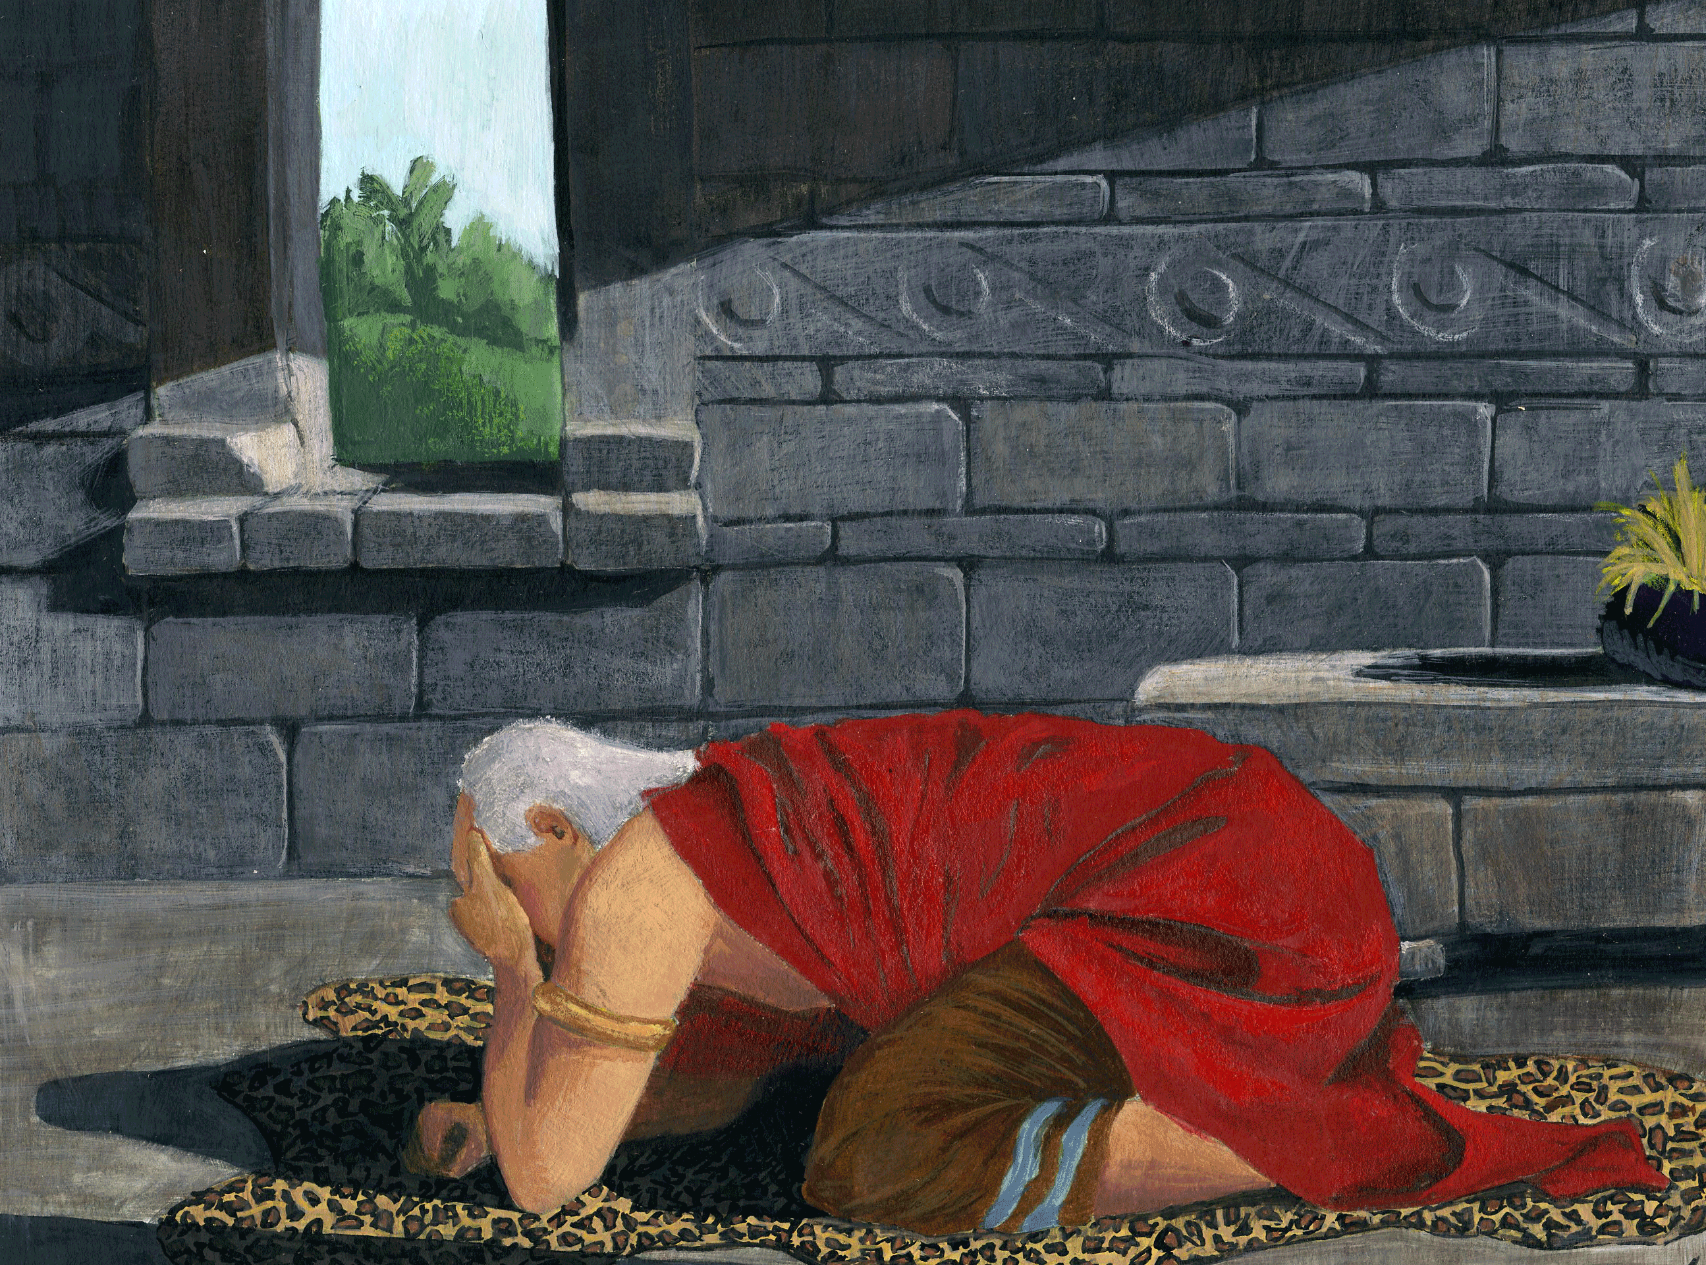
Carried Away In God
“O God, Aaron hath told me that there is a God; and if there is a God, and if thou art God, wilt thou make thyself known unto me, and I will give away all my sins to know thee, and that I may be raised from the dead, and be saved at the last day.”
A Manifestation
The King is struck as if he were dead
The servants tell the queen
The queen is angry with Aaron and his brethren and asked the servants to call the people
Aaron put forth his hand and raised the king from the earth…
The people came and Aaron preaches to them
When he received a manifestation of the Spirit that was so powerful that it caused him to lose physical strength.
“The light of the glory of God” = such a degree that it “had overcome his natural frame, and he was carried away in God.”
Alma 22:18-26

Slide 21
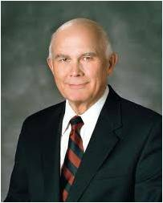
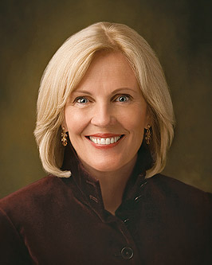
“The gospel of Jesus Christ challenges us to change. ‘Repent’ is its most frequent message, and repenting means giving up all of our practices—personal, family, ethnic, and national—that are contrary to the commandments of God. The purpose of the gospel is to transform common creatures into celestial citizens, and that requires change”
Elder Dallin H. Oaks
If we repent of all our sins and call upon God in faith, then we will be born of God, receive His Spirit, be filled with joy, and ultimately receive eternal life
“Do you have something in your life that you need to change? You can do this. You can repent because of the Savior’s infinite atoning sacrifice. He made it possible for you and me to change, to become pure and clean again, and to become like Him. And He has promised that when we do, He will remember our sins and mistakes no more”
Sister Elaine S. Dalton

Slide 22
The Land
Land of Desolation
Land Bountiful
West Sea
Small Narrow Neck of Land
East Sea
River Sidon
Zarahemla
Jerusalem
Land of Nephi
Alma 22:27-34

Slide 23
Sources:
Video:
Understanding the Fall (0:58)
True Repentance Brings Hope (2:02)
Who’s Who In the Book of Mormon Ed J. Pinegar and Richard J. Allen pg. 2-3, 18, 15, 24-25,134-135
Pictures are from the villages of the southern part of South America…not actual pictures from the Book of Mormon times
President Dieter F. Uchtdorf October General Conf. 2013 “Come Join With Us”
President Henry B. Eyring Sharing the Gospel Heart to Heart Sept. 2012 Ensign
Elder Dallin H. Oaks (“Repentance and Change,” Ensign or Liahona,Nov. 2003, 37).
Sister Elaine S. Dalton (“Now Is the Time to Arise and Shine!” Ensign or Liahona,May 2012, 124).
Robert L. Millet, Joseph Fielding McConkie Doctrinal Commentary 3:151
Presentation by ©http://fashionsbylynda.com/blog/

Slide 24
Land of Desolation
Land far northward that had been peopled and destroyed, Alma 22:30–31.
Place of first landing of people of Zarahemla, Alma 22:30.
A day and a half journey from east to west sea, Alma 22:32.
Moroni names land south of Desolation land of liberty, Alma 46:17.
Places thus far in the Book of Mormon
Land of Nephi
Named after Nephi, 2 Ne. 5:8.
Mosiah flees from Nephi as directed, Omni 1:12.
Large number of Nephites return to Nephi, Omni 1:27–30.
Ammon and brethren go to Nephi, Mosiah 7:6.
Ammon and brethren imprisoned in Nephi, Mosiah 7:7–8.
Limhi, king of Nephi, Mosiah 7:9 (19:26).
Record of Zeniff’s people in land of Nephi, Mosiah 9–22.
Zeniff has knowledge of land of Nephi, Mosiah 9:1.
Zeniff obtains possession of land of Nephi, Mosiah 9:6.
Lamanites invade, steal flocks, Mosiah 9:14.
Peace established in Nephi, Mosiah 10:1.
Noah succeeds father as king in Nephi, Mosiah 11:1.
Abinadi preaches in Nephi, Mosiah 11:20.
Alma teaches in Mormon, in borders of land of Nephi, Mosiah 18:4–5.
Lamanites carry away Nephites’ wives and children in Nephi, Mosiah 19:15.
husbands return to Nephi, Mosiah 19:24.
Lamanites go to destroy Nephites in Nephi, Mosiah 20:7.
Lamanites repulsed, Mosiah 20:11.
Limhi’s people in bondage in Nephi, Mosiah 21:1–4.
Wicked priests come into land of Nephi to steal, Mosiah 21:21.
Limhi’s people escape from Nephi, Mosiah 22:11.
Sons of Mosiah are permitted to go on mission to Nephi, Mosiah 28:1–9 (Alma 17:6–8).
Aaron goes to Nephi, Mosiah 29:3 (Alma 22:1).
Account of mission of sons of Mosiah to Lamanites in Nephi, Alma 17–26.
Lamoni’s father is king over land of Nephi, Alma 18:9.
Lamoni desires Ammon to accompany him to Nephi, Alma 20:1.
The Lord tells Ammon not to go to Nephi, Alma 20:2.
Idle Lamanites inhabit borders of Nephi, Alma 22:28.
Land of Nephi nearly surrounded by water, Alma 22:32.
Nephites kept Lamanites to south in Nephi, Alma 22:34.
Land of Nephi runs in straight course from east sea to west, Alma 50:8.
Land Bountiful
People of Lehi come to land they called Bountiful because of fruit and honey, 1 Ne. 17:5.
voice of the Lord comes to Nephi¹ in Bountiful, 1 Ne. 17:7.
Nephites take possession of Bountiful, Alma 22:29.
Bountiful lies south of land of Desolation, Alma 22:31.
Bountiful runs from east to west sea, Alma 22:33.
Land of Zarahemla
Mosiah made king over land of Zarahemla, Omni 1:12–13.
Benjamin drives Lamanites from Zarahemla, Omni 1:24.
Expedition seeking the land of Nephi returns to Zarahemla, Omni 1:28 (Mosiah 9:2).
No more contention in Zarahemla, Mosiah 1:1 (2:4).
People are gathered in land of Zarahemla to hear Benjamin, Mosiah 1:18.
Zeniff came out of land of Zarahemla, Mosiah 7:9.
Ammon¹ comes from Zarahemla to inquire after people of Zeniff, Mosiah 7:13–14.
Limhi’s expedition failed to find Zarahemla, Mosiah 21:24–26.
Limhi’s people arrive in Zarahemla, Mosiah 22:11–13.
Alma and his people arrive in Zarahemla, Mosiah 24:25.
Alma is permitted to establish churches throughout Zarahemla, Mosiah 25:19–23.
Sons of Mosiah² preach throughout Zarahemla to repair injuries, Mosiah 27:34–35.
Reign of judges commences in Zarahemla, Mosiah 29:44.
Lamanites and Nephites battle near land of Zarahemla, Alma 2:15–25.
No contentions in Zarahemla, Alma 4:1.
Alma begins his mission in Zarahemla, Alma 5:1.
Alma returns to Zarahemla with Amulek, Alma 15:18.
Peace continues in Zarahemla, Alma 16:1.
Lands of Nephi and Zarahemla nearly surrounded by water, Alma 22:32.

