Slide 1
Laying Down Your Weapons
Alma 23-24
Lesson 85
Suggested Hymn: #3 Now Let Us Rejoice
Presentation by ©http://fashionsbylynda.com/blog/

Slide 2
Religious Freedom
“Religious freedom is more than just the freedom to believe what you want.
Everyone needs to have that freedom, no matter what they believe.”
It’s also the freedom to talk about and act on your core beliefs without interference from government or others, except when necessary to protect health and safety.
“Agency is essential in Heavenly Father’s plan of salvation, and religious freedom ensures we can use our agency to live and share what we believe.
It also allows people with similar beliefs to form religious organizations that govern their own affairs. …
lds.org

Slide 3
Religious Liberty
Religious freedom allows the word of God to go forth without obstruction
Aaron and his brothers were allowed to preach
Aaron and his brothers are allowed to establish churches in the Lamanite cities
As a result of this proclamation many thousands of Lamanites were converted
Alma 23:1-5

Slide 4
The Covenant
That they would lay down their weapons of rebellion
The Lamanites who converted:
In the land of Ishmael
In the land of Middoni
In the city of Jerusalem
In the land of Shimlon
In the land of Shemlon
In the city of Lemuel
In the city of Shimnilom
Zarahemla
South
Shimlon
Nephi
Shemlon
Middoni
Jerusalem
Lemuel
Ishmael
Shimnilom
Alma 23:7

Slide 5
Converted Unto the Lord
They were converted unto the Lord and not to the Church and not to the missionaries that taught them
When have you experienced the power of God helping you become converted?
When have you seen the power of God working to help someone else become converted?
When we face difficult circumstances and adversity, why is it important that we be converted to the Lord rather than to other people or ideas?
Never did they fall away
Alma 23:6

Slide 6
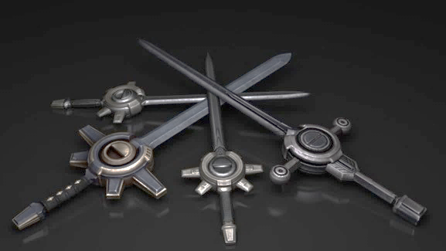
“To set aside cherished ‘weapons of rebellion’ such as selfishness, pride, and disobedience requires more than merely believing and knowing.
Conviction, humility, repentance, and submissiveness precede the abandonment of our weapons of rebellion.
Do you and I still possess weapons of rebellion that keep us from becoming converted unto the Lord?
If so, then we need to repent now.”
David A. Bednar

Slide 7
What Are Our Weapons of Rebellion?
Inappropriate use of electronics
Inappropriate language or attitudes
Inappropriate use of drugs
Inappropriate relationships

Slide 8
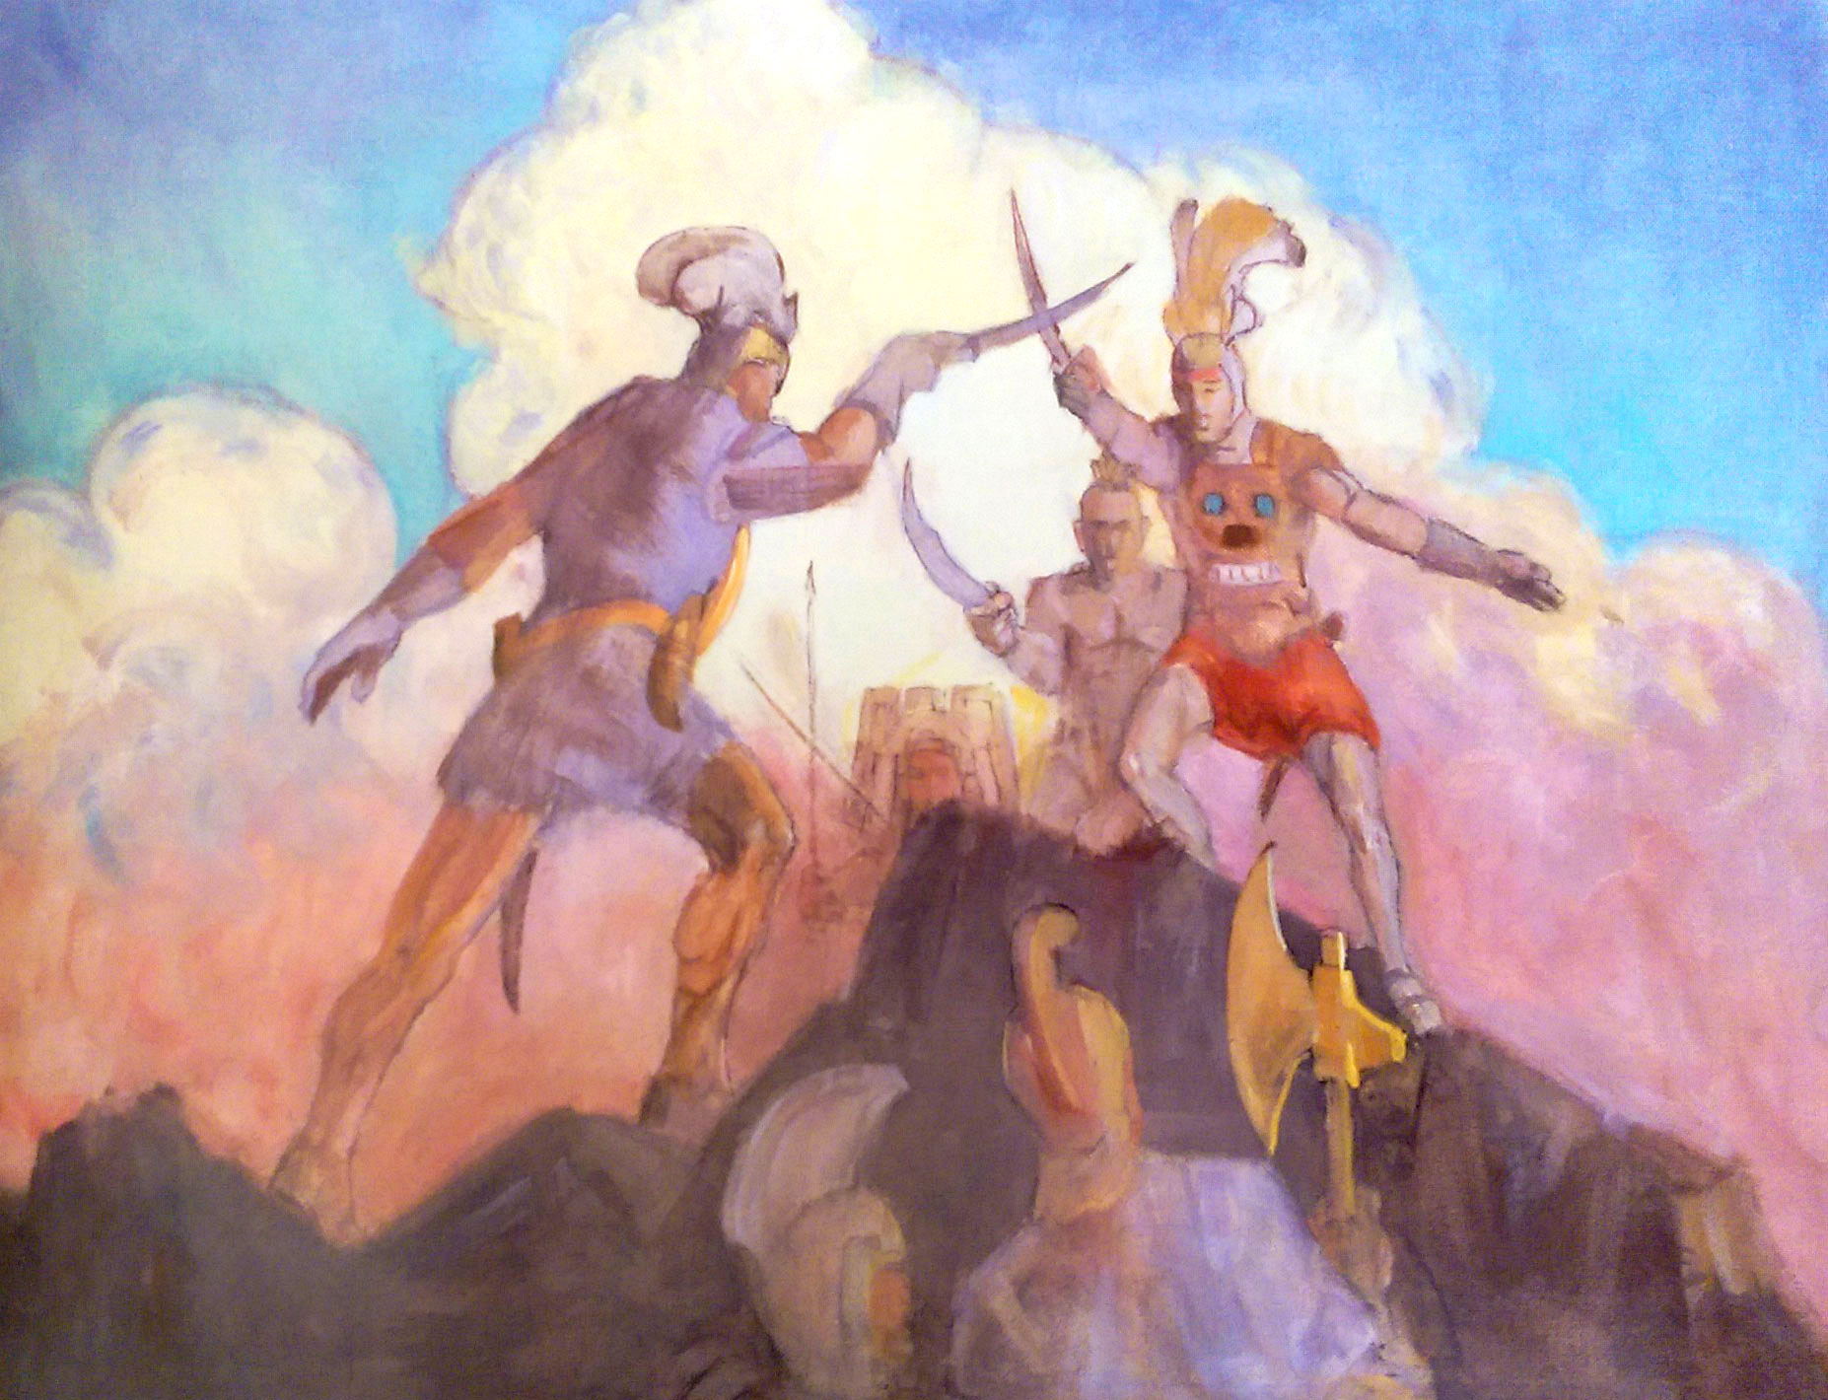
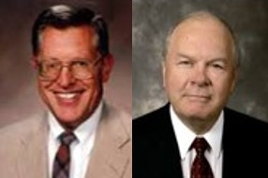
Name Change
The Amalekites were not converted, save only one
The Amulonites also were not converted
“And it came to pass that they called their names Anti-Nephi-Lehies; and they were called by this name and were no more called Lamanites.”
“1982
Webster’s Dictionary
Anti—means “like” or “mirror image of”
Example: Anti-Christ would mean not just opposed to Christ but also deceptively simialar to Christ…
Perhaps the name Anti-Nephi-Lehies would symbolize their desire to be as Nephi and Lehi of old, that is, that they might remember the goodness and faithfulness of their first Nephite prophet leaders.” JFM and RLM
(Helaman 5:6)
Alma 23:6-17

Slide 9
An Industrious People
They had an open correspondence with the Nephites and were friendly with them.
The curse of God did not follow them.
They had their sins remitted, had their souls reoriented toward the things of God, and began to enjoy rich outpouring of is Spirit…It may also be that the mark of the curse, the dark skin (2 Nephi 5:21) was removed from them.
Read 3 Nephi 2:14-16
Alma 23:17-18

Slide 10
Conversion means changing and becoming a new person through the power of God.
“It takes exactly as long to repent as it takes you to say ‘I’ll change’—and mean it. Of course there will be problems to work out and restitutions to make. You may well spend—indeed you had better spend—the rest of your life proving your repentance by its permanence.”
Jeffrey R. Holland
Alma 23:17-18

Slide 11
Wickedness Rebel Against Righteousness
“ And it came to pass that the Amalekites and the Amulonites and the Lamanites who were in the land of Amulon, and also in the land of Helam and who were in the land of Jerusalem, and in fine, in all the land round about, who had not been converted and had not taken upon them the name of Anti-Nephi-Lehi, were stirred up by the Amalekites and by the Amulonites to anger against their brethren.”
King Lamoni’s father confers the kingdom over to another son, Anti-Nephi-Lehi—he dies that same year
Alma 24:1-4

Slide 12
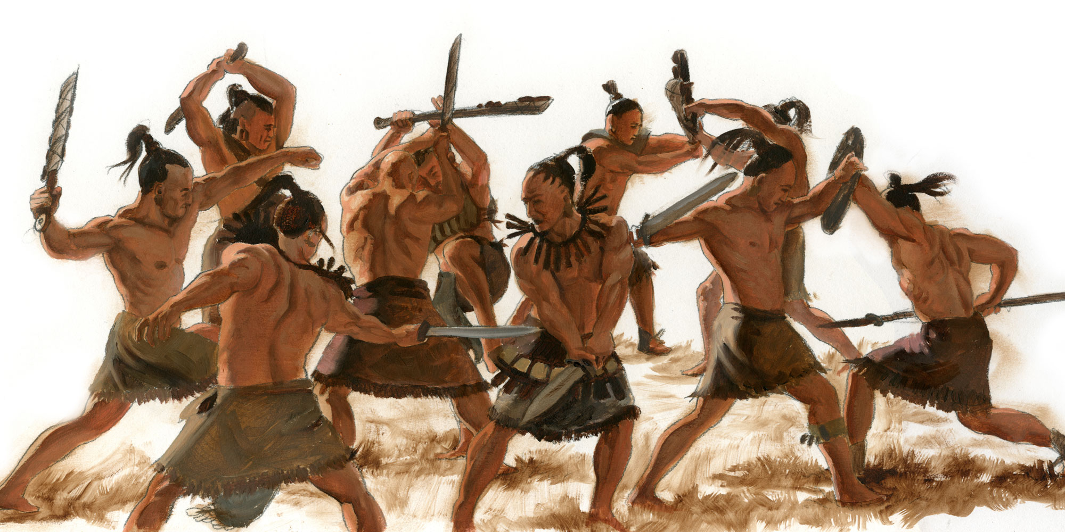
Amalekites and Amulonites
The Amalekites and Amulonites, who were former Nephites, stirred many Lamanites up to anger against their king and the other Anti-Nephi-Lehies.
In their anger, these Lamanites prepared to attack the Anti-Nephi-Lehies.
At this time of strife, the king of the Anti-Nephi-Lehies died.
The kingdom was conferred on one of his sons.
Ammon gathered with the new king and with Lamoni and others to counsel together and determine how to defend themselves against the Lamanites.
Alma 24:1-5

Slide 13
Anti-Nephi-Lehi
The New King: He was the brother of King Lamoni, the son of King Lamoni’s father (Alma 24:3)
The Blessings:
That the Lord had sent the Nephites to preach to them
That the Lord has softened our hearts
That the correspondence has been opened between them and the Nephites
That God had granted repentance and forgiveness for the sins and murders they had committed
That through the Atonement their guilt had been taken away
Alma 24:5-10

Slide 14
The Counsel
Ammon, his brethren, King Lamoni, and his brother Anti-Nephi-Lehi met in the land of Midian to decide how to defend against the rising rebellion
Zarahemla
South
Shimlon
Nephi
Shemlon
Middoni
Jerusalem
Midian
Lemuel
Ishmael
Shimnilom
Alma 24:5

Slide 15
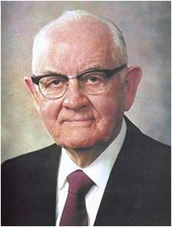
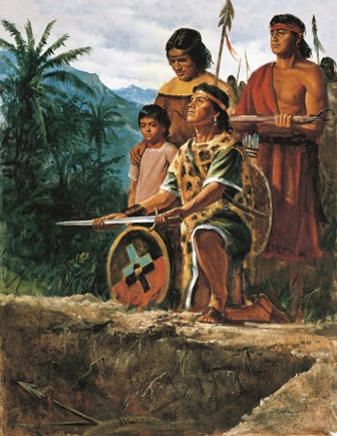
To Remain Clean
“…let us stain our swords no more”
“In abandoning sin one cannot merely wish for better conditions. … He must be certain not only that he has abandoned the sin but that he has changed the situations surrounding the sin. He should avoid the places and conditions and circumstances where the sin occurred, for these could most readily breed it again. He must abandon the people with whom the sin was committed. He may not hate the persons involved but he must avoid them and everything associated with the sin”
President Spencer W. Kimball
“…we will hide away our swords…bury them deep”
Alma 24:11-19

Slide 16
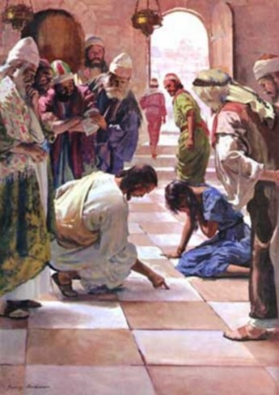
To remain clean after we have repented and received God’s forgiveness, we must avoid circumstances that may lead us to sin
“Because of the atonement of Christ, the truly repentant have not only the burden of sin lifted from them but also the burden of guilt.
Through the Atonement
we become yoked to
Christ; he thereby
shares our burden.”
JFM and RLM
Alma 24:18

Slide 17
Burying Your Weapons
What weapons do you need to bury?
Is there something you need to personally bury?
Why is it difficult to ‘bury your weapons’?
If we bury our weapons should we dig them back up again?
The Anti-Nephi-Lehies did not want their sins to return---this was their testimony

Slide 18
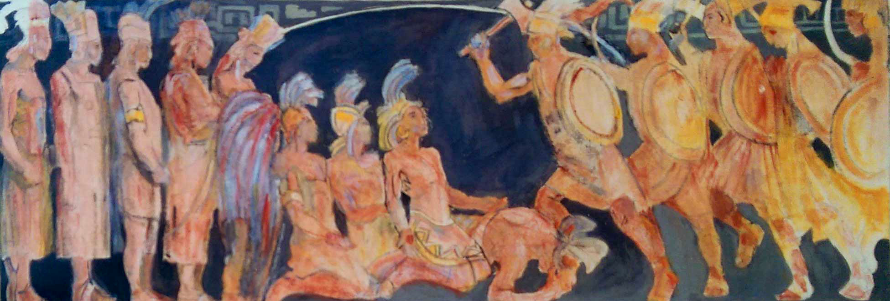
Keeping Their Covenants
The Anti-Nephi-Lehies saw the armies approaching and they ‘prostrated’ themselves down and did not fight and ‘call on the name of the Lord’
The Lamanites began to slay them---more than a thousand
Minerva Terchert
When righteous people die, we have no reason to doubt that they are saved. They are “…received into a state of happiness, which is called paradise, a state of rest, a state of peace, where they shall rest from all their troubles and from all care, and sorrow” (Alma 40:12)
When the Lamanites saw their brethren lay down their lives they did ‘forebare from slaying’---their hearts were swollen from those who had fallen under the sword—they also threw down their swords
Alma 24:20-27

Slide 19
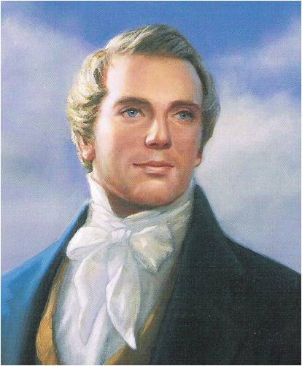
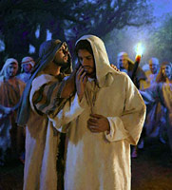
Those Who Have Fallen
Those who have fallen away from righteousness tend to become more bitter and hardened.
“From apostates the faithful have received the severest persecutions. Judas was rebuked and immediately betrayed his Lord into the hands of His enemies, because Satan entered into him…What nearer friend on earth, or in heaven, had Judas than the Savior? And his first object was to destroy Him”
Prophet Joseph Smith
Alma 24:28-30

Slide 20
What Does Mormon Want Us To Know?
If those who have been enlightened by the Spirit of God fall away from the truth, their condition will be worse than if they had never known the things of God.
Alma 24:18

Slide 21
Sources:
“Religious Freedom,” lds.org/religious-freedom
David A. Bednar, “Converted unto the Lord,” Ensign or Liahona, Nov. 2012, 108–9
Joseph Fielding McConkie and Robert L. Millet Doctrinal Commentary of the Book of Mormon Vol. 3 pg. 165, 168
Jeffrey R. Holland(“For Times of Trouble,” New Era,Oct. 1980, 11–12).
President Spencer W. Kimball (The Miracle of Forgiveness[1969], 171–72).
Prophet Joseph Smith Teachings pg. 67
For more information: What it means to be converted
Bonnie L. Oscarson Be Ye Converted Oct. General Conf. 2013 or Nov. 2013 Ensign
Presentation by ©http://fashionsbylynda.com/blog/

