Slide 2
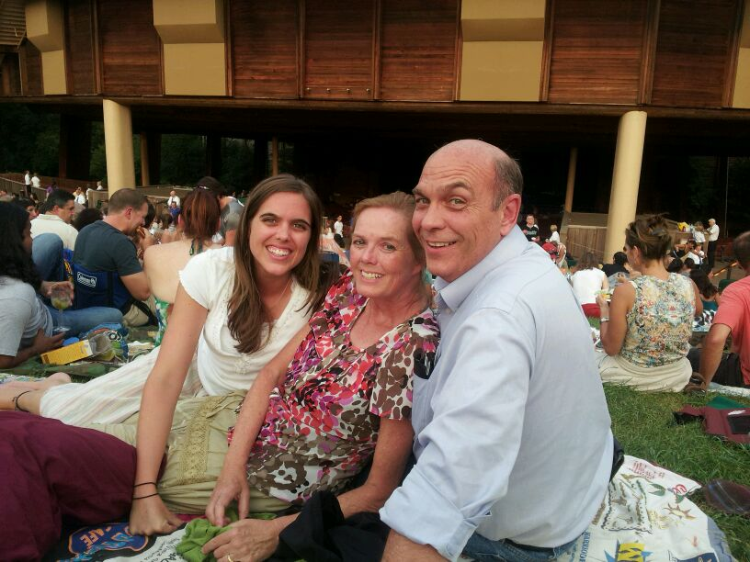
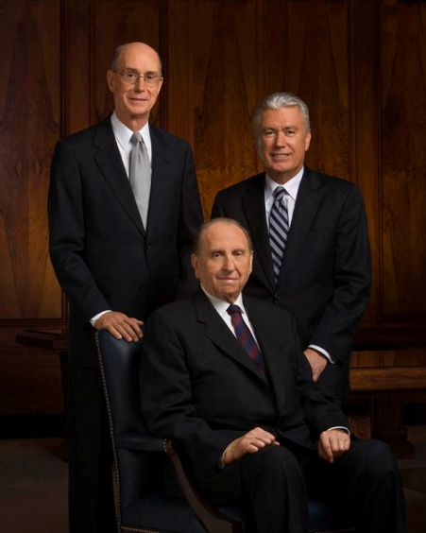
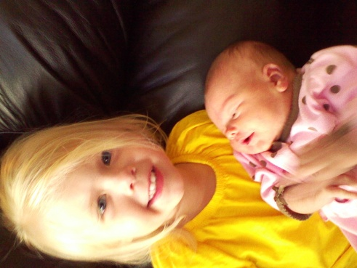
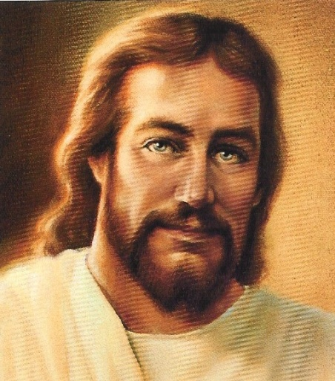
Trust
In whom can we place our trust?
Why is it easier to place our trust in some people and not others?

Slide 3
The Prophesies
What had Alma prophesied of the city of Ammonihah?
(Alma 9:12)
Read: Alma 25:1-2
What did Abinadi prophesy would happen to the descendants of King Noah and his priests?
( Mosiah 17:14–19)
Read: Alma 25:4-9

Slide 4
Prophesies and Promises
The inspired words of the prophets will all be fulfilled
“What I the Lord have spoken, I have spoken, and I excuse not myself; and though the heavens and the earth pass away, my word shall not pass away, but shall all be fulfilled, whether by mine own voice or by the voice of my servants, it is the same.” D&C 1:38

Slide 5
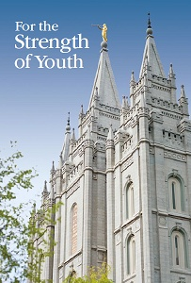
From the First Presidency
“The standards in this booklet will help you with the important choices you are making now and will yet make in the future. We promise that as you keep the covenants you have made and these standards, you will be blessed with the companionship of the Holy Ghost, your faith and testimony will grow stronger, and you will enjoy increasing happiness”

Slide 6
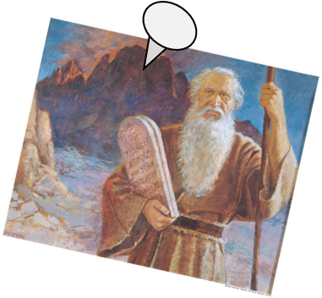
A Successful Mission
After the Lamanites destroyed the Ammonihah, wiping out the seed of Amulon,
They returned home and many went to dwell in the land of Ishmael
They also buried their weapons of war and began to walk in the ways of the Lord and kept His commandments
The Law of Moses:
“…did serve to strengthen their faith in Christ”
They retained hope through faith, unto eternal salvation
They relied on the spirit of prophecy which was to come
Alma 25:14-17

Slide 7
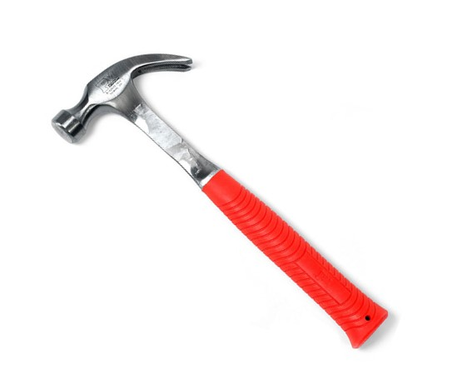
Instruments
God had made Ammon and the other missionaries instruments, or tools, in His hands in doing a great work among the Lamanites.

Slide 8
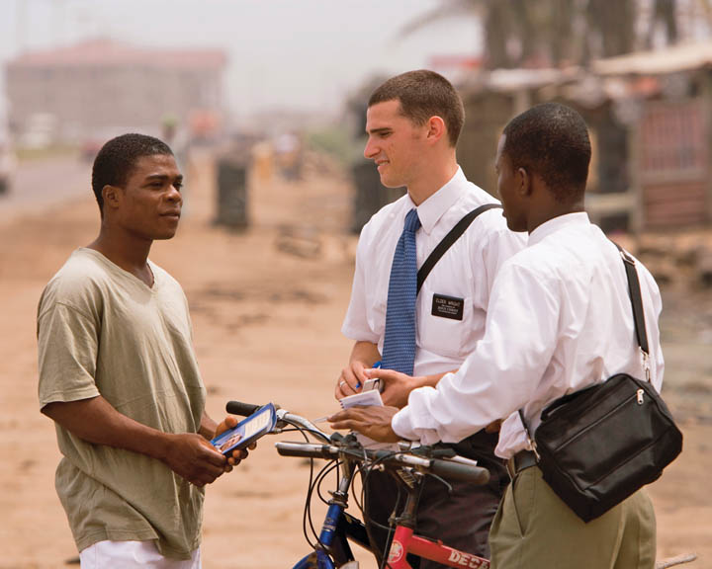
Instruments in the Hands of the Lord
Alma 26:3
As we become instruments in the Lord’s hands, we can help God’s children find safety through the blessings of the temple.

Slide 9
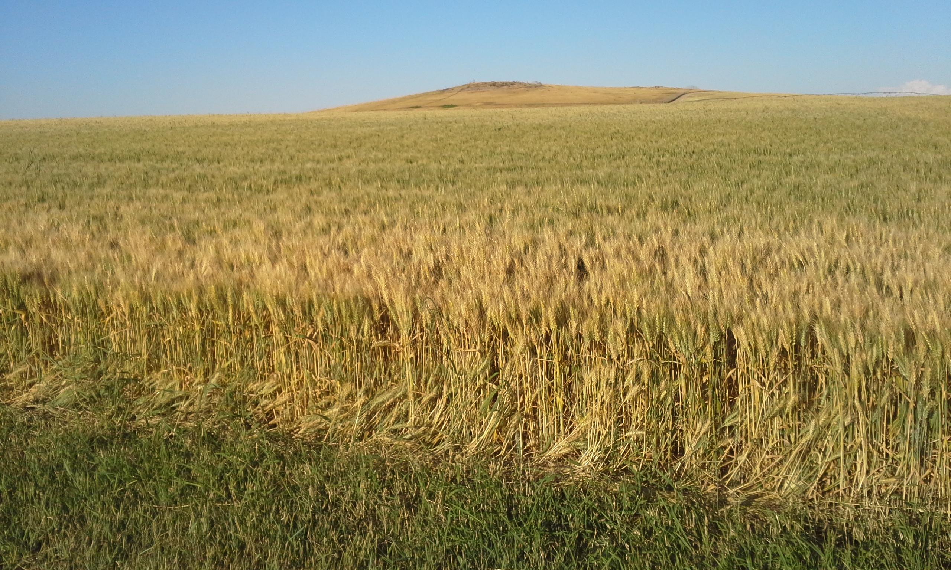
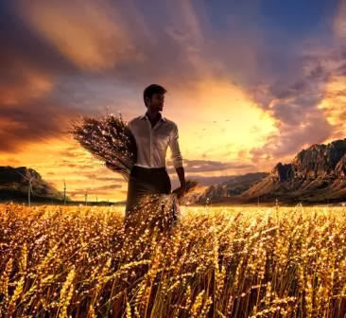
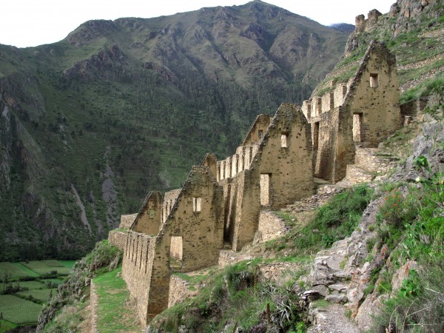
Sheaves and Garners
“Behold, the field was ripe, and blessed are ye, for ye did thrust in the sickle, and did reap with your might, yea, all the day long did ye labor; and behold the number of your sheaves! And they shall be gathered into the garners that they are not wasted.” Alma 26:5
Alma 26:6-7

Slide 10
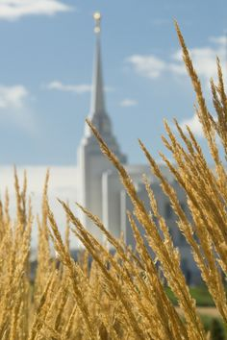
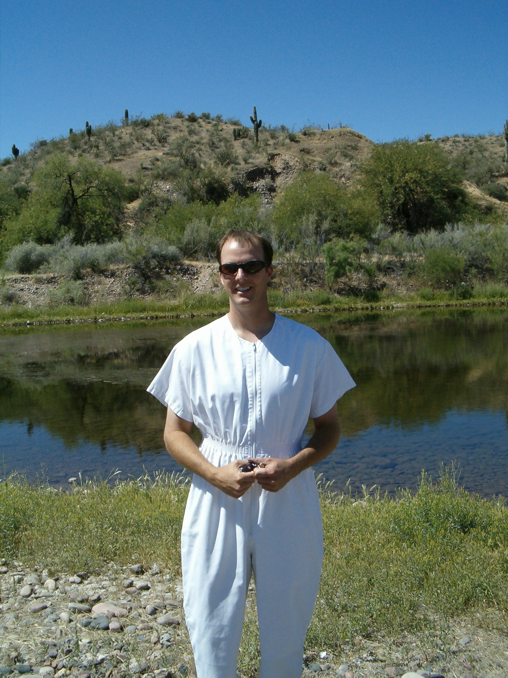
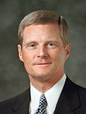
Baptism and Temples
“The sheaves in this analogy represent newly baptized members of the Church. The garners are the holy temples”
David A. Bednar
Alma 26:6-7
As we become instruments in the Lord’s hands, we can help God’s children find safety through the blessings of the temple

Slide 11
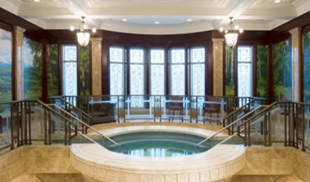
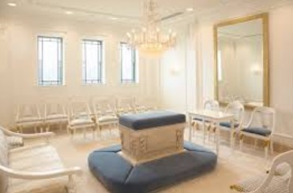
What are the Blessings of the Temple?
The saving ordinances we receive in the temple—the endowment and temple sealing and the spiritual protection and peace we receive as we worship in the temple.
We can encourage others to become temple worthy and to attend the temple, and we can perform ordinances in the temple for people who have died without having had the opportunity to receive them.

Slide 12
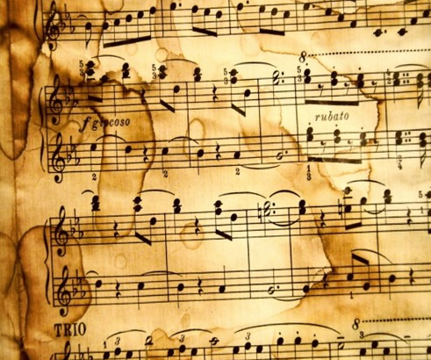
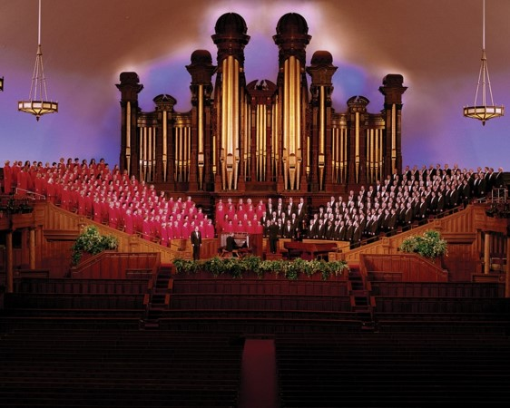
Songs of Praise and Joy
We experience joy as we faithfully serve the Lord and His children
Alma 26:8-10

Slide 13
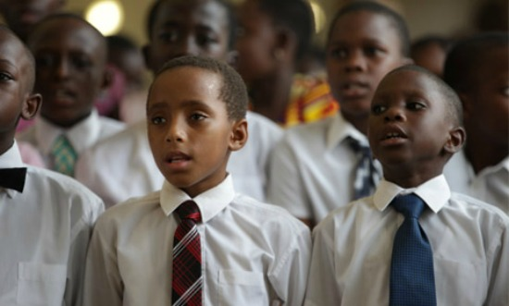
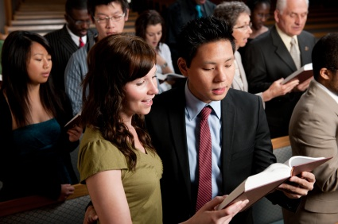
Music and song have been an important part of the worship of the Saints in all gospel dispensations.

Slide 14
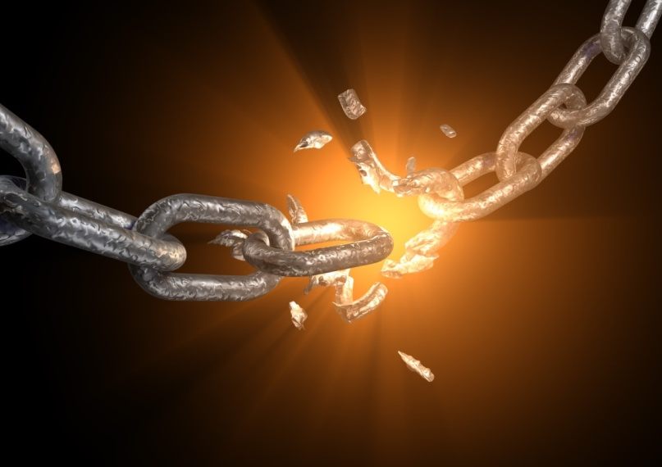
My Joy is Full
Alma 26:16
Behold, he who has repented of his sins, the same is forgiven, and I, the Lord, remember them no more
D&C 58:42

Slide 15
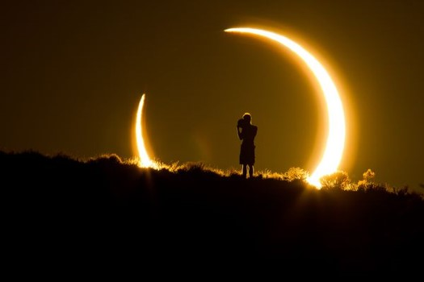
Mysteries of God
The mysteries of God will be revealed to those who repent and exercise faith and do good works and pray continually
Alma 26:22

Slide 16
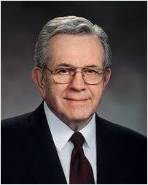
“Letters come from those who have made tragic mistakes.
They ask, ‘Can I ever be forgiven?’
“The answer is yes!
“The gospel teaches us that relief from torment and guilt can be earned through repentance.
Save for those few who defect to perdition after having known a fulness, there is no habit, no addiction, no rebellion, no transgression, no offense exempted from the promise of complete forgiveness.”
President Boyd K. Packer

Slide 17
“However late you think you are, however many chances you think you have missed, however many mistakes you feel you have made or talents you think you don’t have, or however far from home and family and God you feel you have traveled, I testify that you have not traveled beyond the reach of divine love.
It is not possible for you to sink lower than the infinite light of Christ’s Atonement shines.” Jeffrey R. Holland
God is merciful to all who repent and believe on His name.

Slide 18
With Patience and Afflictions
Ammon rehearses how the Lord comforted them while they were laboring with the Lamanites and all the afflictions they had to endure.
Because of this they were successful in bringing many unto the Lord
Alma 26:23-32

Slide 19
So Great A Love
Ammon recognizes the love in all the land of those who embraced the teachings of Ammon, Aaron and the other missionaries.
They buried their weapons and would not fight against their brethren…they would rather die than fight…
They would rather love than hate
Alma 26:34

Slide 20
Sources:
Do Not Deny the Atonement’s Power (1:53)
David A. Dednar “Honorably Hold a Name and Standing,” Ensign or Liahona, May 2009, 97).
(For the Strength of Youth [booklet, 2011], ii).
President Boyd K. Packer
(“The Brilliant Morning of Forgiveness,” Ensign, Nov. 1995, 19).
Jeffrey R. Holland, “The Laborers in the Vineyard,” Ensign or Liahona, May 2012, 33
Featured temples: Payson Baptismal Font, Suva Fiji Endowment Room
Presentation by ©http://fashionsbylynda.com/blog/

