Slide 1
https://www.youtube.com/watch?v=Y0aX3evbh5M

Slide 2
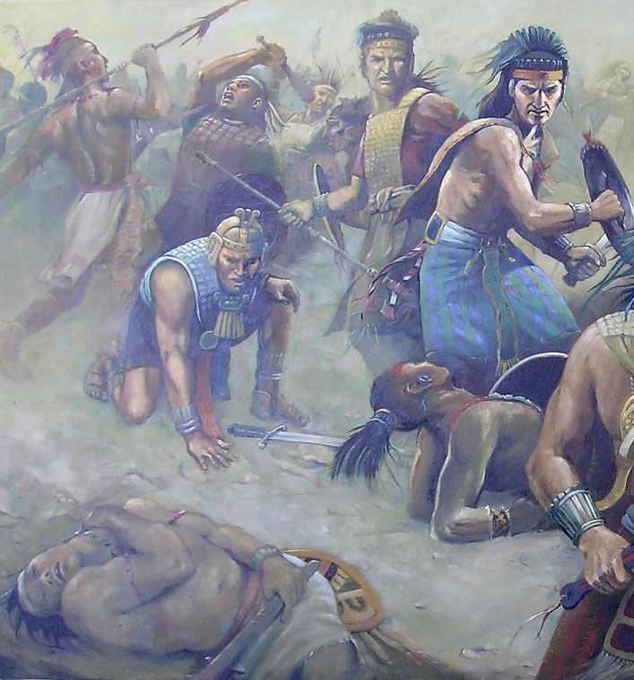
The Anger--Apostasy
The Amalekites devoted the whole energy of their souls to fighting God.
Some of the Lamanites had attacked the people of Anti-Nephi-Lehi, who would not defend themselves, and killed more than a thousand of them.
Some of those Lamanites then attacked the Nephites, destroying the city of Ammonihah, but were then driven from the land by a Nephite army.
Because they could not find success in war with the Nephites, they turn on their brethren the Anti-Nephi-Lehies.
The Anti-Nephi-Lehies had embraced light and truth refusing to take arms
Alma 27:1-3; Alma 24:20-24; Alma 25:1-3 JFM and RLM

Slide 3
The Protector
Ammon saw the destruction of those he loved
The Nephites will destroy us because of our wickedness
Can we gather these people and go to Zarahemla?
I will go and inquire of the Lord and if He says go, will you go?
Yes, and we will be their slaves to repair our sins
Slavery is against our law, let’s rely on the mercies of our brethren
Ammon went to the Lord and He said: “Get This people out…”
Ask the Lord
When we commit to follow the direction we receive from the Lord, He will guide us to make wise decisions
Alma 27:4-12

Slide 4
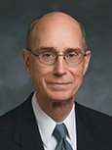
Commit to Follow
“Once the Lord knows our faith is sufficient that He can be certain we will obey, He will send the Spirit to teach us more clearly and more frequently.
The prayer of faith always includes a commitment to obey.”
Henry B. Eyring
When we commit to follow the direction we receive from the Lord, He will guide us to make wise decisions
__
-
Esc
1
2
3
4
5
6
7
8
9
0
Del
Tab
Q
W
E
R
T
Y
U
I
O
P
Back
Caps Lock
A
S
D
J
K
L
;
‘
COMMIT
Shift
C
V
B
N
M
,
.
?
Shift
Alt
Alt

Slide 5
The Departure
Ammon, the king, and all the people of the Lord gathered together all their flocks and herds and departed out of the land and came to the borders of the land of Zarahemla
Ammon left them in the wilderness while he and his brethren went into the land of Zarahemla
Land of Desolation
Land Bountiful
West Sea
East Sea
Land of Jershon
Zarahemla
Jerusalem
Land of Nephi
Alma 27:14

Slide 6
Joyful Reunion
While on their way—
Alma…Ammon, Aaron, Omner, and Himni all had joyful happiness in meeting
“A fulness of joy is found only among resurrected, exalted beings (D&C 93:3).
In mortality men experience joy only in righteousness…in obedience to the laws and ordinances of the gospel.
Joy is characteristic of the presence of the Holy Ghost…
That kind of joy is experienced in the manifestation of our sins being remitted…”
JFM and RLM
Alma 27:14-19

Slide 7
The Voice of the People
The missionaries return to Zarahemla and ask the chief judge, recounting their mission, if they could have the converted people come to Zarahemla
Proclamation:
Would you allow your brethren who are the people of Anti-Nephi-Lehi to live in this land?
“…Behold we will give up the land of Jershon, which is on the east by the sea…for an inheritance…we will set our armies between the land Jershon and the land Nephi, that we may protect our brethren…we will guard them from their enemies…on condition that they will give us a portion of their substance to assist us that we may maintain our armies.”
Alma 27:21-24

Slide 8
Jershon
The name is not mentioned before this event, and would possibly be the only local name by which it was known to the compiler of the Book of Mormon.
Before the date of exodus of the Anti-Nephi-Lehies, it was, we think, considered a part of the Land of Zarahemla.”
GR and JMS
“Jershon means the Land of the expelled, or of the strangers. We think it altogether probable that this significant name was given it at the time it was set off for the habitation of these expatriated Lamanites, as it defines their condition as exiles, and their relation to the Nephites as strangers.
Land of Desolation
Land Bountiful
West Sea
East Sea
Land of Jershon
Zarahemla
Jerusalem
Land of Nephi
Alma 27:21-24

Slide 9
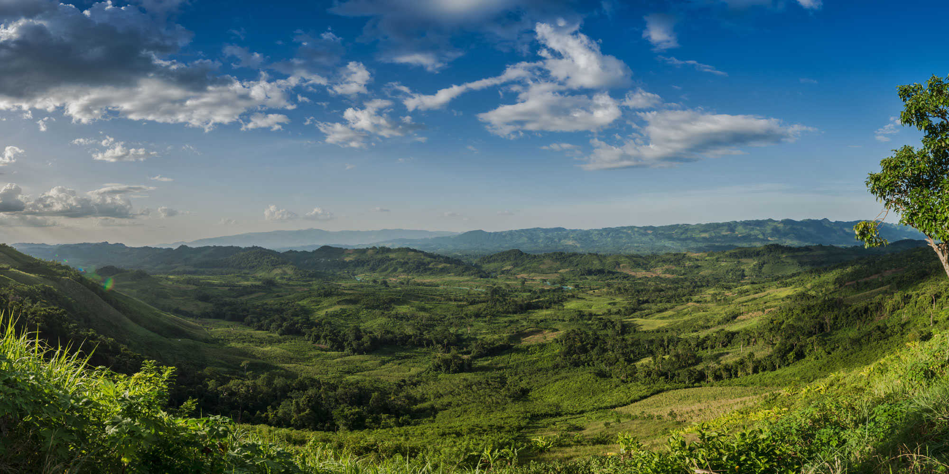
The People of Ammon
After settling in the land of Jershon the Nephites began to call them the “People of Ammon”
This nation within a nation was named after the chief missionary who had labored among them and who now became their residing high priest (Alma 30:20)
The Ammonites were highly favored of the Lord..they were honest and upright and firm in their faith of Christ.
They never did take up arms against their brethren and did not look upon death with any degree of terror.
Alma 27:26-30; Alma 30:20

Slide 10
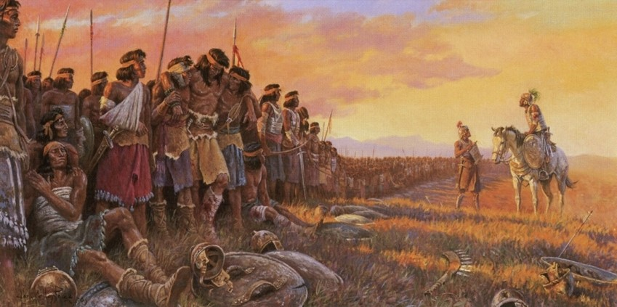
The Examples
The Ammonites are examples of a truly faithful group of people whose covenants were etched in their hearts
When we are fully converted to the Lord, we keep the covenants we have made with Him

Slide 11
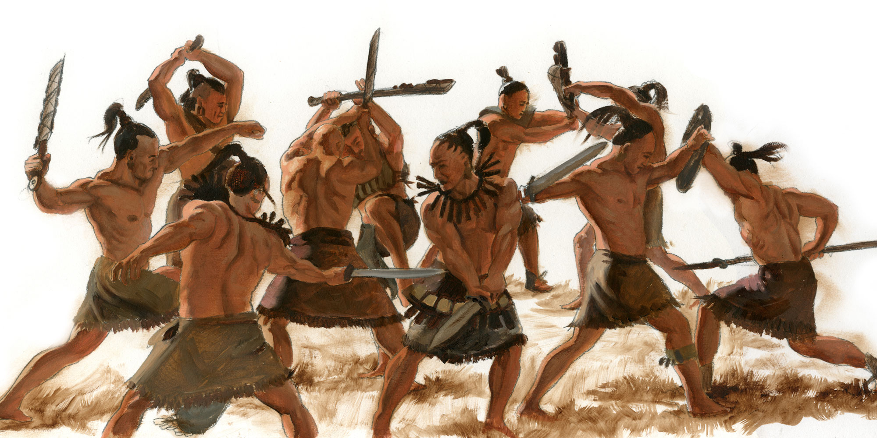
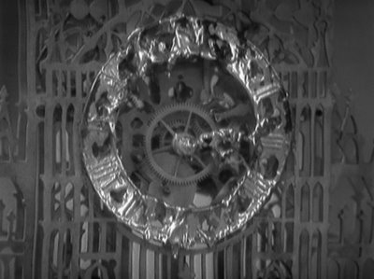
Within 15 Years
The battles between the Lamanites and the Nephites lost tens of thousand of the Lamanites and a tremendous slaughter among the Nephites.
The Lamanites were driven and scattered
The Nephites return to their land
This was the end of the
15th year of the reign of
the judges
Alma 28:1-3

Slide 12
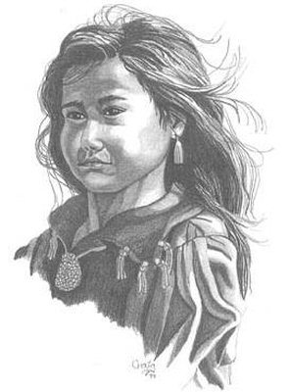
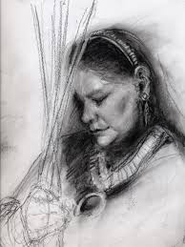
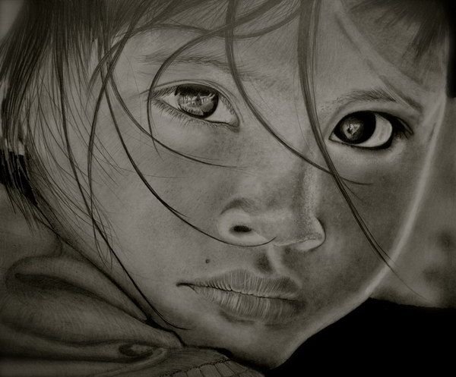
A Time for Sorrow
Mourning and Lamentations—Solemnity--Fasting and Prayer
Wickedness causes great sorrow, while righteousness results in hope and joy because of Christ
“But as for me, when they were sick, my clothing was sackcloth: I humbled my soul with fasting; and my prayer returned into mine own bosom.” Psalm 35:13
Zilfikar Ali
Saul: “And they mourned, and wept, and fasted until even, for Saul, and for Jonathan his son, and for the people of the Lord, and for the house of Israel; because they were fallen by the sword.”
2 Samuel 1:12
The Custom:
“…but it came to pass after they had buried their dead, and also after the days of fasting, and mourning, and prayer, ..”
Alma 30:2
Alma 28:4-6; 11-14

Slide 13
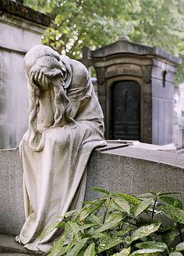
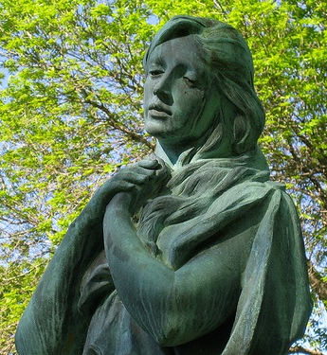
Death
Why might some people experience fear when loved ones die?
Why are some people able to feel hope when loved ones die?
When we have faith in Jesus Christ and the promises of the Lord, we can have hope and joy in times of death

Slide 14
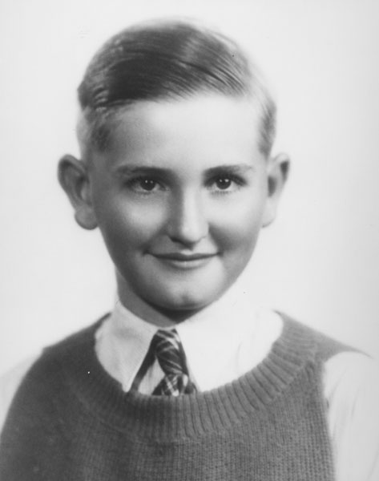
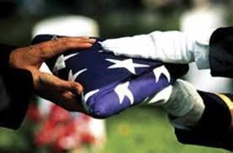
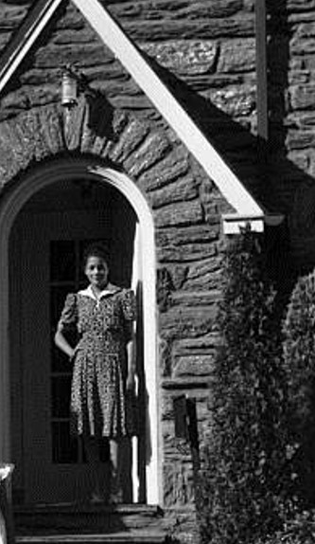
“After hearing that his friend Arthur Patton had died in World War II, young Thomas Monson went to visit Arthur’s mother, who was not a member of the Church. He later recalled:
“A light went out in the life of Mrs. Patton. She groped in utter darkness and deep despair.
“With a prayer in my heart, I approached the familiar walkway to the Patton home, wondering what words of comfort could come from the lips of a mere boy.
“The door opened, and Mrs. Patton embraced me as she would her own son. Home became a chapel as a grief-stricken mother and a less-than-adequate boy knelt in prayer.
“Arising from our knees, Mrs. Patton gazed into my eyes
and spoke: ‘Tommy, I belong to no church, but you do.
Tell me, will Arthur live again?’
“To the best of my ability, I testified to her that Arthur
would indeed live again.”
Thomas S. Monson

Slide 15
“Brothers and sisters, we live to die and we die to live—in another realm. If we are well prepared, death brings no terror. From an eternal perspective, death is premature only for those who are not prepared to meet God.
“Now is the time to prepare. Then, when death comes, we can move toward the celestial glory that Heavenly Father has prepared for His faithful children.
Meanwhile, for sorrowing loved ones left behind … the sting of death is soothed by a steadfast faith in Christ, a perfect brightness of hope, a love of God and of all men,
and a deep desire to serve them”
Russell M. Nelson

Slide 16
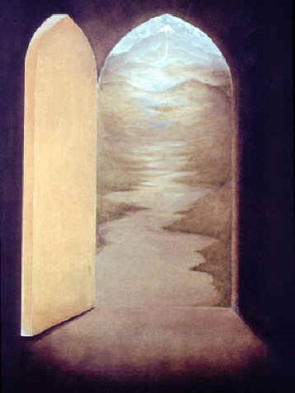
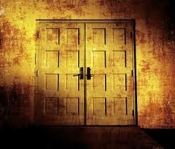
And Thus We See…
“…men and women establish inequality because of their choices—they either open themselves to the happiness and joy of the blessing of God or they block the blessings of that healing and lifting influence which is within reach of all.”
JFM and RLM
Alma 28:13-14

Slide 17
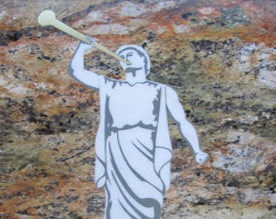
A Desire To Teach
“O that I were an angel, and could have the wish of mine heart, that I might go forth and speak with the trump of God, with a voice to shake the earth, and cry repentance unto every people!”
“Yea, I would declare unto every soul, as with the voice of thunder, repentance and the plan of redemption, that they should repent and ªome unto our God, that there might not be more sorrow upon all the face of the earth.”
“But behold, I am a man, and do sin in my wish; for I ought to be content with the things which the Lord hath allotted unto me.”
Alma 29:1-3

Slide 18
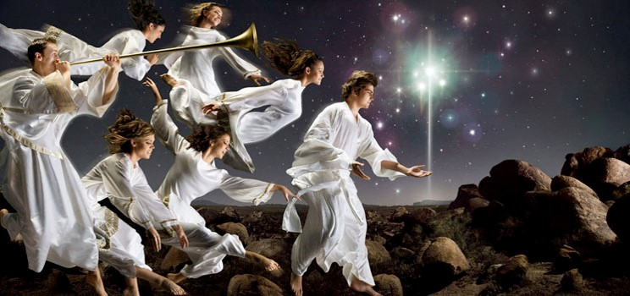
Voice of An Angel
Bringing salvation to everyone
An angel is a messenger of God and Alma is the messenger to this people
Receiving the Holy Ghost one could speak with the tongue of angels.
“It is our right to speak with the same clarity, the same power, and the same assurance known to angels in declaring the gospel”
JFM and RLM
Alma 29:1-3

Slide 19
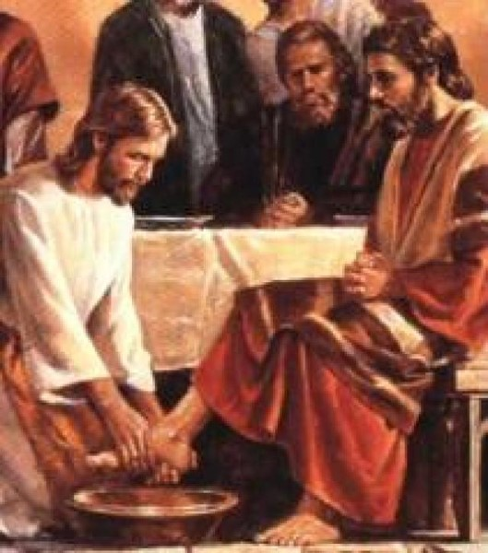
To Be Content
“Each of us must, through the influence and comfort of the Holy Spirit, come to understand and appreciate and value his or her own assignment, learn to magnify it, and thereby experience the accompanying joy which follow in the wake of faithful service.”
“In the Lord’s service it matters not where we serve but how”
Alma 29:3 JFM and RLM

Slide 20
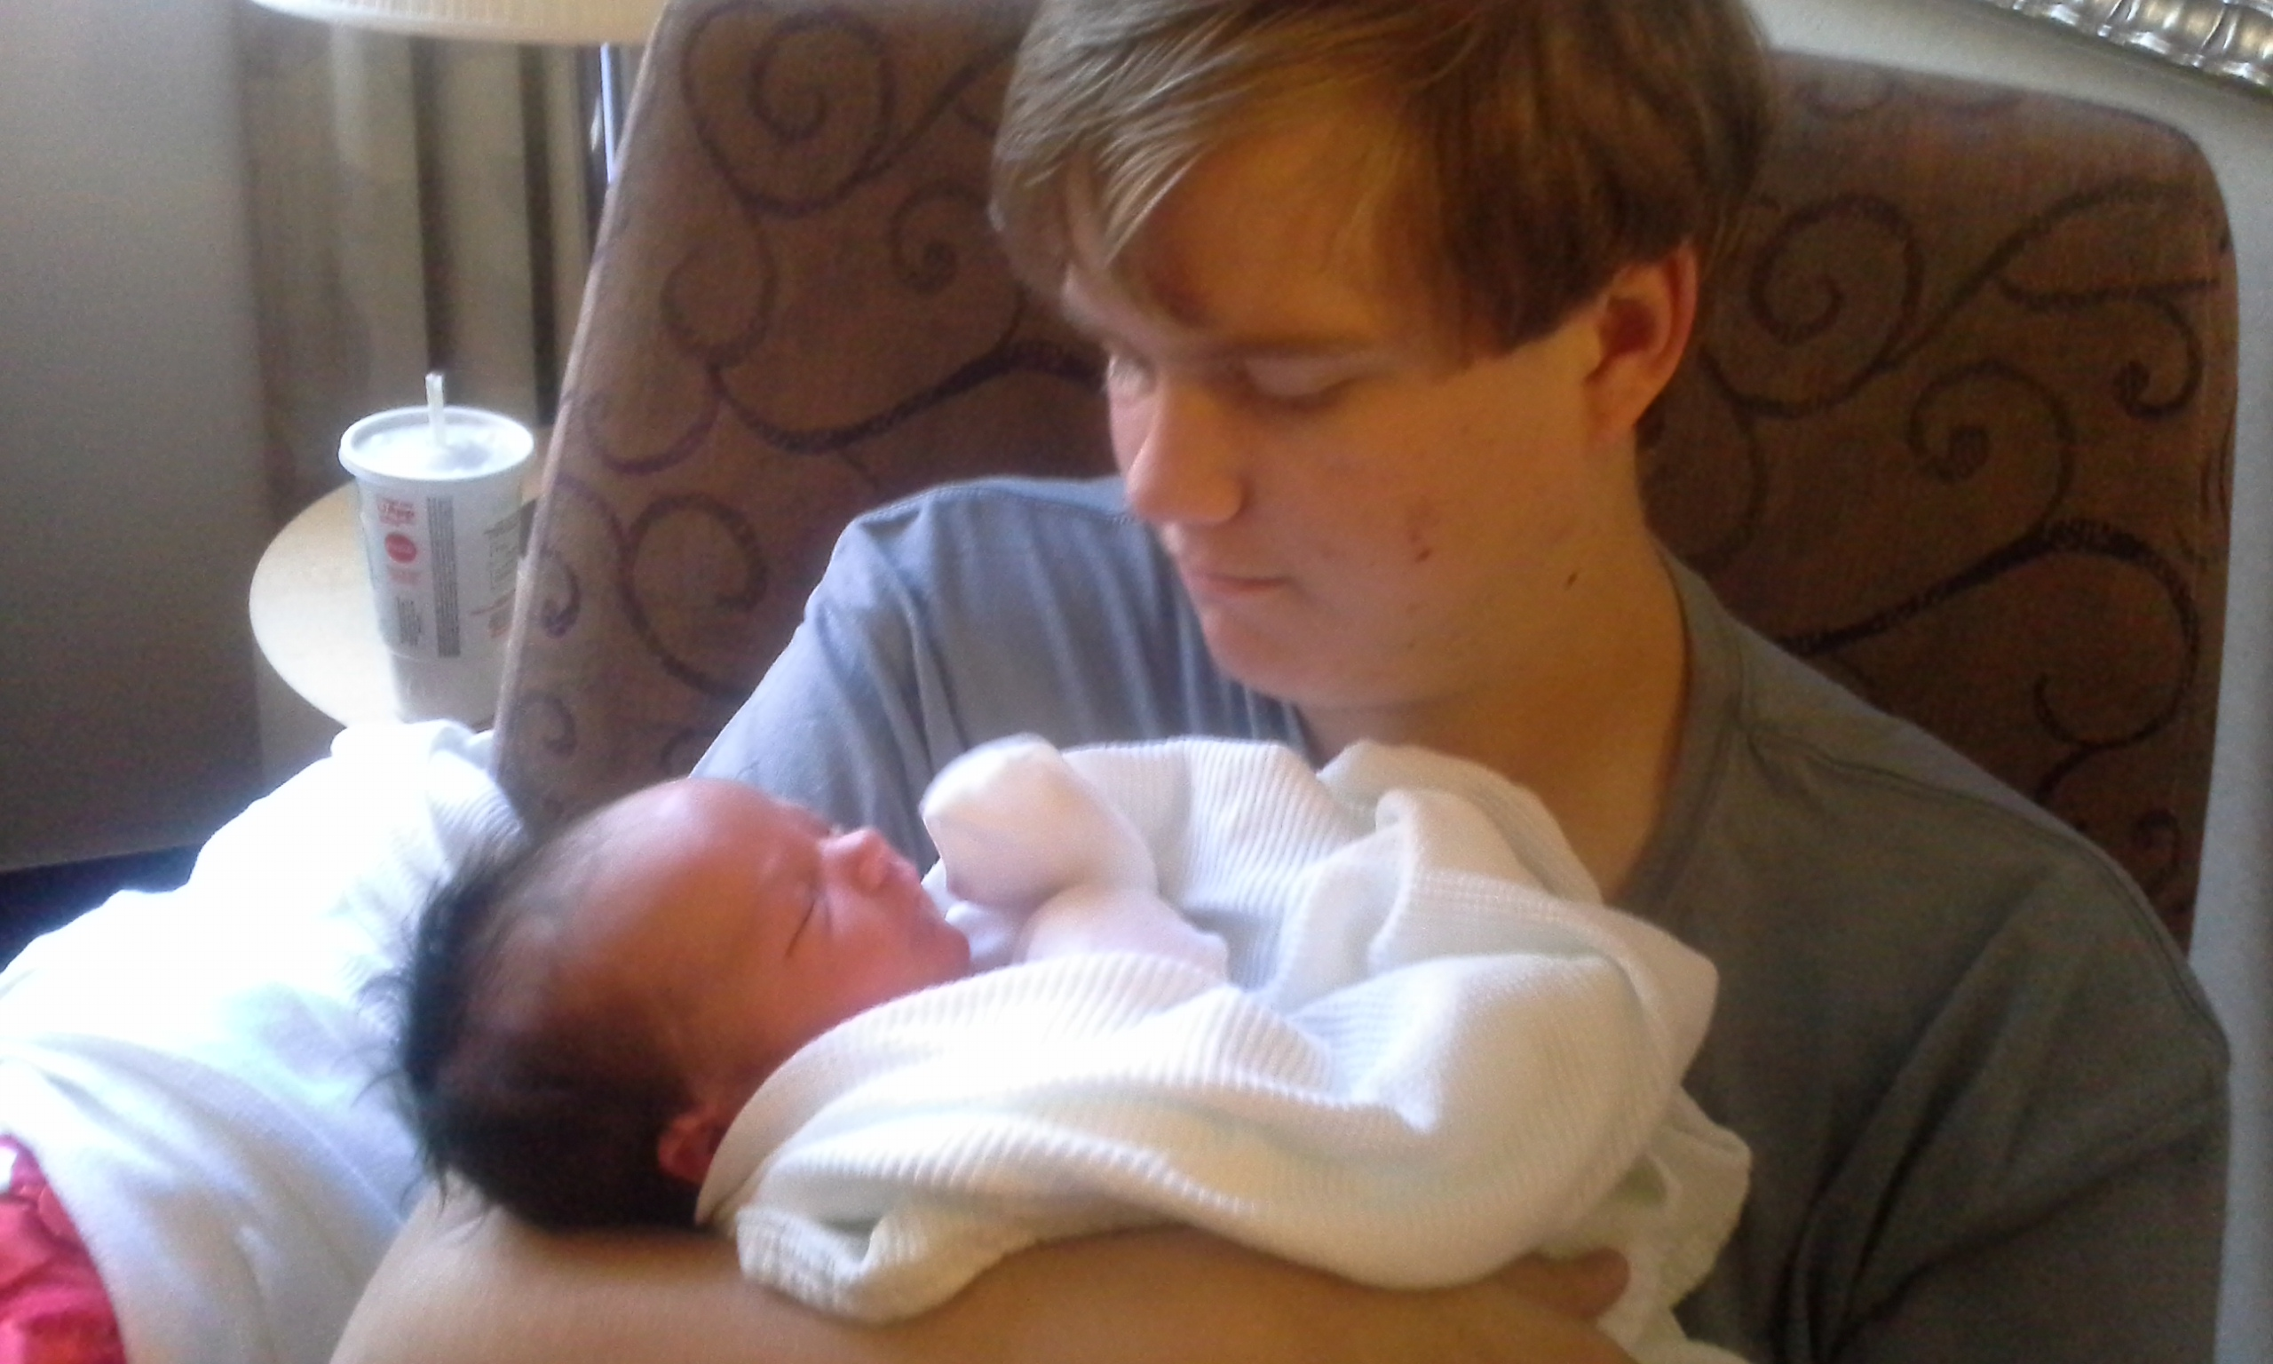
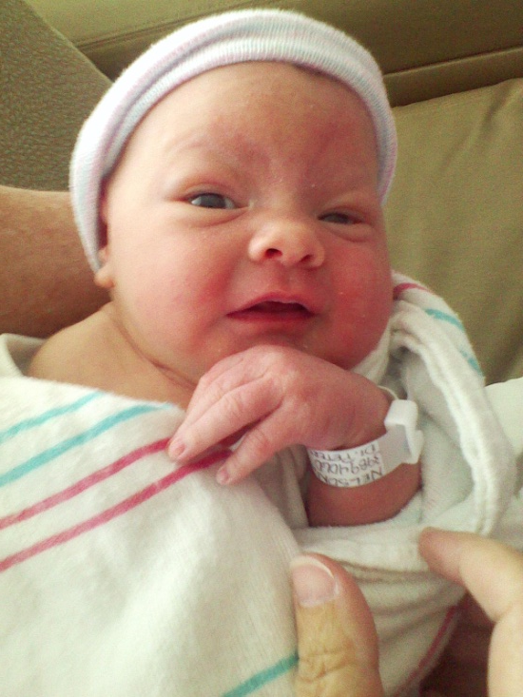
Those With Righteous Desires
Our righteous desires are not fulfilled in this life, they will be fulfilled in the eternities.
If we desire righteous things, the Lord will bless us according to those desires.
We are born without the abilities to distinguish between good and evil…but learn as we grow and become accountable for our choices--agency
Alma 29:4-5

Slide 21
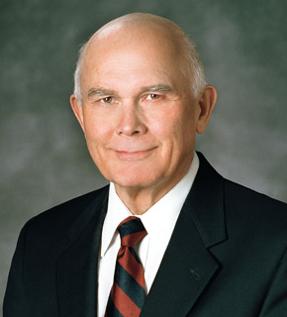
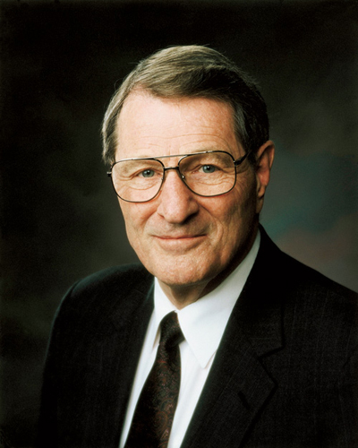
God allows us to make choices based on our desires, whether those desires will lead to our salvation or destruction
“Desires dictate our priorities, priorities shape our choices, and choices determine our actions. The desires we act on determine our changing, our achieving, and our becoming”
Dallin H. Oaks
“What we insistently desire, over time, is what we will eventually become and what we will receive in eternity. … Only by educating and training our desires can they become our allies instead of our enemies!”
Neal A. Maxwell

Slide 22
“The laws of God can reward the righteous desire or attitude because an omniscient God can determine it…
if a person does not perform a particular commandment because he is genuinely unable to do so, but truly would if he could, our Heavenly Father will know this and will reward that person accordingly.
Upon the same principle, evil thoughts or desires are sinful under the laws of God even though not translated into the actions that would make them punishable under the laws of man.
Similarly, if a person performs a seemingly righteous act but does so for the wrong reasons, such as to achieve a selfish purpose, his hands may be clean but his heart is not ‘pure’.
His act will not be counted for righteousness.”
Elder Dallin H. Oaks
Sometimes people have righteous desires that are not fulfilled in this life, such as the desire to marry in the temple or to have children...
However: God will eventually grant us our righteous desires.

Slide 23
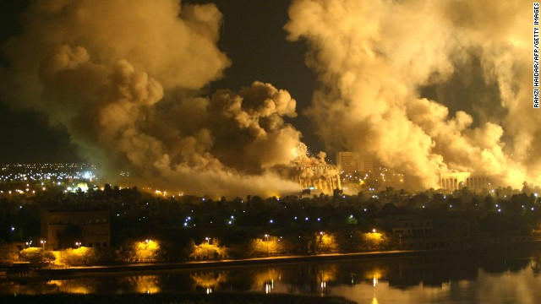
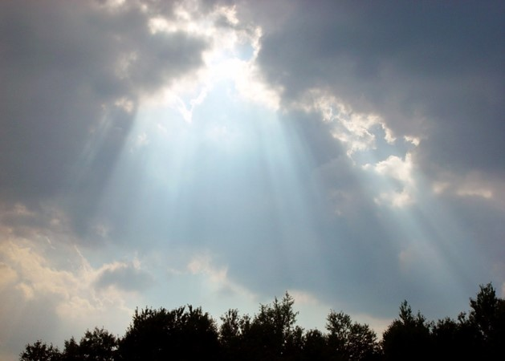
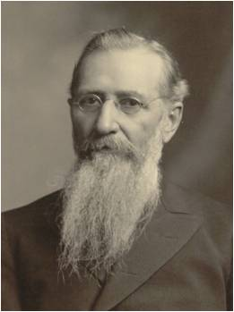
Heaven’s Light
All nations will have the right to receive the treasures of heaven
Some nations have chosen to be hard of heart and to walk in the darkness.
“The Lord will provide an opportunity for every soul to receive the fulness of the everlasting gospel either in this world or in the world to come.”
Joseph F. Smith
Alma 29:8

Slide 24
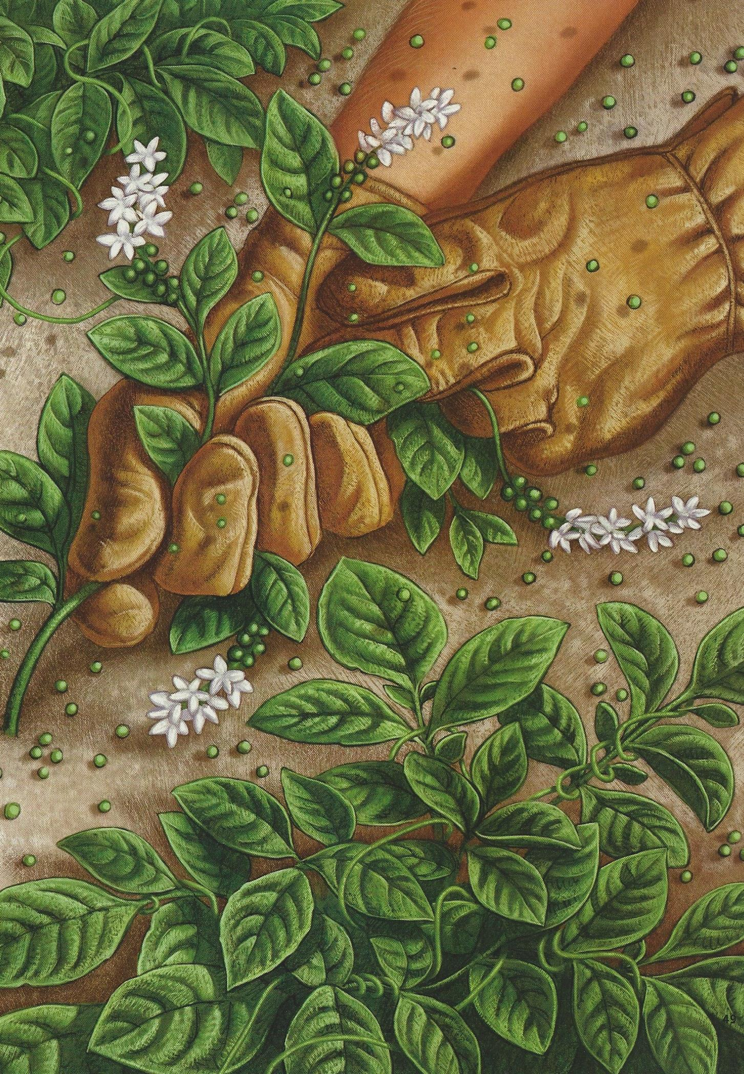
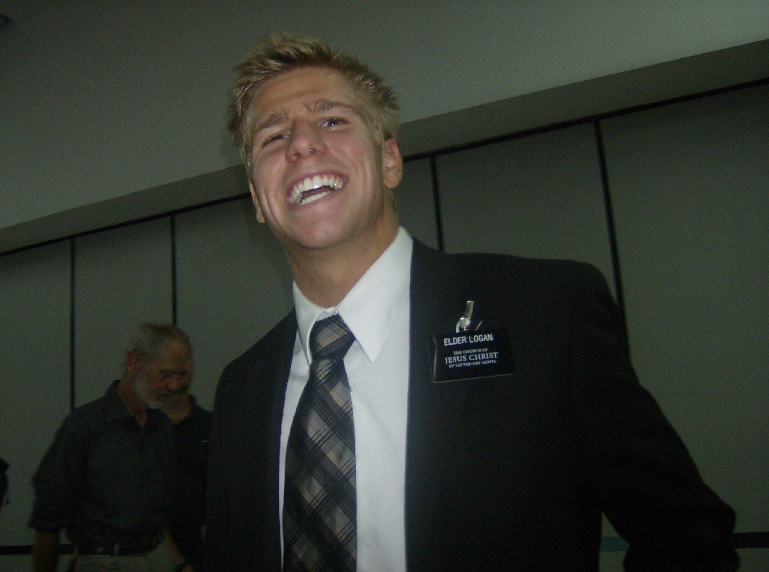
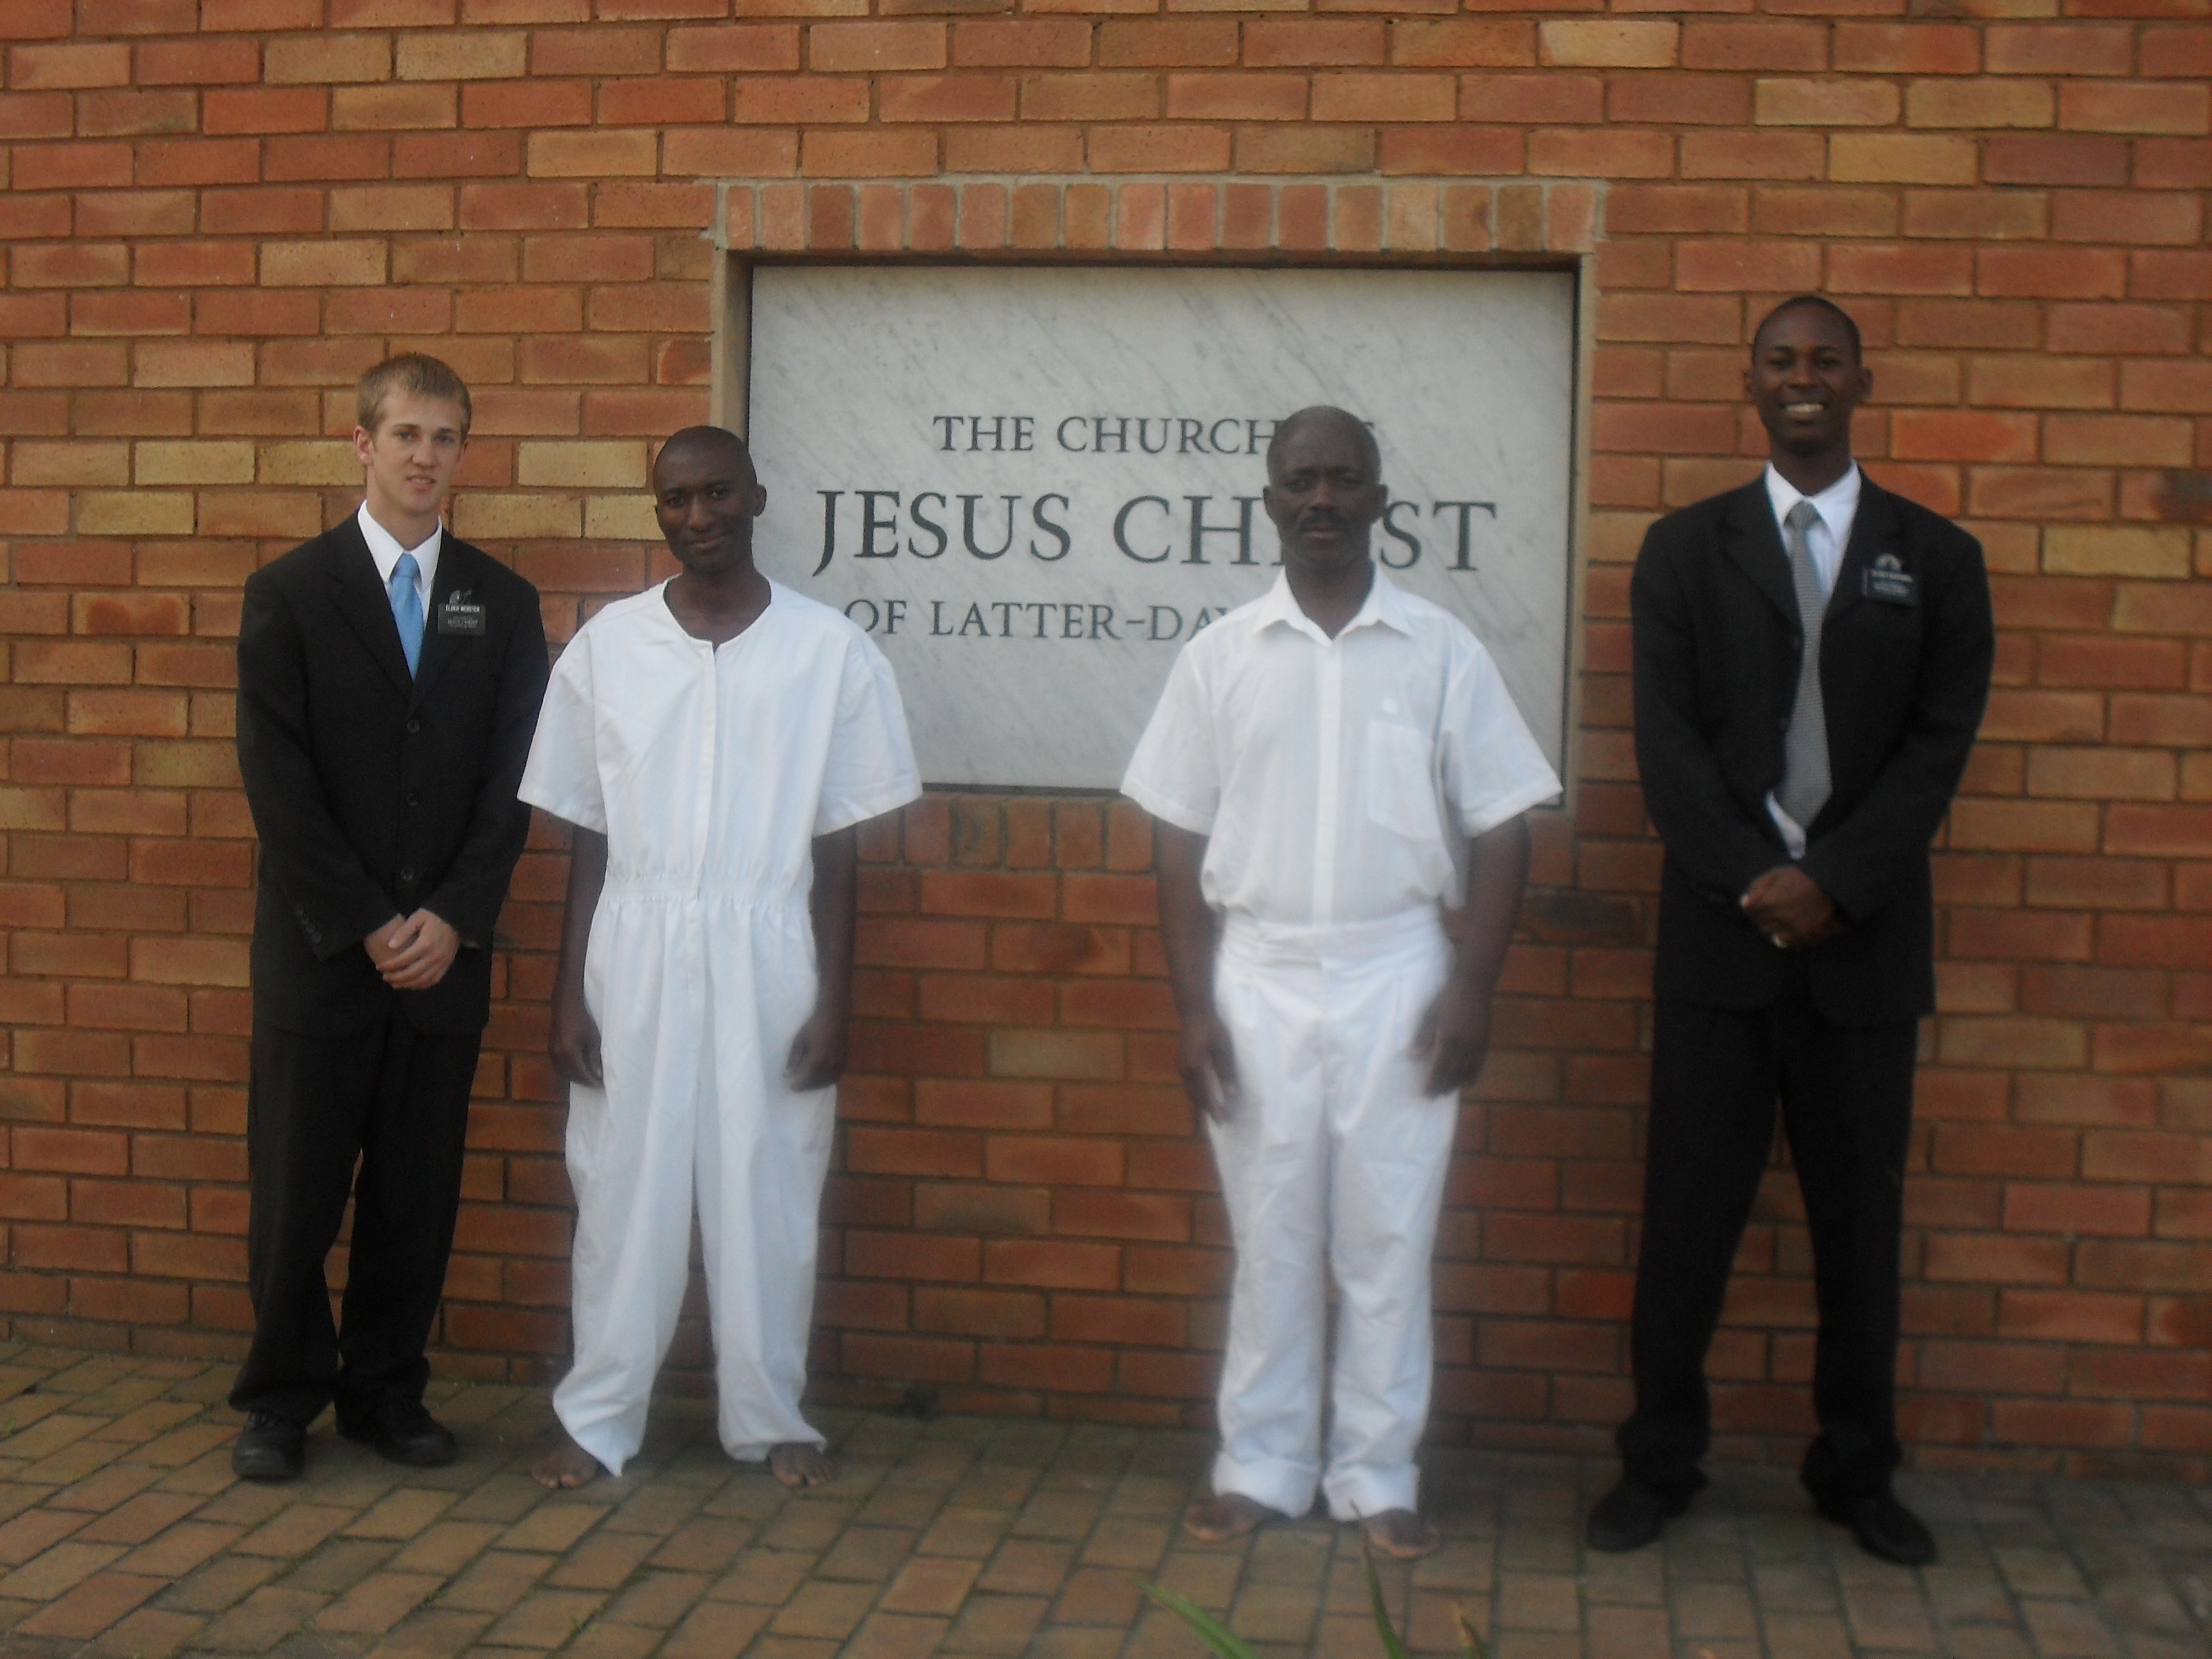
Peace and Joy
Alma rejoices over those whom he has been instrumental in bring back into the fold
Peace
Joy
Peace and Joy are the wages of those who labor in the Lord’s vineyard.
We will experience joy when we help others repent and come unto Christ.
Alma 29:9-10

Slide 25
Sources:
Suggested Hymn—if you can..obtain the music “Oh, That I Were An Angel”
https://www.youtube.com/watch?v=Y0aX3evbh5M
Henry B. Eyring, “The Spirit Must Be Our Constant Companion” [evening with a General Authority, Feb. 7, 2003], 1
Joseph Fielding McConkie and Robert L. Millet Doctrinal Commentary on the Book of Mormon Vol. 3 p. 183, 188,193-195
George Reynolds and Janne M. Sjodahl Commentary on the Book of Mormon 4:42
Source found in Student Manual Religion 121-122
Thomas S. Monson recalling his youth (“Mrs. Patton—the Story Continues,” Ensign or Liahona, Nov. 2007, 22).
Elder Dallin H. Oaks Pure in Heart p. 12-13; “Desire,” Ensign or Liahona, May 2011, 42).
Neal A. Maxwell, “According to the Desire of [Our] Hearts,” Ensign, Nov. 1996, 21–22).
Joseph F. Smith Gospel Doctrine p. 31
Russell M. Nelson (“Now Is the Time to Prepare,” Ensign or Liahona, May 2005, 18).

