Slide 2
What Can You Do?
What would you do if someone in your family or a good friend began to stray from living the gospel?
What might you do to help them have the desire to keep the commandments?
To whom might you turn for help in working with your family member or friend?

Slide 3
Zoramites
They were the descendants of Zoram who were Laban’s servant that went with Lehi and his family to the promised land
Zoram

Slide 4
Alma’s Concern
Alma had received word that the Zoramites were “perverting the ways of the Lord”
They were idol worshippers and separated themselves from the Nephites
Should we be concerned for those who fall away from the gospel?
Alma 31:1-2

Slide 5
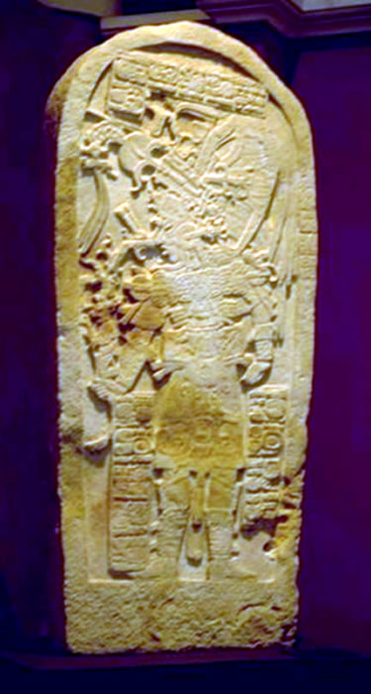
Antionum
Land Bountiful
West Sea
East Sea
Jershon
Antionum
Duane Hurst
Machaquila in Guatemala
(City of Antionum)
Zarahemla
Jerusalem
Land of Nephi
Alma 31:3

Slide 6
Alma’s Fear
Alma feared that the Zoramites would enter into correspondence with the Lamanites
And that it would be a “great loss on the part of the Nephites”
Alma 31:4

Slide 7
Alma’s Ambition
Alma felt that if he were to preach to them they might be able to lead the people back to what is just.
Alma felt that preaching would have a more powerful effect “upon the minds than the sword”
Preaching the word of God can have a more powerful effect than anything else in helping people do what is right
Alma 31:4

Slide 8
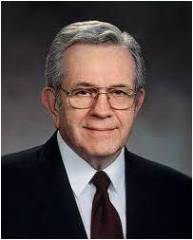
The Virtue of the Word
“True doctrine, understood, changes attitudes and behavior.
“The study of the doctrines of the gospel will improve behavior quicker than a study of behavior will improve behavior…
… That is why we stress so forcefully the study of the doctrines of the gospel.”
Boyd K. Packer

Slide 9
As we study the word of God, it will lead us to do what is right
The
Book
of
Mormon
ANOTHER TESTAMENT
OF JESUS CHRIST

Slide 10
Going with Alma
Alma takes Ammon, Aaron Omner, his two sons, Shiblon and Corianton
Zeezrom and Amulek join them from Melek
Alma 31:6-7

Slide 11
Rameumptom—the Holy Stand
Their Same Prayer unto God
Alma 31:15-18
Built a synagogue—one person at a time—
-one day a week---shouting:

Slide 12
Their Prayer
“Holy, holy God; we believe that thou art God, and we believe that thou art holy, and that thou wast a spirit, and that thou art a spirit, and that thou wilt be a spirit forever.
Holy God, we believe that thou hast separated us from our brethren; and we do not believe in the tradition of our brethren, which was handed down to them by the childishness of their fathers; but we believe that thou hast elected us to be thy holy children; and also thou hast made it known unto us that there shall be no Christ.”
Alma 31:15-16

Slide 13
“But thou art the same yesterday, today, and forever; and thou hast elected us that we shall be saved, whilst all around us are elected to be cast by thy wrath down to hell; for the which holiness, O God, we thank thee; and we also thank thee that thou hast elected us, that we may not be led away after the foolish traditions of our brethren, which doth bind them down to a belief of Christ, which doth lead their hearts to wander far from thee, our God.
And again we thank thee, O God, that we are a chosen and a holy people. Amen.
Alma 31:17-18

Slide 14
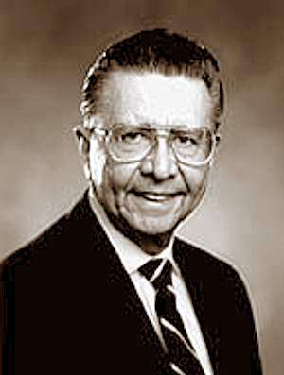
Choosing to not keep the commandments, participate in gospel ordinances, or pray daily will lead us to stray from the gospel.
“During the past years I have at times been asked by the Brethren to meet with repentant members of the Church and interview them for the restoration of their temple blessings.
This has always been a spiritually moving experience to restore the blessings of those wonderful people who have repented.
I have asked some of them the question, ‘What happened in your life that caused you to temporarily lose your membership in the Church?’ With tear-filled eyes they answered: ‘I didn’t obey the basic principles of the gospel: prayer, attending church regularly, serving in church and studying the gospel. I then gave in to temptations and lost the guidance of the Holy Spirit’”
Elder Rulon G. Craven

Slide 15
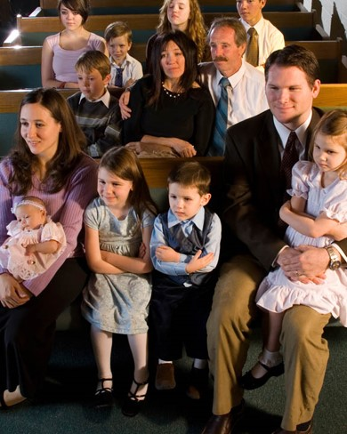
Worshipping
What changes do you think the Zoramites would need to make in order for their worship to be reverent and pleasing to the Lord?
We worship God by giving Him our love, reverence, and devotion.
We should be worshipful not only in our attitude and actions when we pray, fast, and attend Church but in our attitude and actions throughout each day.
How sincere are you in your own worship?
Alma 31:19-23

Slide 16
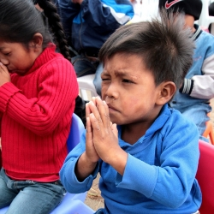
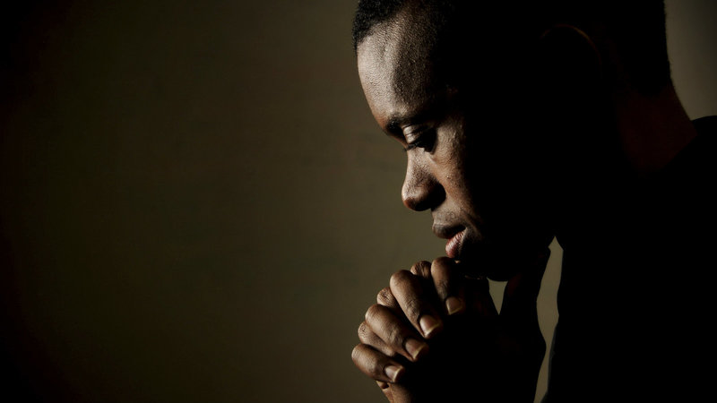
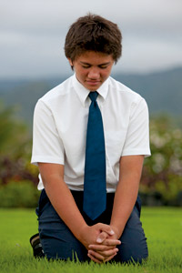
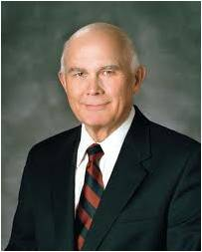
“The attitude of worship evokes the deepest feelings of allegiance, adoration, and awe.
Worship combines love and reverence in a state of devotion that draws our spirits closer to God.”
Elder Dallin H. Oaks

Slide 17
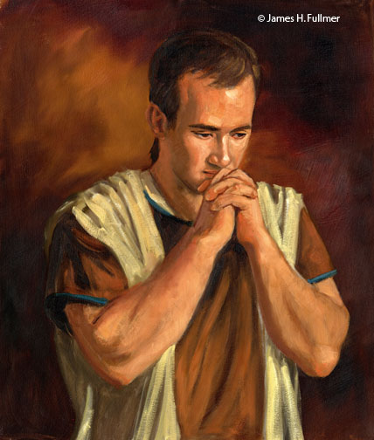
Alma’s Plea
“Comfort in Christ”
A plea for strength
“Success”
A plea for bringing them unto Christ
“Comfort my soul in Christ”
The Spirit heals the soul
“Their souls are precious”
‘the worth of souls is great in the sight of God’ D&C 18:10
James H. Fullmer
Alma 31:24-35

Slide 18
What Was the Focus of:
A
Zoramite Prayer
Alma’s Prayer
What is the focus of your own:
Personal Prayer

Slide 19
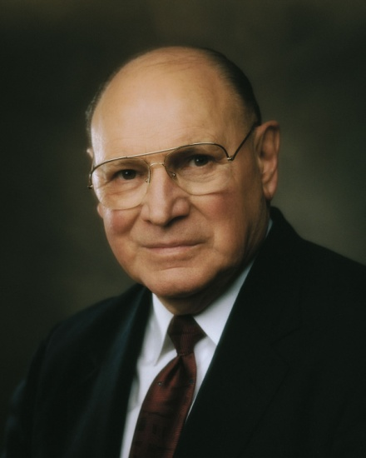
“Do your prayers at times sound and feel the same?
Have you ever said a prayer mechanically, the words pouring forth as though cut from a machine?
Do you sometimes bore yourself as you pray?
Will prayers that do not demand much of your thought merit much attention from our Heavenly Father?
When you find yourself getting into a routine with your prayers, step back and think.
Meditate for a while on the things for which you really are grateful. Look for them. They don’t have to be grand or glorious. Sometimes we should express our gratitude for the small and simple things like the scent of the rain, the taste of your favorite food, or the sound of a loved one’s voice.”
Elder Joseph B. Wirthlin

Slide 20
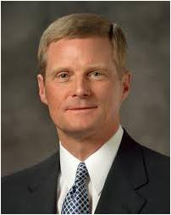
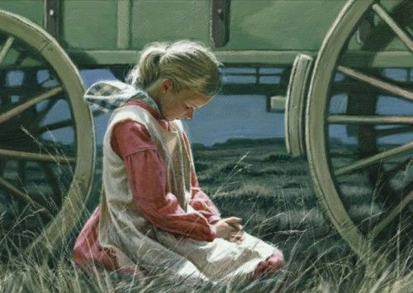
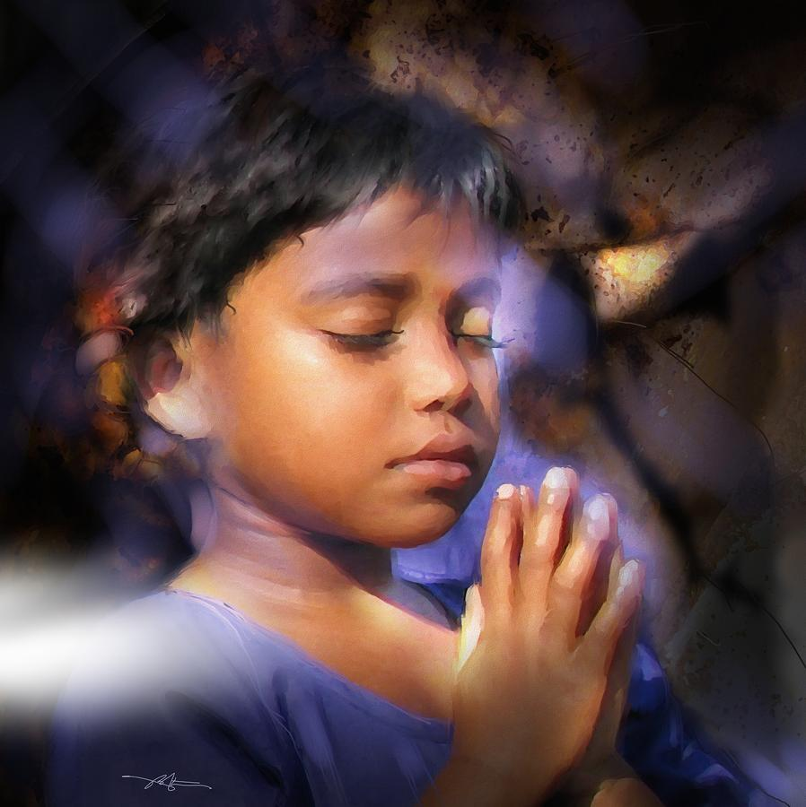
“Petitioning Heavenly Father for the blessings we desire in our personal lives is good and proper. However, praying earnestly for others, both those whom we love and those who despitefully use us, is also an important element of meaningful prayer. …
Praying for others with all of the energy of our souls increases our capacity to hear and to heed the voice of the Lord”
Elder David A. Bednar
If we pray and act in faith, the Lord will strengthen us as we seek to bring others to Him

Slide 21
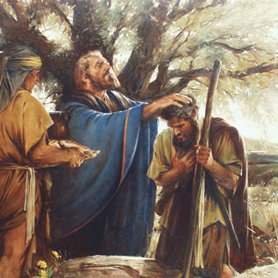
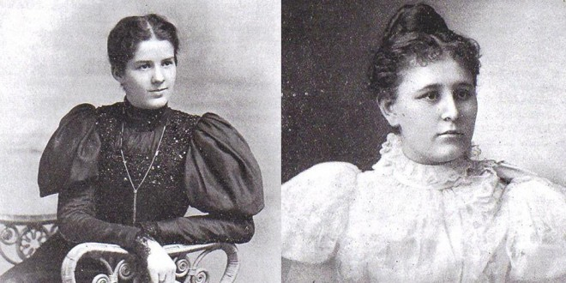
Clapped His Hands
Laying on of hands--Set apart those who were to go with Alma to preach or bestowed upon them a blessing
Taking no thought for themselves---What would they eat?
Where would they sleep?
“Therefore, take ye no thought for the morrow, for what ye shall eat, or what ye shall drink, or wherewithal ye shall be clothed….For your Father, who is in heaven, knoweth that you have need of all these things.”
D&C 84:81,83
Lucy Jane “Jennie” Brimhall and Amanda Inez Knight
Read D&C 84:81-95—the promises for a missionary
Alma 31:37

Slide 22
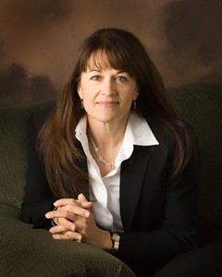
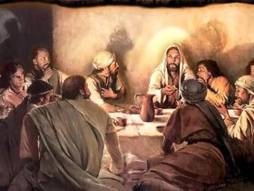
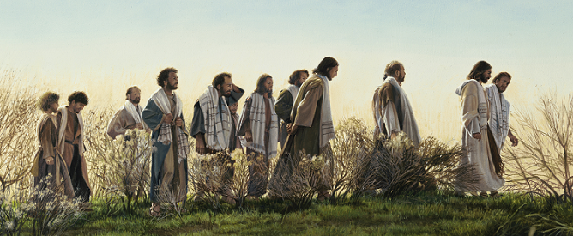
“Early in His ministry, the Savior called His disciples to go forth and preach his word. These were largely fishermen with little money. They must have worried how they would provide for themselves and their families as they left to go and preach. Calming their fears Jesus said, "Provide neither gold, nor silver, nor brass in your purses... for the workman is worthy of his meat." - Matthew 10:9-10
C. Michael Dudash
The Savior, nearing the end of his life, could again sense the fear growing in his disciples. He reminded them, "When I sent you without purse, and scrip, and shoes, lacked ye anything? And they said, Nothing." - Luke 22:35
We live in times of great uncertainty when the necessities of life seem harder to come by and where the burden of providing for our families seems heavier than in days past. This painting reassures me that although the road may be rough, when we walk with Him we need not worry for in Christ we lack nothing.”
Liz Lemon Swindle
“Without Purse Or Script”

Slide 23
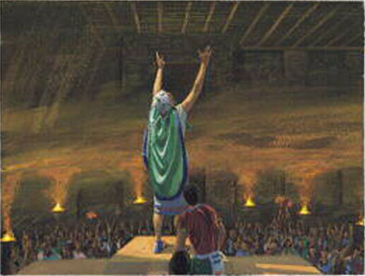
Sources:
Boyd K. Packer (“Little Children,” Ensign, Nov. 1986, 17).
Elder Rulon G. Craven (“Temptation,” Ensign, May 1996, 76).
Elder Dallin H. Oaks (Pure in Heart [1988], 125).
Elder Joseph B. Wirthlin (“Improving Our Prayers,” Ensign, Mar. 2004, 26).
Elder David A. Bednar (“Pray Always,” Ensign or Liahona, Nov. 2008, 43).
Liz Lemon Swindle---Jesus and disciples
www.lizlemonswindle.org http://www.foundationarts.com/p-23979-without-purse-or-scrip.aspx?affiliateid=10199
Duane Hurst Photos: http://www.freeenglishsite.com/duane_background.htm
Presentation by ©http://fashionsbylynda.com/blog/

Slide 24
On April 21, 1898, Lucy Jane “Jennie” Brimhall and Amanda Inez Knight (pictured above) arrived in Liverpool England to start their missions for the Mormon Church. While this may not seem like something spectacular today, it was at the time. In fact, Inez and Jennie were the first single women formally set-apart as full-time, proselyting missionaries. Childhood friends, the two served as companions in England. Their story, though centuries old, will resonate with modern day sisters and continue to inspire future generations.
Growing Up Friends
Jennie and Inez both grew up in Utah territory and were brought together by the love their families had for education. Jennie was born in Spanish Fork and was the daughter of George Brimhall, who would eventually serve as the President of Brigham Young University from 1904 to 1921. Inez’s father, Jesse Knight, had a great desire for his children to be educated through the Church’s school. He moved them from the Payson area where Inez was born so they could enroll.
In the spring of 1898, at the ages of 23 and 22, the friends were planning an excursion to Europe. Little did they know what was to come.
The Call to Serve
President George Q. Cannon, inspired by the many wives of missionaries who accompanied their husbands overseas and taught the gospel, determined the time had come for the women to enter the mission field on their own. Jennie recorded the following thoughts about the night they learned they were being asked to serve as missionaries:
“I had accepted an invitation to accompany Inez on a trip of two or three months to Europe; one day while at home making preparations for our journey, Bishop Keeler called and asked me if I would accept a call to go on a mission. I told him that I would. Later, I received word to be present at Brother Jesse Knight’s home and there be set apart as a missionary to Great Britain. We met according to appointment, and found the bishop of our ward, and the presidency of our stake, Presidents Partridge, John, and Smoot. A letter was read from the first presidency of the Church authorizing the Brethren to set us apart as missionaries. We were then set apart, President David John being mouth in my own case. I was also given a certificate, and am thus numbered among the full-fledged missionaries of the Church of Jesus Christ of Latter-day Saints.”
Missionary Life in England
The struggles Jennie and Inez faced are similar to the ones modern-day missionaries faced. Inez, who anticipated tracting to be easier than public speaking, was accosted by a woman who had been offended by a Mormon. She followed Inez and Jennie door to door and told everyone not to let them inside.
“I went home and cried,” Inez wrote in her diary. They also endured people hurling stones and trash at them, soiling their clothes and bruising their spirits.
The sisters regularly spoke in meetings, being something of a novelty as women preachers for the Church. Inez noted, “We attended Priesthood meeting at which I was the only girl. I felt more conspicuous by the elders beginning their remarks; ‘My brethren and sister.'”
After just six months, Jennie had to return to the United States because of her health. Inez was given a new companion for six months, Liza Chipman. Inez would go on to serve for a total of two years and a month. For much of the time she served alone.
First LDS Sister Missionaries
Something of Insterest
Jennie, upon her return home, married Inez’s brother William Knight. They would have two children. She then went on establish an LDS settlement with her husband in Canada. After returning to Utah in the 1920s, she was called as the first counselor in the General Relief Society Presidency, serving faithfully for 7 years. She lived a long life, passing away at age 81 in 1957.
Inez was active in the Relief Society and politics after her mission. She served on the Relief Society general board from 1927 until her death in 1937. She also served as the Dean of Women for Brigham Young Academy and as a Utah delegate to the Democratic Nation Convention in Ohio. She even ran as a Democratic candidate for the Utah State Senate. She married Robert Eugene Allen and had five sons.
Both women have buildings named after their families on the Brigham Young University campus.
These two sisters, so ready to serve faithfully in a calling that had never before been filled in such a capacity, helped pave the way for sisters to serve today. Their efforts did not go unnoticed. In a magazine describe Jennie’s power as a missionary many years later, it was written:
“So effective was her testimony that after twenty years an unbeliever who listened to her speak wrote, saying he could never forget her sincere, guileless expression and was led further to investigate and receive the blessings of membership.”
http://www.ldsdaily.com/world/heres-a-rare-look-at-the-first-lds-sister-missionaries/

