Slide 2
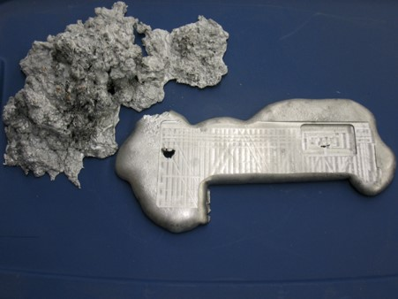
Poor, and Poor in Spirit
The poor had been cast our of the synagogues because of their apparel
They could not worship God…having been esteemed filthy
Dross—The scum thrown off in the smelting process
However:
They were in a state ready to receive to the word of God…a state of humility
Alma 32:1-3

Slide 3
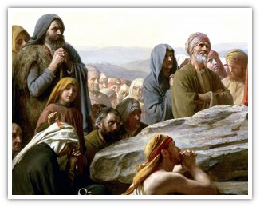
A Humble Group
“Wherefore, I call upon the weak things of the world, those who are unlearned and despised, to thresh the nations by the power of my Spirit
And the poor and the meek shall have the gospel preached unto them…”
D&C 35:13, 15
“The meek also shall increase their joy in the LORD, and the poor among men shall rejoice in the Holy One of Israel.”
Isaiah 29:19
“Hearken, my beloved brethren, Hath not God chosen the poor of this world rich in faith and heirs of the kingdom which he hath promised to them that love him?
James 2:5

Slide 4
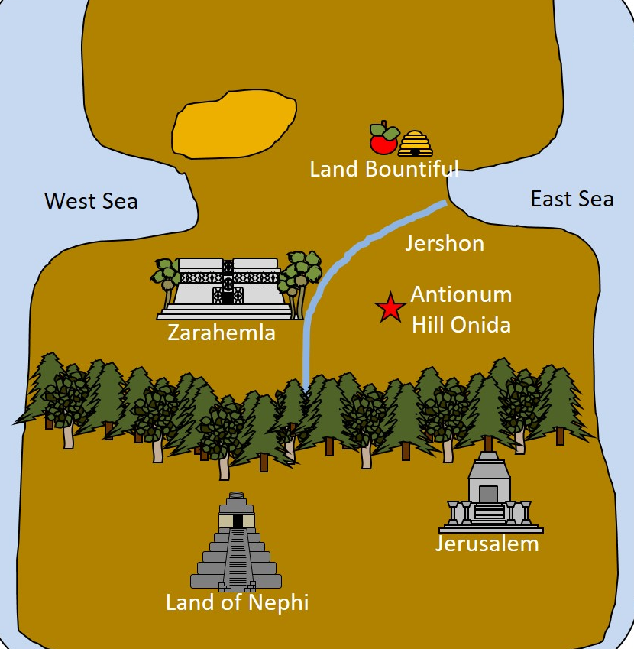
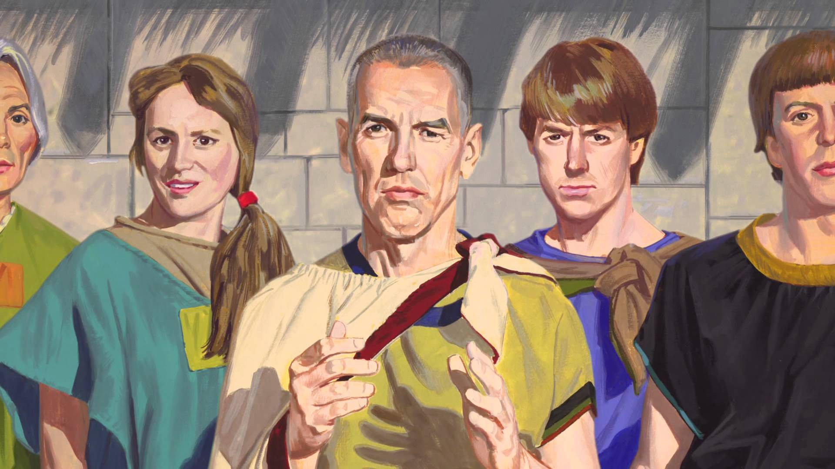
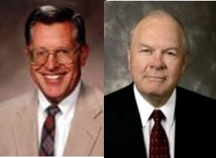
Hill Onidah
The poor ask Alma what they should do because they could not worship in the synagogues
Alma knew they were prepared to hear the word
Humility prepares us to receive the word of God
“In order to receive or accept the word of truth, the person must be prepared to hear it.”
JFM and RLM
Alma 32:4-6

Slide 5
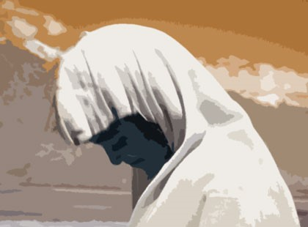
Blessed Are They
“And now, because ye are compelled to be humble blessed are ye; for a man sometimes, if he is compelled to be humble, seeketh repentance; and now surely, whosoever repenteth shall find mercy; and he that findeth mercy and endureth to the end the same shall be saved.”
We are more blessed when we choose to be humble than when we are compelled to be humble
Alma 32:13

Slide 6
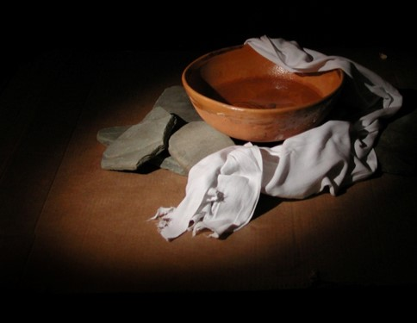
Therefore:
“Therefore, blessed are they who humble themselves without being compelled to be humble; or rather, in other words, blessed is he that believeth in the word of God, and is baptized without stubbornness of heart, yea, without being brought to know the word, or even compelled to know, before they will believe.”
“…those who respond most readily to the message of the missionaries continue after baptism to grow in the things of the Spirit more rapidly, and sink their spiritual roots deeper, than those who confused intellect and independence of thought with stubbornness of heart.”
JFM and RLM
Alma 32:16

Slide 7
Sign Demanders
Sherem in Jacob 7:13-16
Korihor in Alma 30:43-52
“And he that seeketh signs shall see signs, but not unto salvation…
But, behold, faith cometh not by signs, but signs follow those that believe…
Yea, signs come by faith, not by the will of men, nor as they please, but by the will of God.”
D&C 63:7,9,10
Signs are a product of faith, not something we should demand before we have faith
Alma 32:17-20

Slide 8
Faith is Built On:
The idea of the Existence of God
A correct idea of his character, perfections, and attributes
An actual knowledge that the course in life one is pursuing is according to God’s will
Through:
Studying, searching, pondering the words of the Lord, and through testimonies of others
Ourselves:
A person may have the assurance that they are on the course only if they are “on the course”
Joseph Smith

Slide 9
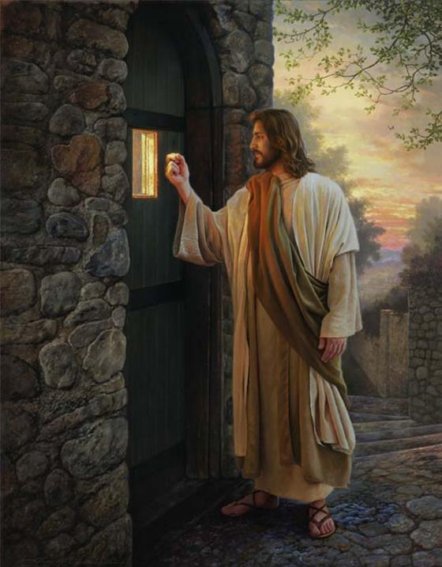
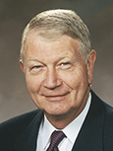
“Because of the conflicts and challenges we face in today’s world, I wish to suggest a single choice—
a choice of peace and protection and a choice that is appropriate for all.
That choice is faith.
Be aware that faith is not a free gift given without thought, desire, or effort. It does not come as the dew falls from heaven.
The Savior said, ‘Come unto me’ (Matthew 11:28) and ‘Knock, and it shall be [given] you’ (Matthew 7:7). These are action verbs—come, knock. They are choices. So I say, choose faith. Choose faith over doubt, choose faith over fear, choose faith over the unknown and the unseen, and choose faith over pessimism…
…Alma gave us a directive to choose. His were words of action initiated by choosing. He used the words awake, arouse, experiment, exercise, desire, work, and plant. Then Alma explained that if we make these choices and do not cast the seed out by unbelief, then ‘it will begin to swell within [our] breasts’…
Faith is a Choice; it is our responsibility
Alma 32:21-22, 26-27
Richard C. Edgley

Slide 10
The Hypothesis
There are unseen realities, things not seen which are true (vs. 21)
Faith is a hope in the truth of unseen things rather than a perfect knowledge (vs. 21)
This is a person who refuses to believe in something unless he can “know of a surety”…something he can see or hear or feel.
One cannot know of a surety at first the truth of unseen realities any more than faith itself constitutes perfect knowledge (vs. 26)
A particle of faith (even a desire to believe), if planted in the heart and nourished properly, will bring one to know the unseen (vs. 27)

Slide 11
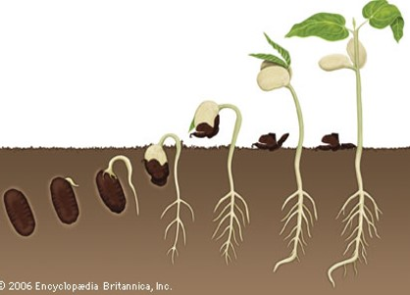
The Experiment
1. Compare the word of God unto a seed (vs. 28)
2. Plant the seed in your heart, not just in your head (vs. 28)
3. Neither cast it out by unbelief nor resist the Spirit of the Lord which accompanies it (vs. 38)
4. If it begins to swell within you and enlarges your soul and enlightens your understanding, it is good: if it does not, it is bad and should be cast away.

Slide 12
The Conclusion
Your faith is now dormant and your knowledge is perfect in one
thing: the fact that the seed was good or bad (vss. 33-35)
2. If the seed is good and begins to grow, additional nourishment and care will cause the seed to become a tree which brings forth fruit (added knowledge of the truth of other things). (vss. 36-37)
3. If the seed or the tree is neglected, it will wither; but this does not mean that the seed was not good. It means that one’s spiritual ground is barren and unproductive. In other words, the experiment did not fail; you failed the experiment! (vss. 38-40)
On the other hand, diligence, patience, and a continuance of faith will cause the tree to spring up “unto everlasting life” (vs. 41) and enable you to “pluck the fruit thereof, which is most precious,…sweet above all that is sweet,…white above all that is white,…pure above all that is pure” (vs. 42)
Student Manual

Slide 13
Your Experiment
Will your faith be perfect after performing this experiment?
What more do you need to do to receive a lasting testimony of the gospel?
What do you need to do to have your faith continue to grow?
What happens when you neglect ‘the word’ that had been planted in your heart?
If we give place in our hearts for Jesus Christ and His gospel, then our testimony of Him will begin to grow.

Slide 14
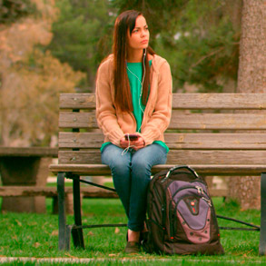
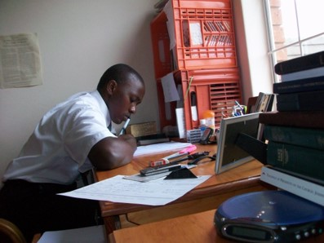
Who Has Exercised Their Faith?
1. A young woman wants physical evidence that the Book of Mormon is true before she will believe it.
2. A young man hears that all worthy young men should serve a full-time mission. Though his family is poor, he is determined to serve and make preparations to serve.
3. A young woman wants to become clean from her sins through the Atonement of Jesus Christ. She knows she needs to confess some transgressions to her bishop in order to fully repent. She makes an appointment to see her bishop

Slide 15
Sources:
Joseph Fielding McConkie and Robert L. Millet Doctrinal Commentary on the Book of Mormon Vol. 3 pg. 224-225
Joseph Smith Lectures on Faith 3:2-5
Richard C. Edgley, “Faith—the Choice Is Yours,” Ensign or Liahona, Nov. 2010, 31–32
Student Manual Religion 121-122 Book of Mormon pg. 300
Presentation by ©http://fashionsbylynda.com/blog/

Slide 16
Experimenting on the word | WHAT DID ALMA INSTRUCT US TO DO WITH THE WORD? | WHAT DID ALMA SAY THE RESULTS WILL BE?
Phase 1 (Alma 32:28–34)
Phase 2 (Alma 32:37–43)
Experimenting on the word | WHAT DID ALMA INSTRUCT US TO DO WITH THE WORD? | WHAT DID ALMA SAY THE RESULTS WILL BE?
Phase 1 (Alma 32:28–34)
Phase 2 (Alma 32:37–43)
Experimenting on the word | WHAT DID ALMA INSTRUCT US TO DO WITH THE WORD? | WHAT DID ALMA SAY THE RESULTS WILL BE?
Phase 1 (Alma 32:28–34)
Phase 2 (Alma 32:37–43)
Experimenting on the word | WHAT DID ALMA INSTRUCT US TO DO WITH THE WORD? | WHAT DID ALMA SAY THE RESULTS WILL BE?
Phase 1 (Alma 32:28–34)
Phase 2 (Alma 32:37–43)

