Slide 2
a. My son, give ear to my words (1)
b. Keep the commandments (and) ye shall prosper in the land (1)
c. Captivity of our fathers—bondage (2)
d. Surely God did deliver them (2)
e. Trust in God (3)
f. Support in trials, trouble, and afflictions (3)
g. I know this not of myself, but of God (4)
h. Born of God (5)
i. Seek no more to destroy the church of God (9)
j. Fell to earth (10)
k. Limbs paralyzed (10)
l. The agony of conversion: destroyed, torment, harrowed up, racked, the pains of hell, inexpressible horror, banished and extinct, the pains of a damned soul
m. I remember… the coming of one Jesus Christ, a Son of God, to atone for the sins of the world (11-16)
m. I cried within my heart: O Jesus, thou Son of God, have mercy on me (17)
l. The Joy of conversion: no more pain, what joy, marvelous light, exquisite, nothing as sweet, sing and praising god, longing to be with God (19-22)
k. Limbs received their strength again (23)
j. Stood upon my feet (23)
i. Labored without ceasing to bring souls unto repentance (24)
h. Many have been born of God (26)
g. Knowledge is of God (26)
f. Supported under trials and troubles, yea afflictions (27)
e. Trust in Him (27)
d. He will still deliver me (27)
c. Egypt—captivity (28-29)
b. Keep the commandments and ye shall prosper in the land (30)
a. This according to His word (30)
Chiasmus—Alma 36: 1-30
Alma gives his son Helaman a blessing
The main message of the Blessing

Slide 3
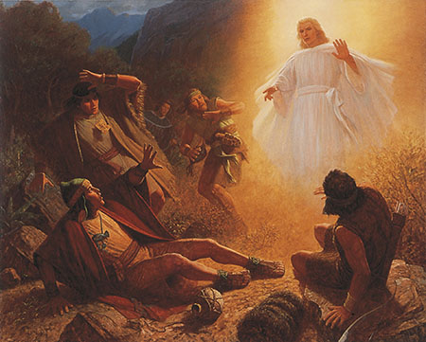
Previously…
Earlier Alma and the sons of Mosiah went about seeking to destroy the Church. (Mosiah 27:8-9)
Alma described his experience years earlier when he was delivered from the pain of his sins through the Atonement of Jesus Christ to Helaman.
An angel of the Lord and spake with a voice of thunder’ and ‘cause the earth to shake’for 3 days and nights (Mosiah 27:11-19)
Sin leads to great pain, suffering, and regret.

Slide 4
Helaman
He was the eldest son of Alma
He lived around 100 BC to 57 BC
He was a leading high priest and a military hero
Alma gave him charge over “the sacred plates” including the plates of brass, the Nephite records, the 24 Jaredite plates, the “interpreters” (Urim and Thummin) –Alma 37:24
He was the spiritual leader among the people
He supported Captain Moroni in withstanding attacks from traitors such as Amalickiah and Ammoron
He became the leader of the legendary 2,000 stripling warriors to defend the liberty of the people
Alma shared with him prophecies of the Nephite’s future
Who’s Who

Slide 5
God’s Power to Deliver
Keep the Commandments
Remember the prophets of old
Remember that I have been ‘born of God’ by a visitation from an angel
Alma’s testimony to Helaman
Hear the words and learn of me
Think on the spiritual things of God
Put your trust in God and endure to the end
Alma 36: 1-5

Slide 6
Alma’s Rebellion and Conversion
Reborn—remembered sins no more
Struck with eternal torment
Three days and nights—could not speak or walk
The angel tells him to stop destroying the church of God
“And oh, what joy, and what marvelous light I did behold; yea, my soul was filled with joy as exceeding as was my pain!”
An angle visited him with power (earth trembled)
Rebellion along with the sons of Mosiah
Alma 36: 6-20

Slide 7
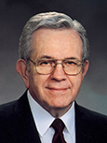
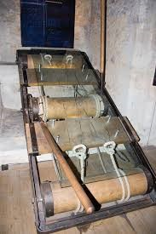
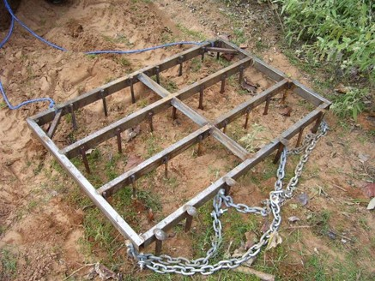
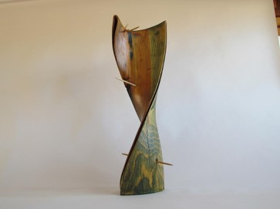
Racked and Tormented
“Racked means ‘tortured.’ Anciently a rack was a framework on which the victim was laid with each ankle and wrist tied to a spindle which could then be turned to cause unbearable pain.
“A harrow is a frame with spikes through it. When pulled across the ground, it rips and tears into the soil. The scriptures frequently speak of souls and minds being ‘harrowed up’ with guilt.
“Torment means ‘to twist,’ a means of torture so painful that even the innocent would confess”
President Boyd K. Packer
Alma experienced pain and regret for his sins
Alma 36:12-13

Slide 8
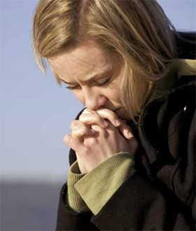
The Cure
“Every one of us has at least tasted the pain of conscience which follows our mistakes. …
“If you are burdened with depressing feelings of guilt or disappointment, of failure or shame, there is a cure” President Boyd K. Packer
“…I remembered also to have heard my father prophesy unto the people concerning the coming of one Jesus Christ, a Son of God, to atone for the sins of the world.”
Now, as my mind caught hold upon this thought, I cried within my heart: O Jesus, thou Son of God, have mercy on me, who am in the gall of bitterness, and am encircled about by the everlasting chains of death.”
Alma 36:17-18

Slide 9
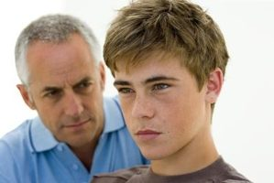
Are They Really Listening?
Alma must have heard his father and what he said to his people while preaching.
Parents should continue to teach even though they think their children may not listening.
Alma 36:17

Slide 10
“Alma had been touched by the teaching of his father, but it is particularly important that the prophecy he remembered was one regarding ‘the coming of one Jesus Christ, a Son of God, to atone for the sins of the world.
That is the name and that is the message that every person must hear. …
Whatever other prayers we offer, whatever other needs we have, all somehow depends on that plea: ‘O Jesus, thou Son of God, have mercy on me.’ He is prepared to provide that mercy. He paid with his very life in order to give it.”
Elder Jeffrey R. Holland
Alma 36:17

Slide 11
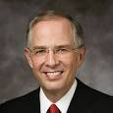
Bitter and Sweet--Anguish and Peace
“Yea, I say unto you, my son, that there could be nothing so exquisite and so bitter as were my pains. Yea, and again I say unto you, my son, that on the other hand, there can be nothing so exquisite and sweet as was my joy.”
“As we honestly confess our sins, restore what we can to the offended, and forsake our sins by keeping the commandments, we are in the process of receiving forgiveness. With time, we will feel the anguish of our sorrow subside, taking “away the guilt from our hearts” and bringing “peace of conscience.”
Neil A. Andersen
Alma 36:21

Slide 12
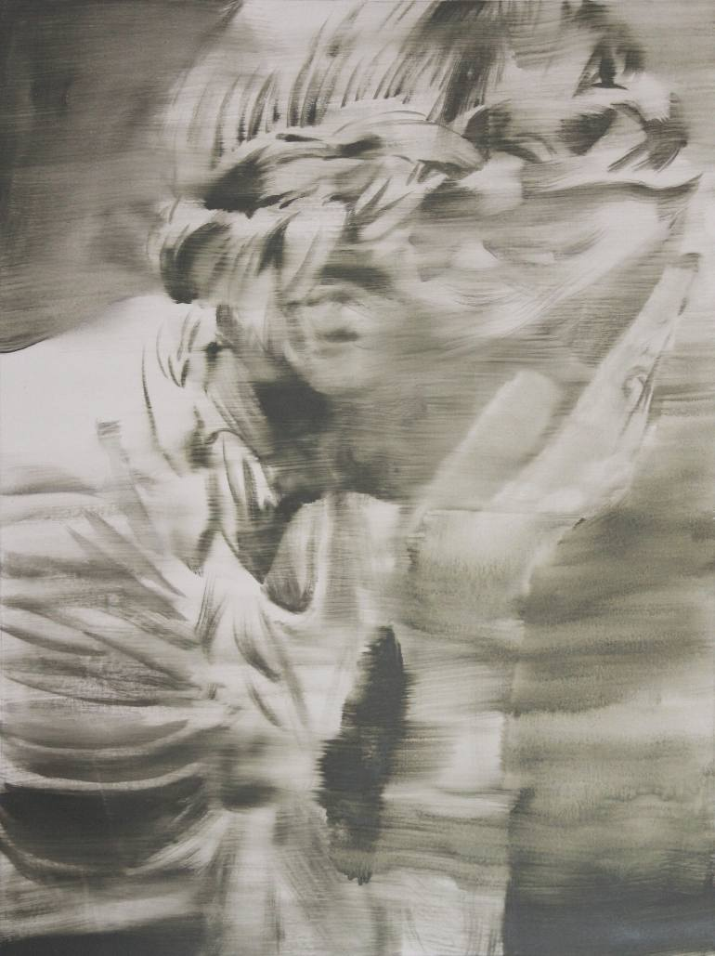
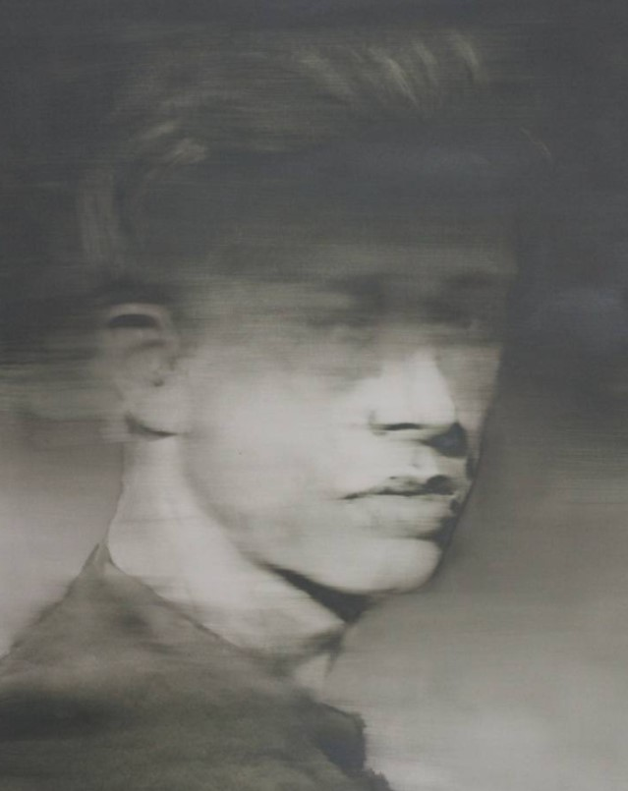
If we exercise faith in Jesus Christ and His Atonement, then He will deliver us from the pain of our sins and fill us with joy.
What can we do to exercise faith in Jesus Christ so that we can be delivered from the feelings of pain or remorse caused by our sins?
János Huszti
János Huszti

Slide 13
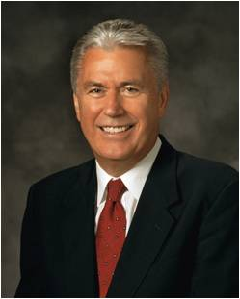
A Situation:
Your friend asks you, “If I can remember my sins and still feel sorry for them, does it mean I haven’t been forgiven?”
“Satan will try to make us believe that our sins are not forgiven because we can remember them. Satan is a liar; he tries to blur our vision and lead us away from the path of repentance and forgiveness.
God did not promise that we would not remember our sins. Remembering will help us avoid making the same mistakes again. But if we stay true and faithful, the memory of our sins will be softened over time. This will be part of the needed healing and sanctification process. Alma testified that after he cried out to Jesus for mercy, he could still remember his sins, but the memory of his sins no longer distressed and tortured him, because he knew he had been forgiven.
“It is our responsibility to avoid anything that would bring back old sinful memories. When we continue to have a ‘broken heart and a contrite spirit’, we may trust that God will ‘remember [our sins] no more.’”
President Dieter F. Uchtdorf
Alma 36:17–19; 3 Nephi 12:19

Slide 14
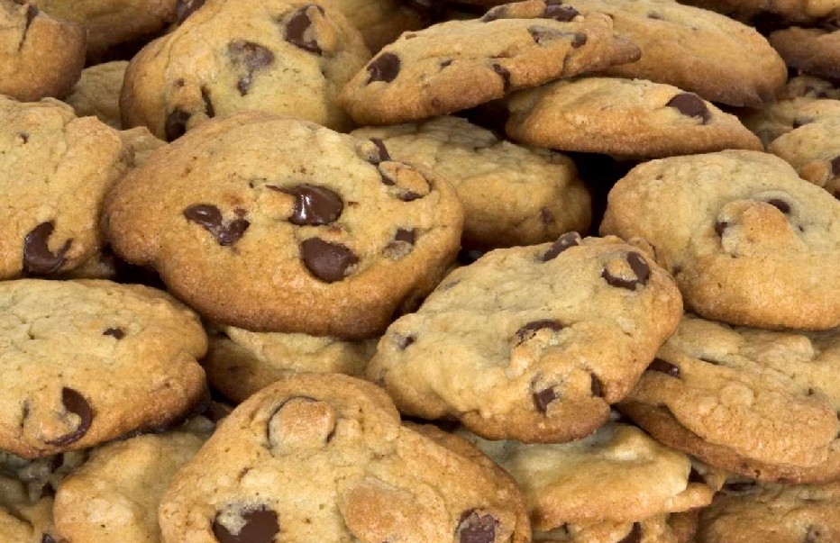
Laboring Continually
“…that I might bring souls unto repentance; that I might bring them to taste of the exceeding joy of which I did taste; that they might also be born of God, and be filled with the Holy Ghost.
“Yea, and now behold, O my son, the Lord doth give me exceedingly great joy in the fruit of my labors;”
Sharing Your Treat
Now that you are all hungry, did your teacher bring treats?
Alma 36:24-25

Slide 15
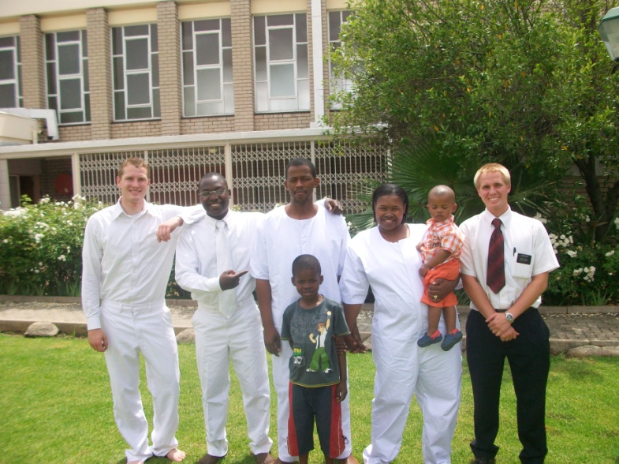
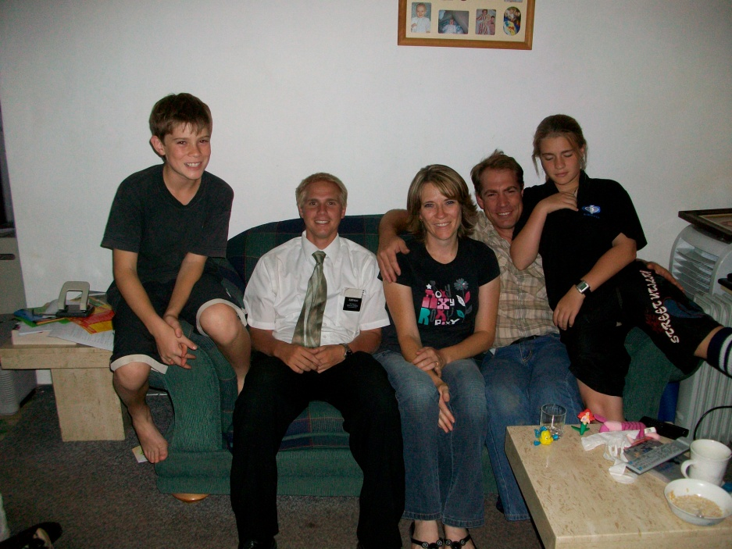
We can receive great joy as we seek to bring others to Christ

Slide 16
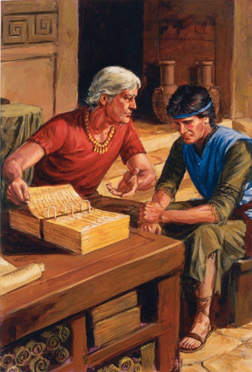
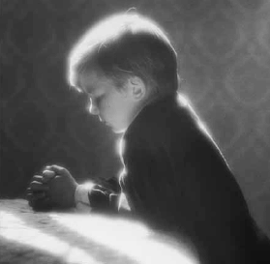
Trust in the Lord
Alma 36:27-30

Slide 17
Sources:
Videos:
God Has Delivered Me (16:25)
Racked with Eternal Torment (1:56)
Replace Suffering with Joy (1:00)
Chiasmus From, "Chiasmus in the Book of Mormon," by John W. Welch, BYU Studies, Autumn 1969
Who’s Who Book of Mormon Ed J. Pinegar and Richard J. Allen pg. 63-64
President Boyd K. Packer (“The Touch of the Master’s Hand, ”Ensign, May 2001, 23) and (“The Touch of the Master’s Hand,” 22).
Neil A. Andersen “Repent … That I May Heal You” Oct. 2009 Gen Conf.
Elder Jeffrey R. Holland (However Long and Hard the Road[1985], 85).
President Dieter F. Uchtdorf (“Point of Safe Return,” Ensign or Liahona, May 2007, 101).
Presentation by ©http://fashionsbylynda.com/blog/

Slide 18
a. My son, give ear to my words (1)
b. Keep the commandments (and) ye shall prosper in the land (1)
c. Captivity of our fathers—bondage (2)
d. Surely God did deliver them (2)
e. Trust in God (3)
f. Support in trials, trouble, and afflictions (3)
g. I know this not of myself, but of God (4)
h. Born of God (5)
i. Seek no more to destroy the church of God (9)
j. Fell to earth (10)
k. Limbs paralyzed (10)
l. The agony of conversion: destroyed, torment, harrowed up, racked, the pains of hell, inexpressible horror, banished and extinct, the pains of a damned soul
m. I remember… the coming of one Jesus Christ, a Son of God, to atone for the sins of the world (11-16)
m. I cried within my heart: O Jesus, thou Son of God, have mercy on me (17)
l. The Joy of conversion: no more pain, what joy, marvelous light, exquisite, nothing as sweet, sing and praising god, longing to be with God (19-22)
k. Limbs received their strength again (23)
j. Stood upon my feet (23)
i. Labored without ceasing to bring souls unto repentance (24)
h. Many have been born of God (26)
g. Knowledge is of God (26)
f. Supported under trials and troubles, yea afflictions (27)
e. Trust in Him (27)
d. He will still deliver me (27)
c. Egypt—captivity (28-29)
b. Keep the commandments and ye shall prosper in the land (30)
a. This according to His word (30)
Chiasmus—Alma 36: 1-30
Alma gives his son Helaman a blessing
The main message of the Blessing

Slide 19
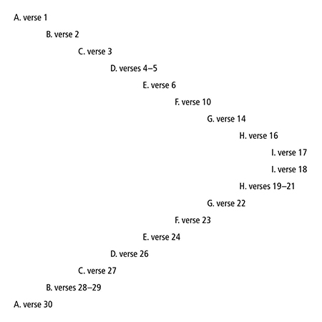
Elder Dallin H. Oaks:
“Justice requires that the unrepentant transgressor suffer for his own sins [see D&C 19:16–19]. …
“… What about repentant transgressors? Are they punished? Must they suffer? …
“… The person who repents does not need to suffer ‘even as’ the Savior suffered for that sin. Sinners who are repenting will experience some suffering, but, because of their repentance and because of the Atonement, they will not experience the full ‘exquisite’ extent of eternal torment the Savior suffered for that sin.”
“President Spencer W. Kimball, who gave such comprehensive teachings on repentance and forgiveness, said that personal suffering ‘is a very important part of repentance. One has not begun to repent until he has suffered intensely for his sins’ (Teachings of Spencer W. Kimball, p. 88).
“‘If a person hasn’t suffered, he hasn’t repented. … He has got to go through a change in his system whereby he suffers and then forgiveness is a possibility’ (Teachings of Spencer W. Kimball, p. 99). …
“All of our experience confirms the fact that we must endure personal suffering in the process of repentance—and for serious transgressions that suffering can be severe and prolonged. I believe that every one of us who is truly honest with himself or herself recognizes the truth of this principle. We have felt it in our own lives, and we have seen it in the lives of others.
Chiasmus—Alma 36: 1-30
“We should also observe that our personal suffering for sin is private, not public. Often only the sinner and the Lord and the Lord’s servant know what is happening. In contrast to the public nature of the punishment inflicted by the laws of man, the suffering that leads to mercy under the laws of God is intensely personal” Dallin H. Oaks (“Sins, Crimes, and Atonement” [address to CES religious educators, Feb. 7, 1992], 4–6, si.lds.org).

