Slide 2
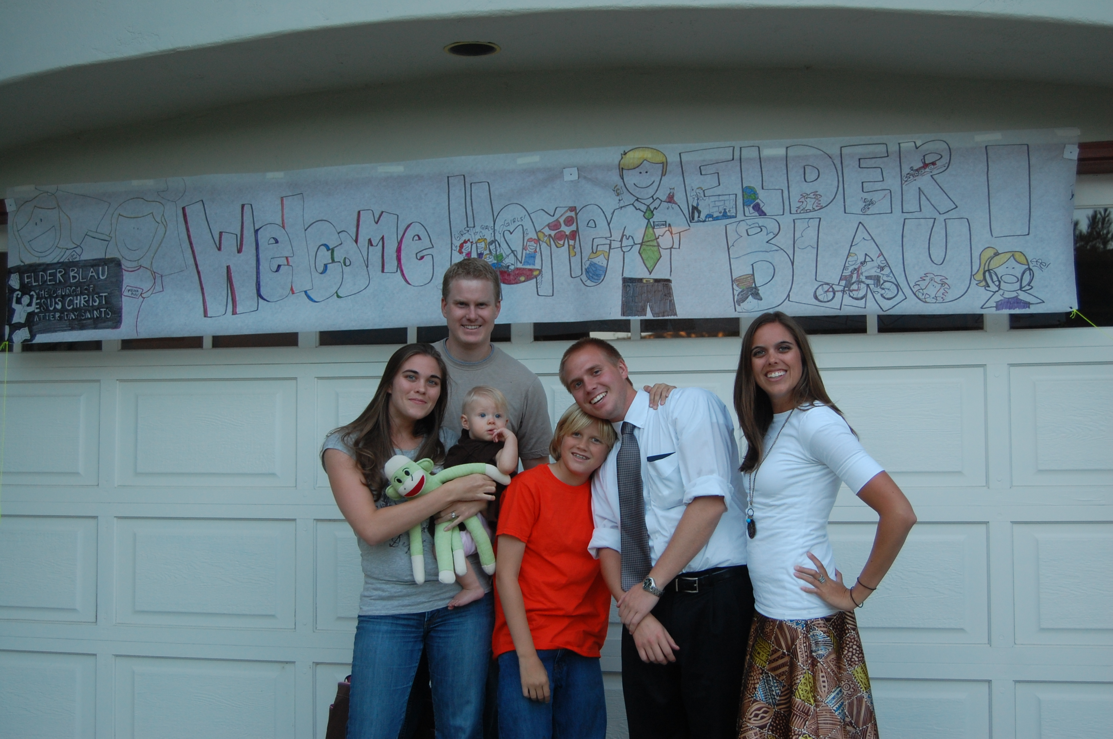
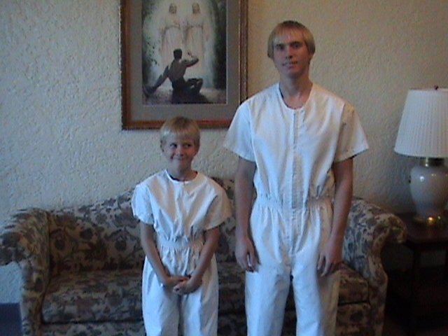
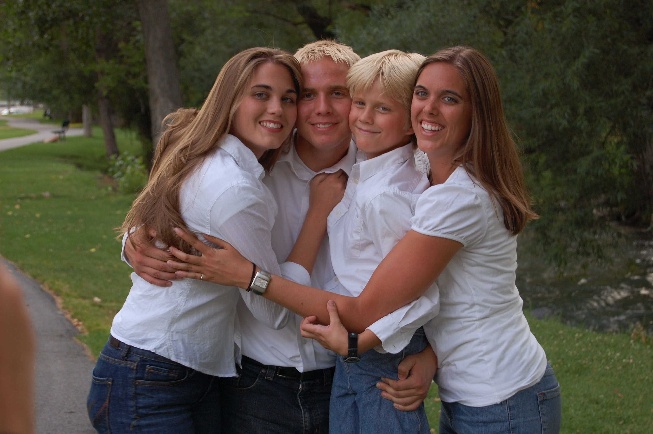
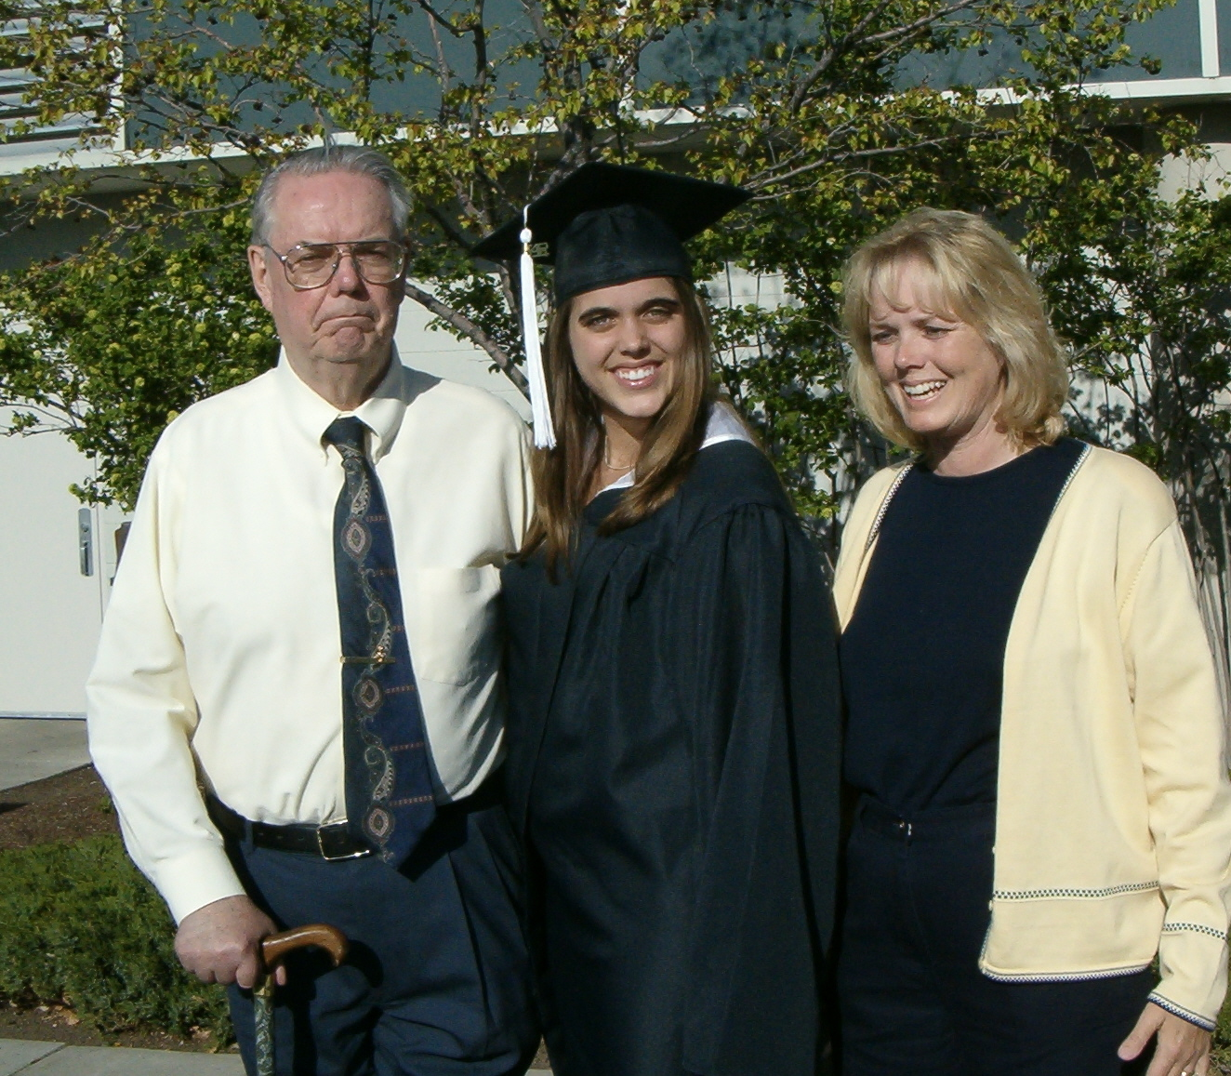
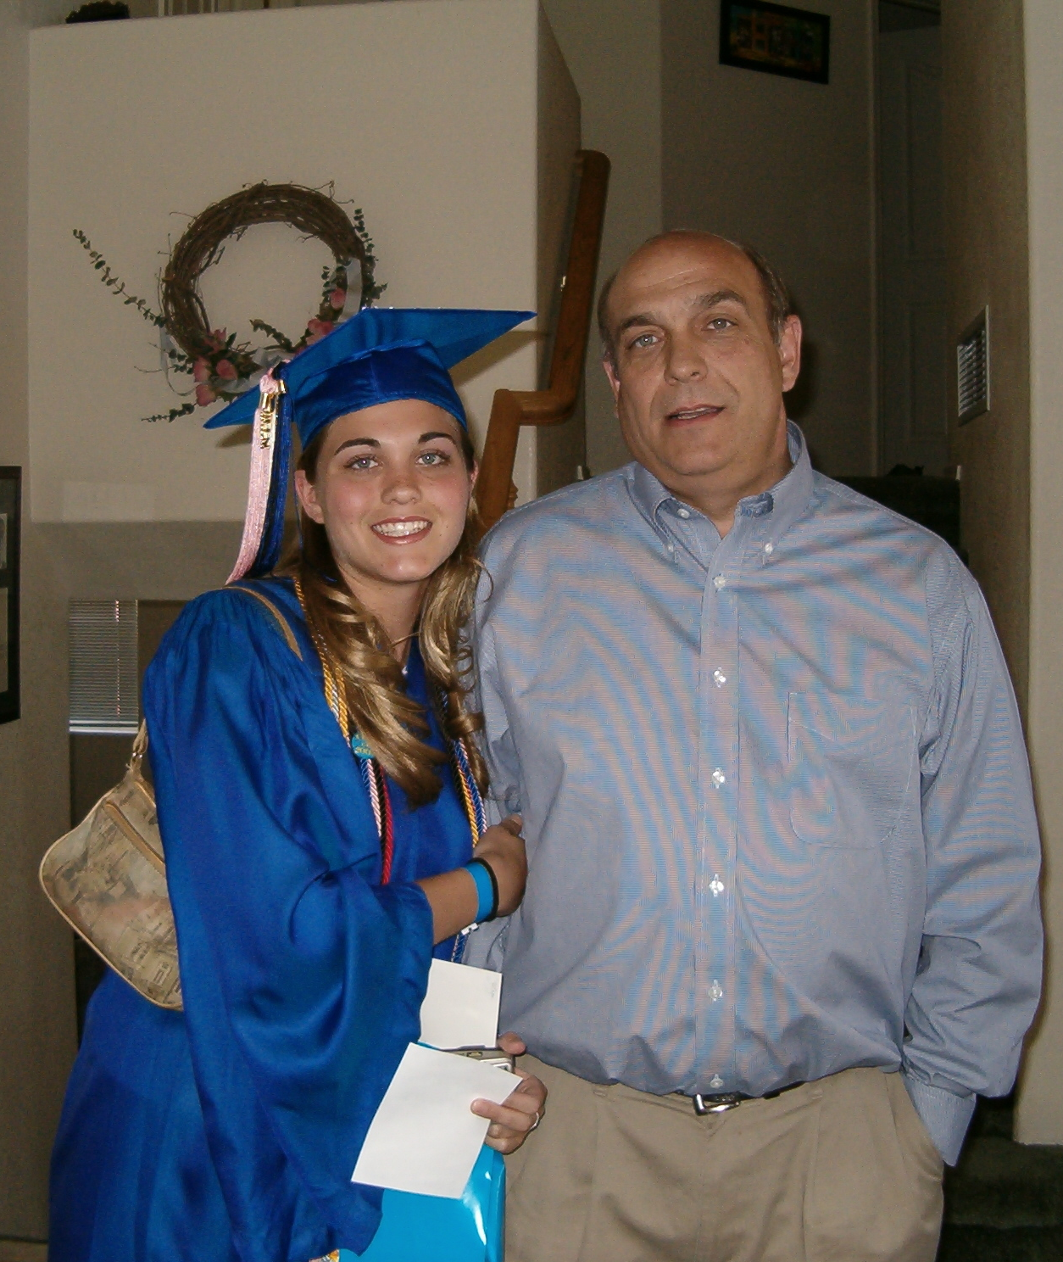
What are some ways in which our actions can affect our relationships with family members?
As youth are steady and faithful in keeping the commandments, they can bring great joy to their parents

Slide 3
Shiblon
He was the son of Alma, grandson of Alma the Elder
He was described by Mormon as a “just man and he did walk uprightly before God” (Alma 63:2)
He went with his father on his mission to the Zoramites in about 74 BC along with his brother Corianton, Amulek, Zeezrom, Ammon, Aaron, and Omner (Alma 31:6-7)
He suffered long and was patient on his mission to the Zoramites (Alma 38:5)
He received the sacred records from his older brother, Helaman in about 56 BC
He conveyed the records to his nephew, Helaman, son of Helaman in 53 BC and died shortly thereafter (Alma 63:11)
Who’s Who

Slide 4
Words to Shiblon
If you keep the commandments…
If you do not keep the commandments…
Because of your steadfastness…
I had great joy in you because…
Because you were in bonds and were stoned…
Because you have trusted in the Lord…
I know these things because…
a…you will be cut off from the Lord’s presence
b.…you will be blessed if you endure to the end
c.…you will prosper in the land
d…an angel I have seen face to face
g.…of your faithfulness, patience, long suffering
e…you will be lifted up in the last days
f…you did bare them and knew the Lord was with you
Alma 38:1-7

Slide 5
Shiblon’s Experience
If we bear all things with patience and trust in God, He will deliver us from trials, troubles, and afflictions and lift us up at the last day
Alma 38:3-4

Slide 6
No Other Way
Alma tells Shiblon of his torment and remission of sins
Salvation: Alma tells Shiblon that there is no other way that a man can be saved except through the atonement of Christ
“One Lord, one faith, one baptism” (Ephesian 4:5)
“…and that there could be no redemption for mankind save it were through the death and sufferings of Christ, and the atonement of his blood.”
Alma 21:9
To receive a remission of our sins and find peace to our souls, we must exercise faith in Jesus Christ and seek His mercy.
We can be saved only in and through Jesus Christ. Jesus Christ is the Life and the Light of the World
“…and as the Lord God liveth, there is none other name given under heaven save it be this Jesus Christ, of which I have spoken, whereby man can be saved.”
2 Nephi 25:20
Alma 38:8-9

Slide 7
He is the Light
6 He that ascended up on high, as also he descended below all things, in that he comprehended all things, that he might be in all and through all things, the light of truth;
7 Which truth shineth. This is the light of Christ. As also he is in the sun, and the light of the sun, and the power thereof by which it was made.
8 As also he is in the moon, and is the light of the moon, and the power thereof by which it was made;
9 As also the light of the stars, and the power thereof by which they were made;
10 And the earth also, and the power thereof, even the earth upon which you stand.
11 And the light which shineth, which giveth you light, is through him who enlighteneth your eyes, which is the same light that quickeneth your understandings;
12 Which light proceedeth forth from the presence of God to fill the immensity of space—
13 The light which is in all things, which giveth life to all things, which is the law by which all things are governed, even the power of God who sitteth upon his throne, who is in the bosom of eternity, who is in the midst of all things.
D&C 88:6-13
Alma 38:9

Slide 8
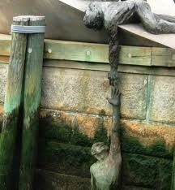
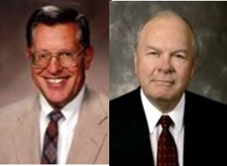
Salvation
“For I the Lord cannot look upon sin with the least degree of allowance…
…Nevertheless, he that repents and does the commandments of the Lord shall be forgiven.”
D&C 1:31-32
Salvation requires a perfect relationship between truth and righteousness. Surely there can be no salvation in ignorance and sin.”
JFM and RLM

Slide 9
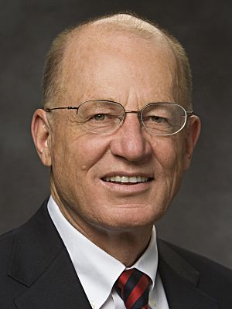
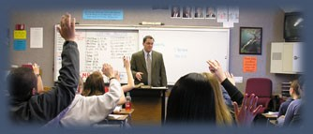
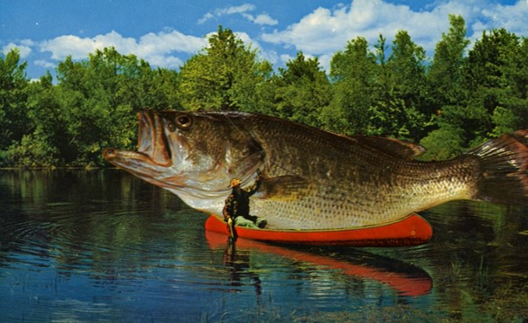
Temperate In All Things
Diligence is consistent, careful, and conscientious effort. To be temperate is to “use moderation in all things or to exercise self-control.”
Kent D. Watson
Wise teachers will confine themselves to that which they understand, or that for which they are reliable witnesses.
“Exaggerations, stretching of the truth, and embellished stories and quotations bring no dignity to the gospel or to the teacher. Indeed, such practices are offensive to the Spirit.”
JFM and RLM
Alma 38:10

Slide 10
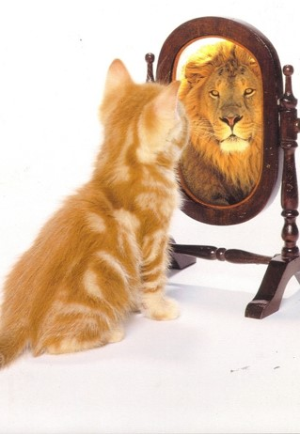
Not Lifted in Pride
“He that speaketh of himself seeketh his own glory; but he that seeketh his glory that sent him, the same is true, and no unrighteousness is in him”
(John 7:18)
“Pride is a very misunderstood sin, and many are sinning in ignorance.
In the scriptures there is no such thing as righteous pride—it is always considered a sin. Therefore, no matter how the world uses the term, we must understand how God uses the term so we can understand the language of holy writ and profit thereby.
“The central feature of pride is enmity—enmity toward God and enmity toward our fellowmen.
Enmity means “hatred toward, hostility to, or a state of opposition.” It is the power by which Satan wishes to reign over us.
Pride is essentially competitive in nature. We pit our will against God’s. When we direct our pride toward God…
Our will in competition to God’s will allows desires, appetites, and passions to go unbridled.”
President Ezra Taft Benson
President Ezra Taft Benson
Alma 38:11

Slide 11
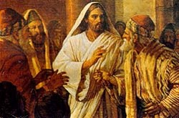
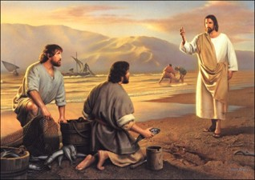
Use Boldness—Not Overbearance
“Those who teach by the Spirit teach with confidence, for the Spirit does not lack confidence. They teach, as did the master, as one having authority, and not as the scribes.
“For he taught them as one having authority, and not as the scribes.” Matthew 7:29
Our efforts to develop righteous attributes prepare us to teach and serve others
Yet they teach with kindness, love, patience, and understanding. Their purpose is to teach, not impress; to edify, not overwhelm.”
JFM and RLM
Alma 38:12

Slide 12
Bridle All Your Passions
To bridle means to restrain, guide, or control. A passion is a strong emotion.
“Passions are to be bridled in order that one may be filled with love.
Passions, in the sense that we most often use the word—excessive emotion of a negative sort—are antagonistic to patience, kindness, and virtue.”
JFM and RLM
Speaking on the Men and Women of Christ:
“Whereas the natural man vents his anger, the men and women of Christ are “not easily provoked.” (1 Cor. 13:5.) Whereas the natural man is filled with greed, the men and women of Christ “seeketh not [their] own.” (1 Cor. 13:5.)
Whereas the natural man seldom denies himself worldly pleasures, the men and women of Christ seek to bridle all their passions.
Neal A. Maxwell
Alma 38:12

Slide 13
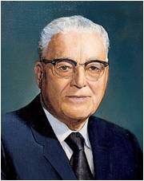
Refrain From Idleness
“are idlers … and [our] children are also growing up in wickedness; they also seek not earnestly the riches of eternity, but their eyes are full of greediness.” (D&C 68:31.)
“If these words are clearly understood, we have been told where the roots of all evil are to be found. Our children have not been properly taught by parents in the home. Our communities have adopted policies which encourage idleness instead of work for those who want to work for what they need, and have failed to adopt measures to see that idleness and unemployment are reduced to the absolute minimum.”
Harold B. Lee
“Cease to be idle; cease to be unclean; cease to find fault one with another; cease to sleep longer than is needful; retire to thy bed early, that ye may not be weary; arise early, that your bodies and your minds may be invigorated.”
D&C 88:124
Alma 38:12

Slide 14
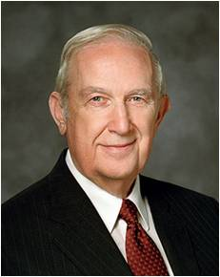
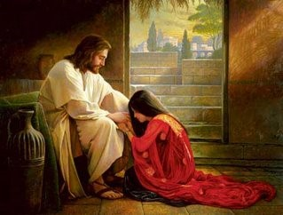
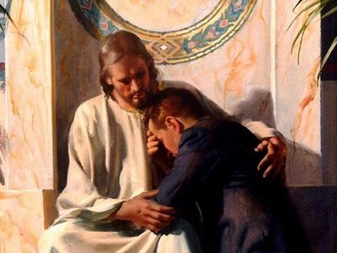
Forgive Me
“Do not say: O God, I thank thee that we are better than our brethren; but rather say: O Lord, forgive my unworthiness, and remember my brethren in mercy—yea, acknowledge your unworthiness before God at all times.”
“Of all the necessary steps to repentance, I testify that the most critically important is for you to have a conviction that forgiveness comes because of the redeemer.” Richard G. Scott
D&C 1:31-32
Alma 38:14

Slide 15
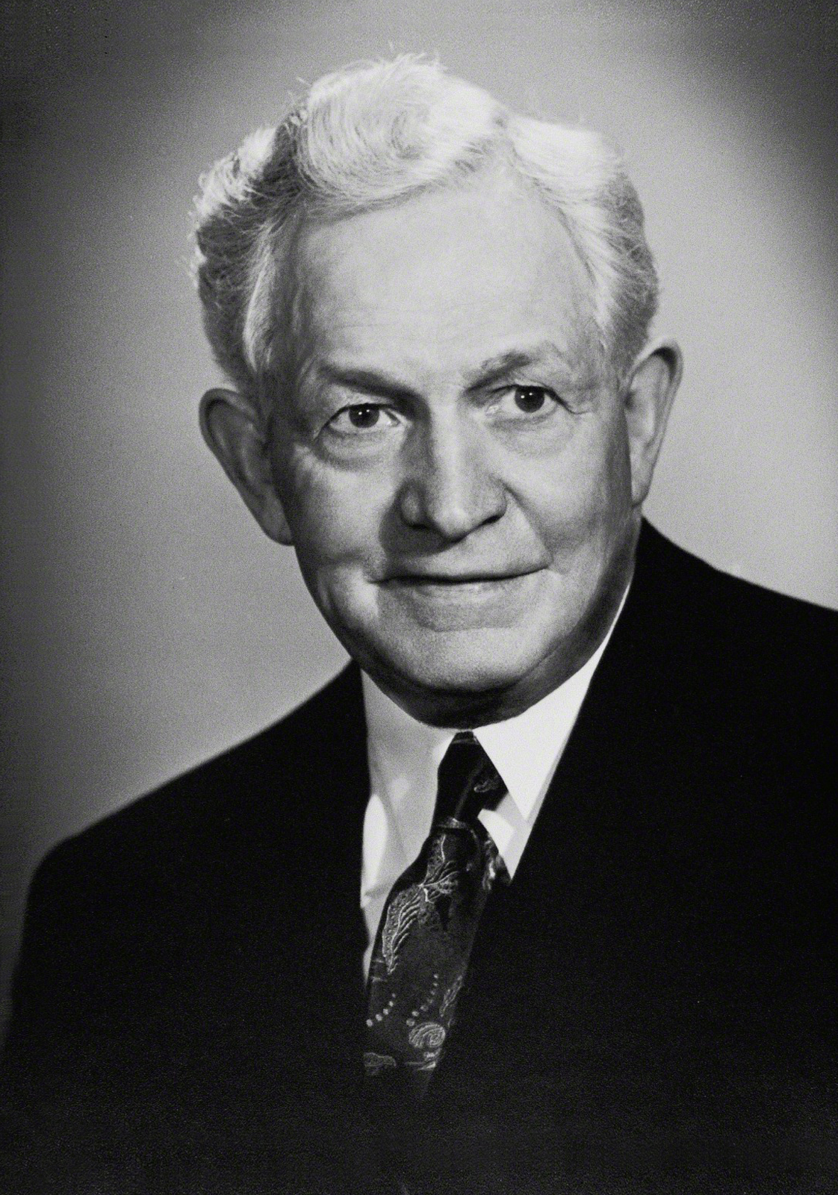
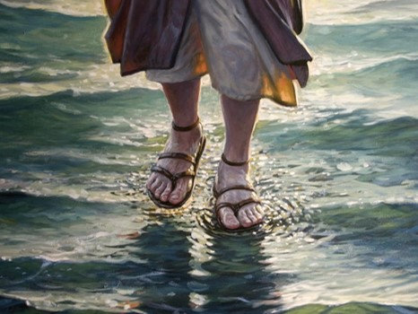
To Sit Down In Peace
Alma blesses Shiblon and request that he teach the people
“The peace of Christ does not come by seeking the superficial things of life, neither does it come except as it springs from the individual’s heart.” He said further that this peace is “conditioned upon obedience to the principles of the Gospel of Jesus Christ. …
No man is at peace with himself or his God who is untrue to his better self, who transgresses the law of what is right either in dealing with himself by indulging in passion, in appetite, yielding to temptations against his accusing conscience, or in dealing with his fellowmen, being untrue to their trust.
Peace does not come to the transgressor of law; peace comes by obedience to law, and it is that message which Jesus would have us proclaim among men.”
President David O. McKay
D&C 1:31-32
Alma 38:15

Slide 16
Sources:
Book of Mormon Who’s Who Ed J. Pinegar and Richard J. Allen pg 171-172
Joseph Fielding McConkie and Robert L. Millet Doctrinal Commentary on the Book of Mormon Vol. 3 pg. 286
(Kent D. Watson, “Being Temperate in All Things,” Ensign or Liahona,Nov. 2009, 38).
President Ezra Taft Benson Beware of Pride April Conf. 1989 READ OR DOWNLOAD THIS MESSAGE…. http://www.lds.org/general-conference/1989/04/beware-of-pride?lang=eng
Neal A. Maxwell Put Off the Natural Man, and Come Off Conqueror Oct. Conf. 1990
Harold B. Lee Teach the Gospel of Salvation Oct. Conf. 1972
Richard G. Scott (Ensign, May 1995 pp. 76-77)
President David O. McKay (in Conference Report, Oct. 1938, p. 133.)
Presentation by ©http://fashionsbylynda.com/blog/

