Slide 2
Corianton
He was the son of Alma, the grandson of Alma the elder
He accompanied his father along with his brother, Shiblon, Ammon, Aaron, Omner, Amulek and Zeezrom about 74 BC to the Zoramites to the city of Antionum
Alma had firm word of reproof and admonition for him because of his sinful conduct
He also received instructions from Alma about the coming of the Messiah, the nature of the resurrection, and the state of the soul between death and the resurrection
He humbly repented and served a mission
In 72 BC he was in good standing among the leading brethren of the Church
He sailed into the north countries around 56 BC to 54 BC to carry provisions to a large number of people who had migrated northward (Alma 63:9-10)
Who’s Who

Slide 3
Disobedience
While the group was on their mission Corianton went over to the land of Siron and associated himself with the harlot Isabel
Land Bountiful
West Sea
East Sea
Jershon
Land of Siron
Zarahemla
Jerusalem
Land of Nephi
Alma 39:1-3

Slide 4
Isabel
She was a prostitute in the land of Siron that was among the borders of the Lamanites
She did ‘steal away the hearts of many’
Corianton forsook the ministry to be with her around 74 BC
Because of her seductive ways Corianton’s reputation was at stake
Who’s Who

Slide 5
5 Lies About the Law of Chastity
1. I know a lot of people who don’t keep the law of chastity, so I shouldn’t have to obey the law of chastity either.
2. Committing sexual sin is not very serious.
3. I can commit sexual sin and no one will know.
4. Because of all the temptations around me, it isn’t possible to stay sexually pure.
5. If I have committed sexual sin, I can’t be forgiven.

Slide 6
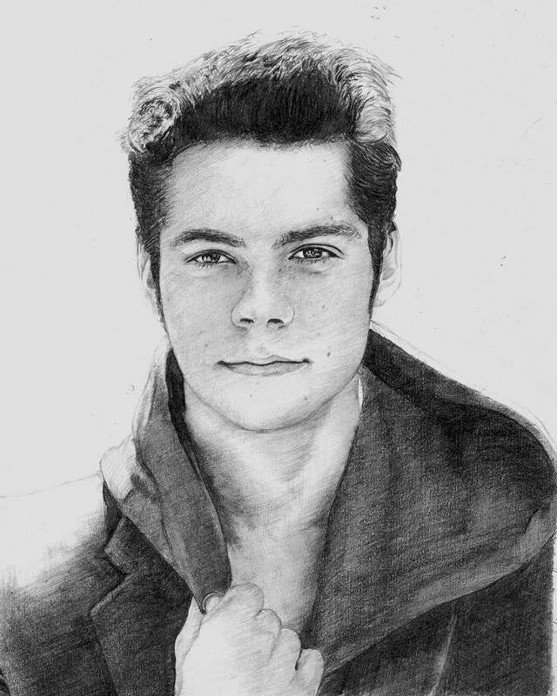
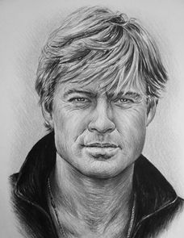
Why do you think worldly views about chastity are so different from the Lord’s teachings?
she did steal away the hearts of many
The sins of others do not provide an excuse for us to sin
The Lord’s commandments and expectations for us do not change because of other people’s choices.

Slide 7
A Formula For A Fall
He Boasted in Strength
He thought he could ‘handle it’. He didn’t place enough trust in the power of the Lord
He felt he had enough confidence and willpower to deal with the situation himself
2. He left his duty station
Missionaries who disobey the mission rules or members failing to attend their meetings have forsaken their ministry
Alma 39:2-3

Slide 8
A Formula For A Fall
3. He associated with the wrong type of person
There are certain people and places the missionaries are to stay away from, likewise there are certain people and places we should avoid
4. He yielded to pressure from others
He knew that others had indulged in the sin, so he justified it to himself. Committing sin because everyone else is doing it is wrong. There is no safety nor security in following a crowd
Alma 39:2-4 JFM and RLM

Slide 9
The Three Most Serious Sins
Why are some sins more serious than others?
Denying the Holy Ghost---unpardonable
Judgment by God
Murder—not easy to obtain forgiveness
Judgment by God and the law
Sexual Sin—abominable in the sight of the Lord—not easy to obtain forgiveness..but possible
Judgment by God and sometimes the law
Alma 39:5-6

Slide 10
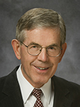
Abomination
Sexual sin is an abomination in the sight of the Lord.
something that is sinful, wicked, or awful
“Perhaps there is a common element in those two things—unchastity and murder.
Both have to do with life, which touches upon the highest of divine powers.
Murder involves the wrongful taking of life; sexual transgression may involve the wrongful giving of life, or the wrongful tampering with the sacred fountains of life-giving power.”
We cannot hide our sins from God.
Bruce C. Hafen
Alma 39:5-8

Slide 11
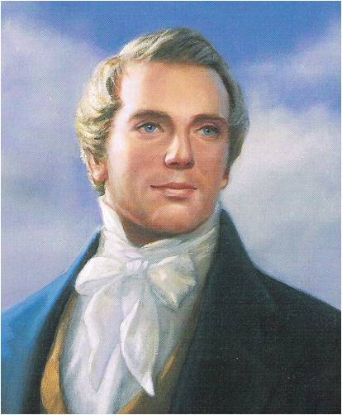
“All sins shall be forgiven, except the sin against the Holy Ghost; for Jesus will save all except the sons of perdition.
What must a man do to commit the unpardonable sin?
He must receive the Holy Ghost, have the heavens opened unto him, and know God, and then sin against him.
After a man has sinned against the Holy Ghost, there is no repentance for him. He has got to say that the sun does not shine while he sees it; he has got to deny Jesus Christ when the heavens have been opened unto him, and to deny the plan of salvation with his eyes open to the truth of it; and from that time he begins to be an enemy.
This is the case with many apostates of the Church of Jesus Christ of Latter-day Saints”
Joseph Smith
An individual who receives a witness of the Holy Ghost and then falls away or becomes less active in the Church is not guilty of the unpardonable sin.

Slide 12
Sexual Purity
The Lord’s standard regarding sexual purity is clear and unchanging.
Do not have any sexual relations before marriage, and be completely faithful to your spouse after marriage.
Do not allow the media, your peers, or others to persuade you that sexual intimacy before marriage is acceptable. It is not.
In God’s sight, sexual sins are extremely serious.
They defile the sacred power God has given us to create life.
For the Strength of Youth

Slide 13
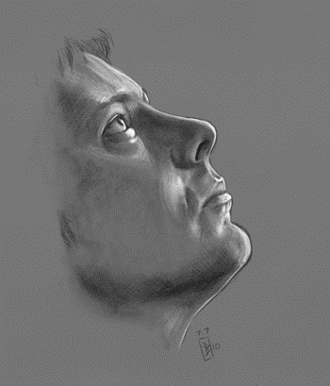
Sensitive Issues
Alma’s Counsel to his son:
Do not dwell on your crimes
You can not hide from of crimes
But you can repent and forsake of your sins
Take advice from your elder brothers
Do not be led away by any vain or foolish things
Do not let Satan take a hold of your heart
Alma 39:7-11

Slide 14
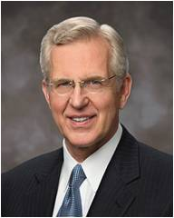
“The invitation to repent is an expression of love. … If we do not invite others to change or if we do not demand repentance of ourselves, we fail in a fundamental duty we owe to one another and to ourselves.
A permissive parent, an indulgent friend, a fearful Church leader are in reality more concerned about themselves than the welfare and happiness of those they could help.
Yes, the call to repentance is at times regarded as intolerant or offensive and may even be resented, but guided by the Spirit, it is in reality an act of genuine caring.”
Elder D. Todd Christofferson

Slide 15
Doctrinal Mastery
”Now my son, I would that ye should repent and forsake your sins, and go no more after the lusts of your eyes, but cross yourself in all these things; for except ye do this ye can in nowise inherit the kingdom of God. Oh, remember, and take it upon you, and cross yourself in these things.”
Alma 39:9

Slide 16
Do’s and Don’ts
“Never do anything that could lead to sexual transgression.
Treat others with respect, not as objects used to satisfy lustful and selfish desires. Before marriage, do not participate in passionate kissing, lie on top of another person, or touch the private, sacred parts of another person’s body, with or without clothing.
Do not do anything else that arouses sexual feelings.
Do not arouse those emotions in your own body. Pay attention to the promptings of the Spirit so that you can be clean and virtuous.
The Spirit of the Lord will withdraw from one who is in sexual transgression.
“Avoid situations that invite increased temptation, such as late-night or overnight activities away from home or activities where there is a lack of adult supervision.
Do not participate in discussions or any media that arouse sexual feelings.
Do not participate in any type of pornography.
The Spirit can help you know when you are at risk and give you the strength to remove yourself from the situation.
Have faith in and be obedient to the righteous counsel of your parents and leaders.”
For the Strength of Youth

Slide 17
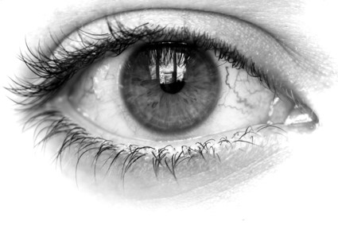
Overcome
Forsaking Your Sins
Going no more after the lusts of your eyes
Crossing yourself in all these things
To stop committing them
One’s who eyes are not focused on Christ…Lusting after those things of the world
Exercise self control
We can overcome temptation and forsake our sins by exercising self-control
Alma 39:9

Slide 18
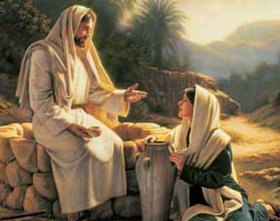
Repentance Includes:
In what ways can seeking spiritual nourishment—possibly from parents, Church leaders, siblings, or trusted friends—help us to repent?
What does it mean to “suffer not yourself to be led away”? (Suffer means to allow)
What are some “vain or foolish” things that you see people being led away by today?
What does it mean to refrain from iniquity? (To avoid sin.)
What do you think it means to “turn to the Lord with all your mind, might, and strength”?
Repentance includes turning to the Lord with all our mind, might, and strength and acknowledging our sins
Turn to the Lord---usually denotes Repentance
Alma 39:10-13

Slide 19
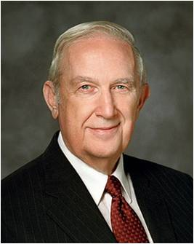
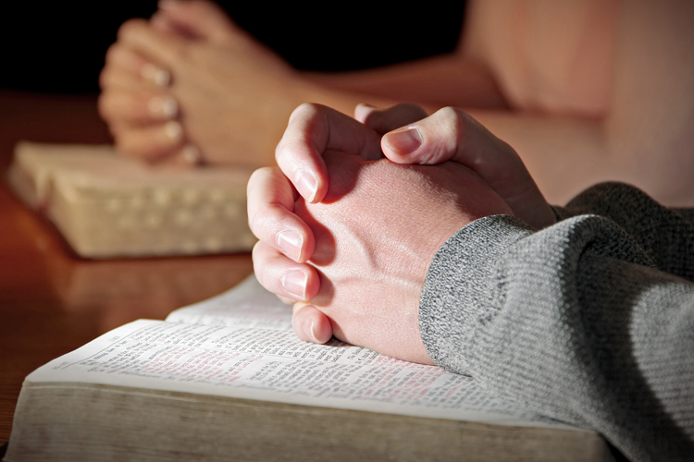
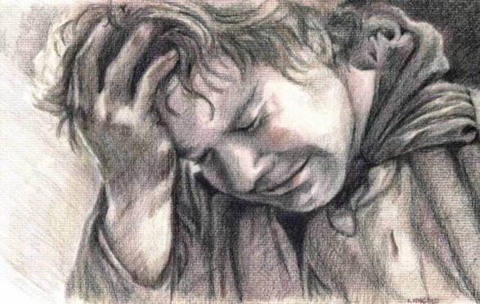
Sorrow for sin
“Study and ponder to determine how serious the Lord defines your transgression to be. That will bring healing sorrow and remorse.
It will also bring a sincere desire for change and a willingness to submit to every requirement for forgiveness.
Elder Richard G. Scott

Slide 20
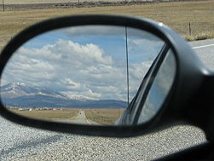
Abandonment of sin
This is an unyielding, permanent resolve to not repeat the transgression.
By keeping this commitment, the bitter aftertaste of that sin need not be experienced again. Remember: “But unto that soul who sinneth shall the former sins return.”
Elder Richard G. Scott

Slide 21
Confession of sin
You always need to confess your sins to the Lord. If they are serious transgressions, such as immorality, they need to be confessed to a bishop or stake president.
Please understand that confession is not
repentance. It is an essential step, but is not of
itself adequate.
Partial confession by mentioning lesser mistakes will not help you resolve a more serious, undisclosed transgression.
Essential to forgiveness is a willingness to fully disclose to the Lord and, where necessary, His priesthood judge all that you have done.
Elder Richard G. Scott

Slide 22
Restitution for sin
You must restore as far as possible all that which is stolen, damaged, or defiled.
Willing restitution is concrete evidence to the Lord that you are committed to do all you can to repent.
Elder Richard G. Scott

Slide 23
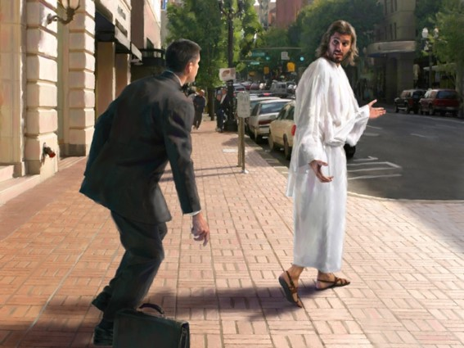
Obedience to all the commandments
Full obedience brings the complete power of the gospel into your life with strength to focus on the abandonment of specific sins.
It includes things you might not initially consider part of repentance, such as attending meetings, paying tithing, giving service, and forgiving others.
Elder Richard G. Scott

Slide 24
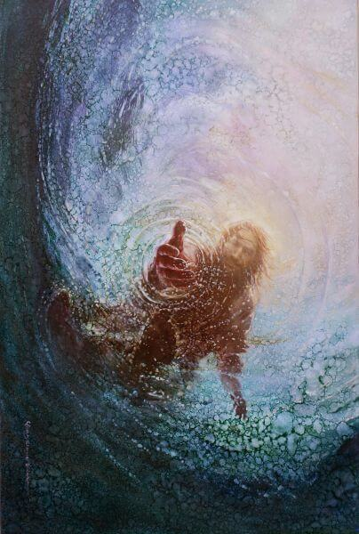
Restitution for sin
You must restore as far as possible all that which is stolen, damaged, or defiled.
Willing restitution is concrete evidence to the Lord that you are committed to do all you can to repent.”
R
E
S
T
O
R
E
E
P
E
N
T
Yongsung Kim
Elder Richard G. Scott

Slide 25
“Only repentance leads to the sunlit uplands of a better life. And, of course, only through repentance do we gain access to the atoning grace of Jesus Christ and salvation. Repentance is a divine gift, and there should be a smile on our faces when we speak of it. It points us to freedom, confidence, and peace. Rather than interrupting the celebration, the gift of repentance is the cause for true celebration.
“Repentance exists as an option only because of the Atonement of Jesus Christ. It is His infinite sacrifice that ‘bringeth about means unto men that they may have faith unto repentance’ (Alma 34:15). Repentance is the necessary condition, and the grace of Christ is the power by which ‘mercy can satisfy the demands of justice’ (Alma 34:16). …
“… Repentance requires a seriousness of purpose and a willingness to persevere, even through pain. Attempts to create a list of specific steps of repentance may be helpful to some, but it may also lead to a mechanical, check-off-the-boxes approach with no real feeling or change. True repentance is not superficial.
The Lord gives two overarching requirements: ‘By this ye may know if a man repenteth of his sins—behold, he will confess them and forsake them’ (D&C 58:43)”
Elder D. Todd Christofferson

Slide 26
Sources:
Videos:
Chastity: What Are The Limits (3:59)
I Choose to Be Pure (4:20)
The Book of Mormon Who’s Who Ed J. Pinegar and Richard J. Allen pg. 93-94,68-69
Bruce C. Hafen, “The Gospel and Romantic Love,” New Era, Feb. 2002, 10
Joseph Smith in History of the Church, 6:314
Joseph Fielding McConkie and Robert L. Millet Doctrinal Commentary on the Book of Mormon Vol. 3 pg. 288
For the Strength of Youth Booklet (2011) p. 36
Elder D. Todd Christofferson (“The Divine Gift of Repentance,” Ensign or Liahona, Nov. 2011, 39).
Elder Richard G. Scott Finding Forgiveness May 1995 Gen. Conf.
Elder D. Todd Christofferson (“The Divine Gift of Repentance,” Ensign or Liahona,Nov. 2011, 38, 40).
Presentation by ©http://fashionsbylynda.com/blog/

Slide 27
Other Materials
Sexual Sin
(Alma 39:3) Elder Jeffrey R. Holland teaches the spiritual dangers and damages caused by sexual sin. (1:46)
If you can find this video….It is very good
Elder Jeffrey R. Holland of the Quorum of the Twelve Apostles spoke of the seriousness and the consequences of sexual sin:
“By assigning such seriousness to a physical appetite so universally bestowed, what is God trying to tell us about its place in His plan for all men and women? I submit to you He is doing precisely that—commenting about the very plan of life itself. Clearly among His greatest concerns regarding mortality are how one gets into this world and how one gets out of it. He has set very strict limits in these matters. …
“The body is an essential part of the soul. This distinctive and very important Latter-day Saint doctrine underscores why sexual sin is so serious. We declare that one who uses the God-given body of another without divine sanction abuses the very soul of that individual, abuses the central purpose and processes of life, ‘the very key’ to life, as President Boyd K. Packer once called it [see Ensign, July 1972, 113]. In exploiting the body of another—which means exploiting his or her soul—one desecrates the Atonement of Christ, which saved that soul and which makes possible the gift of eternal life. And when one mocks the Son of Righteousness, one steps into a realm of heat hotter and holier than the noonday sun. You cannot do so and not be burned.

Slide 28
“Please, never say: ‘Who does it hurt? Why not a little freedom? I can transgress now and repent later.’ Please don’t be so foolish and so cruel. You cannot with impunity ‘crucify Christ afresh.’ [See Hebrews 6:6.] ‘Flee fornication,’ Paul cries [see 1 Corinthians 6:18], and flee ‘anything like unto it,’ the Doctrine and Covenants adds [see D&C 59:6; emphasis added]. Why? Well, for one reason because of the incalculable suffering in both body and spirit endured by the Savior of the world so that we could flee [see especially D&C 19:15–20]. We owe Him something for that. Indeed, we owe Him everything for that. ‘Ye are not your own,’ Paul says. ‘Ye [have been] bought with a price: therefore glorify God in your body, and in your spirit, which are God’s.’ [1 Corinthians 6:19–20; emphasis added; see also vv. 13–18.] In sexual transgression the soul is at stake—the body and the spirit. …
“In matters of human intimacy, you must wait! You must wait until you can give everything, and you cannot give everything until you are legally and lawfully married. To give illicitly that which is not yours to give (remember, ‘you are not your own’) and to give only part of that which cannot be followed with the gift of your whole self is emotional Russian roulette. If you persist in pursuing physical satisfaction without the sanction of heaven, you run the terrible risk of such spiritual, psychic damage that you may undermine both your longing for physical intimacy and your ability to give wholehearted devotion to a later, truer love. You may come to that truer moment of ordained love, of real union, only to discover to your horror that what you should have saved you have spent, and that only God’s grace can recover the piecemeal dissipation of the virtue you so casually gave away. On your wedding day the very best gift you can give your eternal companion is your very best self—clean and pure and worthy of such purity in return”
Jeffrey R. Holland (“Personal Purity,” Ensign, Nov. 1998, 76–77).

