Slide 2
Relax and concentrate on the 4 small dots in the middle of the picture for about 30 seconds. Then look at the next slide.

Slide 3
You will see a circle of light developing. Start blinking your eyes a couple of times and you will see a figure emerging.

Slide 4
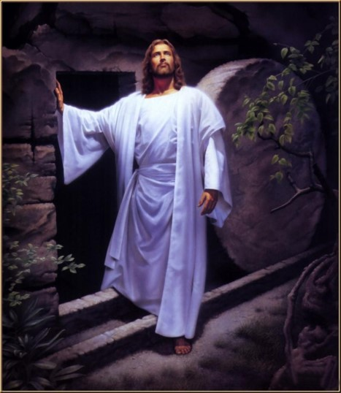
Resurrection
What makes it possible for us to live after we die?
Who will be resurrected?
There was no resurrection from the dead in history until Christ’s death
All men who had mortal bodies shall rise from the dead in resurrection
Because of Jesus Christ, all mankind will be resurrected
“But now is Christ risen from the dead, and become the firstfruits of them that slept.
For since by man came death by man came also the resurrection of the dead.”
1 Corinthians 15:20-21
Alma 40:1-5

Slide 5
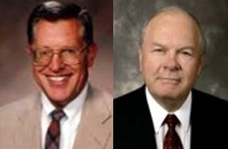
Mortal--Immortality
This physical body, subject to death, does not become immortal—no longer subject to death—until after Christ rises from the grave.
JFM and RLM
Alma 40:2

Slide 6
Corruption--Incorruption
The physical body, subject to disease and decay, does not become incorrupt—no longer subject to those conditions—until after Christ rises from the grave.
JFM and RLM
Alma 40:2

Slide 7
“Every living being will be resurrected. ‘As Adam all die, even so in Christ shall all be made alive.’
Those who live and die before the millennial era, all in their proper order, will have their bodies and spirits reunited in resurrected immortality.
The righteous who live after the Second Coming shall be changed from mortality to immortality in the twinkling of an eye, their bodies and spirits being united inseparably.”
Bruce R. McConkie
Alma 40:1-5; 1 Corinthians 15:22

Slide 8
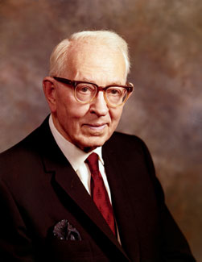
Life After Death
Where will we go when we die?
What is it like there?
“All spirits of men after death return to the spirit world…
The righteous--meaning those who have been baptized and who have been faithful—are gathered in one part and all the others in another part of the spirit world.”
Joseph Fielding Smith
The faithful
Received into paradise—a state of Happiness, Rest, and Peace
Alma 40:12

Slide 9
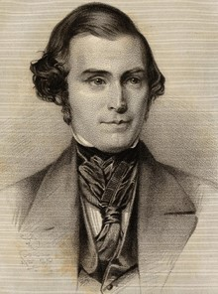
“When our spirits leave these bodies, will they be happy? Not perfectly so.
Why? Because the spirit is absent from the body; it cannot be perfectly happy while a part of the man is lying in the earth.
How can the happiness be complete when only part of the redemption is accomplished?
You cannot be perfectly happy until you get to a new house…
All the holy men that have lived in days of old, have looked forward to the resurrection of their bodies; for then their glory will be complete.”
Elder Orson Pratt
Alma 40:11-15

Slide 10
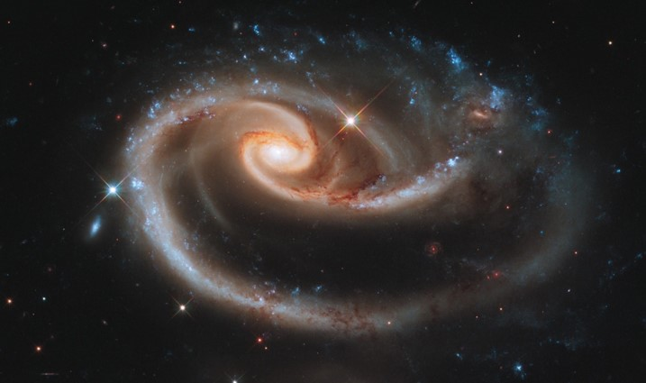
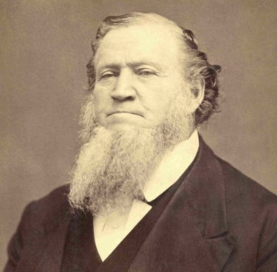
“Where is the spirit world? It is right here. … Do they [the spirits of those who have died] go beyond the boundaries of the organized earth? No, they do not. They are brought forth upon this earth.”
Brigham Young

Slide 11
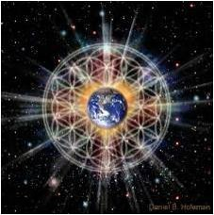
Eternal Compass
Alma does not know the appointed times of the resurrection because:
“…all is as one day with God, and time only is measured unto men.”
“Where God dwells, all things ‘are manifest, past, present, and future and are continually before the Lord’” D&C 130:7
The duration of the circumstances in which God resides and by which He is encompassed is eternal, infinite, and unlimited. It will never have an end.
Hebrews 1:12—Student Manuel
Alma 40:8

Slide 12
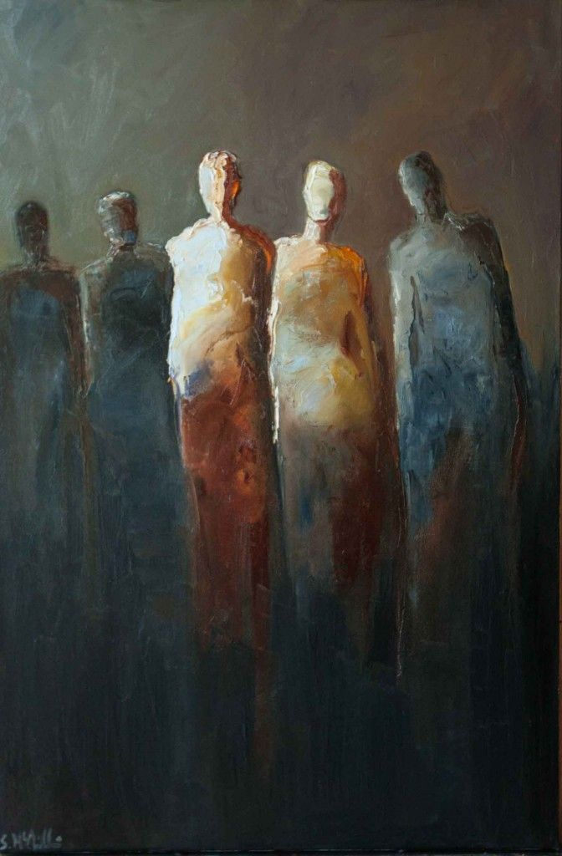
Paradise
Taken home = Not to the presence of Heavenly Father, but to an ‘in between place’ called Paradise.
Then shall the dust return to the earth as it was: and the spirit shall return unto God who gave it.
Ecclesiastes 12:7
Between death and resurrection, the spirits of the righteous dwell in paradise
Shelby McQuilkin
“The mortal existence has come to an end, and returned to the spirit world, where they are assigned to a place according to their works with the just or with the unjust, there to await the resurrection.”
Joseph Fielding Smith
Alma 40:11-12

Slide 13
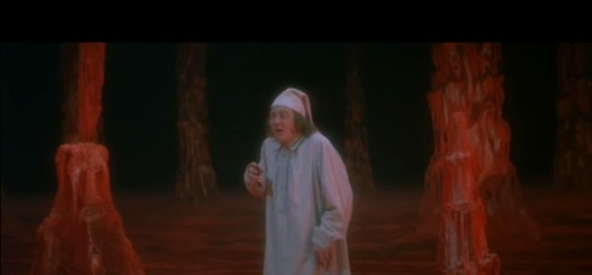
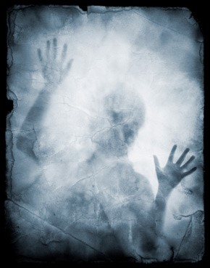
Commissioned to Carry the Message of Salvation
Those spirits who have not been righteous are received into a “spirit prison” where they remain until their punishment for sin has been completed.
Student Manual
“Before Christ bridged the gulf between paradise and hell—so that the righteous could mingle with the wicked and preach them the gospel—the wicked in hell were confined to locations which precluded them from contact with the righteous in paradise…
Alma 40:11-15

Slide 14
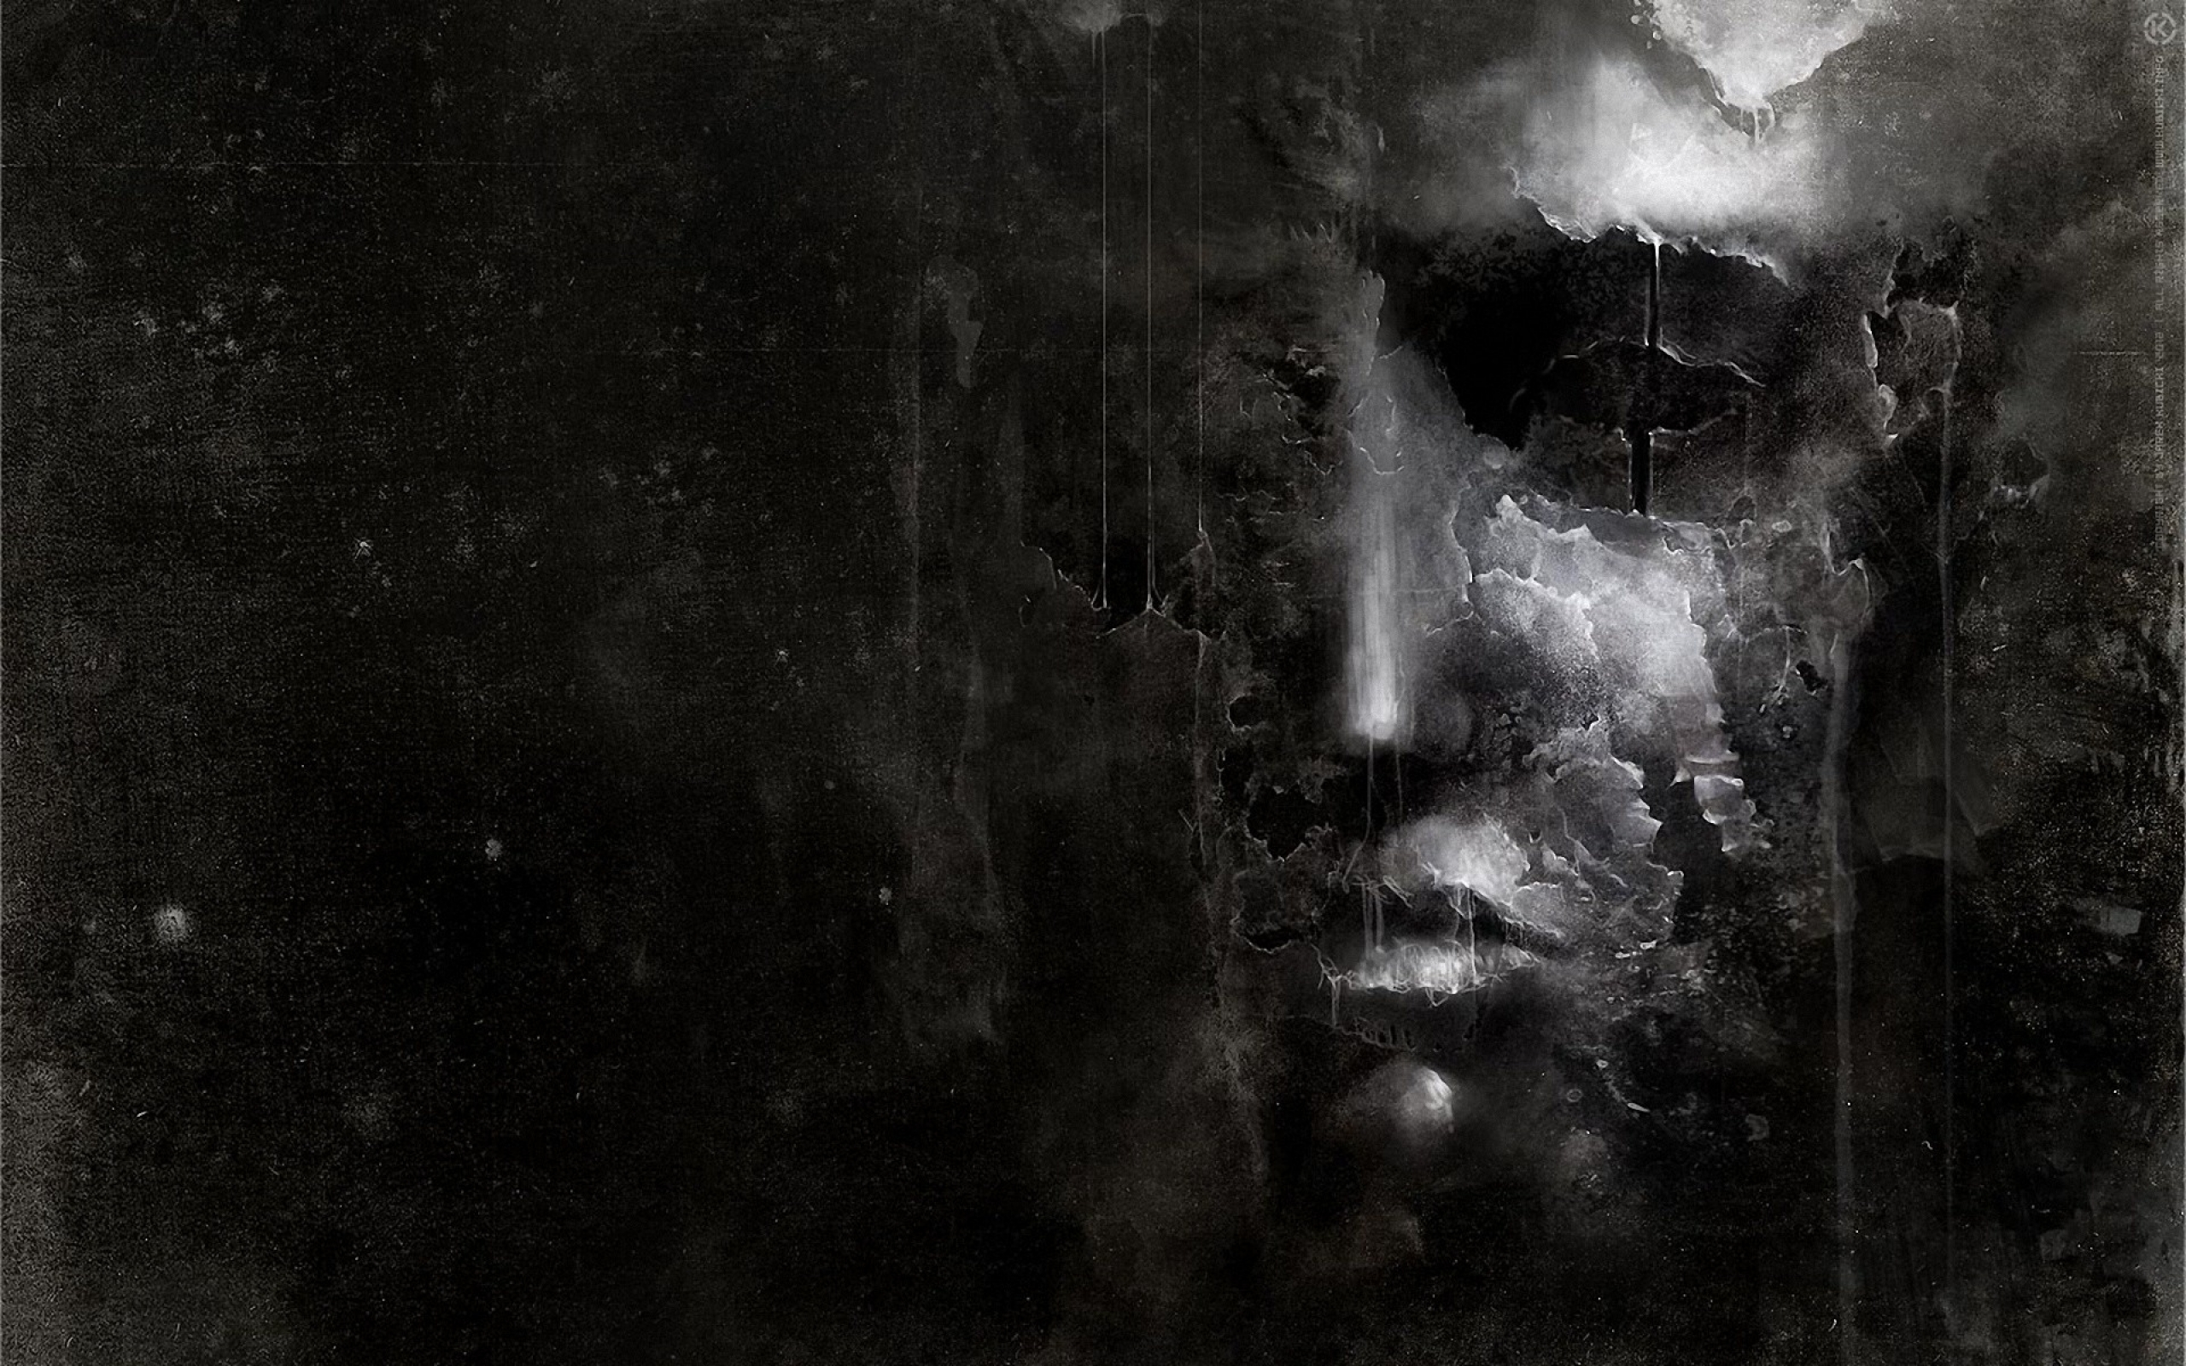
Spirit Prison
Alma used the phrase “outer darkness,” he did not refer to the final state of Satan and those who are damned.
He referred to the state of the wicked between the time of their death and the time of their resurrection.
Today, we usually refer to this state as spirit prison.
Between death and resurrection, the spirits of the wicked dwell in spirit prison
Alma 40:13-14

Slide 15
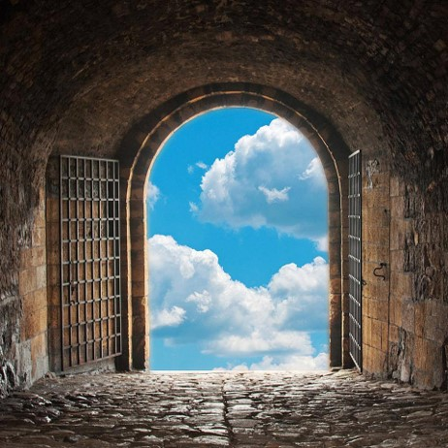
Repentance Opens the Prison Doors
“…Now that the righteous spirits in paradise have been commissioned to carry the message of salvation to the wicked spirits in hell, there is a certain amount of mingling together of the good and bad spirits. Repentance opens the prison doors to the spirits in hell; it enables those bound with the chains of hell to free themselves from darkness, unbelief, ignorance, and sin.
“…As rapidly as they can overcome these obstacles—gain light, believe truth, acquire intelligence, cast off sin, and break the chains of hell—they can leave the hell that imprisons them and dwell with the righteous in the peace of paradise.”
Bruce R. McConkie
Alma 40:11-15

Slide 16
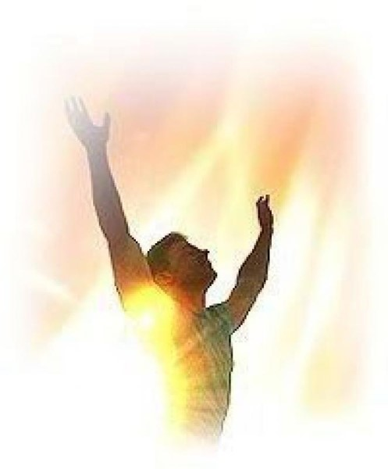
What is Resurrection?
All things restored to their proper and perfect frame
The reuniting of the spirit body with the physical body of flesh and bones after death.
After resurrection, the spirit and body will never again be separated, and the person will become immortal. Every person born on earth will be resurrected because Jesus Christ overcame death (1 Cor. 15:20–22).
Alma 40:21-26

Slide 17
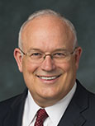
“Resurrection makes it possible for a person’s spirit and body to be united again, only this time that body will be immortal and perfect—not subject to pain, disease, or other problems…
“Each of us has physical, mental, and emotional limitations and weaknesses.
. . . None of these problems will plague us after we are resurrected. . . .
“. . . [Jesus Christ] can make us whole no matter what is broken in us.”
Paul V. Johnson
Resurrection is the reuniting of the spirit and the body, with all things restored to their proper and perfect frame
Alma 40:21-25; Alma 11:43

Slide 18
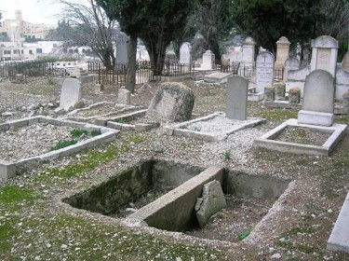
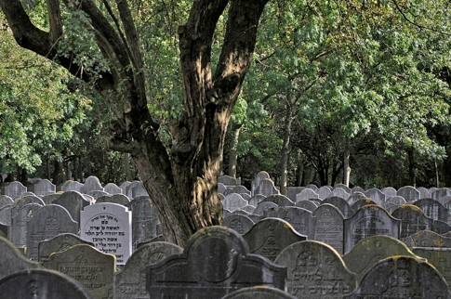
Stages of Resurrection
A general resurrection---At the time Christ arose from the dead—of the righteous.
Matthew 28:52-53
1st Resurrection—a resurrection of the righteous at the Second Coming of Christ—The first to us.
“The graves will be opened and the just shall come forth to reign with him on the earth for a thousand years”
Joseph Fielding Smith
See also: D&C 88:97-98
Alma 40:21-26

Slide 19
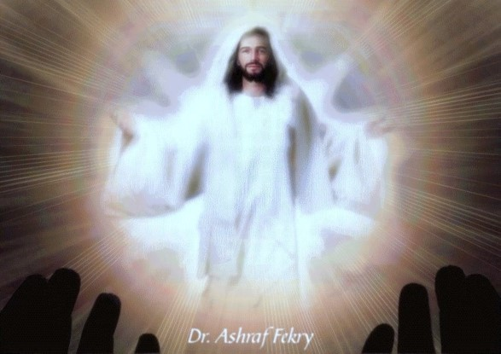
Another Resurrection
Those who have met with Christ and descended upon the earth…
“There will come to pass another resurrection.
This may be considered as a part of the first, although it comes later.
In this resurrection will come forth those of the terrestrial order, who were not worthy to be caught up to meet him, but who are worthy to come forth to enjoy the millennial reign…”
Joseph Fielding Smith
Alma 40:21-26

Slide 20
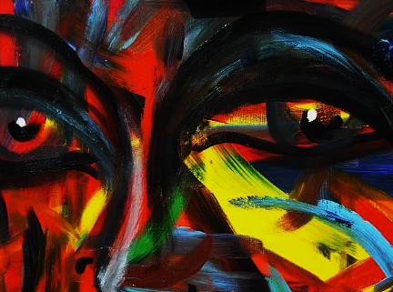
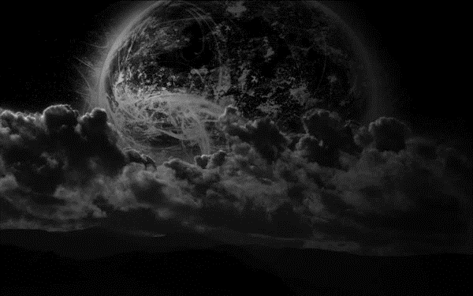
Those Not Resurrected—at this time
“All liars, and sorcerers, and adulterers and all who love and make a lie, shall not receive the resurrection at this time, but for a thousand years shall be thrust down into hell where they shall suffer the wrath of God until they pay the price of their sinning, if it is possible, by the things which they shall suffer…
These are the ‘spirits of men who are to be judged, and are found under condemnation; and these are the rest of the dead; and they live not again until the thousand years are ended, neither again, until the end of the earth’ (D&C 88:100-101)
Joseph Fielding Smith
Alma 40:21-26

Slide 21
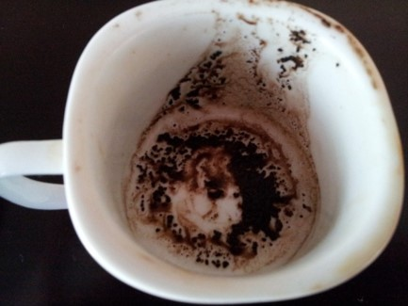
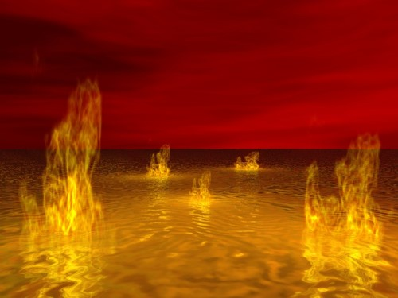
Death Pronounced Upon the Wicked
“But behold, an awful death cometh upon the wicked; for they die as to things pertaining to things of righteousness; for they are unclean, and no unclean thing can inherit the kingdom of God; but they are cast out, and consigned to partake of the fruits of their labors or their works, which have been evil; and they drink the dregs of a bitter cup.”
The 2nd Death—The sons of perdition
Judged out of Book of Life
Cast into the lake of fire
No place for them in heaven
Revelation 20:12-15
Alma 40:26

Slide 22
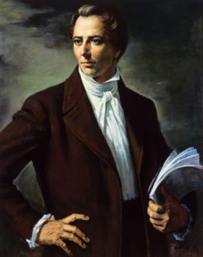
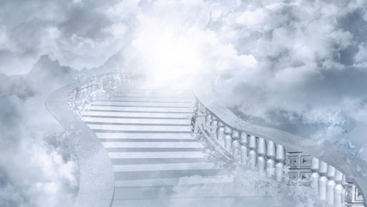
The Finale
What will we do after we are resurrected?
“Here, then, is eternal life…to know the only wise and true God; and you have got to learn how to be Gods yourselves, and to be kings and priests to God, the same as all Gods have done before you…”
Joseph Smith
”And I heard a voice from heaven saying unto me, Write, Blessed are the dead which die in the Lord from henceforth: Yea, saith the Spirit, that they may rest from their labours; and their works do follow them.”
Revelation 14:13
Alma 40:21-26

Slide 23
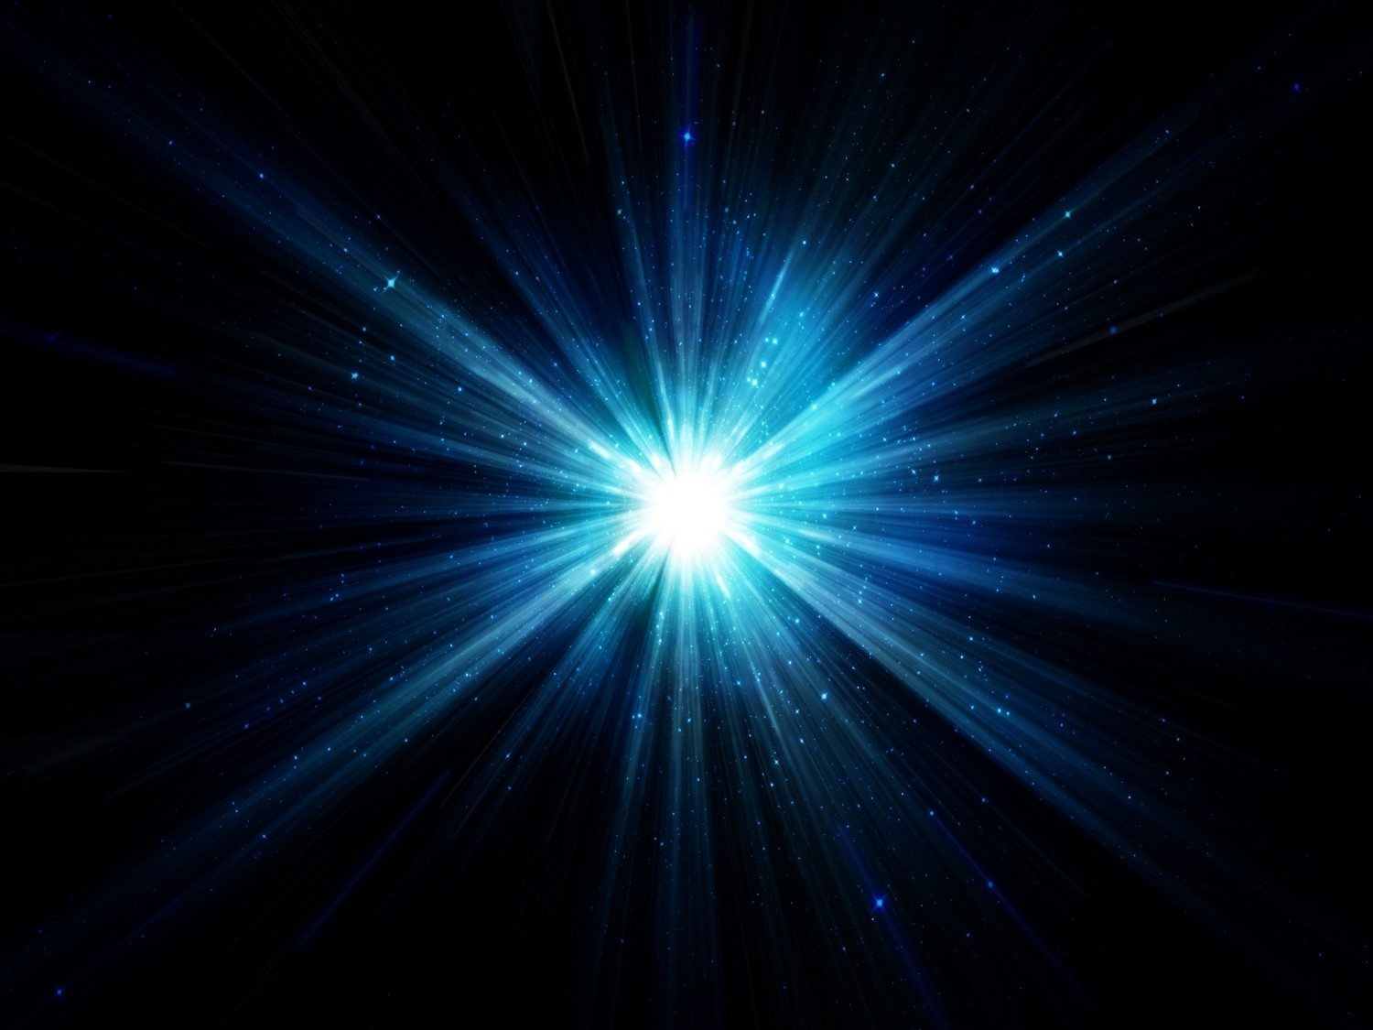
And then shall the righteous shine forth in the kingdom of God.
Alma 40:25

Slide 24
Sources:
Joseph Fielding McConkie and Robert L. Millet Doctrinal Commentary on the Book of Mormon Vol. 3 pg. 295
Bruce R. McConkie Mormon Doctrine pg. 638, 755
Student Manual Book of Mormon Religion 121-122 pg. 320
Joseph Fielding Smith Doctrines of Salvation 2:230, 2:295-97; Answers to Gospel Questions, comp. Joseph Fielding Smith Jr. [1958], 2:85
Elder Orson Pratt…quoted from Student Manual Religion 121-122 (JD; 1:289-90)
Brigham Young (Discourses of Brigham Young, sel. John A. Widtsoe [1954], 376).
Joseph Smith Teachings pg. 346-47
Paul V. Johnson, “And There Shall Be No More Death,” Ensign or Liahona, May 2016, 121–22, 123
Presentation by ©http://fashionsbylynda.com/blog/

Slide 25
What happens to spirits in the spirit world? Alma 40:11-15
“When the physical body dies, the spirit continues to live. In the spirit world, the spirits of the righteous ‘are received into a state of happiness, which is called paradise, a state of rest, a state of peace, where they shall rest from all their troubles and from all care, and sorrow’ (Alma 40:12). A place called spirit prison is reserved for ‘those who [have] died in their sins, without a knowledge of the truth, or in transgression, having rejected the prophets’ (D&C 138:32). The spirits in prison are ‘taught faith in God, repentance from sin, vicarious baptism for the remission of sins, the gift of the Holy Ghost by the laying on of hands, and all other principles of the gospel that [are] necessary for them to know’ (D&C 138:33–34). If they accept the principles of the gospel, repent of their sins, and accept ordinances performed in their behalf in temples, they will be welcomed into paradise” (True to the Faith: A Gospel Reference [2004], 46–47).
Outer darkness
When Alma used the phrase “outer darkness,” he referred to the temporary place in the postmortal spirit world in which the wicked will wait for the resurrection (see Alma 40:13–14). Other prophets have referred to this place as a prison (see 1 Peter 3:18–20; D&C 76:73;138:28–42).

