Slide 2
Gone Far Astray
Corianton was burdened with sin:
He was offended of the idea that a merciful God would punish the sinner.
He tended to excuse his actions by wresting the scriptures.
Wrested—twisted or distort the scriptures for justification
Alma 41:1

Slide 3
Plan of Restoration
Requisite—Required or necessary
Spiritual
Physical
The soul of a man should be restored to its body
Every part of the body should be restored to itself
Bring back or to put back into former state
Alma 41:2

Slide 4
Choosing to Live:
Celestial Law
Terrestrial standard
Telestial standard
Sons of Perdition
Celestial resurrection
Terrestrial resurrection
Telestial resurrection
In a resurrection of their own
Alma 41:1

Slide 5
Resurrection
Morning of 1st Resurrection
Inseparably united with Celestial bodies
Afternoon of the 1st Resurrection
Eternally united with Terrestrial bodies
Morning of 2nd Resurrection
Resurrection of the unjust
Endlessly bound with telestial bodies
Those even in the resurrection who are filthy still
The sons of perdition will be called forth
Alma 41:1

Slide 6
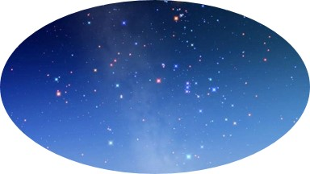
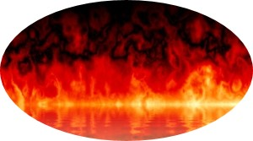
D&C 88:
29 Ye who are quickened by a portion of the celestial glory shall then receive of the same, even a fulness.
30 And they who are quickened by a portion of the terrestrial glory shall then receive of the same, even a fulness.
31 And also they who are quickened by a portion of the telestial glory shall then receive of the same, even a fulness.
32 And they who remain shall also be quickened; nevertheless, they shall return again to their own place, to enjoy that which they are willing to receive, because they were not willing to enjoy that which they might have received.

Slide 7
Happiness or Misery
We will be judged according to our works and our desires
Righteousness
Thoughts and Actions
“Yea, and I know that good and evil have come before all men; he that knoweth not good from evil is blameless; but he that knoweth good and evil, to him it is given according to his desires, whether he desireth good or evil, life or death, joy or remorse of conscience”
Alma 29:5
Thoughts and Actions
Sin
Alma 41:3-7

Slide 8
Desires
If our desires and actions are evil in this life, then we will receive a reward of evil after this life
If our desires and actions are good in this life, then we will be restored to that which is good after this life
Alma 41:3-7

Slide 9
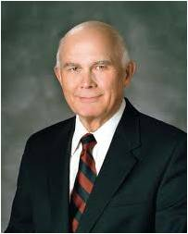
“Just as we will be accountable for our evil desires, we will also be rewarded for our righteous ones…
This principle means that when we have done all that we can, our desires will carry us the rest of the way.
It also means that if our desires are right, we can be forgiven for the unintended errors or mistakes we will inevitably make as we try to carry those desires into effect.
What a comfort for our feeling of inadequacy!”
Dallin H. Oaks
If we repent of our sins and desire righteousness for the rest of our lives, then we will be rewarded unto righteousness when we are resurrected and judged

Slide 10
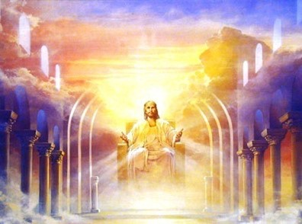
Who Are Our Judges?
“the Father judgeth no man, but hath committed all judgment unto the Son” (John 5:22).
The Son, in turn, will call upon others to assist in the Judgment. The Twelve who were with Him in His ministry will judge the twelve tribes of Israel (see Matthew 19:28;Luke 22:30).
The twelve Nephite disciples will judge the Nephite and Lamanite people (see 1 Nephi 12:9–10; Mormon 3:18–19).
Us today? –we will be judged by the apostles who are alive during our time on earth—bishops and stake presidents. (D&C 107:68-84 and 58:13-23)
Our choices in mortality determine the kind of judgment we will receive when we stand before God
Alma 41:7

Slide 11
Doctrinal Mastery
“Do not suppose, because it has been spoken concerning restoration, that ye shall be restored from sin to happiness. Behold, I say unto you, wickedness never was happiness.”
Alma 41:10

Slide 12
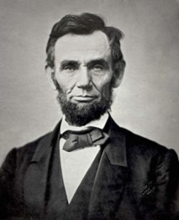
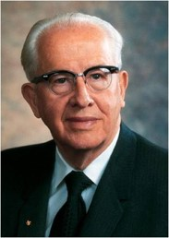
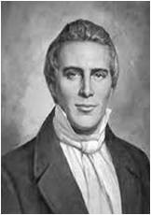
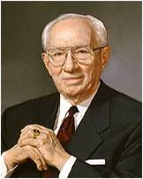
Wickedness Never Was Happiness
“When I do good I feel good, when I do bad I feel bad.”
Abraham Lincoln
“You can not do wrong and feel right. It is impossible”
Ezra T. Benson
Happiness is the object and design of our existence: and will be the end thereof; if we pursue the path that leads to it; and this path is virtue, uprightness, faithfulness, holiness, and keeping all the commandments of God.”
Joseph Smith
“…so many of us are fearful of what our peers will say, that we will be looked upon with disdain and criticized if we stand for what is right…Happiness lies in the power and the love and the sweet simplicity of the gospel of Jesus Christ…
Gordon B. Hinckley
Alma 41:10

Slide 13
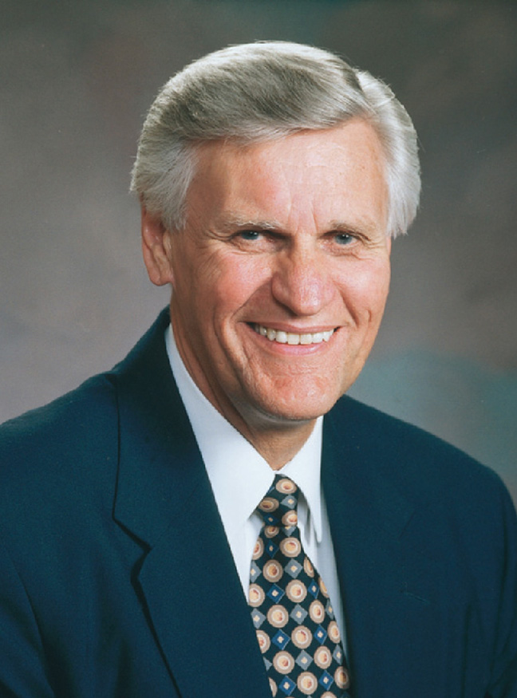
“Activities always forbidden by the Lord and for many years frowned upon by society are now accepted and promoted by that same society. The media serves up these activities in such a fashion as to make them look very desirable.
Do not suppose, because it has been spoken concerning restoration, that ye shall be restored from sin to happiness. Behold, I say unto you, wickedness never was happiness.
“… The commandments you observe were not given by a dispassionate God to prevent you from having fun, but by a loving Father in Heaven who wants you to be happy while you are living on this earth as well as in the hereafter”
Elder Glenn L. Pace

Slide 14
Nature of God
1. “In a carnal state”
2. “In the gall of bitterness and in the bonds of iniquity”
3. “Without God in the world”
a. Limited and burdened by our sins
b. Lacking the blessings and direction of God; the loss of the companionship of the Holy Ghost
c. Ruled by the will of the flesh
Alma 41:11

Slide 15
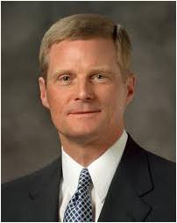
We will be restored to either happiness or misery according to our works and desires in mortality
“The essence of the gospel of Jesus Christ entails a fundamental and permanent change in our very nature made possible through our reliance upon ‘the merits, and mercy, and grace of the Holy Messiah’ (2 Nephi 2:8). As we choose to follow the Master, we choose to be changed—to be spiritually reborn”
David A. Bednar

Slide 16
Alma’s Advise to Corianton
“Therefore, my son, see that you are merciful unto your brethren; deal justly, judge righteously, and do good continually; and if ye do all these things then shall ye receive your reward; yea, ye shall have mercy restored unto you again; ye shall have justice restored unto you again; ye shall have a righteous judgment restored unto you again; and ye shall have good rewarded unto you again.”
Alma 41:14

Slide 17
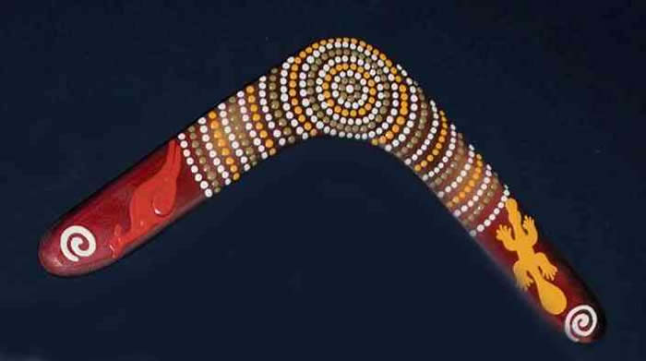
The Boomerang
What happens when you throw a boomerang correctly?
That which we send out shall return unto us on the Day of Judgment
“For that which ye do send out shall return unto you again, and be restored; therefore, the word restoration more fully condemneth the sinner, and justifieth him not at all.”
Alma 41:15

Slide 18
Sources:
Dallin H. Oaks Pure in Heart pg. 59
Bruce R. McConkie Millennial Messiah pg. 520
Ezra Taft Benson New Era June 1986
Joseph Smith (History of the Church 5: 134-135)
Gordon B. Hinckley Ensign May 1997
Elder Glenn L. Pace (“They’re Not Really Happy,” Ensign, Nov. 1987, 39–40).
David A. Bednar (“Ye Must Be Born Again,” Ensign or Liahona, May 2007, 20).
Twisted Art Work by Richard Deacon, Restless
Couldn’t resist this image

Slide 19
“Many people try to find happiness and fulfillment in activities that are contrary to the Lord’s commandments. Ignoring God’s plan for them, they reject the only source of real happiness. They give in to the devil, who ‘seeketh that all men might be miserable like unto himself’ (2 Nephi 2:27). Eventually they learn the truth of Alma’s warning to his son Corianton: ‘Wickedness never was happiness’ (Alma 41:10). …
“As you seek to be happy, remember that the only way to real happiness is to live the gospel. You will find peaceful, eternal happiness as you strive to keep the commandments, pray for strength, repent of your sins, participate in wholesome activities, and give meaningful service. You will learn to have fun within the limits set by a loving Father in Heaven” (True to the Faith: A Gospel Reference [2004], 79–80).
President David O. McKay taught that we have a dual nature and the ability to choose happiness through self-mastery:
“Living a life of truth and moral purity brings joy and happiness, while violations of moral and social laws result only in dissatisfaction, sorrow, and, when carried to extreme, in degradation.
“Man has a dual nature—one, related to the earthly or animal life; the other, the spiritual life, akin to the divine. Man’s body is but the tabernacle in which his spirit dwells. Too many, far too many, are prone to regard the body as the man and, consequently, to direct their efforts to the gratifying of the body’s pleasures, its appetites, its desires, its passions. Too few recognize that the real man is an immortal spirit, which ‘intelligence or light of truth’ was animated as an individual entity before the body was begotten, and that this spiritual entity, with all its distinguishing traits, will continue after the body ceases to respond to its earthly environment.
“Whether a man remains satisfied within what we designate the animal world, satisfied with what the animal world will give him, yielding without effort to the whim of his appetites and passions, and slipping further and further into the realm of indulgence, or whether, through self-mastery, he rises toward intellectual, moral, and spiritual enjoyments depends upon the kind of choice he makes every day—nay, every hour of his life” (in Conference Report, Apr. 1967, 6–7).
Wickedness Never Was Happiness Alma 41:10:
“If we look to the world and follow its formulas for happiness, we will never know joy. The unrighteous may experience any number of emotions and sensations, but they will never experience joy! Joy is a gift for the faithful [see 2 Nephi 9:18]. It is the gift that comes from intentionally trying to live a righteous life, as taught by Jesus Christ [for examples, see 2 Nephi 27:30; Alma 27:16–18]” (Russell M. Nelson, “Joy and Spiritual Survival,” Ensign or Liahona, Nov. 2016, 84).
“We live in an age when, as the Lord foretold, men’s hearts are failing them, not only physically but in spirit. (See D&C 45:26.) Many are giving up heart for the battle of life. Suicide ranks as a major cause of the deaths to college students. As the showdown between good and evil approaches with its accompanying trials and tabulations, Satan is increasingly striving to overcome the Saints with despair, discouragement, despondency, and depression…Sin pulls a man down into despondency and despair. While a man may take some temporary pleasure in sin, the end result is unhappiness….Sin creates disharmony with God and is depressing to the spirit. Therefore, a man would do well to examine himself to see that he is in harmony with all of God’s laws. Every law kept brings a particular blessing. Every law broken brings a particular blight. Those who are heavy laden with despair should come unto the Lord, for his yoke is easy and his burden is light (See Matt. 11:28-30)
Ezra Taft Benson in CR Oct. 1974 pp. 90-91)
Obedience is Liberty Alma 41:10:
“God reveals to His prophets that there are moral absolutes. Sin will always be sin. Disobedience to the Lord’s commandments will always deprive us of His blessings. The world changes constantly and dramatically, but God, His commandments, and promised blessings do not change. They are immutable and unchanging. Men and women receive their agency as a gift from God, but their liberty and, in turn, their eternal happiness come from obedience to His laws. As Alma counseled his errant son Corianton, ‘Wickedness never was happiness’ (Alma 41:10)” (L. Tom Perry, “Obedience to Law Is Liberty,” Ensign or Liahona, May 2013, 88).

