Slide 2
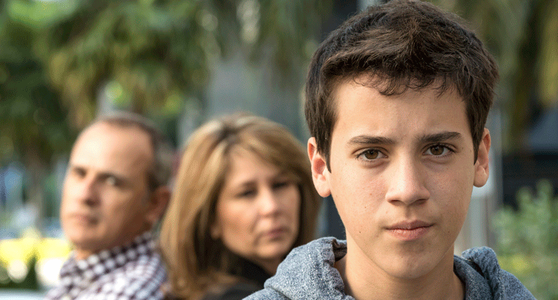
Excuses
A young man’s parents find out that he has done something wrong.
When they discuss the problem with him, he tries to excuse his behavior rather than acknowledging the wrong choice he has made.
After the young man’s parents explain that he will receive consequences for his poor choice, he becomes upset and claims it is not fair that he will receive consequences.
What are some other examples of times when we might be tempted to try to excuse our wrong behavior rather than acknowledging our errors and accepting the consequences?

Slide 3
I Want The Final Judgment To Be Fair
Fair
Justice
Fairness is getting what you deserve
A concept of moral rightness
The justice of God either rewards righteousness or punishes sin

Slide 4
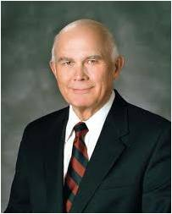
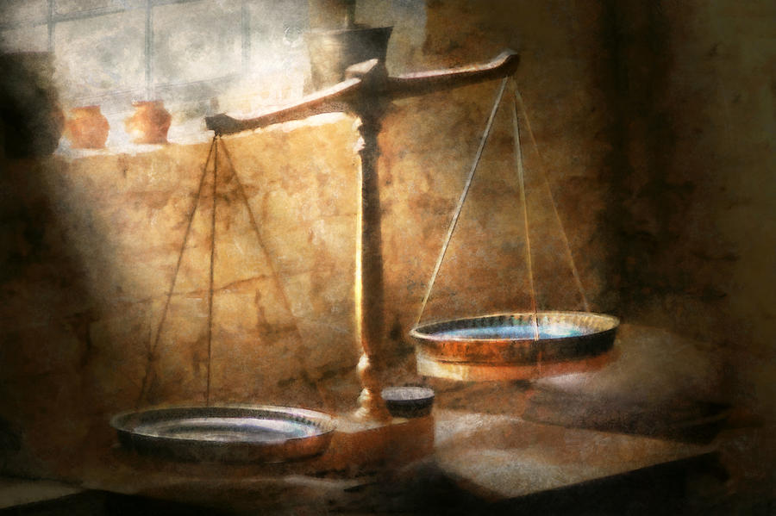
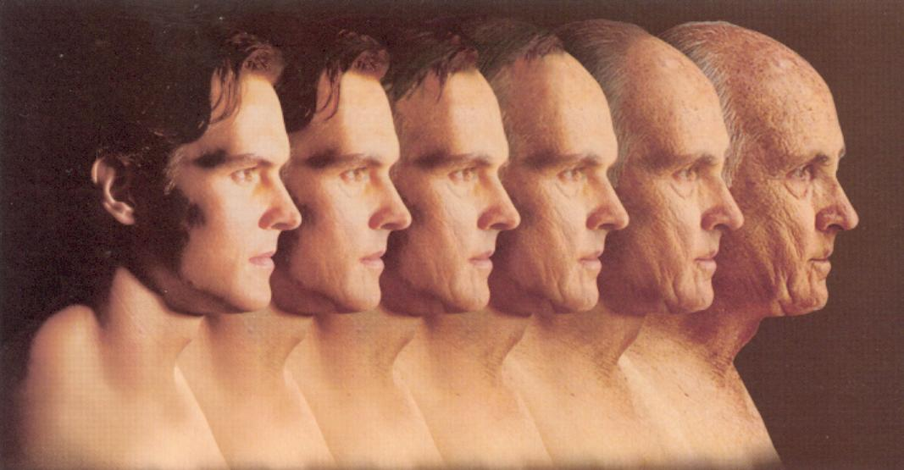
“Justice has many meanings. One is balance. A popular symbol of justice is scales in balance. Thus, when the laws of man have been violated, justice usually requires that a punishment be imposed, a penalty that will restore the balance [to the scales]. …
“[The] laws of God are likewise concerned with justice. The idea of justice as what one deserves is the fundamental premise of all scriptures that speak of men’s being judged according to their works.”
Dallin H. Oaks

Slide 5
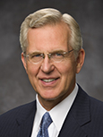
The Fairness of the Final Judgment
Corianton
Should a sinner be confined to a state of misery?
Justice means receiving what we deserve and being punished for our sins
We all sin and are subject to the demands of justice
“Real happiness lies not in denying the justice of God or trying to circumvent the consequences of sin but in repentance and forgiveness through the atoning grace of the Son of God” --Elder D. Todd Christofferson
Alma 42:1

Slide 6
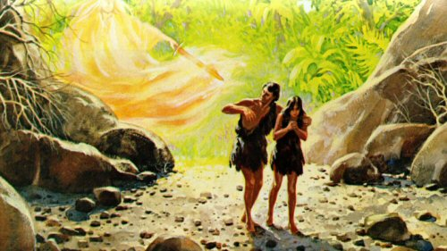
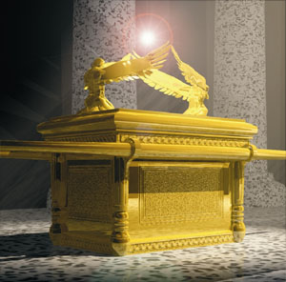
Cherubim
Webster’s Dictionary 1828—in the celestial hierarchy, cherubs are represented as spirits next in order to seraphs”
Hebrew word—plural of cherub though it is used in scriptures as a singular noun.
Their duties are to guard the holy place, or the place where God dwells
Alma 42:2

Slide 7
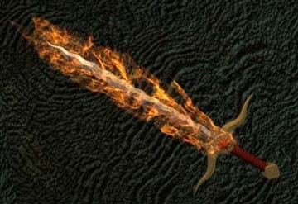
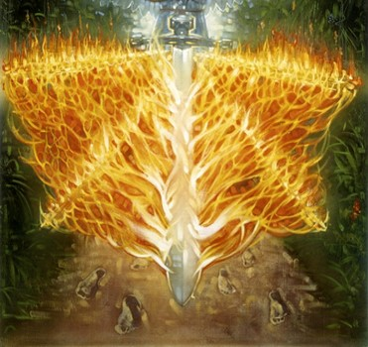
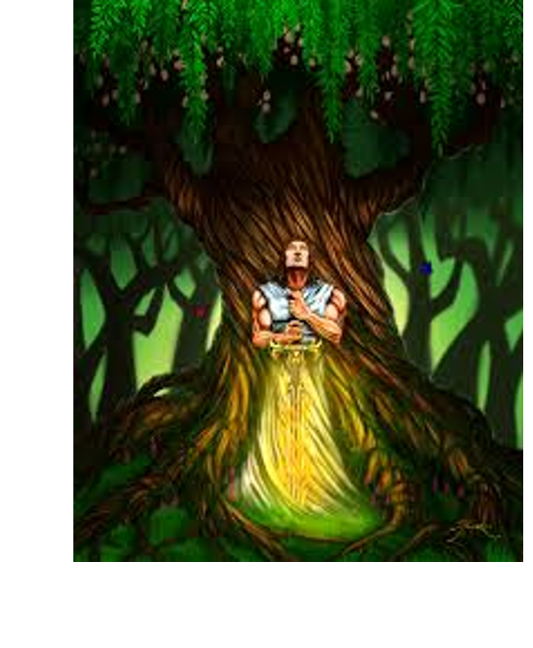
The Flaming Sword—The Tree of Life
In the allegorical representations of Eden it is from the tree of life that the nourishment of immortality is obtained.
Thus the cherubim were called upon to guard the fruits of the tree from Adam and Eve in their fallen state.”
JFM and RLM
Alma 42:2

Slide 8
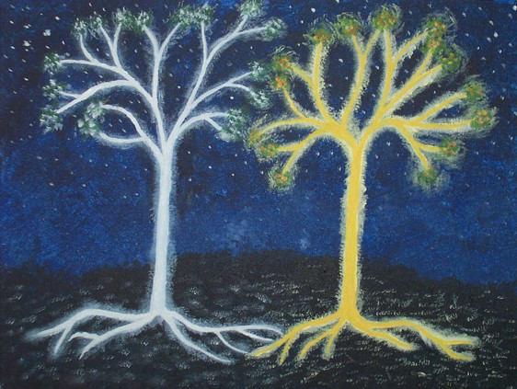
Two Trees
The Tree of Life
Leading to Eternal life
The Tree of Knowledge of Good and Evil
Leading to death (the fall)—away from the presence of God—once taken of the fruit the access to the Tree of Life was taken away
“I, the Lord God, planted the tree of life also in the midst of the garden, and also the tree of knowledge of good and evil. …
“And I, the Lord God, commanded the man, saying: Of every tree of the garden thou mayest freely eat,
“But of the tree of the knowledge of good and evil, thou shalt not eat of it, nevertheless, thou mayest choose for thyself, for it is given unto thee; but, remember that I forbid it, for in the day thou eatest thereof thou shalt surely die.” (Moses 3:9, 16–17.)
If Adam and Eve had partaken of the tree of life they would have lived in their sins forever—so He took Adam and Eve away from the Tree of Life.
C. Wilfred Griggs
Alma 42:3, 5

Slide 9
Probationary Time—Mortal Life
“And the days of the children of men were prolonged, according to the will of God, that they might repent while in the flesh; wherefore, their state became a state of probation, and their time was lengthened, according to the commandments which the Lord God gave unto the children of men. For he gave commandment that all men must repent; for he showed unto all men that they were lost, because of the transgression of their parents.”
2 Nephi 2:21
“And we will prove them herewith, to see if they will do all things whatsoever the Lord their God shall command them;”
Abraham 3:25
Alma 42:3

Slide 10
The Fall of Adam—All Men to Die
To Return
The Fall of Adam
Brought all mankind into a fallen state in which they must experience physical death and spiritual death
There must be a way to be reclaimed from this fallen state; for all mankind would be miserable and cut off from God’s presence forever
Alma 42:6-12

Slide 11
Being “Cut Off” from God’s Presence
Because of our disobedience, the law of justice requires that we be cut off from God’s presence
Disobedience
or sin
Cut off from God’s Presence
Justice
Alma 42:11

Slide 12
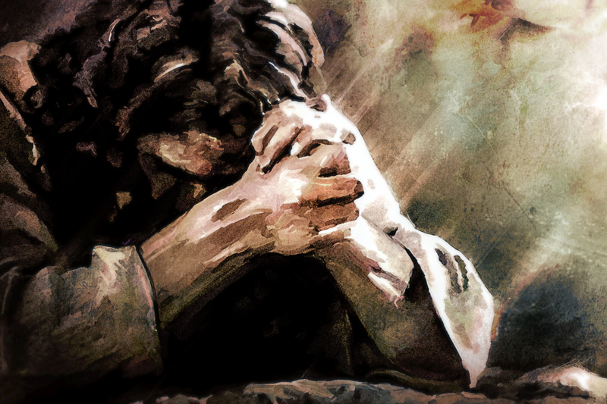
If the demands of justice cannot be erased, then how can those who have sinned (each of us) ever have peace of conscience and be restored to the presence of God?
God has made it possible for us to be saved from misery and to return to His presence for eternity.

Slide 13
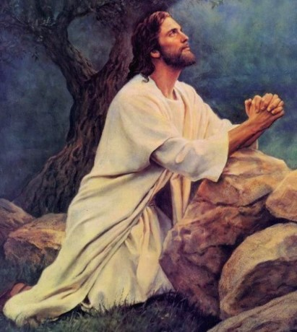
The Plan of Mercy
The demands of Justice must be satisfied
When God’s laws are broken, justice requires punishment…the demands must somehow be met.
“And now, the plan of mercy could not be brought about except an atonement should be made; therefore God himself atoneth for the sins of the world, to bring about the plan of mercy, to appease the demands of justice, that God might be a perfect, just God, and a merciful God also.”
Alma 42:15-31

Slide 14
Atonement of Jesus Christ and Mercy
Through His Atonement, Jesus Christ satisfied the demands of justice so that mercy could be extended to us
Disobedience
or sin
Atonement of Jesus Christ
Mercy
Justice
Alma 42:15

Slide 15
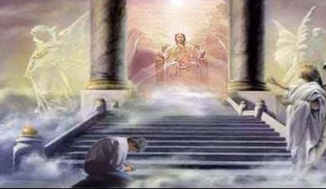
The Mediator
“Christ is not only a mediator but also a judge. It is in that role of judge that we may find even greater meaning in [the] expression that ‘God himself’ will come down to redeem his people.
It is as if the judge in that great courtroom in heaven, unwilling to ask anyone but himself to bear the burdens of the guilty people standing in the dock, takes off his judicial robes and comes down to earth to bear their stripes personally. Christ as merciful judge is as beautiful and wonderful a concept as that of Christ as counselor, mediator, and advocate.”
Elder Jeffrey R. Holland

Slide 16
Repentance And Suffering
The plan of redemption can be brought about only on conditions of repentance
Gift of the Holy Ghost
Baptism
If we repent, we will receive mercy through the Savior’s Atonement
Repentance
Faith
Alma 42:22-24

Slide 17
Partake of the Waters Freely
Alma encourages Corianton to:
To not let the plan of salvation trouble him
That his sins will bring him down to repentance
Cease from excusing himself in sin and in denying the justice of God
To return to his missionary labor and “declare the word with truth and soberness”
Alma 42:29-31

Slide 18
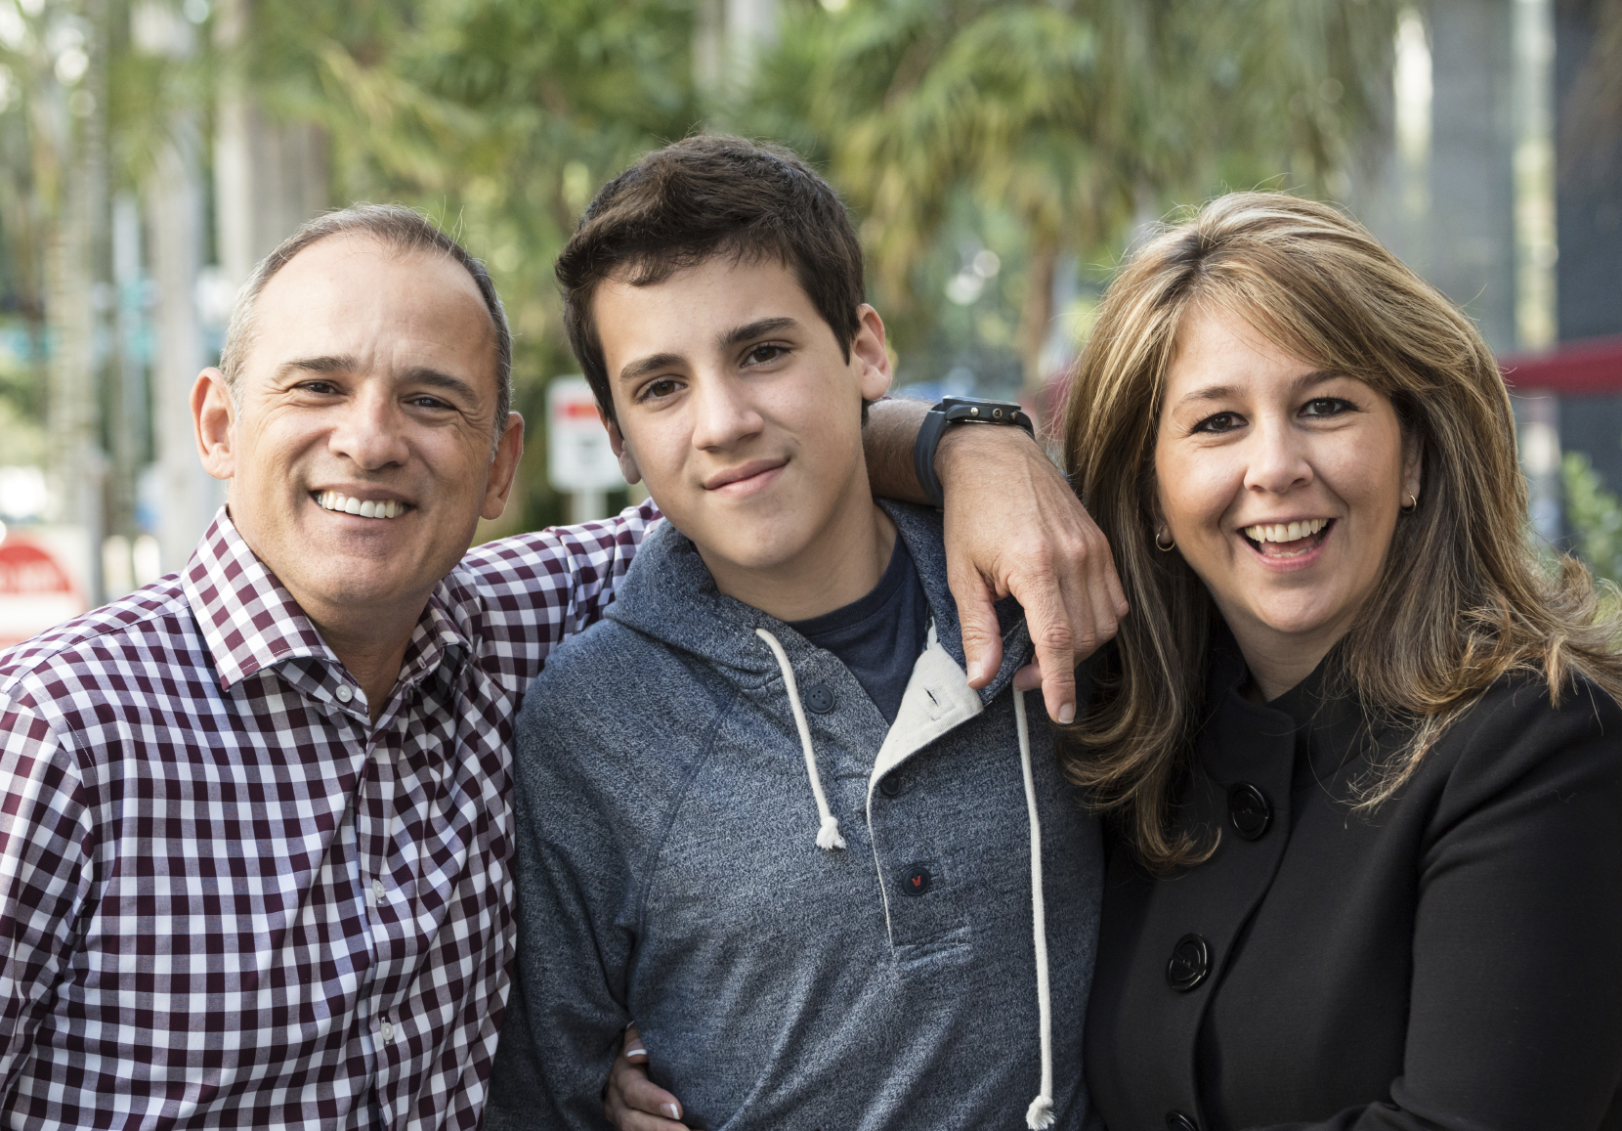
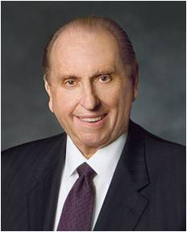
Trouble Down Unto Repentance
Rather than seeking to excuse our sins, we can let our sins trouble us and bring us to repentance.
“(We) should not persist in remembering that which the Lord has said He is willing to forget”
Thomas S. Monson
Alma 42:29

Slide 19
Sources:
Video:
The Mediator (10:44)
Dallin H. Oaks (“Sins, Crimes, and Atonement” [address to CES religious educators, Feb. 7, 1992], 1, si.lds.org).
Joseph Fielding McConkie and Robert L. Millet Doctrinal Commentary on the Book of Mormon Vol. 3 pg. 311
Elder D. Todd Christofferson (“The Blessing of Scripture,” Ensign or Liahona, May 2010, 34).
C. Wilfred Griggs The Tree of Life in Ancient Cultures June Ensign 1988
The Two Trees of Valinor by rainqueen01
Elder Jeffrey R. Holland (Christ and the New Covenant: The Messianic Message of the Book of Mormon [1997], 81).
“The Mediator,” which is found on Book of Mormon DVD Presentations 1–19 (54011) and LDS.org. Allow 10:44…This video presentation could be used in place of the statement by President Boyd K. Packer in the lesson. If you choose to use the video, adjust your lesson plan to make sure you have enough time to finish the video and teach the principle of repentance and receiving mercy through the Savior’s Atonement. April 1997 Gen. Conf. Address
Thomas S. Monson quoting Hugh B. Brown---Ensign May 1995 pg 59-60
Presentation by ©http://fashionsbylynda.com/blog/

Slide 20
Jesus Christ is our Mediator. A mediator is one who stands between two parties to help resolve a conflict. Ask a student to read aloud the following statement by President Boyd K. Packer of the Quorum of the Twelve Apostles:
“By eternal law, mercy cannot be extended save there be one who is both willing and able to assume our debt and pay the price and arrange the terms for our redemption.
“Unless there is a mediator, unless we have a friend, the full weight of justice untempered, unsympathetic, must, positively must fall on us. The full recompense for every transgression, however minor or however deep, will be exacted from us to the uttermost farthing.
“But know this: Truth, glorious truth, proclaims there is such a Mediator. …
“Through Him mercy can be fully extended to each of us without offending the eternal law of justice. …
“The extension of mercy will not be automatic. It will be through covenant with Him. It will be on His terms, His generous terms” (“The Mediator,” Ensign, May 1977, 55–56).

