Slide 2
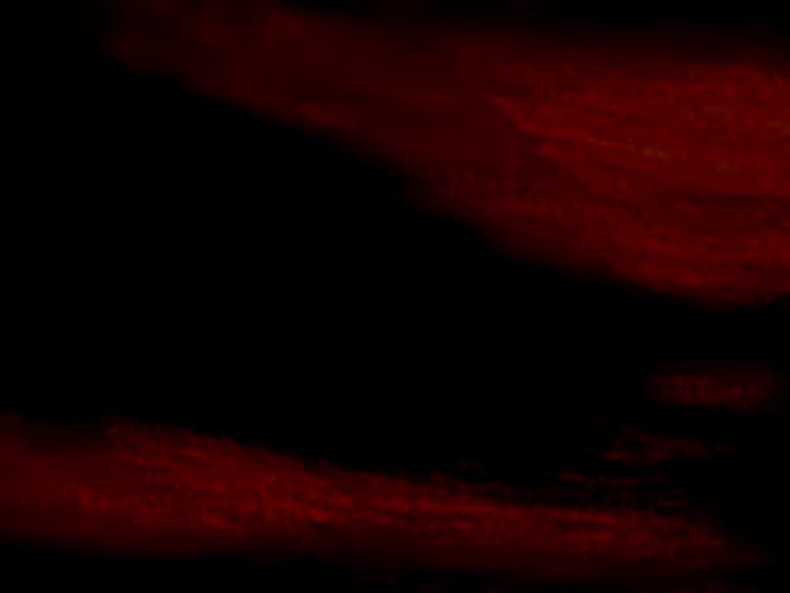
Previously on Mormon
After retaking their lands from the Lamanites, the Nephites prepared again for battle.
Mormon pleaded with the Nephites to repent. Instead, they boasted in their own strength and swore to avenge their fallen brethren.
Because the Lord had forbidden His people to seek revenge, Mormon refused to lead the Nephite army and they were defeated.
As the Nephites persisted in wickedness, God poured out His judgments upon them, and the Lamanites began to sweep them from the earth.

Slide 3
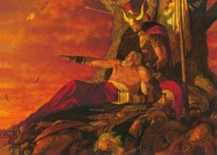
Mormon ‘Repents’ of the Oath
The Nephite’s last hope:
With compassion for his people, he relented and again took up the command of their armies.
Not only could Mormon see that their efforts were futile but also he was well aware of the prophecies, as to the final fate of his people.
Read: 1 Nephi 12
Mormon 5:1-8 JFM and RLM

Slide 4
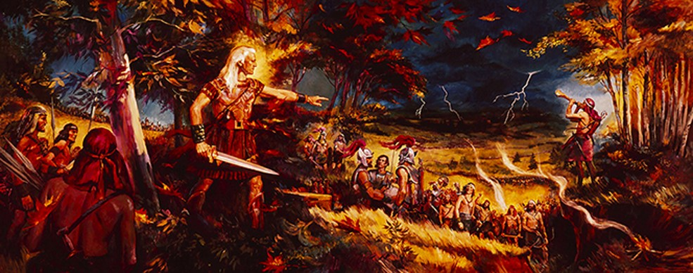
Lamanites Defeat the Nephites
AD 375-380
Eventually the Lamanites “did tread the people of the Nephites under their feet”.
As the Nephites retreated, those who could not flee quickly enough were destroyed.
Mormon 5:1-8

Slide 5
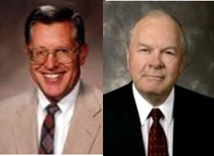
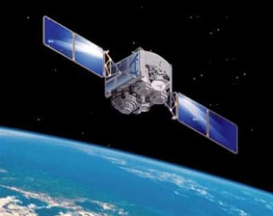
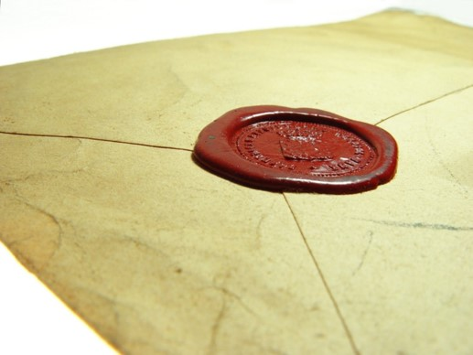
Revealed Upon the Housetops
AD 375-380
“…and that all things which are hid must be revealed upon the house-tops—
“…therefore I write a small abridgment, daring not to give a full account of the things which I have seen, because of the commandment which I have received, and also that ye might not have too great sorrow because of the wickedness of this people.”
“As this record which is ‘sealed by the power of God” comes to light in the last days, all the working of God will be revealed, and the deeds and destructions of the Nephites and the Lamanites which Mormon could not describe will indeed “be reveled upon the house-tops”
JFM and RLM
Mormon 5:8-9

Slide 6
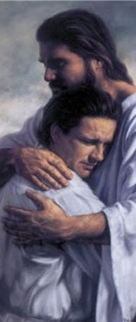
Clasped in the Arms of Jesus
To be held tightly or securely or to be embraced
Through repentance, we can be “clasped in the arms of Jesus
Mormon 5:11

Slide 7
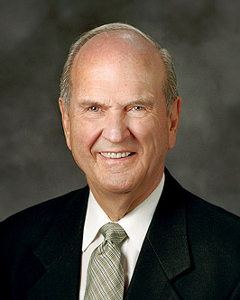
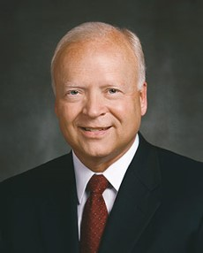
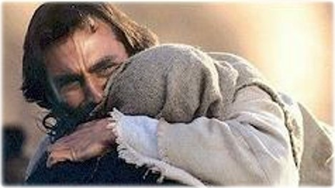
“All that will come may be ‘clasped in the arms of Jesus.’ [Mormon 5:11.] All souls can be healed by His power. All pain can be soothed. In Him, we can ‘find rest unto [our] souls.’ [Matthew 11:29.] Our mortal circumstances may not immediately change, but our pain, worry, suffering, and fear can be swallowed up in His peace and healing balm”
Elder Kent F. Richards
“Rich meaning is found in study of the word atonement in the Semitic languages of Old Testament times. In Hebrew, the basic word for atonement is kaphar, a verb that means ‘to cover’ or ‘to forgive.’ Closely related is the Aramaic and Arabic word kafat, meaning ‘a close embrace’—no doubt related to the Egyptian ritual embrace.
References to that embrace are evident in the Book of Mormon. One states that ‘the Lord hath redeemed my soul … ; I have beheld his glory, and I am encircled about eternally in the arms of his love.’ [2 Nephi 1:15.] Another proffers the glorious hope of our being ‘clasped in the arms of Jesus.’ [Mormon 5:11.]” Elder Russell M. Nelson

Slide 8
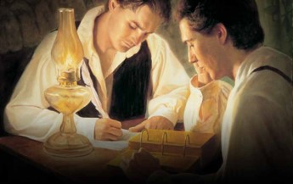
Hidden and Brought Forth
To be read by all people
In His wisdom--When He shall see fit to bring the writings to the people
Written to persuade all people that Jesus is the Christ, to help God fulfill His covenant with the house of Israel, and to help descendants of the Lamanites believe the gospel more fully
The Purpose of the Book of Mormon
Mormon 5:12-15

Slide 9
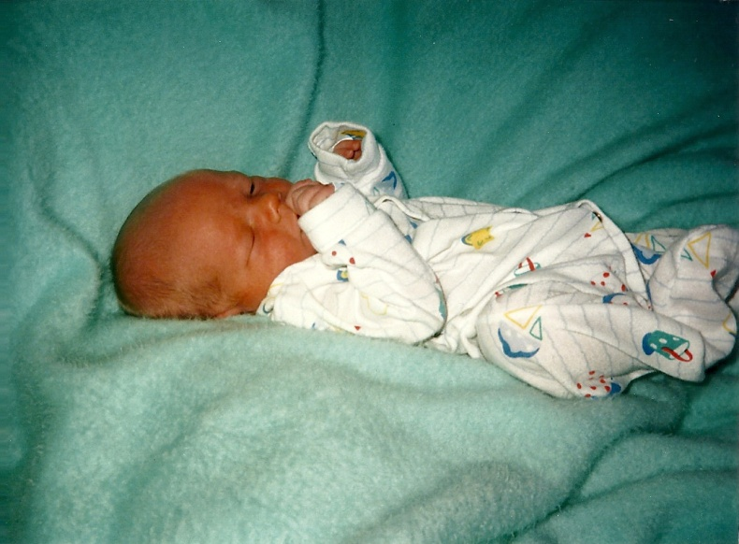
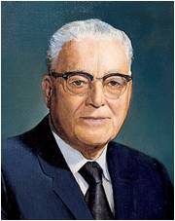
“without Christ and God in the world”
Refusal to repent--The spirit will cease to be present
To live without faith in Jesus Christ or Heavenly Father and without divine influence and guidance.
“…it seems clear to me that what he (Mormon) was talking about was not merely the inability to have the companionship of or the gift of the Holy Ghost, but he was talking of the light of truth to which every one born into the world is entitled and which will never cease in strive with the individual unless he loses it through his own sinning.” President Harold B. Lee
Mormon 5:16

Slide 10
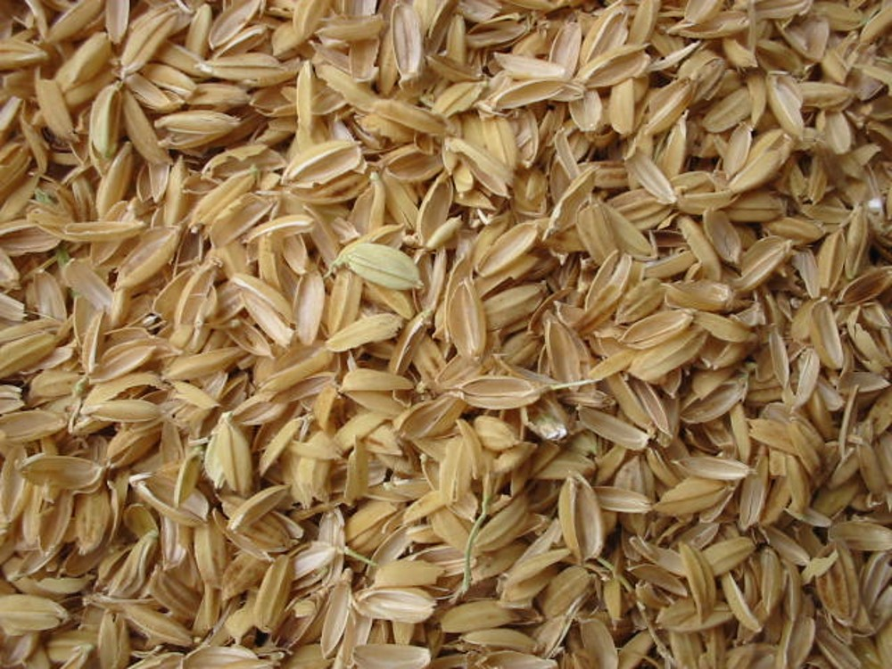
“driven about as chaff before the wind”
Chaff is a light husk on the outside of grain. When the grain is harvested, the chaff is discarded.
If we refuse to repent, the Spirit will withdraw and we will lose the Lord’s guidance.
Mormon 5:16-18

Slide 11
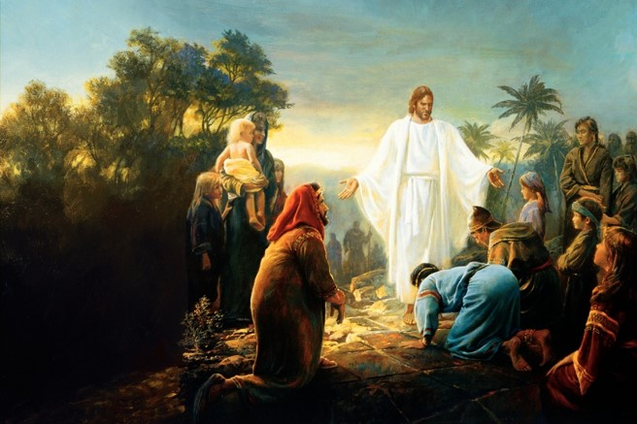
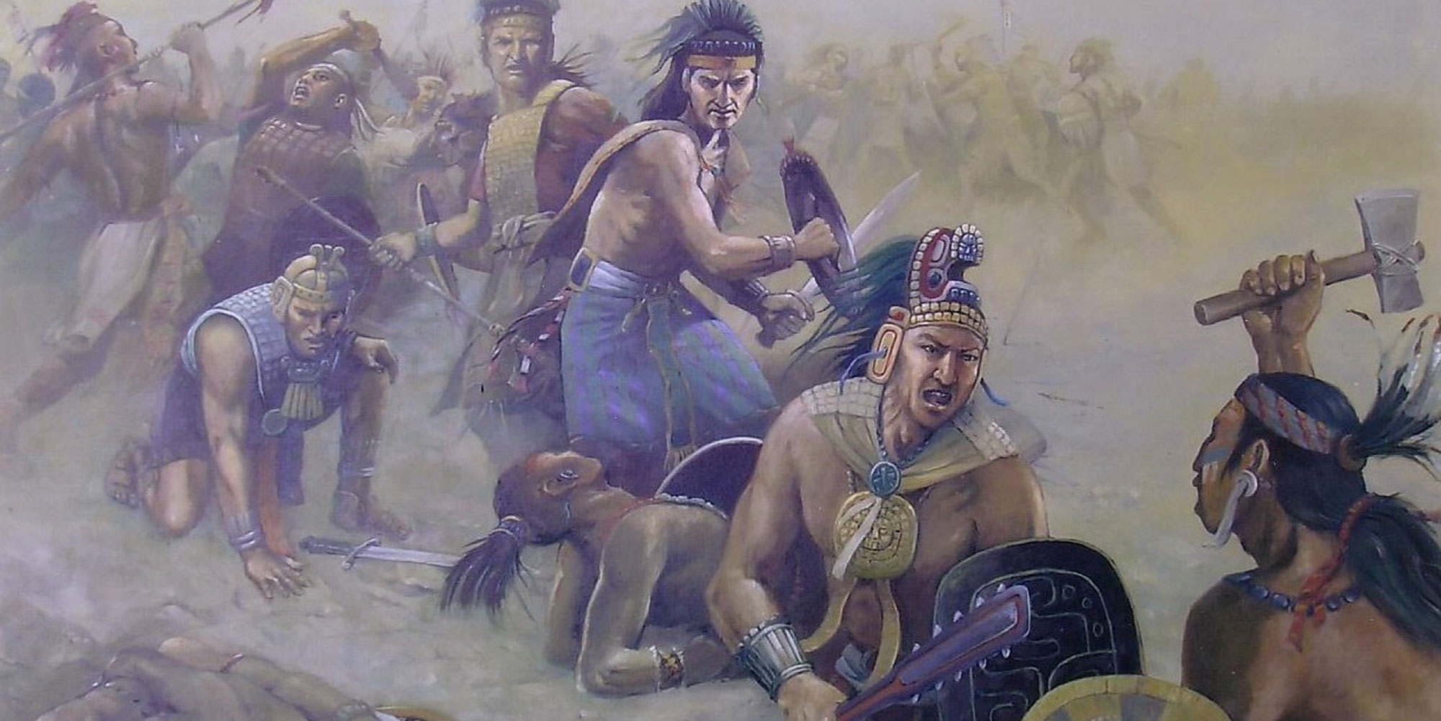
Remembering How They Used To Be
“They were once a delightsome people, and they had Christ for their shepherd; yea, they were led even by God the Father.”
“But now, behold, they are led about by Satan, even as chaff is driven before the wind, or as a vessel is tossed about upon the waves, without sail or anchor, or without anything wherewith to steer her; and even as she is, so are they.”
Mormon 5:17-18

Slide 12
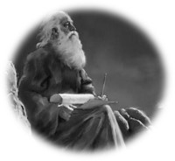
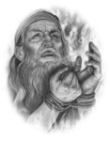
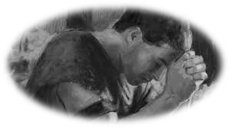
The Prayers of the Righteous
“Speaking specifically of the record that will be preserved to come forth for the Lord’s righteous purposes, it is clear that the prayers of the righteous that the Lord will remember will be those of the prophets who preceded Mormon and who had fervently prayed that their records would be preserved.”
JFM and RLM
“…the Lord said unto me: I will grant unto thee according to thy desires, because of thy faith.”
To Enos:
“And I had faith, and I did cry unto God that he would preserve the records; and he covenanted with me that he would bring them forth unto the Lamanites in his own due time.” (Enos 1:12-18)
Mormon 5:21
James H. Fullmer

Slide 13
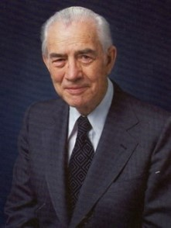
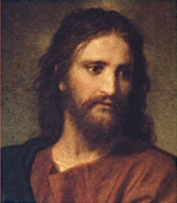
‘The Earth shall be rolled together as a scroll’
“Before his death, Mormon wrote that his record would, of course, be a warning to those he called Gentiles, but that it would be a blessing to the Lamanites.
Also he said that it would come with a special message to the Jews.
For them it was published that they “may be persuaded that Jesus is the Christ, the Son of the living God; that the Father may bring about, through his most Beloved, his great and eternal purpose, in restoring the Jews, or all the house of Israel, to the land of their inheritance, which the Lord their God hath given them, unto the fulfilling of his covenant” (Morm. 5:14).
Consider the current significance of that scripture!”
Mark E. Peterson
Mormon 5:23

Slide 14
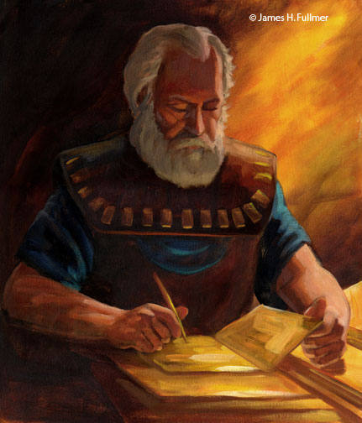
The Death of a Loved One
How might you feel at the death of a loved one who was faithful to God throughout his or her life?
How might you feel at the death of a loved one who was disobedient to God’s commandments throughout his or her life?
Mormon felt great sorrow at the death of all his people because he knew they were not prepared to meet God.
Mormon 6:1-6
James H. Fullmer

Slide 15
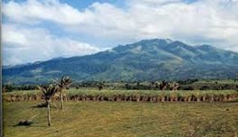
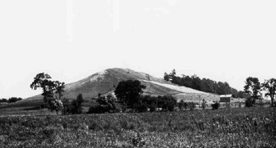
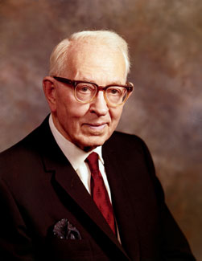
Gathering At Hill Cumorah
“It is known that the Hill Cumorah where the Nephites were destroyed is the hill where the Jaredites were also destroyed.
This hill was known to the Jaredites as Ramah.
It was approximately near the waters of Ripliancum, which the Book of Ether says, ‘by interpretation, is large, or to exceed all.’ (Ether 15:8-11).
It must be conceded that this description fits perfectly the land of Cumorah in New York, as it has been know since the visitation of Moroni to the Prophet Joseph Smith, for the hill is in the proximity of the Great lakes and also in the land of many rivers and fountains.
Moreover, the Prophet Joseph Smith himself is on record, definitely declaring the present hill called Cumorah to be the exact hill spoken of in the Book of Mormon.”
Joseph Fielding Smith
Mormon 6:1-6

Slide 16
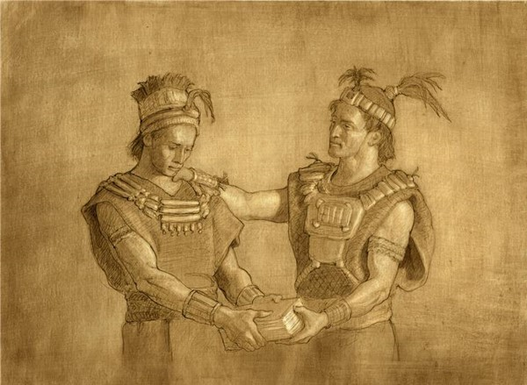
Entrusting the Records
Mormon entrusted a few of the sacred records to his son Moroni, and he hid the rest of the records in the Hill Cumorah.
He recorded what he witnessed of the final destruction of his people.
Joseph Brickey
Fearing death–
“And it shall come to pass that those that die in me shall not taste of death, for it shall be sweet unto them;
And they that die not in me, wo unto them, for their death is bitter.”
D&C 42:46-47
Mormon 6:6-7

Slide 17
Moroni
He was the son of Mormon and lived about 350 to 421 AD
He was the protector and additional author to ancient records given to him by his father Mormon
He made an Abridgement of the Jaradites –Book of Ether and the Book of Moroni
He wrote the title page for the entire Book of Mormon
He was entrusted with the keys of restoring the divine message of hope and exaltation in the latter-days.
He was viewed by John the Revelator “And I saw another angel fly in the midst of heaven, having the everlasting gospel to preach unto them that dwell on the earth, and to every nation, and kindred, and tongue, and people…”
Revelation 14:6-7
He buried the records in a vault, then in the ground
He was an Angelic messenger who visited the young Joseph Smith on Sept 21, 1832
His image appears on spires of modern-day temples throughout the world
After his father’s slaying by the Lamanites, Moroni was left alone to wander and protect his own life for 35 years

Slide 18
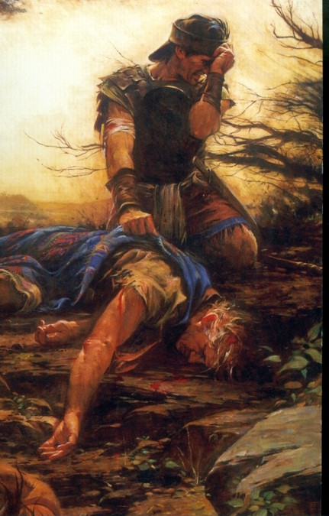
Those That Fell In Death
Mormon fell wounded but did not die
Twenty four saved: Mormon and Moroni included fled to the south
Those who died led by Moroni:
10 thousand each ‘tribe’
Gidgiddonah
Lamah
Gilgal
Jeneum
Cumenihah
Moronihah
Antionum
Shiblom
Shem
Josh
And 10 more with 10,000 each
Mormon 6:9-15
Walter Rane

Slide 19
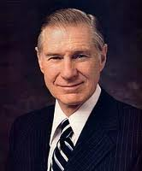
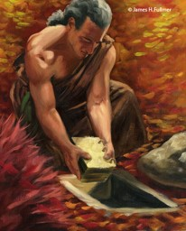
Do Not Reject His Open Arms
Mormon mourned the deaths of his people and sorrowed that they had not changed their ways. He said that if they had set aside their pride and repented of their sins, their reunion with the Savior would have been joyful.
“We long for the ultimate blessing of the Atonement—to become one with Him, to be in His divine presence, to be called individually by name as He warmly welcomes us home with a radiant smile, beckoning us with open arms to be enfolded in His boundless love. How gloriously sublime this experience will be if we can feel worthy enough to be in His presence!
The free gift of His great atoning sacrifice for each of us is the only way we can be exalted enough to stand before Him and see Him face-to-face. The overwhelming message of the Atonement is the perfect love the Savior has for each and all of us. It is a love which is full of mercy, patience, grace, equity, long-suffering, and, above all, forgiving.
“The evil influence of Satan would destroy any hope we have in overcoming our mistakes. He would have us feel that we are lost and that there is no hope. In contrast, Jesus reaches down to us to lift us up. Through our repentance and the gift of the Atonement, we can prepare to be worthy to stand in His presence.”
President James E. Faust
James H. Fullmer
Mormon 6:16-22

Slide 20
Why do prophets and priesthood leaders encourage us so diligently to repent?
How does the hope of the Lord’s embrace help you to repent?
(See Mormon 6:17.)
In what ways do you feel the Lord wants you to improve right now?

Slide 21
Sources:
In The Hands of God (1:59)
Oh ye Fair Ones (5:21)
Joseph Fielding McConkie and Robert L. Millet Doctrinal Commentary on the Book of Mormon pgs. 229,230
Elder Kent F. Richards (“The Atonement Covers All Pain,” Ensign or Liahona, May 2011, 16).
Elder Russell M. Nelson (“The Atonement,” Ensign, Nov. 1996, 34).
President Harold B. Lee CR, April 1956 pg. 108
Mark E. Peterson The Last Words of Moroni Conf Report October 1978
Joseph Fielding Smith Doctrines of Salvation 3:233-34
President James E. Faust (“The Atonement: Our Greatest Hope,” Ensign, Nov. 2001, 20).
Presentation by ©http://fashionsbylynda.com/blog/

Slide 22
Hugh Nibley adds an important insight about the Nephite society at this time.
"The Nephites foolishly took the offensive and as a result lost both the land and the city of Desolation. 'And the remainder did flee and join the inhabitants of the city of Teancum .... '
(Morm. 4:3) This makes it clear that we are still reading only of Mormon's band of Nephites, and not a history of the whole nation, for the people of Teancum, which was' ... in the borders by the seashore ... near the city Desolation' (Morm. 4:3) had up to then taken no part in the fighting. It must always be borne in mind that by this time the Nephite people had become broken up into 'tribes,' each living by itself and following its own tribal laws. (Hel. 7:2-4,11.) So what Mormon gives us is only a sampling of the sort of thing that was going on.
" ... Here you have a clear picture of Nephite society. Separate 'lands' living their own lives, now in this last crisis terribly reluctant to move and join the swelling host in the retreat to the north. Those who refused to pull up stakes were one by one completely wiped out by the Lamanites. This was no planned migration but a forced evacuation, like dozens of such we read about in the grim and terrible times of the 'Invasion of the Barbarians' that destroyed the classic civilizations of the Old World. In this case Mormon's people were only part of the general and gradual evacuation of the whole land." (An Approach, pp. 361-62.)
Further information on Hill Cumorah by Joseph Fielding Smith:
“Further, the fact that all of his associates from the beginning down have spoken of it as the identical hill where Mormon and Moroni hid the records, must carry some weight. It is difficult for a reasonable person to believe that such men as Oliver Cowdery, Brigham Young, Parley P. Pratt, Orson Pratt, David Whitmer, and many others, could speak frequently of the spot where the prophet Joseph Smith obtained the plates as the Hill Cumorah, and not be corrected by the Prophet, if that were not the fact. That they did speak of this hill in the days of the Prophet in this definite manner is an established record of history.” Doctrines of Salvation 3:233-34
Mormon 6:7-11. How Long Did the Battle of the Hill Cumorah Last?
"The Book of Mormon is not absolutely clear on this point. It states that the battle of Cumorah started when 'three hundred and eighty and four years had passed away,' that is, A.D. 385. (Mormon 6:5.) After the battle was completed and the Lamanites had killed most of the Nephites, Mormon took the Nephite survivors with him and they' did behold on the morrow, when the Lamanites had returned unto their camps,' the terrible scene of destruction. (Mormon 6:11,15.) This could mean 'on the morrow' after the battle was completed, regardless of how long the battle lasted. (Ludlow, Companion, p. 302.)
Note that both Mormon and his son Moroni were among the "twenty and four" (vs. 11) Nephites who survived the last great Nephite-Lamanite conflict. What happened to each of these people is not known. Moroni does inform us later that "the Nephites who had escaped into the country southward were hunted by the Lamanites, until they were all destroyed." (Mormon 8:2; see also Mormon 6:15.)
These people may have been among those thus killed, for Moroni sadly adds: "And my father also was killed by them, and I even remain alone to write the sad tale of the destruction of my people.“(Mormon 8:3.)
Later Moroni says of his solitary state: "I make not myself known to the Lamanites lest they should destroy me ... wherefore, I wander whithersoever I can for the safety of mine own life." (Moroni 1:1, 3.)
(48-19) Mormon 6:10-22
Mormon here records the number of the dead in terms of his military leaders, each of whom commanded ten thousand men. What is the total of the number killed? The scene of carnage must have been one of inexpressible horror. How does Mormon express himself as he views the slaughtered dead "from the top of the hill Cumorah" (vs. 11)? What one thing could have prevented "this great destruction" (vs. 22)? Mormon's lament (see vss. 16-22) is one of those beautiful and moving pieces of literature that we find so often being written by inspired men of God.
Student Manual Religion 121-122 Book of Mormon

