Slide 1
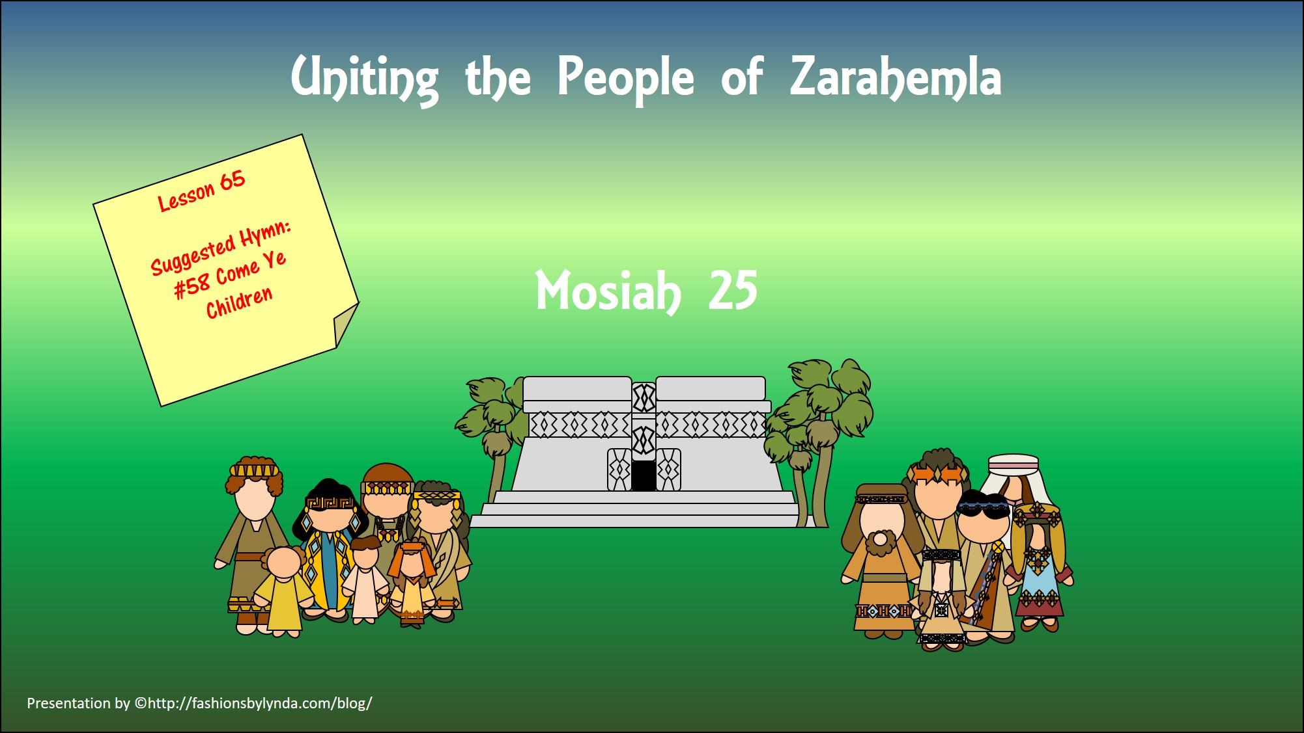

Slide 2
Assembly
By studying the records of God’s dealings with others, we can feel joy and gratitude for the goodness of God
Zeniff
Alma
King Mosiah read the records of:
Zeniff
Alma
Wonder and Amazement
Sorrowful
Mosiah 25:1-11
Raised voices and gave thanks
Pain and anguish

Slide 3
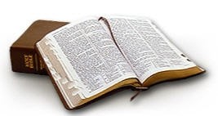

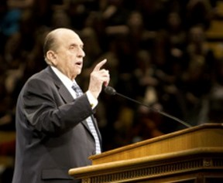
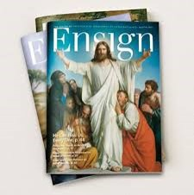
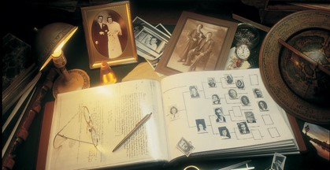
Learning From Others Experiences
Can we learn from other’s experiences?
To what sources can we turn to learn of others’ experiences with the goodness of God?
The scriptures
General conference addresses
Church magazines
Biographies of Church leaders and others
Family histories
How do you think the people, from hearing the records of Zeniff and Alma, increased their testimony of Jesus Christ?
Can you think of an experience that has helped you with your testimony?
Mosiah 25:5

Slide 4
Taking on the Name of Nephi
The children of Amulon
Amulon:
One of King Noah’s priests.
The priests took the daughters of the Lamanites and lived in the land of Amulon.
Lost Lamanites found land and chose not to go to battle with Amulon and his people and joined forces.
They wandered and found the city of Helam where Alma and his people were.
Some of Amulon’s people went back to land of Nephi where the Lamanite kingdom was and some stayed with Alma having escaped from bondage to Zarahemla.
Mosiah 25:12

Slide 5
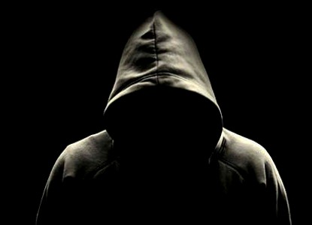
Dishonored Name
Honor--As usually used in the scriptures, to show respect and reverence to someone or something.
“When we dishonor ourselves or others, we dishonor our Father in Heaven and our Savior. They have blessed us with gifts, talents, and intelligence to bless mankind, but some misuse this.”
Vaughn J. Featherstone
“No one wants to bear a name that has been dishonored. Their action typifies that which is to happen in the world to come. Those whose fathers have no place in the kingdom of God will, like links of a chain, be removed, while their righteous seed will unite themselves with those of their progenitors worthy of that honor.”
JFM and RLM
Mosiah 25:12

Slide 6
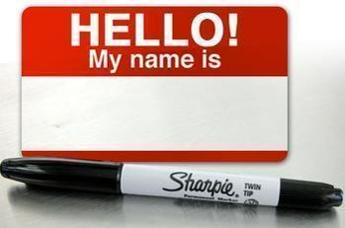
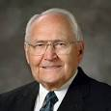
A Good Name
“…a good name is rather to be chosen than great riches, and loving favour rather than silver and gold.” (Proverbs 22:1).
We cannot isolate ourselves from those around us. Our good name can be a special valued asset worth more than the riches of the world.
Your good name connects you with your past family history. Your righteous living, your example, your teachings, and your worthwhile service will bless numerous people with your vision. It is almost impossible to comprehend the number.
May the Lord bless you with a greater understanding of his great plan of happiness and your special role in it. I add my witness that families are important.
Your name is special. It is recorded in the histories of our Father in Heaven, and how you value that, how you treat it, will literally affect generations to come. God bless you with the vision that is yours of who you are and the great privilege that is yours to belong to the Church of Jesus Christ.
L. Tom Perry

Slide 7
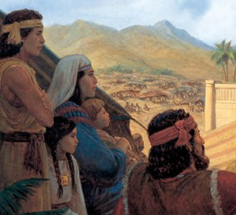
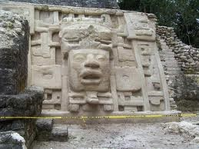
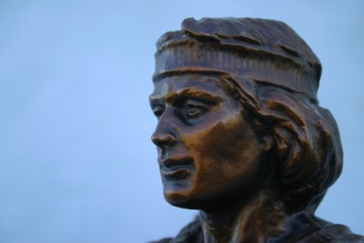
The Union – Taking the Name of Nephi
The Children of Amulon take upon themselves the name of Nephi
Though the Mulekites were more numerous they chose to call themselves Nephites
“Wherefore, the people were desirous to retain in remembrance his (Nephi’s)name. And whoso should reign in his stead were called by the people, second Nephi, third Nephi, and so forth, according to the reigns of the kings; and thus they were called by the people, let them be of whatever name they would.”
Jacob 1:11
Mosiah 25:12-13

Slide 8
Alma Establishes Church
Mosiah desires Alma to teach
Alma preaches “repentance and faith on the Lord”
Alma exhorts the people to remember their bondage and deliverance
The people of Limhi were desirous to be baptized
Mosiah granted unto Alma to establish churches throughout all the land of Zarahemla
Mosiah 25:14-19

Slide 9
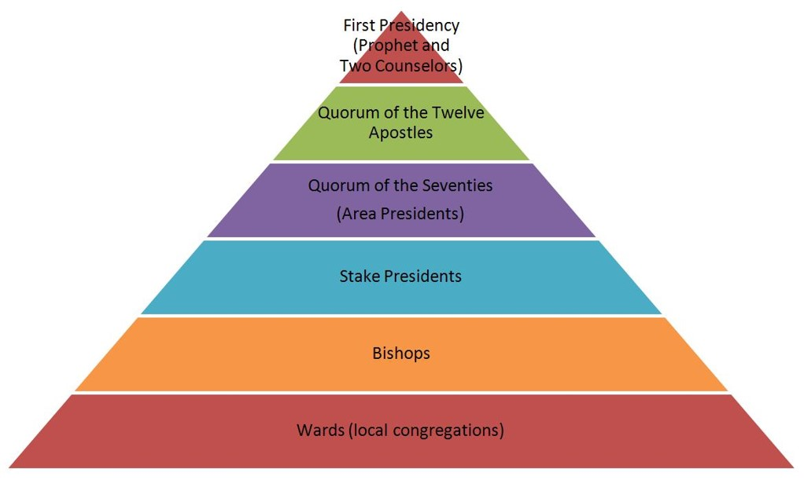
Organization
Mosiah held the keys of the kingdom
Alma could take no action in organizing various bodies of the church except under his direction.
One man cannot teach and preach to a vast number of people.
In organizing a church there must be authority and order.
The Lord organizes His Church so that all members may be taught and receive His word
Mosiah 25:21-22

Slide 10
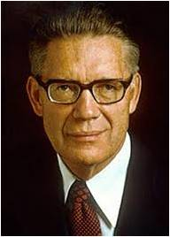
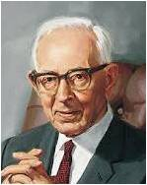
“The Book of Mormon does not give specific details about the priesthood held by prophets and other brethren among the Nephites and Lamanites. However, the references to ordinances and the manner in which the Church was conducted provide sufficient evidence that they held the Melchizedek Priesthood.
President Joseph Fielding Smith taught that “the priesthood which [the Nephites] held and under which they officiated was the Priesthood after the holy order, the order of the Son of
God. This higher
priesthood can officiate in every
ordinance of the gospel.”
Bruce R. McConkie
Alma 13:1–20

Slide 11
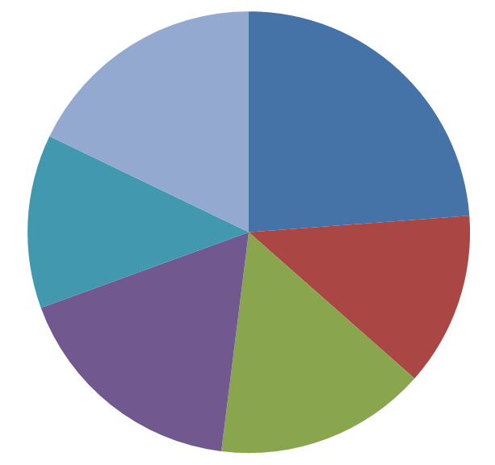
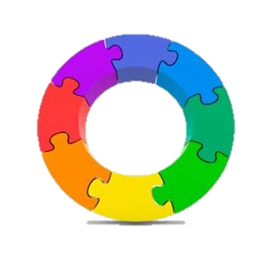
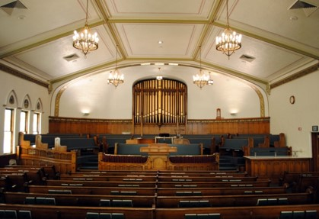
Seven Churches
It was necessary to divide the Church into various congregations because there were so many people
“Those who have entered into the waters of baptism have been commanded to meet together often ‘to fast and to pray, and to speak one with another concerning the welfare of their souls.”
Moroni 6:5
“As there was a unity of doctrine among all the churches in Zarahemla, so there has been a unity of doctrine among all the churches in all times and in al dispensations.”
Today:
When a people outgrow a ward, the ward or Stake is divided.
What is the criteria for a Ward or Stake to be divided?
Mosiah 25:21-22 JFM and RLM

Slide 12
The People of God
“And they were called the people of God…”
“…And the Lord did pour out his Spirit upon them, and they were blessed, and prospered in the Land.”
As we take upon ourselves the name of Jesus Christ and live accordingly, the Lord will pour out His Spirit upon us.
Mosiah 25:24 JFM and RLM

Slide 13
Sources:
Vaughn J. Featherstone Secret of the Second Mile May Ensign 1990
Joseph Fielding McConkie and Robert L. Millet Doctrinal Commentary on the Book of Mormon Vol. 2 p. 289,291
L. Tom Perry The Value of a Good Name Feb. Ensign 2009
Joseph Fielding Smith and Bruce R. McConkie (Doctrines of Salvation, ed. Bruce R. McConkie, 3 vols. [1954–56], 3:87).
Presentation by ©http://fashionsbylynda.com/blog/

